Slide 1

Evidence-based decision support for food security
‘Feeding Britain’ – a Shock for Middle England?
AN END USER PERSPECTIVE
17 April 2015
Notes:
WHY? – “A Shock for Midland England” – simply because
The reality of people not being able to feed themselves – is a surprise to many people in an advanced industrialised nation – capable of so much else, … and
of an assumption of a return to business as usual … high rates of economic growth in which pretty well every one can feed themselves
It’s my perception that feeding oneself has long been seen as what we as individuals are responsible for – and the state has no role.
‘Middle England’ has high expectations of achieving all the good things our society can offer – of what has been promised. I suspect there are many who never expected the squeeze and changes in in lifestyles taking place.

Slide 2

Why is a local council involved?
Councils – have the powers …
are closest to the people / communities
statutory duties
discretionary powers …
Colleague’s response …
‘we don’t really forecast future demand - anything which helps ……’
Notes:
Jim and Martine … their clear view was that the focus of the work they were embarking on SHOULD TARGET THE MOST VULNERABLE
COUNCILS area closest to the people - providers of services / wide range of infrastructure – RE-actively + PRO-actively to support their localities
They form the local policies within the context of national priorities – whether or not it is they that do the delivery
Work closely with other local service providers – Health Services, Police and Third Sector
Together Councils / Other Service Providers - are at the sharp end of dealing with the consequences of national / international circumstances and national government policies to address the issues
In discussing the research with a colleague – he said – WE DON’T DO FORECASTING …
THIS IS A DRIVER FOR ME – WE EXIST TO LOOK AFTER THE TENSIONS BETWEEN MANY COMPETING PRESSURES
This may not be true around all the Council – BUT IS A REFLECTION of the ability to work on matters much beyond the immediate.
WHY IS WCC INVOLVED IN RESEARCH ABOUT FOOD … ?

Slide 3
R’ship ‘tween Food + Energy costs?
Finite world / finite resources
Ingenuity of humans – ultimately limited
Focus on DEPLETING OIL RESERVES
Oil – abundant + affordable – underpins industrial society / wealth
Economies are much more local - without oil based transport
Production / wealth generation much lower
Range of substantive global issues / shifts
Notes:
… CHANCE CONVERSATIONS played a key part
coming about as a - follow-up to questions I’d been asking around the …
implications on service delivery of higher priced energy / oil – and
more specifically about the r’ship between food and energy costs
THE THOUGHT STREAM … goes like this
We live in a FINITE WORLD.
Ultimately human ingenuity is limited - not in relation to science / technology –
BUT certainly in relation to …
delivery of mechanisms, systems and solutions that are of benefit not a few consumers – but can be accessed by mass markets global
Despite low oil prices now – still an underlying problem despite

Slide 4
Energy + Food Energy as enablers
Suggest we have a challenge
Fossil energy - taken as a given …
Food energy – about pleasure / being full
and not …
ABOUT WHAT THEY ENABLE US TO DO
Notes:
Our economies / prosperity are dependent on
ABUNDANT / CHEAP ENERGY
ALMOST WHOLEY ON DEBT FINANCE - which carries its own big risks …
Food + Food Energy are TAKEN FOR GRANTED
It’s not about what they enable us to do …
KEEN TO UNDERSTAND THE ISSUES / IMPLICATIONS FOR OUR CUSTOMERS – OF WHAT COULD BECOME A NEW PARADIGM
I’M REALLY HOPING THAT YOU ALL CAN SUPPORT THIS RESEARCH AND SIMILAR – WITH A CLEAR FOCUS ON ORDINARY PEOPLE
The challenges demand a real understanding of complexity and how to work with it - and then enable better decisions
WE FOCUS ON FOOD – but this is not just a food issues …
It’s about public health,
About how we seek to influence our economies
The skills we teach
Enable communities
SO – LET’S TAKE A BRIEF LOOK AT HOW WE ARE ORGANISED + WHAT WE DO
AS CONTEXT FOR THIS RESEARCH – AND WHERE THE ISSUE OF FOOD SITS IN THINKING

Slide 5
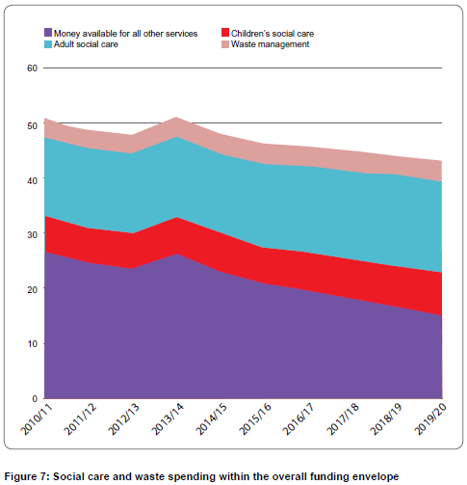
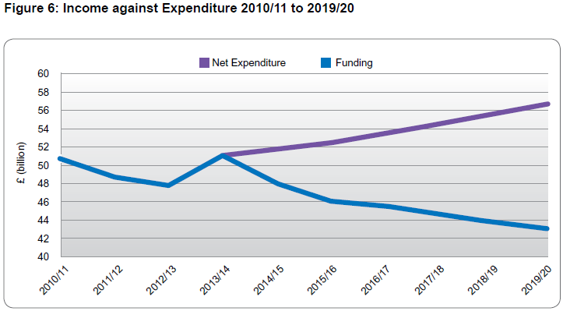
Disappearing budgets
Reductions in Local Government spending
40% in Core Central Government since 2010
Notes:
We all know the world is changing around us …
By 2015-16 central government core funding was down 40% since 2010
By end of next parliament – 2020 …
ALL COUNCILS - Funding gap will have grown to £12.4B year in terms of
reduced central ‘grants’
+ caps on how much local councils can raise through Council Tax / income generation - without being penalised
Revenue Support Grant, councils’ largest single needs-based grant, will have fallen from £14.5 billion to £2.2 billion – “there will be almost nothing left to cut.”
Many services are STAT UTORY – FEW ARE DISCURETIONARY – so it is largely on the DISCRETIONARY services the budgets reductions are made
Future reductions - well into the 2020’s
NOT ONLY are budgets reducing … but our customers are changing as well
PRIMARY OBJECTIVES - to deliver WITHIN AVAILABLE BUDGETS - THE SERVICES NEEDED TODAY + TOMORROW – not the services needed by a previous generation ….
As can be seen ………

Slide 6
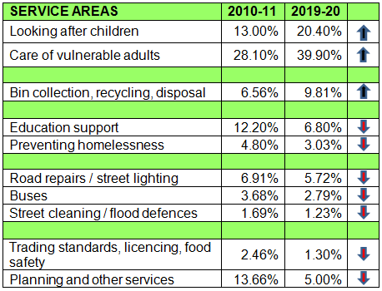
Disappearing budgets
Biggest pressures
Adult/Children’s Social Care
Waste Management
Local Government Association
Notes:
KEY POINT – DELIVERY OF RADICAL CHANGE IN WHAT + HOW SERVICES ARE DELIVERED
Driven by both national focus on debt reduction + political views about small government
Table shows the proportions of overall expenditure in different LA areas – in different service blocks
[Overall figures mask ups / downs within broader service areas]
WHAT THIS IS LEADING INTO IS ………. New models of service delivery

Slide 7
‘New’ models of delivery
Commissioning of Services – internally + externally
Private / public ‘partnerships’ …
Joint services from shared CEO’s / Directors to specific services (i.e. CSW Local Resilience Team)
Merging LA’s – more ‘Unitary’ councils
Local Enterprise Partnerships …
Health and Wellbeing Boards
Combined Authorities – as per Manchester recent announcements
Notes:
IF we continue to deliver a service …
Commissioners + Providers – works best where there are clearly defined roles …
Highways Maintenance – partnership with …
Mechanical and Electrical M’, partnership with …
Others ???
All the contracts having limited / periodic opportunities for changes to be made … to enable a looming food crisis to be managed
Public Health brought into Local Gov’t 2014
National moves to bring social care and NHS services closer together – witness recently - the £6B experiment in giving the NHS budget to Manchester City Region council [?] to manage
CHECK OUT MEANING OF COMBINED AUTHORITIES

Slide 8
Local Service Delivery – a snapshot
Councils
Unitary – all locally devolved powers
Two tier – same powers - split between counties / districts
Elected Mayors / Cabinet Government
Other key providers
Education – Academies – Colleges – Higher
Local Enterprise Partnerships
NHS – Clinical Commissioning / Acute Trusts / ...
Police Services
Notes:
+ Parishes / Town Councils
Regional governance abolished
WARWICKSHIRE
5 districts – wrapped around Coventry
80km N-S and 50km W-E
c 550,000 population

Slide 9
Warwickshire’s Services
PEOPLE
GROUP
Children’s Social Care and Safeguarding
Early Help / Targeted Support
Adult Social Care and Support
Professional Practice and Governance
Strategic Commissioning
COMMUNITIES GROUP
Economic Growth
Education and Learning
Localities & Community Safety
Public Health
Transport & Highways
RESOURCES GROUP
Customer Service
Finance
HR & Organisational Development
Information Assets
Law & Governance
Physical Assets
Service Improvement & Change Management
FIRE & RESCUE SERVICE
Notes:
See script for words

Slide 10
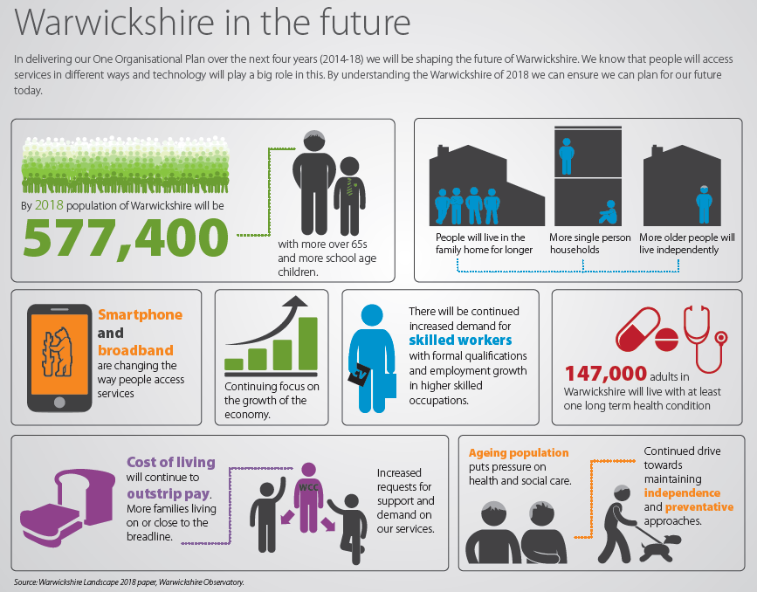

One Organisation Plan 2014-18
A changing landscape
More kids
More 65+’s
Living differently
Social care/ health changes
Services delivered through ICT
Notes:
Andy is responsible for in house research and reporting thereon – and so is far better placed than I to talk about this … but …
More kids and More 65+’s
Living differently – children at home longer / more single person homes / more elderly in larger houses
Social care / health changes
Services delivered through ICT
CHALLENGING ASSUMPTIONS about
Growing the economy
Cost of living outstripping pay

Slide 11
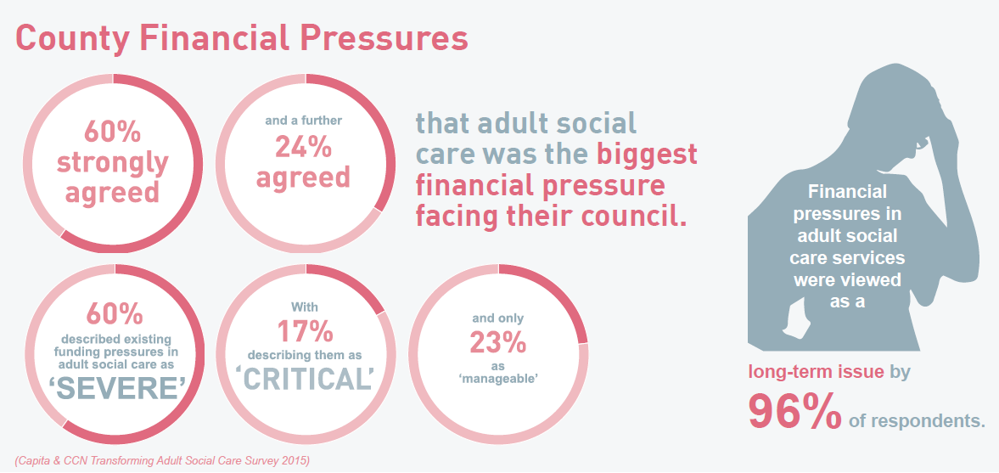
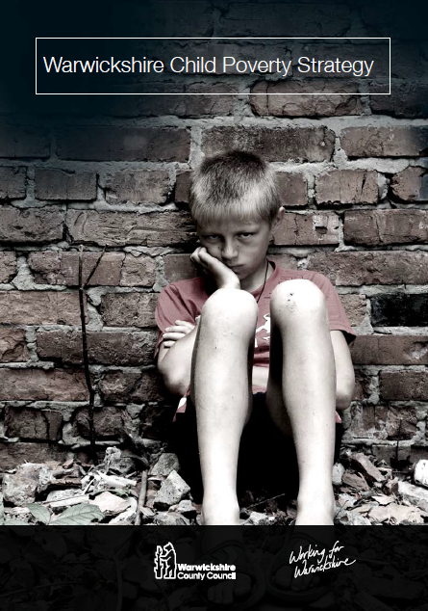

Adult social care / children's care …
County Councils Network
FINANCIAL PRESSURES
CHANGING REGIMES
Notes:
To press home the point about social care pressures …
PRESSURES
84% - biggest pressure facing councils
77% - say it is severe or critical
96% - believe it to be long term
REGIMES
WCC’s own Child Poverty Strategy work
CARE ACT 2014 – the biggest change in 60 years
The Care Act contains provisions to help preparation for adulthood for three particular groups of people – children, young carers and carers of children. Specifically, local authorities will have new duties to provide timely Transitions Assessments in order to support young people and their families to plan for the future.
The Care Act represents the most significant reform of care & support in more than 60 years. Implementation of the Care Act will have significant implications for the workforce and will include changes to organisational culture, processes and procedure across Warwickshire County Council, not just within Adult Social Care.
The Children and Families Act requires Education, Health and Care (EHC) Plans to embed good transitions planning from when a young person is aged 14.

Slide 12



Food within corporate thinking ...
Public Health joined WCC – 2014
early days !
good range of links on food on the portal
Health and Wellbeing Strategy 2014-18
NO MENTIONS of ‘food’ / hunger / nutrition
1 passing reference to ‘obesity’
Child Poverty Strategy 2011
Action to increase take up of free school meals
WCC’s ‘County Catering’ has been awarded >
  serving over 110,000 meals / week
Notes:
A quick trawl across a range of strategies – suggests that mention of food, nutrition, obesity, hunger – few / far between
As you’d expect the Warwickshire Public Health has a wide range of information / links – but
PH function only joined LA’s a year ago – so their influence is still young
2011 Children’s Poverty Strategy has a passing ref’ to ‘obesity’ – and an action to increase the take up of school meals.
Beyond that food / hunger does not appear as an issue ……………………
TURNING NOW TO THE MODEL ITSELF ………………….
ANDY WILL REFER TO FOOD BANKS IN W’SHIRE
Food for Life Partnership
Seasonal food, some organic / fair trade / local /
Free range eggs
All meat / fish traceable
No GM / additives

Slide 13
Engaging National Gov’t /
Agencies
Model needs to work at both national + local levels
Will only be relevant locally - if national circumstances + policies / further are fed in first
Notes:
WE ONLY EXIST AS THEY DO - BECAUSE NATIONAL GOVERNMENT EMPOWERS US TO DO SO.
We have those statutory and discretionary powers …..
They will use them to minimise the numbers who become hungry
and beyond ….???
In OR towards extreme circumstances – might Government take emergency powers – as in WW2?
Including direct local service providers how to operate ….
We would need to know in those circumstances – the range of options for local discretion
ANTICIPATE HOW IT’LL BE USED, HOW FUNDED, BY WHOM – AND PLAN DISSEMINATION

Slide 14
Modelling – national level
‘Outliers’ need to be tested
Challenging ‘experts’ + conventional wisdoms
Circumstances in the global economy – including
Geo-politics and territorial / energy conflicts
Debt based growth - bubbles burst !
Are there …
Black Swan events / non-linear circumstances and consequences
Notes:
This is a personal line of thinking ….
Times – arguably much more uncertain than in our lifetimes
My understanding of probabilities / Bayesian thinking may be limited – but my understanding of human nature and world circumstances isn’t too bad at all.
BUSINESS IS NOT AS USUAL – we should I think run the models + broadcast the results around a range of specialist and expert opinion – but I suggest it should still expect the unexpected
.. Sinclair - "It's difficult to get a man to understand something - … if his salary depends upon his not understanding it."

Slide 15
Modelling - local level
When is a Crisis a Crisis?
Largely a numbers game …
Ability of households / agencies to cope …
Who may become vulnerable next?
Interactions with other issues + Cumulative negative impacts?
Notes:
Colleagues undertook n exercise to focus on what a food crisis could look like ….
Fairly quickly concluded that … - it is a NUMBERS GAME
Hunger being a real and immediate issue (crisis) for the hungry or poorly fed person – but
For agencies / government, communities and society at large –
a ‘crisis’ is more about the scale of the ‘problem’
Big difference between somebody else is / will help out and – I need to do something for myself
Then it is about - the ABILITY TO COPE
How can a family be helped to cope better -
At what point voluntary / third sector organisations reach the limits of what they can provide (be it increasing demand or falling supplies)
At what point to Local Service providers re-allocate scarce their own budgets to enable one measure or another to be implemented
WE KNOW WHO WE CONSIDER VULNERABLE NOW – BUT WHICH GROUP / LOCALITY WILL BE NEXT …
DO WE UNDERSTAND THE INTERACTIONS WITH OTHER ISSUES?

Slide 16
Rising Tide and Rapid Response?
Jim asked … which one do we model for …?
Answer … BOTH
Local delivery agencies
focus on the rising tide issues to enable decision makers to minimise impacts
However for the Police
the remit is very much about the rapid response as well
Notes:
Jim asked …………. what is the main issue – RISING TIDE or RAPID RESPONSE?
BOTH
Local Service Delivery agencies (well versed with risk management)
- focus on the rising tide issues – our job should be to do what we need to avoid / minimise any future crises.
However - Police / other emergency services [primary] remit is very much about the rapid response as well
- They need to anticipate when a few hungry people finding ways of coping (including shop lifting) – becomes a lot of angry people out on the streets …
The exercise is seen very much as the development of a tool that can be used to forecast likely outcomes - and identifying when a ‘rising tide’ will change to ‘rapid response’ preparedness. The notion of early-on identifying likely ‘tipping points’ was seen as important

Slide 17

Living in Warwickshire
What our residents like about living in Warwickshire…
Lots of open spaces, good children's centres. Good sports facilities, good recycling facilities and lots of good parks for children to play in
Pleasant countryside, good schools and universities, central for access to whole country, close to airport, good job prospects, good restaurants and public houses
Clean air, beautiful countryside lived around here all my life and not going to move now
Beautiful country, good local history, great diverse shopping area. Fairly low crime rate. Centrally located for getting to anywhere in the UK, large cities in fairly local reach
Everyone seems to be very friendly and willing to help if they can

Slide 18
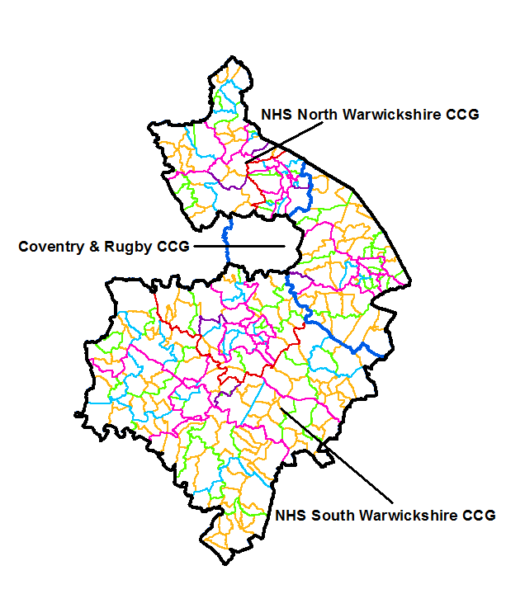
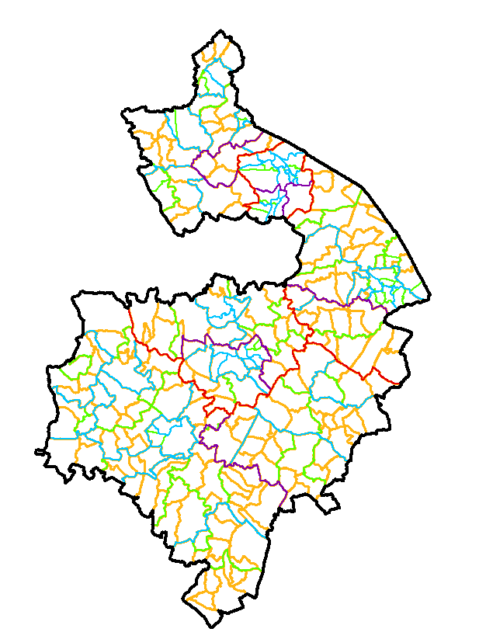
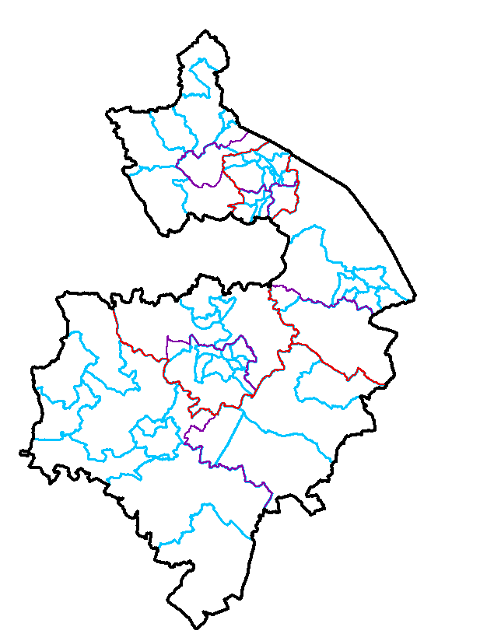
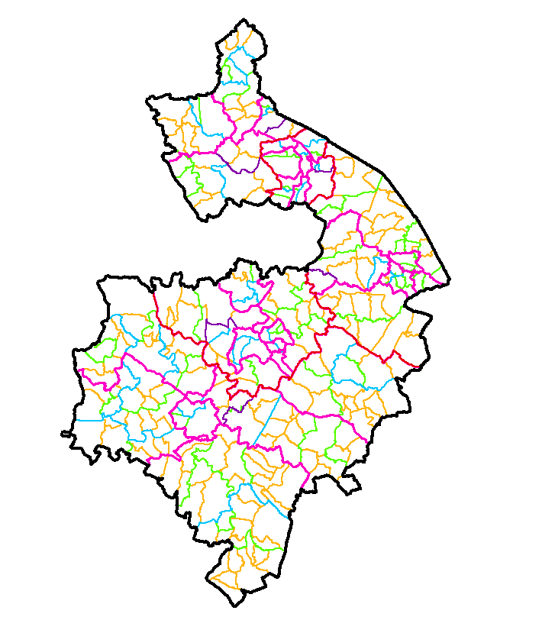
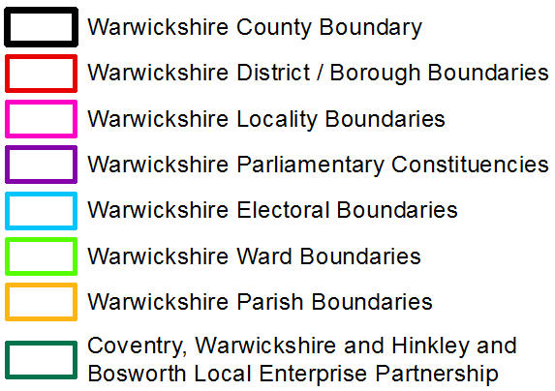
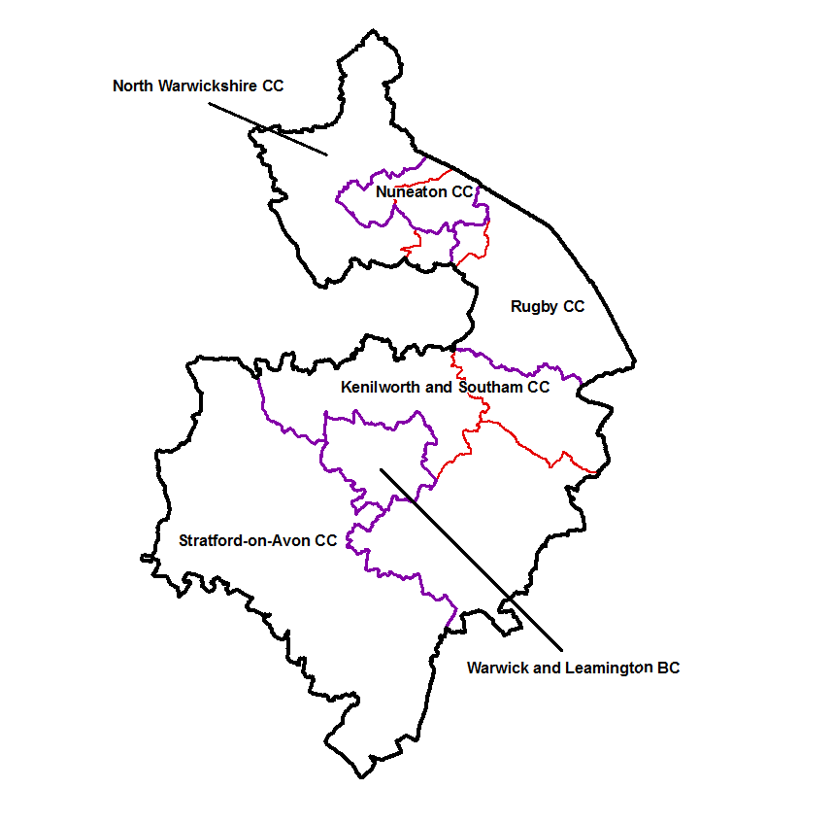
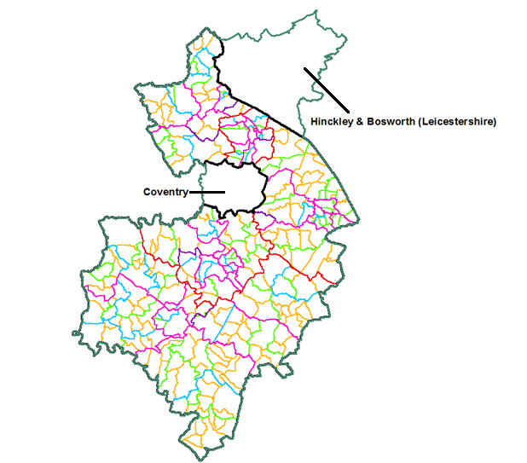
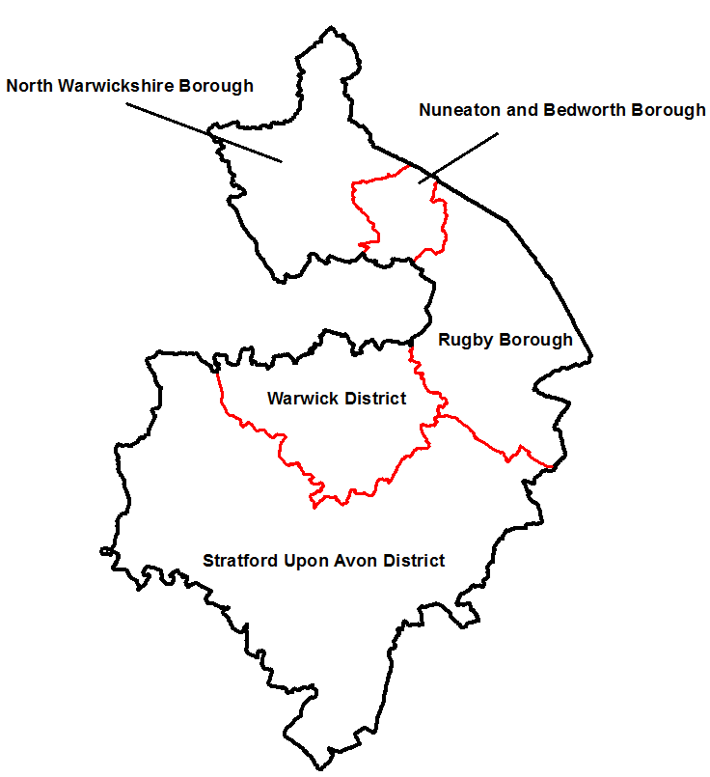
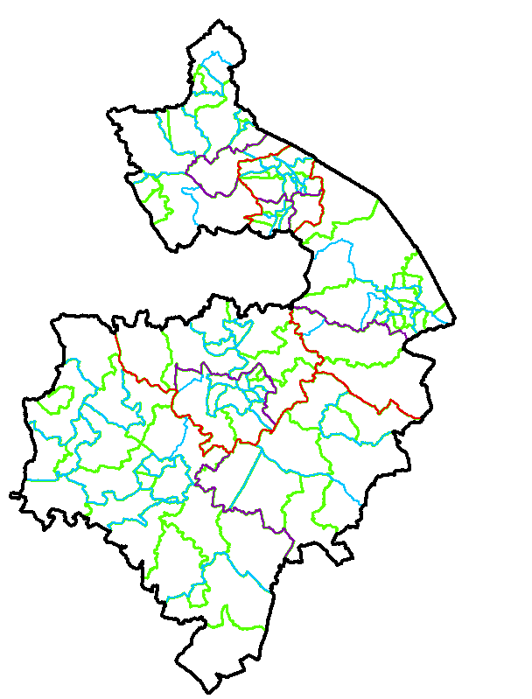
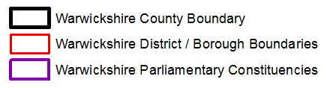
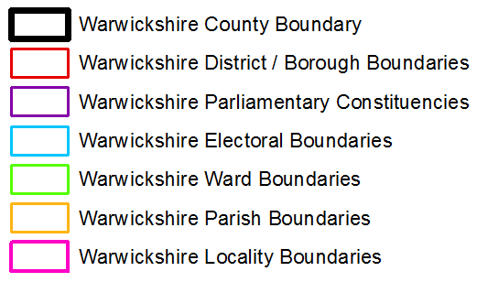

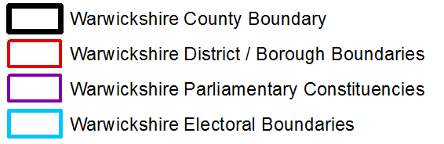
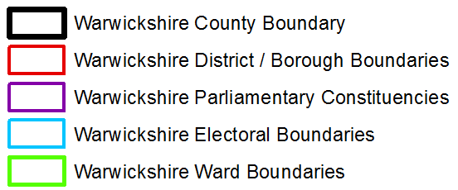
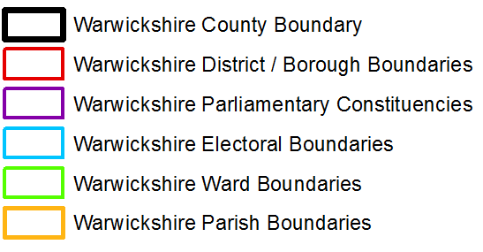
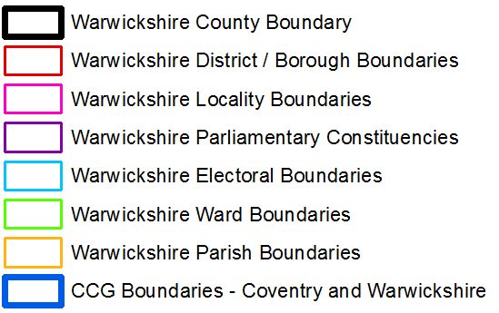
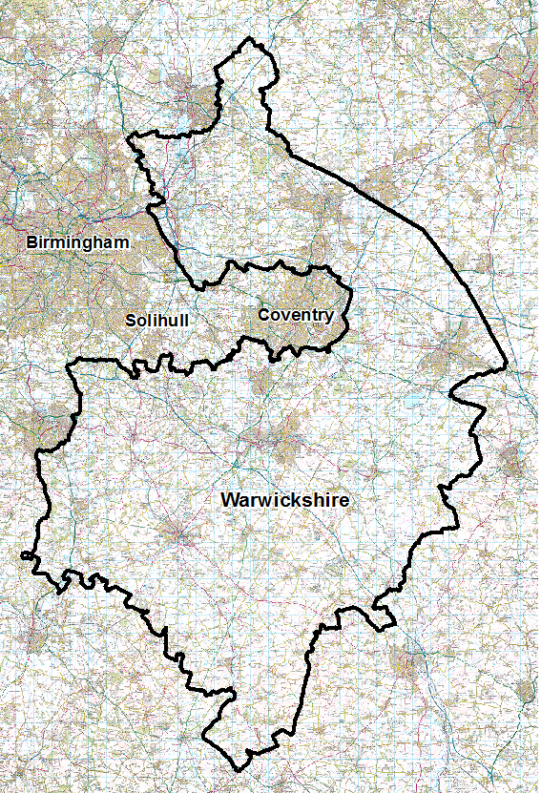

Warwickshire
© Crown Copyright and database right 2015. Ordnance Survey 100019520.
Notes:
Warwickshire is a two-tier local authority and comprises five district/borough areas:
• North Warwickshire Borough
• Nuneaton & Bedworth Borough
• Rugby Borough
• Stratford-on-Avon District
• Warwick District
At the most recent general election in 2010, new parliamentary boundaries came into effect
in Warwickshire, moving from five to six constituencies:
• North Warwickshire
• Nuneaton
• Rugby
• Kenilworth and Southam
• Warwick and Leamington
• Stratford-on-Avon
-CCGs

Slide 19



Demographics
32.5% of Warwickshire’s population lives in rural areas
The latest population figures from the 2013 mid-year estimates show that Warwickshire is home to 548,729 people
67.5% of Warwickshire’s population lives in urban areas
The population of Warwickshire is projected
to reach 624,000 by 2037
Sources: Office for National Statistics Mid-2013 Estimates and 2011 Census; Defra Rural and Urban area classification; Office for National Statistics 2012 mid-year population estimates 2012-based Sub-National Population Projections(www.statistics.gov.uk)
Notes:
**Talk here about how a growing population puts increased pressure on food resource- more mouths to feed

Slide 20

Workforce
The medium workplace-based gross annual earnings (before tax) for a full time worker in Warwickshire is £22,017 which is slightly lower than the medium workplace-based gross annual earnings for England (£22,343).
The medium residence-based gross annual earnings (before tax) for a full time worker in Warwickshire is £23,094 which is slightly higher than the medium residence-based gross annual earnings for England (£22,354).
The percentage of Warwickshire residents claiming Job Seeker’s Allowance (unemployed)is 1.1% (3,749), for England as a whole this figure is 2.0% (673,750).
Sources: Claimant Count,;Annual Survey of Hours and Earnings 2012 (ASHE);National Statistics (www.statistics.gov.uk)

Slide 21



Deprivation
In 2012, 15.1% of households in Warwickshire were considered fuel poor
Around 14% of all Warwickshire children are considered to be living in poverty (15,315)
The costs of this to Warwickshire are £134 million annually
Two thirds of children living in poverty have at least one parent who is working
            North Warwickshire = 14%
            Nuneaton & Bedworth = 19%
            Rugby = 13%
            Stratford Upon Avon = 10%
            Warwick = 11%
There is some variation in the proportion of children in “Poverty” between districts
Sources: Department of Energy & Climate Change, Fuel Poverty Data; HM Revenue & Customs
Notes:
A household is said to be in fuel poverty if it needs to spend more than 10% of its income on
fuel in order to maintain a satisfactory heating regime. This is generally defined as 21°C in the
main living room and 18°C in all other rooms.
The ‘Fuel poverty ratio’ is therefore defined as:
Fuel Poverty Ratio =
Estimated Consumption × Energy Price /
Household Income
Number of children in families in receipt of either out of work benefits,
or tax credits where their reported income is less than 60% median income
Total number of children in the area

Slide 22
Warwickshire Child Poverty Strategy
The government has stated an ambition to eradicate child poverty by 2020. Its Child Poverty Strategy focuses on:
supporting families into work and increasing earnings
improving living standards
educational attainment
Locally, there is a requirement to have a multi-agency strategy in place supported by a needs assessment. In Warwickshire a Strategy was adopted in 2011, and is currently being revised (draft March 2015).
Current Vision
Reduce and mitigate effects of child poverty within Warwickshire by 2018.
Reduce demand on crisis services ( food banks, debt advice) as a result of better provision of services at point of contact.
An integrated approach to early years, education and health will seek to break the cycle of poverty.
In terms of Early Intervention and Breaking the Cycle of Poverty the Warwickshire Child Poverty Strategy focuses on the themes of ‘child ready’, ‘school ready’ and ‘life ready’.
“address poverty now and break the cycle of intergenerational poverty”
Notes:
Following the global economic crisis of 2008 and the period of austerity that has
followed, there are now signs of general improvement in the economy with an
increase in the quantity and quality of jobs. This will certainly assist in meeting the
aims of the Child Poverty Strategy.
However, increased employment does not necessarily correlate to a reduction in
child poverty. According to the Child Poverty Action Group, “work does not provide
a guaranteed route out of poverty in the UK. Two-thirds (66 per cent) of children
growing up in poverty live in a family where at least one member works”. There are
many other factors, often specific to local areas, which
have a greater influence. The government strategy does recognise
that local areas are best placed to tacklelocal child poverty problems, and
encourages local agencies to take a lead on implementing plans. With this in mind,
Public Health Warwickshire and the Warwickshire Financial Inclusion Partnership have been modelling the impact of welfare reform, and their results will be fed into Warwickshire’s Joint Strategic Needs Assessment (JSNA) to inform future commissioning decisions.

Slide 23
Warwickshire Child Poverty Strategy
Approach
In seeking to achieve our Vision and Priorities, the Warwickshire Child Poverty Strategy have regard to the following agreed priorities of the Warwickshire Health & Well-Being Strategy:
Promoting Independence
Community Resilience
Integration and Working Together
During the delivery of the Warwickshire Child Poverty Strategy prioritisation will be given to: Vulnerable Young People, Priority Families and Carers.
Priorities
Jobs & Skills
Early Intervention & Breaking the Cycle
Financial Inclusions & Resilience
According to the Child Poverty Action Group, “work does not provide
a guaranteed route out of poverty in the UK”

Slide 24
Free School Meals in Warwickshire
Number of pupils (aged 5-16) recorded as claimants of Free School Meals (FSM) on Spring School Census day in January 2014.
Warwickshire had 7,035 pupils receiving FSM, accounting for 10.8% of all 5 to 16 years olds.
Nuneaton and Bedworth had highest proportion of FSM claimants (15.9%), with Stratford-on-Avon having the smallest proportion of claimants (6.9%).
Source: Spring School Census Day Janaury 2014, DfE 2014

Slide 25
Free School Meals and Educational Attainment
% 5+ A*-C inc Eng & Math GCSE
Proportion of pupils achieving 5 or more GCSEs graded A*-C including English and Maths.
There is a clear attainment gap between those eligible for Free School Meals and those who are not, with pupils who are not eligible for Free School Meals outperforming those who are eligible.
Source: District figures from NCER EPAS using DfE datafeed 2013

Slide 26
Warwickshire Food banks
There are 13 food banks across Warwickshire, nine of which are managed by the Trussell Trust. The Trussell Trust fed almost 11,000 people in Warwickshire between April to December 2014, 35.4% of these people were children.
The above figure shows the number of people fed by individual Trussell Trust food banks in Warwickshire
Source: The Trussell Trust, 2014
Notes:
Research into the impact of welfare reform has been conducted nationally.
One report, published by the Joseph Rowntree Foundation, ‘The Impact
of Welfare Reform on Social Landlords and Tenants’, reveals that some
tenants are having to make difficult decisions such as cutting back on food,
heat and electricity bills, selling personal belongings and falling into debt.
Some tenants admit they are becoming more vulnerable to debt and are
having to borrow to pay for essentials. They also admit that anxiety and
insecurity is increasing and this is likely to impact upon their health and
well-being.
Foodbanks are also being relied upon more and more. The Trussell Trust
reports a 163% increase nationally in foodbank use, and foodbanks that
have been open for three years or more have seen an average increase
of 51% in numbers between 2012/13 and 2013/14
Trussell Trust statistics are collected using an online data collection system into which foodbanks enter the data from each foodbank voucher. The system records the number of adults and children given three days’ emergency food. Trussell Trust figures have always been reported in this way. We cannot measure unique users on a national scale, but recent evidence collected from a sample of foodbanks indicates that over 65 percent of foodbank users were only helped once over a six month period, and that only 7.5 percent needed four or more vouchers.
In 2013/14 financial year, 913,138 received three days’ emergency food from Trussell Trust foodbanks (582,933 adults and 330,205 children). Numbers turning to Trussell Trust foodbanks have increased dramatically in recent years, in 2011-12 128,697 people received three days’ food.

Slide 27
Warwickshire Food Banks
The figure above shows the reason for crisis for the people being fed by Trussell Trust food banks only between April 2014 and December 2014.
Source: The Trussell Trust, 2014
Notes:
The top three reasons for people in crisis visiting a foodbank have
been listed by the trust as due to benefit delays, low incomes, and changes
to benefits.

Slide 28
Eating habits in Warwickshire
During September 2013, a large-scale household survey entitled ‘Living in Warwickshire’ was undertaken across the county. The survey included questions on general health, lifestyles, diet, and people’s perception of their own weight.
One in four respondents reports consuming the recommended amount of five or more portions of fruit and vegetables per day, 20% eat four portions and 27% eat three portions.
Source: Living in Warwickshire Survey 2013
Notes:
During Autumn 2013, 25,000 surveys were sent out to a random stratified sample of households across Warwickshire. By the time of the closing date, 7,617 completed surveys were returned, resulting in a response rate of 30%. This was over 50% higher than our target response of 5,000 surveys.
Although paper surveys went sent out in the post, recipients were also given the option to complete the survey online if they wished. Just under 300 people, or 4% of all respondents, chose to complete the survey this way.
Warwickshire Overview
According to the survey respondents, 25.5% consume 5 or more portions of fruit and vegetables per day. 19.8% eat four portions and 26.6% eat three portions, indicating that 71.6% of respondents consume three or more portions of fruit and vegetables per day. 17.2% of respondents reported eating two portions, whilst 9.4% said they eat 2 portions. 1.7% of respondents reported consuming no fruit or vegetables.
When compared to the National Diet and Nutrition Survey (DH 2012) where 34% of adults consume 5 portions of fruit and vegetables per day, this indicates that residents of Warwickshire are consuming an amount of fruit and vegetables below the national average.

Slide 29
Eating habits in Warwickshire
With takeaway and fast food consumption was considered, 46% of respondents typically consumed a takeaway meal once a week (e.g. Chinese, Indian, Thai, pizza, fish & chips). The proportion of respondents who ate fast food once a week (e.g. McDonalds, Burger King, KFC) was considerably lower at 15%.
The corresponding figure shows the number of fast food outlets by district, in addition to the crude rate of outlets per 100,000 persons.
Source: National Obesity Observatory, Ordnance Survey InterestMap™ 2010
Notes:
During Autumn 2013, 25,000 surveys were sent out to a random stratified sample of households across Warwickshire. By the time of the closing date, 7,617 completed surveys were returned, resulting in a response rate of 30%. This was over 50% higher than our target response of 5,000 surveys.
Although paper surveys went sent out in the post, recipients were also given the option to complete the survey online if they wished. Just under 300 people, or 4% of all respondents, chose to complete the survey this way.
Warwickshire Overview
According to the survey respondents, 25.5% consume 5 or more portions of fruit and vegetables per day. 19.8% eat four portions and 26.6% eat three portions, indicating that 71.6% of respondents consume three or more portions of fruit and vegetables per day. 17.2% of respondents reported eating two portions, whilst 9.4% said they eat 2 portions. 1.7% of respondents reported consuming no fruit or vegetables.
When compared to the National Diet and Nutrition Survey (DH 2012) where 34% of adults consume 5 portions of fruit and vegetables per day, this indicates that residents of Warwickshire are consuming an amount of fruit and vegetables below the national average.

Slide 30
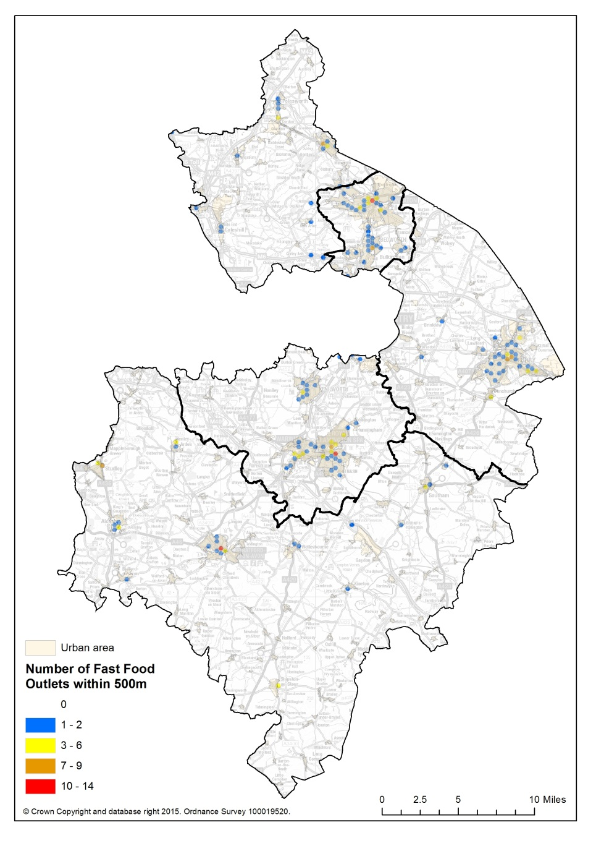
Eating habits in Warwickshire
The corresponding figure shows the location of fast food/takeaway outlets in Warwickshire
Notes:
During Autumn 2013, 25,000 surveys were sent out to a random stratified sample of households across Warwickshire. By the time of the closing date, 7,617 completed surveys were returned, resulting in a response rate of 30%. This was over 50% higher than our target response of 5,000 surveys.
Although paper surveys went sent out in the post, recipients were also given the option to complete the survey online if they wished. Just under 300 people, or 4% of all respondents, chose to complete the survey this way.
Warwickshire Overview
According to the survey respondents, 25.5% consume 5 or more portions of fruit and vegetables per day. 19.8% eat four portions and 26.6% eat three portions, indicating that 71.6% of respondents consume three or more portions of fruit and vegetables per day. 17.2% of respondents reported eating two portions, whilst 9.4% said they eat 2 portions. 1.7% of respondents reported consuming no fruit or vegetables.
When compared to the National Diet and Nutrition Survey (DH 2012) where 34% of adults consume 5 portions of fruit and vegetables per day, this indicates that residents of Warwickshire are consuming an amount of fruit and vegetables below the national average.

Slide 31
Adult Weight Status in Warwickshire
In terms of self-reported weight status, 47% of respondents across Warwickshire felt they were about the correct weight. However, 44% felt they were a little overweight, whilst 6% self-reported that they were very overweight with 3% underweight.
The Sport England Active People Survey 2013 asked respondents for their height and weight. Using this data we can see 0.7% of Warwickshire residents are classed as underweight, 34.5% are classed as a healthy weight and 43.0% and 21.0% are classed as overweight or obese respectively.
Source: Sport England Active People Survey PHE 2012, Living in Warwickshire Survey 2013

Slide 32
Child Weight Status in Warwickshire
The National Child Measurement Programme (NCMP) measures the height and weight of over one-million children aged 4-5 and 10-11 years each year in primary schools in England.
Weight status of Warwickshire children in reception, compared with England overall.
Source: National Child Measurement Programme, 2013/14

Slide 33
Child Weight Status in Warwickshire
Weight status of Warwickshire children in Year 6, compared with England overall.
Source: National Child Measurement Programme, 2013/14

Slide 34
Relationship between Deprivation and Obesity in Warwickshire
The above figure shows the relationship between the proportion of children classified as being ‘overweight’ or ‘very overweight’ and deprivation; each point represents a Lower Super Output Area within Warwickshire.
Overall, in the 20% most deprived communities in the county, 23.1% of children measures are classified as overweight, compared to 15.7% in the 20% least deprived communities in the county.
Source: National Child Measurement Programme; English Indices of Deprivation, Department of Communities & Local Government, 2010
Notes:
The trend line shows that the areas with higher IMD scores (more deprived communities) are slightly more likely to have a higher proportion of pupils classified as overweight. However, the correlation is not strong, and the chart shows that there are communities in more affluent areas with a high proportion of children overweight

Slide 35

Gaps in the Data
Weight status of adults & children using Food Banks
Health status of food bank users, including mental health
Educational attainment of children who are food bank users
The true proportion of Warwickshire residents going hungry
How residents who don’t use food banks cope – e.g. borrow money from friends, ‘payday’ loans
What are our residents really eating

Slide 36
Key Points
Budgets reducing rapidly – reducing flexibilities
Local Government/other providers – are in constant change – unwise to rely on the links made now – will they be the links in 3 to 5 years
Involve other local service providers
Get ‘buy-in’ v. SOON with national agencies and national representatives of local providers
Anticipate how it’ll be used, how funded, by whom – and plan dissemination

Slide 37
Key Points
The complexity of decision making at the local level
View of Warwickshire as affluent ‘Middle England’ – comparison with reality
Around 14% of all Warwickshire children are considered to be living in poverty
The Trussell Trust fed close to 11,000 people in Warwickshire between April and December 2014, the most common reasons benefit/welfare delays but also low incomes
Longer term economic, social, health/wellbeing impacts of poor food/nutrition on local children over their lifetimes
Using data that is common across the country, or spatial levels
How can we fill data gaps, to give more up to date and comprehensive local insight

Slide 38
Thank you
Jonathan Horsfield, Renewable Energy Advisor
jonathanhorsfield@warwickshire.gov.uk
Andy Davis, Warwickshire Observatory Manager
andydavis@warwickshire.gov.uk

