Slide 1


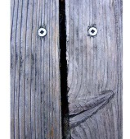

The psychology of explanation: Why hypothesis-testing doesn’t come naturally
Nick Chater
Behavioural Science Group, WBS

Slide 2
Overview
Part 1: The cycle of thought
Perception as a model for thought
The extreme seriality of perception
Perception = memory + metaphor
The cycle of thought
Part 2: Implications for the psychology of hypothesis testing
V. One interpretation at a time
VI. Precedents not principles

Slide 3
PART 1. THE CYCLE OF THOUGHT

Slide 4
I. PERCEPTION AS A MODEL FOR THOUGHT

Slide 5

“Effort after meaning” (Bartlett, 1932)
Idasawa’s spikey sphere
One operationalization is simplicity: choose the interpretation generating the shortest encoding of the image (Mach, Hochberg, Leeuwenberg, Chater & Vitanyi)

Slide 6
II. THE EXTREME SERIALITY OF PERCEPTION

Slide 7
We can only perceive one colour-map at once (Huang & Pashler, 2007)

Slide 8
We can only perceive one colour at once! (Huang & Pashler, 2007)
Task: do you see red or purple? (after brief flash)
When flashed successively vs simultaneously, performance declines for colours, not locations.
We load each colour serially!

Slide 9
III. PERCEPTION = MEMORY + METAPHOR

Slide 10
Vast memory for visual images, tunes, voices,… etc
Very high recognition accuracy
Lower recognition when subtle details removed
Vogt S & Magnussen S (2007) Long-term memory for 400 pictures on a common theme. Experimental Psychology, 54, 298–303.

Slide 11
Memory for interpreted, not raw, images; the “raw” sensory data is immediately thrown away (cf. Christiansen & Chater, 2016)
Dallenbach’s figure
So probably you won’t remember much about this strange image…

Slide 12
…until you have some clues
Dallenbach’s cow

Slide 13
And now you will remember it forever

Slide 14
Incredible flexibility of perception
Suggests an ad hoc patching together of patterns, rather than a coherent generative model
(e.g., these will never be created by a model of the human face)

Slide 15
IV. THE CYCLE OF THOUGHT

Slide 16
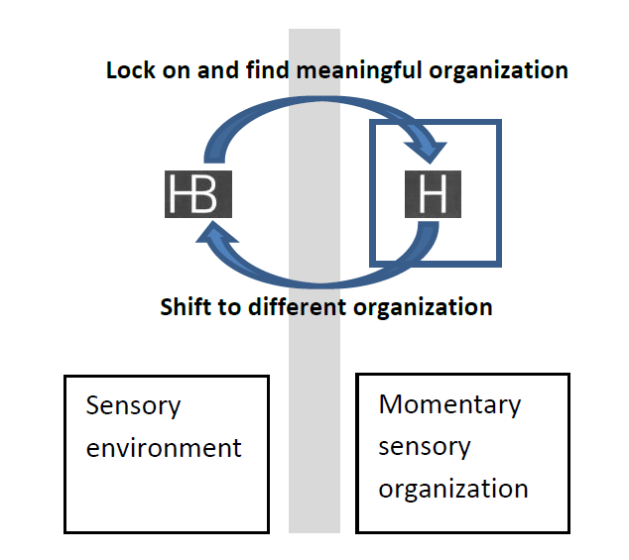
The cycle of thought

Slide 17
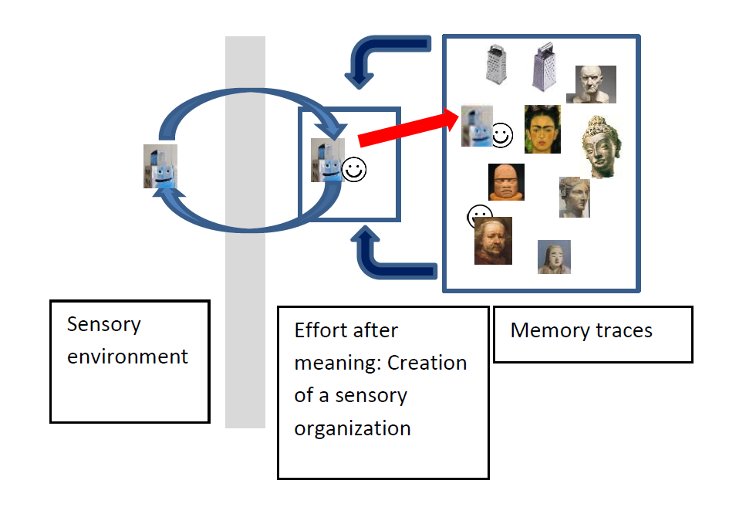
With memory…

Slide 18
PART 2. IMPLICATIONS FOR THE PSYCHOLOGY OF HYPOTHESIS TESTING

Slide 19
V. ONE INTERPRETATION AT A TIME

Slide 20
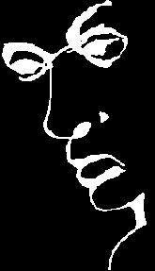
One interpretation at a time
A face

Slide 21
One interpretation at a time
A word

Slide 22
One interpretation at a time
A face or a word,
but not both at once

Slide 23
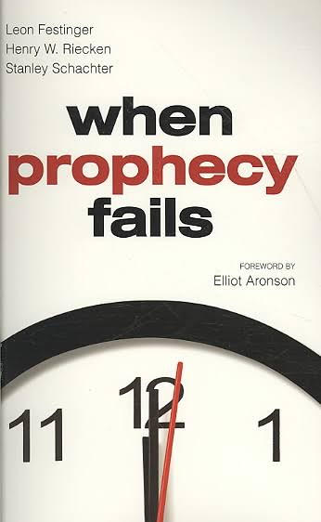
The one-interpretion limit applies to abstract thinking too
Johnson-Laird: one-model thinking as the fundamental human reasoning error
We interpret our data in terms of our current model, and then throw away the data
So we tend to get “locked in”
Festinger et al (1956)
So not much active hypothesis testing…

Slide 24
VI. PRECEDENTS NOT PRINCIPLES

Slide 25
Hypothesis testing – or other sophisticated statistics – is needed to augment everyday thought
1. Requires hard mental work to isolate specific hypotheses (e.g., our assumptions)
And we are bad at working out what our assumptions are (cf AI)
2. Let alone experimentally test them (between) them
nb. experimental science only since the Renaissance)
3. Or do any statistical analysis
Even the need for statistics only slowly appreciated from late C19 onwards
The mind is more “naïve lawyer” than “naïve scientist”

Slide 26
The brain fits a loose, non-parametric model, rather than testing hypotheses
Which accumulates precedents, but doesn’t distill principles
And hypothesis-testing is cognitively unnatural
We don’t normally explicit consider multiple alternatives
But thought proceeds by “enriching” our existing instance-based model of the world
We need a experimental and statistical methodology precisely to combat our mental frailties

