Slide 1
Statistical Issues in Searches for New Physics
Louis Lyons
Imperial College, London
and
Oxford
Hypothesis Testing
Warwick, Sept 2016
Version of 12/9/2016

Slide 2
Theme:
Using data to make judgements about H1 (New Physics) versus
H0 (S.M. with nothing new)
Why?
HEP is expensive and time-consuming
so
Worth investing effort in statistical analysis
→ better information from data
Topics:
Examples of Particle Physics hypotheses
Why we don’t use Bayes for HT
Are p-values useful?
Why p ≠ L-ratio
LEE = Look Elsewhere Effect
Why 5σ for discovery?
Why Limits?
CLs for excluding H1
Background Systematics
Coverage
p₀ v p₁ plots
Example: Higgs – Discovery, Mass and Spin
Conclusions

Slide 3
Examples of Hypotheses
1) Event selector (Event = particle interaction)
Events produced at CERN LHC at enormous rate
Online ‘trigger’ to select events for recording (~1 kiloHertz)
e.g. events with many particles
Offline selection based on required features
e.g. H0: At least 2 electrons H1: 0 or 1 electron
Possible outcomes: Events assigned as H0 or H1
2) Result of experiment
e.g. H0 = nothing new
H1 = new particle produced as well
(Higgs, SUSY, 4th neutrino,…..)
Possible outcomes H0 H1
✓ X Exclude H1
X ✓ Discovery
✓ ✓ No decision
X X ?
.

Slide 4
Bayesian methods?
Particle Physicists like Frequentism.
“Avoid personal beliefs”
“Let the data speak for themselves”
For parameter ϕ determination,
a) Range Δ of prior for ϕ unimportant, provided……
b) Bayes’ upper limit for Poisson rate (constant prior) agrees with Frequentist UL
c) Easier to incorporate systematics / nuisance parameters
BUT for Hypothesis Testing (e.g. smooth background versus bgd + peak),
Δ does not cancel, so posterior odds etc. depend on Δ.
Compare: Frequentist local p → global p via Look Elsewhere Effect
Effects similar but not same (not surprising):
LEE also can allow for selection options, different plots, etc.
Bayesian prior also includes signal strength prior (unless δ-function at expected value)
Usually we don’t perform prior sensitivity analysis.

Slide 5
(a) (b)
pdf’s and p-values
H0 H1
t_{obs}
t
t_{obs}
t
p₁ p₀
With 2 hypotheses, each with own pdf, p-values are defined as tail areas, pointing in towards each other
(c)
H0 H1
t_{obs}
t

Slide 6
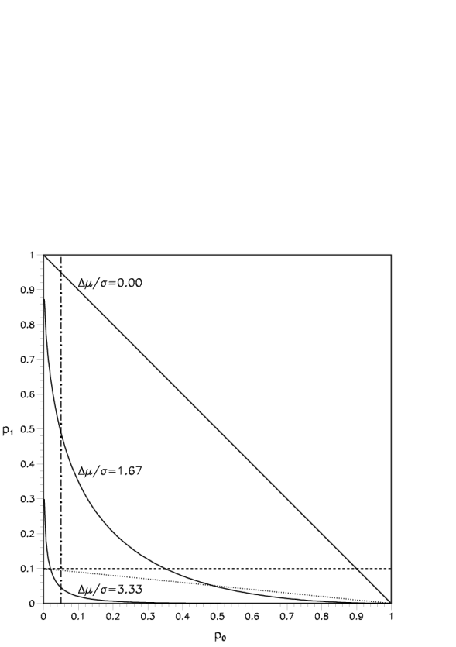
Are p-values useful?
Particle Physicists use p-values for exclusion and for discovery
Have come in for strong criticism:
People think it is prob(theory|data)
p-values over-emphasize evidence (much smaller than L-ratio)
Over 50% of results with p₀ < 5% are wrong
In Particle Physics, we use L-ratio as data statistic for p-values
Can regard this as:
p-value method, which just happens to use L-ratio as test statistic
or
This is a L-ratio method with p-values used as calibration

Slide 7
Are p-values useful?
Particle Physicists use p-values for exclusion and for discovery
Have come in for strong criticism:
People think it is prob(theory|data) Stop using relativity, because misunderstood?
p-values over-emphasize evidence (much smaller than L-ratio)
Is mass or height `better` for sizes of mice and elephants?
Over 50% of results with p₀ < 5% are wrong Confusing p(A;B) with p(B;A)
In Particle Physics, we use L-ratio as data statistic for p-values
Can regard this as:
p-value method, which just happens to use L-ratio as test statistic
or
This is a L-ratio method with p-values used as calibration

Slide 8
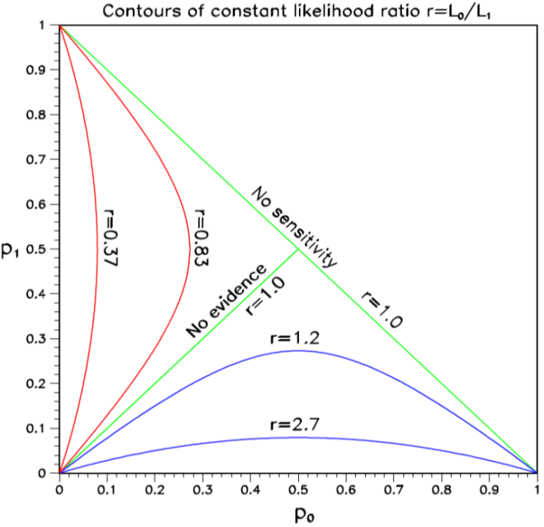
Why p ≠ Likelihood ratio
Measure different things:
p₀ refers just to H0; L₀₁ compares H0 and H1
Depends on amount of data:
e.g. Poisson counting expt little data:
For H0, μ₀ = 1.0. For H1, μ₁ =10.0
Observe n = 10 p₀ ~ 10⁻⁷ L₀₁ ~10⁻⁵
Now with 100 times as much data, μ₀ = 100.0 μ₁ =1000.0
Observe n = 160 p₀ ~ 10⁻⁷ L₀₁ ~10⁺¹⁴

Slide 9
Look Elsewhere Effect (LEE)
Prob of bgd fluctuation at that place = local p-value
Prob of bgd fluctuation ‘anywhere’ = global p-value
Global p > Local p
Where is `anywhere’?
Any location in this histogram in sensible range
Any location in this histogram
Also in histogram produced with different cuts, binning, etc.
Also in other plausible histograms for this analysis
Also in other searches in this PHYSICS group (e.g. SUSY at CMS)
In any search in this experiment (e.g. CMS)
In all CERN expts (e.g. LHC expts + NA62 + OPERA + ASACUSA + ….)
In all HEP expts
etc.
d) relevant for graduate student doing analysis
f) relevant for experiment’s Spokesperson
INFORMAL CONSENSUS:
Quote local p, and global p according to a) above.
Explain which global p

Slide 10
Why 5σ for Discovery?
Statisticians ridicule our belief in extreme tails (esp. for systematics)
Our reasons:
1) Past history (Many 3σ and 4σ effects have gone away)
2) LEE
3) Worries about underestimated systematics
4) Subconscious Bayes calculation
p(H₁|x) = p(x|H₁) * π(H₁)
p(H₀|x) p(x|H₀) π(H₀)
Posterior Likelihood Priors
prob ratio
“Extraordinary claims require extraordinary evidence”
N.B. Points 2), 3) and 4) are experiment-dependent
Alternative suggestion:
L.L. “Discovering the significance of 5σ” http://arxiv.org/abs/1310.1284

Slide 11
How many σ’s for discovery?
SEARCH | SURPRISE | IMPACT | LEE | SYSTEMATICS | No. σ
Higgs search | Medium | Very high | M | Medium | 5
Single top | No | Low | No | No | 3
SUSY | Yes | Very high | Very large | Yes | 7
B_{s} oscillations | Medium/Low | Medium | Δm | No | 4
Neutrino osc | Medium | High | sin²2ϑ, Δm² | No | 4
B_{s}→ μ μ | No | Low/Medium | No | Medium | 3
Pentaquark | Yes | High/V. high | M, decay mode | Medium | 7
(g-2)_{μ} anom | Yes | High | No | Yes | 4
H spin ≠ 0 | Yes | High | No | Medium | 5
4th gen q, l, ν | Yes | High | M, mode | No | 6
Dark energy | Yes | Very high | Strength | Yes | 5
Grav Waves | No | High | Enormous | Yes | 8
Suggestions to provoke discussion, rather than `delivered on Mt. Sinai’
Bob Cousins: “2 independent expts each with 3.5σ better than one expt with 5σ”

Slide 12
Combining different p-values
Several results quote independent p-values for same effect:
p₁, p₂, p₃….. e.g. 0.9, 0.001, 0.3 ……..
What is combined significance? Not just p_{1*}p_{2*}p₃…..
If 10 expts each have p ~ 0.5, product ~ 0.001 and is clearly NOT correct combined p
S = z * (-ln z)^{j} /j! , z = p₁p₂p₃…….
(e.g. For 2 measurements, S = z * (1 - lnz) ≥ z )
Problems:
1) Recipe is not unique (Uniform dist in n-D hypercube → uniform in 1-D)
2) Formula is not associative
Combining {{p₁ and p₂}, and then p₃} gives different answer
from {{p₃ and p₂}, and then p₁} , or all together
Due to different options for “more extreme than x₁, x₂, x₃”.
3) Small p’s due to different discrepancies
4) Correlated systematics
******* Better to combine data ************

Slide 13
WHY LIMITS?
Michelson-Morley experiment → death of aether
HEP experiments: If UL on expected rate for new particle < expected, exclude particle
CERN CLW (Jan 2000)
FNAL CLW (March 2000)
Heinrich, PHYSTAT-LHC,
“Review of Banff Challenge”
Production
rate
Prediction
Exptl
UL
M_{X}

Slide 14
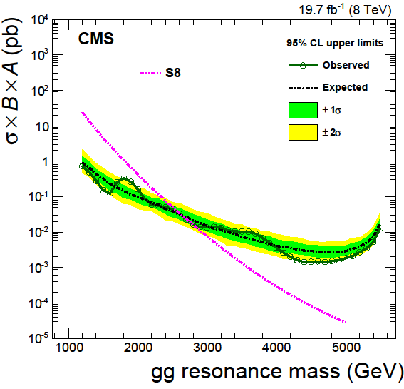
CMS data, excludes X→ gg with M_{X}<2800 GeV

Slide 15
Ilya Narsky, FNAL CLW 2000

Slide 16

CLs for exclusion
CLs = p₁/(1-p₀) → diagonal line
Provides protection against excluding H₁ when little or no sensitivity
`Conservative Frequentist’ approach
Δµ
H₀ H₁
t
N.B. p₀ = tail towards H₁
p₁ = tail towards H₀

Slide 17
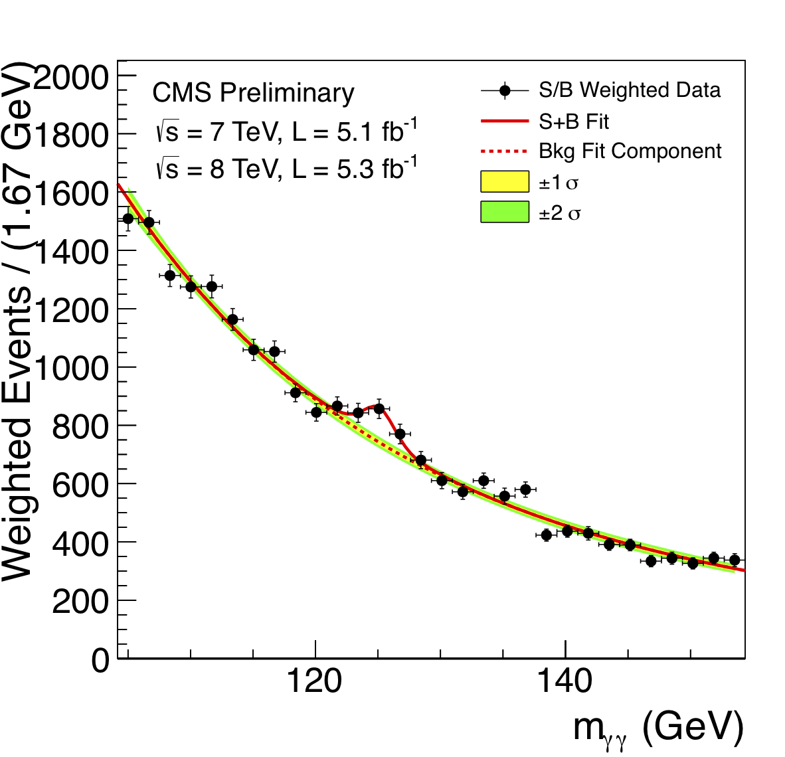
Background systematics

Slide 18
-2lnL
∆
s

Slide 19
Coverage
μ_{best} μ
* What it is:
For given statistical method applied to many sets of data to extract confidence intervals for param µ, coverage C is fraction of ranges that contain true value of param. Can vary with µ
* Does not apply to your data:
It is a property of the statistical method used
It is NOT a probability statement about whether µ_{true} lies in your confidence range for µ
* Coverage plot for Poisson counting expt
Observe n counts
Estimate µ_{best} from maximum of likelihood µ
L(µ) = e^{-µ} µ^{n}/n! and range of µ from ln{L(µ_{best})/L(µ)} < 0.5
For each µ_{true} calculate coverage C(µ_{true}), and compare with nominal 68%
C(µ)
Ideal coverage plot
68%

Slide 20
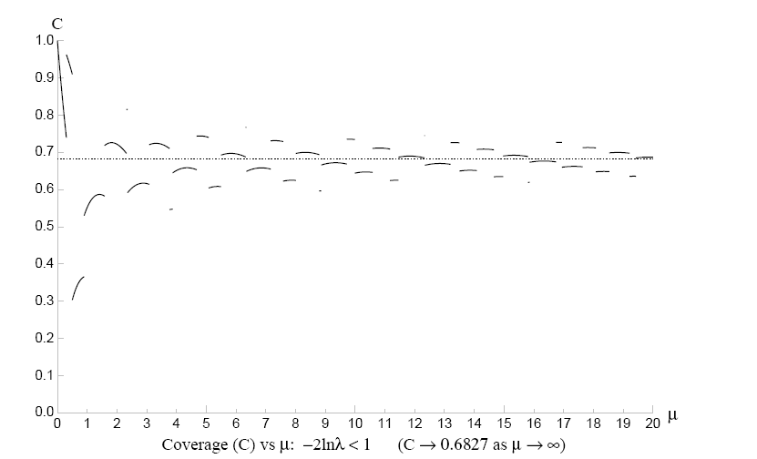
Coverage : ΔlnL intervals for μ
P(n,μ) = e^{-μ}μ^{n}/n! (Joel Heinrich CDF note 6438)
-2 lnλ< 1 λ = p(n,μ)/p(n,μ_{best})
Coverage
Discontinuities because data n are discrete
UNDERCOVERS because ΔlnL intervals not equiv to Neyman constructiom
µ_{true}

Slide 21
p₀ v p₁ plots
Preprint by Luc Demortier and LL,
“Testing Hypotheses in Particle Physics: Plots of p₀ versus p₁”
For hypotheses H0 and H1, p₀ and p₁ are the tail probabilities for data statistic t
Provide insights on:
CLs for exclusion
Punzi definition of sensitivity
Relation of p-values and Likelihoods
Probability of misleading evidence
Jeffries-Lindley paradox

Slide 22
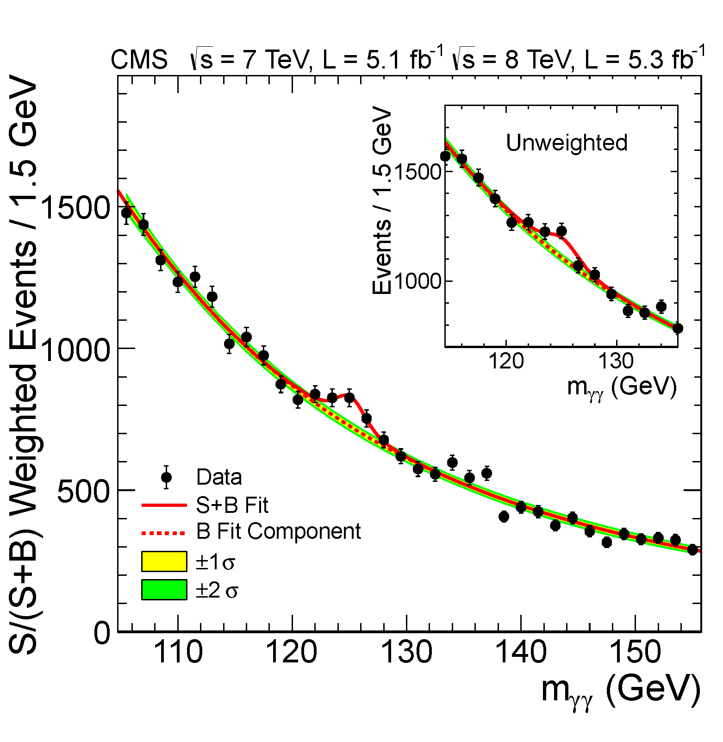
Search for Higgs:
H→ γ γ: low S/B, high statistics

Slide 23
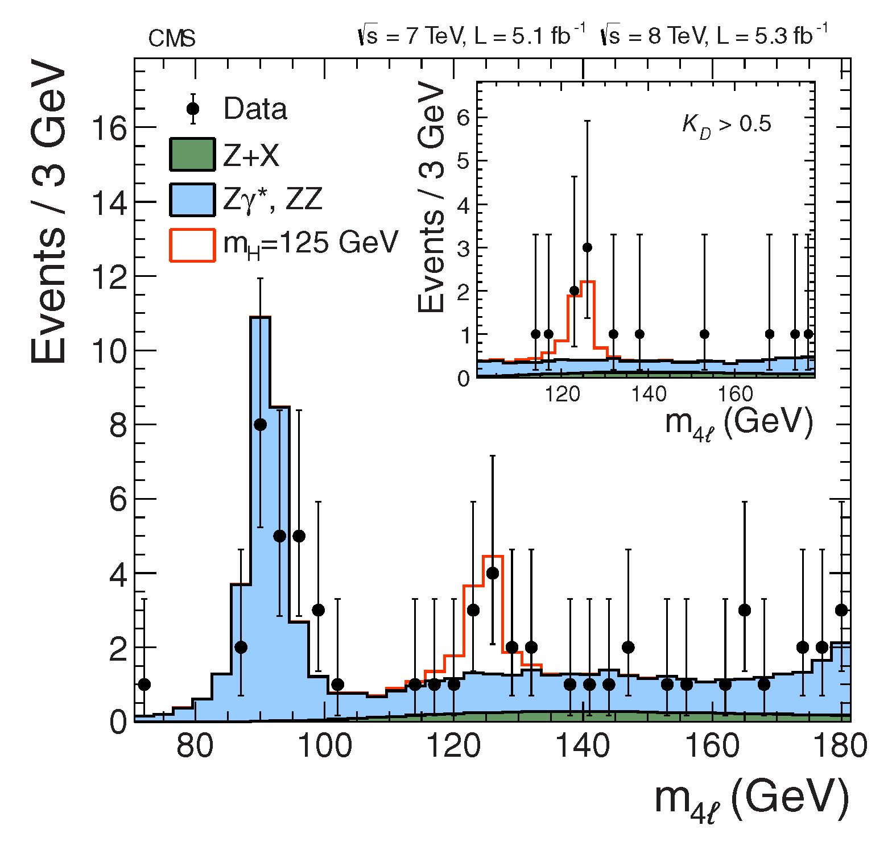
H→Z Z → 4 l: high S/B, low statistics

Slide 24
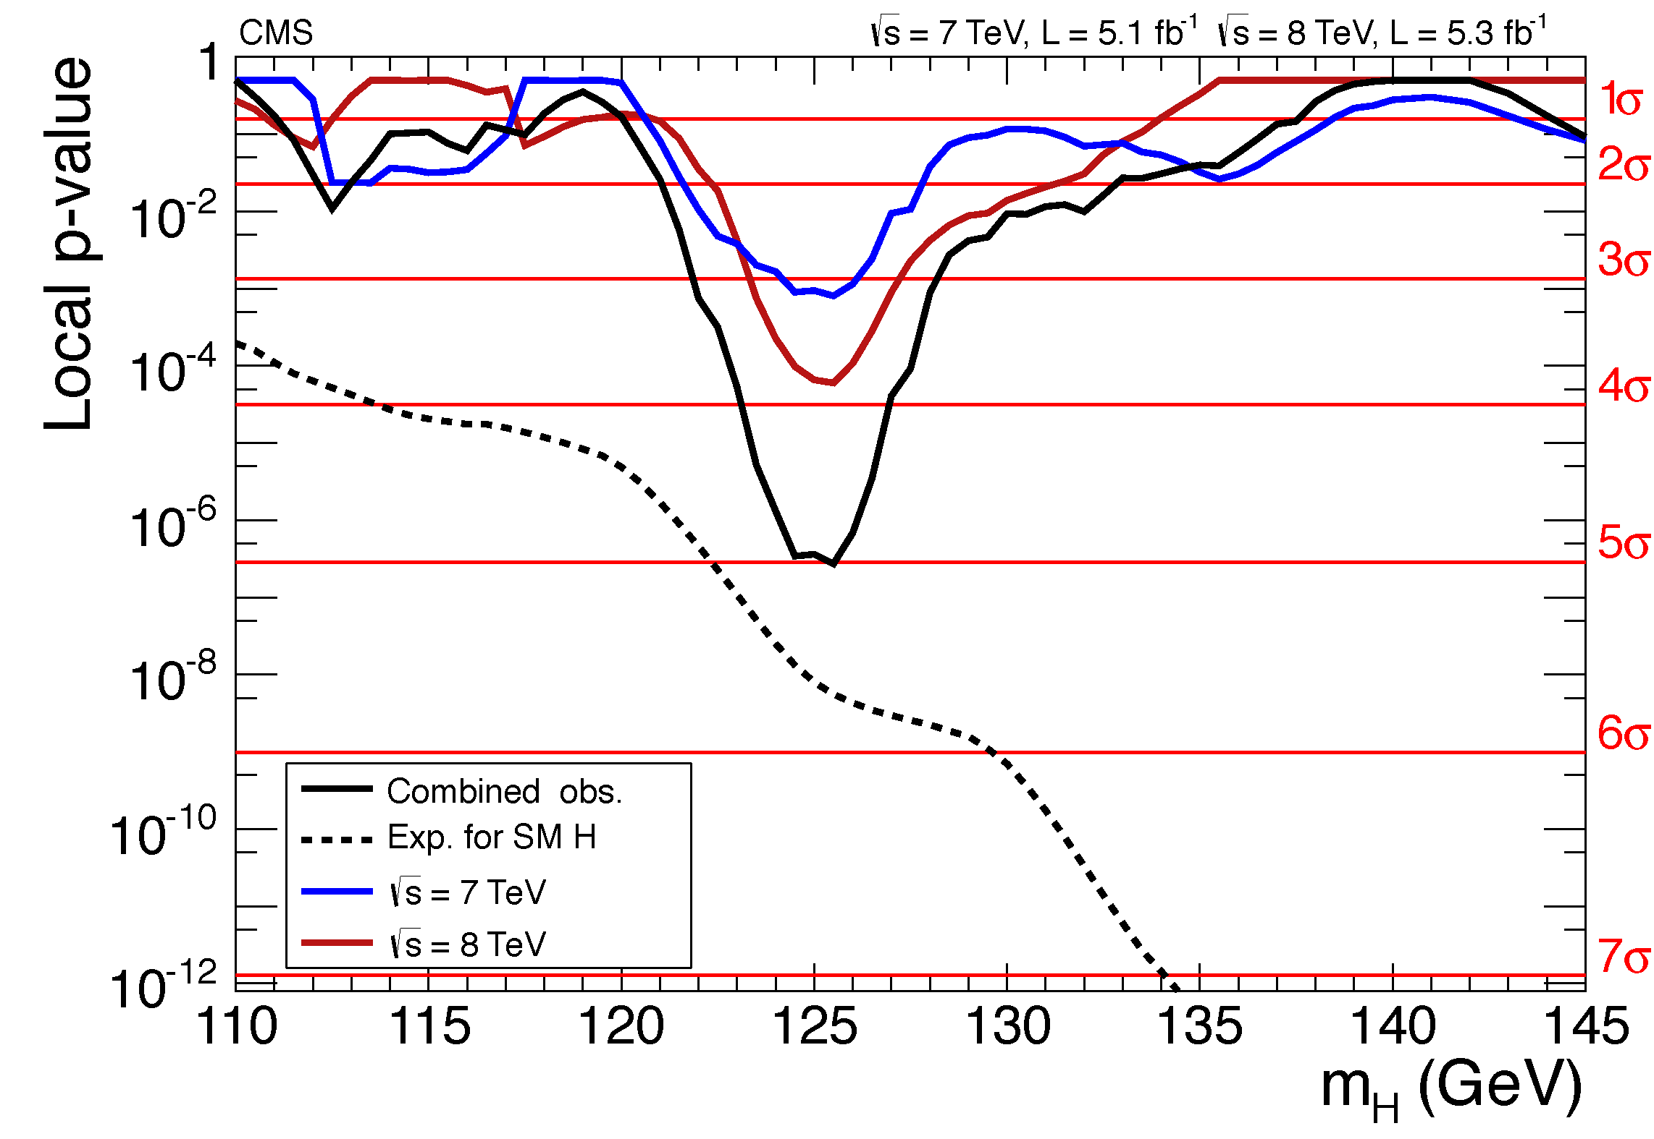
p-value for ‘No Higgs’ versus m_{H}

Slide 25
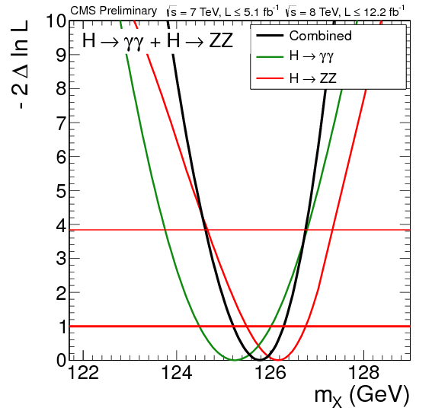
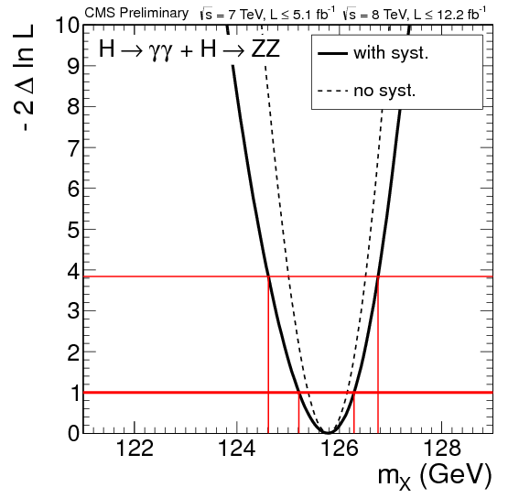
Mass of Higgs:
Likelihood versus mass

Slide 26
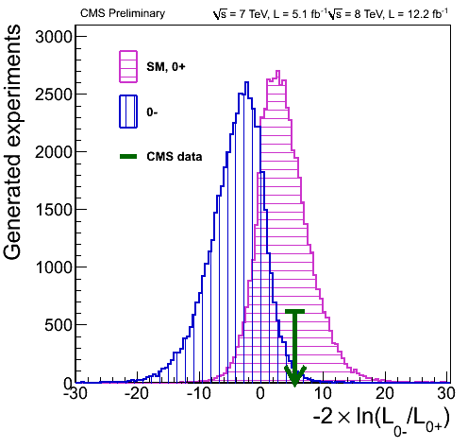
Comparing 0⁺ versus 0⁻ for Higgs
(like Neutrino Mass Hierarchy)
http://cms.web.cern.ch/news/highlights-cms-results-presented-hcp

Slide 27
Conclusions
Many interesting open statistical issues
Some problems similar to those in other fields
e.g. Astrophysics
Help from Statisticians welcome. We would rather use your circular “wheels” than our own square ones.
Come and help us

