Slide 1






The King’s shilling and the Kiwi dollar: experiences of how models inform policy
Nigel French
Massey University, New Zealand
InFer, Warwick 2011

Slide 2
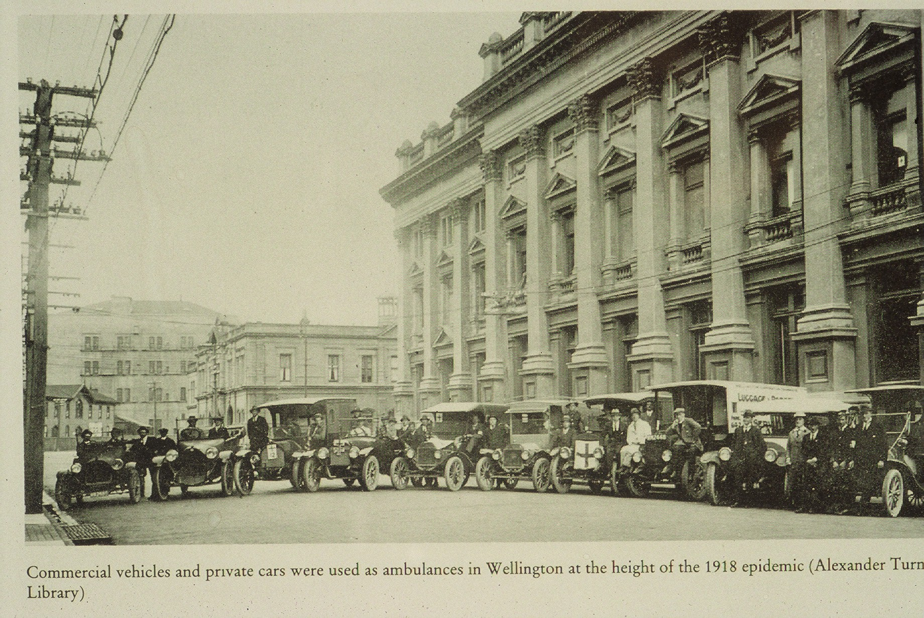
H1N1 influenza in 1918
80% mortality in some towns

Slide 3
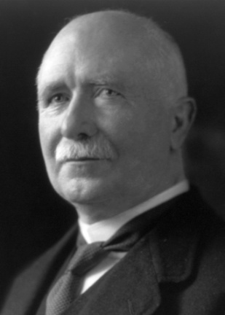
Dire consequences of poor decisions
H1N1 influenza in New Zealand in 1918
1st bad decision
  More important to get Prime Minister Massey to Wellington than obey quarantine
  Ignore contingency plan
2nd bad decision
  Set up zinc sulphate inhalation chambers
Key message: advising policy comes with considerable responsibility
  Could save or cost lives

Slide 4
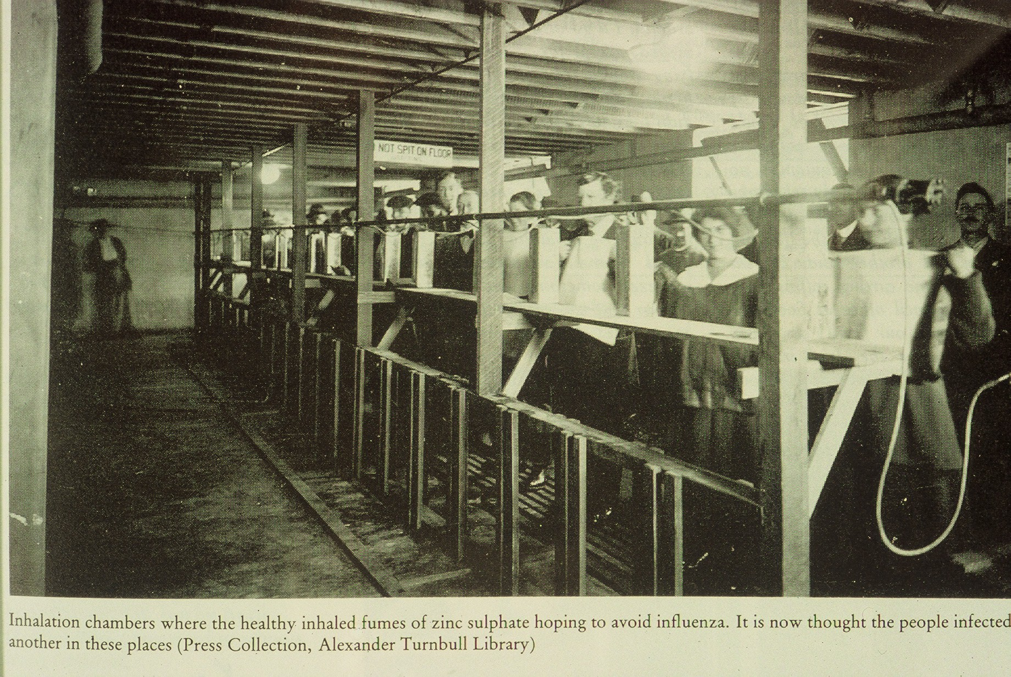
Lives may depend on advice
8,500 deaths in NZ

Slide 5
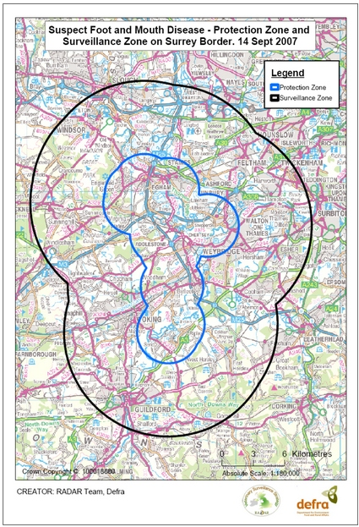
Policy decisions informed by infectious disease modelling
International
  EU directive on zone sizes (in line with OIE) – overrides national law
  WHO target setting HIV/AIDS
National
  Contingency planning for outbreaks (vaccination strategies, simulation exercises)
  Emergency measures during outbreak (school closure, culling)
  Emerging issues – eradicate or not? / assessing PH risk
  Standard setting, licensing of medicines / treatments
  National control programmes
    Food borne zoonoses
    MMR vaccination campaign
Protected and surveillance zones

Slide 6
Decision makers influenced by epidemiological models
International politicians
National bodies / government
  Government ministers
Local government / decision makers
  Medical Officer of Health
  NHS Managers
Industry
  Farming – CEOs of industry bodies
  Racing Industry – CEOs
  Supermarkets

Slide 7
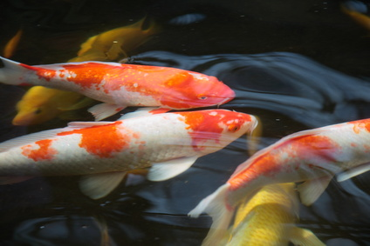
One pathway...
Policy officials
Core Group of stakeholders
Ministers
External stakeholders
Expert advice
Thanks to Simon Scanlon, Defra

Slide 8
Policy makers gather evidence
Policy officials
Economic analysis
Legal advice
Scientific knowledge
Expert opinion
Veterinary advice

Slide 9
Economic analysis integrates evidence and leads to an impact assessment
Economic
analysis
Epidemiological
modelling
Policy officials
Veterinary opinion
Scientific
knowledge

Slide 10
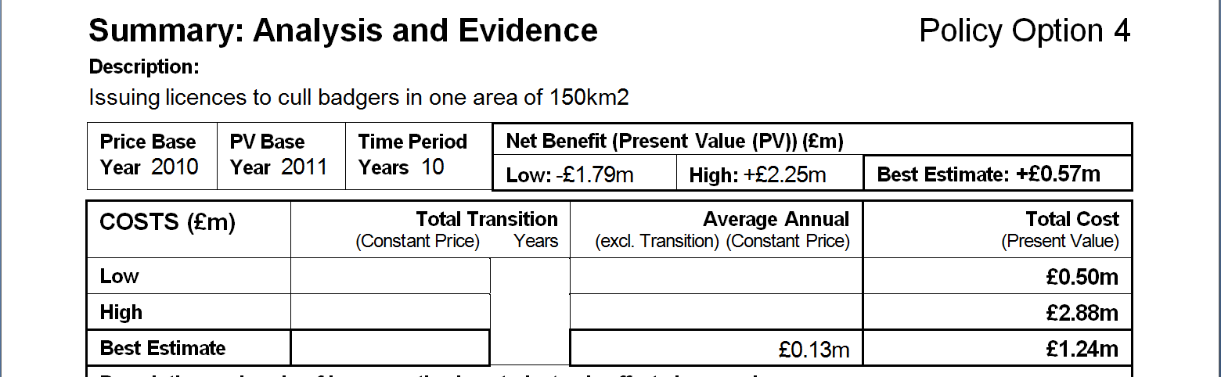
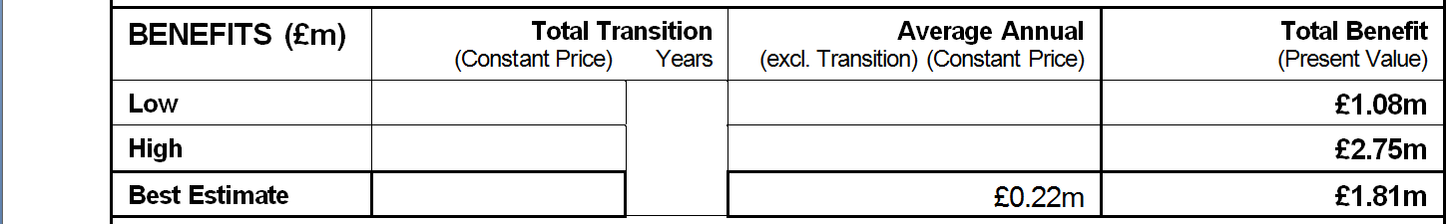
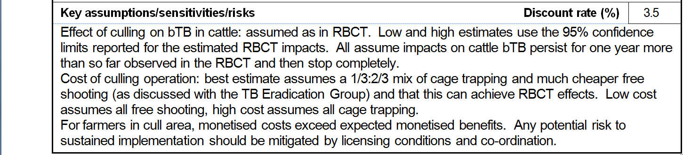
Impact assessment required for regulation and policy change: RBCT

Slide 11
Problems with this pathway…
Policy officials may have little understanding of the science – transient population of civil servants.
Limited dialogue between modellers/epidemiologists and economists/policy makers.
Need for rapid answers – focus on immediate agenda.
Need for an (unequivocal) decision
  Ministers want clear cut evidence that leads to a obvious answer (no need for decision)
  Or at least….don’t want controversy (need to be re-elected / avoid challenge in court)
Can lead to poor decision making, based on limited data and analyses that lack rigour.

Slide 12
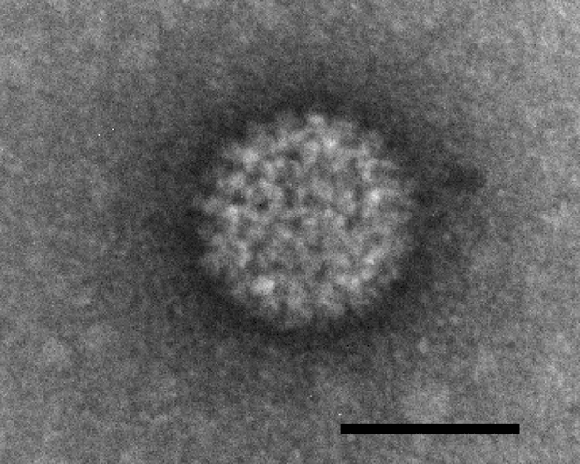
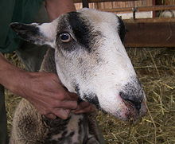
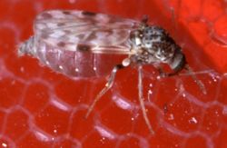
Expected Bluetongue virus outbreak costs
Probability of virus circulating near French coast
X
Probability wind conditions can transport midges
X
Probability midges infect livestock in England
X
Probability outbreak then takes off
X
Expected scale of outbreak (IPs)
X
Average cost of an IP
Expert opinion based on surveillance
Met Office NAME model new runs
Expert opinion
IAH BTV model new runs
IAH BTV model new runs
Economists using animal incidence from IAH model

Slide 13
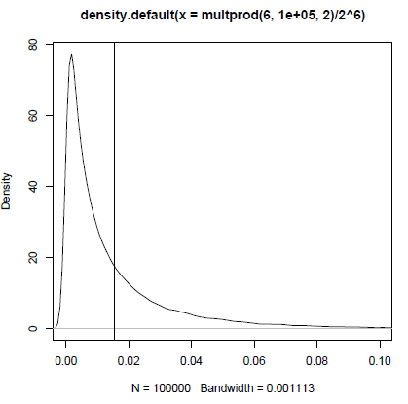
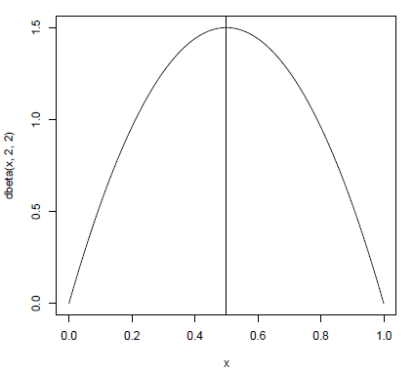
Problems with multiplying probabilities …Gareth Roberts
Sample 6 probabilities from distribution
And multiply them (0.5^6)
True value much higher than mode of the distribution of estimated values
=0.0156
Mean =0.5
A fully Bayesian analysis would recognise this large uncertainty and skew.
May have resulted in a different decision (more chance of outbreaks, greater benefit of vaccination)

Slide 14
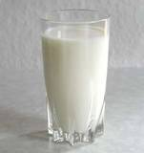

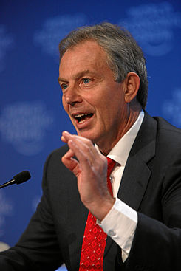
Alternative pathways
Where there’s a will….
Larger democracies evolved complex systems for decision making and setting policy.
US – highly complex structure. Formal and informal pathways for influencing regional, national and international policy.
UK – good example of ‘flexibility’ in policy making during 2001 epidemic
  Powerful industry lobbying
  The contiguous cull

Slide 15
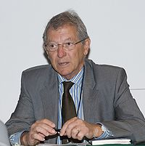
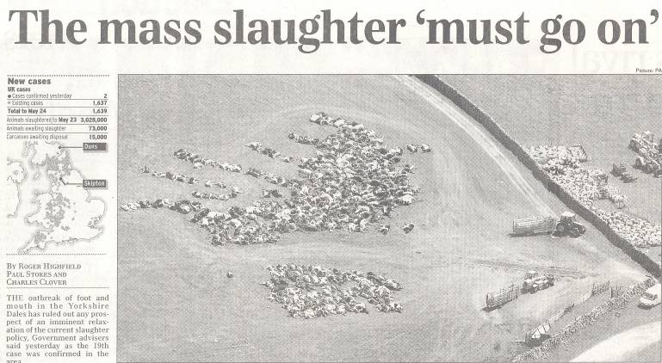
FMD and the King’s shilling

Slide 16
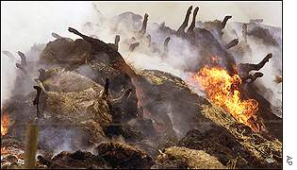
Controversial policy: FMD 2001
First case Feb 19th
Statement that FMD was not under control on 21st March triggered change
  (Cumbria / SW Scotland: 3km cull of sheep March 22nd )
Rapid and pre-emptive culling – the 24/48hr policy
  Rapid culling of IPs before diagnosis (SOS) 24th March
  Contiguous premises culling within 48 hours (March 26th)
Resulted in:
  Change in control policy
  Changes in organisation of response
    GCS took over lead role in policy
“Speedier slaughter of infected animals will help to reduce transmission. But this needs to be accompanied by immediate slaughter of all susceptible species around infected farms…”

Slide 17
FMD in GB: control options
450
Model predictions by Dr Neil Ferguson, Dr Christl Donnelly & Prof. Roy Anderson, Imperial College
400
350
A: Several days to slaughter
300
76% of farms infected & culled in total.
A
250
B: Slaughter on infected premises
within 24 hours
200
35% of farms infected & culled in total
150
C: Slaughter on infected and neighbouring farms
100
within 48 hours
B
21% of farms infected &/or culled in total
50
C
0
27-Jan
10-Feb
24-Feb
10-Mar
24-Mar
7-Apr
21-Apr
5-May
19-May
2-Jun
16-Jun
Date

Slide 18
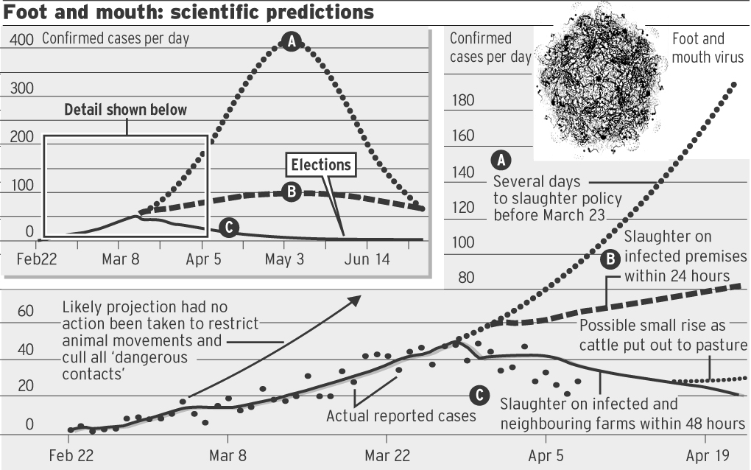
Telegraph – April 2001
Christl Donnelly

Slide 19
Predictions as released by OST (Christl Donnelly)
Predictions as made using data up to 29-March.
Last case on 30th September
2026 IPs, 8570 pre-emptive

Slide 20
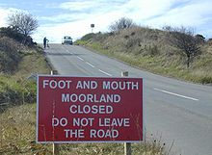
Policy change – the contiguous cull
Contiguous cull controversial
  Did it work?
  Was it necessary?
  How did it work?
    Removal of occult infection
    Removal of susceptible population (i.e. like vaccination)
  If it wasn’t done as intended why did it still work in the way predicted?

Slide 21
Key messages / observations
Short cutting of policy making process / change in command and control structure
Models “dictated” policy rather than supported decision making?
Limited dialogue between increasingly polarised experts
High emotion
Controversy remains but new work, and the 2007 outbreak, leading to consensus view.
  Importance of rigorously peer-reviewed, transparent models.
  Importance of good collaboration

Slide 22
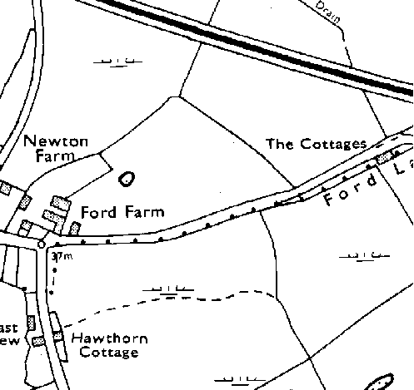
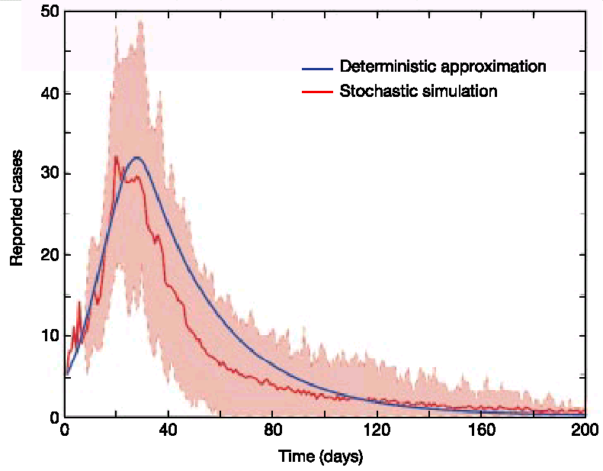
Key messages / observations
Models being used by different decision makers for different purposes
  Defra control team, CVO – EpiMAN, Interspread
  GCS (King), Minister, PM – Imperial, Edinburgh, Cambridge models
Credibility crucial, but different decision makers had different views about who was ‘credible’.
Model outputs were very powerful instruments for changing attitude, belief and behaviour.

Slide 23


Research funding
Assessment / advisory panels may recommend gathering new data.
…but this takes time
  Delay may be seen as useful
    Avoid having to make a decision.
    Can always claim ignorance.
Who funds research is important
  Government: Defra
  Research councils: BBSRC
  Charities / Industry
  Industry

Slide 24

Who provides the science?
Academia
  can’t do approach, poor communication
Private companies
  can do approach, good communication
Experts
  True uncertainty vs false certainty
  Desire to be helpful…
Transparency important
  Models open to inspection, criticism and change
  Expert opinion?

Slide 25
Improving relationship between modellers and policy makers
Mutual understanding of roles and expertise
  Policy officials
    Transient population
    May have little understanding of science
    Working to short-term deadlines
  Modellers / research scientists
    Often far removed from process of policy making
    Can’t communicate effectively with non-scientists
    Often disagree with each other
    May not be interested in informing control policy
      Doing it for “beauty of mathematics”

Slide 26
Other lessons learned
Just because an organisation funds your work doesn’t mean it will be interested in the outcome.
Or at least not in the way you intended….

Slide 27
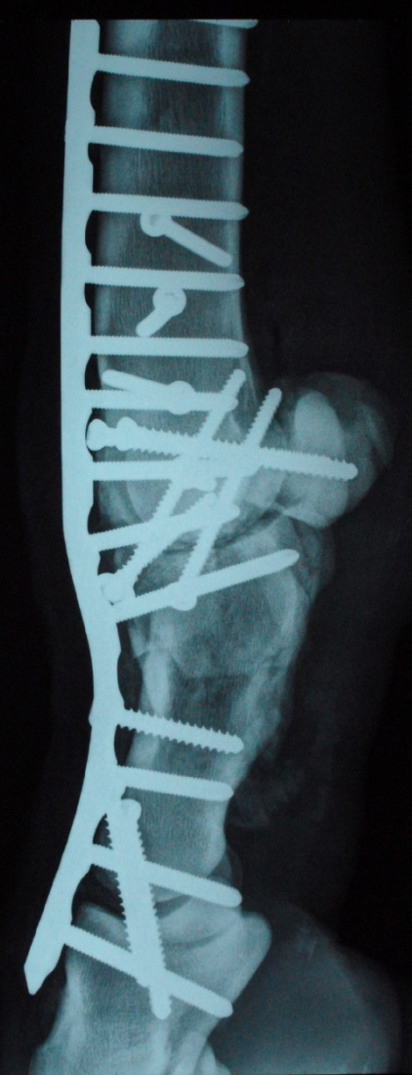
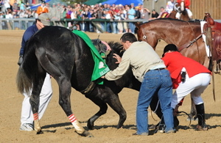
Horse welfare: falling and racing injuries

Slide 28
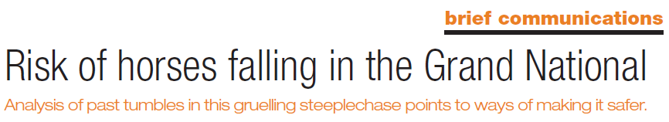
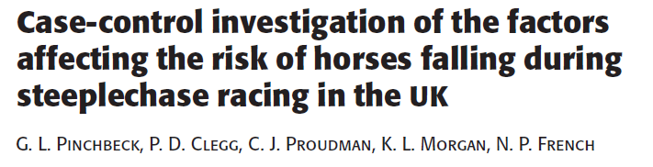
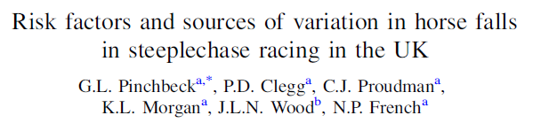
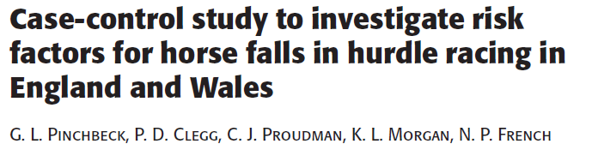
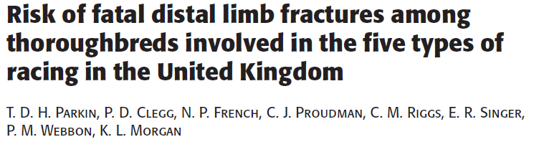
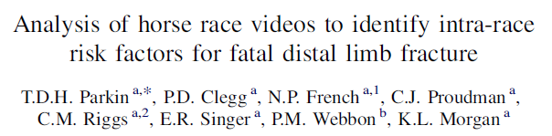
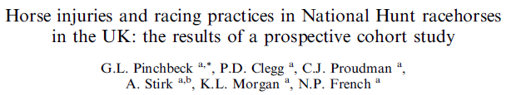

Slide 29
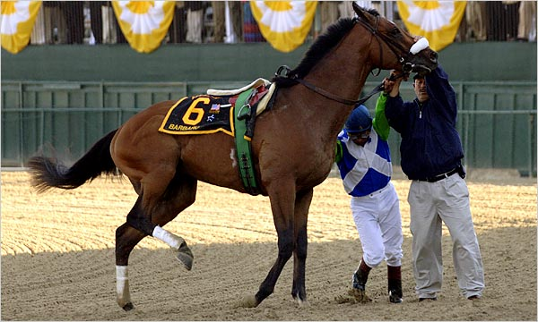
Did it inform policy
Some small changes and recommendations made by industry .
Useful for betting…
Or even making falling more likely…
  Horse welfare > Jockey welfare

Slide 30
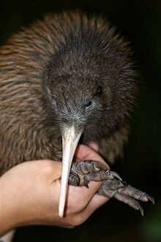
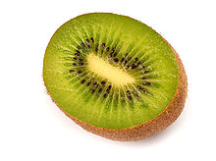
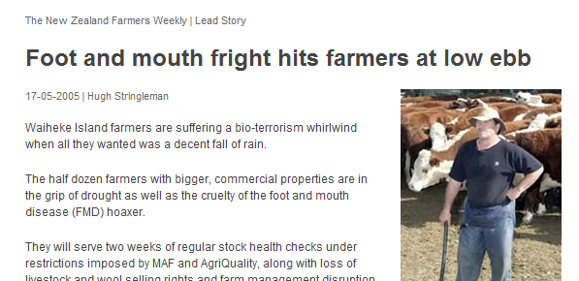
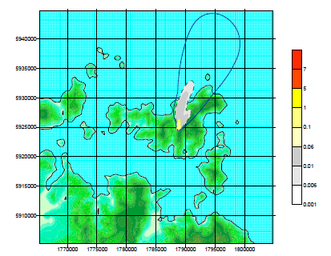
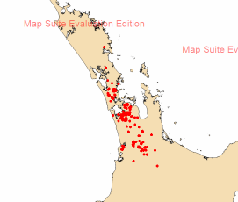
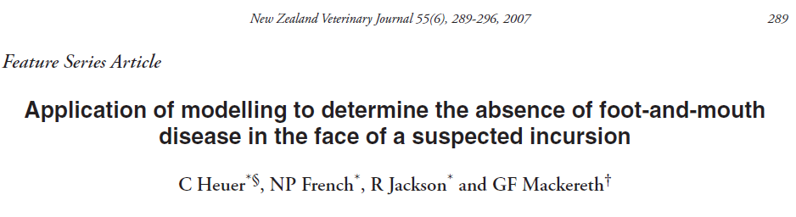
The Waiheke incident

Slide 31
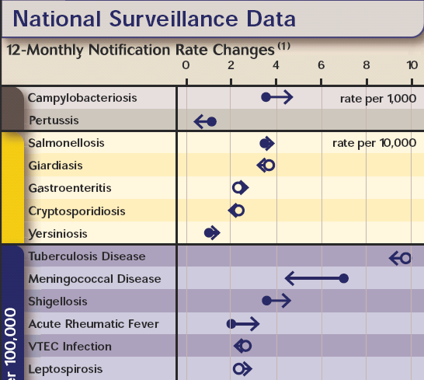
Pathogens
2006
Most important notifiable diseases are zoonoses.
Food and environmental
exposures
Source: ESR

Slide 32
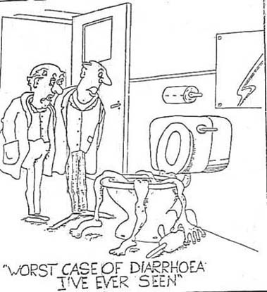
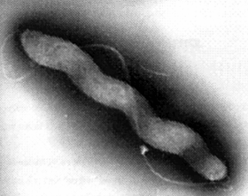
Campylobacter
Diarrhoea (98%), abdominal pain (92%), fever (85%), vomiting (39%), bloody diarrhoea (33%)
7.6% cases hospitalised (2004)
Complications
  Guillain Barré / Miller Fischer/ RA

Slide 33
Campylobacteriosis in NZ
From Baker et al 2006

Slide 34
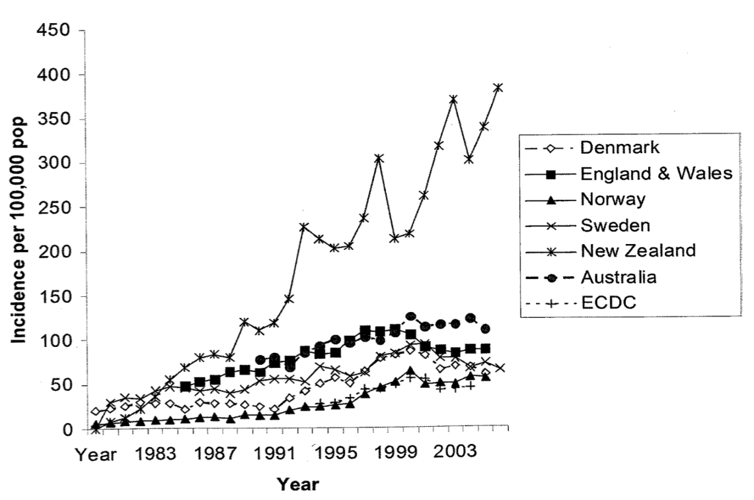
An International Comparison
Source: Olsen et al Campylobacter. 3rd ed. Washington DC: ASM Press; 2008 .

Slide 35
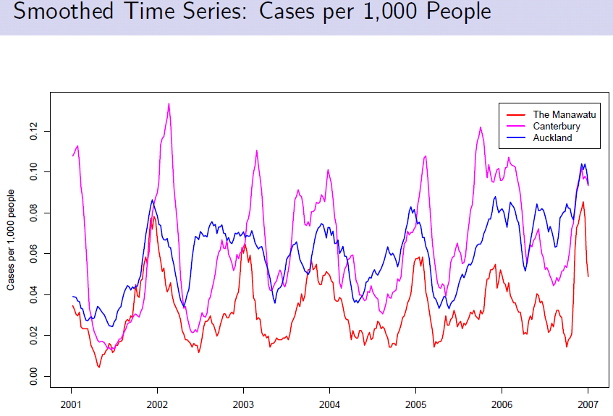
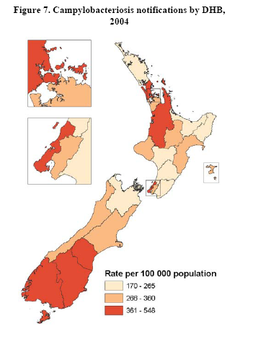
Epidemiology: seasonal pattern

Slide 36
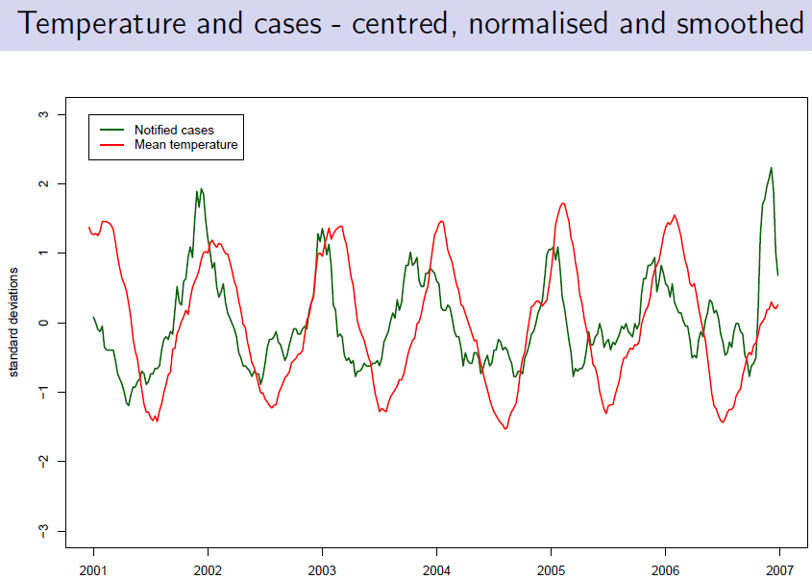
Campylobacter predicts weather

Slide 37
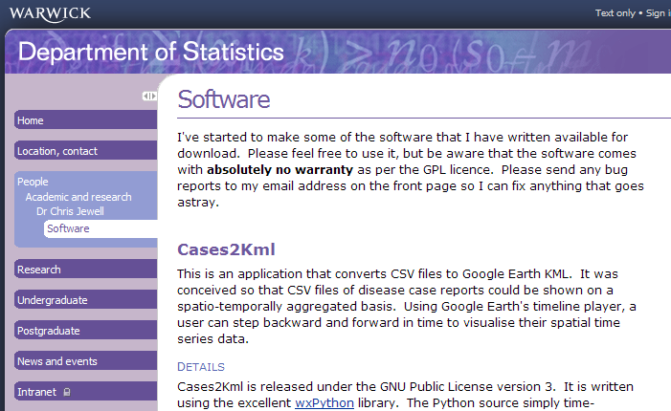
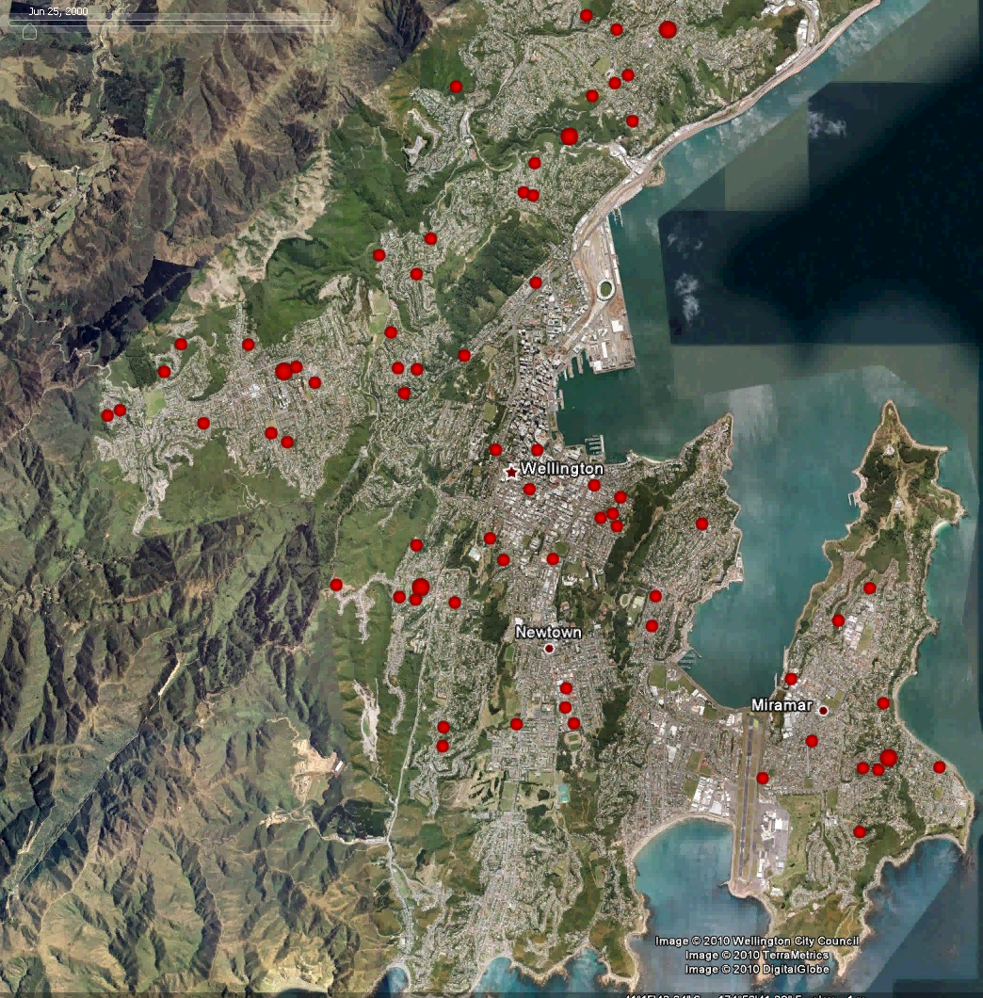
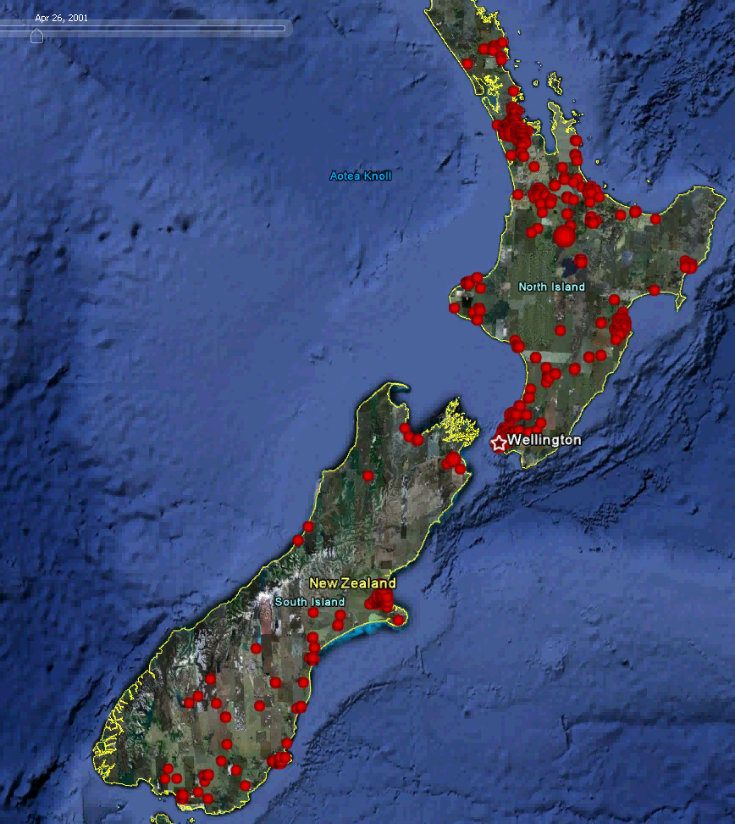
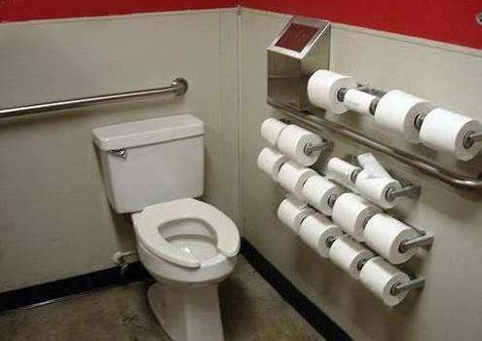
Campylobacter in Google Earth

Slide 38
Spatio-temporal modelling
Bayesian hierarchical modelling
Simon Spencer
meshblocks

Slide 39
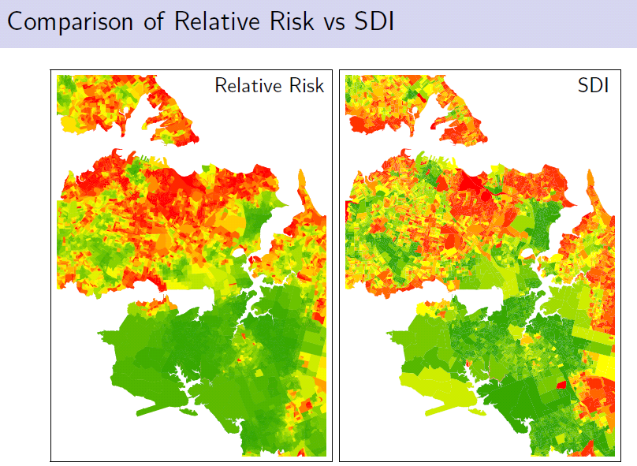
Epidemiology: spatial pattern
Wealthy area
Deprived area
>1M pop^{n}

Slide 40
Spatial epidemiology - age
0-4 year olds
Pre-school children predominantly rural

Slide 41
Spatial epidemiology - age
5-9 year olds
School children predominantly urban

Slide 42

Interventions in poultry industry demanded
2006
Poultry ~ 40% of meat consumption, no imports or exports

Slide 43




Slide 44

Chicken – confusing / conflicting evidence?
Ikram 1994, New Zealand Campylobacter study

Slide 45
Source attribution
Essential for:
  Managing public health risks
  Prioritising resources
  Directing research effort

Slide 46
Model-based approaches to ‘source attribution’
  (Analytical) epidemiology
    Population-based epidemiological studies
  Simulation modelling / Risk assessment
  Molecular epidemiology
    Microbial subtyping / source tracking
    Applying molecular tools, population genetics and epidemiological modelling to inform public health policy
    NZFSA funded

Slide 47
Approaches to ‘source attribution’
  (Analytical) epidemiology
    Population-based epidemiological studies
  Simulation modelling / Risk assessment
  Molecular epidemiology
    Microbial subtyping / source tracking
    Applying molecular tools, population genetics and epidemiological modelling to inform public health policy
    NZFSA funded

Slide 48
Setting up the sentinel site
Collaboration
  MedLab Central
  Public Health Unit
  Human health surveillance unit: ESR
  Industry body: PIANZ / suppliers
  Dairy and sheep farmers
  Regional council
  Institutes at Massey
  Regulator: NZFSA

Slide 49




Manawatu study 2005-2010
Sentinel site (5 yrs)
Identify genotypes common to particular sources
Modelling (risk attribution)

Slide 50
Numbers of samples/isolates:
C. jejuni
Human 520 (770 samples)
Poultry 562 samples 75% +ve
Red meat 1312 samples 12% +ve
Ruminant faeces 278 samples 58% +ve
Env. Water 335 samples 30% +ve
Wild bird 192 samples 13% +ve
March 1st 2005 to Feb 29th 2008

Slide 51


Multi Locus Sequence Typing
MLST
PCR highly conserved genes
7 housekeeping genes
Used to define:
ST = sequence type – unique pattern of 7 genes
Clonal complex = group of related STs
  Website: Oxford University
  http://campylobacter.mlst.net
Notes:
Workhorse typing tool
Details not necessary but useful because some types are strongly associated with particular hosts
And good website, transportable

Slide 52

PubMLST database

Slide 53



Minimum spanning tree: isolates from the Manawatu
Poultry STs
River water STs
Ruminant STs
N=3120 isolates
Poultry A
Poultry B

Slide 54

Host associated sequence types in NZ
Ruminant associated
Poultry associated

Slide 55
Need for good epidemiological data
EpiSurv, PHU

Slide 56


Slide 57
Source attribution
Source attribution – used 4 approaches
  Proportional similarity
    Simple, area of overlap
  Dutch model
    Simple assignment
  Hald model
    Complex, epidemiology based
  Island model
    Complex, population genetics based

Slide 58





Proportional Similarity Index (PS)
The PS estimates the area of overlap between the frequency distributions of e.g. bacterial sub types from different sources.
Human origin
“Bovine” origin

Slide 59
The Hald model (Hald et al 2004)
Number of cases of type i attributable to food source j
p_{ij} = matrix of prevalence of different strain types
M_{j}= relative amount of food consumed
a_{j} = relative ‘danger’ of food (or environmental) sources.
q_{i} = relative ‘virulence’ of strains.
Estimates number of cases with measure of uncertainty (Bayesian inference)

Slide 60

Modified Hald Model (Mullner et al 2009)
Risk Analysis, June 2009
Model prevalence uncertainty
Hierarchical model for bacterial parameters
Omit food consumption weights (M)

Slide 61

Asymmetric Island model
Population genetics approach
Based on coalescent (mutation and recombination)
Used to find out source of human infections
Flow into the human “island” from animal “islands”
Sheep
Chicken
Cow
Wild bird
Human
Water

Slide 62

Source attribution in New Zealand:
Island model

Slide 63

Source of human cases,
Lancashire, England
poultry
cattle
sheep

Slide 64


Source attribution (Mullner et al)
Proportion of human campylobacteriosis cases attributable to each source: comparing, from left to right, the Dutch (I), modified Hald (II) and asymmetric island model (III). Error bars represent 95% confidence / credible intervals.

Slide 65

Auckland MLST (T. Wong)
Pink = human
Rest poultry
474
Auckland

Slide 66


…2006-2009, now 2010-2012

Slide 67

Campylobacter Performance Target (CPT)
Moving Window Failure (MWF)
  Rinsate > 3.78 log₁₀ CFU, >6 samples,
  moving window of 45 samples
High Count Failure (HCF)
  Rinsate > 5.88 log₁₀ CFU, > 3 / 15 samples
Quarterly Failure
  Premises median > 4.16 log₁₀ CFU/rinsate
Response to alerts increasingly more severe (5 levels)
Plant closure

Slide 68
Poultry industry intervention
Post spin-chill:
Sanova (ASC)
Pre spin chill:
Inspexx
(hydrogen peroxide and peroxyactic acid)
Spin chill: pH, chlorination, filtration

Slide 69


National Micro Database: poultry initiated
Target: 1 log reduction in contamination. Action depends on number of non-compliances

Slide 70


Slide 71
The 2008/9 situation…
09
Data Source: ESR Ltd

Slide 72

Human notifications

Slide 73

Surveillance factors – could the decline be surveillance ‘artefact’?
Changes in the clinical presentation of campylobacteriosis?
Changes in GP practices?
Changes in laboratory practices?
Changes in notification practices?
  NB: direct laboratory notifications since 18th Dec 2007

Slide 74

Trends in notified zoonoses

Slide 75
Relationship between Campylobacteriosis Notifications and Hospitalisations (A. Sears)
Data Sources: ESR Ltd notification data; NZHIS hospitalisation data (filtered)
Notes:
Hospitalisation filter: principle diagnosis, and excluding non-NZ residents, day cases, readmissions within one month, transfers, planned admissions, privately-funded
75

Slide 76

Human cases Manawatu – Sequence types
% human
cases
ST 474 – poultry associated
Ruminant
associated
Year

Slide 77

Modelling post intervention change in attribution
N=800+ human cases
Poultry
Bovine
Ovine
Dynamic Hald model

Slide 78

Modelling post intervention change in attribution: poultry with CrI

Slide 79

The changing epidemiology of campylobacteriosis in New Zealand
% Reduction in case rates most marked in urban adults...
...and least in rural children.
Why?
Notes:
This has resulted in a shift in the epidemiology of human cases – the highest rates are now in rural areas, and in pre-school children... And most associated with cattle and sheep..

Slide 80

Recent trends
Rates:
Number of cases per 1000 people
Year

Slide 81



Why different epidemiology in rural areas?
Notes:
We’ve seen a marked increase in dairy cattle densities in some areas of NZ – particularly Southland and the Waikato.

Slide 82



Identifying potential outbreaks in water supply regions
SSTE in press
Notes:
The tool has been validated using known outbreaks

Slide 83



Tararua outbreak in 2008
ST 190
Water flow
Episurv
Notes:
As a more recent example detected by surveillance tool, in first week of August 2008, high rainfall resulted in high flows in rivers in region. This coincided with an increase in the number of cases with onset dates between 5th and 9th of August in Pahiatua water supply region. Inspection of episurv reveals interesting comments!! And a cluster of genotypes ST 190 – most likely of ruminant origin.

Slide 84


Models showed strong correlation with density of dairy cattle in rural areas
Transmission pathways?
No significant relationship with sheep density but strongly related to dairying
Notes:
And these areas have relatively high rates of campylobacteriosis. Dairy cow density was a very important predictor for human cases in rural areas. Highlighted in orange is the strong positive relationship between dairy cattle density and the rate of campy in rural areas. Note that sheep were not associated with campy rates and that only in urban areas did the case rates reduce markedly below their 2000 value in 2008/9 (blue squares). The table shows coefficients from a Poisson regression model.
This is pointing to the importance of dairy cattle as a source of human infection in rural areas – which was consistent with the molecular evidence.

Slide 85

Surface water sampling
Dairy=227,658
Beef=181,196
Manawatu – farmland and bush

Slide 86

Prevalence of Campylobacter spp.

Slide 87



Ruminant

Slide 88

Source attribution: water
Most isolates from water are associated with wildlife – even in dairy catchments
Cattle and sheep isolates more likely to be associated with human infection
Water birds
Sheep
Cattle

Slide 89

Waikato human cases 2000-2009

Slide 90

Time series in urban and rural areas
Poultry intervention
2000
2001
2002
2003
2004
2005
2006
2007
2008
2009
Notes:
Using data visualisation tools and time series analysis we observed that the peak in cases was a few months earlier in high dairy cow areas – green line is high density dairying areas which peaks before the peaks in urban areas and rural areas without dairy cattle (blue and purple lines). Note also that the incidence in dairy areas doesn’t decline post intervention in 2007/8.

Slide 91

Seasonality and dairy density
Notes:
This is very evident in these box plots as a peak around calving time in the high day rural areas (red arrow). Again this points to increased dairy exposure at the time of calving.
In the post-poultry intervention period, ruminants, particularly dairy cattle are becoming increasingly important to target for control and prevention. This will present many new challenges....

Slide 92
Cattle-associated cases
Young children
During calving season
Direct contact?
Epidemiology changed
  Different set of policy and decision makers
  Different stakeholders

Slide 93

Conclusions: campylobacteriosis in NZ
Much better understanding of epidemiology of campylobacteriosis
Source attribution modelling
  Tools advanced in recent years
  Applied to Campylobacter in NZ and identified food, particularly poultry, most important source, informed policy
  Major decline in human cases 2007-9
Estimated $40M saving to economy per year
Control of ruminant-acquired infections – new focus.

Slide 94
Summary
What we do (epidemiologists, modellers, statisticians…) is important and should inform policy for control of infectious disease.
Few other disciplines do (climate change)
Huge responsibility (lives / livelihoods depend on decisions).
Produce policy-ready research?
Study design important – need for good data
  Must address relevant question.
  “strong assumptions often make up for poor data”.
  Good surveillance (human, animal, contacts).

Slide 95
Summary
Need to produce flexible/future-proof models
  Pathogen and context always change
More than one way to influence policy
  Formal and informal
  Lobbying or “ear bending”
Policy officials closer to decision making than scientists, but may have limited understanding of science
  Communication of uncertainty
  (Honest) Visualisation important
  Scientists need to educate policy officials
  …and vice versa

Slide 96

Summary
Suggest don’t just do academic research - get involved:
  advisory panels, expert committees, simulation exercises, preparedness planning…etc.
  Appointments commission
Engage with individuals at all levels of decision making process.
  Continue dialogue throughout process
Educate and be prepared to be educated
https://www.appointments.org.uk/

Slide 97







Acknowledgements
Staff – lecturers, RAs
  Dr Julie Collins-Emerson, Dr Anne Midwinter,,
  Dr Simon Spencer, Dr Jonathan Marshall, Dr Patrick Biggs
Lab team:
  Rukhshana Akhter, Errol Kwan, Lynn Rogers, Sarah Moore, Angie Reynolds
PhD students
  Petra Mullner, Vathsala Mohan
Masters students
  Particularly Tui Shadbolt, Ann Sears
MidCentral Public Health
    - Dr Jill McKenzie
MedLab Central
ESR - Dr Phil Carter
AgResearch – Grant Hotter, Adrian Cookson
Michael Baker
Dr Chris Jewel (Warwick)
Dr Barbara Holland, Dr Geoff Jones, Dr Alasdair Noble,
Prof Martin Hazelton
  Allan Wilson Centre
Dr Danny Wilson, Prof Paul Fearnhead
NZFSA, MoH, FRST, Royal Society Marsden and Industry funding

Slide 98



Thanks for a great conference!

