Slide 1
Ensemble-Based Probabilistic Forecasts for Wind Speeds at Multiple Look-Ahead Times
Gruffudd Edwards
with Stan Zachary
Heriot-Watt University

Slide 2


Slide 3
Wind powered generators are making a rapidly increasing contribution to meeting electrical energy demands across the world.
The output of such generators is highly variable and only partially predictable, even when time-averaged over periods such as an hour.
Therefore, the time-averaged outputs of a collection of wind-farms should be considered as a stochastic process observed at discrete points in time.

Slide 4
Electricity networks often cover an extensive geographical area, with wind resource availability at some parts potentially very different to others.
Since the relationship between wind speed and power output is highly nonlinear, can’t take average speed for the entire area.
Total power output must be represented as a spatio-temporal stochastic process observed at discrete points in time and space.

Slide 5
For electricity networks where a significant proportion of generation capacity is comprised of wind (or other renewable) generators, optimal real time operation and management requires joint probabilistic forecasts of their output values in the near future.
Such forecasts are useful to a wide variety of actors such as TSOs, wind farm operators and energy traders.
Transition to probabilistic view a work in progress!

Slide 6
Forecast users typically interested in wind speeds at a set of look-ahead times, running from the nearest future point to some desired forecast length.
Assume lead times have a regular resolution equal to the observation sampling rate – hourly for available data here.
Many dimensions, so difficult to construct and interpret the joint distribution.

Slide 7
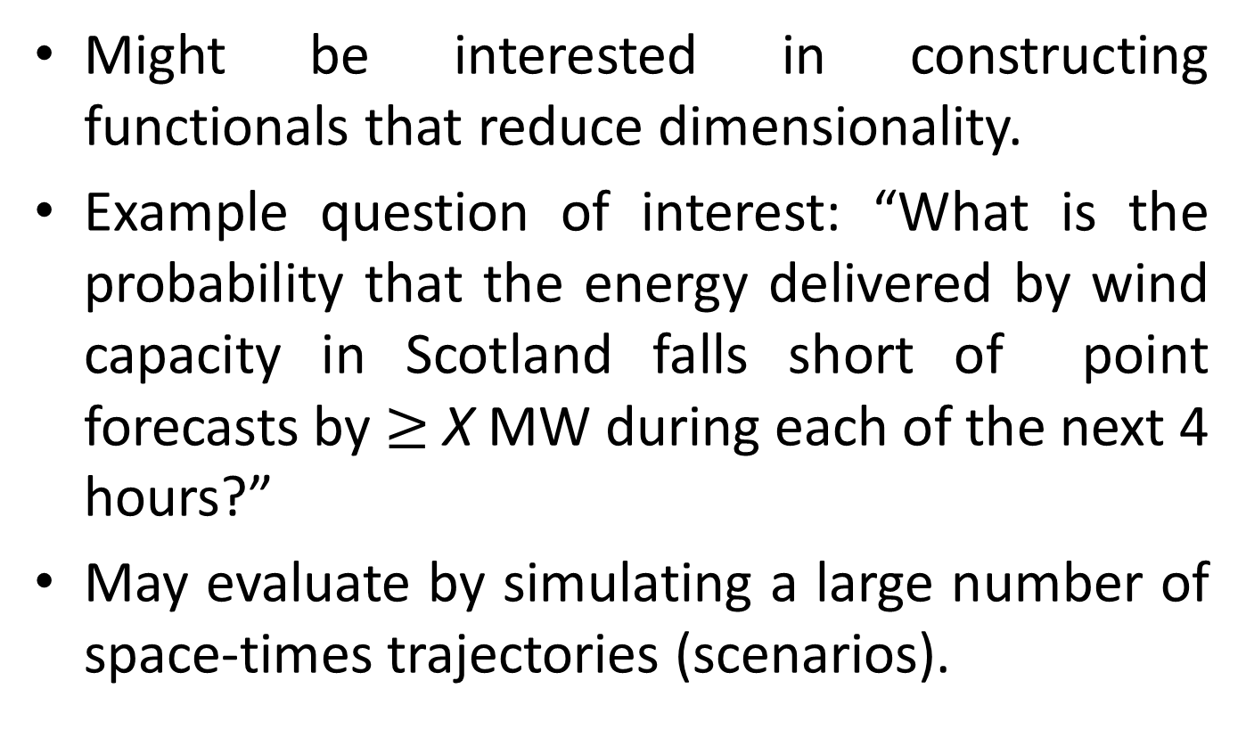
Might be interested in constructing functionals that reduce dimensionality.
Example question of interest: “What is the probability that the energy delivered by wind capacity in Scotland falls short of point forecasts by $≥$ X MW during each of the next 4 hours?”
May evaluate by simulating a large number of space-times trajectories (scenarios).

Slide 8
Relationship of 10m wind speed & power is affected by local meteorological conditions and condition of machinery. Since these cannot realistically be fully known, process should be conceived as resulting from a set of stochastic functions.
Establishing these functions are beyond scope of current work.

Slide 9
Current work is interested in the strong and complex spatio-temporal relationships in wind power output processes, best achieved through examining wind speeds rather than power outputs.
Wind speeds represent much more information about power outputs than vice versa.

Slide 10
The forecasts should be updated in a manner that is as timely as possible, making use of the most recent observations and forecasts as they become available.

Slide 11
The conditioning information set can be decomposed into two elements:
- observations from across the area covered, including past and present wind speeds and other relevant meteorological variables; and
- ensembles of meteorological forecasts.

Slide 12
Comprehensive use of both has not yet been achieved, certainly not in the case of joint distributions
Making start at exploring this rich territory.

Slide 13
For shortest look ahead times, typically considered , best approach is a time series model, primarily utilising .
Best models use informative neighbouring locations, and model parameters should be conditional on e.g. regime-switching models with regimes defined by atmospheric circulation types.
Forecasts are naturally updated at the observation frequency.

Slide 14
For longer look-ahead times, best approach is meteorological i.e. Numerical Weather Prediction (NWP).
Forecasts comprise of sets (ensembles) of trajectories for points in a regular spatial grid.
The ensemble members differ in the assumed initial state of the atmosphere, the range of values reflecting the forecaster’s uncertainty.

Slide 15
Differences derive from perturbations to the best guess about the state of the atmosphere.
Most combinations of perturbations turn out to be physically inconsistent, or lead to rapid convergence with the trajectory of the best guess.
There is a correspondence between ensemble members across locations, but not forecast issue times.

Slide 16
Ensembles may also comprise of several physical models.
The aim is to represent the range of what could happen as well as possible, and form (possibly crude) predictive distributions.
Obtaining more accurate predictive distributions generally requires statistical post processing.

Slide 17
One popular method is EMOS.
Assume truncated normal distribution, with density
otherwise

Slide 18
Parameters depend on look-ahead time, not ensemble member and optionally location.

Slide 19
Bayesian Model Averaging (BMA) is another approach based on creating a mixture distribution:
When all ensemble members are derived from a single physical model, the weights are equal.

Slide 20
The component distributions may again be truncated normal, with constant standard deviations, unique to each look-ahead time and possibly location, but common to all ensemble members.
The same can be said of the (typically linear)
re-calibration parameters defining

Slide 21
Parameters fitted are those which minimize the continuous ranked probability score (CRPS) over all instances in a calibration sample.
crps(FX,y) = E[X - y] – ½ E[X’ - X]
Found that simple estimation methods can be superior.

Slide 22
These approaches examine fixed look-ahead times, and do not consider the trajectory ensembles as a spatio-temporal process.
In the current work, we examine the extent to which NWP trajectories may indeed be considered as stochastic processes with realistic characteristics – potentially following re-calibration and the addition of a suitable error process, which hopefully is small.

Slide 23
Due to their computational expense, the update frequency for meteorological forecasts is generally significantly lower than the lead-time resolution.
Improving this is the subject of considerable research effort in the Meteorological community, and need for it is even further highlighted by the work presented here.

Slide 24
In the meantime, important to understand how to update predictive distributions derived from NWP ensembles, based on observations received during the period between forecast updates, and assess the quality of the resulting conditional distributions.

Slide 25
NWP ensemble data has kindly been provided by MeteoGroup – wind speed and direction, along with other variables for possible future model refinement, such as temperature.
Data is based on widely used forecast ensembles issued by the European Centre for Medium-Range Weather Forecasts ECMWF, but with finer spatial resolution.

Slide 26
Forecasts can be evaluated by comparison with Met Office records, i.e. the MIDAS dataset, available through the BADC.
Looking at southern Scotland, due to the concentration of installed capacity and challenging orography.

Slide 27
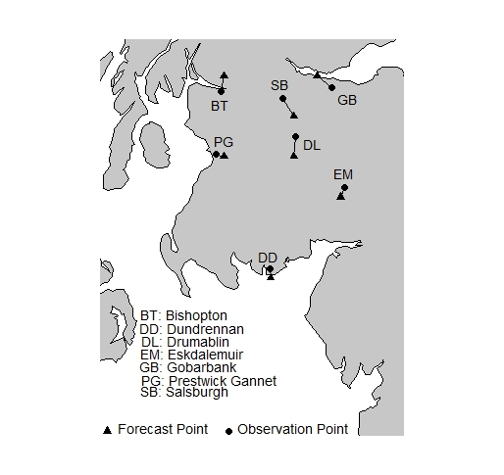

Slide 28
Dec-Feb 2011/12 & 2012/13.
Forecasts issued at 00.00h and 12.00h.
Forecasts provided for 1/6th of hours, to limit dataset size.
Forecast look-ahead time ranges from 0h to 360h.
50 ensembles, all representing a random perturbation to the best guess initial state of the atmosphere. (Best guess is excluded).

Slide 31
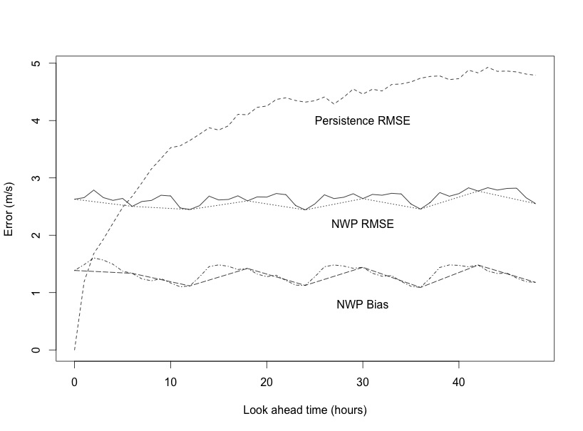
Drumablin Errors.
Linear interpolation used to ‘fill-in’ the NWP errors.

Slide 33
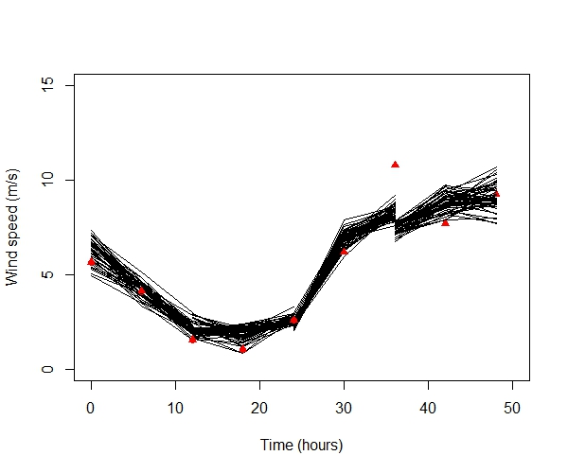

Slide 34
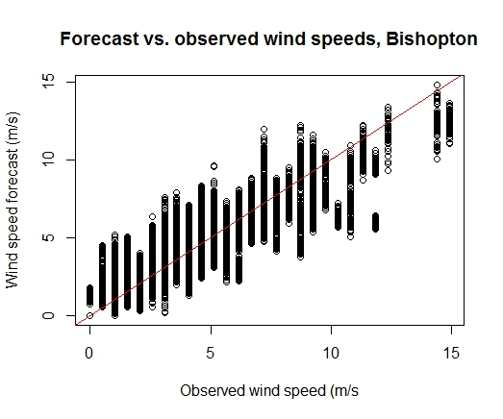

Slide 35
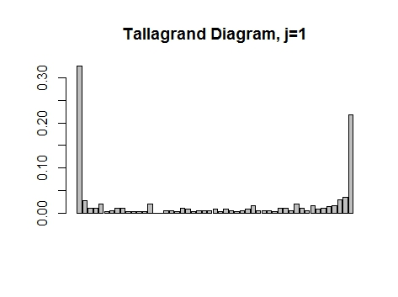

Slide 36
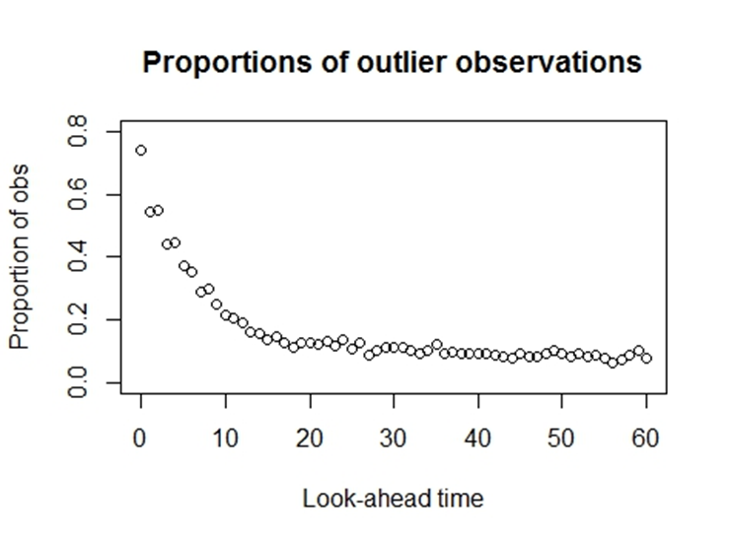

Slide 37
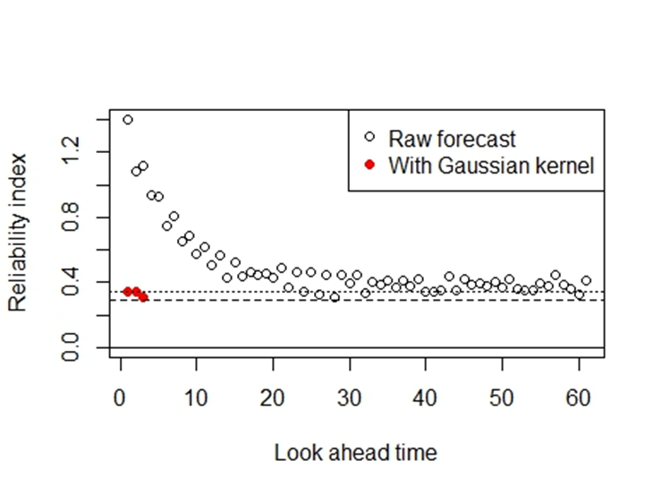

Slide 38
If ensemble has e.g. one of the highest predicted wind speeds at a given look-ahead time, does this continue to be the case for several steps, before mixing?
Is this true for the observations, acting as one more ensemble?

Slide 39
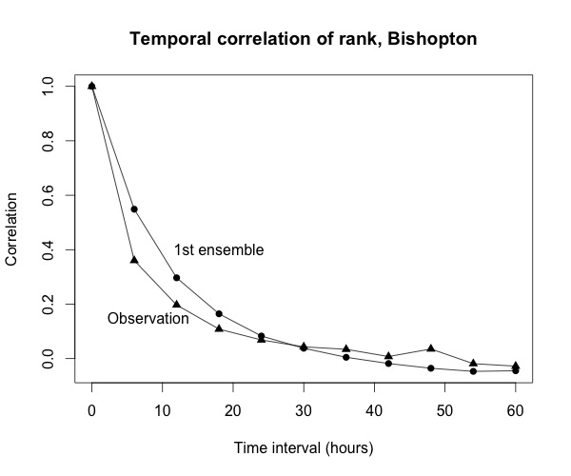

Slide 40
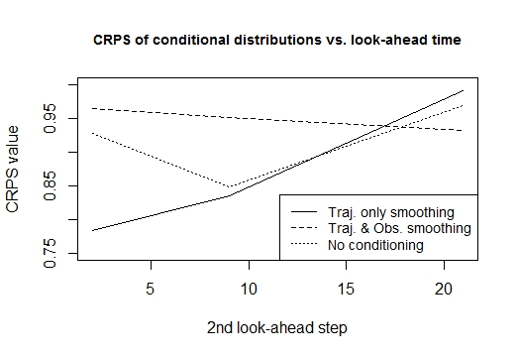

Slide 41
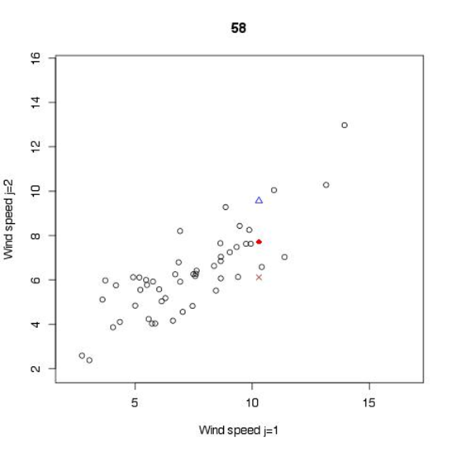

Slide 42
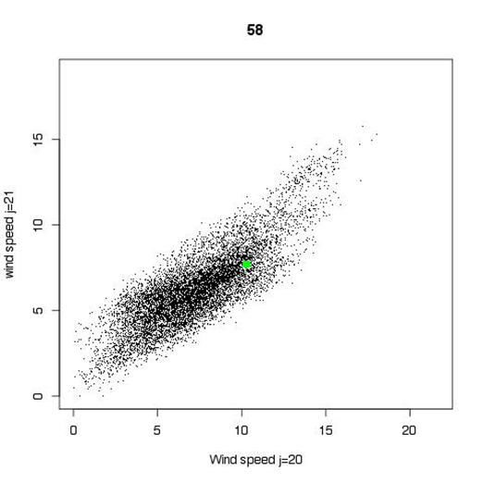
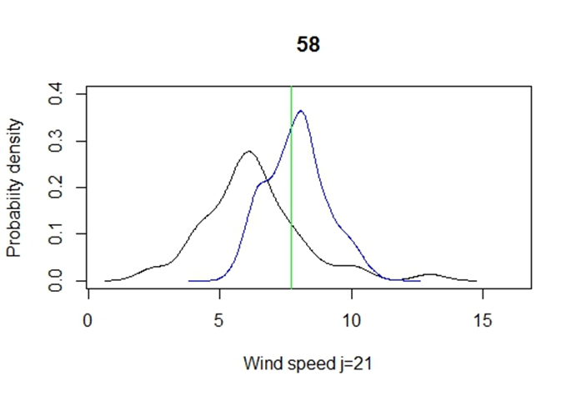

Slide 43
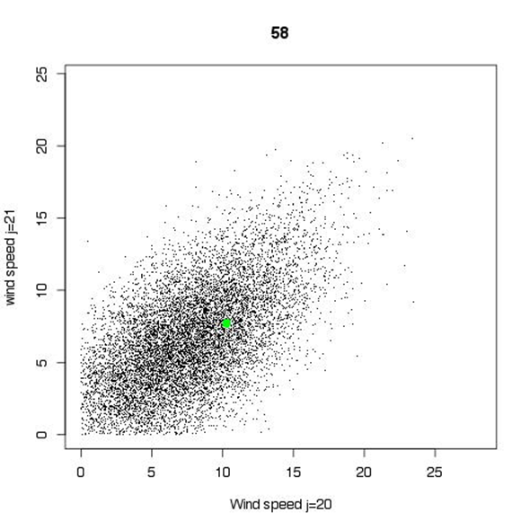
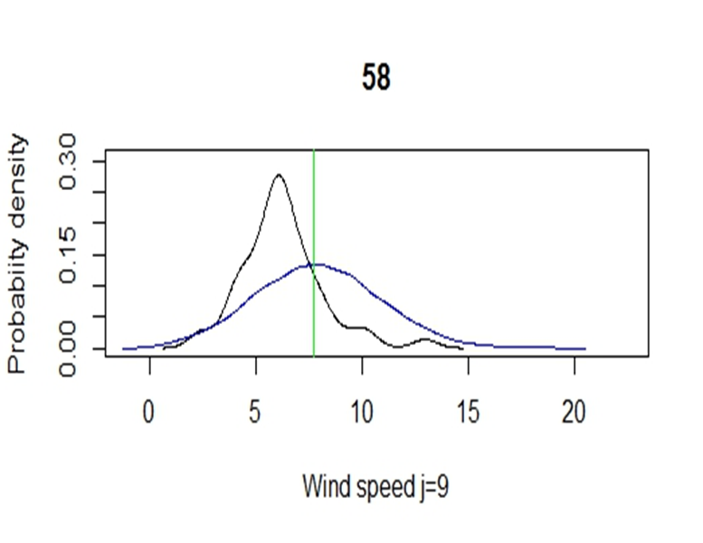

Slide 44
Next stage is to investigate conditioning with observations at upwind locations, in addition to / instead of the same location, when the forecasted wind direction is favourable.

Slide 45
Interested in covariances and linear correlation coefficients for trajectories – mean(trajectories) and observations – mean(trajectories).
For j = 1 & 2, forc.cov = 0.03, obs.cov = 0.41
For J = 8 & 9, forc.cov = 0.33, obs.cov = 0.47
For J = 20 & 21, forc.cov = 1.48, obs.cov = 1.78
For j=1 & 2, forc.cor=0.17, obs.cor = 0.23
For j=8 & 9, forc.cor=0.41, obs.cor = 0.20
For j=20 & 21, forc.cor=0.64, obs.cor = 0.45

Slide 49
Conclusions
Ensemble NWP forecasts provide multiple spatio-temporal trajectories for wind speeds, but they are only probabilistically calibrated for long look-ahead times.
Statistical post-processing techniques exist to re-calibrate and allow for the generation of much larger sample sizes.
Once the process has settled, temporal behaviour is quite realisti in many respects.

Slide 50
For some applications, ‘mature’ raw trajectories behaved better than smoothed ones, in experiments conducted so far.
The study of the trajectories as spatio-temporal processes is a new/ neglected area, with significant rewards.

Slide 51
Another interesting area of research is the merging of time series and conditioned NWP ensembles into a single method that is optimal for all horizons.
A starting point could be e.g. the 90th percentile of the NWP predicted ramping rate (along with direction) setting regimes with different relative weights given to informative neighbours in a VAR model.

