Slide 1


Revenues from storage in a competitive energy market: empirical evidence from Great Britain
CRISM Workshop on Statistical and Probabilistic Methodologies for Energy Systems
University of Warwick - 14 April 2014
Monica Giulietti, joint work with:
Luigi Grossi (Universita’ di Verona) and Michael Waterson (University of Warwick)

Slide 2
Plan on the talk
Introduction and motivation
The ‘park spread’ concept
Data and methodology
Analysis of profitability conditions
Extreme value theory analysis
Conclusions

Slide 3
Introduction and motivation
Increased role of intermittent renewable sources of energy makes storage a desirable option, despite cost
Main focus on wind power and ability to deal with week-long calms
Energy storage facilities will be provided through a market system, rather than being subject to command imperatives
Given existing energy market system, what arbitrage conditions make it privately worthwhile to construct and run the facility?

Slide 4
The ‘park spread’ concept
Storage facility arbitrage strategy which maximises the expected profits, while limiting the risk associated with price volatility.
Storage can participate in the forward market buying electricity when prices are low and selling it for delivery at time T in the future.
The inter-temporal price gap needs to meet at least a ‘conservative’ efficiency rate of the facility (current technology: 60-70%).
Existing technology does not allow for energy storage beyond a month (differently from gas or other fuels).

Slide 5
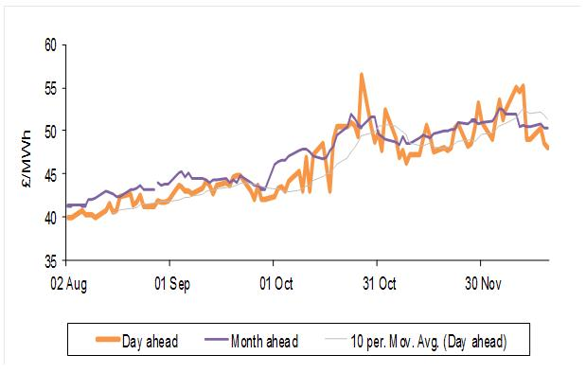
Observed price patterns (2004)

Slide 6
The park-spread index
Profitability of storing power purchased at time t and sold on the same day in the forward market for delivery in the future N periods ahead can be defined as:
The owner of the storage facility aims to exploit fully arbitrage opportunities to discharge at a point in the future for given realistic levels of round trip efficiency.

Slide 7
Data source: Platts UK Power Market database
Day-ahead power assessments, base load and peak price.
Baseload assessments refer to delivery from 23:00 on the day of trade to 23:00 the day after
Peak assessments are for delivery 7:00 to 19:00 on the day following trade
Week-ahead power assessments, peak (for delivery Monday to Friday the following week).
Month-ahead peak assessment for delivery in the 4(5) weeks following trade.
Daily frequency (5 working days) from March 2001 to November 2012. All prices measured in £/MWh

Slide 8
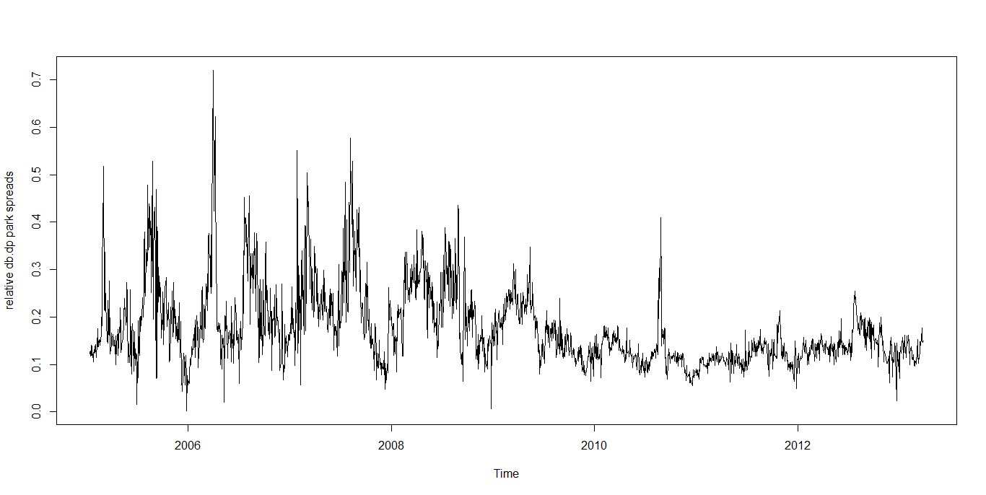
Day ahead peak – base load returns
Returns on average about 20%, but lower after 2009/2010

Slide 9
Analysis of profitability conditions
Year |  | 60% | 70% | Year |  | 60% | 70%
2001 | rdb.wp | 0 | 0.1 | 2007 | rdb.wp | 0.06 | 0.22
 | rdb.mp | 0 | 0.3 |  | rdb.mp | 0.22 | 0.41
2002 | rdb.wp | 0.1 | 0.2 | 2008 | rdb.wp | 0.03 | 0.1
 | rdb.mp | 0.1 | 0.3 |  | rdb.mp | 0.07 | 0.15
2003 | rdb.wp | 0.1 | 0.3 | 2009 | rdb.wp | 0 | 0
 | rdb.mp | 0.2 | 0.4 |  | rdb.mp | 0 | 0.03
2004 | rdb.wp | 0.1 | 0.2 | 2010 | rdb.wp | 0 | 0
 | rdb.mp | 0.1 | 0.3 |  | rdb.mp | 0 | 0
2005 | rdb.wp | 0 | 0.1 | 2011 | rdb.wp | 0 | 0
 | rdb.mp | 0 | 0.2 |  | rdb.mp | 0 | 0
2006 | rdb.wp | 0.1 | 0.2 | 2012 | rdb.wp | 0 | 0
 | rdb.mp | 0.2 | 0.4 |  | rdb.mp | 0 | 0
Day-ahead (baseload) to week-ahead (peak), Day-ahead (baseload) to month-ahead (peak)

Slide 10
Summary of results (1)
Profitable gaps between day-ahead and forward prices which are compatible with efficiency rates are observed with reasonable frequency over a period 10 years, especially around 2005-2008, but not in the last 3 years.
Occurrence of profitable arbitrage opportunities is more prevalent with monthly horizon and for the higher level of round trip efficiency (70%).

Slide 11
Methodology
Stationarity tests: KPSS (no unit root) and Phillips-Perron (unit root)
Seasonal ARIMA leading to residuals which are nearly white-noise (residual noise due to intra-day aggregation).
Extreme value theory – suitable to model markets with a pattern of D-S imbalances (rather than anomalous behaviour).

Slide 12
Stationarity analysis: park spread measure (electricity)
 | Day ahead baseload day ahead peak | Day ahead baseload Week ahead peak | Day ahead baseload Month ahead peak
KPSS test statistic (H₀ no unit root) | 0.263 | 0.251 | 0.166
Test critical values (1% level) | 0.216 | 0.216 | 0.216
Test critical values (5% level) | 0.146 | 0.146 | 0.146
Phillips-Perron test statistic (H₀ unit root) | -11.979 | -15.548 | -10.007
Test critical values (1% level) | -3.968 | -3.968 | -3.968
Test critical values (5% level) | -3.415 | -3.415 | -3.415

Slide 13
Dynamic analysis: ARIMA model (electricity)
 | Day ahead baseload Day ahead peak | Day ahead baseload Week ahead peak | Day ahead baseload Month ahead peak
SAR1 coefficient | 0.6979 (***) | 0.6040 (***) | 0.7180 (***)
Intercept | 8.3914 (***) | 9.2110 (***) | 10.7162 (***)
Adjusted R² (seasonal regression with dummies) | 0.7497 | 0.6462 | 0.8155
Seasonal ARIMA(1,0,0) model
with weekly seasonality (5 working days)

Slide 14
Stationarity analysis: park spread measure (gas)
 | Day ahead Week ahead | Day ahead Month ahead
KPSS test statistic (H₀ no unit root) | 0.143 | 0.0398
Test critical values (1% level) | 0.119 | 0.119
Phillips-Perron test statistic (H₀ unit root) | -26.269 | -12.635
Test critical values (1% level) | -3.969 | -3.969

Slide 15
Dynamic analysis: ARIMA model (gas)
 | Day ahead Week ahead | Day ahead Month ahead
SAR1 coefficient | 0.1587(***) | 0.5081 (***)
Intercept | 0.4291(***) | 1.219(***)
Adjusted R² (seasonal regression with dummies) | 0.7296 | 0.7328
Seasonal ARIMA(1,0,0) model
with weekly seasonality (5 working days)

Slide 16
Summary of results (2)
The stationarity analysis leads to inconclusive results. Further analysis led us to conclude that the park spread measures are fractionally integrated.
The park spread measures modelled as ARIMA(1,0,0) with 5 periods seasonality generate nearly white noise residuals (with discrepancies due to intra-day aggregation).

Slide 17
Extreme value theory analysis
Threshold for extreme values exogenously determined by technology, round trip efficiency implies thresholds of 0.6 and 0.429 respectively
Insufficient observations for reliable analysis for 60%.
At 70% r.t.e. we have 335 observations. 11.5% of the observations for the original series
With 11.5% of observations we estimated a Generalized Pareto distribution which satisfactorily fits the theoretical one (density plot).
Both form and scale parameters are highly significant.
Same process for SARIMA residuals to check for autocorrelated effects, this generates even better fit.

Slide 18
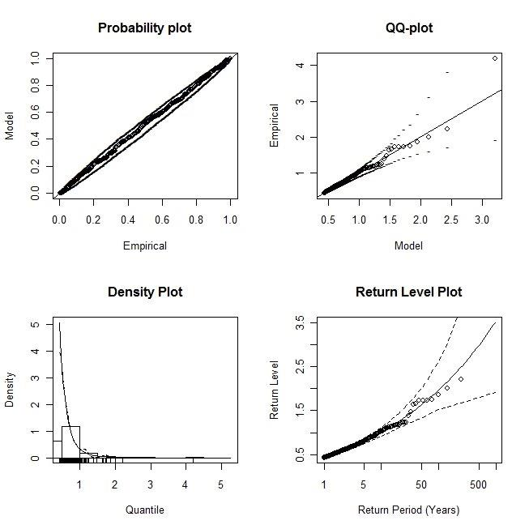
Extreme values analysis: original series (70% r.t.e.)

Slide 19
Extreme values analysis: park spread measure (70% r.t.e.)

Slide 20
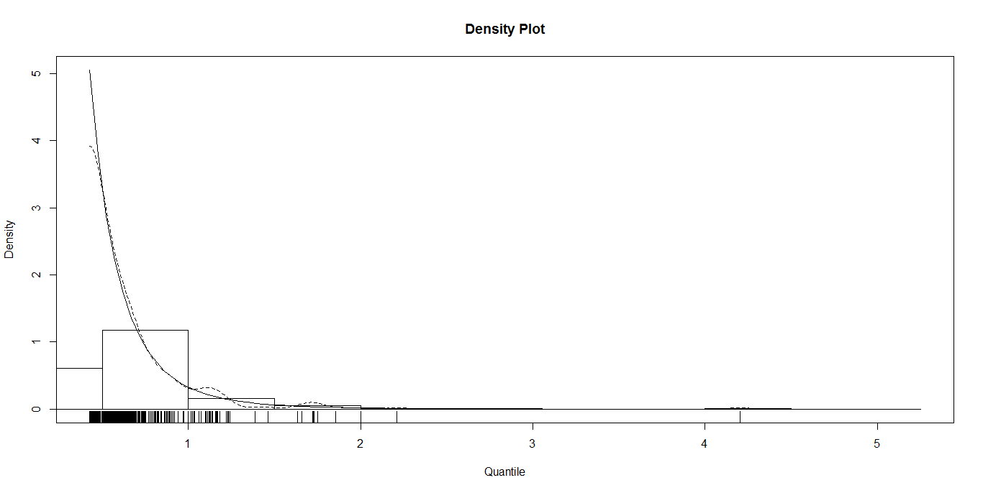
Extreme values analysis: park spread measure (70% r.t.e.)

Slide 21
Summary of results (3)
This method provides a measure of the likelihood of arbitrage opportunities arising in the forward markets in future periods rather than predicting expected returns.
We are able to model and forecast the extreme values which make the exploitation of arbitrage opportunities profitable for the highest level of round trip efficiency, with up to 1 year horizon.

Slide 22
Conclusions
Despite their social benefits, if storage facilities are to be provided privately their commercial appeal will depend on their expected profitability.
One potential source of profitability is the exploitation of arbitrage opportunities in forward markets.
Evidence from the UK indicates that these opportunities were present in the last decade but have not been observed in the last 3 years (impact of economic recession?).
Extreme value theory can be used effectively to forecast arbitrage opportunities up to one year ahead

Slide 23
Thank you

