Slide 1



Excellent teaching in
mathematics and statistics
Duncan Lawson
Teaching Forum, Warwick University 11 December 2019

Slide 2
Just for fun!
Let’s do some maths!

Slide 3
Overview
Excellent teaching – according to the Government
Excellent teaching – some scholarship
Excellent teaching in maths & stats – some research evidence
Implementing active learning in maths & stats
Any questions

Slide 4

Excellent teaching according to the Government

Slide 5



What is Excellent Teaching?
2015 Government Green Pape Fulfilling our Potential: Teaching Excellence, Social Mobility and Student Choice stated:
‘There is no one broadly accepted definition of “teaching excellence” in practice it has many interpretations and there are likely to be different ways of measuring it.’
Nonetheless, we now have a TEACHING EXCELLENCE FRAMEWORK
Excellent teaching according to the Government

Slide 6
What does TEF measure?
The latest round of TEF (institutional level) used six core metrics:
  Teaching on my course (from NSS)
  Assessment and feedback (from NSS)
  Academic support (from NSS)
  Continuation (from HESA)
  Employment of further study (from DLHE)
  Highly skilled employment of further study (from DLHE)
And three supplementary metrics:
  Grade inflation
  Sustained employment of further study (from LEO)
  Above median earnings threshold or further study (from LEO)
Excellent teaching according to the Government

Slide 7
Subject level TEF is waiting in the wings
Piloted last year with nine core metrics:
  Teaching on my course (from NSS) Weighted 0.5
  Assessment and feedback (from NSS) Weighted 0.5
  Student voice (from NSS) Weighted 0.5
  Academic support (from NSS) Weighted 0.5
  Learning resources (from NSS) Weighted 0.5
  Continuation (from HESA) Weighted 2
  Highly skilled employment of further study (from DLHE) Weighted 1
  Sustained employment of further study (from LEO) Weighted 1
  Above median earnings threshold or further study (from LEO) Weighted 1
These don’t tell us what excellent teaching looks like – possibly(??) they tell us about what the outcomes of excellent teaching might be
Excellent teaching according to the Government

Slide 8

Other Government measures
What makes a ‘low quality’ course in the mind of the Conservative party?
“courses deemed below par on graduate earnings”
Excellent teaching according to the Government

Slide 9
For some relief
Let’s do some maths!

Slide 10
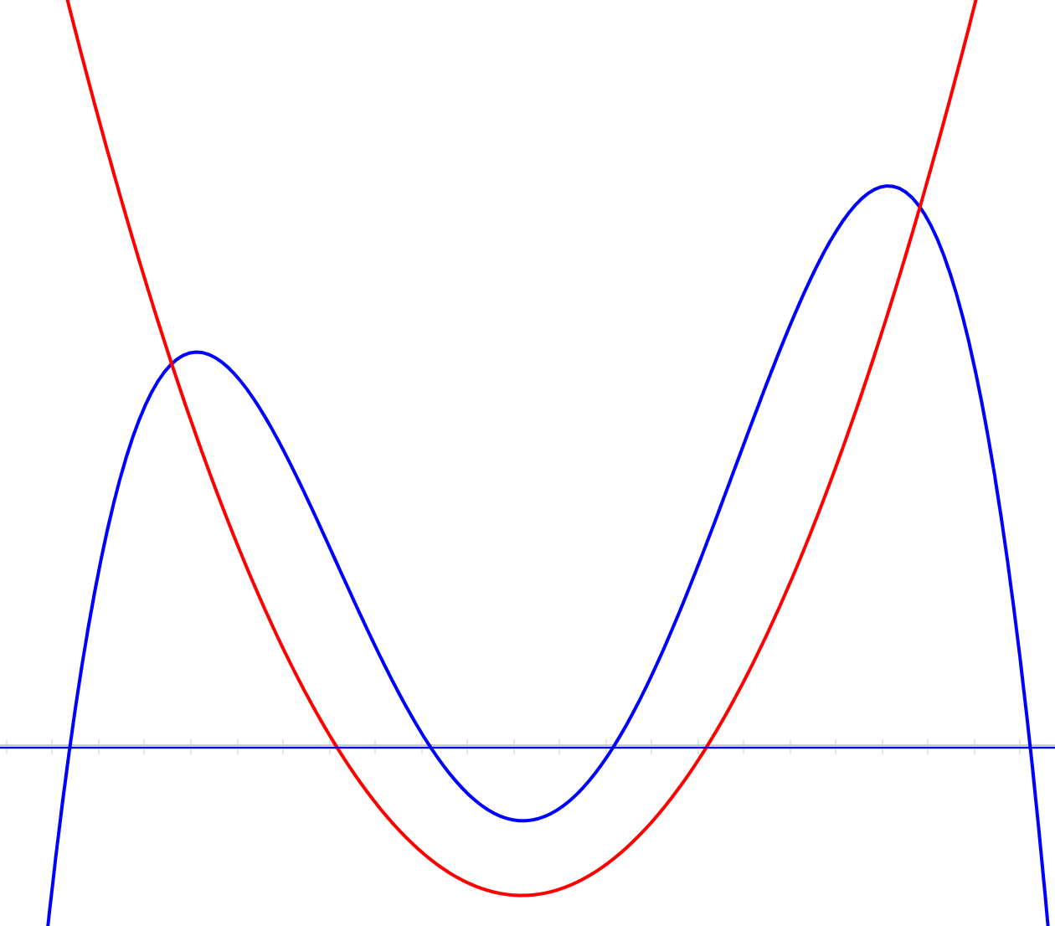
Rational Polynomials
(adapted from John Mason)
The red curve is the denominator and is a quadratic
The blue curve is the numerator and is a quartic
Sketch* the graph of the quotient?
What about the quotient if the blue curve is the denominator and the red curve is the numerator?

Slide 11

Excellent teaching – some scholarship

Slide 12

What is Excellent Teaching? A more scholarly approach
Considering teaching excellence in higher education: 2007-2013
by Vicky Gunn & Anna Fisk
(Higher Education Academy 2013)
This was a follow-on to Excellence in Teaching and Learning: a review of literature by Little, B., Locke. W., Parker, J. and Richardson, J. (2007)
It is a literature review covering published work since 2007
Excellent teaching – some scholarship

Slide 13
Gunn & Fisk findings 1
“… still ambiguities and contention around the definition of teaching excellence” (p6)
Excellent teaching – some scholarship

Slide 14
Gunn & Fisk findings 2
Characteristics of teaching excellence
Dynamic engagement
Inspire & motivate
Respect for students as individuals
Active learning
Critical & scholarly
Excellent teaching – some scholarship

Slide 15

Active learning in maths & stats: some research evidence

Slide 16
Active learning in maths & stats
Consensus definition (Freeman et al, 2014)
Active learning engages students in the process of learning through activities and/or discussions in class as opposed to passively listening to an expert. It emphasises higher order thinking and often involves group work.
Conference Board of the Mathematical Sciences definition (CBMS, 2016)
Active learning refers to classroom practices that engage students in activities, such as reading, writing, discussion or problem-solving that promote higher order thinking
Active learning in maths & stats: some research evidence

Slide 17
Active Learning in Post-Secondary Mathematics (CBMS)
In 2016 CBMS issued a statement Active Learning in Post-Secondary Mathematics signed by the presidents of 15 US Mathematical Sciences organisations including Mathematical Association of America, American Mathematical Society, American Statistical Associations, Institute of Mathematical Statistics, SIAM exhorting
We call on institutions of higher education, mathematics departments and mathematics faculty, public policy makers and funding agencies to invest time and resources to ensure that effective active learning is incorporated into post-secondary mathematics classrooms
Active learning in maths & stats: some research evidence

Slide 18
Active Learning (AL) in Post-Secondary Mathematics (CBMS)
CBMS statement points to “a landmark study” by Freeman et al (2014)
A meta-analysis of 225 studies across all STEM disciplines comparing course taught with an element of AL to those taught by traditional lecturing alone
Demonstrates that AL results in better student performance and retention than traditional passive forms alone across all STEM disciplines
AL is effective in all class sizes, but greatest gain in small (n<50) classes
Research shows AL most effective with under-prepared students and under-represented groups (eg women)
Active learning in maths & stats: some research evidence

Slide 19
Active Learning (AL) in Post-Secondary Mathematics (CBMS)
Not a silver bullet
The statement notes that poor implementation can be detrimental, active learning methods should be used alongside other effective teaching practices
Barriers to implementation include being able to cover the required content, problems in large classes, increased preparation time
Active learning in maths & stats: some research evidence

Slide 20
Kogan & Laursen (2014) Study of IBL in maths
Inquiry-based learning: students explore mathematical problems, proposing & testing conjectures, developing proofs or solutions and explaining their ideas
In IBL classes studied around 60% of time was spent on student-centred activities (eg small group work, student presentations at board, whole class discussion)
In non-IBL classes over 85% class time consisted of instructor talking
Reviewed performance in follow-on courses for students taught using IBL vs those not
Key finding 1: the impact of IBL on previously low-achieving students’ grades is sizeable and persistent
Key finding 2: The impact of IBL on women is primarily affective – they were more likely to choose optional follow on course than those from non-IBL courses
“Covering” less material in IBL courses had no negative effect on students’ later performance
Active learning in maths & stats: some research evidence

Slide 21
Let’s do some more maths!

Slide 22
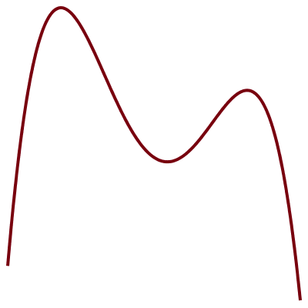
Tangent power
(courtesy of John Mason)
A
The tangent power of a point P with respect to a differentiable function f is the number of tangents to f through P
The red curve is a quartic
What are the tangent powers of points A and B?
B

Slide 23

Implementing active learning in maths & stats

Slide 24
How can AL be implemented in maths and stats?
See Braun et al (2017) for more details
Think – pair – share
Another and another and another
Classroom response systems (some are LaTeX friendly eg Pingo (Evans(2017))
Inverted or flipped classroom
IBL – class time is spent with students working on problem sets individually or in groups, presenting solutions or proof to the class, receiving feedback from peers and staff. The activities need to be carefully structured to guide learning.
Implementing active learning in maths & stats

Slide 25
Common concerns about AL in maths and stats
How will students learn the maths properly if we do not clearly tell them everything about it?
Telling is not enough for deep learning (“I hear I forget, I see I remember, I do I understand) – but we do need a balance between direct instruction and AL
What if I can’t cover the same amount of material?
Depends what the learning goals are. Recent research suggests that coverage of material is less important for student persistence and achievement in mathematical sciences than use of learning techniques that address cognitive goals
Implementing active learning in maths & stats

Slide 26
2015 MAA CUPM Curriculum Guide for Maths Majors
Cognitive goals include:
  Recognise and make mathematically rigorous arguments
  Communicate mathematical ideas clearly and coherently
  Work creatively and self-sufficiently
  Assess the correctness of solutions
  Create and explore examples
  Devise and test conjectures
  Develop mathematical independence and experience open-ended inquiry
Are these good goals?
What teaching and learning approaches would promote them?
Implementing active learning in maths & stats

Slide 27
References
Braun, B., Bremser, P., Duval, A., Lockwood, E. and White, D. (2017) What does active learning mean for mathematicians?, Notices of the AMS, 64(2):124-129
CBMS (2016) Active Learning in Post-Secondary Mathematics Education – position statement, Conference Board of the Mathematical Sciences
Evans, K (2018) An overview of the Pingo audience response system in undergraduate mathematics and statistics teaching, MSOR Connections 17(1):25-31
Freeman, S., Eddy, S., McDonough, M., Smith, M., Okoroafor, N., Jordt, H. and Wenderoth, M. (2014) Active learning increases student performance in science, engineering and mathematics, PNAS, 111(23):8410-8415
Gunn, V. and Fisk, A. (2013) Considering teaching excellence in higher education: 2007-2013, Higher Education Academy
Kogan, M. and Laursen, S. (2014) Assessing long-term effects of Inquiry-based learning: a case study from college mathematics, Innovative Higher Education, 39:183-199
Mason, J (ongoing) Promoting mathematics thinking http://www.pmtheta.com/
Schumacher, C., Siegel, M. and Zorn, E. (2015) CUPM Curriculum Guide to Majors in the Mathematical Sciences, MAA

Slide 28
Thank you for listening

Slide 29

Any Questions?
Any questions

