Slide 1
Household food insecurity and food bank usage in Canada and the UK.
Rachel Loopstra
Department of Sociology, University of Oxford
rachel.Loopstra@sociology.ox.ac.uk

Slide 2
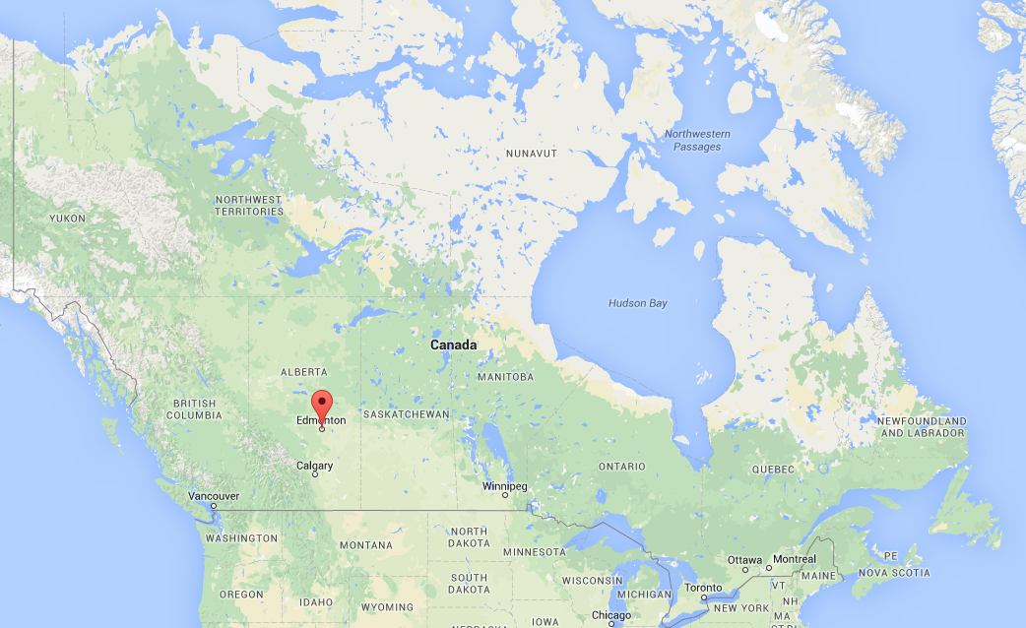
The first food bank was initiated in Canada in 1981 at a time of recession and erosion of social security.

Slide 3
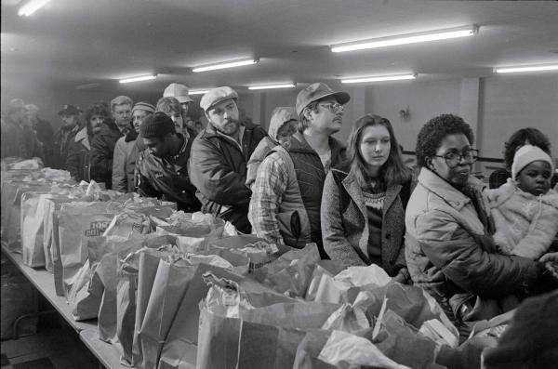
Lines of people lining up for food raised alarm: people are hungry in Canada.
Notes:
http://explorepahistory.com/displayimage.php?imgId=1-2-17EF
Early recognition that clinical measures of undernutrition and nutritional deficiency do not capture ‘hunger’ concept
Development of household food insecurity concept in the United States

Slide 4
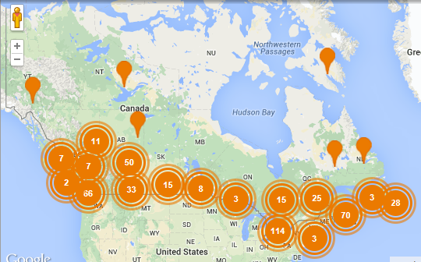
More than 800 food banks operating a total of 3000 food programs.
Food Banks Canada

Slide 5
What we have learned from food bank data

Slide 6
Notes:
Food banks in Canada today.

Slide 7
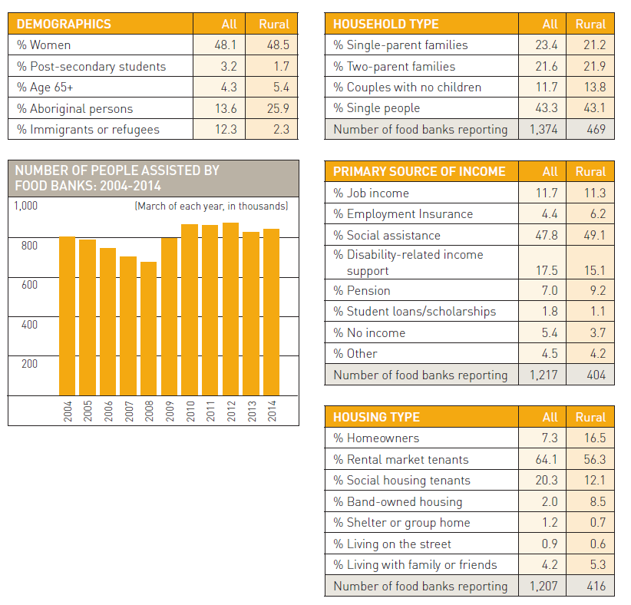
Trends in food bank use over time.
(Food Banks Canada, HungerCount, 2014)

Slide 8
Who uses food banks in Canada?
Most supported by state-benefits:
Long-term unemployed
People with disability
Newly unemployed
Most live in rental housing.
High proportion of Aboriginal people and immigrants or refugees.
(Food Banks Canada, HungerCount, 2014)

Slide 9
Wider view: household food insecurity data

Slide 10
Household Food Insecurity Construct
Food insecurity: uncertain and insufficient access to food arising from resource constraint
Potential
Manifestations*
Reduced food intake
Reduced quality of food intake
Hunger
Stress, worry & anxiety
Social exclusion
* vary in severity and duration

Slide 11
Household Food Security Survey Module
Series of questions referencing past 12 months and that specify lack of money:
Worried that food is going to run out
Food didn't last and there wasn't any money to get more
Couldn't afford to eat balanced meals
Cut size of meals or skipped meals
Ate less than you felt you should
Were ever hungry but did not eat
Lost weight
Did not eat for whole day
Marginal
Moderate
Severe
Note: Consistent with Household Food Security Survey Module used in USA.

Slide 12
Measurement and monitoring in Canada
Regularly included on nationally representative health survey since 2004
Comparable samples available in most provinces since 2007

Slide 13
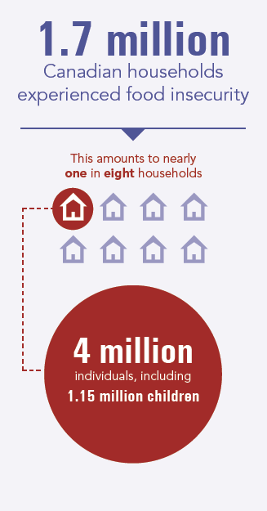
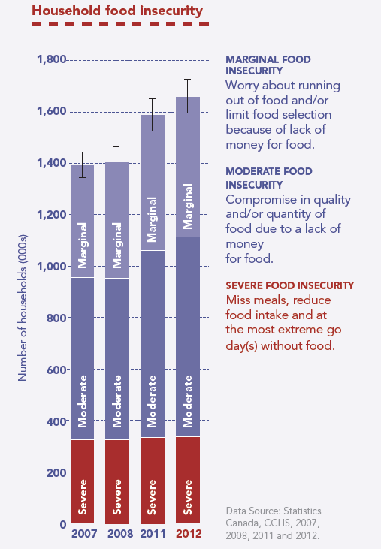
Over 12% of Canadians live in food insecure households and problem worsening.
(Tarasuk et al. PROOF. 2014)

Slide 14
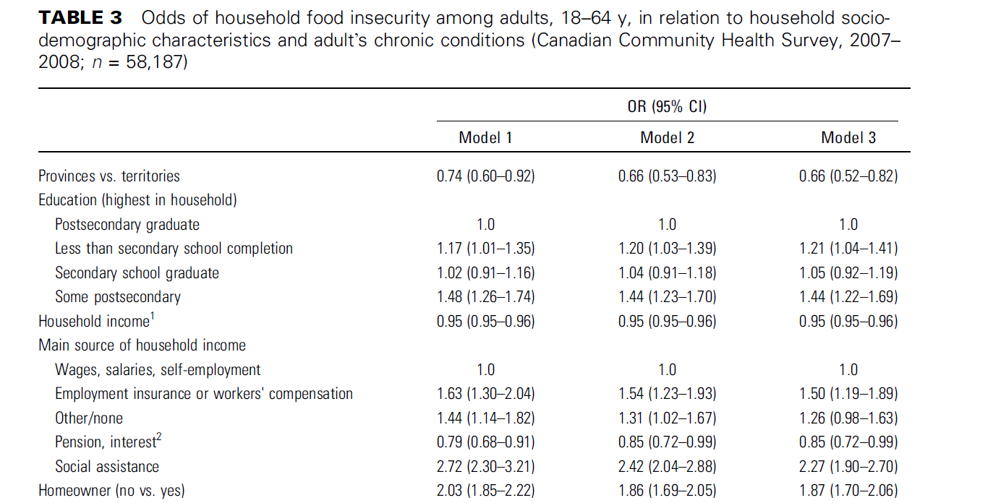
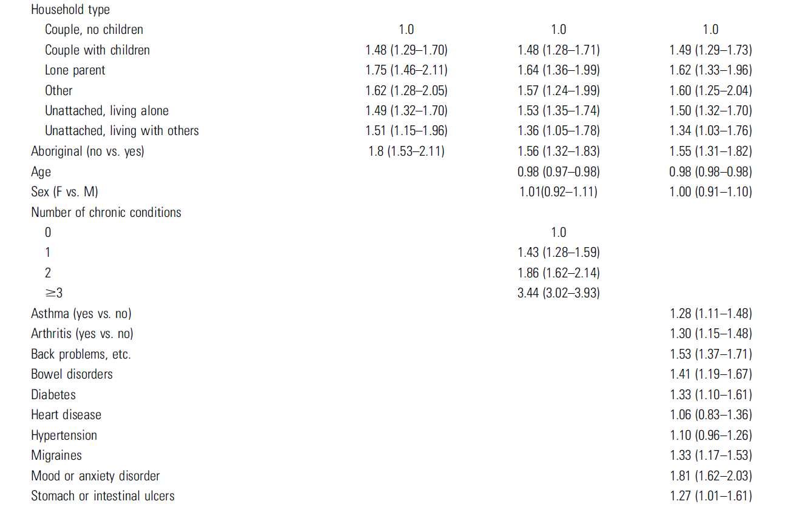
Characteristics associated with vulnerability
Declining household income
Reliance on government support
Rental accommodation
Single adult households, with or without children
Aboriginal status
Chronic health conditions
(Tarasuk, Mitchell, Dachner, 2013.)

Slide 15
Characteristics associated with vulnerability highlight the importance of:
INCOME
Persistent poverty
Security of incomes
Importance of savings and wealth to buffer income shocks
Variation in household costs (e.g. medical expenses, area-variation in cost of living, rent)

Slide 16
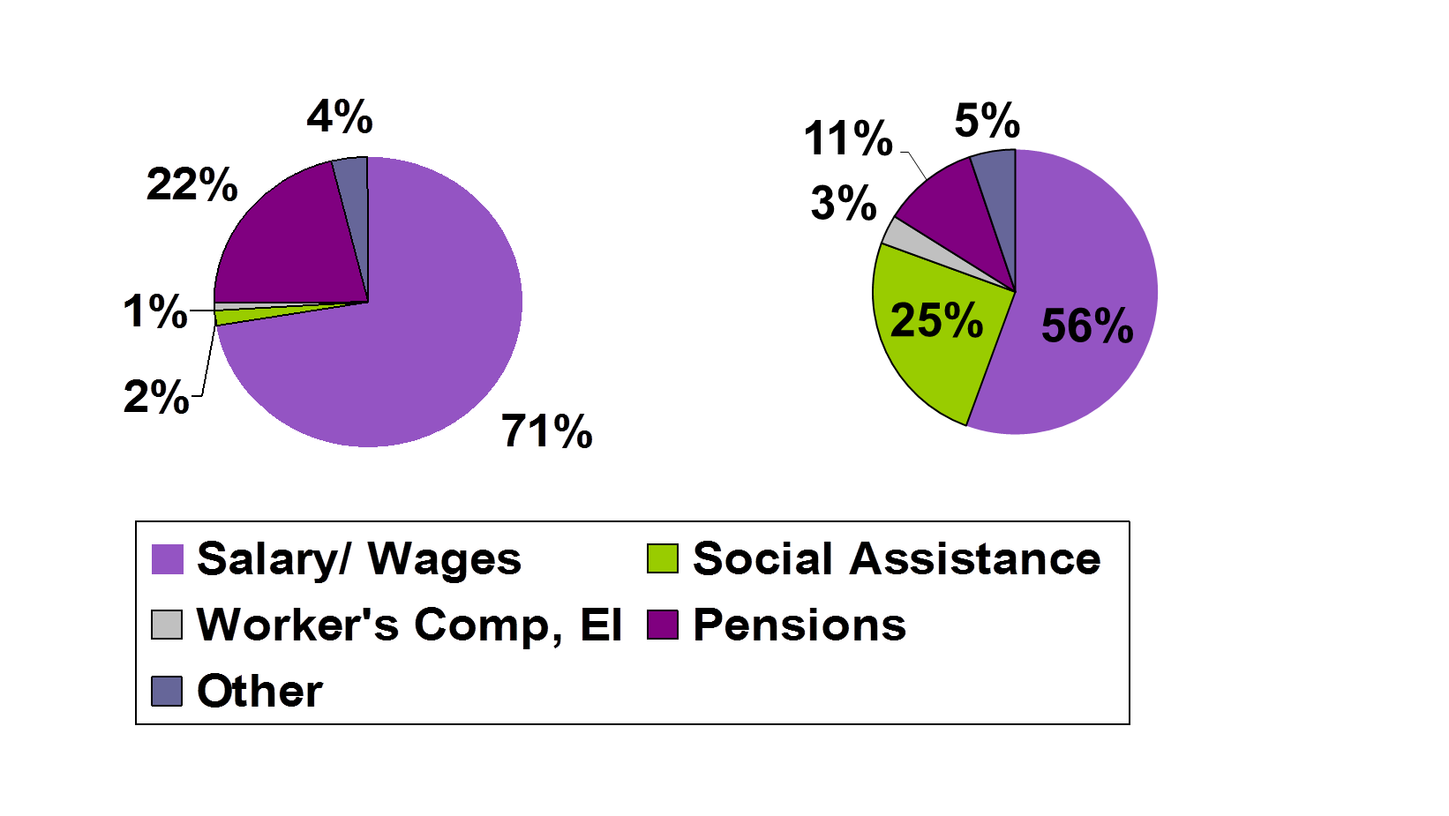
Distribution of Canadian households by main source of income:
Food Secure
Food Insecure

Slide 17
Do food bank statistics give us an accurate picture of vulnerability in the population?

Slide 18
Food bank statistics obscure level of need in the population.
(Loopstra & Tarasuk, Society and Social Policy. 2015)

Slide 19
Differences vary across provinces and over time
3.5-4X gap

Slide 20
Food bank statistics obscure where burden of problem lies.
Social Assistance
Employment
Employment
Social Assistance
Data Sources: Food Banks Canada Hunger Count, 2011; Canadian Community Health Survey, 2011.

Slide 21
Food bank users are subset of food insecure households in most severe circumstances.
Food Insecurity Status of Food Bank Users (n=101)
Study of low income families in Toronto.

Slide 22
Food bank users are subset of food insecure households in most severe circumstances.
 | All Food Insecure Families in Sample (n=283) |  | Families Using Food Banks (n=84)
Highest Level of Employment | n | % | n | %
No Job | 123 | 43.5 | 52 | 61.9
Occasional | 4 | 1.4 | 2 | 2.4
Part-time | 42 | 14.8 | 15 | 17.9
Fulltime | 114 | 40.3 | 15 | 17.9
Largest % of income from:
Unemployment/Workers Comp | 5 | 1.8 | 2 | 2.4
Employment | 145 | 51.2 | 24 | 28.6
Disasbility | 18 | 6.4 | 5 | 6.0
Other | 24 | 8.5 | 8 | 9.5
Welfare | 87 | 30.7 | 44 | 52.4
Seniors' pension | 4 | 1.4 | 1 | 1.2
Income as a % of Low Income Cut-Off | Median | IQR | Median | IQR
 | 61.2 | (48.8-77.9) | 52.8 | (43.6-63.3)
Study of low income families in Toronto.

Slide 23
Figure: Proportion of families who used a food bank in the past 12 months, by household food security status:
Likelihood of using a food bank rises with severity of food insecurity.
% of food security category
Baseline sample: n=485
Notes:
Kirkpatrick, S. & Tarasuk, V., Canadian Journal of Public Health, 2009.

Slide 24
Why the disconnect?
Who perceives food banks as an option for help
Level of need, real and perceived (Loopstra & Tarasuk, 2012)
“I wasn’t desperate enough to use a food bank. That would be a last resort.”
“[Food banks] are for homeless people”
Inability to use food banks
Limited operating hours → difficult for employed households to access
Food bank closure, unable to reach
Turned away because not enough food
Who food banks are “informally” promoted to
Referrals from social workers
Eligibility criteria related to income cut-offs, employment
No restrictions for individuals on social assistance

Slide 25
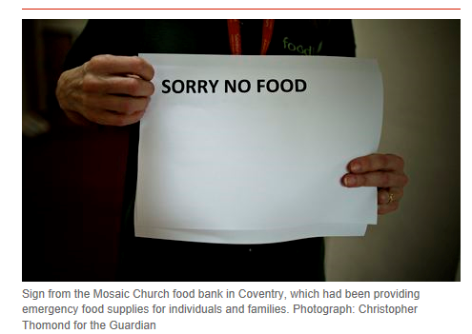

Slide 26
Food banks across Canada have limited capacity.
 | Victoria | Edmonton | Toronto | Quebec City | Halifax | All
Clients need more food than food bank is able to provide. | 58.6% | 66.2% | 77.9% | 67.8% | 83.9% | 71.8%
Agency would expand food program if more resources were available | 58.6% | 48.5% | 74.6% | 55.6% | 71.0% | 62.7%
Agency sometimes cut the size of the hampers provided because of insufficient food | 6.9% | 23.5% | 52.5% | 47.8% | 48.4% | 41.2%
Agency sometimes took additional measures to restrict access* | 13.8% | 14.7% | 35.3% | 31.1% | 25.8% | 27.4%
ªThe additional measures assessed included prioritizing who to serve, reducing the hours of service, and turning people away because the agency had insufficient food to meet demands.
(Tarasuk et al. BMC Public Health. 2014.)

Slide 27
Figure: Drivers of overlap between food insecurity and food bank use.
Food Insecure
Food Bank Users
Perceived need
Stigma
Quantity and quality of food
Lack of accessibility
Desperation
Referral
Real and perceived eligibility
Food bank accessibility and capacity

Slide 28
Food insecurity in the UK

Slide 29

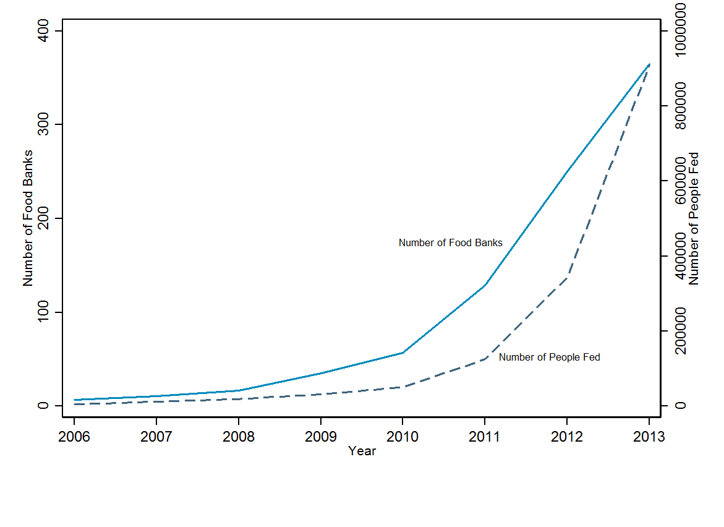
Daily Mail, April 2012 “Staggering rise of the British food bank: One opens every week after rise in families unable to afford to eat.”
Trussell Trust, 16 April 2014 “Latest foodbank figures top 900, 000”
Notes:
http://www.dailymail.co.uk/news/article-2131010/Staggering-rise-British-food-bank-One-opens-week-families-pay-packet-away-having-money.html#ixzz3DJ7JcJJc

Slide 30
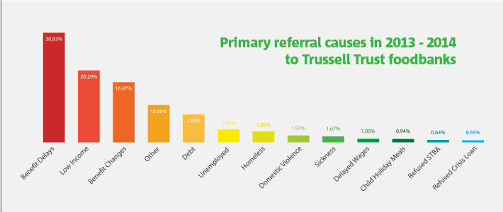
Reasons for referral to Trussell Trust Foodbanks
(Perry, Jane et al. Emergency Use Only: Understanding and reducing the use of food banks in the UK. 2014.)

Slide 31
Interviews with local authority staff highlighting links between cuts and food bank referrals.
“We’ve faced very substantial reductions in our funding… what we used to do was work a different scheme, which was funded through grant funding… so we were trying to think of creative ways in which we could continue to support families... so we gave [distributing food bank vouchers] a try.”
– Excerpt from interview with a local authority family support team worker; Lambie-Mumford, J Social Policy, 2013

Slide 32
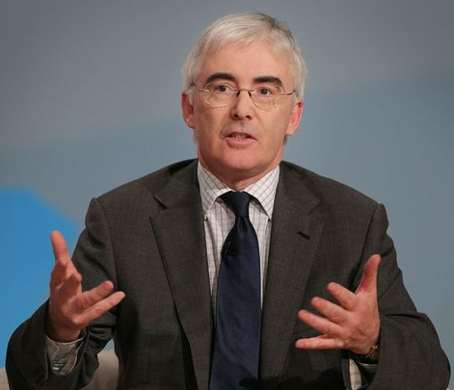

Other Views
"Food from a food bank—the supply—is a free good, and by definition there is an almost infinite demand for a free good." - Lord Freud, Parliamentary Under Secretary of State, Minister for Welfare Reform
“…no robust evidence linking food bank usage to welfare reform“ - Esther McVey, Minister of State for Employment, Letter to Scottish Government, June 2014
Notes:
https://www.gov.uk/government/speeches/easter-reception-at-downing-street-2014

Slide 33
Research Questions
Has the initiation of food banks across the UK related to local area socioeconomic conditions, budget cuts, and welfare sanctions?
Is there evidence that these factors are driving more people to use food banks where they open?

Slide 34
Local authority data from 375 Local authorities in England, Scotland, Wales
Gross Value Added
Subregional measure of economic production
Unemployment
Annual cut in local authority spending per capita
Social care, housing, community etc.
Annual cut in central welfare benefit spending per capita
Jobseeker’s Allowance, Housing Benefit, Pension Credit etc.
Rate of adverse sanctions applied to Jobseeker’s Claimants
Proportion of local area population identifying as Christian

Slide 35
Analysis 1: Food bank initiation
Cross-local authority logistic regression model examining potential drivers of first food bank initiation in 375 local authorities after 2009 to 2013.
Local authority-years excluded from analysis after censoring.
N=1071 local-authority years included.
Clustered standard errors by local authority

Slide 36
The expansion of food banks across local authorities in the UK
2009
Trussell Trust food banks in 29 local authorities
2013
Trussell Trust food banks in 251 local authorities
(Loopstra et al. BMJ. 2015)

Slide 37
Analysis 2: Density of food parcel distribution
Cross-local linear regression model examining potential drivers of food parcel distribution in local authority-years when food banks were operating over 2010 to 2013.
N=575 local authority-years included.
Clustered standard errors by local authority
Control for food bank operations
Duration
Number of operational food banks

Slide 38
Where have food banks opened?
Local Authority Spending
The odds of a first food bank opening rose with:
Unemployment
Magnitude of cut to local authority spending
Magnitude of cut to central welfare benefit spending
(Loopstra et al. BMJ. 2015)

Slide 39
Food Parcel Distribution as Percent of Population in Local Authorities with Foodbanks.
(Loopstra et al. BMJ. 2015)

Slide 40
Where are more people using food banks?
Jobseeker’s Allowance Sanctioning
Cuts in Central Benefit Spending
(Loopstra et al. BMJ. 2015)

Slide 41
Role of supply-side: obscure need?
But food bank operations also influence level of food parcel distribution:
Where more food banks available
Where food banks established for longer
If food banks not as available, can reduce accessibility and obscure wider need in communities.
Referral system must link welfare reforms and unemployment with food bank use.
Outstanding question: how many people are food insecure in the UK and vulnerability among groups not gaining/seeking referrals?
(Loopstra et al. BMJ. 2015)

Slide 42
Conclusions
Link between food bank initiation and use to indicators of economic hardship suggest food bank data are indicative of rising levels of need.
Yet, lack of accessibility and use of food banks could be obscuring true level of need in population arising from these factors, and referral system may obscure other vulnerable groups in the population.
(Loopstra et al. BMJ. 2015)

Slide 43
Moving forward on food insecurity research in UK
Monitoring of food insecurity needed to understand the magnitude of the problem, severity, trends over time, and vulnerability.
Food bank use indicates vulnerability connected to inadequacy of welfare system.
Less known about:
Vulnerability linked to insecure employment, insufficient wages, and underemployment.
Vulnerability arising from costs of living:
Areas of greater hardship related to costs of acquiring food, rent
Household-arrangement specific: childcare costs, health conditions

Slide 44
Understanding prevention and intervention
Food Insecurity Status of Food Bank Users (n=101)
Does availability of food aid reduce household food insecurity?
Security that food will always be available?
Unlikely, given inherent limitations of system: restricted use and provision, reliance on volunteers/charity
Sufficient to ensure food needs are met?
What forms of social security ensure households are protected from income shocks?
What regulations are needed to ensure security and adequacy of earned incomes?

Slide 45


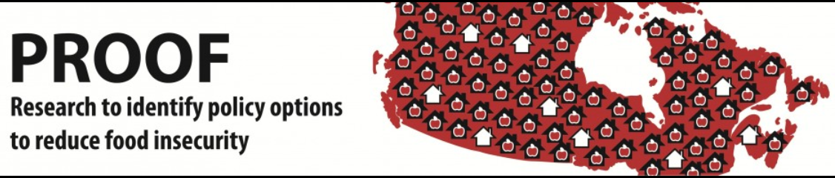

Thank you
Acknowledgements:
Valerie Tarasuk, Professor, University of Toronto, & PROOF research team.
Aaron Reeves, David Taylor-Robinson, Ben Barr, Martin McKee, David Stuckler
http://nutritionalsciences.lamp.utoronto.ca/

