Slide 1
The Complex Challenges to Participation in Child Nutrition Programs
Rachel L. Wilkerson
Notes:
Started in 2009 as a project of the Baylor University School of Social Work.
Hunger was the “low-hanging fruit” of poverty. Both sides—democrats and republicans—were willing to work on hunger.

Slide 2
Outline
The Problem:
Child Food Insecurity in America
The existing safety net
Barriers to accessing benefits
View for children and families
Systems view
Our Efforts:
Data collection
Community Organizing
Multi-sector collaboration
Notes:
Where we’re going

Slide 3
The Challenge: Child Food Insecurity
49 million Americans
4.8 million Texans
1 in 4 Texas children
Notes:
The problem in America. 27 million americans

Slide 4
The Challenge: Why Texas?
Notes:
Why look at Texas? Strikeforce state. All eyes on texas

Slide 5
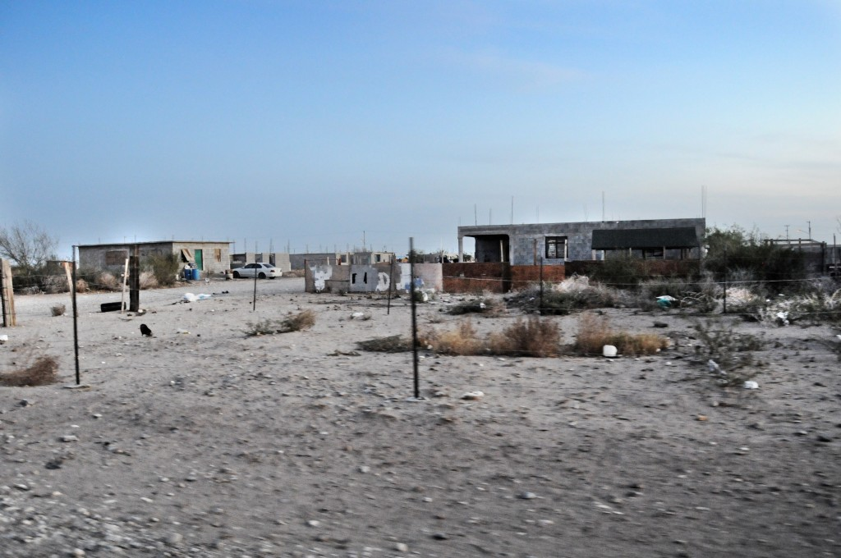
Notes:
This is the Rio Grande Valley, we had a tremendous immigrant crisis this past summer

Slide 6
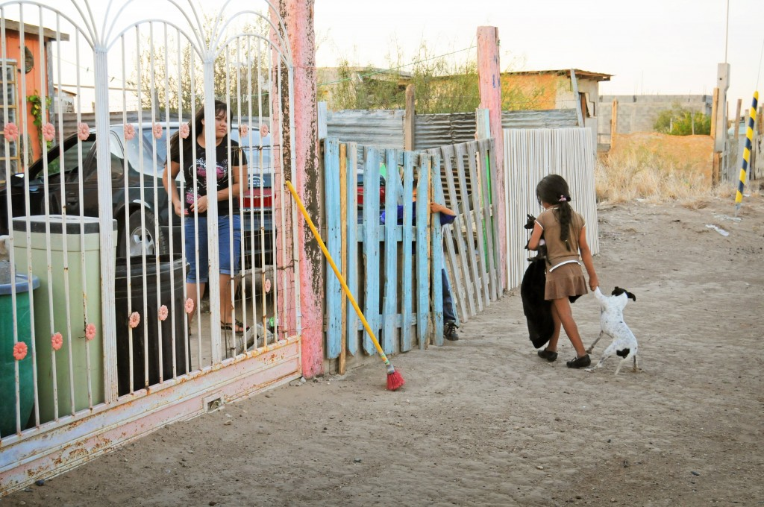

Slide 7
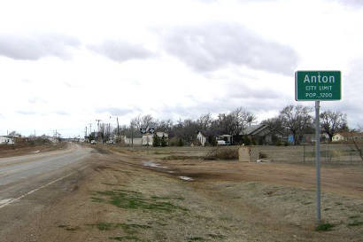
Notes:
This is Anton, near where I’m from. It’s a 30 minute drive to the nearest food shop, and the population is aging.

Slide 8
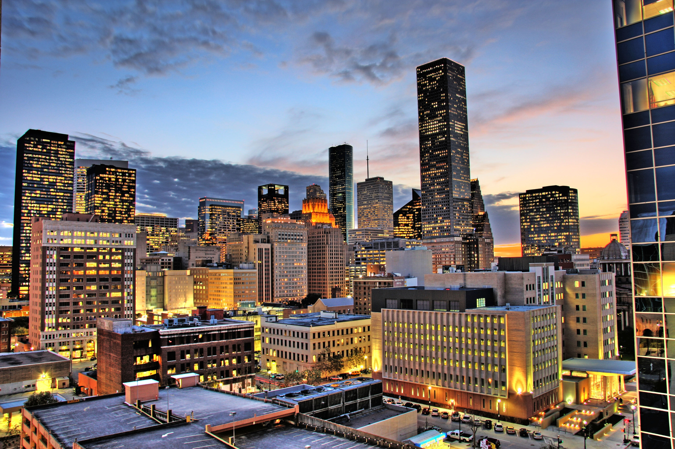
Notes:
This is Houston: The Kinder Institute for Urban Studies remarks that Texas has historically been a harbinger of demographic trends in the United States as a whole. The problems Texas is facing right now will affect the whole of the US in 15 years. Consequently, addressing these problems in Texas has a tremendous impact for the US as a whole.

Slide 9
The Challenge: Defining Food Insecurity
The United States Census Bureau measures these indicators of insufficient food through a survey called the Core Food Security Module
Notes:
Each stage of hunger consists of characteristic conditions and experience of food insufficiency to fully meet the basic needs of household members. . It asks questions like "did you eat less than you should have in order to feed your children? Did you cut meal portions to stretch resources? Were you hungry and unable to afford more food?"

Slide 10
The Challenge: Defining Food Insecurity
"The poor are the ones who can never afford to have any bad luck. They can't get an infection because they don't have access to medicine. They can't get sick or miss their bus or get injured because they will lose their menial labor job if they don't show up for work. They can't misplace their pocket change because it's actually the only money they have left for food.” -Victor Butros, The Lotus Effect
Notes:
Food insecurity is complex, multidimensional phenomenonOf course, the bad news is, everyone has bad luck. The difference is that the poor lack the societal infrastructure to recover from bad luck.

Slide 11
The Challenge: Safety Net Infrastructure
Federal programs provide funds for groceries
Supplemental Nutrition Assistance Program (SNAP, formerly known as food stamps)
Women Infants and Children (WIC)
…and meals
National School Lunch Program
School Breakfast Program
Afterschool Meal Program
Summer Meals Program
Notes:
In an attempt to remedy this, the US government works to compose a safety net for food insecure individuals. This is composed of federal programs designed to alleviate food insecurity for low-income individuals. This safety net includes program like
-the Supplemental Nutrition Assistance Program (SNAP or food stamps) that provides families with additional funds to purchase groceries, and a host of child nutrition programs that serve meals to children living in poverty. These child nutrition programs serve breakfast and lunch during the school year, and after school and summer meals when children are out of school.

Slide 12
The Challenge: A Snapshot of Hunger
Lubbock county has 43,830 food insecure residents.
Of those, 32% are ineligible for most nutrition programs
15% are eligible for some nutrition programs
53% are eligible for most nutrition program.
On average, these food insecure residents report an annual budget shortfall of $393 needed to afford "just enough" food $17,204,806 in total.
Lubbock county leaves $49,881,635 in SNAP benefits "on the table" in Washington.
Notes:
Ostensibly, we have a saftey net. What does that look like at the local level? USDA Thrifty Food Plan. 280,000

Slide 13
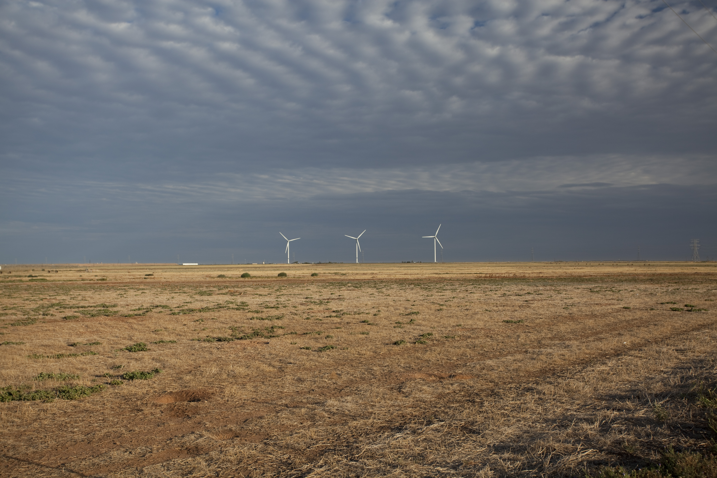

Slide 14
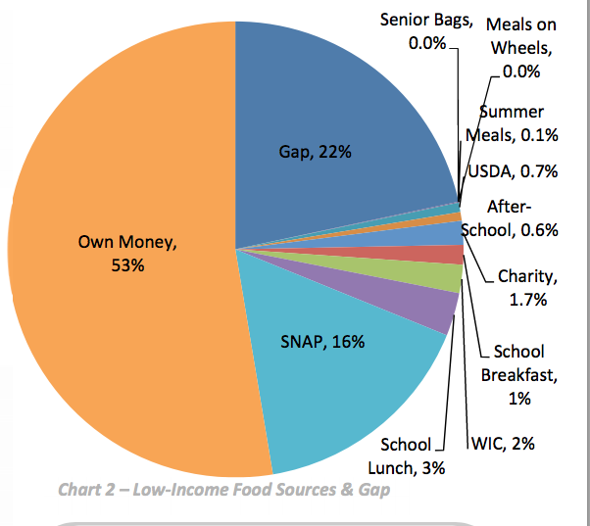
The Challenge: Blueprint to End Hunger
Notes:
The goal here is to widen the bits of the pie that we can. Note that the food banks are included in the charity meet 1.7%

Slide 15
The Challenge: Benefits access
12% of eligible children use the summer meal program.
Notes:
Why is the pie slice so small?? Scope of program: majority of children are eligible
Each stage of hunger consists of characteristic conditions and experience of food insufficiency to fully meet the basic needs of household members. . It asks questions like "did you eat less than you should have in order to feed your children? Did you cut meal portions to stretch resources? Were you hungry and unable to afford more food?"

Slide 16
The Challenge: A Snapshot of Hunger
"…The whole system disguises rather than navigates complexity, and it does so at various levels--in developing countries and within the aid system. This maintains a series of collective illusions and overly simplistic assumptions about the nature of systems, about the nature of change, and about the nature of human actors.” -Ben Ramalingam Aid on the Edge of Chaos
Notes:
Our work at THI involves trying to understand the underlying structure and dynamics of the systems designed to support food insecure citizens. T

Slide 17
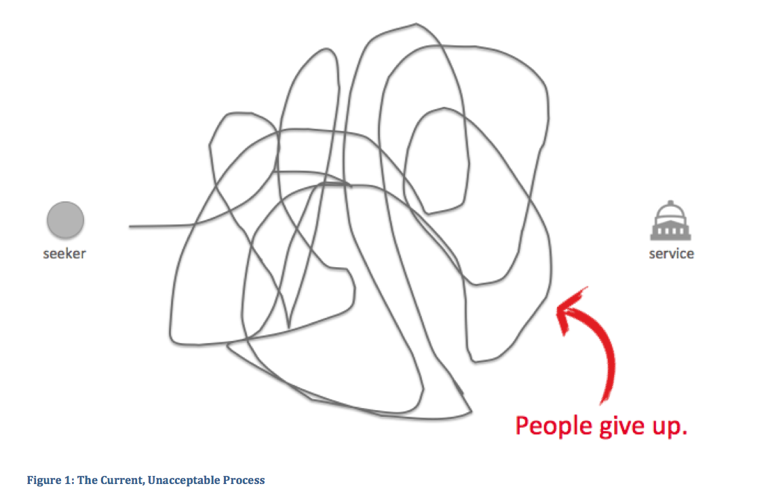

Slide 18
Notes:
Fruit cups. Gospel radio singer. Colonias. Dumpsters in san antonio.

Slide 19
The Challenge: Barriers Framework
Access barriers consist of factors that hinder children and their families from obtaining a meal at a site
Eligibility barriers consist of programmatic rules, regulations, and restrictions that may create artificial constructs that block food insecure children from needed meals
Finally, participation barriers encompass the varied reasons why children and their families may elect not to seek federal food assistance.
Notes:
This last question is a question of human behavior--and consequently is difficult to evaluate directly. As a proxy for this question, we address demographic trends that correspond with participation in assistance programs in addition to offering anecdotal evidence from the field surrounding issues of stigma and cultural expectations. In total, this framework for defining the barriers to participation provides a multi-faceted look at the many points in which barriers confront those seeking food assistance.

Slide 20
The Challenge: Access Barriers
Transportation
Site location
Attendance rates
Late buses
Unstable family situations
Awareness
Notes:
In a survey of summer meals sponsors, both Both schools and nonprofits report transportation as a major obstacle (20% and 18%, respectively), especially in rural areas.

Slide 21
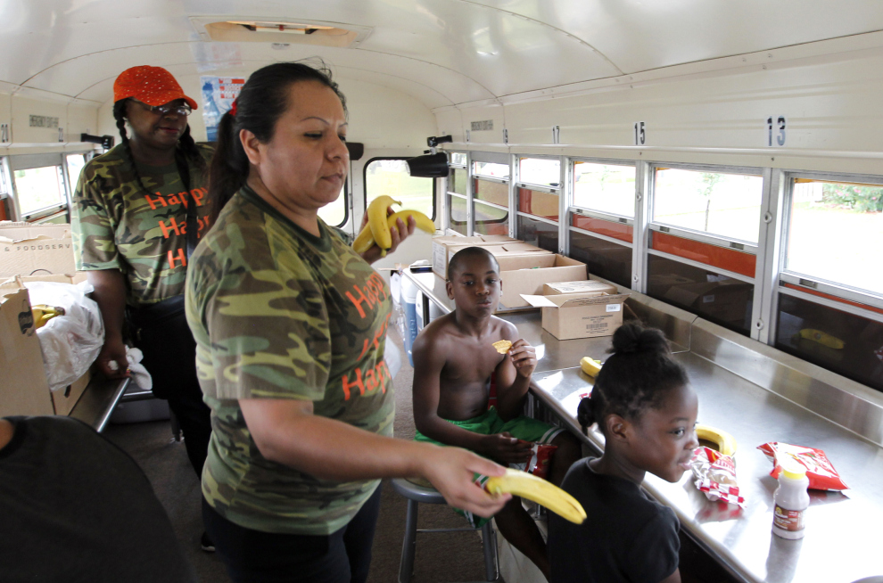
Transportation
Notes:
The Stingmobile

Slide 22
Site Location
Notes:
circles-schools, triangles-sites

Slide 23
The Challenge: Eligibility Barriers
Paperwork
The “50% cliff”
Closed and open sites

Slide 24
The Challenge: Participation Barriers
Cultural expectations
Stigma
Immigration fears
Teenagers
Language barriers
Notes:
This last question is a question of human behavior--and consequently is difficult to evaluate directly. As a proxy for this question, we address demographic trends that correspond with participation in assistance programs in addition to offering anecdotal evidence from the field surrounding issues of stigma and cultural expectations. In total, this framework for defining the barriers to participation provides a multi-faceted look at the many points in which barriers confront those seeking food assistance.

Slide 25
The Challenge: The Wider System
TFPR
NCH
funds
TDA
paperwork
USDA
funds
THI
sponsor
meals
meals
site
site
meals, programming
meals, programming
child
child
child
child

Slide 26
The Challenge: System Breakdown
TFPR
NCH
fraudulent sponsors
funds
TDA
political pressure
paperwork
USDA
funds
THI
communication breakdown
sponsor
financial solvency
meals
rules
meals
site
site
staff turnover
meals, programming
meals, programming
child
child
child
child
Notes:
Dairy council. Staff turnover. Language barriers, cultural barriers, fraud, auditing

Slide 27
Our Efforts: Community Organizing
NCH
TFPR
TDA
FPA
USDA
THI
RO
FPA
sponsor
site
site
child
child
child
child

Slide 28
Food Bank
City Council
FPA
Non Profit Leaders
Schools
Food Insecure Individuals

Slide 29
Notes:
We strive to always participate in informed engagement and continuously evaluate our work to ensure it is effective.
One thing that is unique about THI is that we’re part of a university and we’re applying research and information to the problem that we’re trying to solve.
Baylor has a wealth of knowledge and resources that we’re utilizing to help us create solutions.
We use our research and data gathering to inform the programs we work with and support which in turn inform the policy recommendations we make.

Slide 30
Our Efforts: Data Collection
Liberating program data from the Texas Department of Agriculture
Integrating federal, state, and local data sources via Aunt Bertha
Tracking sponsor operations by creating database
Customer Relationship Management database, Salesforce that tracks community organizing efforts

Slide 31
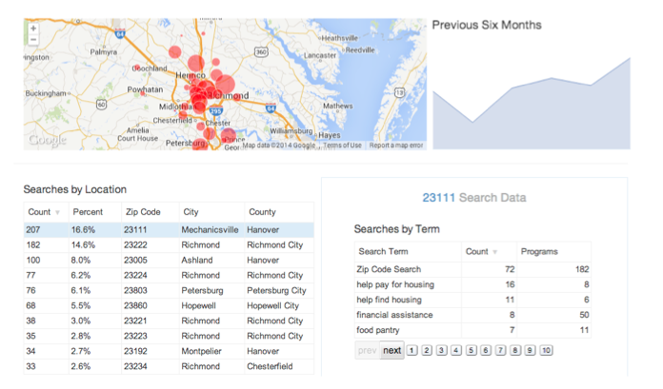
Aunt Bertha

Slide 32
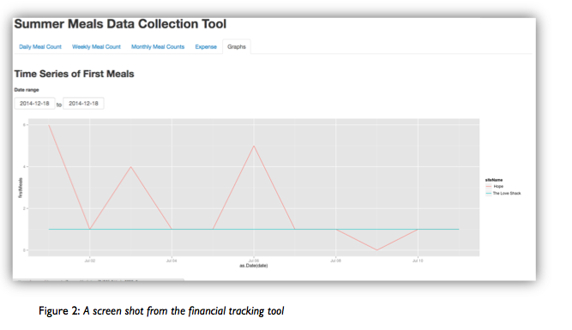
Financial tracking tool

Slide 33
Our Efforts: Program Improvements
SUMMER MEALS
Since 2009
200+ more Summer Meals sponsors were added
2,100+ more Summer Meal sites were added
63,000+ more kids per day receive Summer Meals
6 million more Summer Meals served
SCHOOL BREAKFAST
Since 2009
60 million more school breakfasts served each year
300,000 more kids per day eat school breakfast

Slide 34
Our Efforts: Community Organizing
HUNGER AND POVERTY COALITIONS
In Texas, more than 60 coalitions are functioning in the anti-hunger and anti-poverty space.
Because of an exciting new partnership between the Texas Hunger Initiative and AgriLife Extension offices, Texas hunger and poverty coalitions will be expanding to include more rural communities.
Nationally, there are 51 communities with Hunger-Free Coalitions.

Slide 35
Our Efforts: Multi-sector collaborations
Our model is not the sphere...instead it is the polyhedron, which reflects the convergence of all its parts...pastoral and political activity alike seek to gather in this polyhedron the best of each. There is a place for the poor and their culture, their aspirations and their potential. Even people who can be considered dubious on account of their errors have something to offer which must not be overlooked...it is the sum total of persons within a society which pursues the common good. --Pope Francis Evangelii Gaudium
Notes:
Harken back to the blueprint

Slide 36
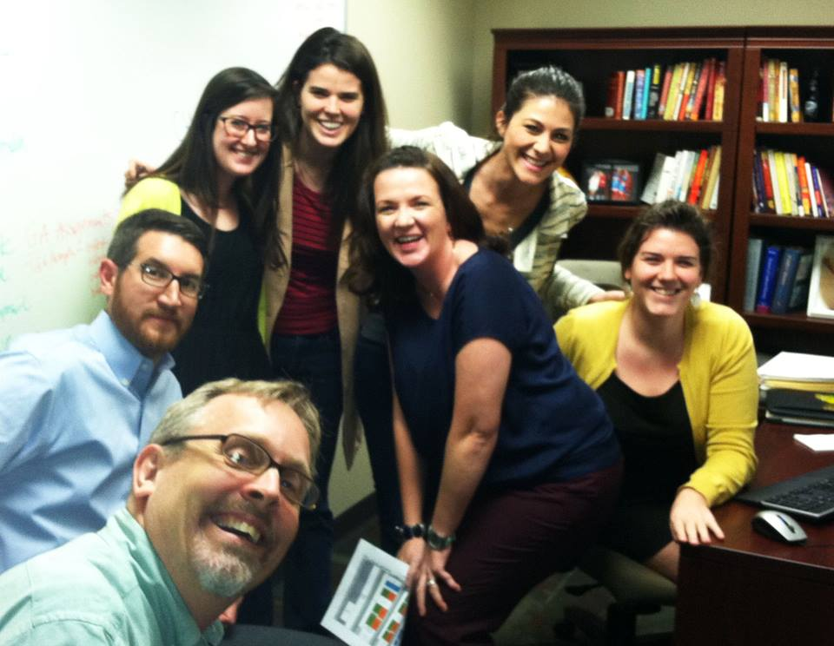
Acknowledgements
The THI Staff

Slide 37



Acknowledgements
Research funded by…

Slide 38

Additional Info…
Thank you! Questions?

