Slide 1
WAGOS
Conformal Changes of Divergence and Information Geometry
Shun-ichi Amari
RIKEN Brain Science Institute

Slide 2
Information Geometry
Systems Theory
Information Theory
Statistics
Neural Networks
Combinatorics
Physics
Information Sciences
Math.
AI
Vision,
Shape
Riemannian Manifold
Dual Affine Connections
optimization
Manifold of Probability Distributions

Slide 3
Information Geometry ?
Riemannian metric
Dual affine connections

Slide 4
Manifold of Probability Distributions

Slide 5
Riemannian Structure
Fisher information

Slide 6
Affine Connection
covariant derivative
straight line

Slide 7
Duality
Y
X
Y
X
Riemannian geometry:

Slide 8
Dual Affine Connections
e-geodesic
m-geodesic

Slide 9
Divergence
M
Y
Z
positive-definite

Slide 10
Metric and Connections Induced by Divergence
(Eguchi)
Riemannian metric
affine connections

Slide 11
Duality:

Slide 12
Two Types of Divergence
Invariant divergence (Chentsov, Csiszar) f-divergence: Fisher- structure
Flat divergence (Bregman)
KL-divergence belongs to both classes

Slide 13
Invariant divergence
(manifold of probability distributions; )
Chentsov
Amari -Nagaoka
Notes:
13

Slide 14
Csiszar f-divergence
Ali-Silvey
Morimoto
Notes:
14

Slide 15
Invariant geometrical structure
alpha-geometry
(derived from invariant divergence)
Fisher information
-connection
Levi-civita:
: dually coupled
Notes:
15

Slide 16
：Dually Flat Structure

Slide 17
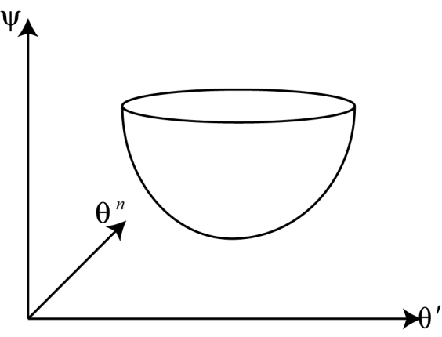
Dually flat manifold:
Manifold with Convex Function
coordinates
: convex function
negative entropy
energy
Euclidean
mathematical programming, control systems, physics, engineering, economics

Slide 18
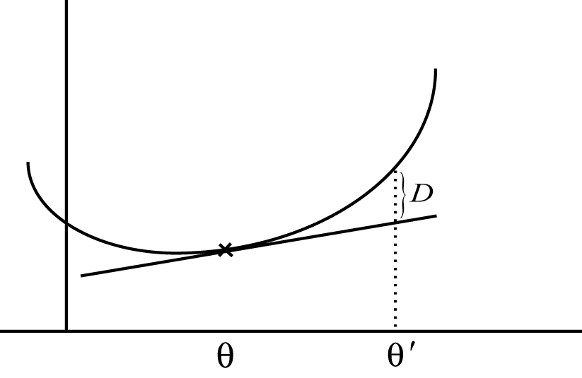
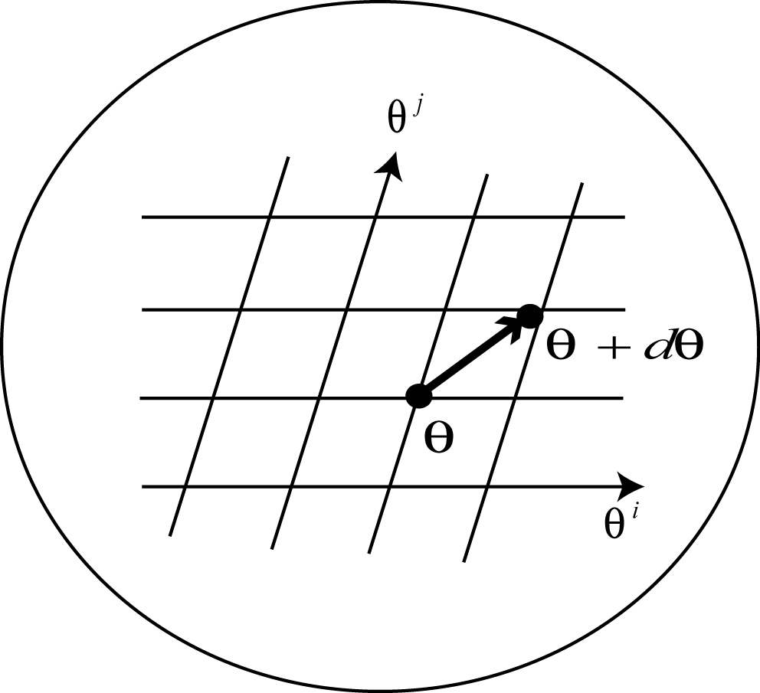
Riemannian metric and flatness
Bregman divergence
Flatness (affine)
: geodesic (notLevi-Civita)

Slide 19
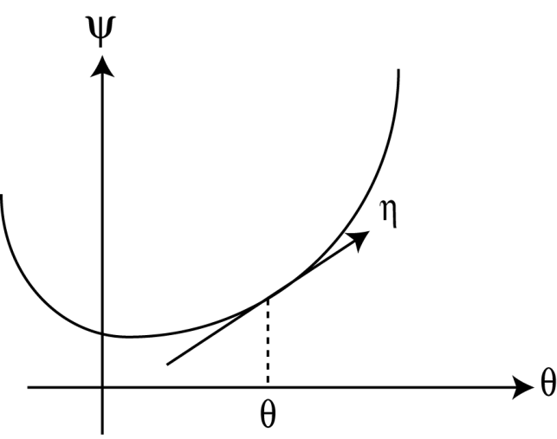
Legendre Transformation
one-to-one

Slide 20
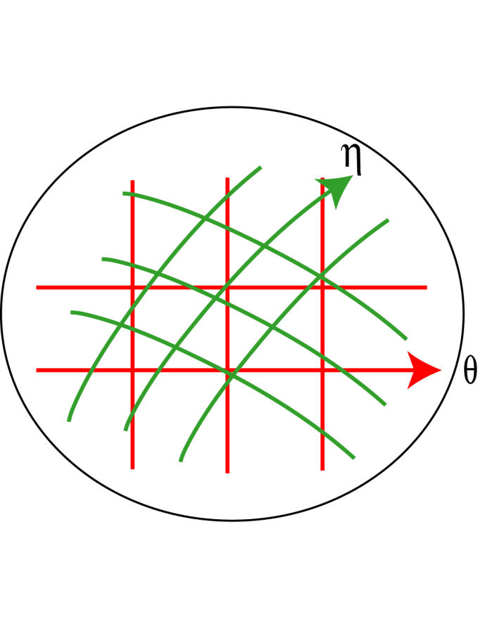
Two flat coordinate systems
: geodesic (e-geodesic)
: dual geodesic (m-geodesic)
“dually orthogonal”

Slide 21
Geometry
Straightness (affine connection)
Notes:
21

Slide 22
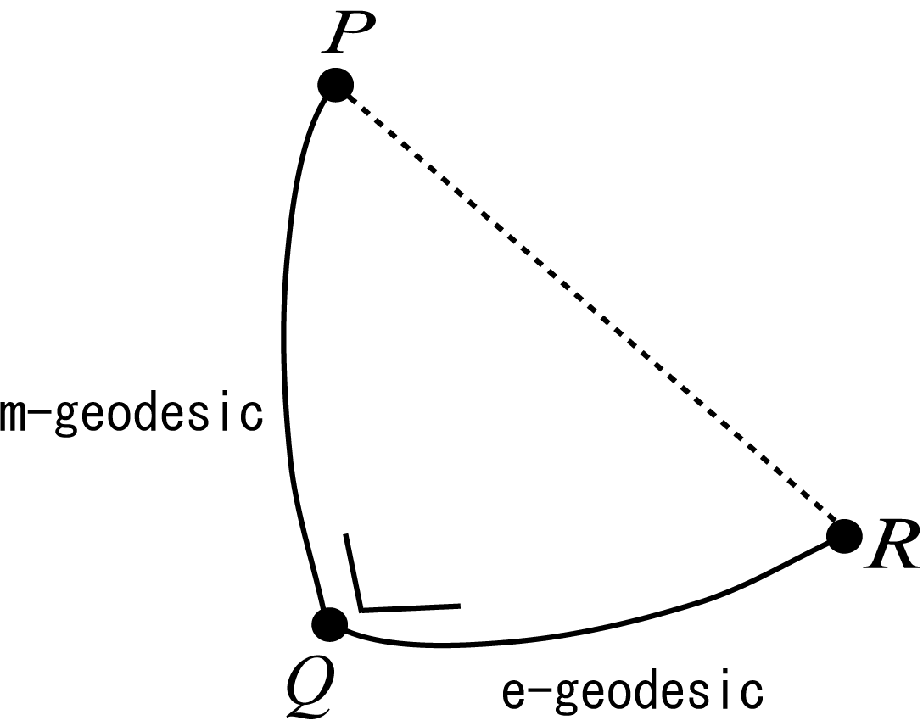
Pythagorean Theorem
(dually flat manifold)
Euclidean space: self-dual

Slide 23
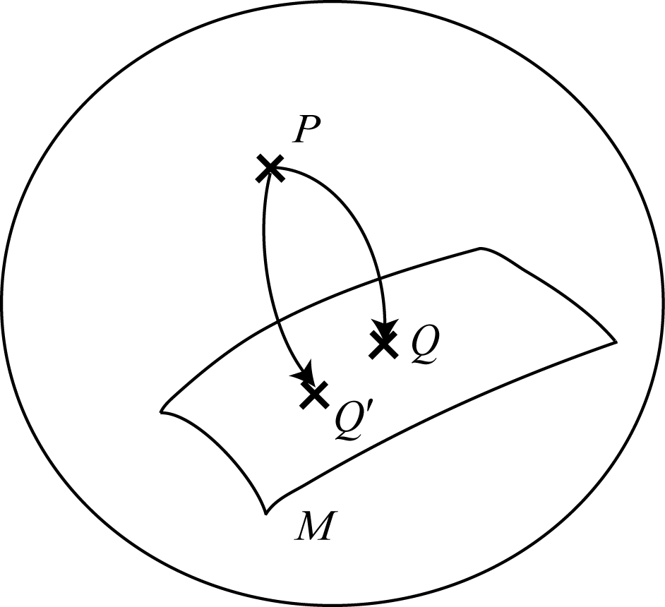
Projection Theorem
Q = m-geodesic projection of P to M
Q’ = e-geodesic projection of P to M

Slide 24
divergence
: space of probability distributions
invariance
dually flat space
Flat divergence
invariant divergence
convex functions
Bregman
F-divergence
Fisher inf metric
Alpha connection
KL-divergence
Notes:
24

Slide 25
Space of positive measures :
vectors, matrices, arrays
f-divergence
Bregman divergence
α-divergence
Notes:
25

Slide 26
divergence
KL-divergence

Slide 27
α-representation (Amari-Nagaoka, Zhang)
typical case: u-representation,
Notes:
27

Slide 28
Divergence over α-representation
Notes:
28

Slide 29
β-divergence (Eguchi)
Notes:
29

Slide 31
Tsallis
-Entropy--
structure
Shannon entropy
Generalized log

Slide 34
-exponential family
cf Pistone exponential

Slide 35
q-Geometry derived from
: dually flat

Slide 36
Dually flat structure of q-escort
geodesic: exponential family
dual geodesic: q-family

Slide 37
q-escort probability distribution
Escort geometry

Slide 38
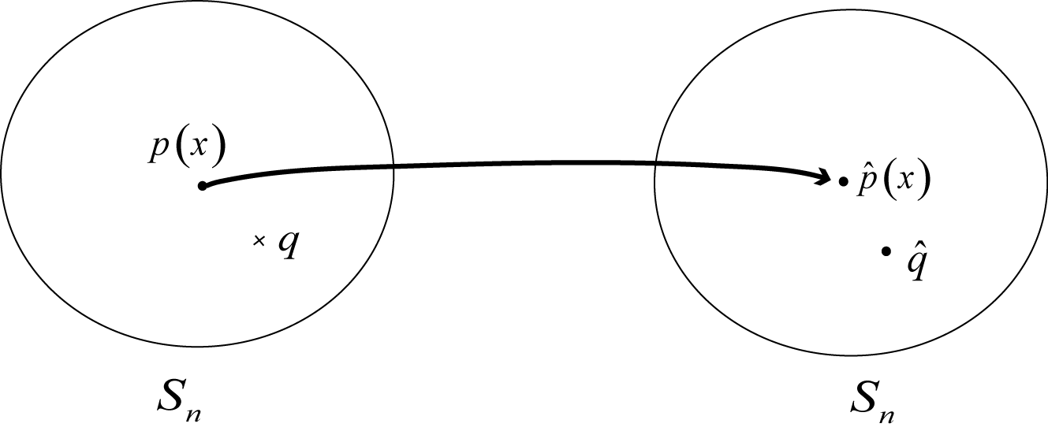
-escort geometry

Slide 39
Dually flat structure of q-escort
geodesic: exponential family
dual geodesic: q-family

Slide 40
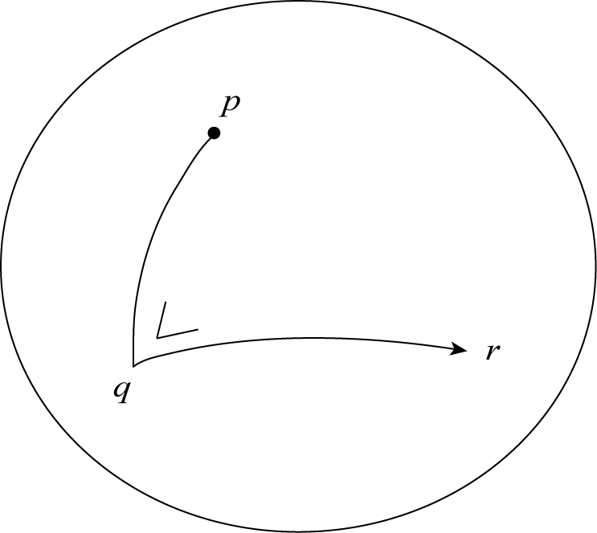

Slide 41
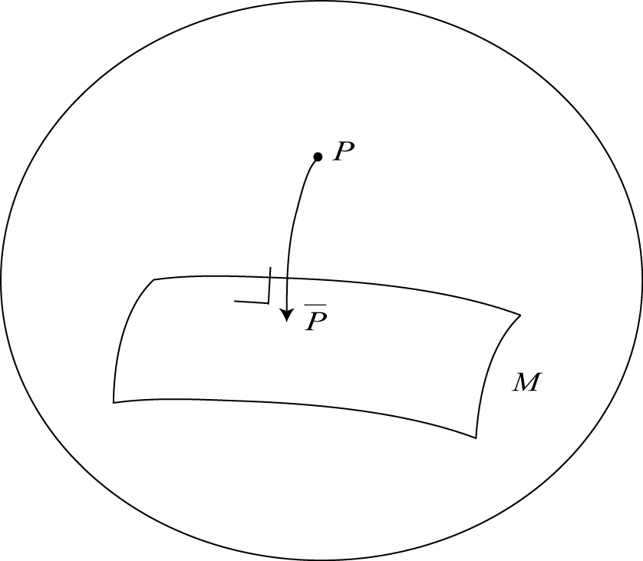
Projection theorem

Slide 42
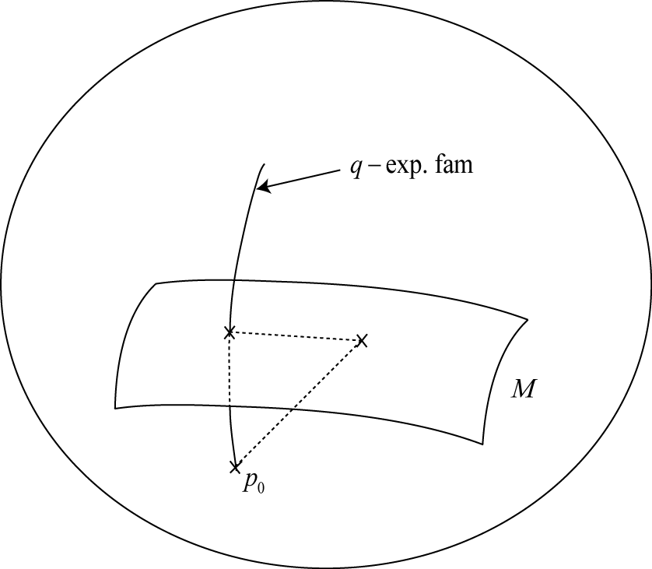
Max-entropy theorem

Slide 43
-Cramer Rao theorem

Slide 44
-maximum likelihood estimator

Slide 45
-super-robust estimator (Eguchi)

Slide 46
Conformal change of divergence

Slide 47
conformal transformation
-Fisher information

Slide 48
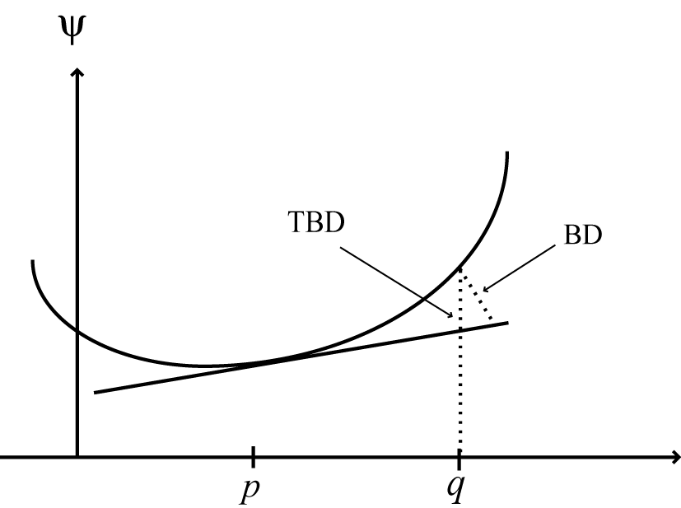
Total Bregman divergence (Vemuri)

Slide 49
Total Bregman Divergence and its Applications to Shape Retrieval
Baba C. Vemuri, Meizhu Liu, Shun-ichi Amari, Frank Nielsen
IEEE Conference on Computer Vision and Pattern Recognition (CVPR), 2010

Slide 50
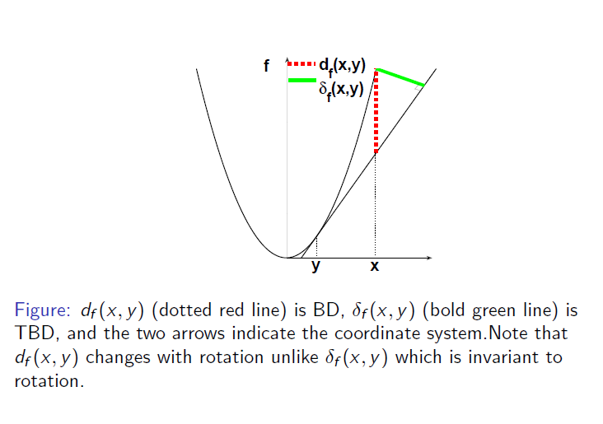
Total Bregman Divergence
rotational invariance
conformal geometry

Slide 51
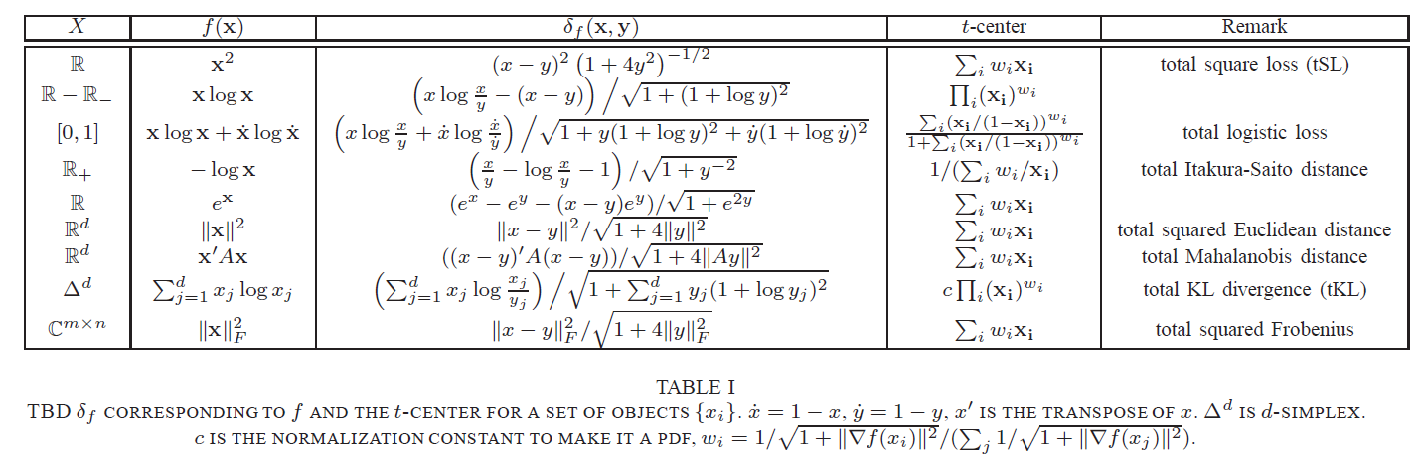
TBD examples

Slide 52
Clustering : t-center
T-center of E

Slide 53
t-center

Slide 54
t-center is robust

Slide 56
How good is Total Bregman Divergence
vision
signal processing
geometry (conformal)

Slide 57
TBD application-shape retrieval
Using MPEG7 database;
70 classes, with 20 shapes each class
(Meizhu Liu)

Slide 58
First clustering then retrieval

Slide 59
Advantages
Accurate;
Easy to access (shape representation);
Space and time efficient (only need to store the closed form t-centers, clustering can be done offline, hierarchical tree storage).

Slide 60
Shape retrieval framework
Shape-->
Extract boundary points & align them-->
Represent using mixture of Gaussians-->
Clustering & use k-tree to store the clustering results;
Query on the tree.

Slide 61
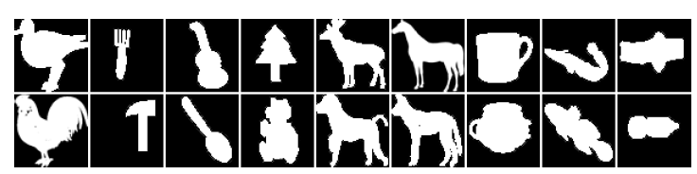
MPEG7 database
Great intraclass variability, and small interclass dissimilarity.

Slide 62
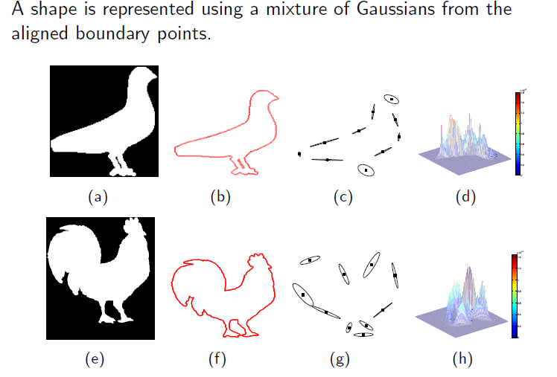
Shape representation

Slide 63
Experimental results

Slide 64
Other TBD applications
Diffusion tensor imaging (DTI) analysis [Vemuri]
Interpolation
Segmentation
Baba C. Vemuri, Meizhu Liu, Shun-ichi Amari and Frank Nielsen, Total Bregman Divergence and its Applications to DTI Analysis, IEEE TMI, to appear

