Slide 1

ST415
IM Introduction Session
ST415 ST421 EC400 IB403
These slides will be made available on the Moodle page -
“ST415 Statistics Integrated Masters Projects 2022/23”
Term 1 Week 5 – Tuesday 1st November, 2022

Slide 2
Guest speaker Yixue Shen
BSC Economics, Beijing (4 years)
MSc Programme and Project Management at WMG (Warwick Management Group)
PhD student with Prof Naomi Brookes (Leeds, previously WMG), Dr Julia Brettschneider (Stats), Dr Vikki Abusidualghoul (WBS)
yixue.shen@warwick.ac.uk
Interaction with some of last year’s 4th year students’ group meetings
Notes:
Should reassure students here that finding a solution isn’t a necessary component in a strong dissertation.

Slide 3
Slide from Week 1 Session
Professional development
Reporting and scientific writing
Oral presentation skills
Independence and ownership
Communication of complex and evolving ideas
Reflecting on your work and its implications
Conducting meetings with a supervisor
Project management (setting and revising objectives, management of time and resources, risk assessment, milestones etc – more in Week 5 Session)
Notes:
Should reassure students here that finding a solution isn’t a necessary component in a strong dissertation.

Slide 4
Aims of today’s session
Overview of general project management principles (Yixue)
Workflow report specifications (Julia)
Standard processes and tools that could be used when managing Master thesis project (Yixue)
Notes:
Should reassure students here that finding a solution isn’t a necessary component in a strong dissertation.

Slide 5

What is a project?
A project features the following characteristics;
Specific start and end date
Series of tasks to achieve a defined outcome or objective
Uses people or resources to achieve that objective
Notes:
Explain that not all projects require funding….

Slide 6
What is project management?
The planning, organising, directing and controlling of....
....activities, people and resources...
....to achieve a specific objective
Notes:
Balance the resources, time and quality of the output to satisfy the expectations.

Slide 7
What is the project life-cycle?
Logical sequence of activities to accomplish the project’s goals or objectives
Initiate
Plan
Deliver
Review
Close

Slide 8
What do you do at each stage?
Initiate
Define scope
Plan
Identify milestones and outputs
Identify required resources
Identify and analyse risks
Identify and analyse stakeholders *
Notes:
Project scope is the part of project planning that involves determining and documenting a list of specific project goals, deliverables, tasks, costs and deadlines.
A milestone is a specific point within a project's life cycle used to measure the progress toward the ultimate goal.
According to the Project Management Institute, project stakeholders are defined as: “Individuals and organizations who are actively involved in the project, or whose interests may be positively or negatively affected as a result of project execution or successful project completion.”

Slide 9
What do you do at each stage?
Deliver
Communicate with stakeholders*
Identify and undertake commissioning exercises
Monitor and report on project progress
Manage risks
Record lessons learned
Review
Hold post project review meeting
Close
Close project

Slide 10
Your questions?

Slide 11
Milestones & outputs in your IM project
Intrinsic and specific to your project: defined by content of your research, developed jointly with your supervisor
External and applied to all IM students: defined by departmental scheme for IM projects for assessment and to provide basic structure
Notes:
Should reassure students here that finding a solution isn’t a necessary component in a strong dissertation.

Slide 12
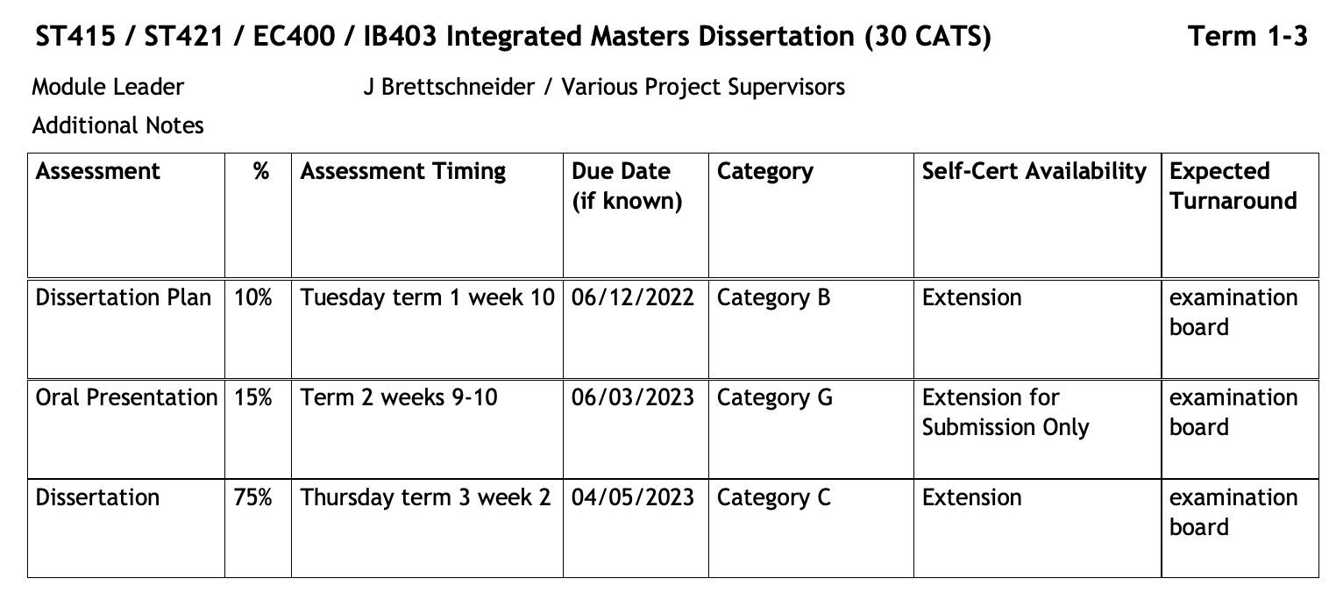
Slide from Week 1 Session
Assessment
https://warwick.ac.uk/fac/sci/statistics/currentstudents/assessment/final_statistics_assessment_handbook_22-23_v1.pdf
(see course handbooks 5.2.4)
“Workflow report”
Notes:
Dario, should we add something in here about your role in the module?

Slide 13
Slide from Week 1 Session
Workflow report?
To make sure you are on the right track with your planned research
Opportunity to reflect on feasibility of objectives, given the time and resource constraints
To learn communication and planning skills, useful in “real-world”/ professional context

Slide 14
Technical & logistic aspects
Short document: 6 pages max plus (optional) cover and table of content
11pt font, single spaced lines, all margins at least 2cm
Optional appendix for non-essential additional plots, formulas, tables, diagrams, formulas, proofs, etc
Supervisor will read at most 1 draft
Submission via Moodle page (uploading function will be added in time)

Slide 15
Content
Dissertation plan: Goals, why, how, done, to do
Mostly non-technical, understandable by your peers
Typical sections: introduction (including motivation, aims & objectives), background, methods, initial results, initial conclusions, future work, references
Assessment criteria and examples on Moodle page
But: no standard approach

Slide 16
Your questions?

Slide 17
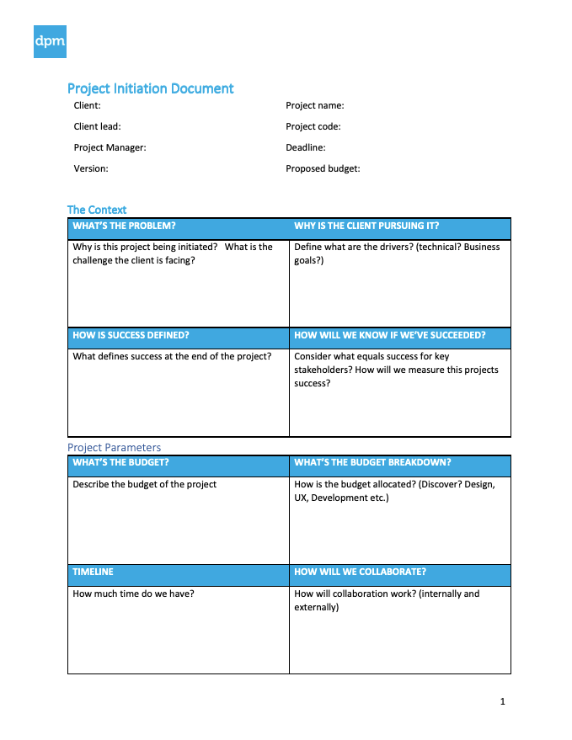
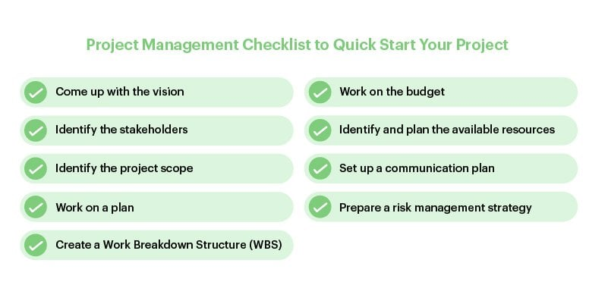
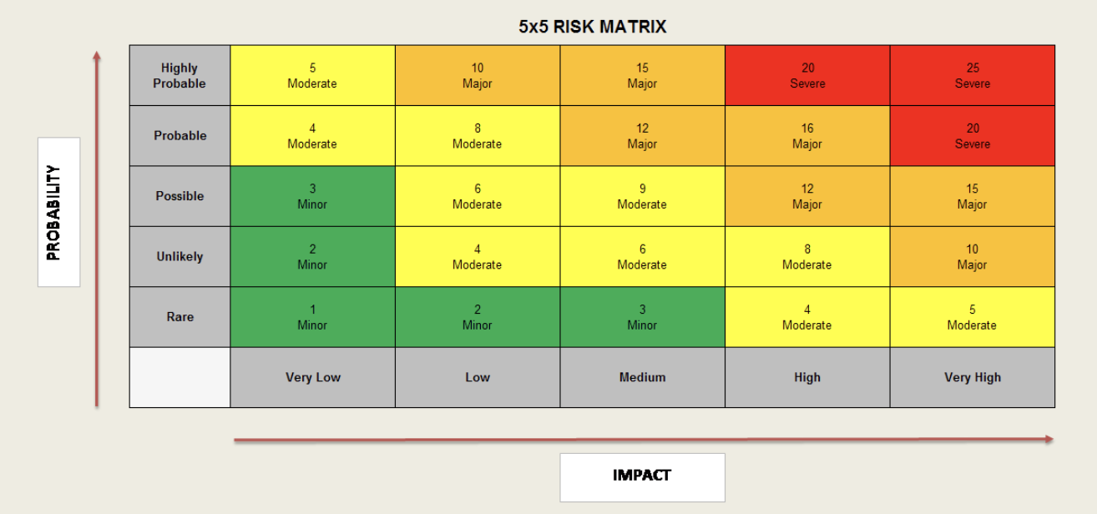
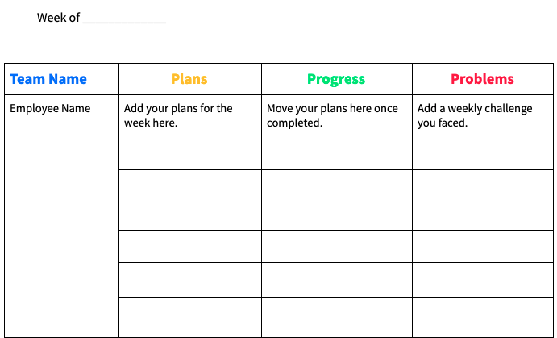
Tools to help you in practice
Starting a Project checklist
Project initiation document
Project plan/Gantt Chart
Risk Analysis toolkit
Progress Reporting template
Post Project Review Meeting

Slide 18
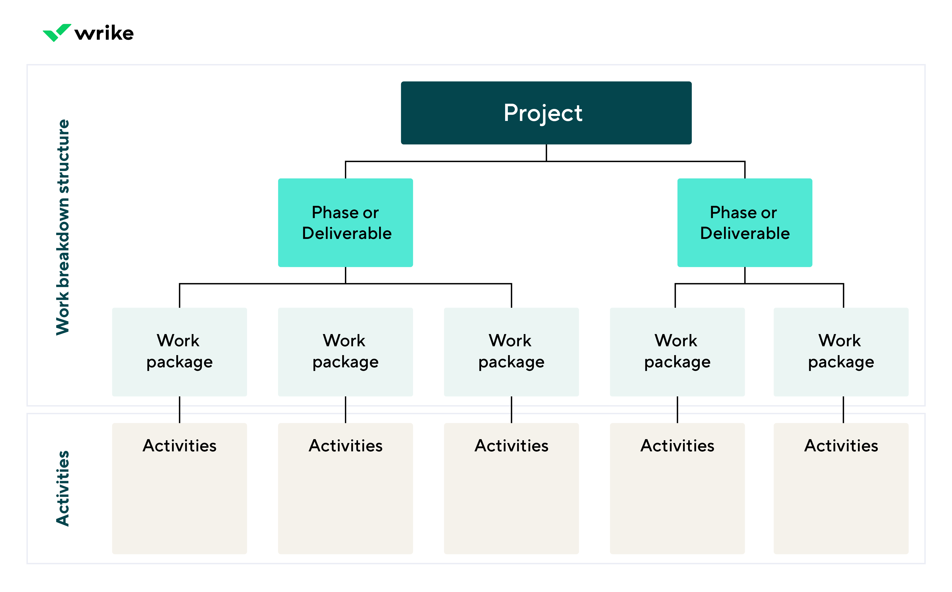
Work breakdown structure
Notes:
A work breakdown structure (WBS) is a project management tool that takes a step-by-step approach to complete large projects with several moving pieces. By breaking down the project into smaller components, a WBS can integrate scope, cost and deliverables into a single tool.

Slide 19
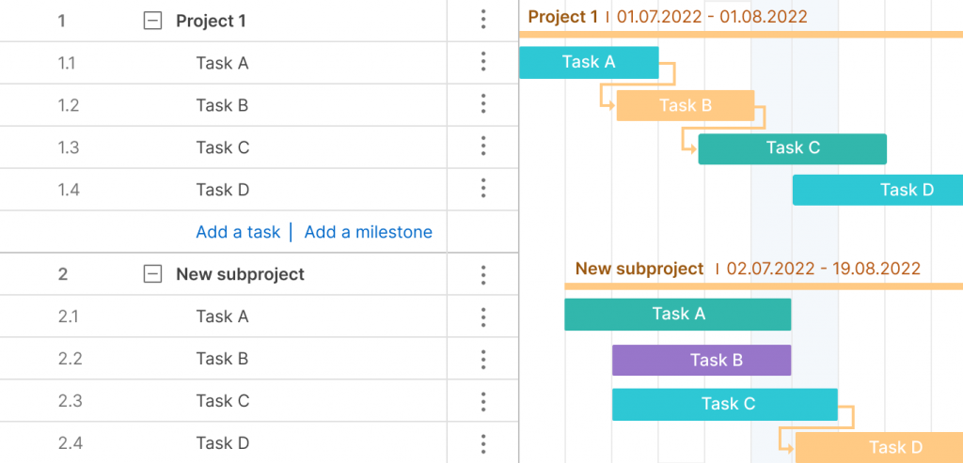
Gantt chart
Notes:
A Gantt chart is a project management tool that illustrates a project plan. It typically includes two sections: the left side outlines a list of tasks, while the right side has a timeline with schedule bars that visualize work.
Know what's going on in your projects.
Improved communication and team cohesion.
Avoid resource overload.
Measure the progress of projects.
See overlapping activities and task dependencies.
Experience more clarity.
Practice better time management.

Slide 20
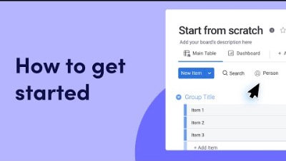
Task – project planning using Monday.com

Slide 21
Task – project planning using Monday.com
Go to Monday.com and click on ‘Get Started’.
Enter your Warwick University email address.
Complete the account details.
Select ‘I’m here for SCHOOL’.
Select ‘I want to manage PROJECTS’.
Select ‘I’m working on INDIVIDUAL PROJECTS’.
For Build your Board with Others, click on ‘I’ll do it later’.
At this point or very soon, you will be asked to confirm your email address so go to your inbox and click on the monday.com email confirmation to verify your account.
Next, back within Monday.com, click on +Add to create a new board.

Slide 22
Any questions?

Slide 23
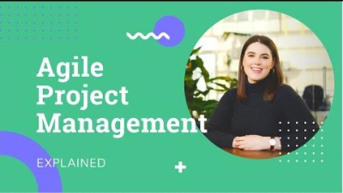
Agile project management
Notes:
https://www.youtube.com/watch?v=zi7uGg6FVM4

Slide 24
Third briefing session:
Term 2 Week 3
Monday 12-1pm
Oral communication and presentation of research projects
Written dissertation

