Slide 1

Doctoral Transferable Skills
PGCTSS
Dr Daniel Franklin
9 October 2024

Slide 2

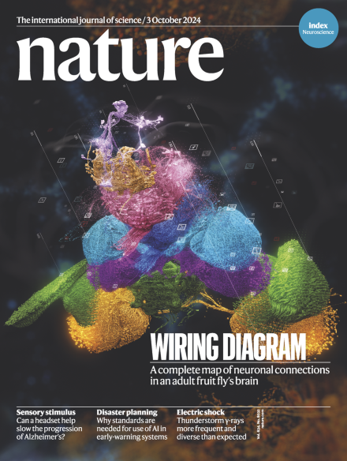

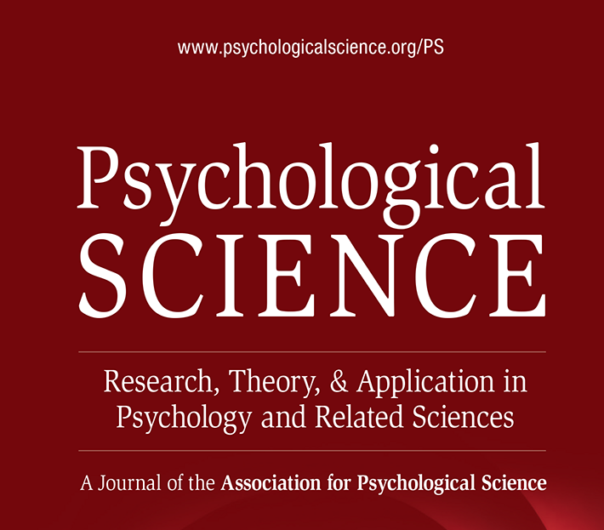
You’ve come here to do high quality research, why do anything else?
Do everything better…
We try to give you the skills you need to increase the quality of your research.
Work effectively with your supervisor, wider research group and external network.
You need to be able to communicate with new and more varied audiences than you are likely to be used to.
You need to be able to plan and project manage.
You need to think/work critically.
And at the end you need to get a good job using your skills.

Slide 3
Why ‘skills’?
Transferable Skills are identified by the majority of employers as important for success…
above sector-specific knowledge or technical skills (RSC, 2023).
‘Essential’ skills boost income, predict job satisfaction, increase life satisfaction, decrease unemployment (Skills Builder Partnership, 2023)
We, the institution that is delivering your discipline specific education, is also telling you that (transferable) skills are important.
Transferable Skills aren’t a distraction, or an optional extra, but a necessary component of your development.

Slide 4
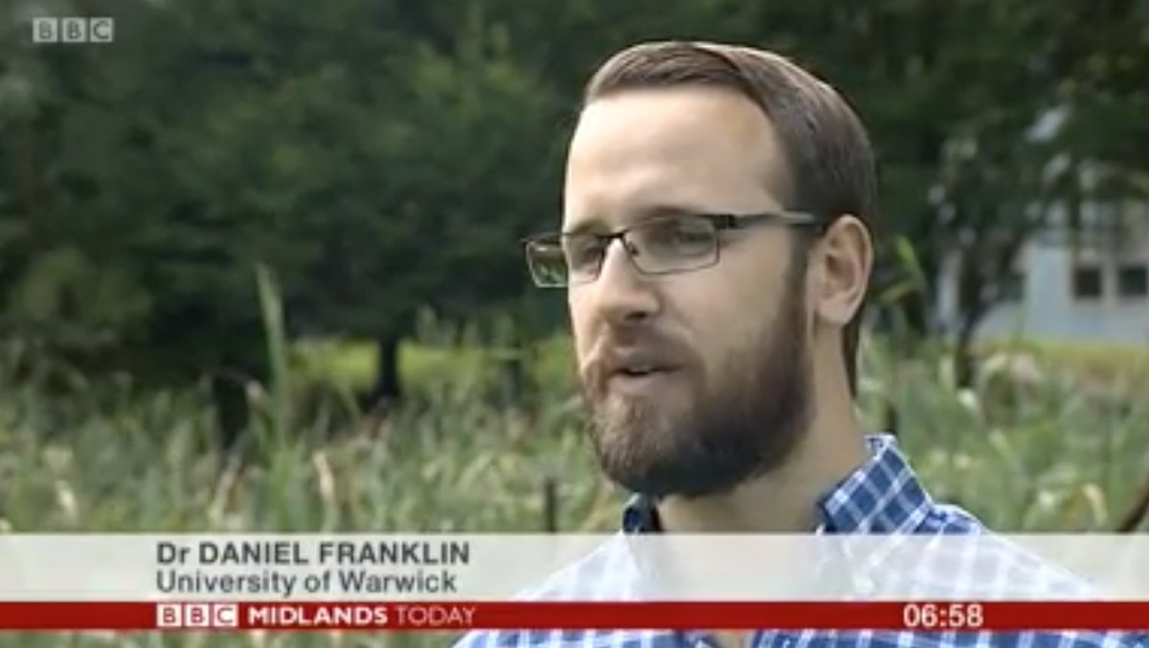
Who am I?
Mostly a higher education ‘manager/leader’.
A Life Scientist in the loosest of terms, yet also quite specifically.
1st degree: Mathematics (2010)
PhD: Epidemiology (2014)
Research Fellow
Teaching Fellow
Assistant Professor
Associate Professor
Director of UG Studies at SLS (2021-2023)
Director of the Faculty PGCert in Transferable Skills (2023 on)
Doing Science Communication

Slide 5



The Postgraduate Certificate in Transferable Skills (PGCTS)
It is an accredited qualification.
Should be harmonious with other training, mandatory or optional. Speak to us if it isn’t.

Slide 6
Employability and careers
Marginal gains for a competitive landscape
DLHE data from 2012/13 to 2016/17
HESA data from 2017/18 to present
Students who attended Transferable Skills courses are:
5% more likely to be in Graduate Employment.
7.5% more likely to be in Full-time employment.
2% less likely to be in Part-time employment.

Slide 7
Aims of the certificate
To enable you:
to be a successful doctoral researcher undertaking world leading research
to improve your research effectiveness,
to maximise your talents in your future career
to transfer skills developed in academic research to other careers
to understand what you already know and how to use those skills to maximum effect.

Slide 8
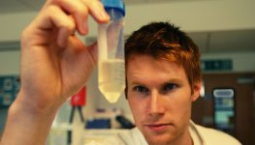
Structure of the Certificate
For all research students in Warwick Faculty of Science, Engineering & Medicine
Total 6 modules × 10 credits each. Usually, 2 per year.
Standards and progress are formally overseen by the Exam Board. In practice you deal mainly with your supervisor and departmental Director of Graduate Studies (or equivalent).
This is training held to an academic standard.

Slide 9
STRUCTURE OF THE CERTIFICATE
YEAR 1
YEAR 2
Doctoral
Skills 2
An option e.g., Science communication
Doctoral
Skills 1
Team working for researchers
YEAR 3
Doctoral
Skills 3
An option e.g., Decision making and leadership

Slide 10
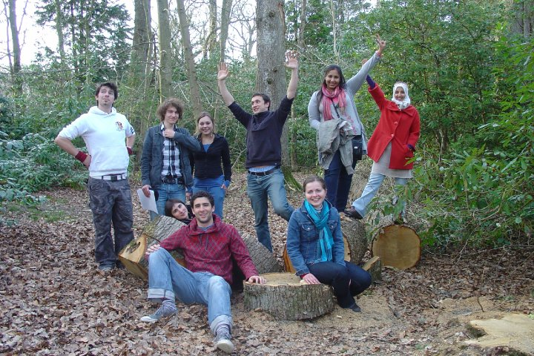
OPTIONAL MODULES
YEAR 1: Team working for Researchers
3-day course, April - July
YEARS 2 & 3: Choose 2 of
  Science Communication
  Decision-making & Leadership
  Research Ethics & Practice
  Business, Innovation &
  Commercialisation
  Scientific writing skills
  Project management
  App development: From ideas to practical tools
  Languages
  Intro to teaching
  You can really do as many as you like, when you like.

Slide 11
Doctoral Skills modules
These modules should simply be a case of gathering evidence!
Doctoral Skills 1-3 cover the basic skills needed and used by science PhD students.
You collate (and maintain) a brief portfolio based around your day-to-day research activities. Keep it up to date!
Year 1 focuses on concerns and skills of graduates starting out on independent research.
Years 2 and 3 focus on skills and activities needed to develop and complete a project and for a career after your PhD.
Tasks signed off by supervisor or relevant academic. DGS or their representative will sign off each module.

Slide 12

Doctoral Skills 1
1. Starting Literature Review – 5 Research Papers
2. Research Plan (including budget) (Keep updating it)
3. Interim Research Report
4. End of year Research Report
5. Year 1 Research Poster or Seminar Review for General Reader
6. Seminar Summaries
7. Poster Marking/Postgraduate Presentation Assessment/Teaching
8. Meeting Planning
9. Webpage

Slide 13


What to do?
Go to Transferable Skills website:
warwick.ac.uk/transferableskills
  Any questions, email: transferable.skills@warwick.ac.uk
Sign up for Doctoral Skills 1 in SkillsForge
Sign up for a Team working for Researchers via Skills Forge

Slide 14
Always focus on your development…
It will be as important as your degree(s)

Slide 15
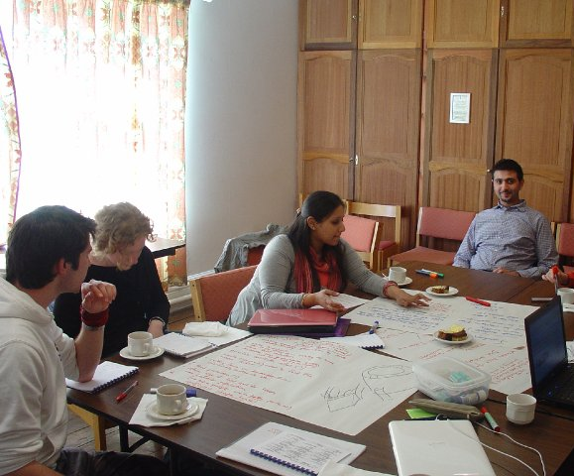
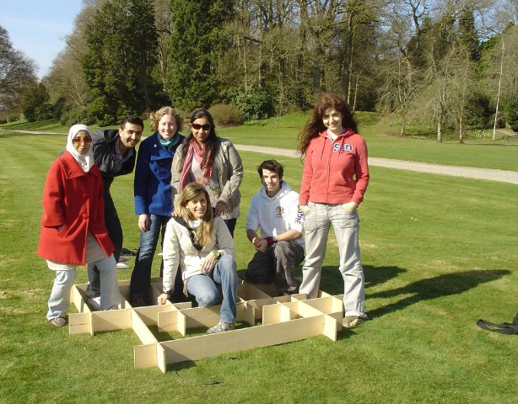

POSTGRADUATE CERTIFICATE IN TRANSFERABLE SKILLS IN SCIENCE
warwick.ac.uk/transferableskills

