Slide 1


2nd Quantum Cambridge-Oxford-Warwick Colloquium (QCOW2)
Matthias C. Caro
April 23, 2026

Slide 2
QCOW: What and Why?
Rotating colloquia: QCOW rotates between Cambridge, Oxford & Warwick, each event with a specific quantum computing theory theme.
Theory must keep pace with hardware: Advances in quantum hardware require parallel innovations in foundational theory.
Strengthening the UK community: QCOW brings together research groups across UK academia + industry and beyond.
QCOW2 Focus: Quantum Learning Theory, a frontier bridging quantum algorithms and complexity, learning theory, and physics.

Slide 3
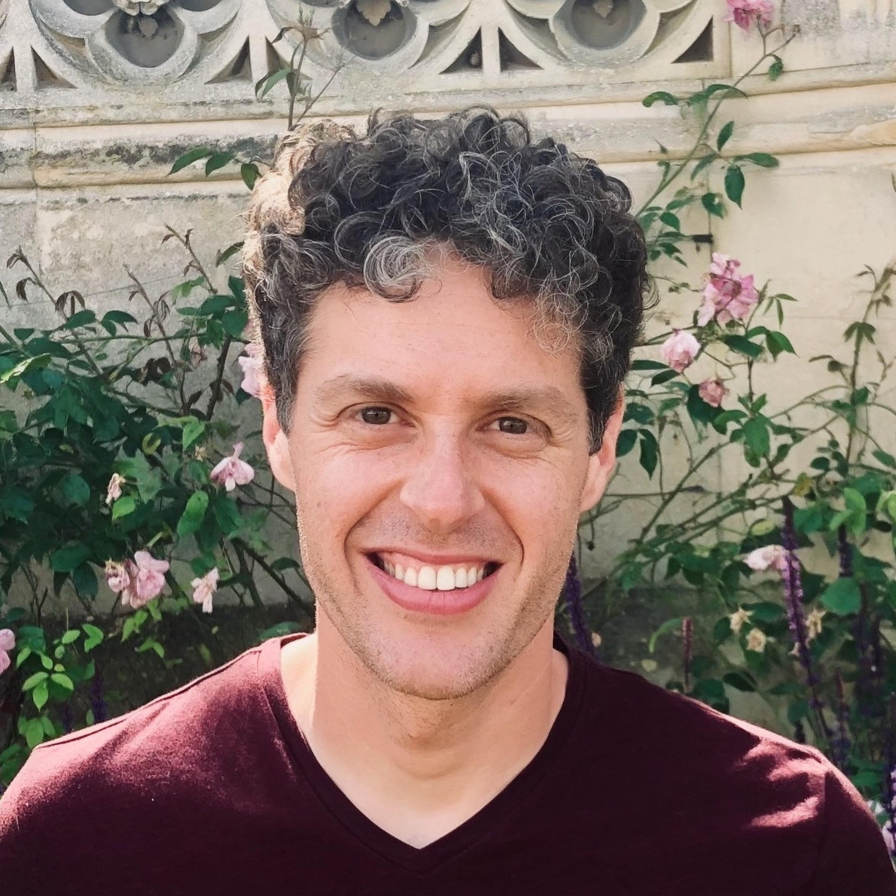
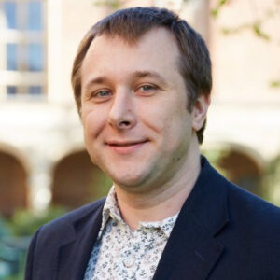
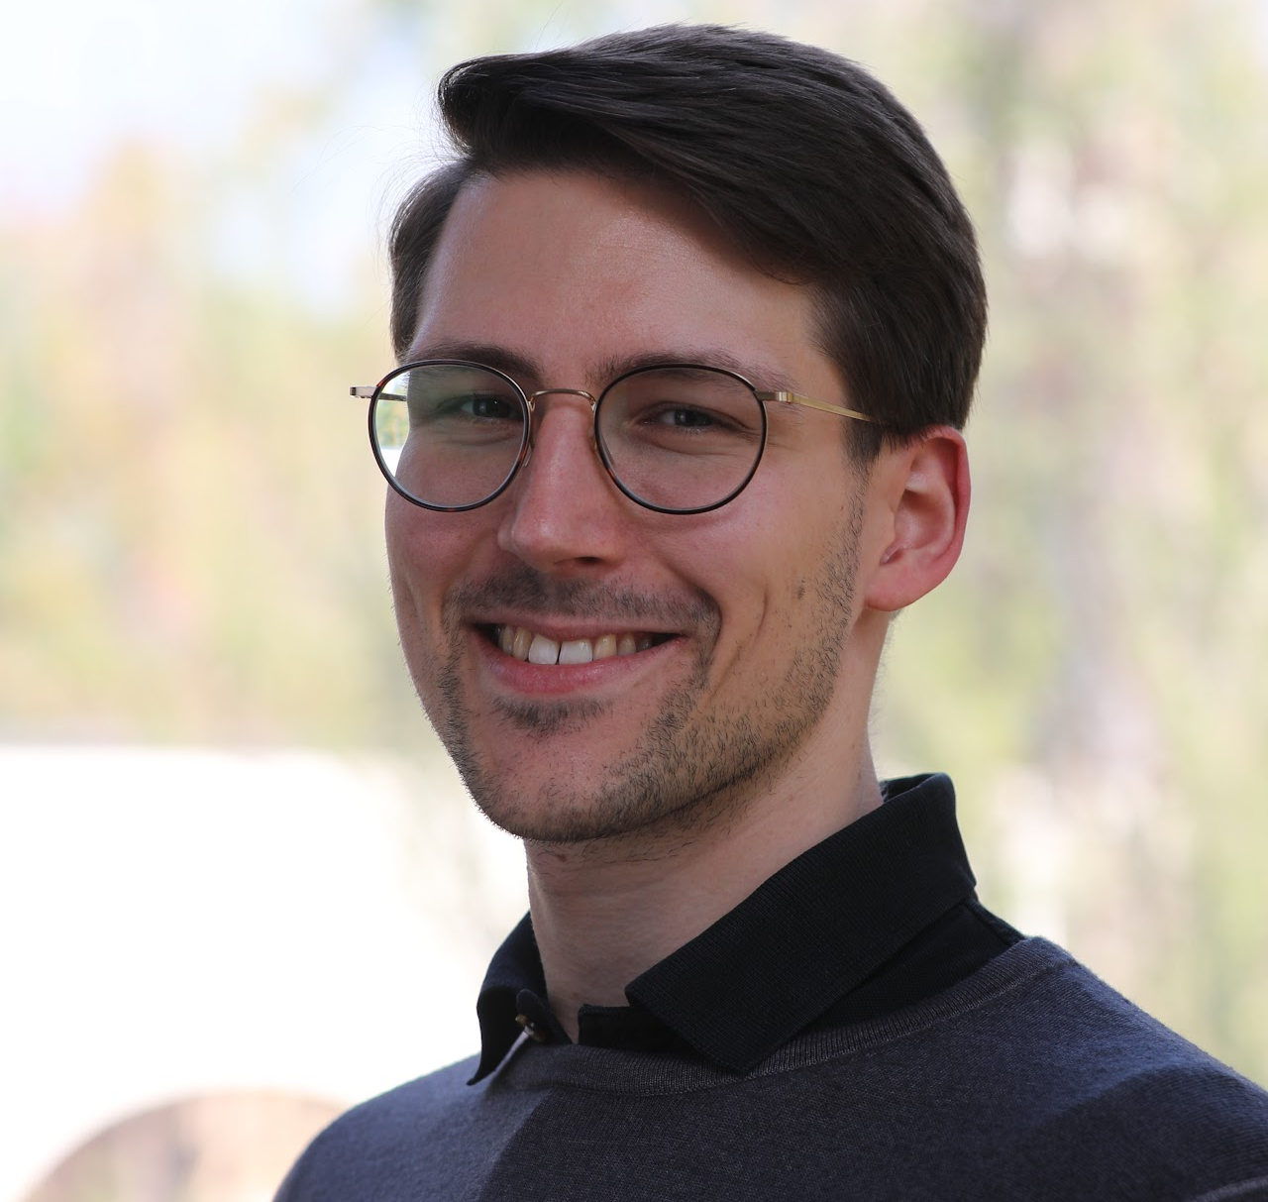
QCOW: Who?
Tom Gur (Cambridge)
Sergii Strelchuk (Oxford)
Matthias C. Caro (Warwick)

Slide 4

QCOW: Who?
AI-generated image created with ChatGPT and Gemini

Slide 5



















QCOW: Who?

Slide 6
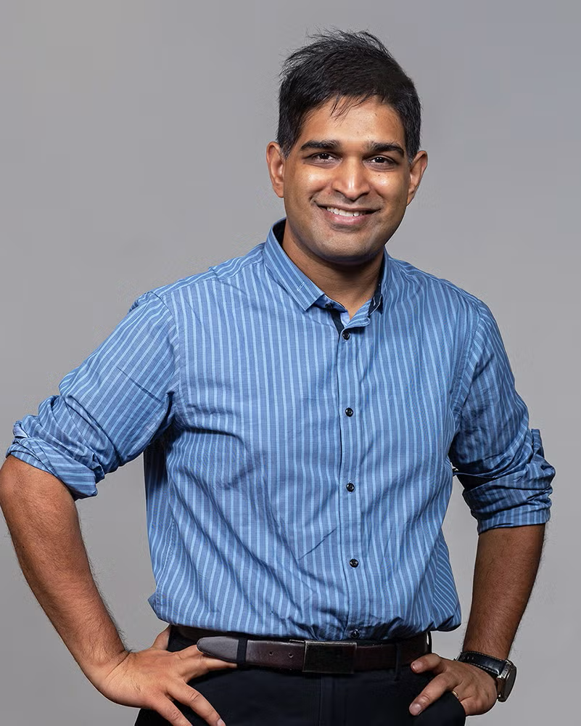
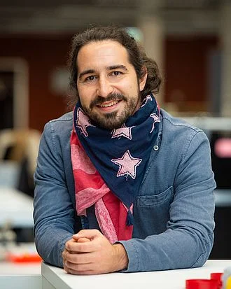
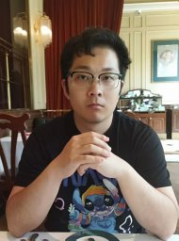
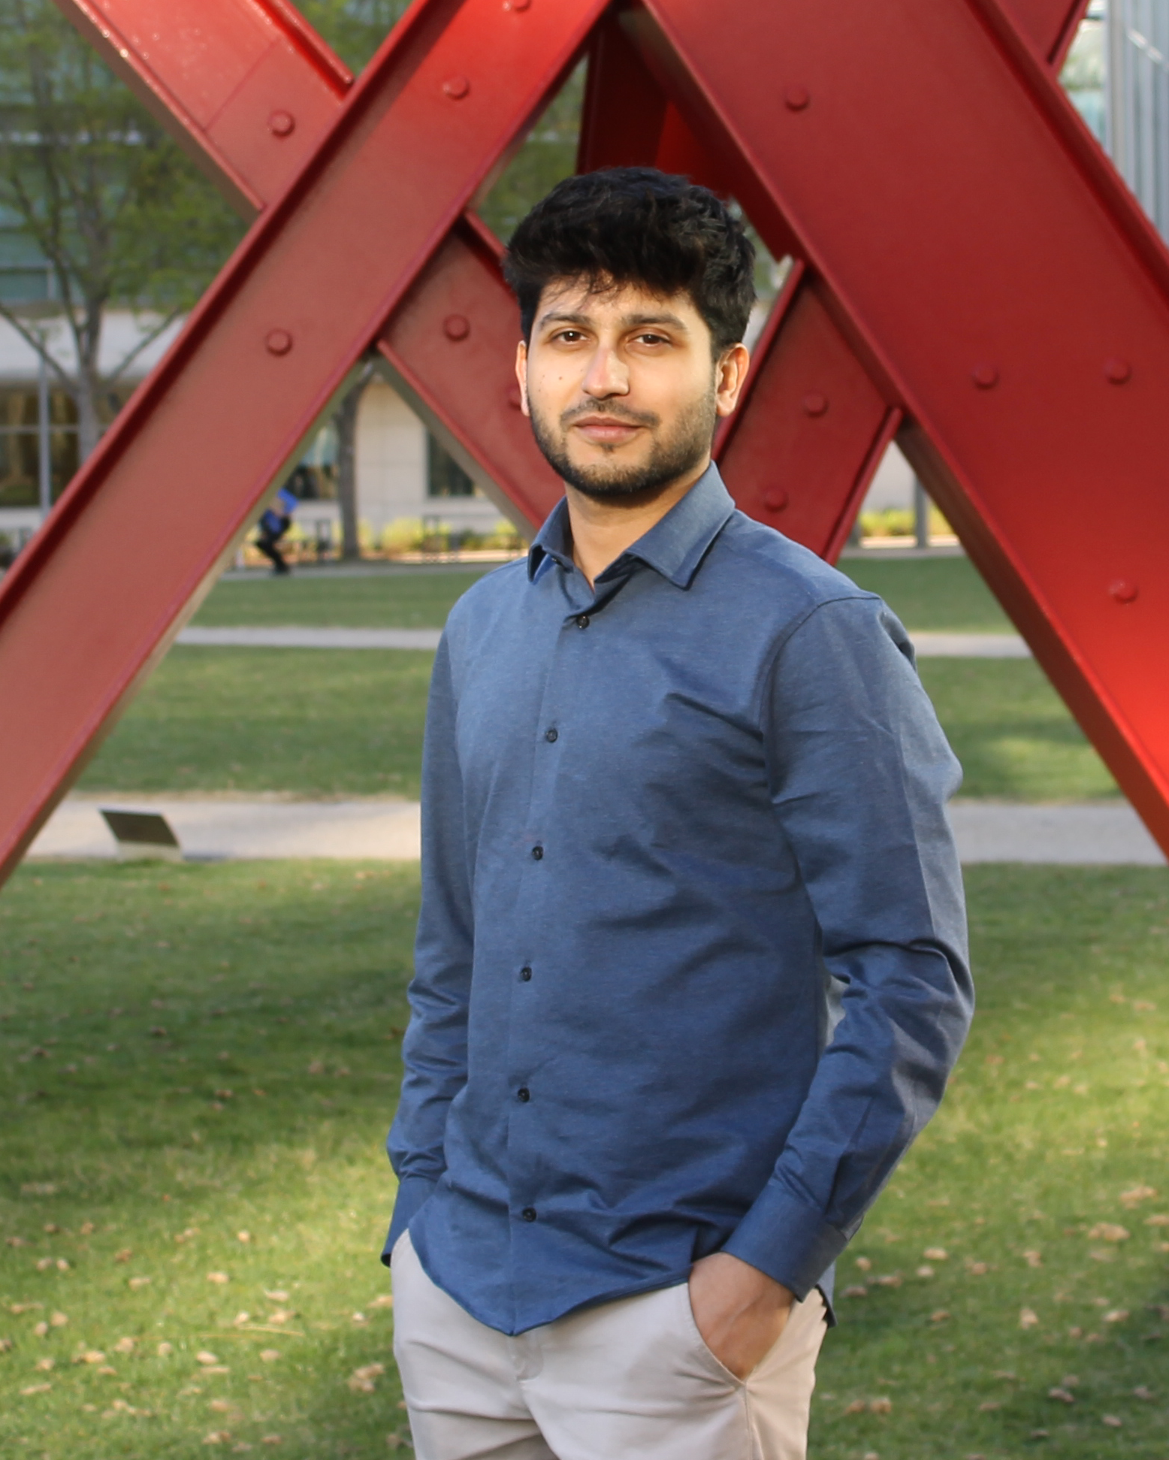
QCOW2 Speakers – Thursday
Arnab Bhattacharya (Warwick)
Richard Küng (JKU Linz)
Zhenhuan Liu
(FU Berlin)
Ainesh Bakshi
(NYU)

Slide 7
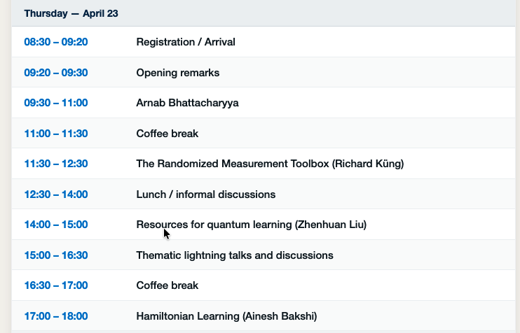
Schedule – Thursday
In front of the lecture hall
In CS1.04 -> Follow Matthias
In front of the lecture hall

Slide 8
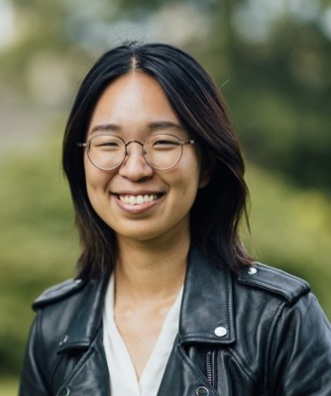
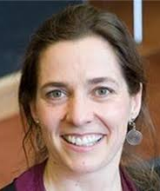
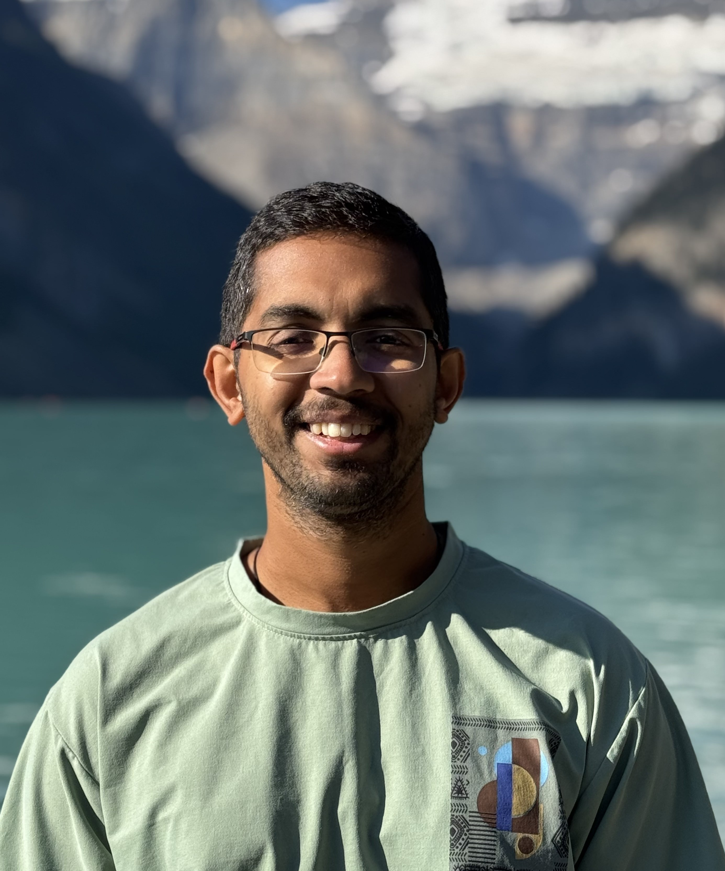
QCOW2 Speakers – Friday
Yihui Quek (EPFL)
Susanne Yelin (Harvard)
Srinivasan Arunachalam (IBM)

Slide 9
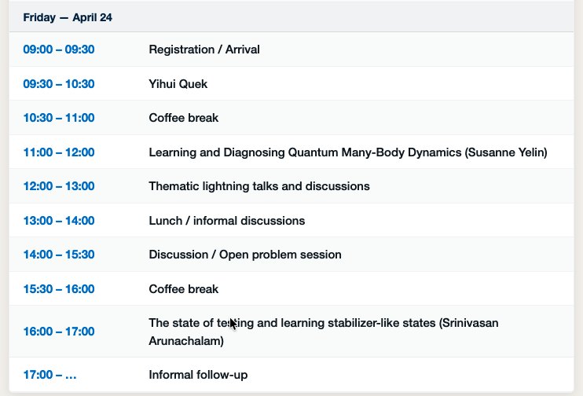
Schedule – Friday
In front of the lecture hall
In CS1.04 -> Follow Matthias
In front of the lecture hall

