Slide 1

Resources for quantum learning
Zhenhuan Liu
Technology Innovation Institute
qubithuan@gmail.com
arXiv:2410.17718
arXiv:2509.21111
arXiv:2509.24000
arXiv:2602.22126
PRX Quantum 7 (1), 010360
Notes:
Hi everyone, I am Zhenhuan Liu, a senior researcher in TII.
I would like to thank the organizers for organizing this super cool workshop, I learned a lot from the talks.
I also want to thank Mateis for inviting me to give this talk, I am very exciting to have the chance of introducing our works to all of you and discuss with you.
I will stay in UK until next weekend, if you are interested in our work and want to discuss, feel free to contact me, this is my email.
OK, this talk is about resources for quantum learning.
Actually, I am very happy to be the talk after Richard. Because when I just entered the quantum information field, I worked on randomized measurements.
And later I found that, although randomized measurement is super good, there are some sample complexity barrier that cannot be overcame by randomized measurements.
I am not saying that randomized measurement is not good. They are actually the best technique, but these sample complexity problem is fundamentally due to properties of quantum mechanics.
So I started to find other ways to overcome them.
I have one hour for this talk and this slice is short, only around 25 pages.
So I am happy if you can interrupt me anytime with your question. I like to discuss.

Slide 2
Learning is about extracting information from target systems.
Notes:
So as we already have two talks, so I guess I can be super quick for the background.

Slide 3
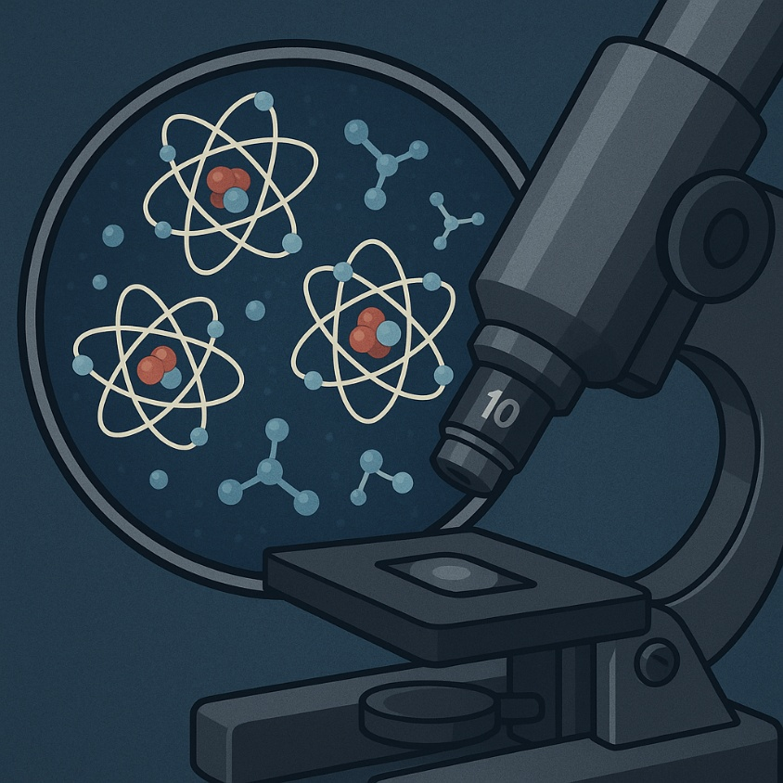
Quantum Learning
Quantum learning is about extracting information from target quantum systems via quantum experiments.
The final step of all quantum information processing tasks; the bridge between quantum and classical worlds.
Quantum systems are intrinsically fragile; learning has fundamental limitations.
  No-cloning
  Disturbance
Notes:
Quantum systems are intrinsically fragile so that learning quantum systems face fundamental limitations.
By fragile, I mean that, first, quantum systems are limited by no-cloning theorem.
This means that, to learn quantum information, we cannot copy the quantum system before learning to enhance the information.
Besides, unlike classical learning, where the measurement itself does not affect the target system.
Quantum measurement will disturb the quantum system being measured.
So a quantum system can only be measured once.

Slide 4









Resources for Quantum Learning
We need to exploit some specific operations or objectives to reduce the complexity of quantum learning.
Entangled operations
Ancillary qubits
Coherent queries
Adaptivity
Deep quantum circuits
Quantum error correction
Quantum control
……
$$|+⟩$$
$$X$$
$$ρ$$
$$𝒞$$
$$ρ$$
$$𝒞$$
$$𝒞$$
$$𝒞$$
$$𝒞$$
[Acharya et al., STOC 2025], [Coltler et al., arXiv:2512.10929], [Huang et al., PRL 2023]
Notes:
So, due to these limitations, we need to exploit resources to reduce the complexity of quantum learning.
Here, by resources, we refer to those specific operations or stuffs that, when without them, the complexity for quantum learning will be high, while if we have these operations or stuffs, the complexity can be significantly reduced.
Some common resources include:
In addition to these, people also exploited other kinds of resources, such as xxx xxx xxx.
If you are interested, please read these references.
The first paper shows that Pauli measurement is not optimal for tomography, so that we need more global measurements.
The second paper shows that noisy measurements can exponentially increase the complexity of quantum learning.
The third one show that quantum control is super useful in achieving Heisenberg limit in Hamiltonian learning
I will list all references later.

Slide 5









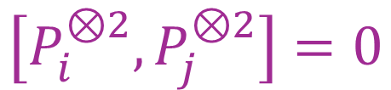



Examples
With Entanglement (joint measurement)
Uncertainty principle
Classical Shadow
$$𝒪\left(poly\left(n\right)\right)$$
Single-copy measurements
$$Tr\left(Pρ\right) ∀P$$
$$Θ(2^{n})$$
$$\left[P_{i}^{⊗2},P_{j}^{⊗2}\right]=0$$
$$ρ$$
$$U$$
$$𝒪(1)$$
$$Tr\left(ρ^{2}\right)=Tr\left(Sρ^{⊗2}\right)$$
$$Tr\left(ρ^{2}\right)$$
$$Θ(2^{n/2})$$
$$|+⟩$$
$$X$$
Linearity of quantum mechanics
Randomized Measurement
$$ρ$$
$$ρ$$
[Aharonov et al., NC 2022], [Chen et al., FOCS 2021], [Huang et al., Nat. Phys. 2020], [Elben et al., Nat. Rev. Phys. 2023]
Notes:
To help you better understand why resources are important for quantum learning, lets see two intuitive examples.
Suppose that you can only perform single-copy quantum measurements. I mean, you can only operate on one copy of rho at a time.
The first task is to estimate all Pauli expectation values, and the second task is the estimation of purity.
You will find that these two tasks are all difficult, but with different reasons.
For the first one, the difficulty is because that all these some Pauli operators do not commute with each other.
So that you cannot measure them in a single measurement basis.
For the second task, the difficulty comes from the intrinsic linearity of quantum mechanics.
In quantum mechanics, it is always easy to learn some linear properties, like the expectation value of a single observable.
If you want to learn some nonlinear observable, sometimes you need to decompose it into many linear terms and estimate them one by one, which also cause exponential complexity.
Actually, for the first task, the sample complexity can be lower bounded by 2^n, which is achieved by classical shadow protocol.
And for the second task, the sample complexity is lower bounded by the square root of d, which is achieved by a randomized measurement protocol.
So, as mentioned by Richard before, we can see randomized measurement toolbox is really a good tool for learning.
OK, if we have entanglement, which means joint measurement performed on many copies of rho, these two tasks can be super easy.
Why?
For the first task, the joint measurement can reduce the sample complexity from 2^n to polynomial of n.
Th reason is simple. Although all Pauli observables do not commute with each other, if you consider P tensor P, you will find that they suddenly become commute.
So this means that, given single copy of rho, we cannot measure all Pauli observables in a single basis, but given two copies of rho, now we can estimate all Pauli observables in a single basis, which can significantly reduce the complexity.
For the estimation of purity, the joint measurement can even reduce the complexity from exponential to a constant. The reason is also simple.
Although purity is a nonlinear function of rho, but it is actually a linear function of two copies of rho.
So, we can just measure a linear observable on rho tensor rho. As stated before, estimating a single linear function of rho is always simple. So the sample complexity can be significantly reduced.

Slide 6

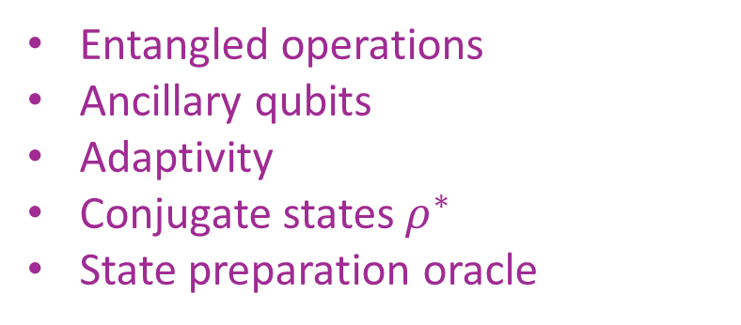
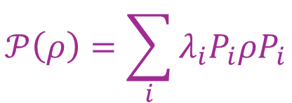
Routines
of quantum state
of quantum channel
Learning
Many Linear Properties
$$Tr\left(O_{i}ρ\right) ∀i∈\{1,…M\}$$
$$𝒫\left(ρ\right)=\sum_{i}{λ_{i}P_{i}ρP_{i}}$$
Entangled operations
Ancillary qubits
Adaptivity
Conjugate states $ρ^{∗}$
State preparation oracle
Ancillary qubits
Coherent queries
[Chen et al., FOCS 2024], [King et al., PRXQ 2024], [Chen et al., PRA 2022],
[Chen et al., arXiv:2412.19022], [Chen et al., PRXQ 2025], [Huggins et al., PRL 2022]
Notes:
Although these two examples are simple, they actually stand for two important routines for studying quantum learning resources.
Actually, if you read the related references of quantum learning resources, you will find that most of them can be roughly classified into these two routines.
The first one is about estimating many linear properties of a quantum system, here, many normally means exponentially many.
There are many papers about learning many linear properties of quantum state, and people have found many useful resources for it, such as entangled operations we mentioned before, and ancillary qubits, adaptive protocols, and even complex conjugate state, and state preparation oracle
People also generalize this task into a channel version, the most famous channel version task is the Pauli channel learning.
This is the definition of Pauli channel, or sometimes called Pauli diagonal channel, these lambda_i represent Pauli coefficients.
The task of Pauli channel learning is about learning all these Pauli coefficients.
Actually, each Pauli coefficient can be regarded as a linear property of the Pauli channel, so it also belongs to this routine.
And researchers have shown that ancillary qubits, coherent queries are useful resources for this task.

Slide 7

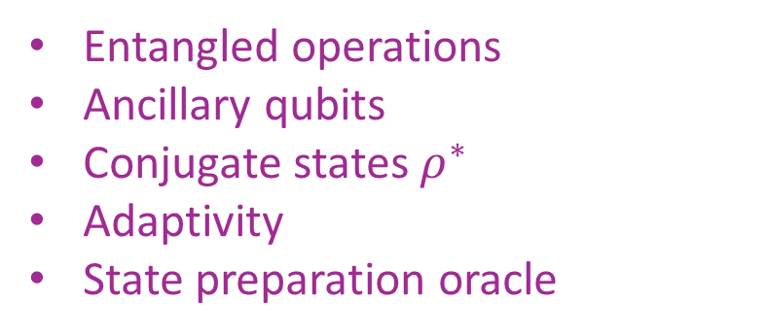

Routines
[Chen et al., FOCS 2024], [King et al., PRXQ 2024], [Chen et al., PRA 2022],
[Chen et al., arXiv:2412.19022], [Chen et al., PRXQ 2025], [Huggins et al., PRL 2022]
of quantum state
of quantum channel
$$Tr\left(O_{i}ρ\right) ∀i∈\{1,…M\}$$
$$𝒫\left(ρ\right)=\sum_{i}{λ_{i}P_{i}ρP_{i}}$$
Learning
Many Linear Properties
Entangled operations
Ancillary qubits
Conjugate states $ρ^{∗}$
Adaptivity
State preparation oracle
Ancillary qubits
Coherent queries
of quantum state
Purity
Pure dilation states
[Gong et al., arXiv:2410.12712]
Learning Nonlinear Properties
Notes:
The second routine is about learning nonlinear properties of quantum systems.
Actually, all of my works I want to introduce in this talk belong to this routine.
We want to answer a question: is quantum learning also linear?
In this routine, people also first study the state learning, where the most typical example is the purity estimation.
In addition to the joint measurement, other resources, like the ancillary qubits, is also proposed as a resource.
Here, I would like to introduce the first work of us, in which we propose a new quantum learning resource, the pure dilation state.

Slide 8

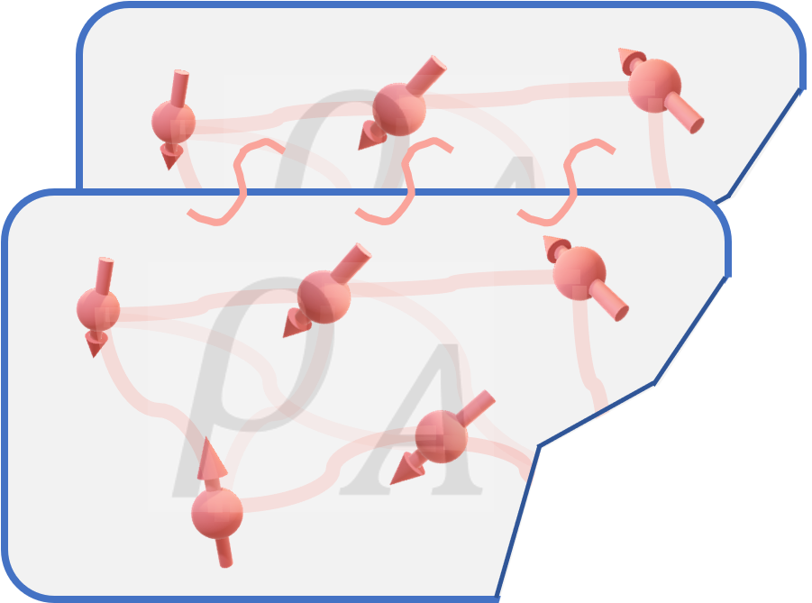
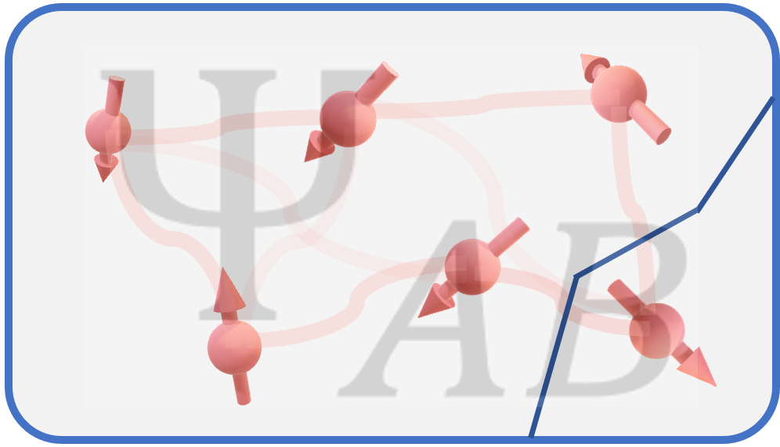
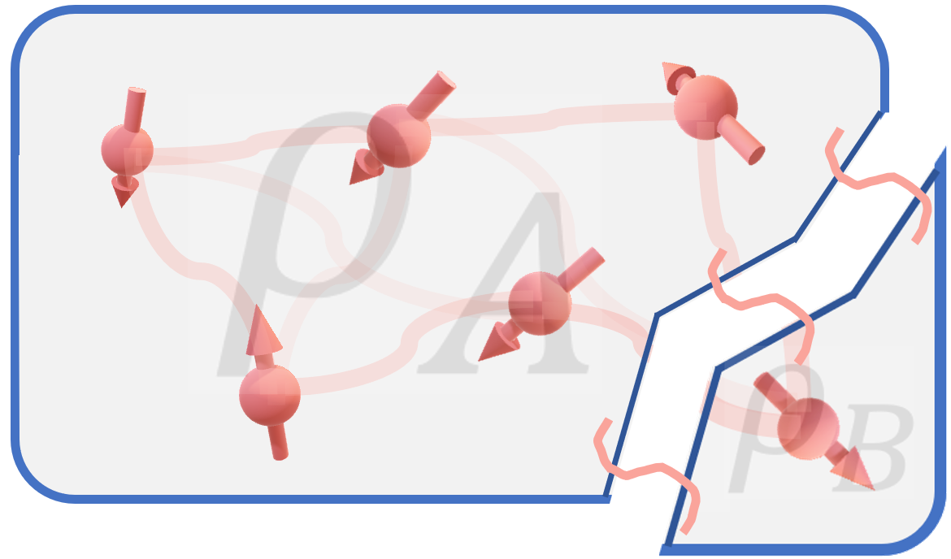
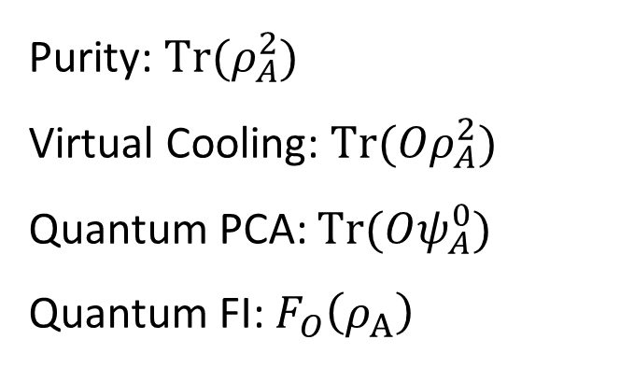
Pure dilation states
Entanglement
Purity: $Tr(ρ_{A}^{2})$
Virtual Cooling: $Tr(Oρ_{A}^{2})$
Quantum PCA: $Tr(Oψ_{A}^{0})$
Quantum FI: $F_{O}\left(ρ_{A}\right)$
Pure dilation
arXiv:2410.17718
Notes:
So what is a pure dilation state. (actually, in textbook, it is called purification, but sometimes purification has a different meaning, similar like the distillation, so here we call it pure dilation state)
Specifically, if we have a large pure state PSI_AB, and its subsystem rho_A, which is a mixed state.
Then we call the large pure state is the pure dilation of the mixed state rho_A
Now we want to learning some nonlinear properties of rho_A.
We already know that, if you can perform joint operations on many copies of rho_A, we can efficiently estimate

Slide 9
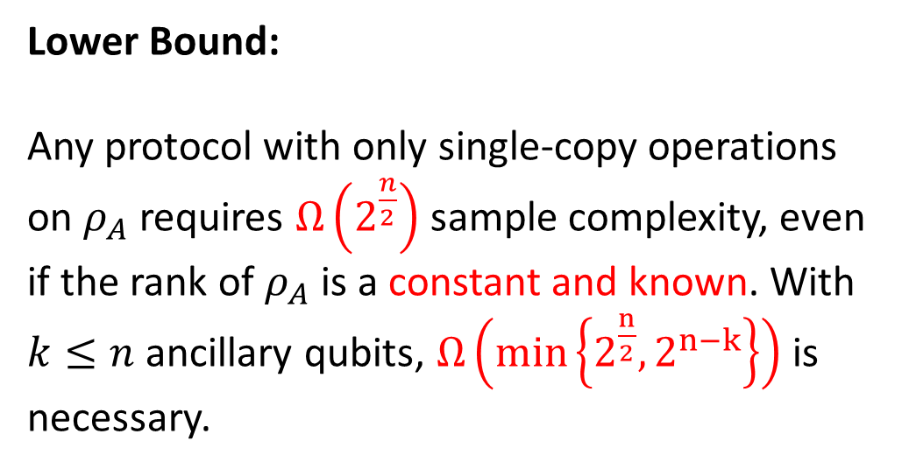
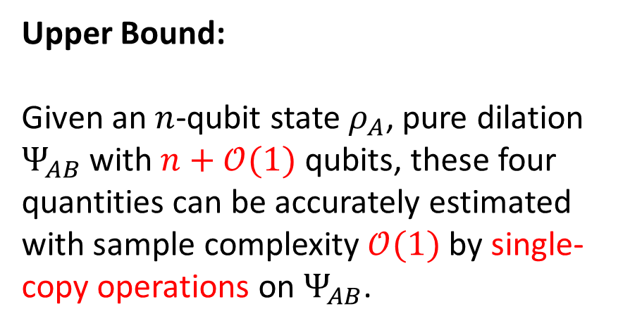
Pure dilation states
Upper Bound:
Given an $n$-qubit state $ρ_{A}$, pure dilation $Ψ_{AB}$ with $n+𝒪(1)$ qubits, these four quantities can be accurately estimated with sample complexity $𝒪(1)$ by single-copy operations on $Ψ_{AB}$.
Lower Bound:
Any protocol with only single-copy operations on $ρ_{A}$ requires $Ω\left(2^{\frac{n}{2}}\right)$ sample complexity, even if the rank of $ρ_{A}$ is a constant and known. With $k≤n$ ancillary qubits, $Ω\left(min\left\{2^{\frac{n}{2}},2^{n−k}\right\}\right)$ is necessary.
arXiv:2410.17718

Slide 10

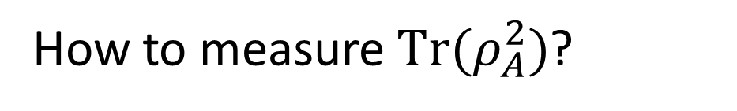
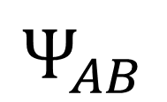
Proof
$$Ψ_{AB}$$
$$ρ_{A}$$
$$ρ_{B}$$
How to measure $Tr(ρ_{A}^{2})$?
$$Tr\left(ρ_{A}^{2}\right)=Tr(ρ_{B}^{2})$$
Hint: It is really simple! 😀

Slide 11
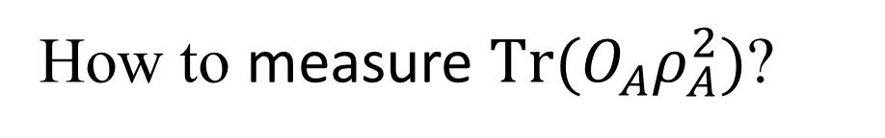
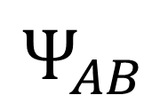
Proof
$$Ψ_{AB}$$
$$ρ_{A}$$
$$ρ_{B}$$
How to measure $Tr(O_{A}ρ_{A}^{2})$?
$$ρ_{A}^{2}={Tr}_{B}\left[Ψ_{AB}\left(𝕀_{A}⊗ρ_{B}\right)\right]$$
Hint: Not that simple 😟
$$Tr\left(O_{A}ρ_{A}^{2}\right)=Tr\left[Ψ_{AB}\left(O_{A}⊗ρ_{B}\right)\right]$$
Pure dilation helps to filter out spectral information of the target state!

Slide 12
[Chen et al., FOCS 2024], [King et al., PRXQ 2024], [Chen et al., PRA 2022],
[Chen et al., arXiv:2412.19022], [Chen et al., PRXQ 2025], [Huggins et al., PRL 2022]
Routines
of quantum state
of quantum channel
$$Tr\left(O_{i}ρ\right) ∀i∈\{1,…M\}$$
$$𝒫\left(ρ\right)=\sum_{i}{λ_{i}P_{i}ρP_{i}}$$
Learning
Many Linear Properties
Entangled operations
Ancillary qubits
Conjugate states $ρ^{∗}$
Adaptivity
State preparation oracle
Ancillary qubits
Coherent queries
of quantum state
Purity
Pure dilation states
  No-purification theorem
[Gong et al., arXiv:2410.12712]
Learning Nonlinear Properties
Notes:
After knowing that pure dilation state is very useful for quantum learning, a very natural question is, can we easily prepare the pure dilation state from the target mixed state rho?
And we give a negative answer. Actually, we prove that, not only preparing dilation state is impossible, preparing any input-dependent pure state is also impossible.

Slide 13
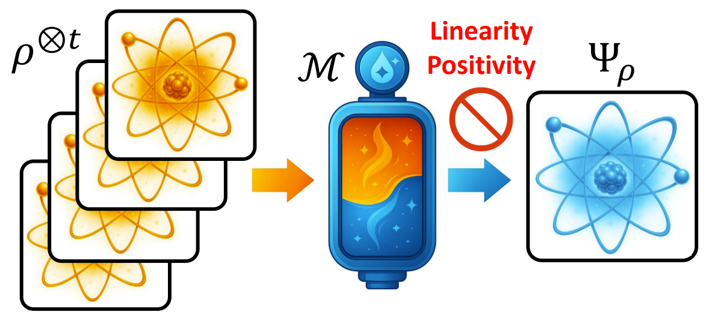
No Purification Theorem
Linearity and Positivity of quantum mechanics prevent input-dependent purification.
arXiv:2509.21111
Notes:
This is the second work I want to introduce to all of you, we uncover that, the linearity and positivity of quantum mechanics prevent the universal quantum purification.
Specifically, it is not possible to design a quantum operation, that takes a finite copy of rho as the input, and outputs a pure state which depends on the input state.

Slide 14
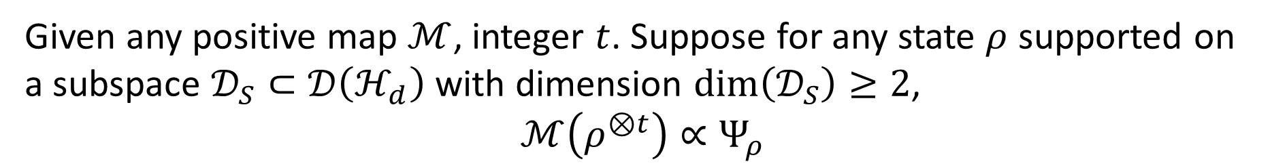
No Purification Theorem
Given any positive map $ℳ$, integer $t$. Suppose for any state $ρ$ supported on a subspace $𝒟_{S}⊂𝒟\left(ℋ_{d}\right)$ with dimension $dim\left(𝒟_{S}\right)≥2$,
$$ℳ\left(ρ^{⊗t}\right)∝Ψ_{ρ}$$
Then we have
$$ℳ\left(ρ^{⊗t}\right)∝Ψ$$
With finite input copies, it is impossible to produce an input-dependent output pure state.
Notes:
Our first results is the following theorem, which we call no purification theorem.
Here we only require the map to be positive map, so actually this result covers all possible quantum operations even considering post-selection

Slide 15
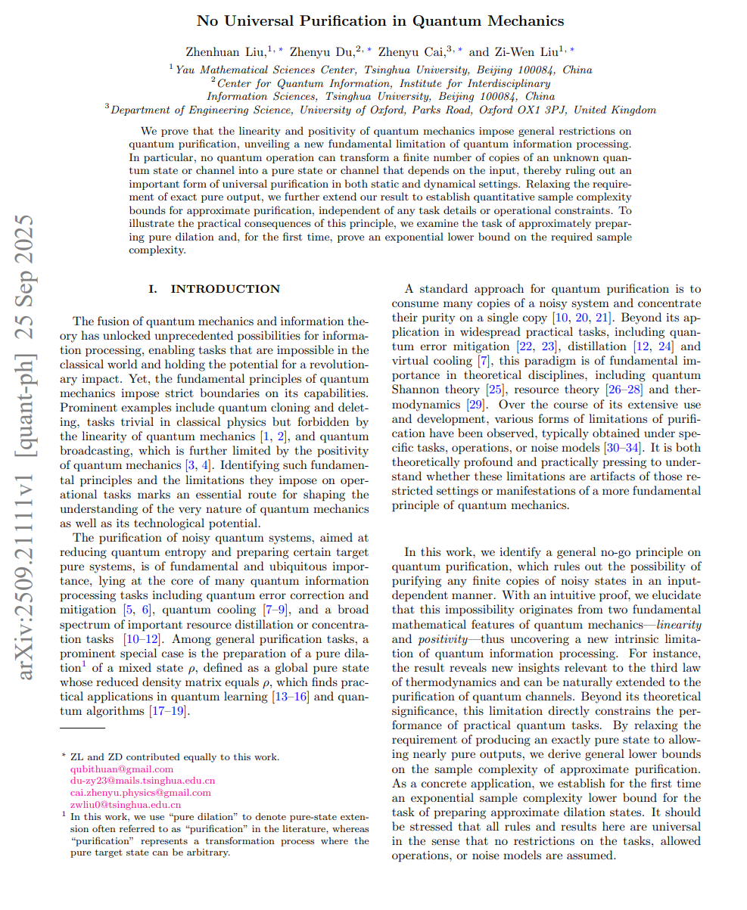
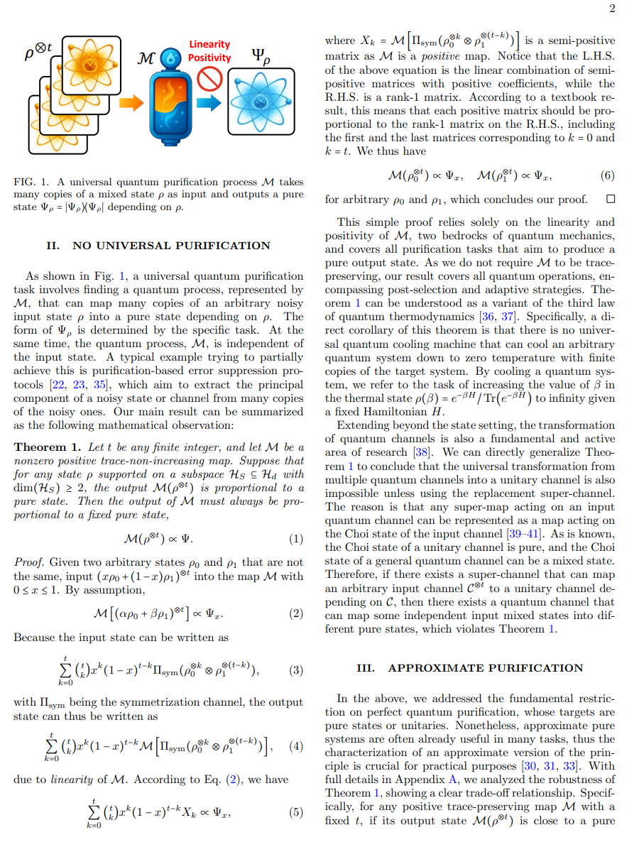
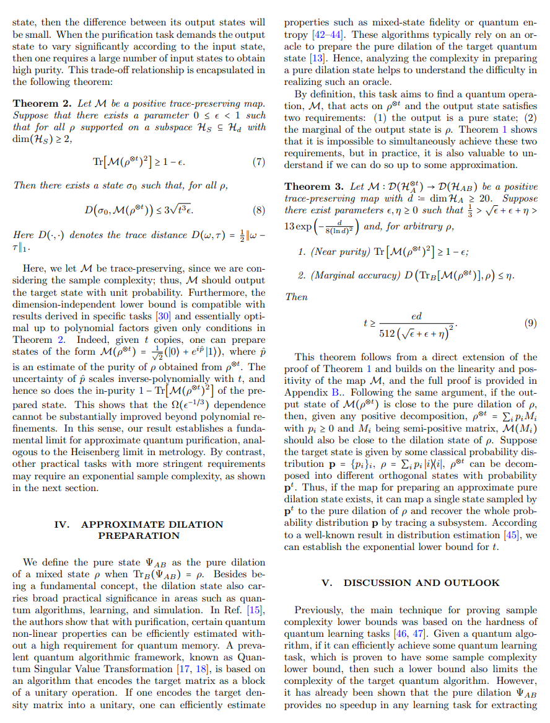
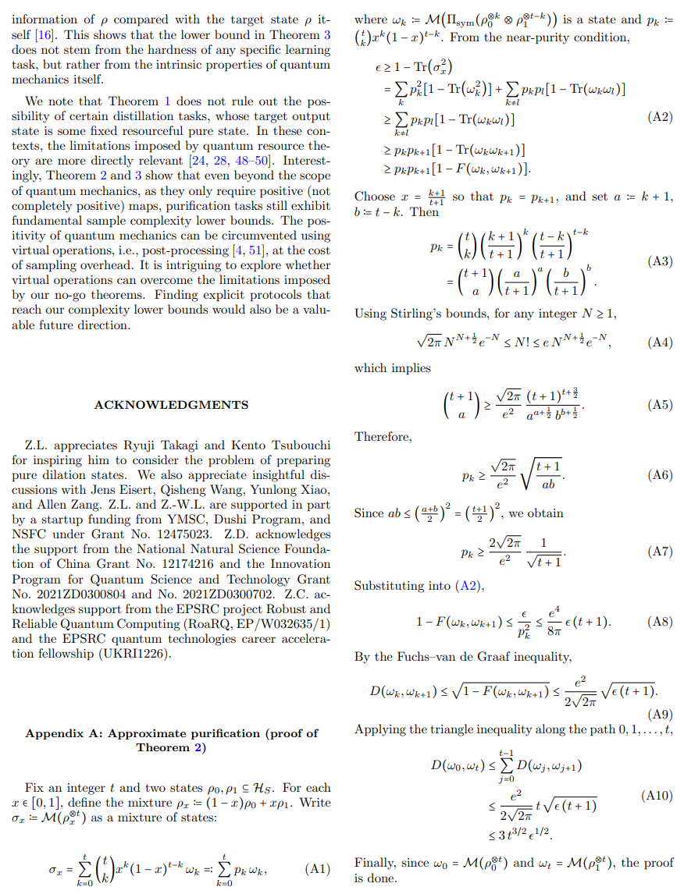
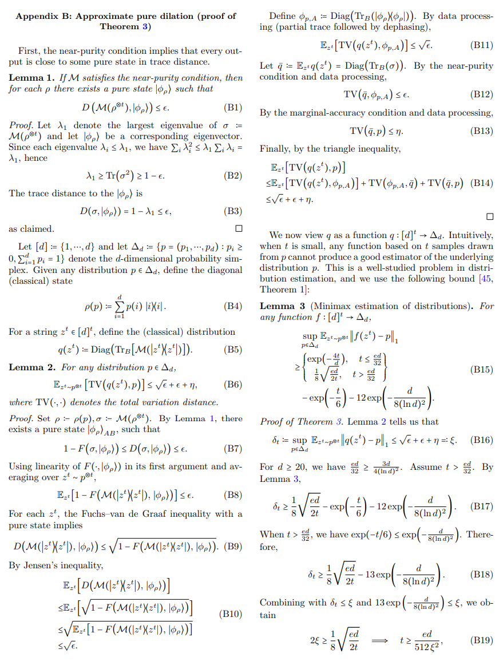
Notes:
I highly suggest you to read our manuscript.
We try to make it easily readable.
It is really short.
The main text has only three pages. And the appendix has only two pages.
We will update it soon, so you should read it recently

Slide 16
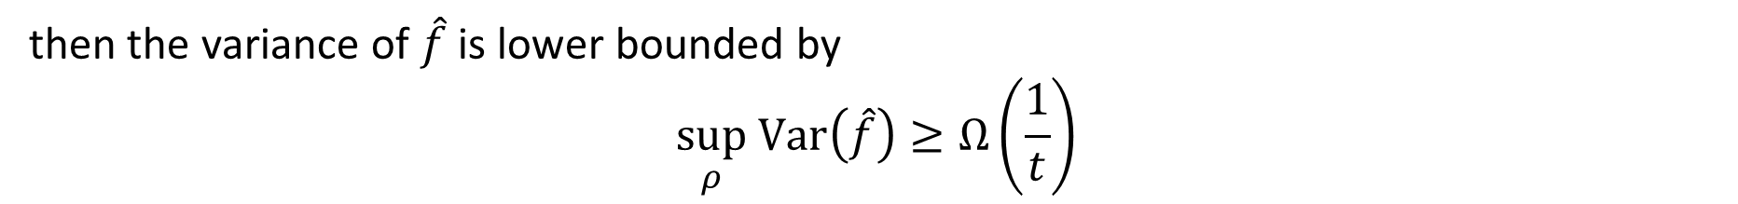
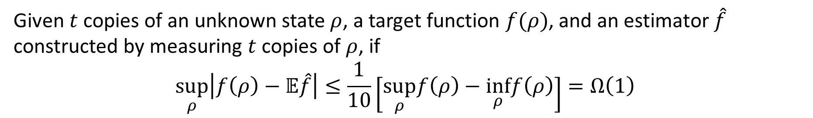
Approximate Purification
Given any positive trace-preserving map $ℳ$, integer $t$. Suppose that
$$Tr\left[ℳ{\left(ρ^{⊗t}\right)}^{2}\right]≥1−ε$$
then there exists a state $σ_{0}$ such that for all $ρ$
$$D\left(σ_{0},ℳ\left(ρ^{⊗t}\right)\right)≤\left(8π\sqrt{2t}+12\right)\sqrt{ε}$$
Standard Quantum Limit
Given $t$ copies of an unknown state $ρ$, a target function $f(ρ)$, and an estimator $\hat{f}$ constructed by measuring $t$ copies of $ρ$, if
$$\sup_{ρ}\left|f\left(ρ\right)−𝔼\hat{f}\right|≤\frac{1}{10}\left[\sup_{ρ}f\left(ρ\right)−\inf_{ρ}f\left(ρ\right)\right]=Ω\left(1\right)$$
then the variance of $\hat{f}$ is lower bounded by
$$\sup_{ρ} Var\left(\hat{f}\right)≥Ω\left(\frac{1}{t}\right)$$
Notes:
Although we show that perfect purification is not possible, but we also acknowledge that in many cases approximate purification is already enough.
So we generalize our theorem to the approximate version, where we relax the requirement from that the output state should be a perfect pure state to that the purity of the output state to be larger than 1-epsilon
After establishing the approximate purification theorem, we further found that quantum learning can also be understood as a special kind of quantum purification task.
An input-dependent purification task. If we can accurately estimate some property of a quantum state, this is similar with purifying a quantum state.
Using this observation, we prove a super general version of the Standard quantum limit, which is a very important result in quantum metrology.
If you are familiar, you know that in quantum metrology, the standard quantum limit is proved using quantum FI, which requires that the target function should be smooth.
Now our new result does not have the requirements.
So this shows that the purification and quantum learning have deep connections.

Slide 17
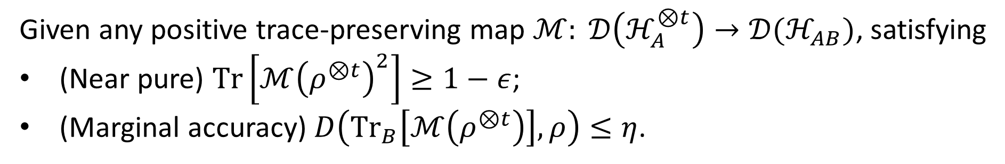
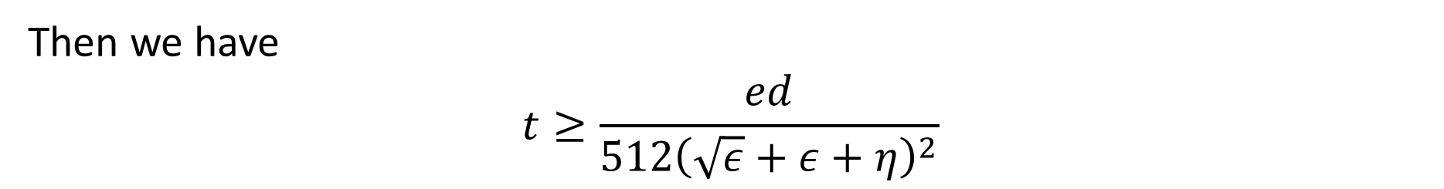
Dilation State Preparation
Given any positive trace-preserving map $ℳ: 𝒟\left(ℋ_{A}^{⊗t}\right)→𝒟(ℋ_{AB})$, satisfying
(Near pure) $Tr\left[ℳ{\left(ρ^{⊗t}\right)}^{2}\right]≥1−ε$;
(Marginal accuracy) $D\left({Tr}_{B}\left[ℳ\left(ρ^{⊗t}\right)\right],ρ\right)≤η$.
Then we have
$$t≥\frac{ed}{512{\left(\sqrt{ε}+ε+η\right)}^{2}}$$
Notes:
We also conder the complexity of preparing pure dilation. We already know that perfectly preparing it is not possible.
So here we consider the approximate version. We only require that the output state is nearly pure and the marginal of the state is close to the input state, not exactly the same.
We proved an exponential lower bound, here d is the dimension of rho.
The proof technique is quite similar with the proof in Mat’s recent paper, where we show that the dilation preparation quantum channel imply a probability distribution learning algorithm, and then use the complexity lower bound of the probability distribution learning to give the lower bound of the pure dilation state preparation.

Slide 18

[Chen et al., FOCS 2024], [King et al., PRXQ 2024], [Chen et al., PRA 2022],
[Chen et al., arXiv:2412.19022], [Chen et al., PRXQ 2025], [Huggins et al., PRL 2022]
Routines
of quantum state
of quantum channel
$$Tr\left(O_{i}ρ\right) ∀i∈\{1,…M\}$$
$$𝒫\left(ρ\right)=\sum_{i}{λ_{i}P_{i}ρP_{i}}$$
Learning
Many Linear Properties
Entangled operations
Ancillary qubits
Conjugate states $ρ^{∗}$
Adaptivity
State preparation oracle
Ancillary qubits
Coherent queries
of quantum state
Purity
Pure dilation states
  No-purification theorem
  Random dilation
of quantum channel
Unitarity
Post-measurement state
[Gong et al., arXiv:2410.12712]
[Chen et al., IEEE TIT 2024]
Learning Nonlinear Properties
[Pelecanos et al., arXiv:2511.15806]
[Tang et al., arXiv:2510.07622]
$$ℛ\left(ρ^{⊗t}\right)=𝔼_{U}\left|Ψ_{U}\right\rangle {\left\langle Ψ_{U}\right|}^{⊗t}$$
Notes:
So, in conclusion, we give a negative answer to the question of preparing pure dilation state.
However, soon after our paper, there are some researchers found a super clever way to avoid this limitation.
I really hope that I can come up with this idea.
So, the no go theorem of our work comes from that we want to prepare a pure state.
So their idea is that, instead of preparing a single one, we can prepare a random pure dilation state.
We know that, given a density matrix, its pure dilation state is not unique, there are freedom for constructing its pure dilation state.
So the real output state of the random dilation channel is the expectation of these pure dilation states, which is actually a mixed state.
Although it is mixed, it still very useful in quantum learning. They show that they can use this random dilation channel to reduce the learning of mixed state into the learning of pure state, which gives a very good sample complexity scaling.
Lets first pause here about state learning.
In the second routine, people also consider about learning nonlinear properties of quantum channel.
A very typical example is the estimation of unitarity, which is defined to be the purity of Choi state of the quantum channel.
And in this paper they have already show that coherent queries are important in this task.
In learning nonlinear properties of quantum channel, we also propose a new resource, which is the post-measurement state.

Slide 19
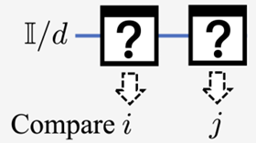
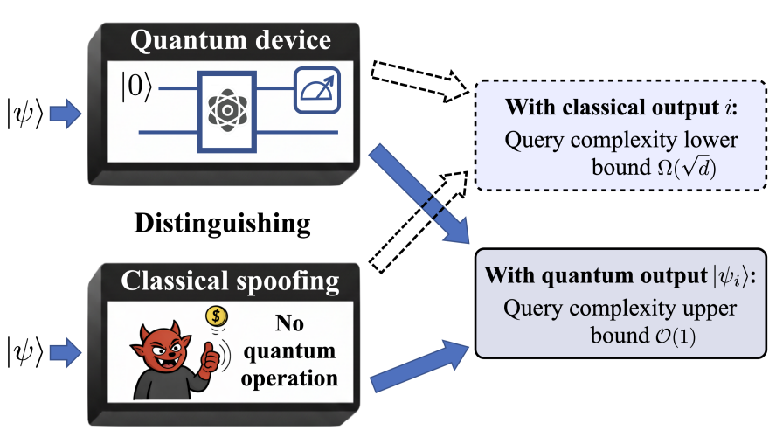
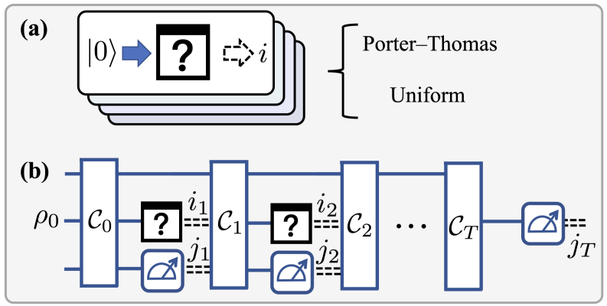
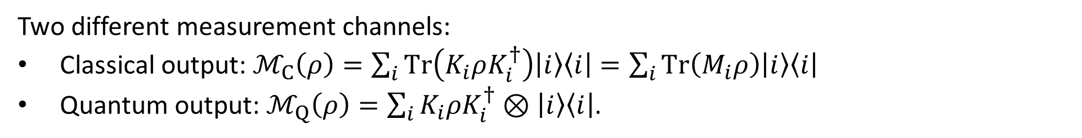
Post-measurement state
Two different measurement channels:
Classical output: $ℳ_{C}\left(ρ\right)=\sum_{i}{Tr\left(K_{i}ρK_{i}^{†}\right)\left|i\right\rangle \left\langle i\right|}=\sum_{i}{Tr\left(M_{i}ρ\right)\left|i\right\rangle \left\langle i\right|}$
Quantum output: $ℳ_{Q}\left(ρ\right)=\sum_{i}{K_{i}ρK_{i}^{†}⊗\left|i\right\rangle \left\langle i\right|}$.
Post-measurement state is the only resource matters in this learning task!
Task: Estimating Sharpness $𝒮\left({\left\{M_{i}\right\}}_{i}\right)=\frac{1}{d}\sum_{i}{Tr(M_{i}^{2})}$
arXiv:2602.22126
Notes:
Actually, in this work, we are considering the learning of quantum measurements.
But we know that, quantum measurement is also quantum channel.
And there are two main kinds of measurement channel, the first one is those only output classical results, which can be written in this form, here K is the measurement operator and M is the POVM operator.
The second one is those that can output both classical measurement result and also the post-measurement state, the state that is collapsed by the measurement.
The task is to estimate a nonlinear quantity of the measurement, which is defined to be the sharpness of measurement.
This quantity is useful, imagine that you buy a quantum device from someone and you don’t know whether you can trust him or not.
The device might perform a projective measurement in some random basis or may just flip a coin and generate a classical random number and output to you.
How can you distinguish them?
If you can measure this quantity, you can, because

Slide 20
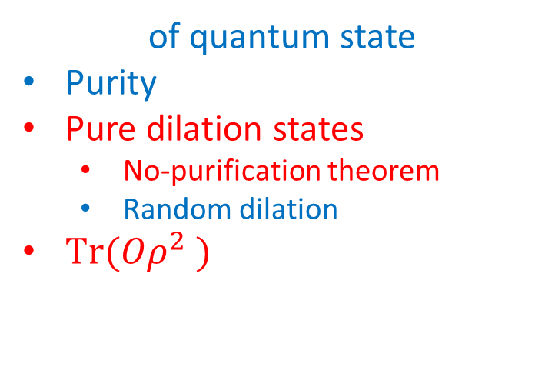
[Chen et al., FOCS 2024], [King et al., PRXQ 2024], [Chen et al., PRA 2022],
[Chen et al., arXiv:2412.19022], [Chen et al., PRXQ 2025], [Huggins et al., PRL 2022]
Routines
of quantum state
of quantum channel
$$Tr\left(O_{i}ρ\right) ∀i∈\{1,…M\}$$
$$𝒫\left(ρ\right)=\sum_{i}{λ_{i}P_{i}ρP_{i}}$$
Learning
Many Linear Properties
Entangled operations
Ancillary qubits
Conjugate states $ρ^{∗}$
Adaptivity
State preparation oracle
Ancillary qubits
Coherent queries
of quantum state
Purity
Pure dilation states
  No-purification theorem
  Random dilation
$Tr(Oρ^{2} )$
of quantum channel
Unitarity
Post-measurement state
Learning Nonlinear Properties
[Gong et al., arXiv:2410.12712], [Pelecanos et al., arXiv:2511.15806], [Tang et al., arXiv:2510.07622], [Chen et al., IEEE TIT 2024]
Notes:
Due to time limitations, I would like to very briefly introduce other two works.
In the first work, we studied the estimation of Tr(Orho^2).

Slide 21
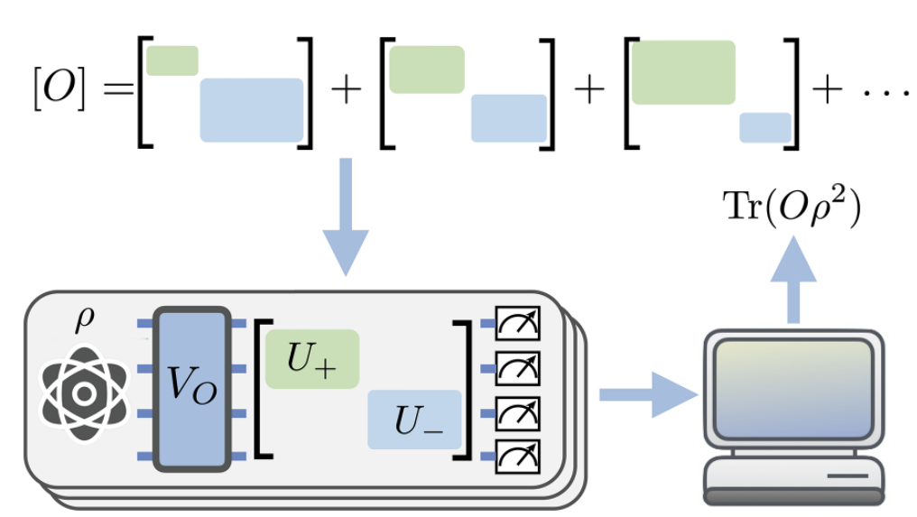
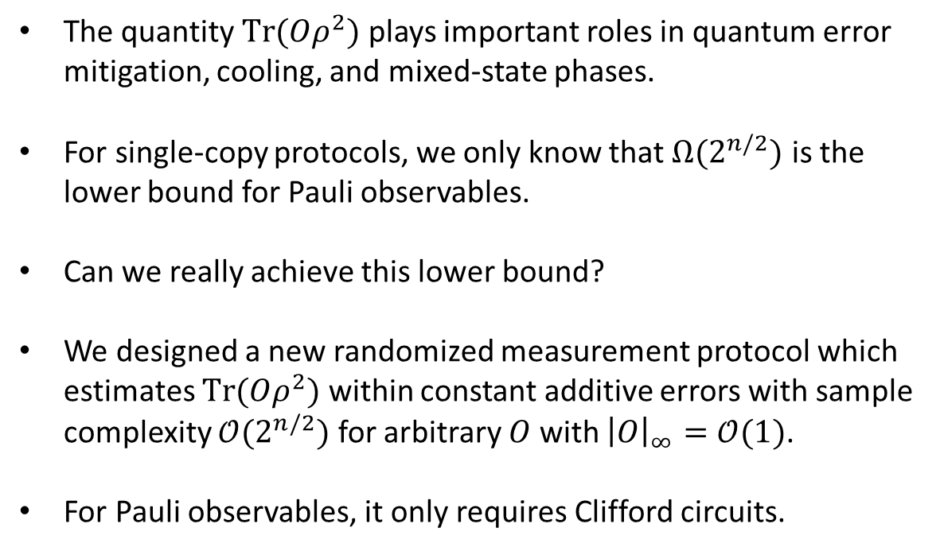
Observable-driven Randomized Measurement
The quantity $Tr(Oρ^{2})$ plays important roles in quantum error mitigation, cooling, and mixed-state phases.
For single-copy protocols, we only know that $Ω(2^{n/2})$ is the lower bound for Pauli observables.
Can we really achieve this lower bound?
We designed a new randomized measurement protocol which estimates $Tr(Oρ^{2})$ within constant additive errors with sample complexity $𝒪(2^{n/2})$ for arbitrary $O$ with ${\left|O\right|}_{∞}=𝒪(1)$.
For Pauli observables, it only requires Clifford circuits.
PRX Quantum 7 (1), 010360

Slide 22
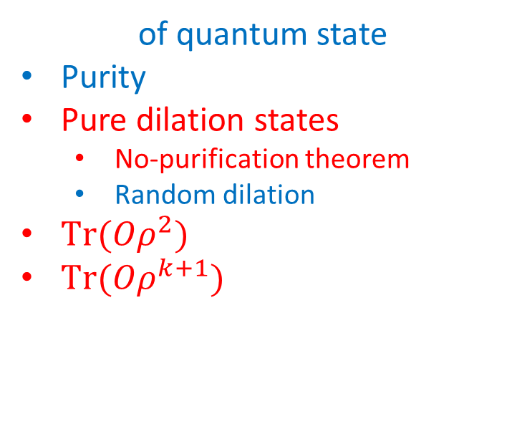
[Chen et al., FOCS 2024], [King et al., PRXQ 2024], [Chen et al., PRA 2022],
[Chen et al., arXiv:2412.19022], [Chen et al., PRXQ 2025], [Huggins et al., PRL 2022]
Routines
of quantum state
of quantum channel
$$Tr\left(O_{i}ρ\right) ∀i∈\{1,…M\}$$
$$𝒫\left(ρ\right)=\sum_{i}{λ_{i}P_{i}ρP_{i}}$$
Learning
Many Linear Properties
Entangled operations
Ancillary qubits
Conjugate states $ρ^{∗}$
Adaptivity
State preparation oracle
Ancillary qubits
Coherent queries
of quantum state
Purity
Pure dilation states
  No-purification theorem
  Random dilation
$Tr(Oρ^{2})$
$Tr(Oρ^{k+1})$
of quantum channel
Unitarity
Post-measurement state
Learning Nonlinear Properties
[Gong et al., arXiv:2410.12712], [Pelecanos et al., arXiv:2511.15806], [Tang et al., arXiv:2510.07622], [Chen et al., IEEE TIT 2024]
Notes:
In the last work, we consider the estimation of Tr(O rho^(k+1)).
Although these two things look similar, actually we try to solve completely different questions.
This work is about lower bound and protocol design, and this work is about lower bound and quantum learning resource.

Slide 23







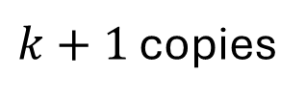
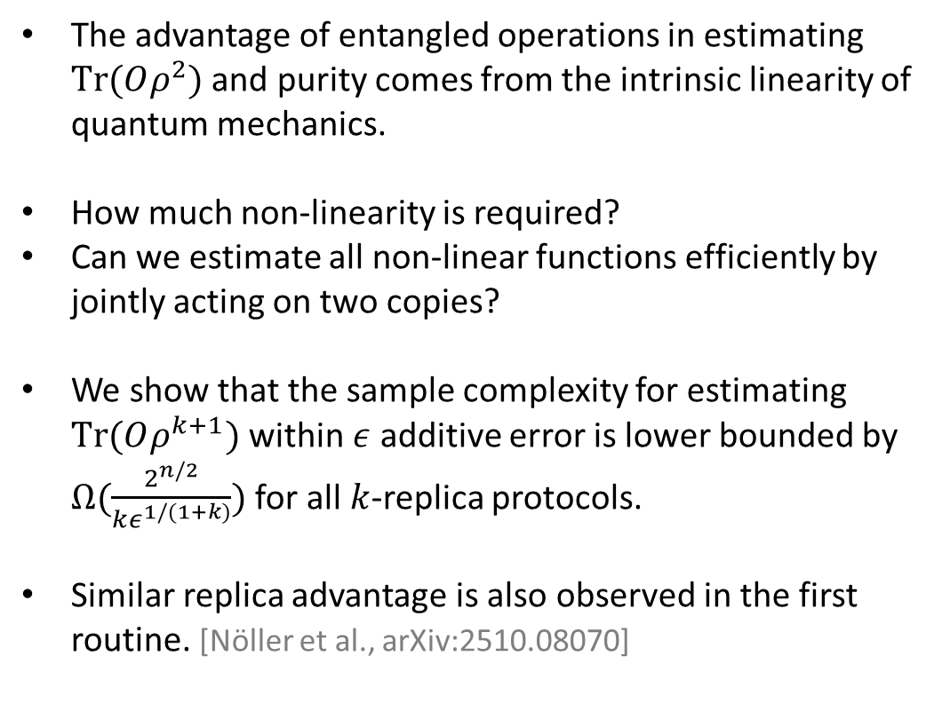
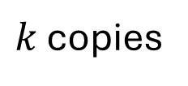
Replica Advantage
$$ρ$$
The advantage of entangled operations in estimating $Tr(Oρ^{2})$ and purity comes from the intrinsic linearity of quantum mechanics.
How much non-linearity is required?
Can we estimate all non-linear functions efficiently by jointly acting on two copies?
We show that the sample complexity for estimating $Tr(Oρ^{k+1})$ within $ε$ additive error is lower bounded by $Ω(\frac{2^{n/2}}{kε^{1/(1+k)}})$ for all $k$-replica protocols.
Similar replica advantage is also observed in the first routine. [Nöller et al., arXiv:2510.08070]
$$ρ$$
$k$ copies
$$ρ$$
$$v. s.$$
$$ρ$$
$$ρ$$
$k+1$ copies
$$ρ$$
arXiv:2509.24000

Slide 24
Conclusions and outlook
[Chen et al., FOCS 2024], [King et al., PRXQ 2024],
[Chen et al., PRA 2022], [Chen et al., arXiv:2412.19022],
[Chen et al., PRXQ 2025], [Huggins et al., PRL 2022]
of quantum state
of quantum channel
$$Tr\left(O_{i}ρ\right) ∀i∈\{1,…M\}$$
$$𝒫\left(ρ\right)=\sum_{i}{λ_{i}P_{i}ρP_{i}}$$
Learning
Many Linear Properties
Entangled operations
Ancillary qubits
Conjugate states $ρ^{∗}$
Adaptivity
State preparation oracle
Ancillary qubits
Coherent queries
Learning Nonlinear Properties
of quantum state
Purity
Pure dilation states
  No-purification theorem
  Random dilation
$Tr(Oρ^{2})$
$Tr(Oρ^{k+1})$
of quantum channel
Unitarity
Post-measurement state
A single linear quantity of quantum channel
arXiv:2410.17718
arXiv:2509.21111
arXiv:2509.24000
arXiv:2602.22126
PRX Quantum 7 (1), 010360
[Gong et al., arXiv:2410.12712], [Pelecanos et al., arXiv:2511.15806], [Tang et al., arXiv:2510.07622], [Chen et al., IEEE TIT 2024]
Notes:
OK! I also want to use this super messy slice to conclude my talk.
I have introduced five of my works to all of you.
In the first one, we propose the pure dilation state to be a very useful learning resource.
In this work, we give the fundamental limitation for all quantum purification tasks.
In this work, we give an optimal single-copy estimation protocol for xxx
In this work, we prove that k+1 copy access has exponential advantage compared with k copy access.
In quantum channel learning, we propose that post-measurement state is a very useful resource.
About outlook, we are now trying to answer a question:

Slide 25
References
Liu Z, Gong W, Du Z, et al. arXiv preprint arXiv:2410.17718, 2024.
Liu Z, Du Z, Cai Z, et al. arXiv preprint arXiv:2509.21111, 2025.
Ye Q, Liu Z, Deng D L. arXiv preprint arXiv:2509.24000, 2025.
Liu Z, Ye Q, Cai Z, et al. arXiv preprint arXiv:2602.22126, 2026.
Du Z, Tang Y, Elben A, et al. PRX Quantum, 2026, 7(1): 010360.
Acharya J, Dharmavarapu A, Liu Y, et al. Proceedings of the 57th Annual ACM Symposium on Theory of Computing. 2025: 718-729.
Cotler J, Gong W, Kannan I. Noisy Quantum Learning Theory[J]. arXiv preprint arXiv:2512.10929, 2025.
Huang H Y, Tong Y, Fang D, et al. Physical Review Letters, 2023, 130(20): 200403.
Aharonov D, Cotler J, Qi X L. Quantum algorithmic measurement[J]. Nature communications, 2022, 13(1): 887.
Chen S, Cotler J, Huang H Y, et al. 2021 IEEE 62nd Annual Symposium on Foundations of Computer Science (FOCS). IEEE, 2022: 574-585.
Huang H Y, Kueng R, Preskill J. Nature Physics, 2020, 16(10): 1050-1057.
Elben A, Flammia S T, Huang H Y, et al. Nature Reviews Physics, 2023, 5(1): 9-24.
Chen S, Gong W, Ye Q. 2024 IEEE 65th Annual Symposium on Foundations of Computer Science (FOCS). IEEE, 2024: 1086-1105.
King R, Wan K, McClean J R. PRX Quantum, 2024, 5(4): 040301.
Chen S, Zhou S, Seif A, et al. Physical Review A, 2022, 105(3): 032435.
Chen S, Oh C, Zhou S, et al. Physical Review Letters, 2024, 132(18): 180805.
Chen S, Gong W. PRX Quantum, 2025, 6(2): 020323.
Gong W, Haferkamp J, Ye Q, et al. arXiv preprint arXiv:2410.12712, 2024.
Pelecanos A, Spilecki J, Tang E, et al. arXiv preprint arXiv:2511.15806, 2025.
Tang E, Wright J, Zhandry M. arXiv preprint arXiv:2510.07622, 2025.
Chen K, Wang Q, Long P, et al. IEEE Transactions on Information Theory, 2023, 69(8): 5116-5134.

Slide 26
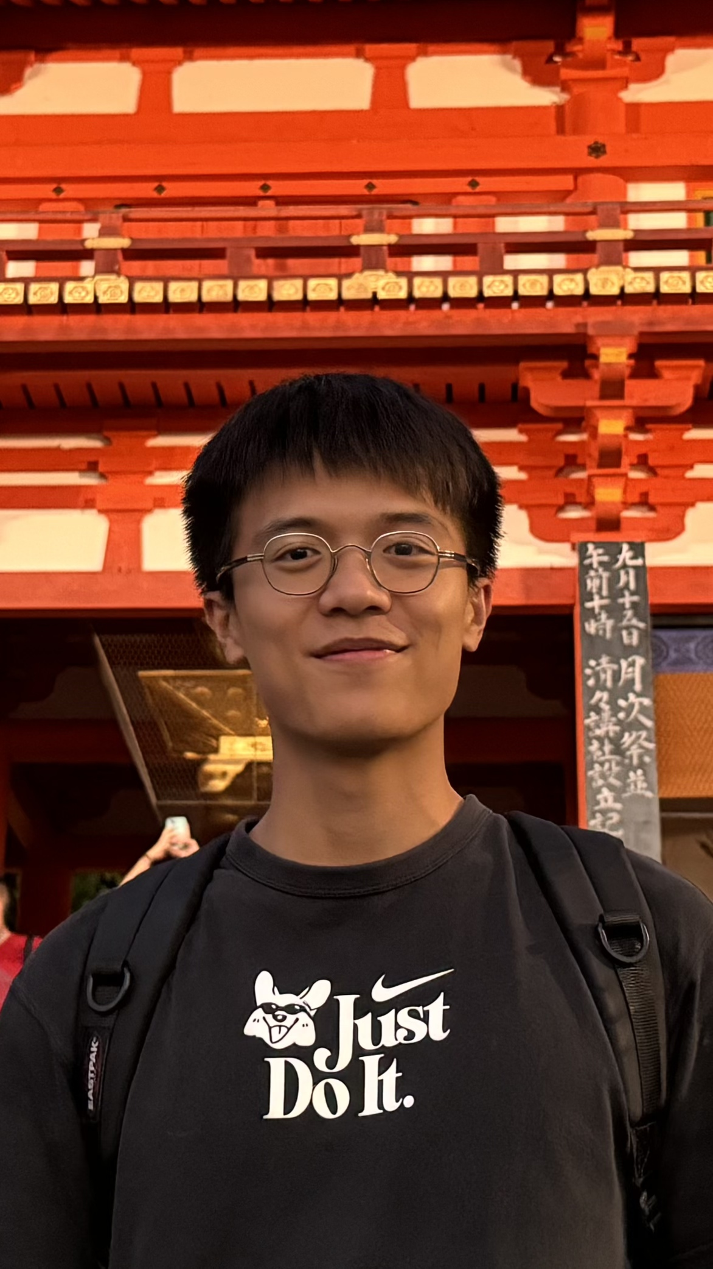
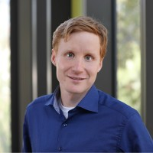
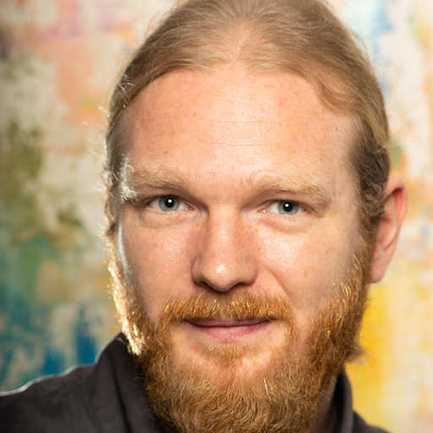
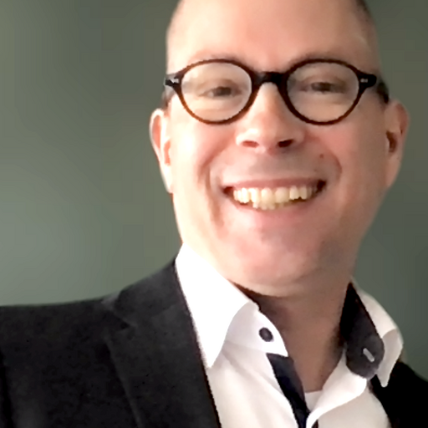

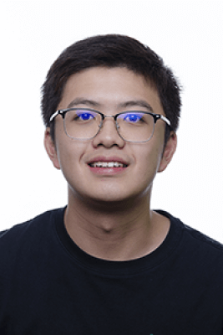

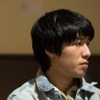

Thank you!
Zhenyu Du
Andreas Elben
Ingo Roth
Jens Eisert
Tsinghua University
Paul Scherrer Institute
TII
FU Berlin
Qi Ye
Zi-Wen Liu
Zhenyu Cai
Dongling Deng
Weiyuan Gong
Tsinghua University
Tsinghua University
Oxford University
Tsinghua University
Harvard University

Slide 27



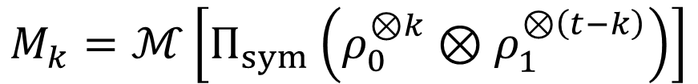

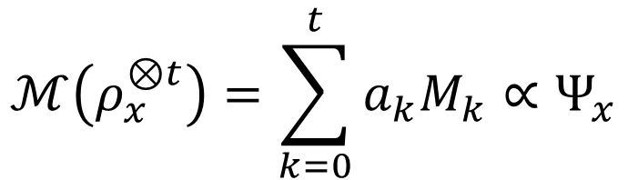
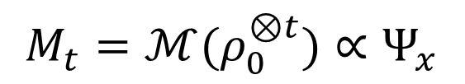
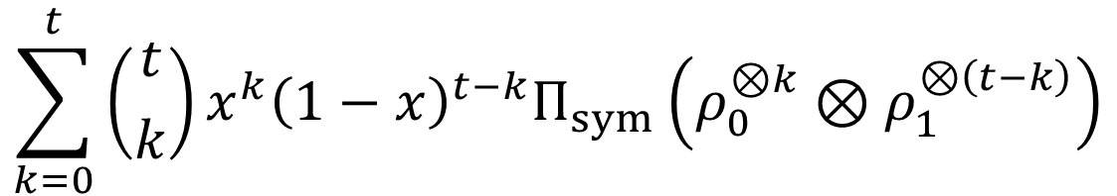


Proof
$$ℳ\left(ρ_{x}^{⊗t}\right)=\sum_{k=0}^{t}{a_{k}M_{k}}∝Ψ_{x}$$
$$ρ_{x}=xρ_{0}+\left(1−x\right)ρ_{1}$$
$$a_{k}≥0 M_{k}≥0$$
$$ℳ\left(ρ_{x}^{⊗t}\right)=ℳ\left[{\left(xρ_{0}+\left(1−x\right)ρ_{1}\right)}^{⊗t}\right]∝Ψ_{x}$$
Positivity
Linearity
$$\sum_{k=0}^{t}{\left({t \atop k}\right)x^{k}{\left(1−x\right)}^{t−k}Π_{sym}\left(ρ_{0}^{⊗k}⊗ρ_{1}^{⊗\left(t−k\right)}\right)}$$
$$M_{k}∝Ψ_{x}$$
$$M_{0}=ℳ(ρ_{1}^{⊗t})∝Ψ_{x}$$
$$a_{k}=\left({t \atop k}\right)x^{k}{\left(1−x\right)}^{t−k}$$
$$M_{t}=ℳ(ρ_{0}^{⊗t})∝Ψ_{x}$$
$$M_{k}=ℳ\left[Π_{sym}\left(ρ_{0}^{⊗k}⊗ρ_{1}^{⊗\left(t−k\right)}\right)\right]$$
$$ℳ(ρ^{⊗t})∝Ψ$$
Notes:
The proof is very simple, please follow me.
I promise this is the only page in this talk you need to use your brain.
So, from this proof, you can notice that the only properties we use of quantum mechanics is the linearity and positivity.

Slide 28
$ℳ\left(ρ^{⊗t}\right)=\frac{1}{2}𝔼[ψ_{\hat{f}}]$ $\left|ψ_{\hat{f}}\right\rangle =\frac{1}{\sqrt{2}}(|0⟩+e^{i\hat{f}}|1⟩)$

Slide 29

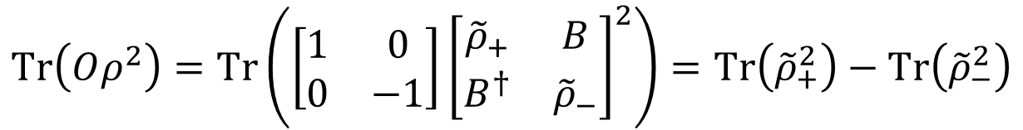



Observable-driven RM (ORM)
Goal: design a RM protocol for $Tr\left(Oρ^{2}\right)$ using only $𝒪\left(\sqrt{d}\right)$ copies
consider dichotomic observable $O$: eigenvalues $±1$
write $ρ$ in $O$’s eigenbasis: $ρ=\left[\begin{matrix}{\tilde{ρ}}_{+} & B \\ B^{†} & {\tilde{ρ}}_{−}\end{matrix}\right]$
How to extract information in each eigenspace?
block-diagonal unitary + post-processing
key observation:
knowledge of $O$ $⇒$ observable-driven
$$Tr\left(Oρ^{2}\right)=Tr\left(\left[\begin{matrix}1 & 0 \\ 0 & −1\end{matrix}\right]{\left[\begin{matrix}{\tilde{ρ}}_{+} & B \\ B^{†} & {\tilde{ρ}}_{−}\end{matrix}\right]}^{2}\right)=Tr\left({\tilde{ρ}}_{+}^{2}\right)−Tr\left({\tilde{ρ}}_{−}^{2}\right)$$
difference of “purities” projected to eigenspaces
purity RM is optimal: requires $𝒪\left(\sqrt{d}\right)$ copies
$$⇒$$
ORM should also require only $𝒪\left(\sqrt{d}\right)$ copies
Science 364, 260 (2019)

Slide 30










Observable-driven RM (ORM)
Goal: design a RM protocol for $Tr\left(Oρ^{2}\right)$ using only $𝒪\left(\sqrt{d}\right)$ copies
consider dichotomic observable $O$: eigenvalues $±1$
write $ρ$ in $O$’s eigenbasis: $ρ=\left[\begin{matrix}{\tilde{ρ}}_{+} & B \\ B^{†} & {\tilde{ρ}}_{−}\end{matrix}\right]$
How to extract information in each eigenspace?
block-diagonal unitary + post-processing
knowledge of $O$ $⇒$ observable-driven
draw $N_{U}$ random unitaries
measure $N_{M}$ times for each unitary
$${\left\{{\vec{s_{i}}}^{\left(u\right)}\right\}}_{i=1, u=1}^{N_{M}, N_{U}}$$
$$Tr(Oρ^{2})$$

Slide 31
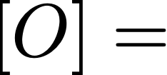



Observable-driven RM (ORM)
Goal: design a RM protocol for $Tr\left(Oρ^{2}\right)$ using only $𝒪\left(\sqrt{d}\right)$ copies
a general observable $O$: dichotomic decomposition
$$O=O_{1}+O_{2}+O_{3}+⋯$$
up to a residual term with small norm
for each $O_{l}$
draw $N_{U}$ random unitaries
measure $N_{M}$ times for each unitary
$${\left\{{\vec{s_{i}}}^{\left(u\right)}\right\}}_{i=1, u=1}^{N_{M}, N_{U}}$$
$$Tr(Oρ^{2})$$

Slide 32
Objective
Classical Simulation
This Talk
Quantum
Quantum
Tool
Classical
Classical ML
Classical
Quantum ML
Notes:
According to the different objectives and tools, learning tasks can be divided roughly into four different types.
If xxx

