Slide 1
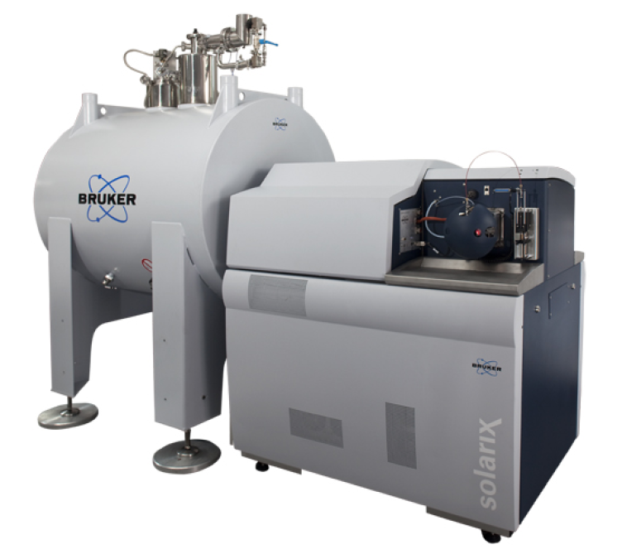
Advanced Mass Spectrometry at Warwick
Prof. Peter O’Connor and Dr. Mark Barrow
FTICR: Extremely high resolution (>5M RP), and exact mass analysis (<0.1 ppm)
Ionisation: ESI, nESI, LC-MS, nLC-MS, APCI, APPI, MALDI
Tandem MS: CID, IRMPD, UVPD (193, 213, and 266 nm), ECD, EID, ETD, EDD,
UV-VIS PDS (220-450 nm)
MS/MS, MS^{n}, 2DMS, MS/2DMS
Molecules: Top-down protein analysis, Bottom up peptide analysis, proteomics, post-translational modifications, polymers, polymer-peptide conjugates, glycans, glycosaminoglycans, DNA, RNA, and small molecules.
Mass spectrometry and ion optic instrument development.
Email: p.oconnor@Warwick.ac.uk
Email: m.p.barrow@Warwick.ac.uk (petroleum and environmental)

Slide 2
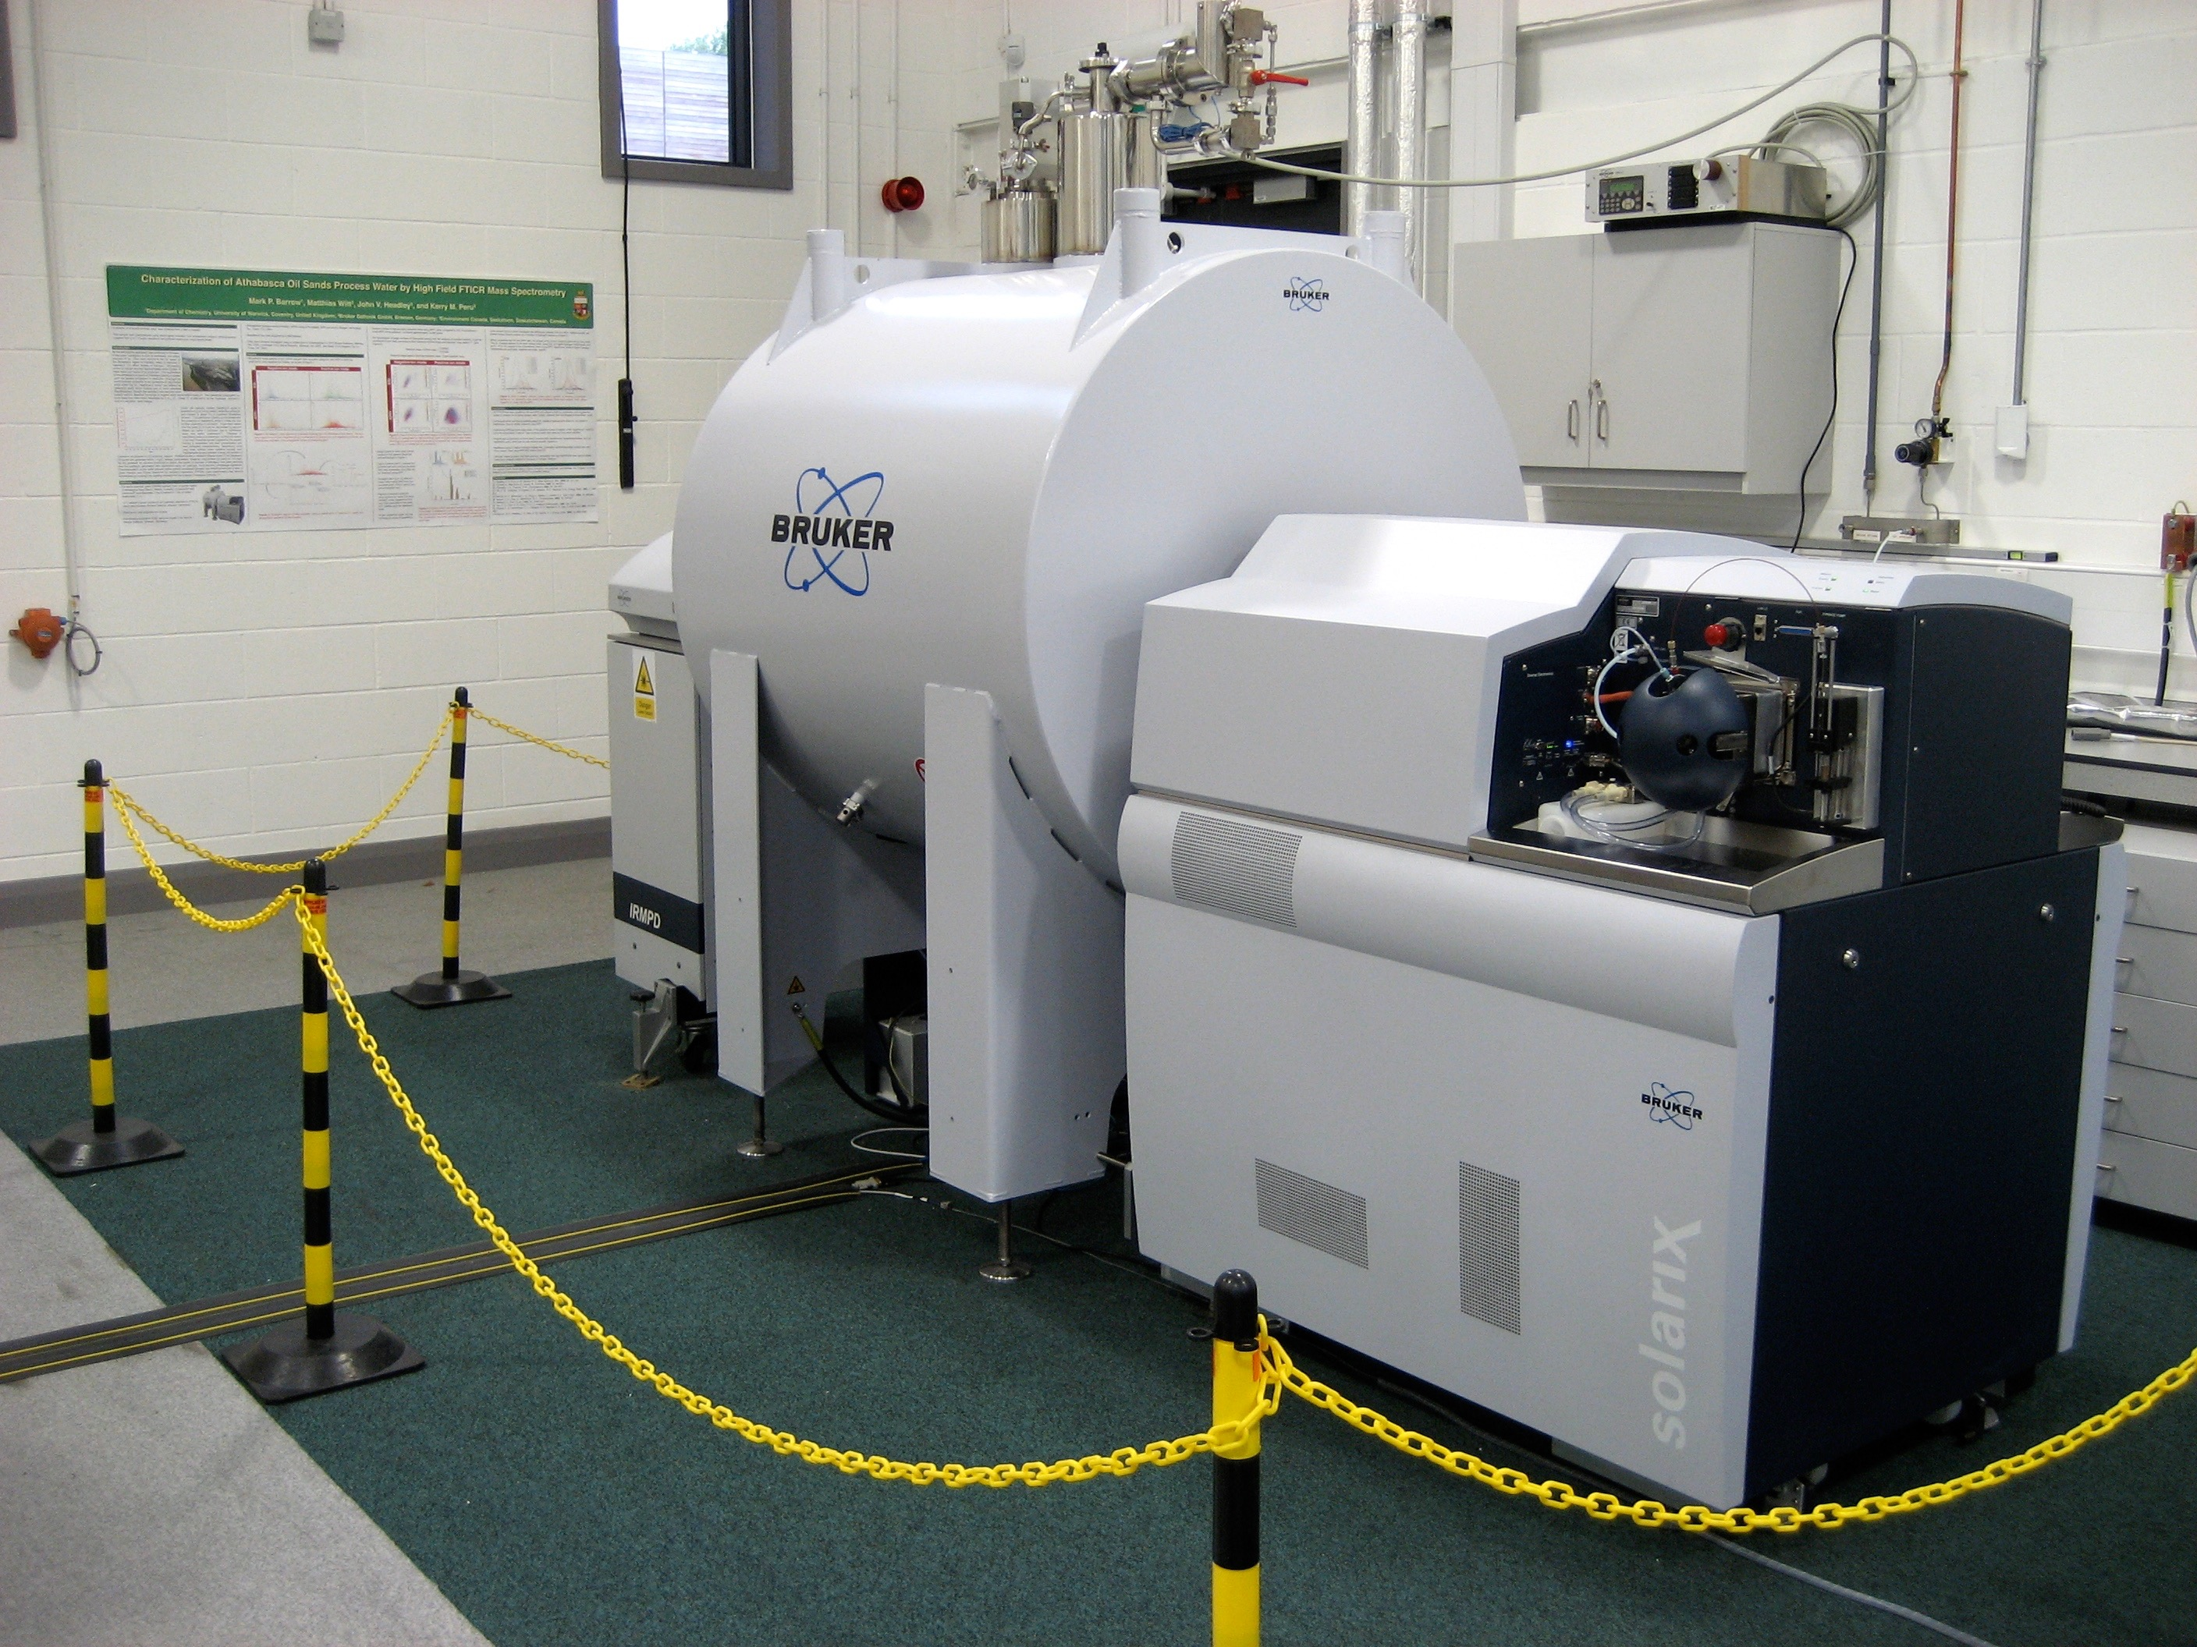

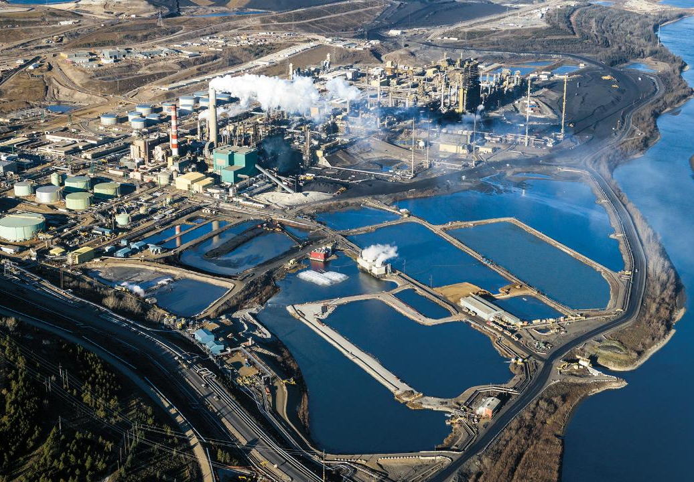
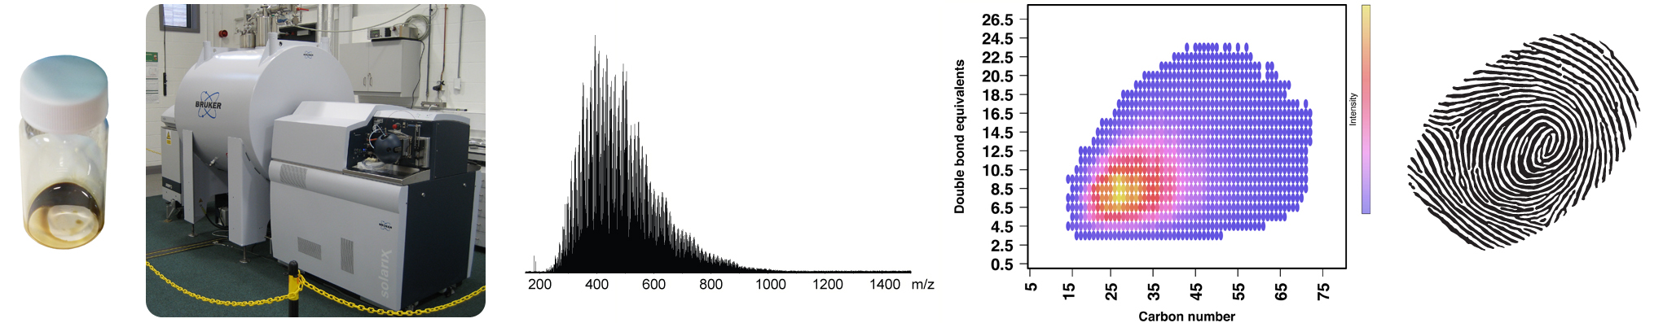
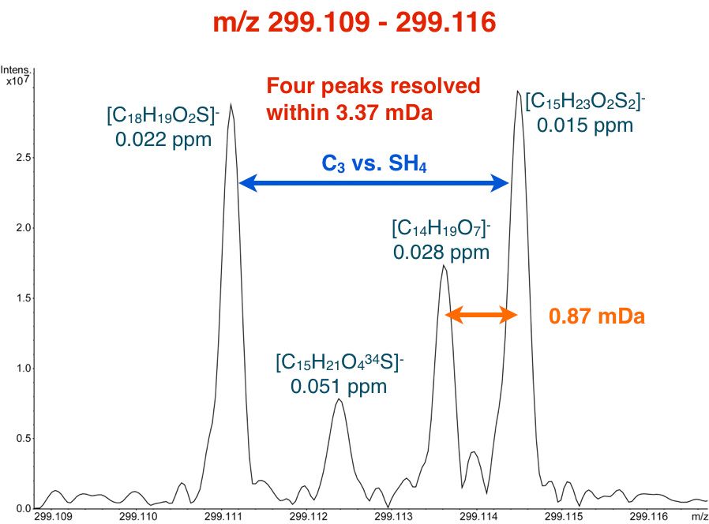
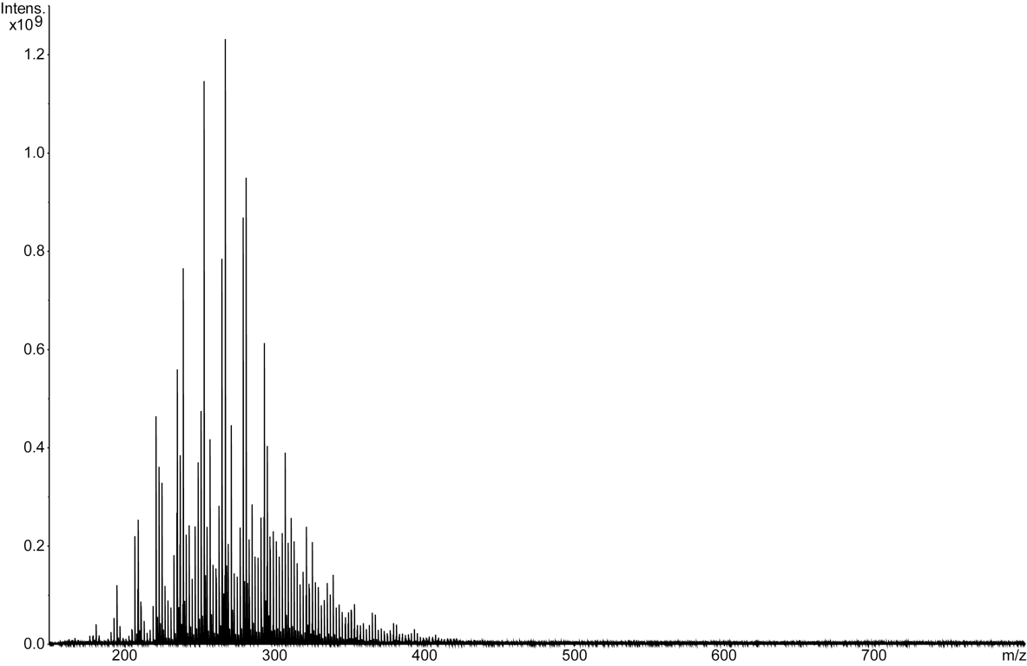
Dr. Mark P. Barrow, Department of Chemistry
Fourier transform ion cyclotron resonance (FTICR) mass spectrometry:
Ultrahigh resolution and mass accuracy
Range of ionization methods (e.g. ESI, APPI, APCI, MALDI/LDI, LTP)
Couple with chromatography (e.g. LC or GC)
MS/MS methods (e.g. CID, EID, IRMPD)
Characterization of highly complex mixtures
Examples of research interests:
Petroleum-related samples
Biofuels/bio-oils
Environmental samples
Archaeological samples
Sample preparation and ionization
Data processing and analysis, including new software
Collaborations include:
Industry (e.g. petrochemical industry)
Environment and Climate Change Canada
British Geological Survey
British Museum
Academic researchers worldwide (Australia, Brazil, Canada, Colombia, Germany, Mexico, South Korea, Sweden, Venezuela, UK, USA)

Slide 3
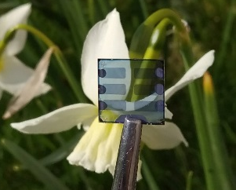
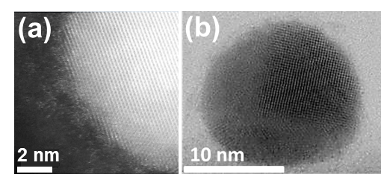
Hatton Group (Chemistry)
Functional thin films & nanoparticles
Nano-structured/patterned metal films
Amorphous semiconducting oxides
Narrow band-gap perovskite semiconductors
Copper nanoparticles
Photovoltaic devices

Slide 4
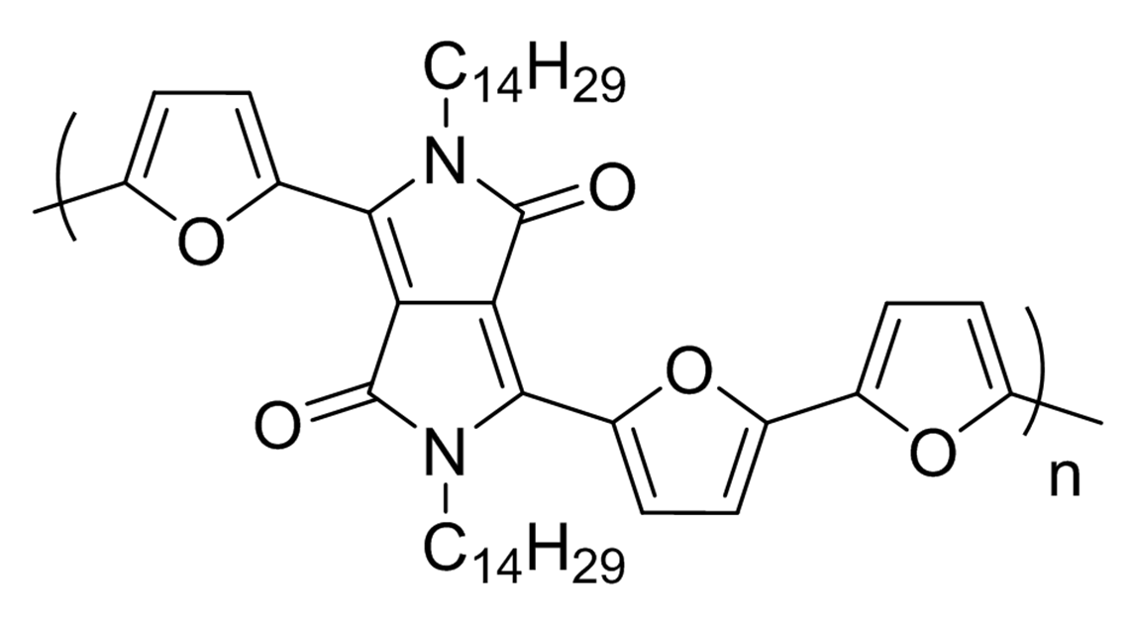
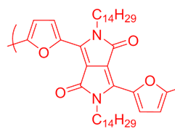
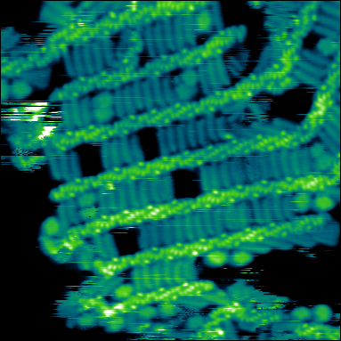
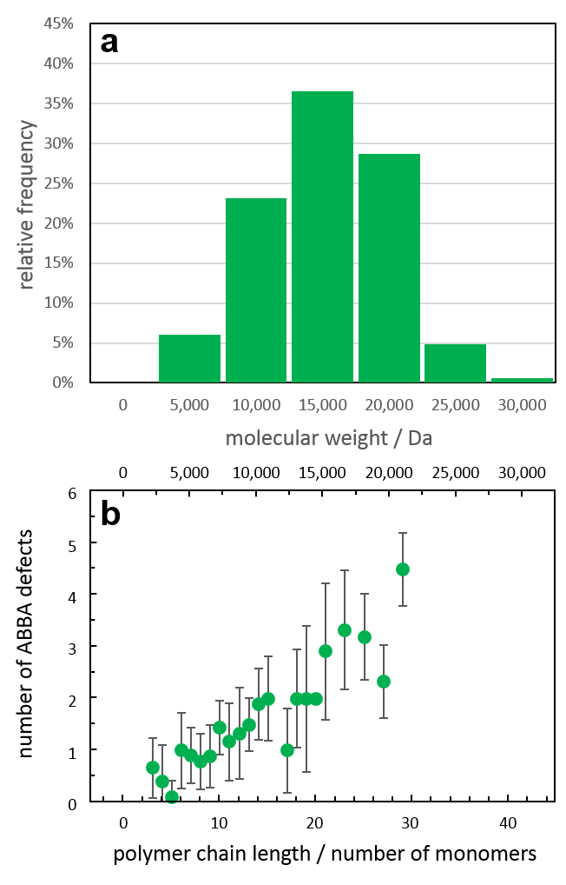
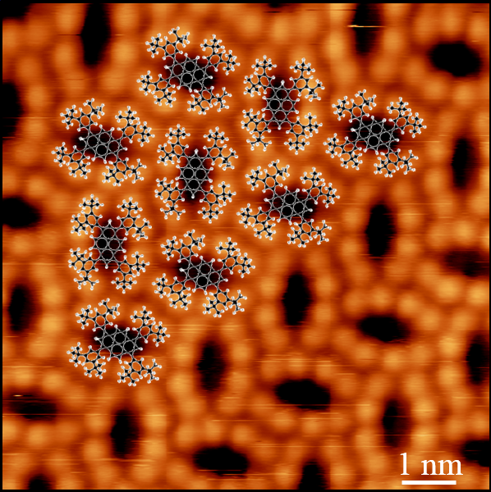
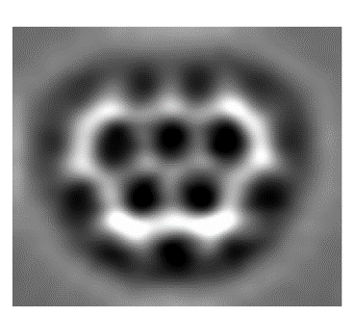
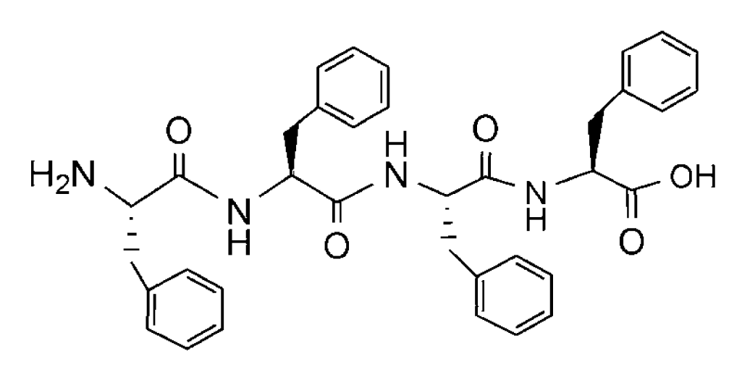
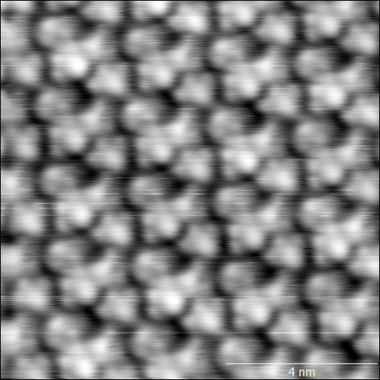
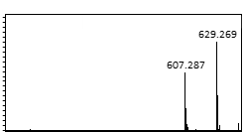
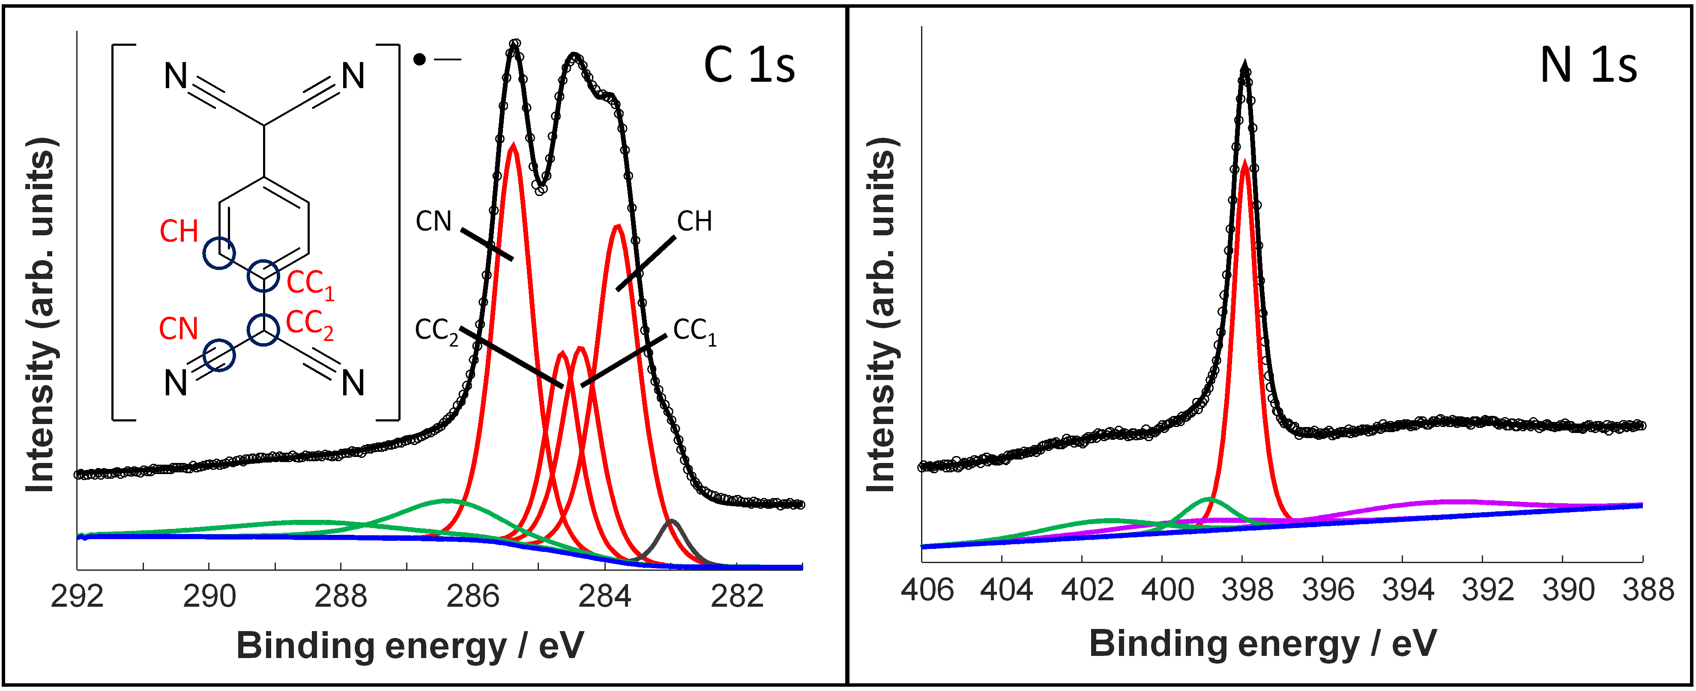
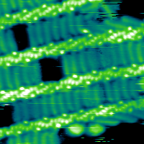
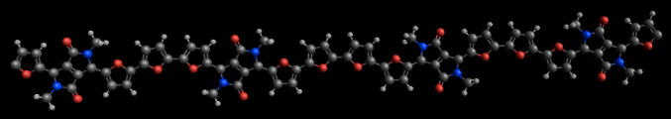
Costantini Lab: molecular-scale surface analytics
4 STM instruments
Conjugated Polymer Analytics
2 ESI-deposition setups
XPS-UPS- ARPES
Synchrotron
A B
2 nm
B
A
B
B
A
B
A
1 nm
A

Slide 5
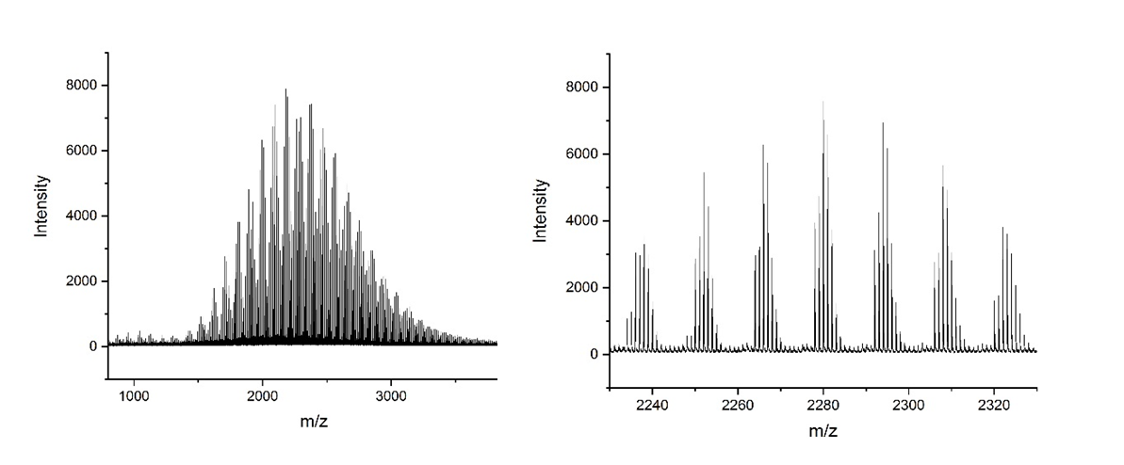
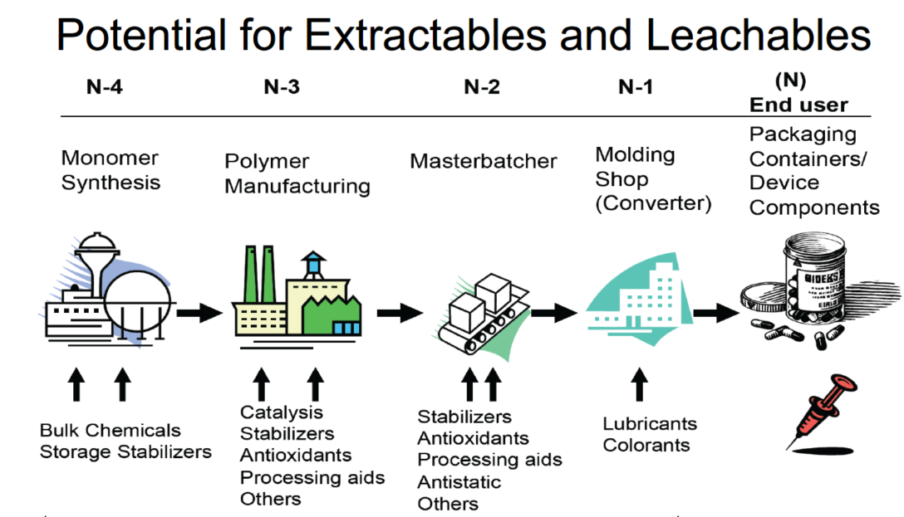
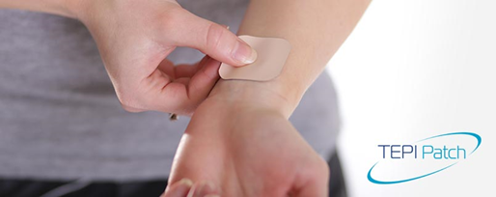
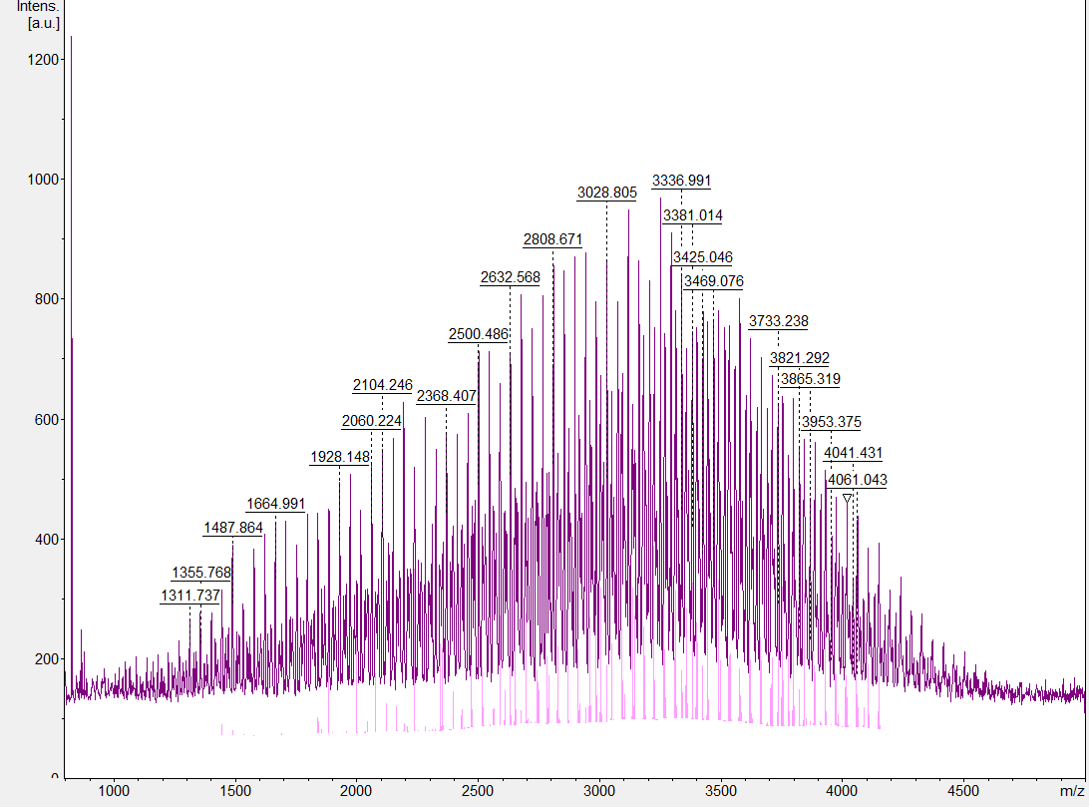
David Haddleton – Polymer Analysis
Tandem Mass Spectrometry Techniques for Copolymer Analysis
Extractables and Leachables
KMD plots
Validation methods with calibration curves are required for different species developed for both GC and LC. In addition we will need to look at the extractable and leachable metals with HPLC, LC, LC-MS, ICP and ICP MS.
Suitable for students who enjoys working as part of a vibrant team and is looking for a future in the pharmaceutical industry.

Slide 6
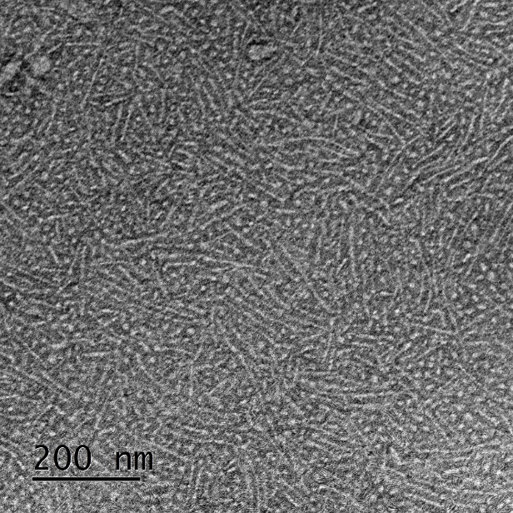
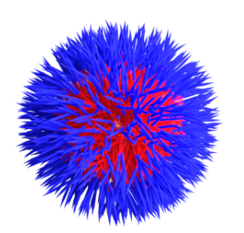
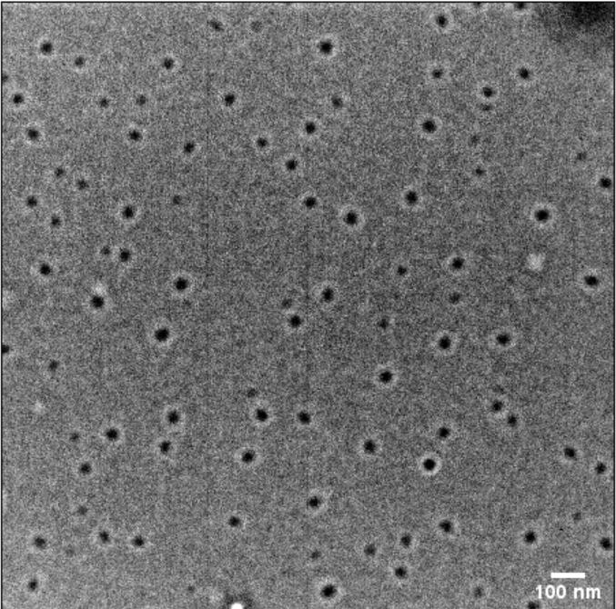
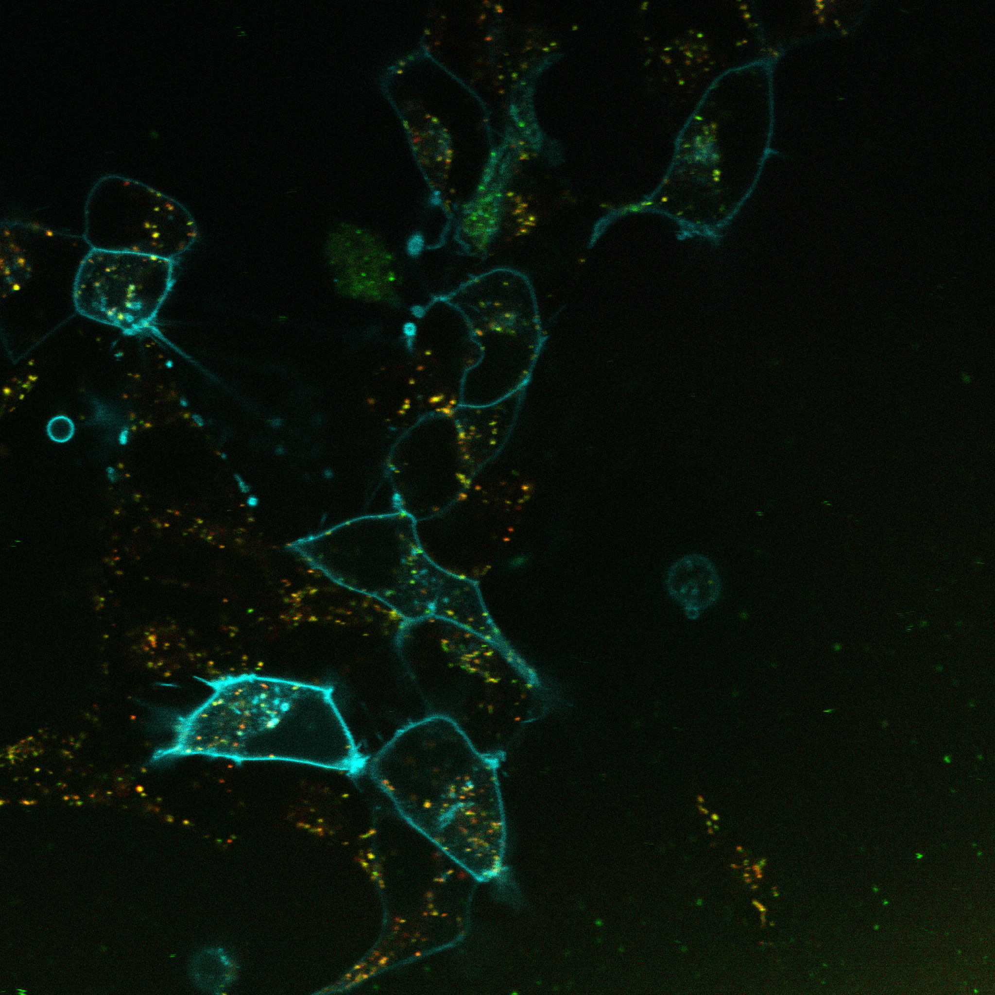
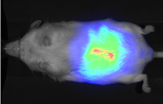
Polymer and nanoparticle Synthesis and Analysis
Prof Seb Perrier
s.perrier@warwick.ac.uk
Nanoparticles for:
Drug delivery
Encapsulation
Coating
Polymers for:
Protein conjugates
Drug delivery
Antiobiotics
Viscosity modifiers
Personal care
Labs in Chemistry and Medical School
Techniques we use:
Chemistry / Materials:
Scattering: Light, X-Ray, Neutron
Chromatography: HPLC (6 HPLC’s), GC (2 GC’s), GPC (RTP Polymer Characterisation), Field Flow Chromatography
Spectroscopy: UV, IR, Fluorescent, NMR, Mass Spec, etc
Quartz Crystal Microbalance
AFM, TEM, SEM
Biology:
Peptide synthesis
Cell culture
Toxicity
MIC
In vivo Imaging

Slide 7
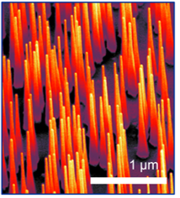
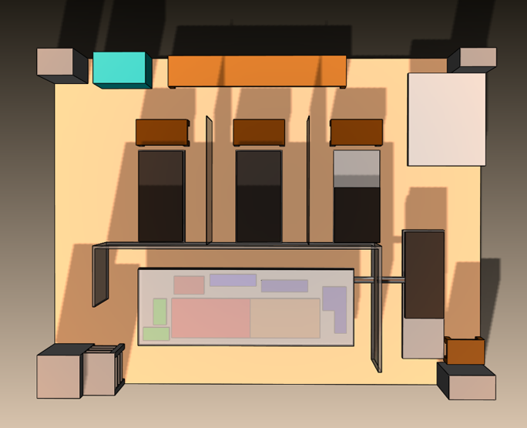
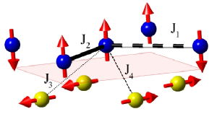
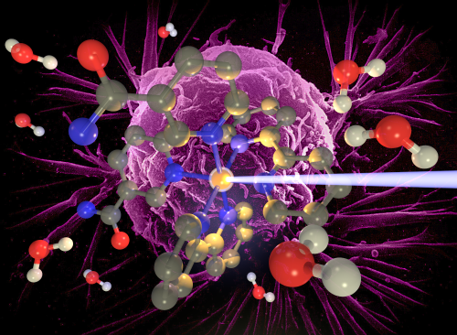
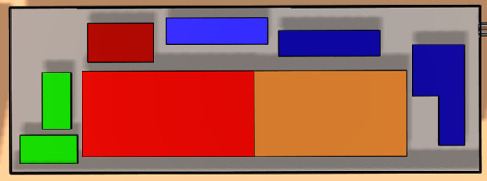


Warwick Centre for Ultrafast Spectroscopy (WCUS)
Semiconductors & nanomaterials
Charge transport Charge trapping Electron mobility
James Lloyd-Hughes
SS
Quantum Materials
Multiferroicity
Magnetoresistance
Defect complexes
BL 1
BL 2
BL 3
Lasers & Medicine
Prodrugs
Nanomedicine
Fluorescent probes
BL 4
Workhorse laser
Vas Stavros
Photostability & photocatalysis
UVA/B filters
Herbicides/pesticides
Cage/host complexes
go.warwick.ac.uk/WCUS

Slide 8
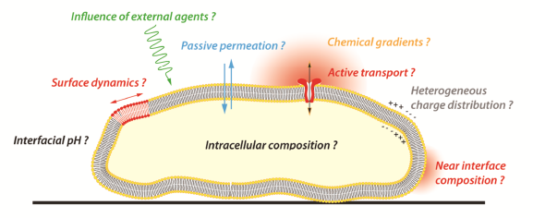
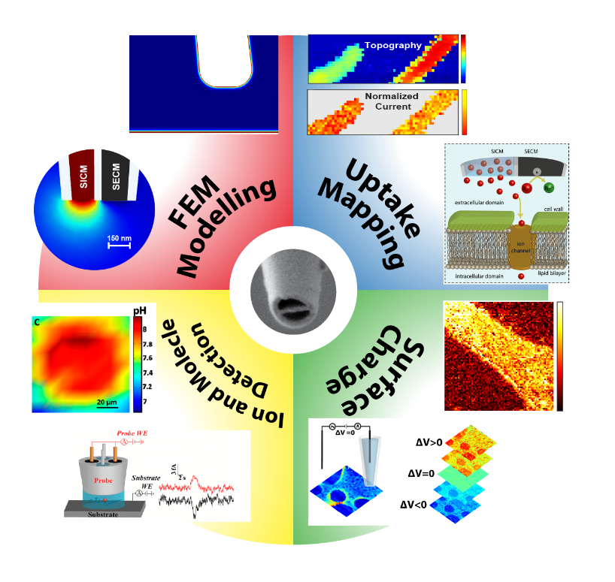
Warwick Electrochemistry & Interfaces Group: Correlative Nanoscale Multifunctional Imaging (Pat Unwin)
“Lab-On-A-Tip” for single cells
Bentley, C. L.; Kang, M.; Unwin, P. R., J. Am. Chem. Soc., 2019, 141, 2179-2193.
Applications:
• Electrocatalysis • Corrosion • Batteries • Sensors

Slide 9
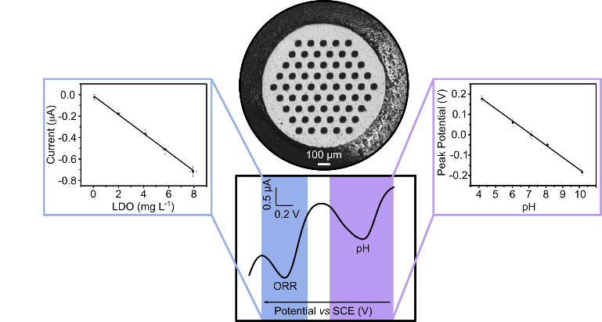
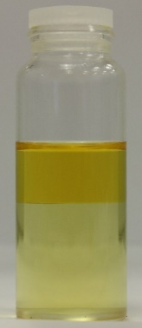
Electrochemical Sensor and Analytical Measurement Development
Based on synthetic boron doped diamond electrodes (robustness, longevity, stability)
Environmental Monitoring
– e.g. heavy metal, pH, free chlorine, conductivity + others, new methods of signal analysis
Medical Monitoring
– e.g. oxygen, pH, temperature sensing +others in biological fluids (in-vitro and in-vivo)
Industrial Collaboration
– many of the technologies developed in partnership with industry
New Substrates for Transmission Electron Microscopy Imaging of Supported Nanostructures
- BDD substrates offering greater stability, robustness
Metal Recovery
– heavy metal removal and recycling in reaction streams
from solution to removal on the electrode
Technologies applicable to a wide range of species detection,
contact: Prof. Julie Macpherson (j.macpherson@warwick.ac.uk)

