Slide 1
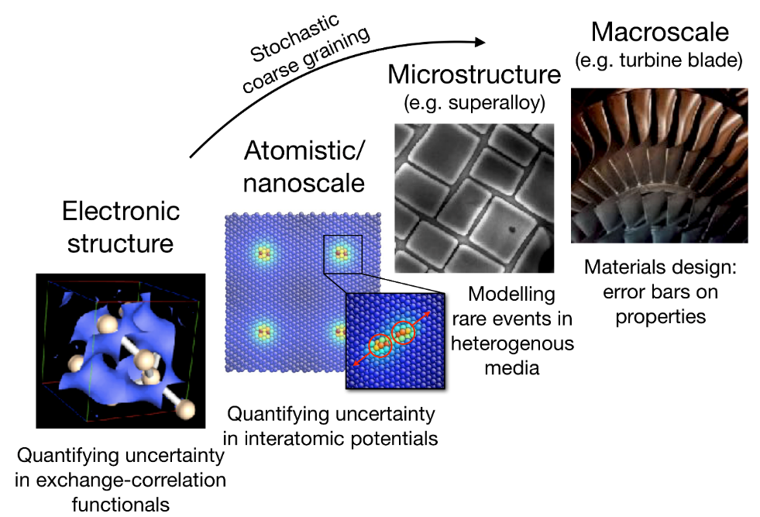
EPSRC CDT in Modelling of Heterogeneous Systems
HetSys CDT at Warwick launching Oct ‘19
Mathematical skills and flexible thinking for complex problems.
Advance computational modelling applied to e.g. devices, catalysts, superalloys, smart fluids, laser-plasma interactions.
Success based on students inspiring new ideas, innovations and going on to become research and technology leaders.
Cross discipline barriers, integrating modelling approaches
Asses reliability of results – uncertainty quantification
Emphasise robust, sustainable software development
Co-creation events with industrial and academic partners each Sept and January
Contact Prof. Julie Staunton or Dr James Kermode via hetsys@warwick.ac.uk
HetSys launch event on campus 9th -10th September – contact us to sign up!
www.warwick.ac.uk/HetSys
Notes:
lots of modelling going across Science Faculty on full wide range of lengths scales
and “full spectrum” from method development to applications. Listed permanent academic staff.
organised into a number of cross-cutting themes and communities, inc. WCPM
Based in Engineering dept, but linking across Science and beyond - one of Warwick’s strengths…

