Slide 1
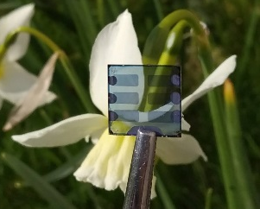
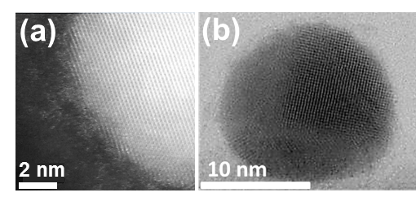
Hatton Group (Chemistry)
Functional thin films & nanoparticles
Nano-structured/patterned metal films
Amorphous semiconducting oxides
Narrow band-gap perovskite semiconductors
Copper nanoparticles
Photovoltaic devices

