Slide 1

Modelling and Simulation at Warwick
Chemistry
Scott Habershon
Becky Notman
Reinhard Maurer
Gabriele Sosso
Physics
Gareth Alexander
Animesh Datta
Nicholas Hine
David Quigley
Julie Staunton
Rudo Roemer
Mathematics
Thomas Hudson
Christoph Ortner
James Sprittles
Florian Theil
Engineering
Peter Brommer
James Kermode
Igor Khovanov
Neophytos Neophytou
Nigel Stocks
Duncan Lockerby
Yongmann Chung
Bob Kerr
WMG
Michael Auinger
Lukasz Figiel
Centre for Scientific Computing
(CSC)
EPSRC CDT in Modelling of Heterogenous Systems
Warwick Centre for Predictive Modelling
(WCPM)
Full spectrum of modellers at Warwick,
from mathematics to manufacturing
www.warwick.ac.uk/HetSys

Slide 2
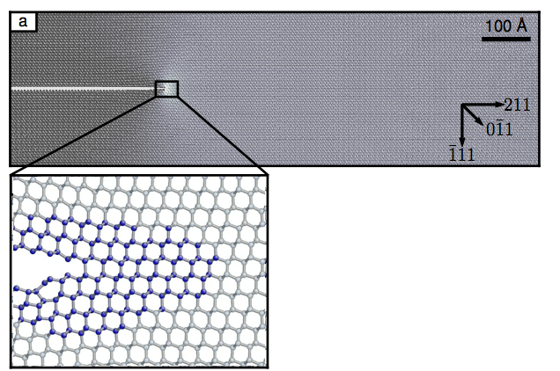
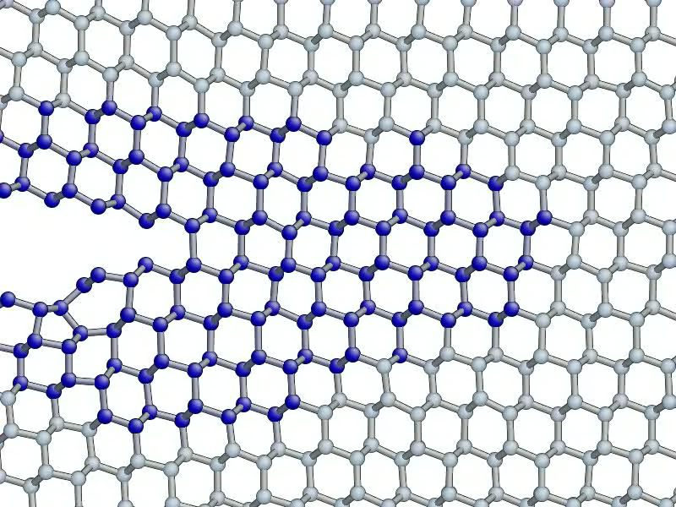
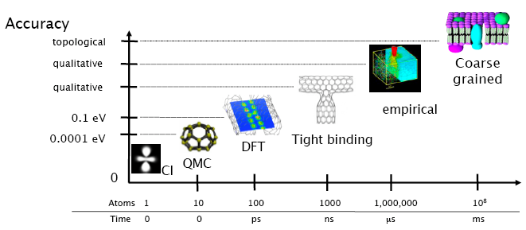
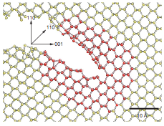
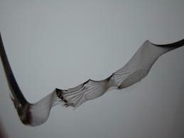

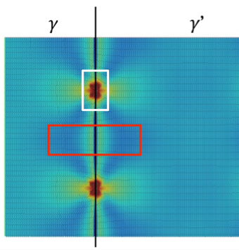
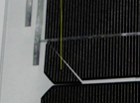
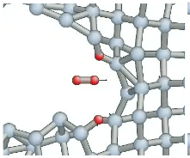
Concurrent Multiscale Materials Modelling
www.warwick.ac.uk/jrkermode
Simultaneous coupling:
the ‘Learn on the Fly’ scheme
Molecular Mechanics
(empirical, fast)‏
Quantum Mechanics
(accurate, slow)‏
JR Kermode et. al. Nature (2008)
A Gleizer et al.,
Phys. Rev. Lett
(2014)
F Bianchini et al.,
Phys Rev Mat (2019)
Notes:
Personally, I’m also interested in concurrent multiscale modelling
bidirectional coupling between long-range stress field and chemical breaking of individual bonds.
’Learn on the Fly’ (LOTF) is an approach that allows accurate QM/MM for materials
Applied to range of problems in ceramics, oxides and metals

Slide 3

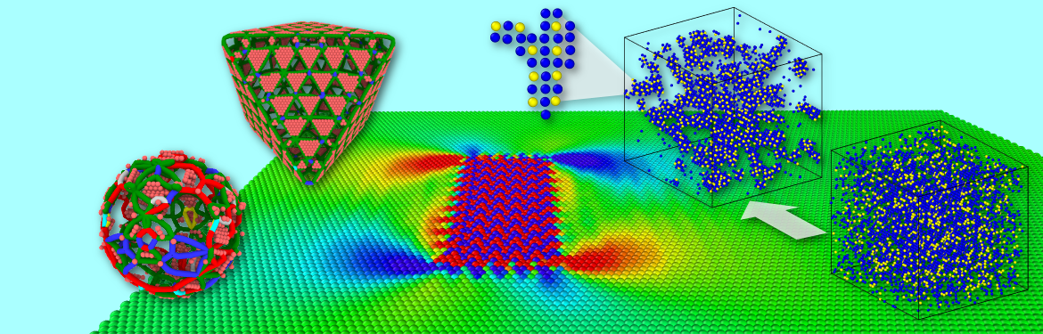
Sequential Multiscale Materials Modelling
www.warwick.ac.uk/pbrommer
Parameterise (fast) classical potentials from ab-initio data.
Propagate uncertainty to QoI.
Efficient and flexible force field optimisation code potfit
(www.potfit.net) with UQ
layer.
Compatible with standard DFT and MD codes.
Brommer et al., MSMSE (2015)
Longbottom & Brommer, MSMSE (2019)
Long-time defect evolution with KMC
Find barriers separating states using open-ended search method ART.
Evolve system over “experimental” time scales (ms…s) from state to state using adaptive KMC code kART.
Application in project: Ageing in precipitation-hardened alloys.
Beland et al., Phys. Rev. E (2011)
Brommer et al., Phys. Rev B (2014)
Notes:
My focus is on sequential multiscaling: How can you extract information and uncertainty from DFT level to atomistic simulations.
Fast force fields with optional uncertainty quantification.
Also: Long-time evolution using kinetic Monte Carlo.

