Slide 1
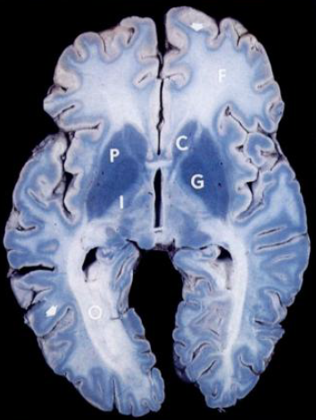
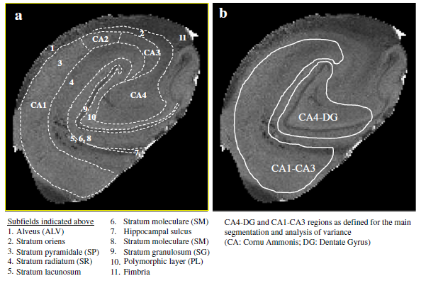
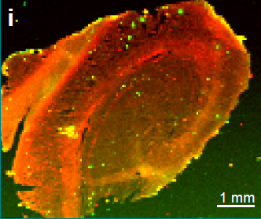
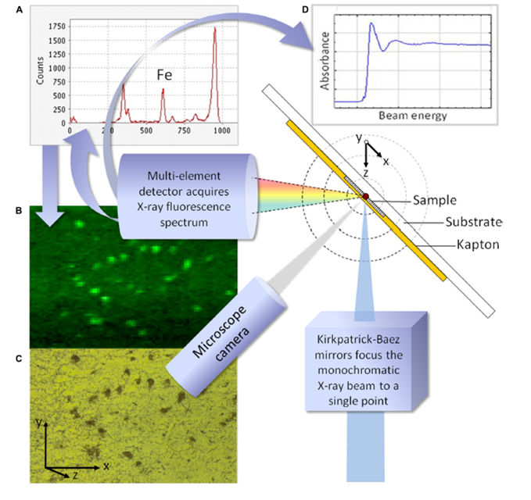
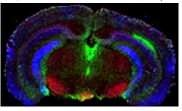
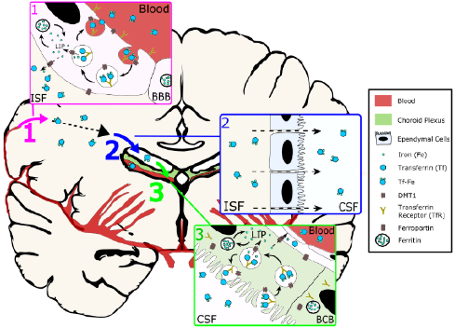
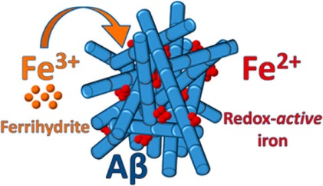
Dr Joanna Collingwood, School of Engineering, Trace Metals in Medicine Laboratory
There are disease-specific changes in concentration distributions of metals
Analytical challenge: sensitivity and specificity of synchrotron X-ray microscopy
Metals are essential to normal metabolism.
Metal chemistry is affected in the presence of peptide aggregation
Computational modelling: to explore dynamics of metal ion metabolism

