Slide 1
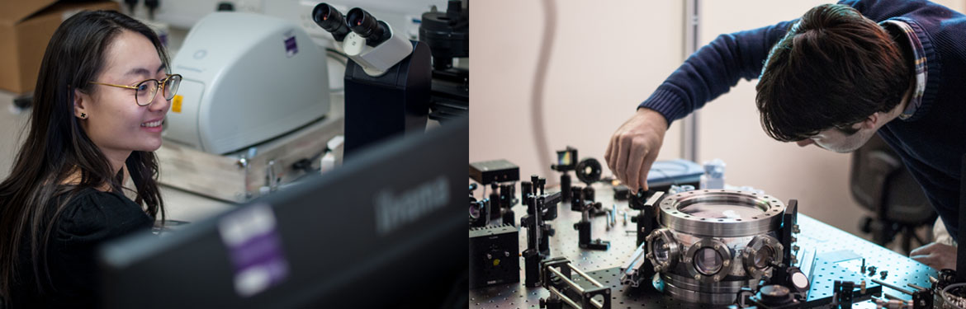
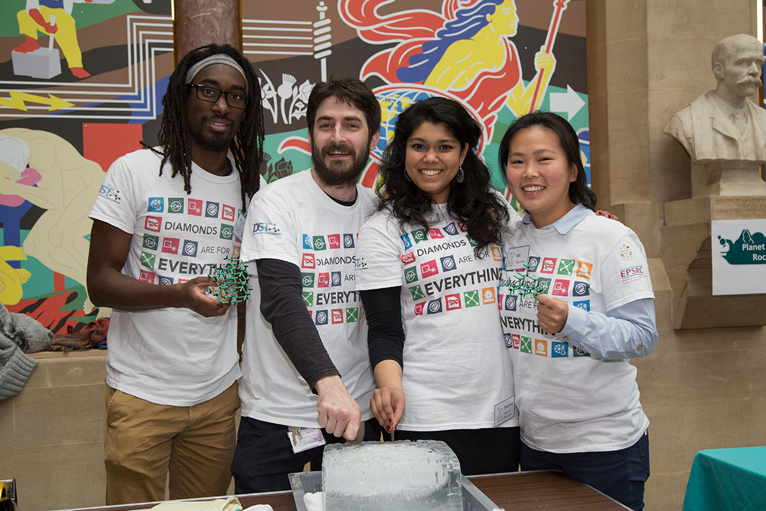
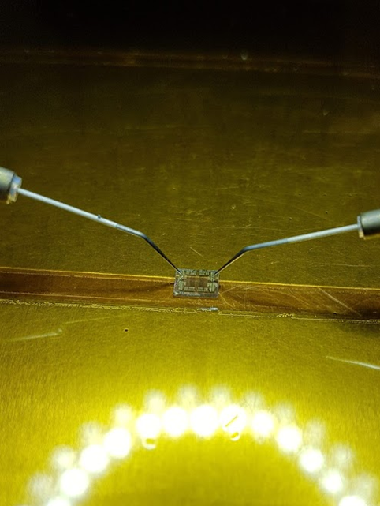
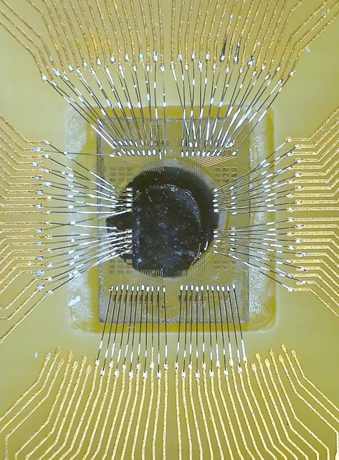
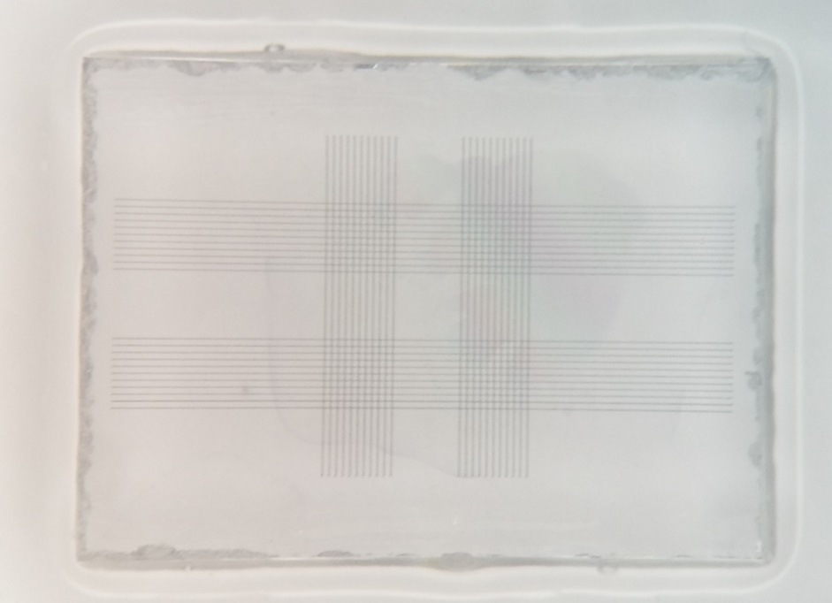
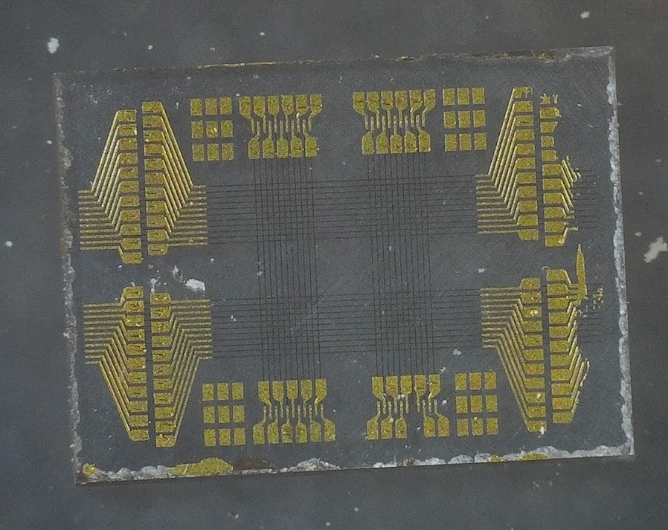






Centre for Doctoral Training in Diamond Science & Technology
Measurement and Sensing
Quantum Science and Technologies
Optics and Photonics
Manufacturing
Electronics and Devices
Theory and Computation
Medical, Biophysics and Biochemistry
Co-funding of PhD’s with industry
Pilot/Scoping Research Projects
Industrial Contract R&D and Manufacturing
Collaborative R&D
UK Network – synthesis through to devices
Contact: DST.Admin@warwick.ac.uk

