Slide 1

CDT External Partner Day
Superconductivity and Magnetism Group
Monday 13th May 2019 / Senate House

Slide 2
Superconductivity and Magnetism: Research Techniques
synthesis of polycrystalline and single crystals samples (GB)
ultra-high magnetic fields (PAG, OAP)
Geetha Balakrishnan (GB)
Paul Goddard (PAG)
Martin Lees (MRL)
Oleg Petrenko (OAP)
skin depth (PAG)
ac and dc magnetometry
applied pressure (PAG, MRL)
heat capacity, electrical transport
muon spectroscopy (MRL, PAG)
elastic and inelastic neutron scattering (OAP, PAG)

Slide 3
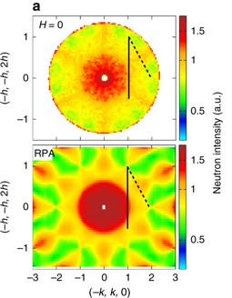
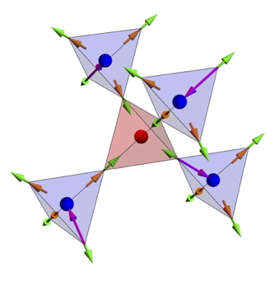
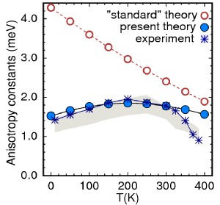
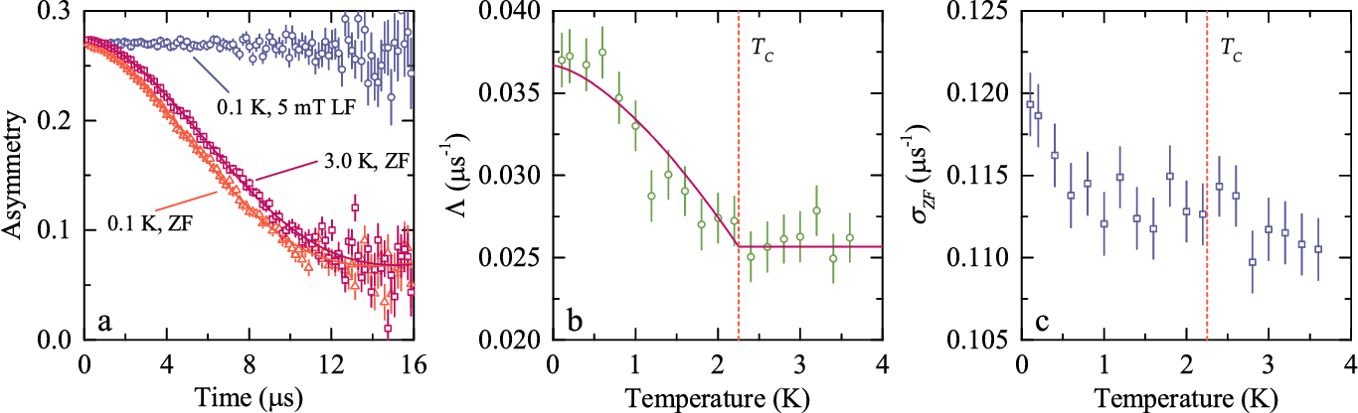
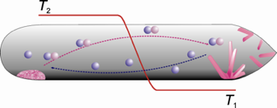
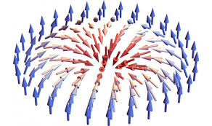
low-dimensional magnetism (PAG)
Unconventional field-induced gap in an S = 1/2 chiral staggered chain
J. Lui, PAG, et al. Phys. Rev. Lett. 122, 057207 (2019).
single crystal growth (GB, OAP)
Fermi surface in the absence of a Fermi liquid in the Kondo insulator SmB₆
M. Hartstein, GB, et al. Nature Phys. 14, 166 (2018).
Research Interests
frustrated magnetic materials - borides and oxides (OAP, GB, MRL)
Calculating the magnetic anisotropy of hidden order in spin-liquid Gd₃Ga₅O₁₂
J. A. M. Paddison, OAP, et al. Science 350, 179 (2015).
skyrmions (GB, MRL)
Magnetic phases of skyrmion-hosting GaV₄S_{8-y}Se_{y}
K. J. A. Franke, GB, et al. Phys. Rev. B 98, 054428 (2018).
permanent magnetism (MRL, GB)
unconventional superconductivity (MRL, PAG, GB)
Calculating the magnetic anisotropy of rare-earth transition-metal ferrimagnets
C. E. Patrick, MRL, GB, et al. Phys. Rev. Lett. 120, 097202 (2018).
Unconventional superconductivity in La₇Ir₃
J. A. T. Barker, MRL, GB, et al. Phys. Rev. Lett. 115, 267001 (2015).

Slide 4
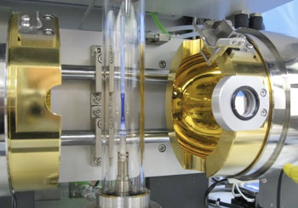
Superconductivity and Magnetism: Experimental Facilities
floating zone technique (optical furnaces T > 3000 ̊C)
arc melting, Czochralski, Bridgman, and CVT
box and tube furnaces, (gas and vacuum, T to 1800 ̊C)
real time x-ray Laue
ac and dc susceptibility (0 to 9 T, 500 mK to 800 K)
heat capacity (0 to 9 T, 50 mK to 400 K)
transport - ac & dc ρ, S, Hall, (0 to 17 T, 60 mK to 400 K)
ultra-high magnetic fields (NHFML, EMFL)
muon spectroscopy (ISIS and PSI) and neutron scattering (ISIS and ILL)
For more details see: go.warwick.ac.uk/supermag

Slide 5
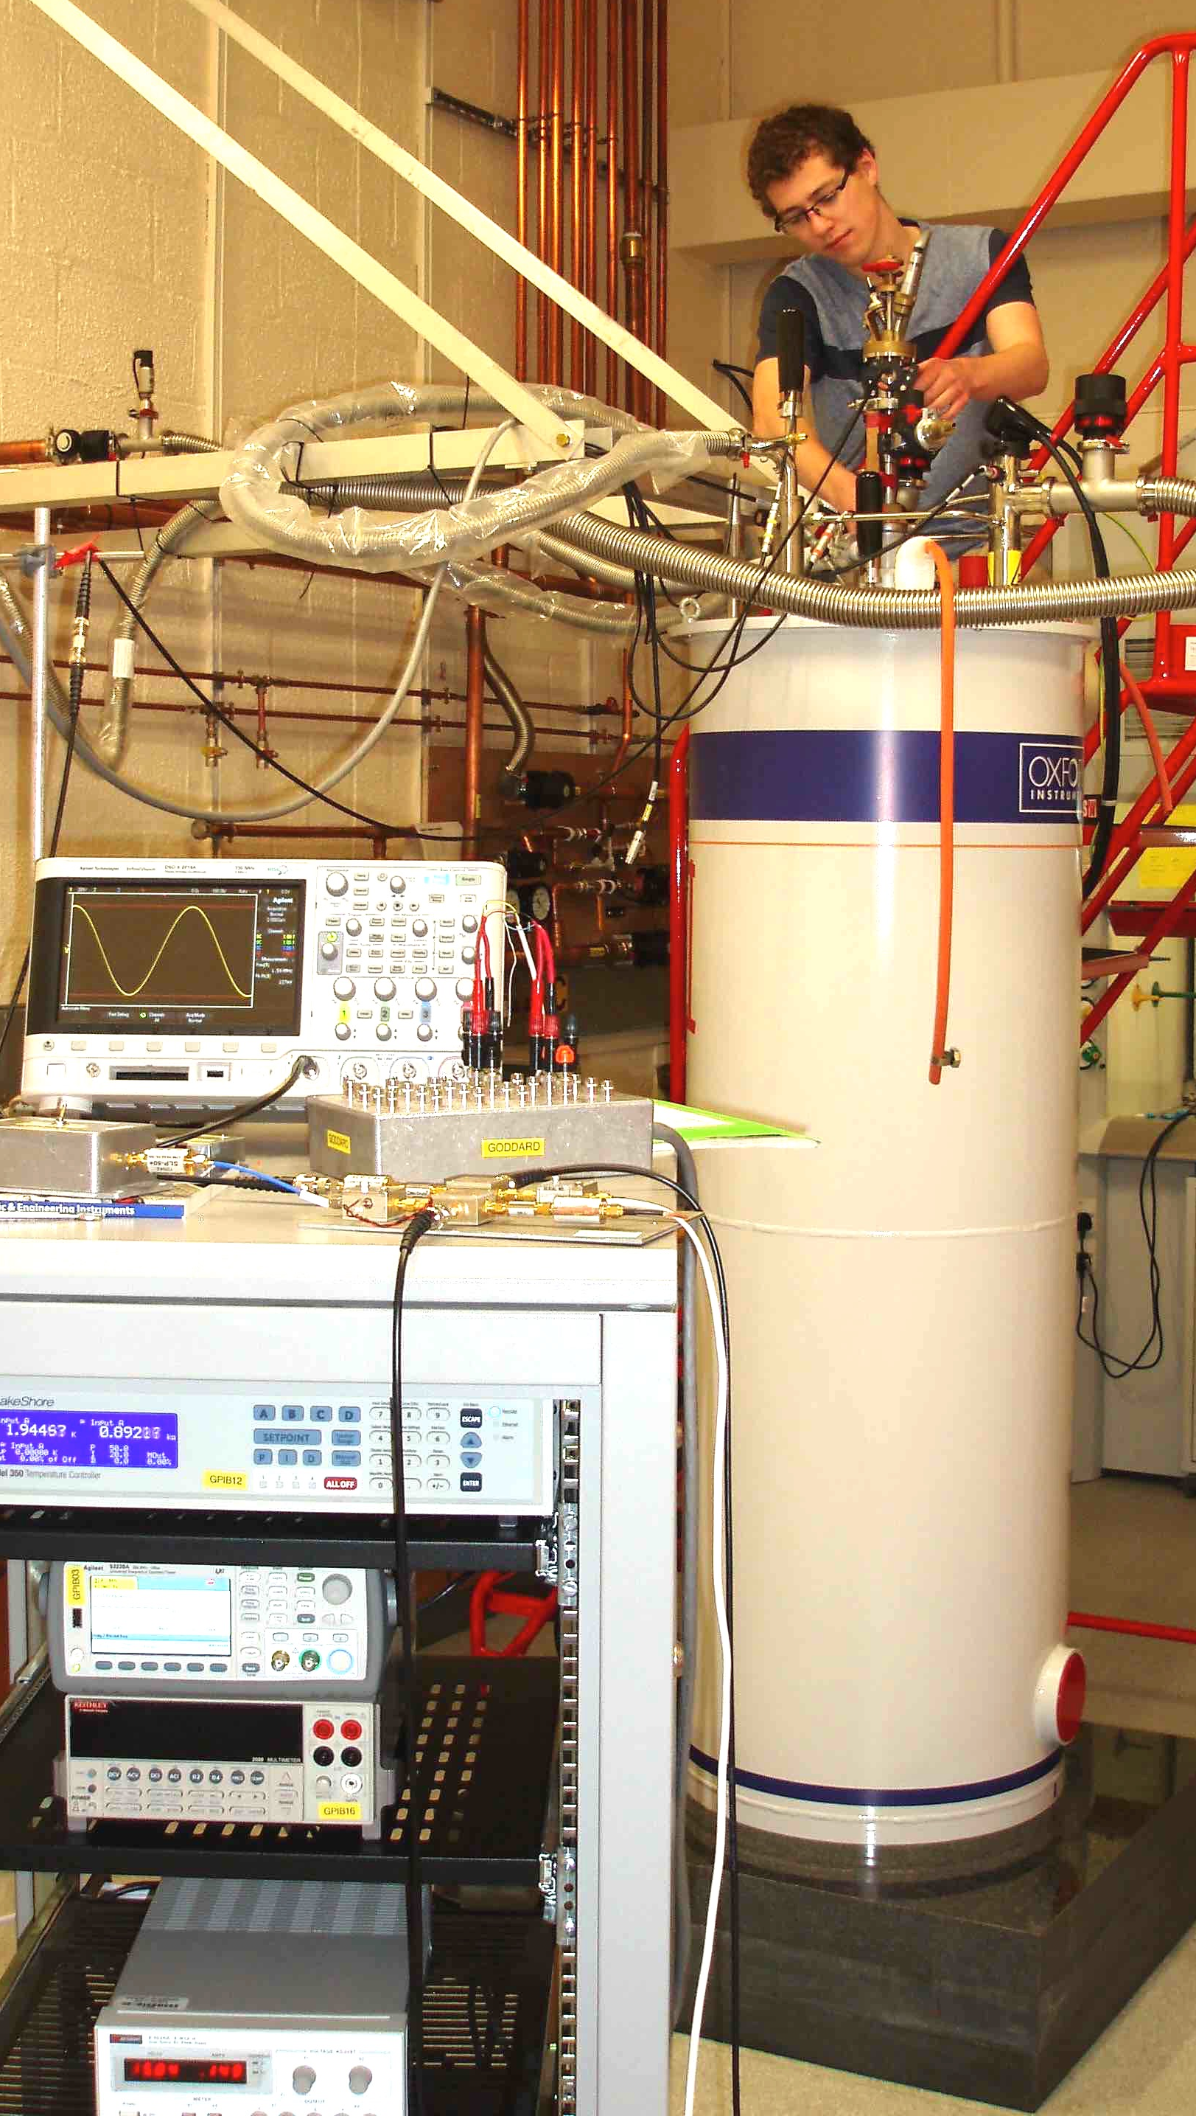
Superconductivity and Magnetism: Experimental Facilities
floating zone technique (optical furnaces T > 3000 ̊C)
arc melting, Czochralski, Bridgman, and CVT
box and tube furnaces, (gas and vacuum, T to 1800 ̊C)
real time x-ray Laue
ac and dc susceptibility (0 to 9 T, 500 mK to 800 K)
heat capacity (0 to 9 T, 50 mK to 400 K)
transport - ac & dc ρ, S, Hall, (0 to 17 T, 60 mK to 400 K)
ultra-high magnetic fields (NHFML, EMFL)
muon spectroscopy (ISIS and PSI) and neutron scattering (ISIS and ILL)
For more details see: go.warwick.ac.uk/supermag

Slide 6
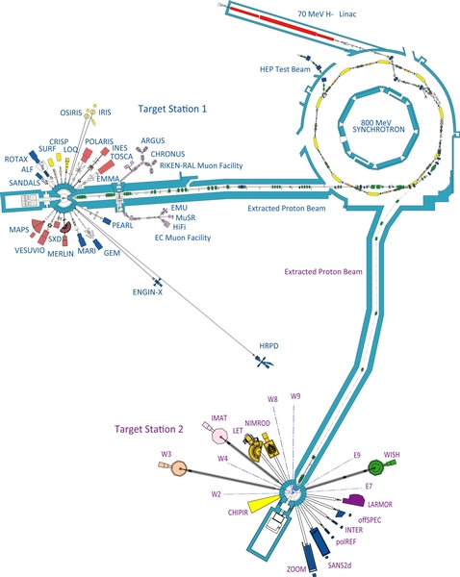
Superconductivity and Magnetism: Experimental Facilities
floating zone technique (optical furnaces T > 3000 ̊C)
arc melting, Czochralski, Bridgman, and CVT
box and tube furnaces, (gas and vacuum, T to 1800 ̊C)
real time x-ray Laue
ac and dc susceptibility (0 to 9 T, 500 mK to 800 K)
heat capacity (0 to 9 T, 50 mK to 400 K)
transport - ac & dc ρ, S, Hall, (0 to 17 T, 60 mK to 400 K)
ultra-high magnetic fields (NHFML and EMFL)
muon spectroscopy (ISIS and PSI) and neutron scattering (ISIS and ILL)
For more details see: go.warwick.ac.uk/supermag

