Slide 1
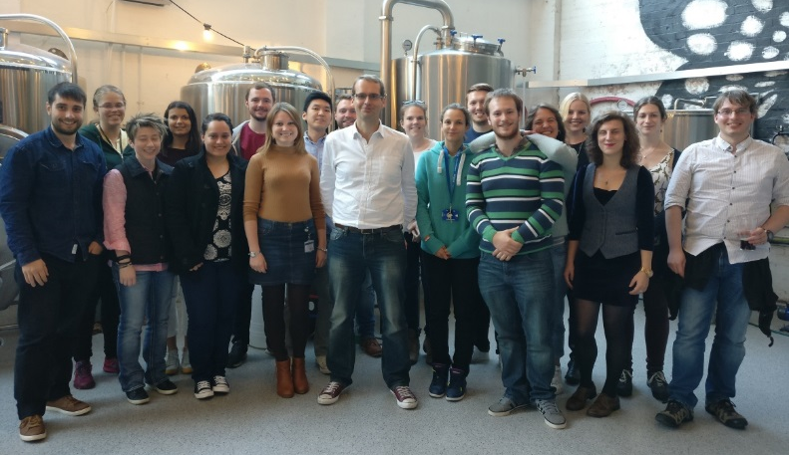
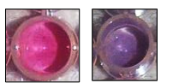
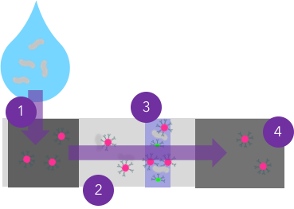
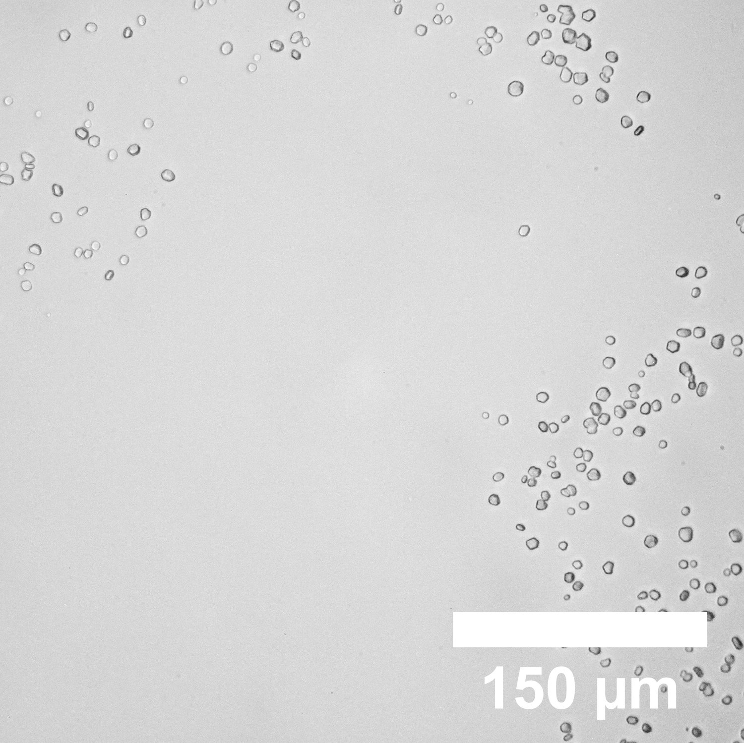
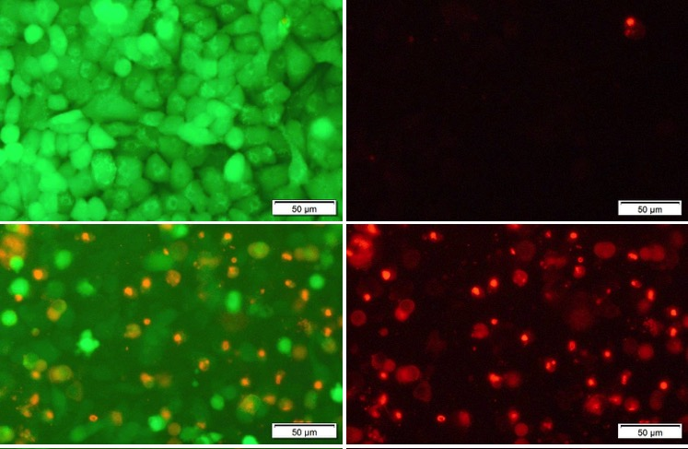
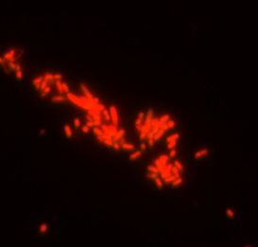
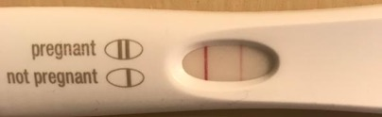




GibsonGroup Research
1. High-throughput Polymer Discovery
400 new copolymers synthesised per day
Linked to robotics
Already discovered new antimicrobial materials and new formulations for biologics
Can create custom screens (have done for 2 industry partners already)
Joint Position Chemistry and Medical School.
Analytical Facilities; Biolayer interferometry, light scattering, microarray, low-temperature crystal growth/nucleation, UV/IR/Fluorescence.
Cell Culture (toxicity and uptake), microbiology (antimicrobial activity and protein expression)
Chem. Eur. J., 2018, 24, 13758
2. Anti-icing materials and crystallisation control
3. Anti-infectives and biosensors
Ice morphology control
Biologic cryostorage
Low cost biosensors
Anti-mycobacterial agents
Nature Communications, 2017, 1546.
Nature Communications, 2014, 5, 3244
Chemical Science 2019, online soon
Patent filed GB 1820829.8
Patents awarded; EP 20130705234.
Patents filed GB1708999.6; GB1804227.5; GB1804227.5; GB1804233.3; 1820829.8

