Slide 1
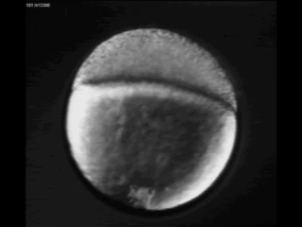
How are embryos shaped?
mechanics - physical forces & material properties
Michael Smutny
WMS
Nano-topography
Zebrafish embryo
Microfluidics
2D
3D
Microfabrication - Force measurements
Single cell
Tissue
Magnetic tweezer
Cantilever
Microdroplets
Microplates

