Slide 1
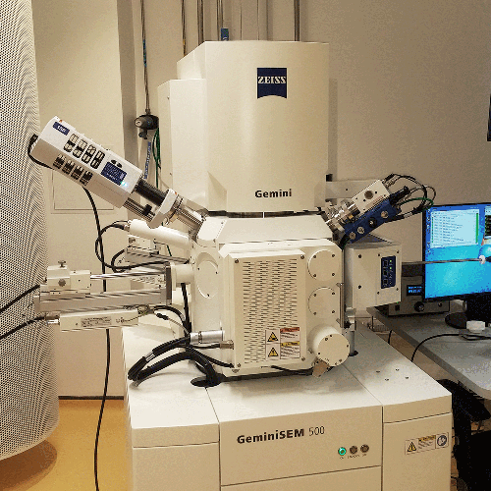
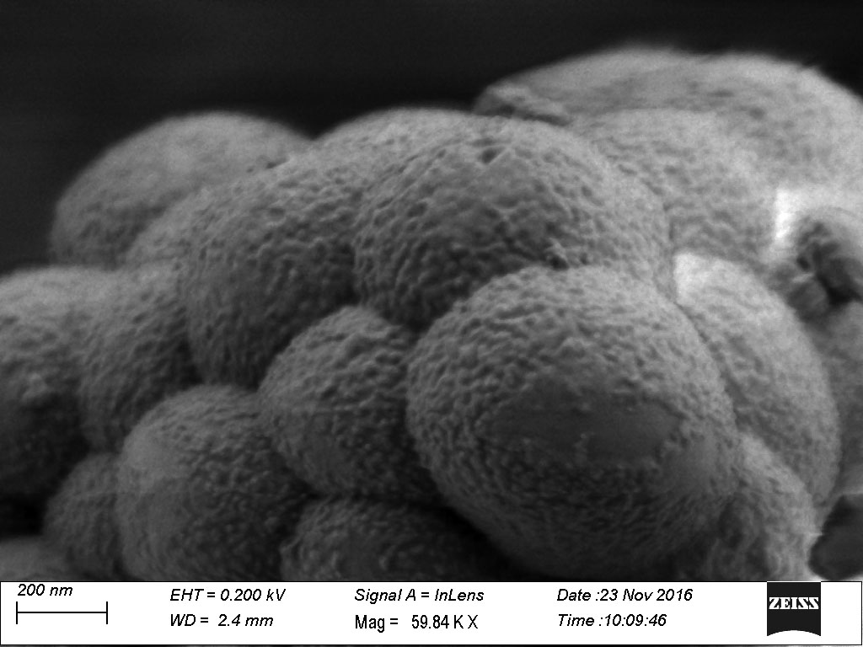
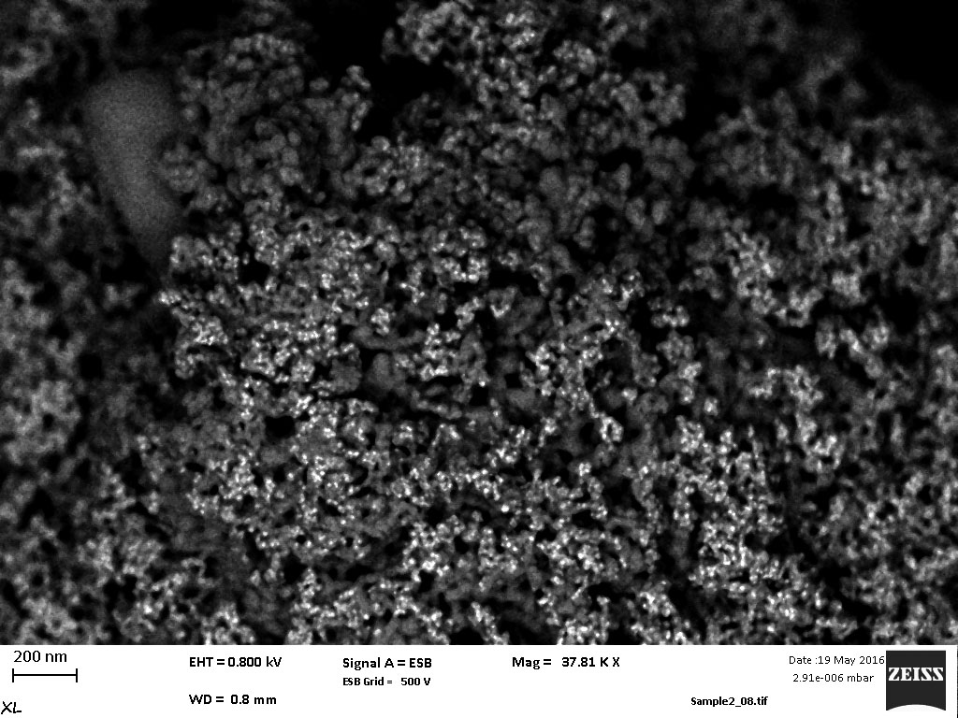
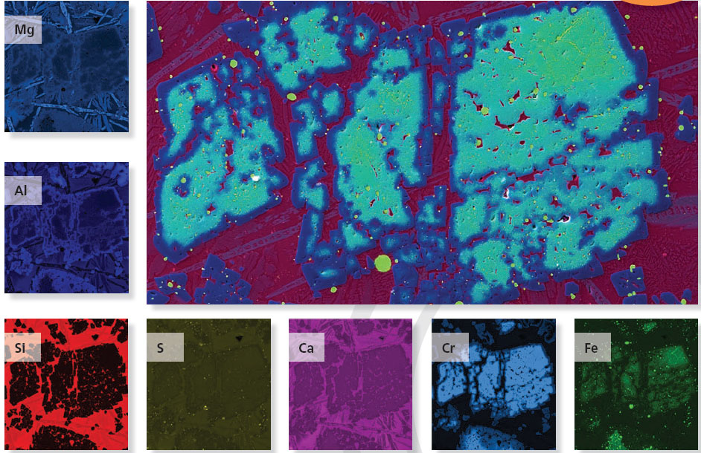
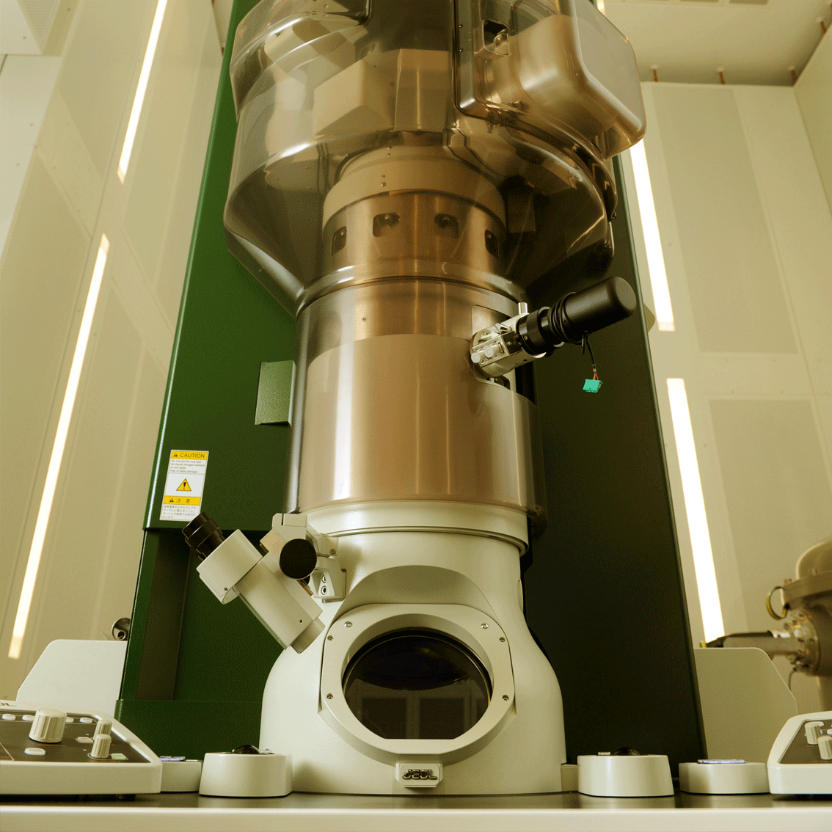
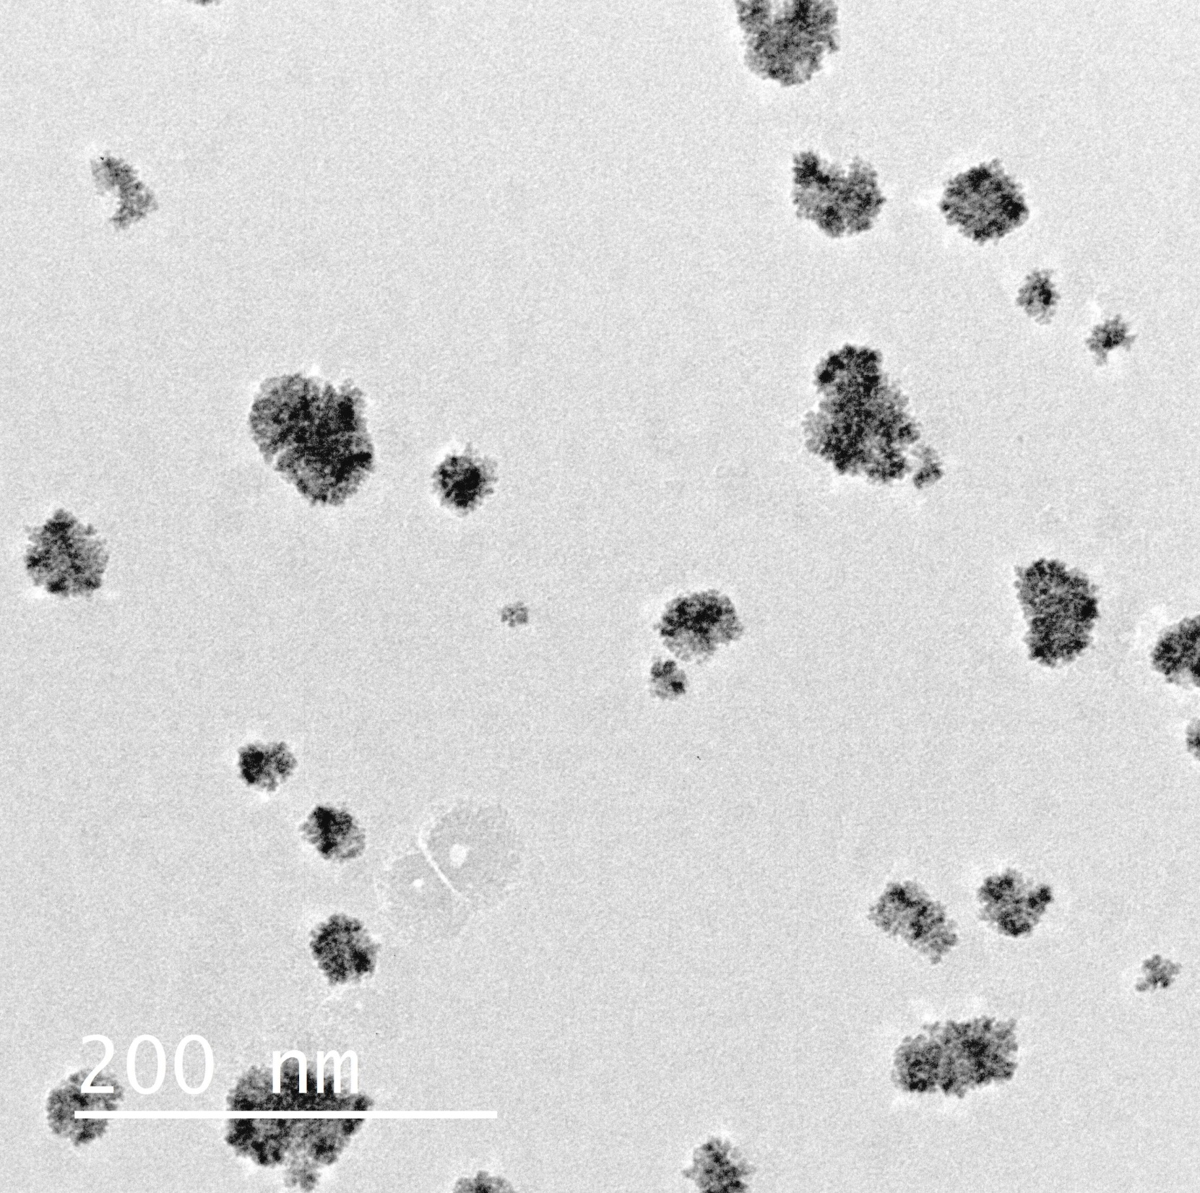
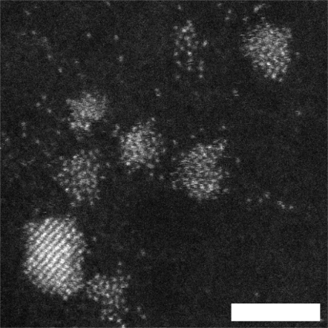
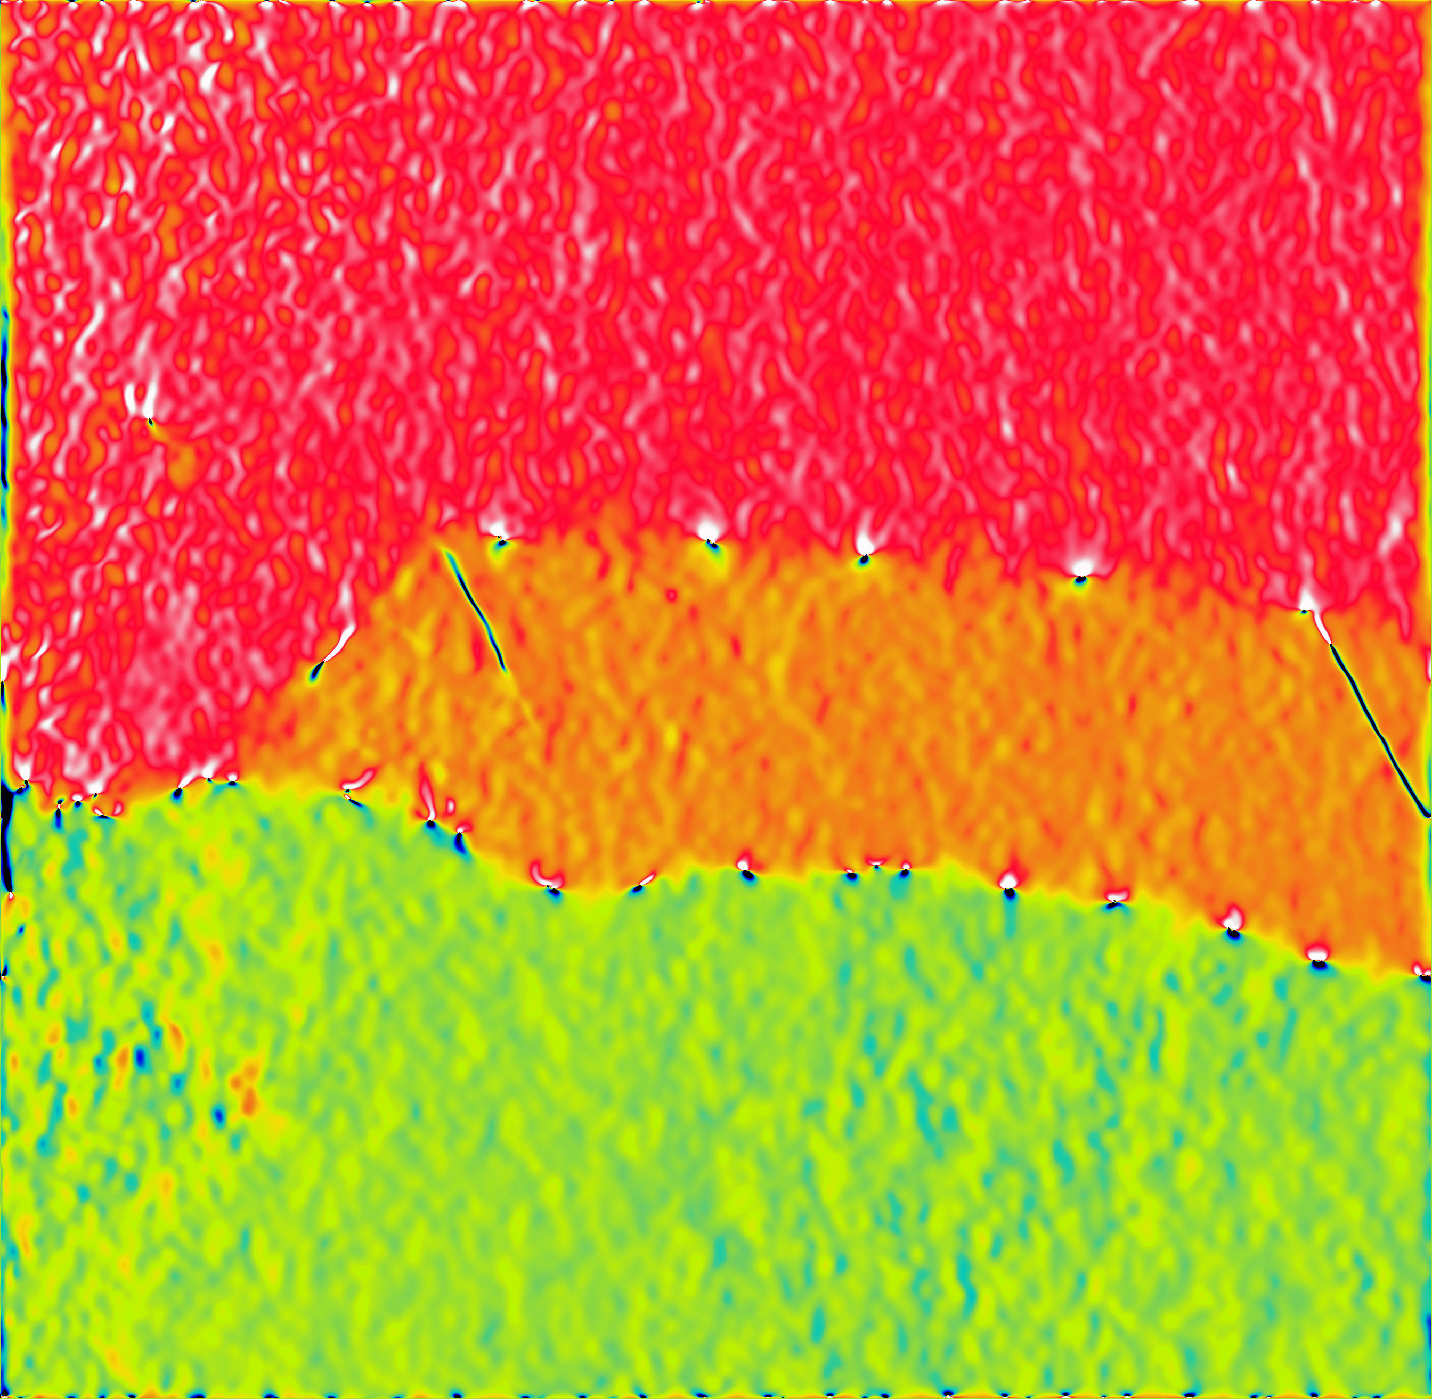
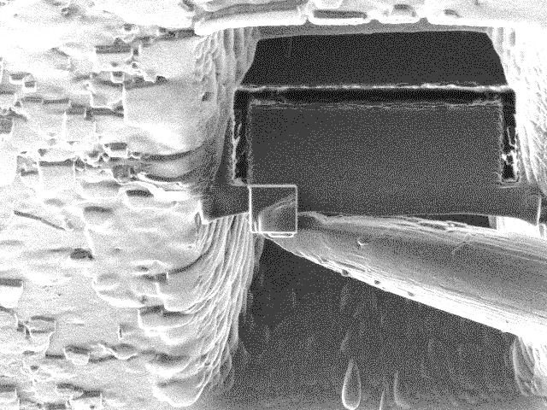
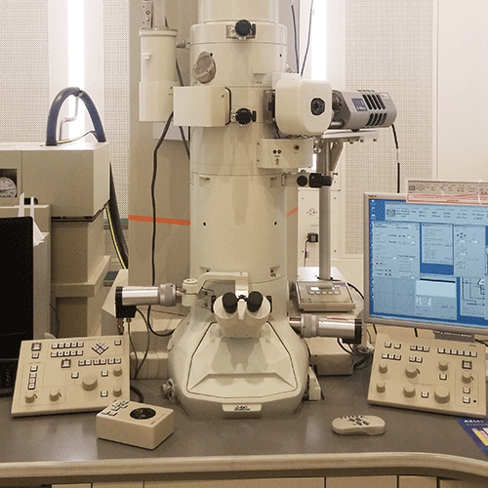
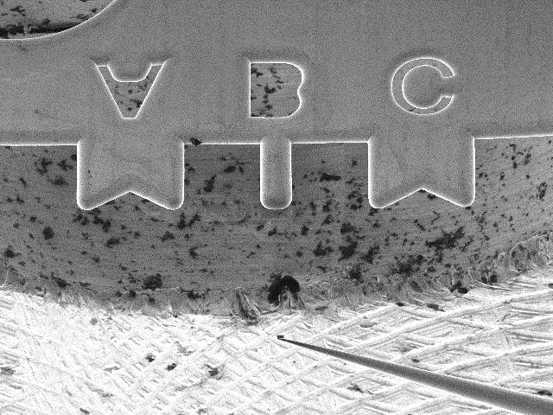
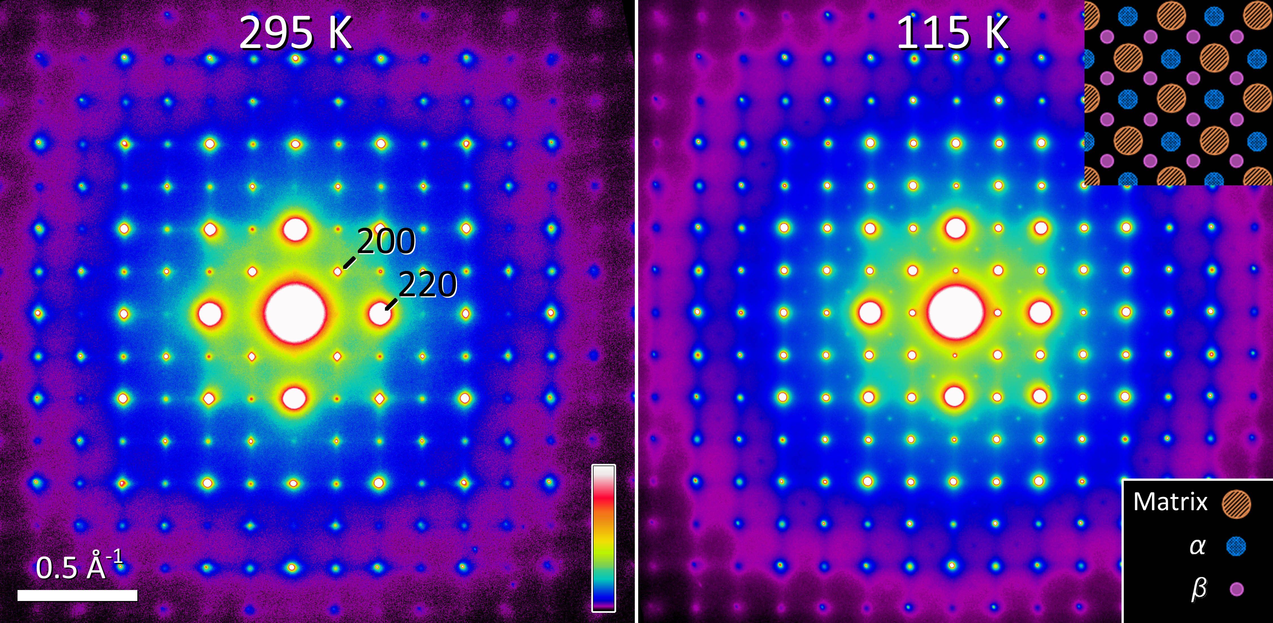
Electron Microscopy Research Technology Platform
Scanning Electron Microscopy (SEM)
2 SEMs, 3 TEMs, AFM + FIB in a purpose built facility (£6M)
Manager, technician and scientific officer to support users
Low kV
<1nm resolution
Composition mapping
Transmission Electron Microscopy (TEM)
TEM
STEM
nm-scale strain
Focused ion beam (FIB-SEM)
Atomic resolution imaging and analysis
Diffraction

