Slide 1
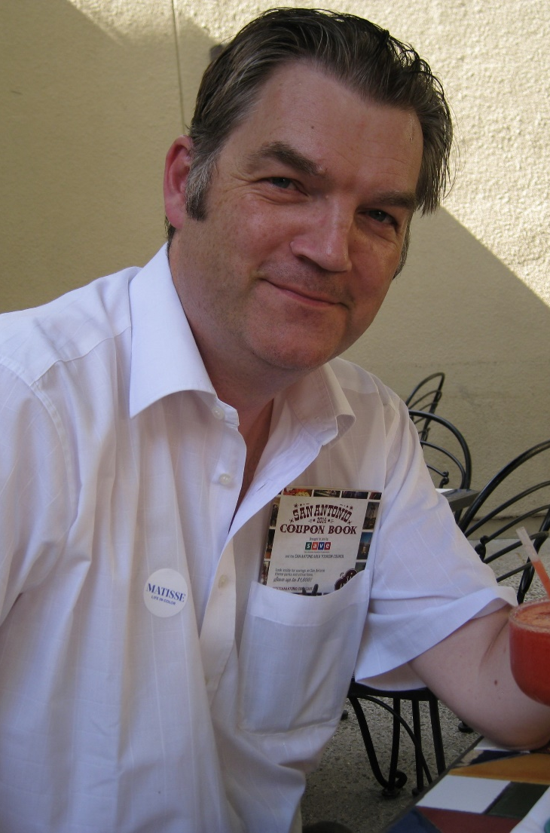
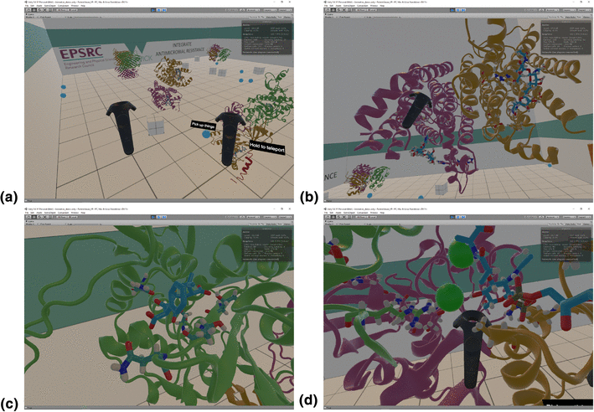
Touching proteins with virtual bare hands
Visualizing protein–drug complexes and their dynamics in self-made virtual reality using gaming hardware
Name: Rudolf A Roemer, Institution: Physics

