Slide 1
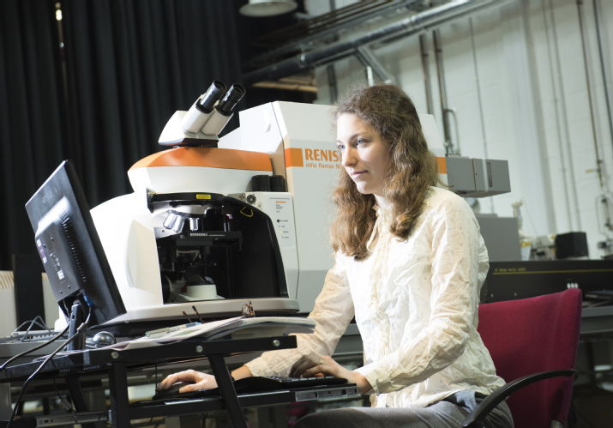
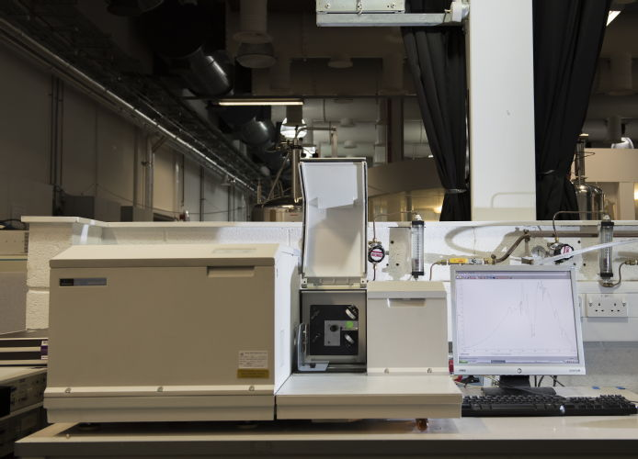
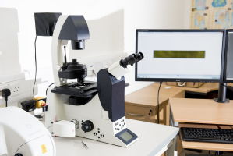
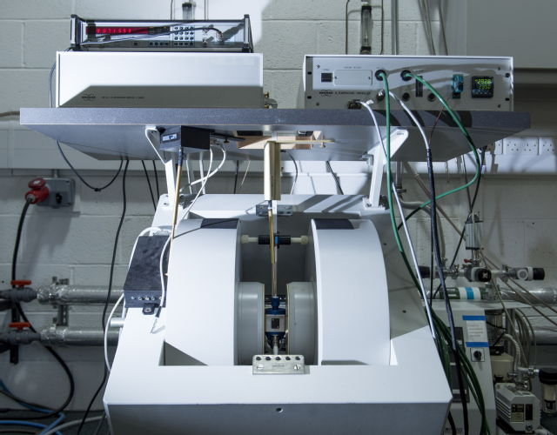
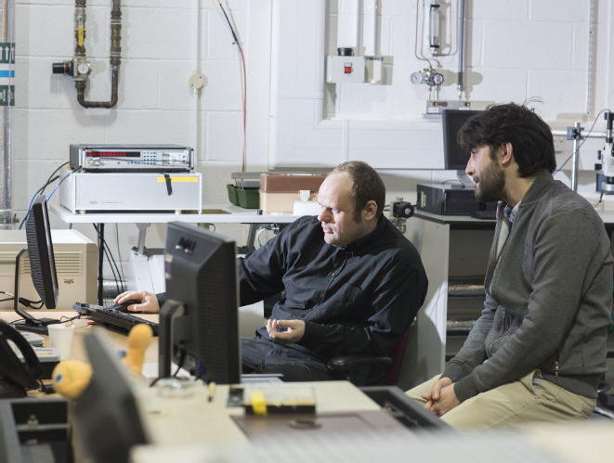

Spectroscopy Research Technology Platform
Raman Spectroscopy/Imaging
Optical Absorption Spectroscopy (IR to UV)
Photoluminescence Spectroscopy
Fluorescence Imaging
Electron (Spin) Paramagnetic Resonance
Variable Temperature (4 K to 1800 K)
Hybrid Techniques
Supporting > 100 Warwick Researchers
Access/Training for External Partners from academia and industry
Industrial Contract R&D
Contact: Spectroscopy@warwick.ac.uk
Manager: Dr Ben Breeze
Information: warwick.ac.uk/research/rtp/

