Slide 1

Power Electronics: cooking up group IV semiconductor materials.
Vishal Shah, Associate Professor, Warwick University

Slide 2
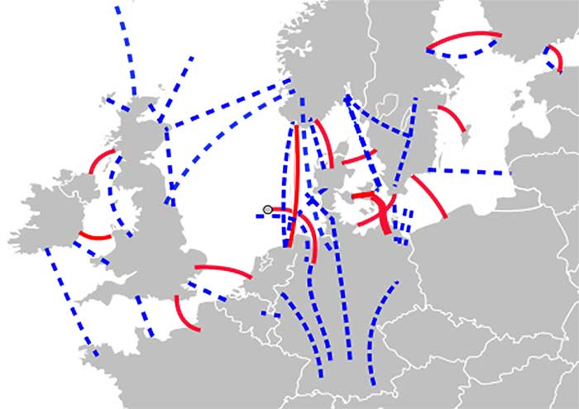
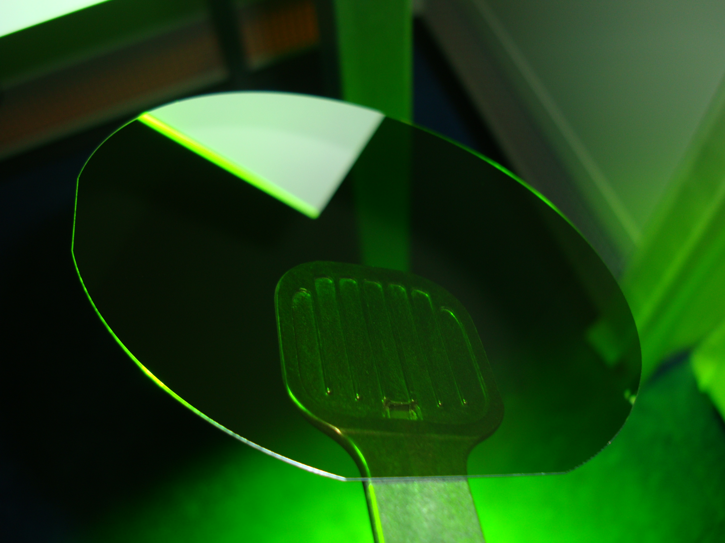
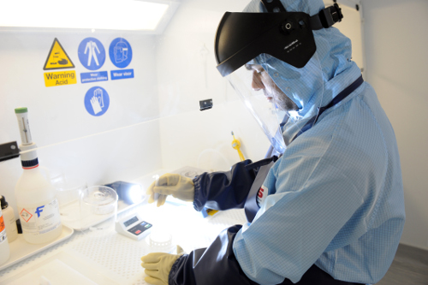
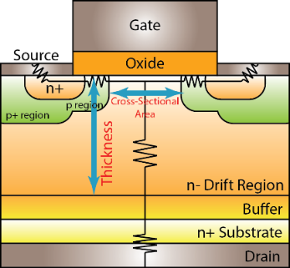
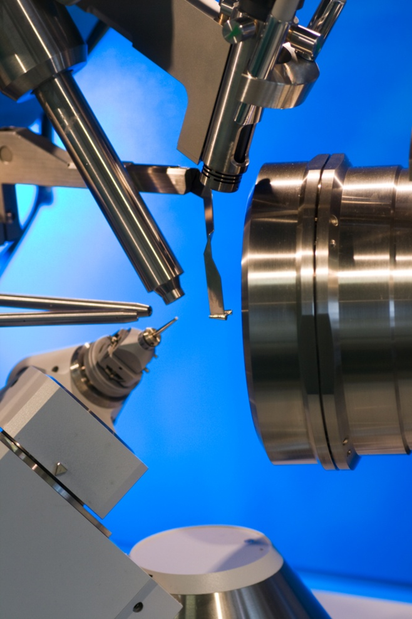
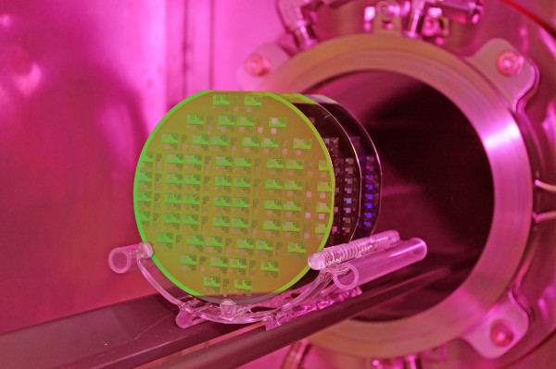
Power Electronics:
Goals and Applications
Challenge: implementation of weather dependant green sources into grid:
  To meet future energy demands - overcapacity limit only 5%
  Decarbonise the grid to meet strict 2050 targets
  To allow access to European energy market
We make and use Silicon Carbide (SiC) materials to fabricate solid state power devices
UK’s only £2.3M SiC Chemical Vapour Deposition (CVD) reactor
£3.4M SiC microelectronics fabrication clean room (>1600C furnaces, passivation, oxidation, metal evaporation/ sputtering plasma etching/cleaning)
Analysis of materials is key. (Raman,
TEM, SEM, AFM, PL, DLTS, etc)
£700k Ultra-high voltage (>30 kV)
power devices through superior
materials (EP/P017363/1)
Materials development leads to
SiC use in Spintronics, RF, MEMS,
UV detectors (and simple ICs)
>30kV SiC Devices

