Slide 1
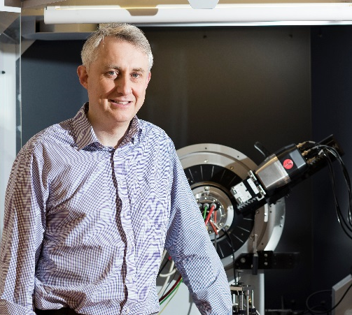
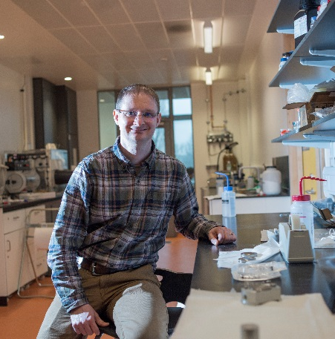
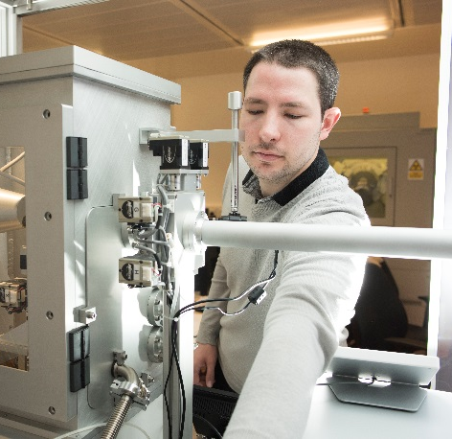
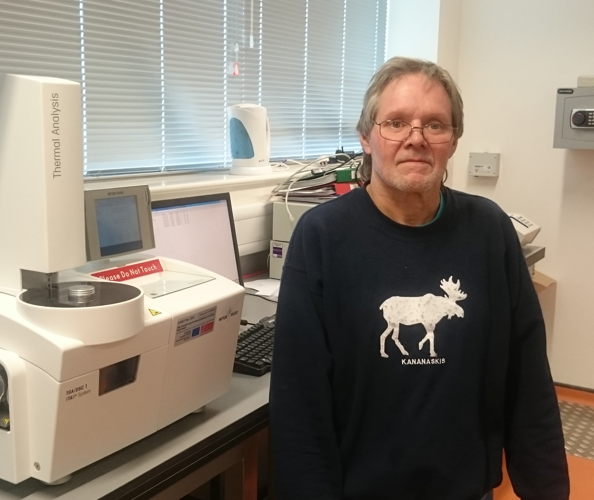
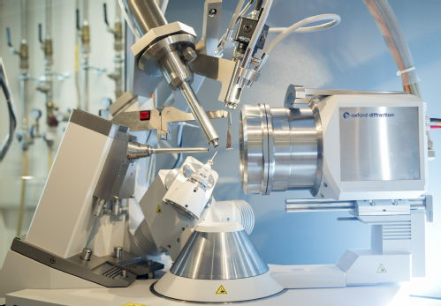
Warwick X-ray Diffraction Research Technology Platform
Richard Walton
Director
David Walker
Facility Manager
Steve Huband
Scientific Technician
David Hammond
Technician (50%)
Single Crystal Diffraction Structural solution (organic & inorganic)
Powder X-ray Diffraction Phase ID, Rietveld refinement, non-ambient
High Resolution Diffraction Thin Films, Coatings, Semiconductors
Small-Angle X-ray Diffraction & GISAXS Size, shape & morphology of Nanoparticles
Wavelength Dispersive X-ray Fluorescence (XRF) Elemental analysis – trace and light element sensitivity

