Slide 1

Outreach and Widening Participation activity planning and evaluation
Marie Diebolt – Outreach Officer - WMG
December 2024
Notes:
Intro – 2 min

Slide 2
Welcome
Why Outreach and Widening Participation?
Evaluation
Pitch for and engage with young people?
Safeguarding

Slide 3

1. Why outreach and WP?
Notes:
Part 1 – 15 min

Slide 4
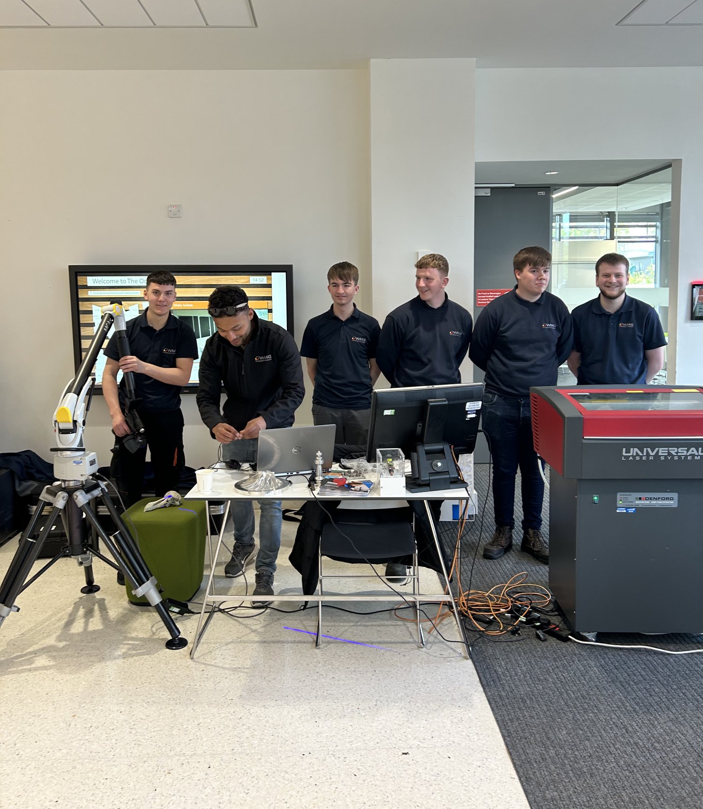

University
Why do we do outreach?
Warwick University WP Strategy
www.Warwick.ac.uk/outreach
Social Inclusion Strategy
www.Warwick.ac.uk/socialinclusion

Slide 5

Your department
“The UK is facing a well-documented engineering skills crisis. An ageing workforce means that hundreds of thousands of skilled technician and professional engineering roles will need replacing over the next ten years.”
Royal Academy of Engineering, 2016

Slide 6
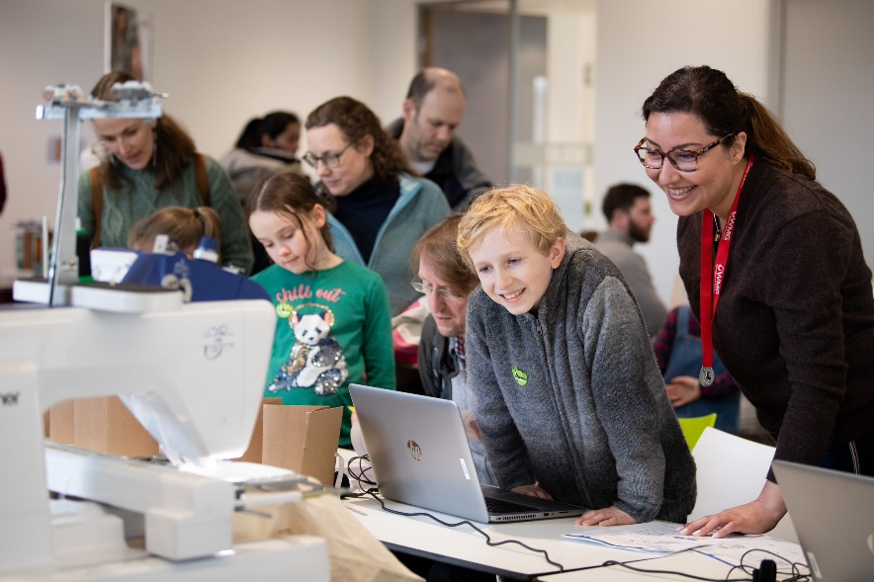
Individual
Participating in outreach activities has been an incredibly rewarding experience. It’s not only fun and engaging but also an opportunity to make a meaningful impact by sharing knowledge and inspiring others. Outreach allows me to connect with diverse audiences and contribute to the broader mission of making science accessible and exciting.
Negar Riazifar, WMG

Slide 7
Discussion
Think of someone who inspired you as a child (someone you read about, someone who spoke to you, a family member, a teacher, a famous person…)
What do you remember about what they said?
What do you remember about how you felt?
What did they do to engage with you?
Notes:
Give 5 minutes in pairs

Slide 8
The bigger picture
Parents
Year 4
Year 5
Year 6
Year 7
Year 8
Year 9
Year 10
Year 11
Year 12
Year 13
UG students
PG students
Teachers
Friends
Educators

Slide 9

2. Evaluation
Notes:
Part 3 – 20 min
6-7 min per point

Slide 10
Who are you focusing on?
Staff: developing other members of staff
Schools: targeting and support
Pupils: shifting attitudes and raising aspirations
Parents: shifting attitudes and expectations

Slide 11
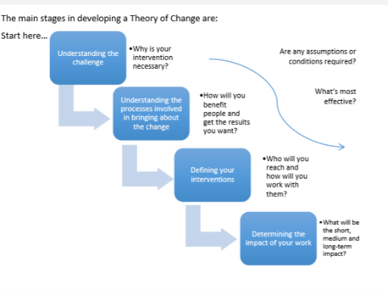
WP Theory of Change
Knowledge and Skills
Attitudes and Identity
Aspirations and Expectations
Attainment
DEVELOP
CHANGE
SUPPORT
SUPPORT
CHALLENGE

Slide 12
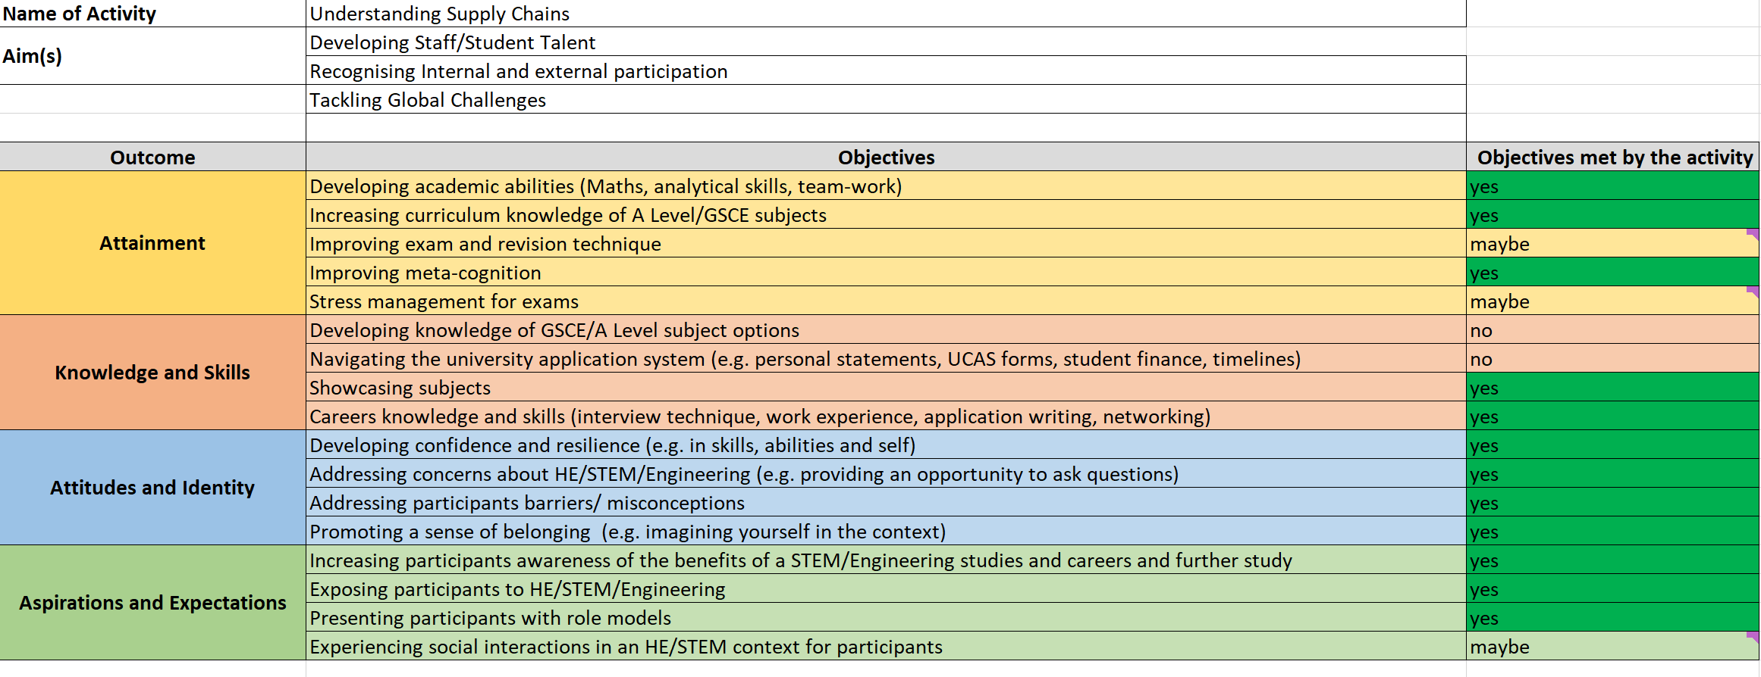
Impact evaluation

Slide 13
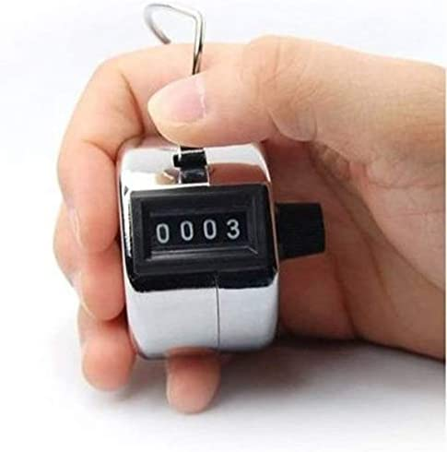
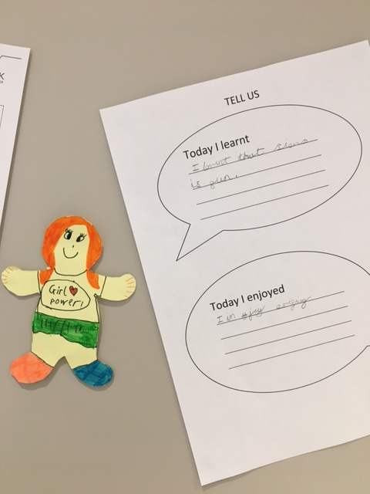
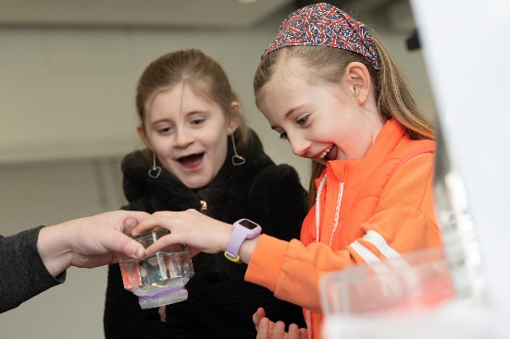
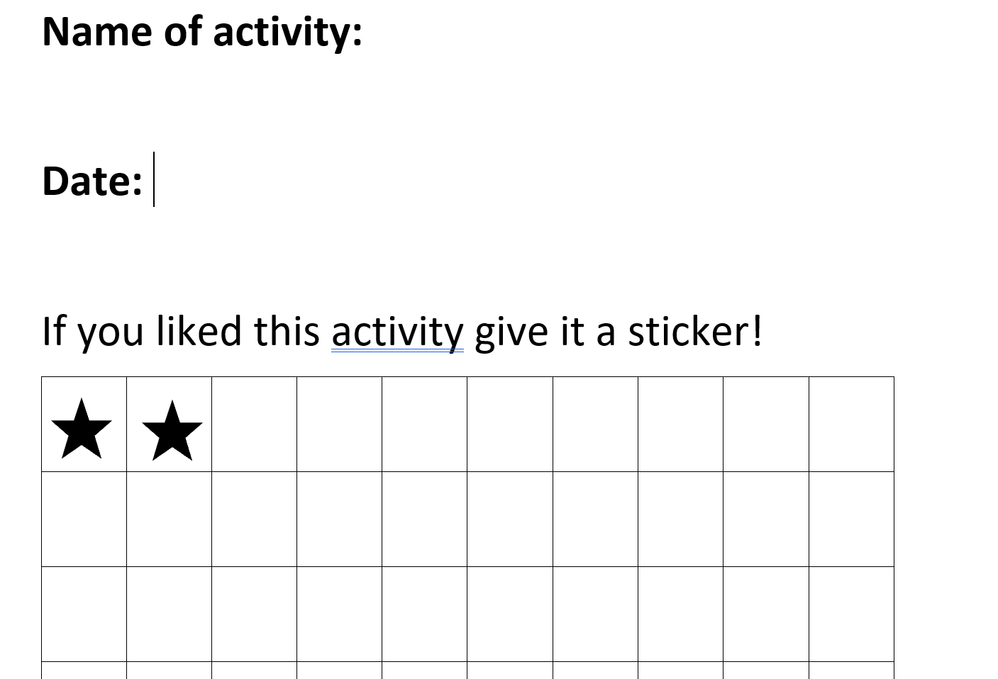
Evaluating your activity – Quantitative data
What did they learn/enjoy?
How many attended?
How many enjoyed it?
Was it a popular event for the university?
350 attendees. The most popular ones were… or 150 attendees visited the stand for…..
They really enjoyed learning about …

Slide 14

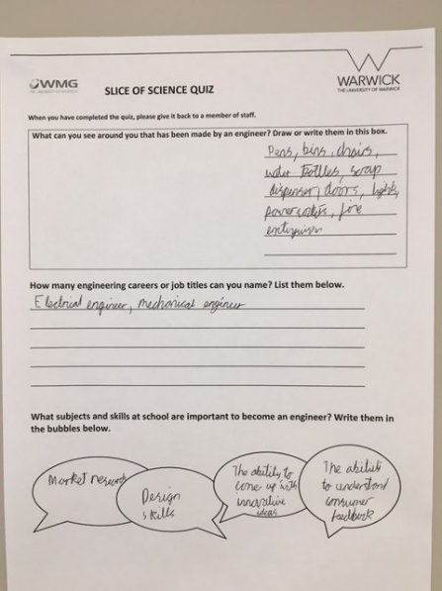
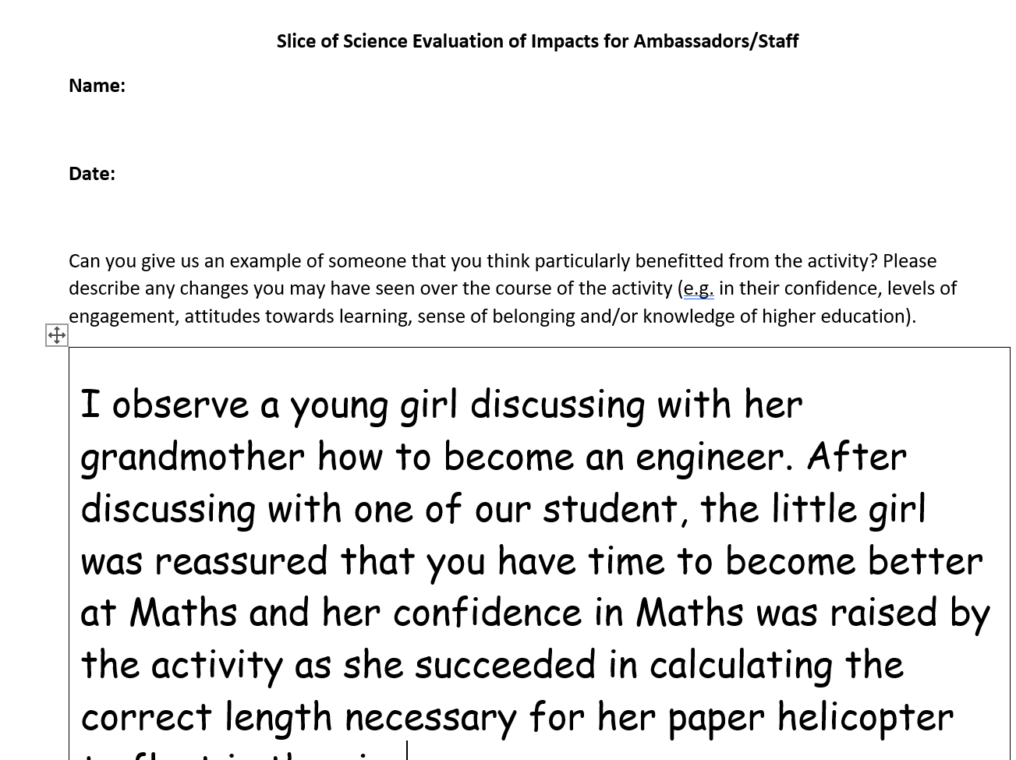
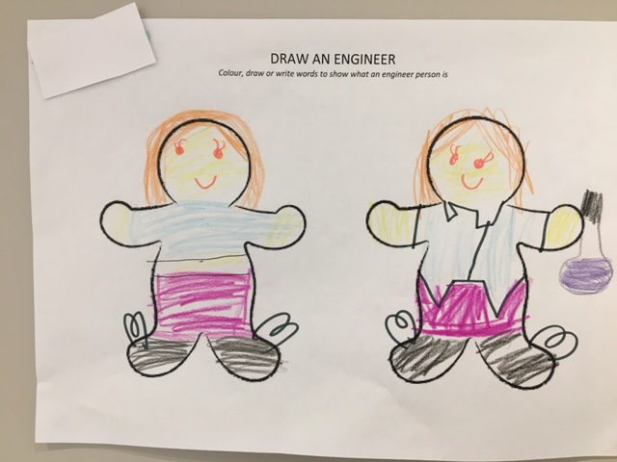
Evaluating your activity – Qualitative Data
Staff observation
What content was covered? What is their prior knowledge?
Was it an impactful event for participants?
75% of participants did not know what school subjects were needed to pursue an engineering career before the event.
100% of young female participants felt that engineering could be an accessible career for them after taking part in the event.
What are their aspirations, attitudes and identity?

Slide 15
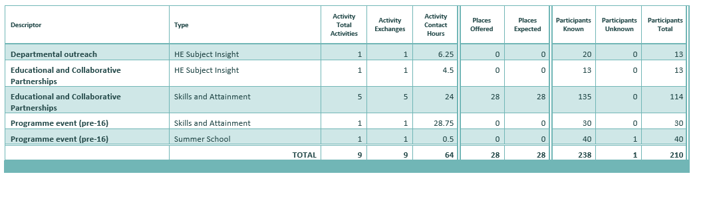
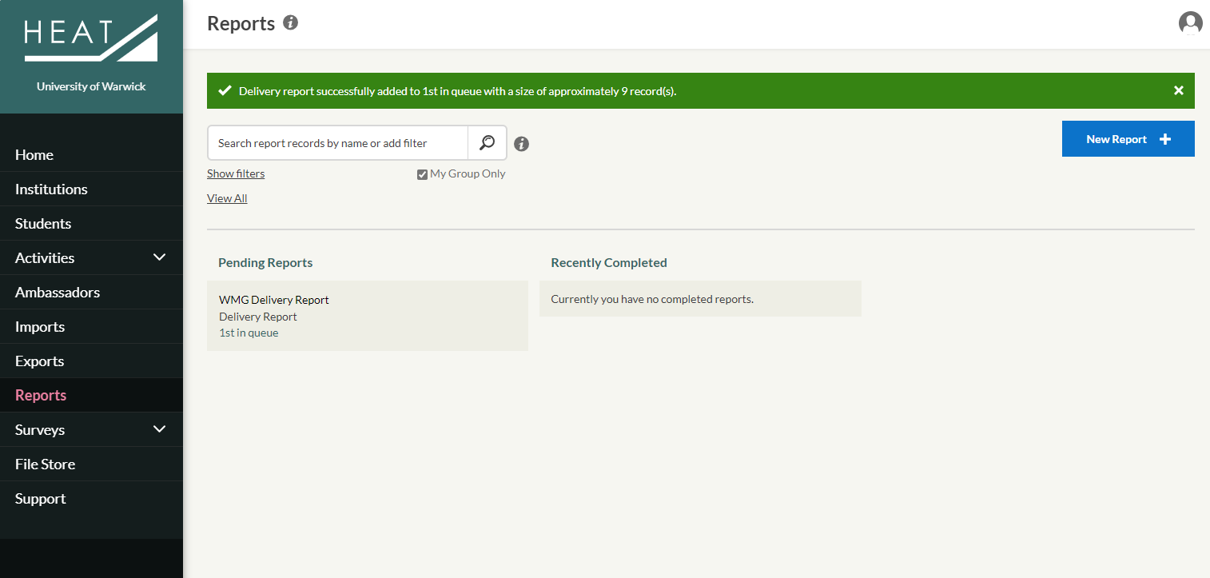
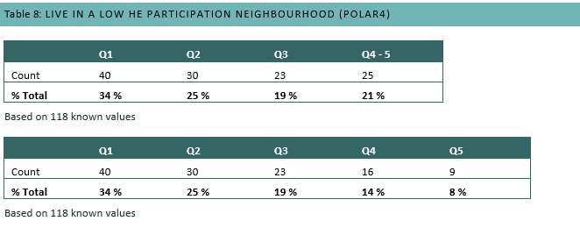
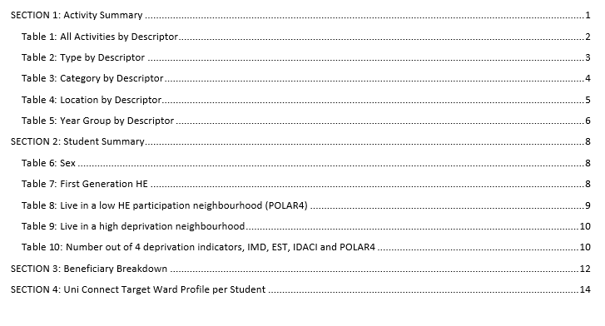
Longitudinal evaluation

Slide 16
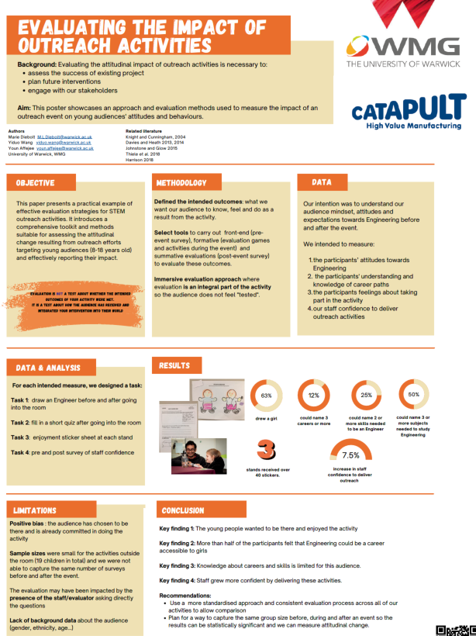

Slide 17
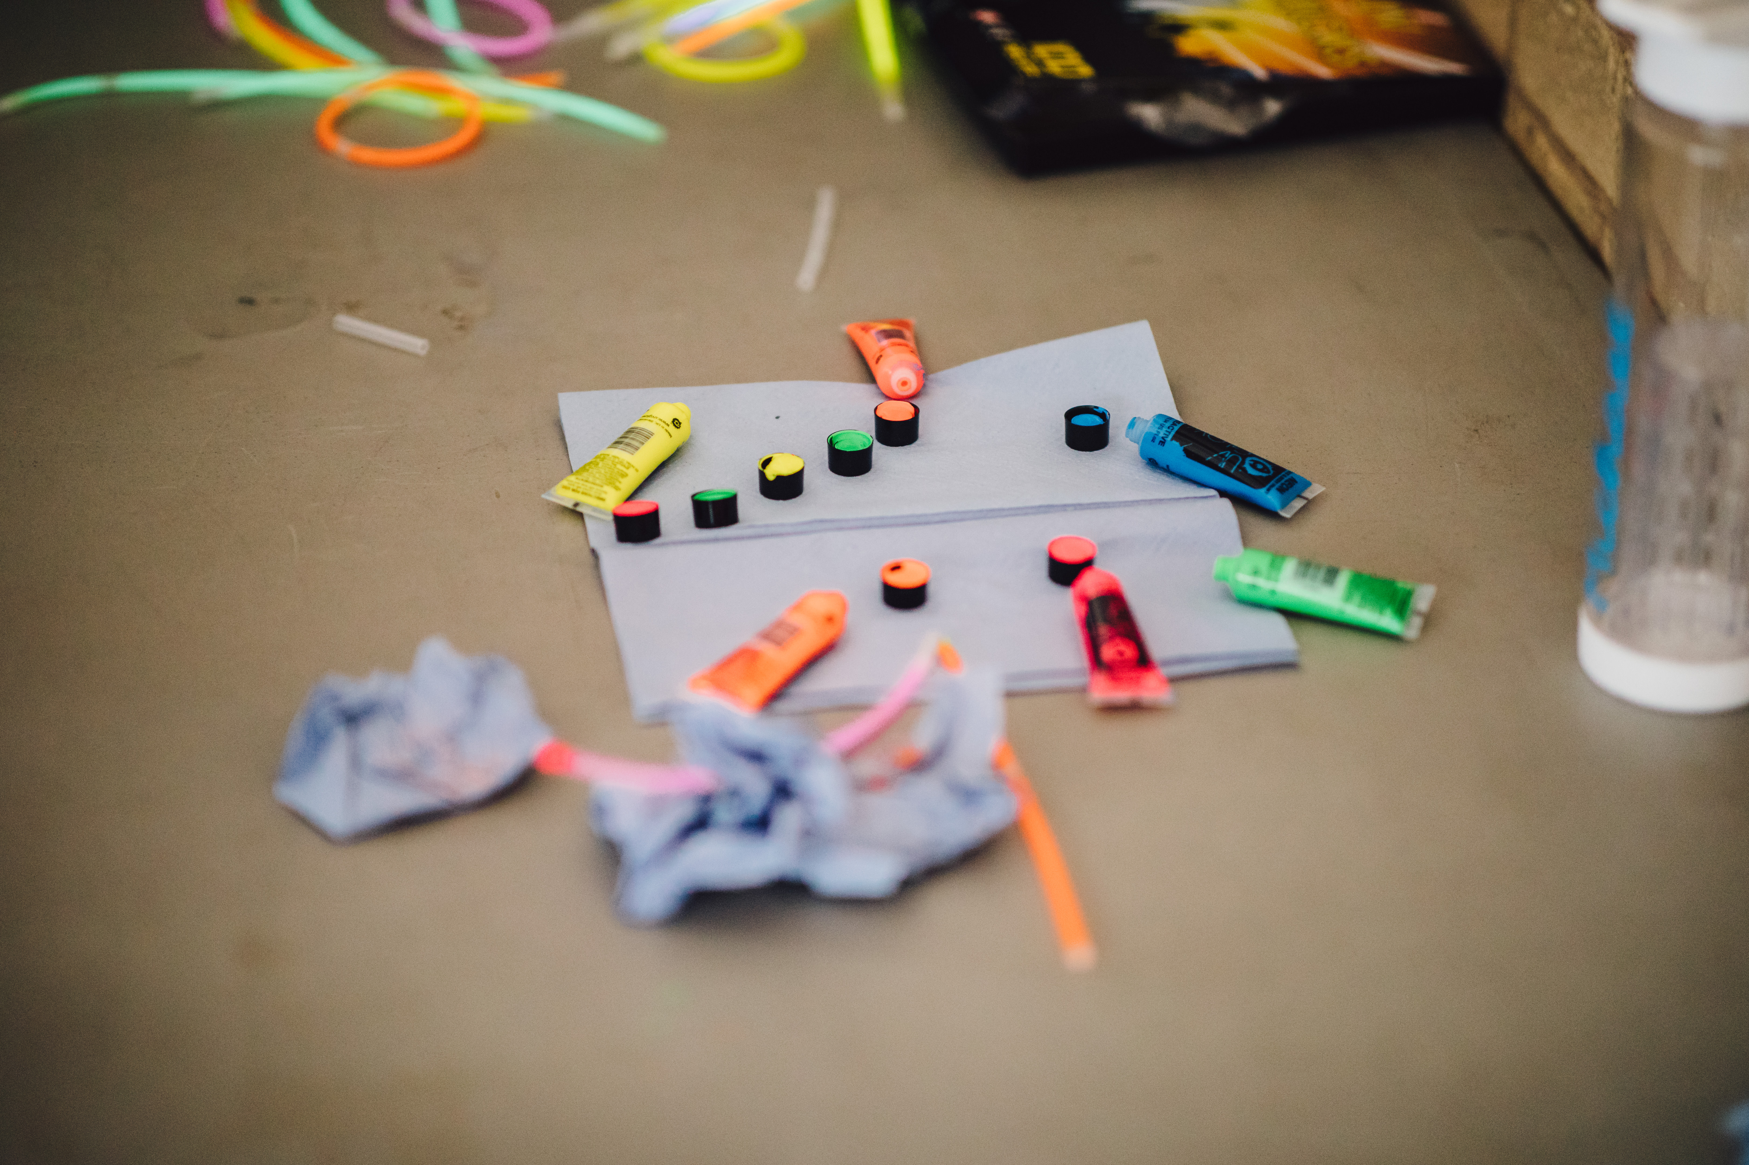
3. Pitch for and engage a young audience
Notes:
Part 2 – 20 minutes
6-7 minutes per discussion

Slide 18
Tip 1: Start with them
What do they already know about the University, the topic or concept you are going to introduce to them?
What can they relate to in their direct environment or day to day that is linked to this topic or concept?
What pre- or misconceptions do you think they may have?
Notes:
Make direct comparison, use visuals

Slide 19
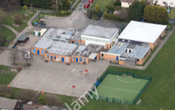

TOP TIPS
Make direct comparison
Be concrete
Notes:
Make direct comparison :a university is like a school
Be concrete: use visuals, give real examples (what is the name of their school? )

Slide 20
Discussion
Using your ideas for your activity, discuss what you think the young children:
May already know
Their pre-conceptions
What in their day-to-day might help them understand what you are trying to introduce to them

Slide 21
Tip 2: be concise
Design an activity with the youngest ones in mind and add levels of complexity.
Age = number of new words
Age = attention span
1 or 2 concept per activity
1 idea introduced at a time / per slide

Slide 22
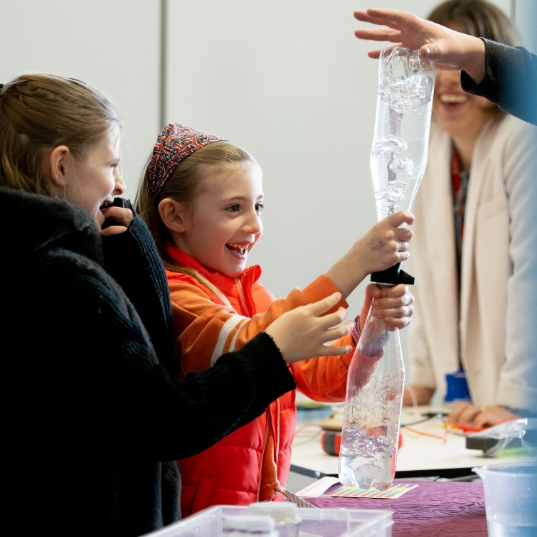
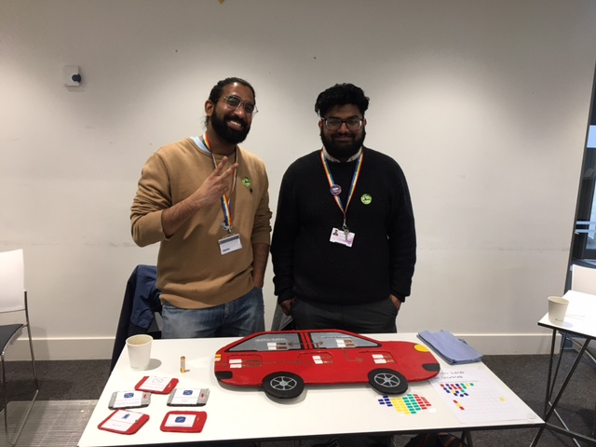
Discussion
What are the two key concepts you want the children to understand?

Slide 23


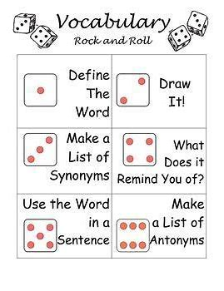


Tip 3: Unpick the jargon
degree
campus
PhD
Notes:
Tell a story
Ask them to spell the new words with scrabble tiles
Word searches
Hangman
Dictionary search with dice

Slide 24
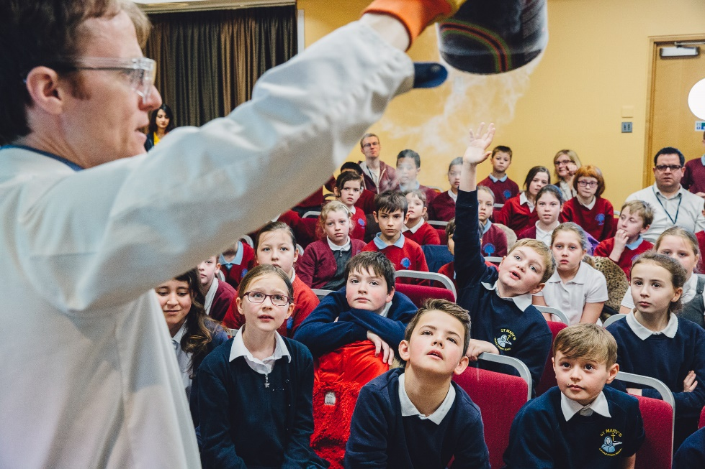
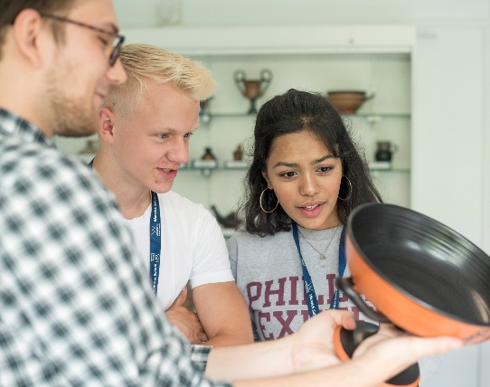
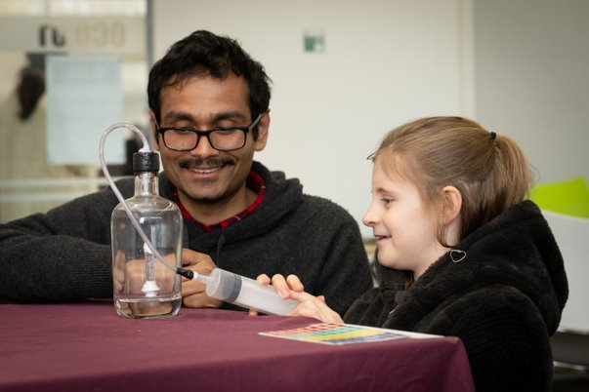
Tip 4: hook them right at the start
Notes:
A mystery object on the table
A fun game
A tickling question/challenge

Slide 25
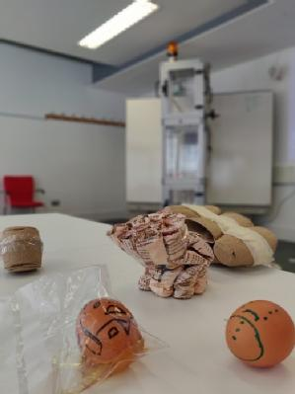
Tip 5: make it challenging and fun
Tell them a story
Tickle their imagination
Take them on a journey
Introduce some role-play
Let them play
Notes:
Examples:
The trial of Jack and the Bean Stalk (Law outreach activity)
The story of Ed the Egg

Slide 26
Tip 6: Get them out of their seat!
Ask them to use the concepts and words learnt and apply them to a “real-life” scenario
Let them test their ideas and improve on them.
Get them moving or changing position

Slide 27
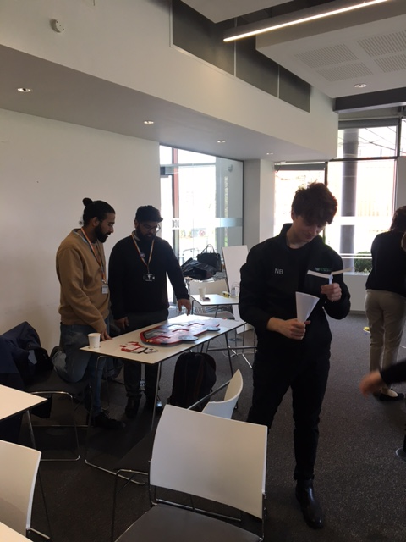
Tip 7: Make the learning explicit
The children need to be clear about what they are learning but also about how you expect them to learn about it (success criteria)
Use these success criteria to allow for peer feedback
Summarise the learning at the end and put the emphasis on the skills rather than the outcomes.

Slide 28
Discussion
What story/ challenge can you build around your activity for them to take part in?
What roles/characters could they play?
What are you going to ask them to test and improve on?
Think of an object you could show the pupils to spark their imagination

Slide 29
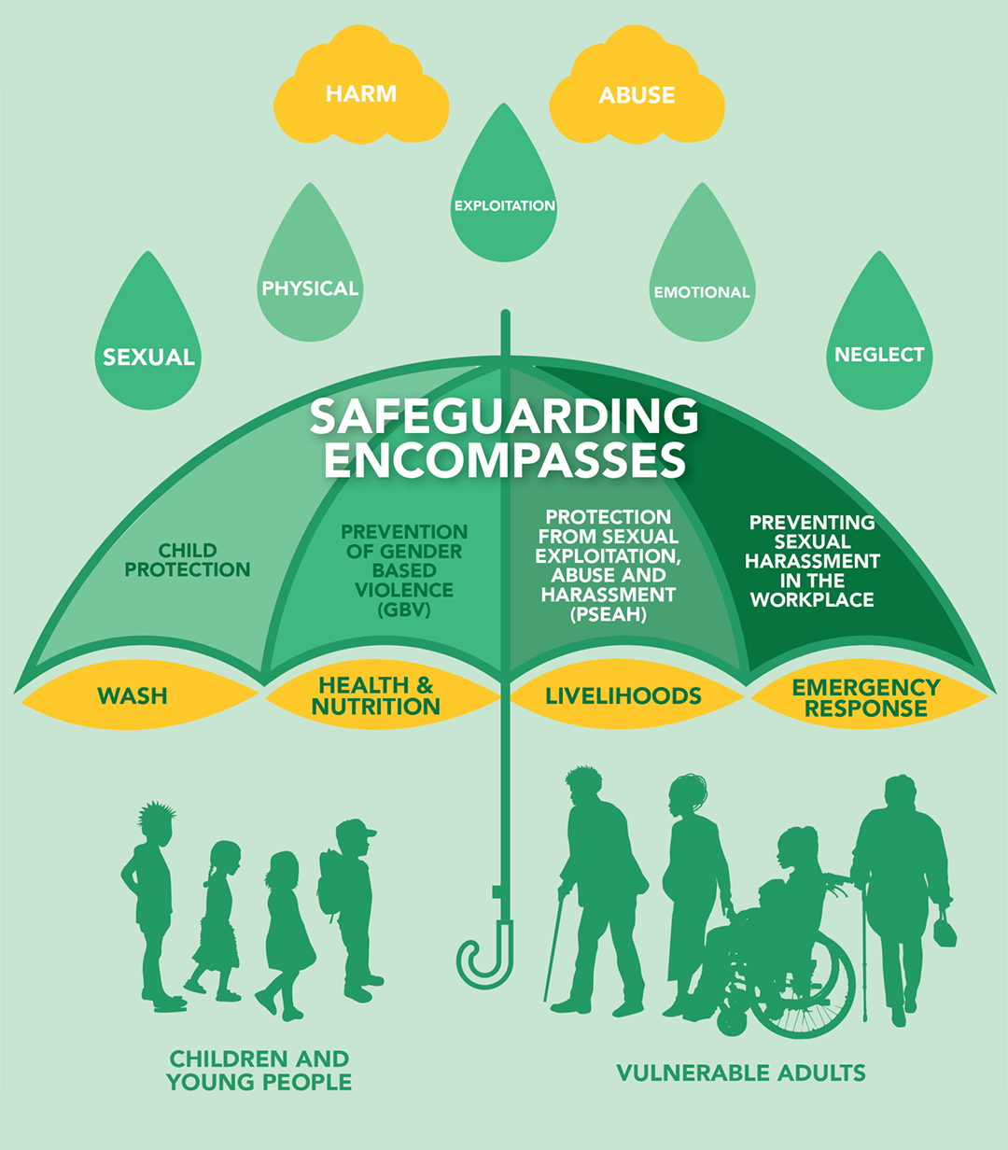

4. Safeguarding
Notes:
Part 4 – 20 min

Slide 30
Reflection
Why is safeguarding important for your role?
What do you need to be aware of in your role?
Where can you get training with the University?
Notes:
Keeping children safe everyone’s business
Boundaries and signs something isn’t right and what to do
Who to report to on the day any concerns?
Safeguarding warwick

Slide 31
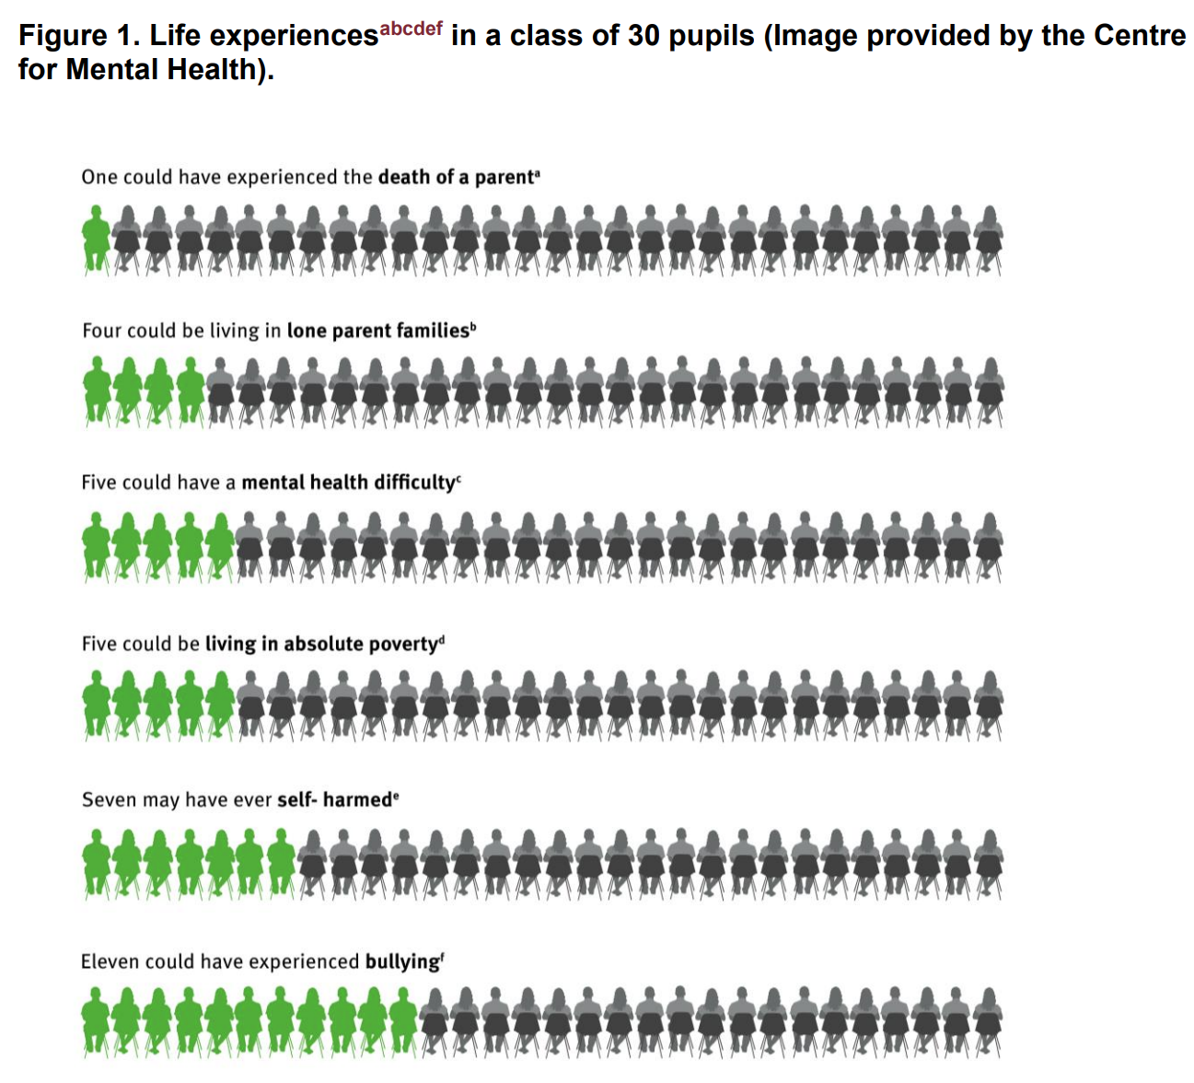
A range of circumstances
Notes:
Be mindful of your language, behaviour and tone/volume of voice, the topics discussed and what this can trigger for the young person

Slide 32
Disclosure Procedure (NSPCC)
Listen carefully
Tell them it's not their fault
Say you will take them seriously
Let them know they've done the right thing
Explain what you'll do next
Don't delay reporting
Notes:
Listen carefully to the child. Avoid expressing your own views on the matter. A reaction of shock or disbelief could cause the child to 'shut down', retract or stop talking
Let them know they've done the right thing. Reassurance can make a big impact to the child who may have been keeping information secret
Tell them it's not their fault. Often it is never the child's fault and they need to know this
Say you will take them seriously. A child could keep information secret in fear they won't be believed. They've told you because they want help and trust you'll be the person who will listen to and support them.
Explain what you'll do next. Explain to the child you'll need to report the information to someone who will be able to help
Don't delay reporting. The sooner the information is reported after the child discloses the better. Report as soon as possible so details are fresh in your mind and action can be taken quickly.

Slide 33
‘Safeguarding is also about safeguarding yourself’
Think about your professional conduct
Maintain professional boundaries – language, topics etc.
Avoid physical contact
Remember actions can be misinterpreted
Do not allow anyone outside the event to interact with the young people.
Do not contact young people after an event
Remove yourself from any uncomfortable situation and report it
Keep yourself safe
‘Friendly not Friends’
‘Stay in earshot and eyeshot’
Notes:
Professional conduct – remembering that safeguarding isn’t just about the child, it’s about safeguarding yourself as well. If you see actions taken by another student or staff that doesn’t seem right it is important to report.
Contact after an event
- EMAIL – Don’t give out email address or social media account details. If a young person has questions they can email the outreach account and we will piggy back responses.
- SOCIAL MEDIA – Don’t give out social media account details to young people. Ensure that privacy settings on accounts are sufficient and if a young person adds you, please let us know.
NAME BADGES – do not give your full name
If you are working by yourself or late, keep yourself safe

Slide 34
Discussion
A young person answers a number of questions in a session. Other pupils laugh and make comments. Later, threats are made to harm the young person after the session.
You are working with a young person and you notice some cuts on their arm. When they realise you’ve noticed, they quickly pull down the sleeve of their jumper.
You realise one student is talking about inappropriate/explicit topic content. You overhear this but are not directly involved in the conversation.

Slide 35
Resources
Contact: M.L.Diebolt@warwick.ac.uk
OUTREACH EVENT PLANNING and EVALUATION TOOLKIT https://warwick.ac.uk/fac/sci/wmg/about/outreach/organiseevent/
Contact: safeguarding@warwick.ac.uk

Slide 36


