Slide 1


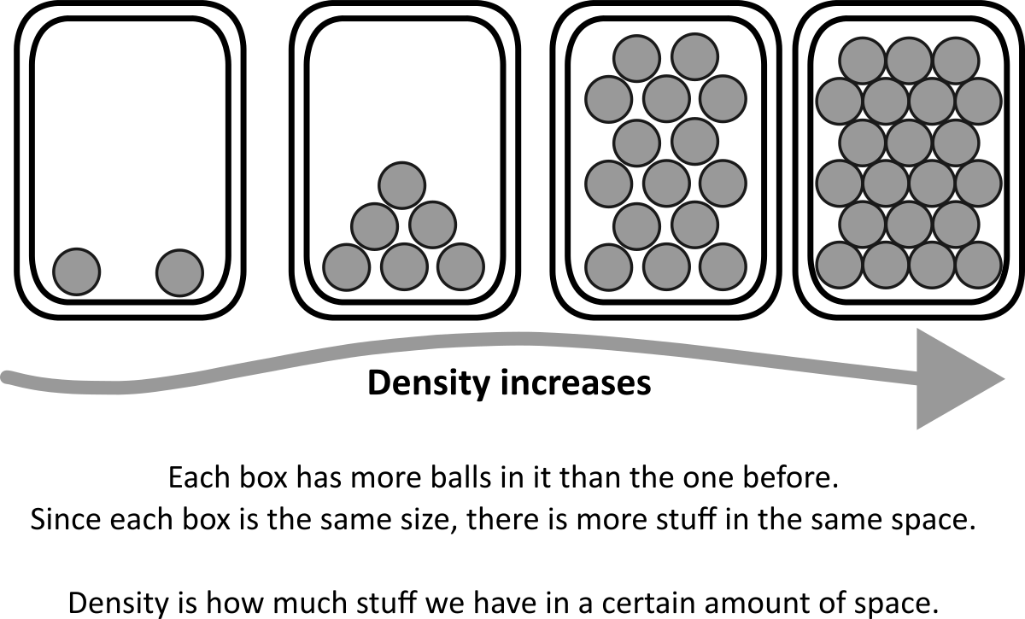


Name of the activity
Thinking about CONCEPT
Explain your concept in a couple of sentences and introduce key vocabulary
Include a visual representation
of your concept
State laws / rules applying to your concept
State laws / rules applying to your concept
A question to pose a problem to solve?

Slide 2
Activity name
Title of your activity
Introductory sentence for your activity.
What you will learn
Learning outcome 1
Learning outcome 2
What you will need:
List
Of
resources
What you need to make/do:
Outcome
How to make/do your activity:
Instructions
Step
By
Step

