Slide 1
Christmas Engineers
How are products and decorations manufactured?

Slide 2
LO: we are learning how products are manufactured
Success criteria:
I can describe how a product can be made from flat materials.
I can make a product using those methods.
I can identify the advantages and disadvantages of this type of manufacturing.

Slide 3
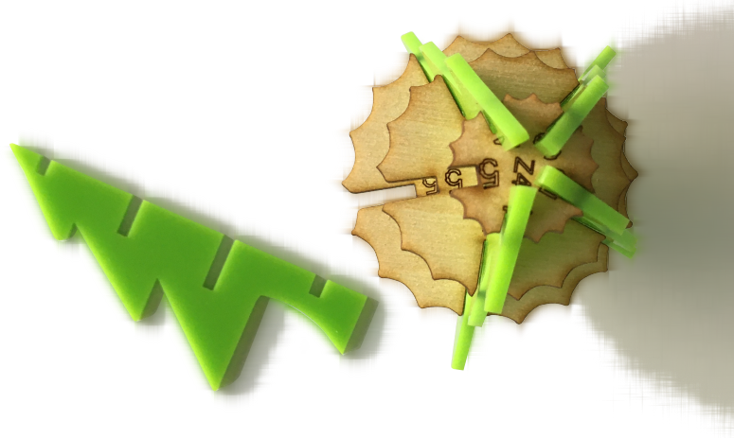
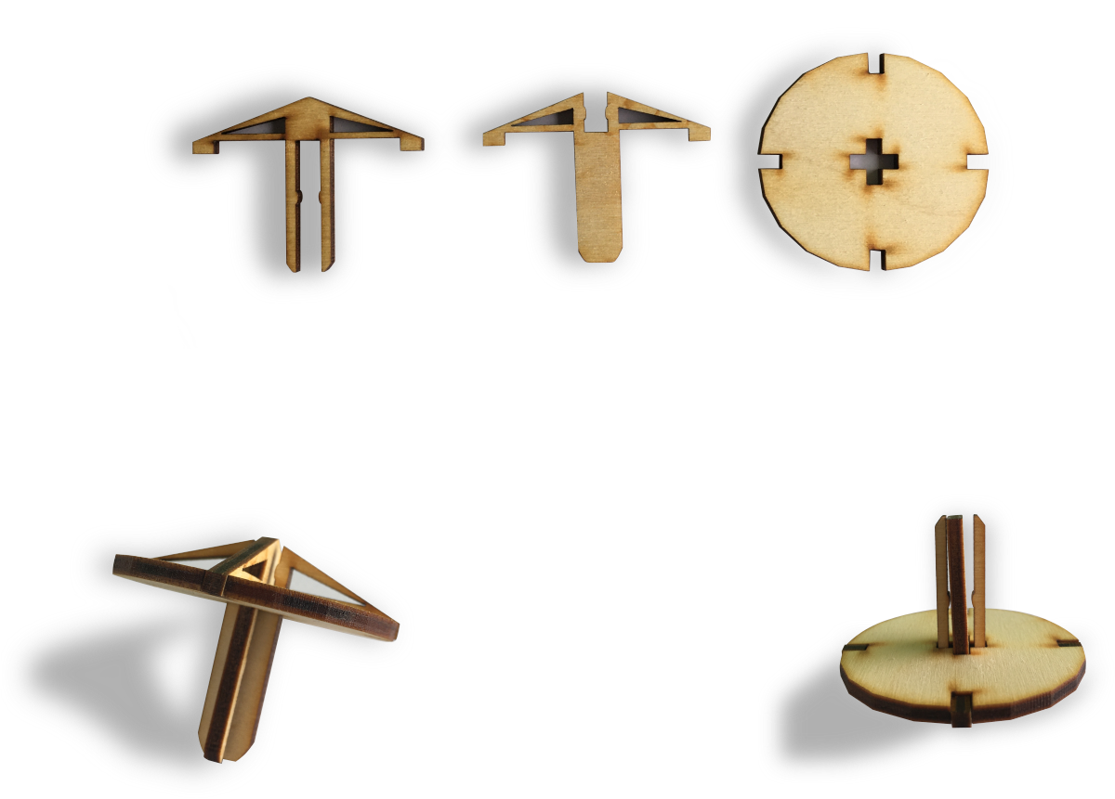
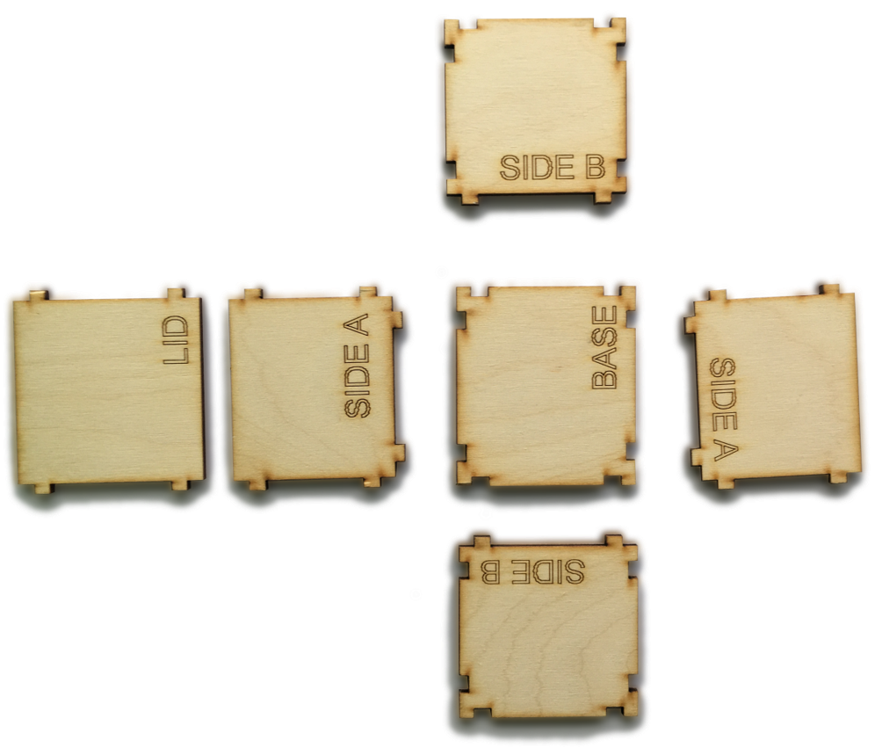
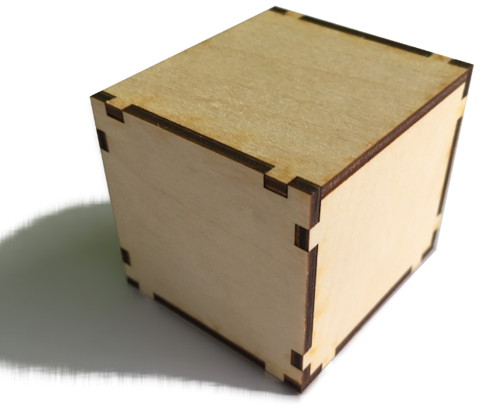
Manufactured Products

Slide 4

Manufactured Products
1. Look at the assembled products.
2. Discuss:
What material(s) are they made of?
How do the pieces join together?
What features make the product stable?
How were the pieces made?

Slide 5
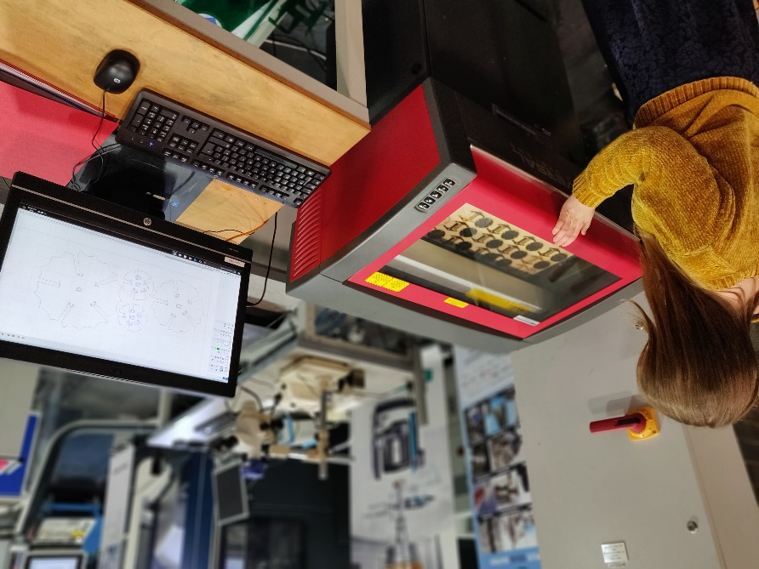
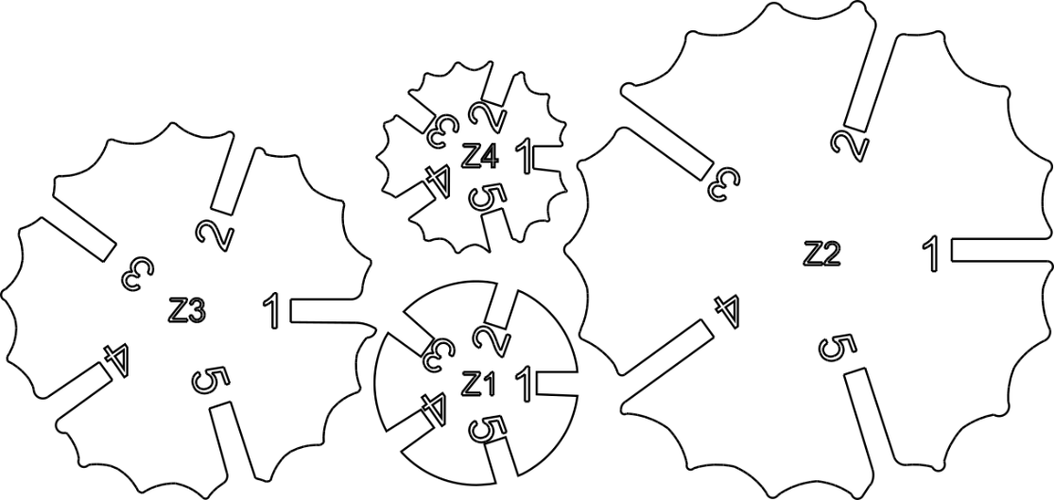
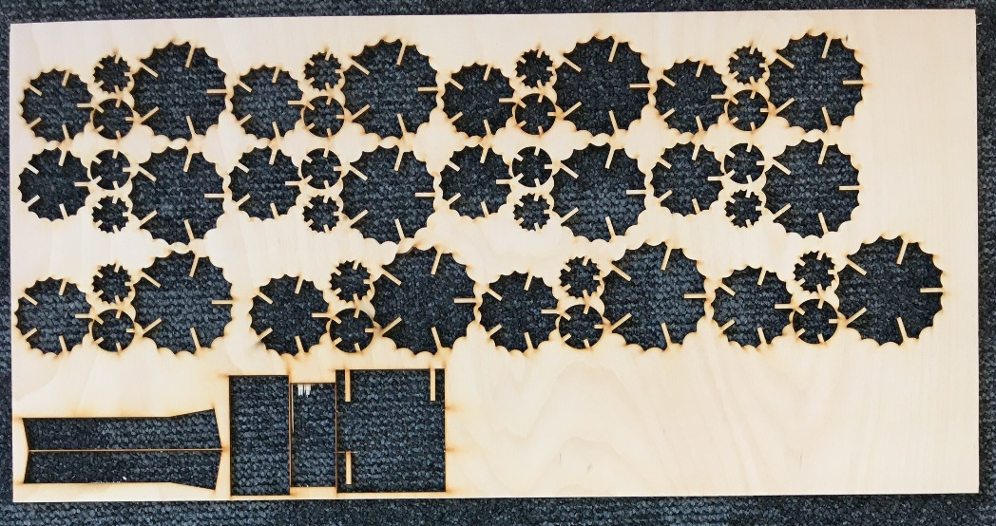
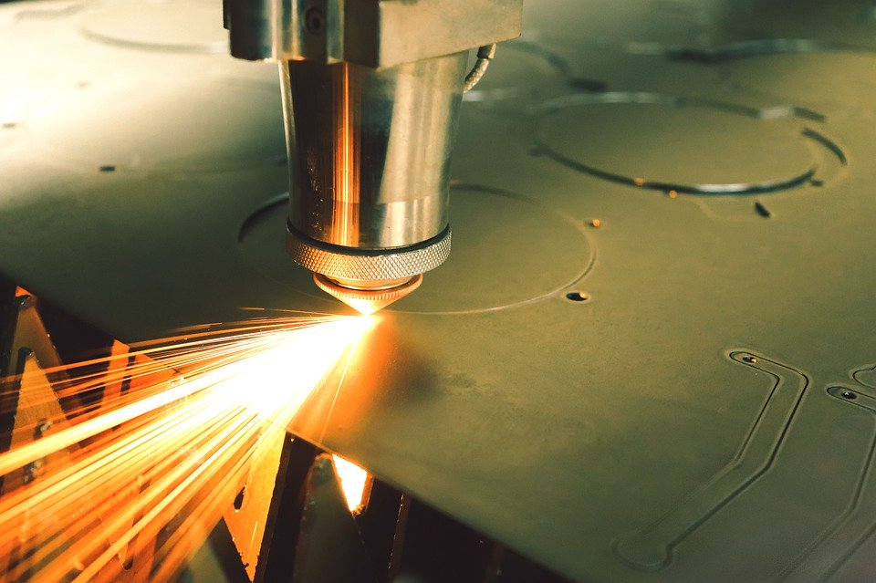
Laser cutting
What are the advantages and disadvantages of laser cutting?

Slide 6
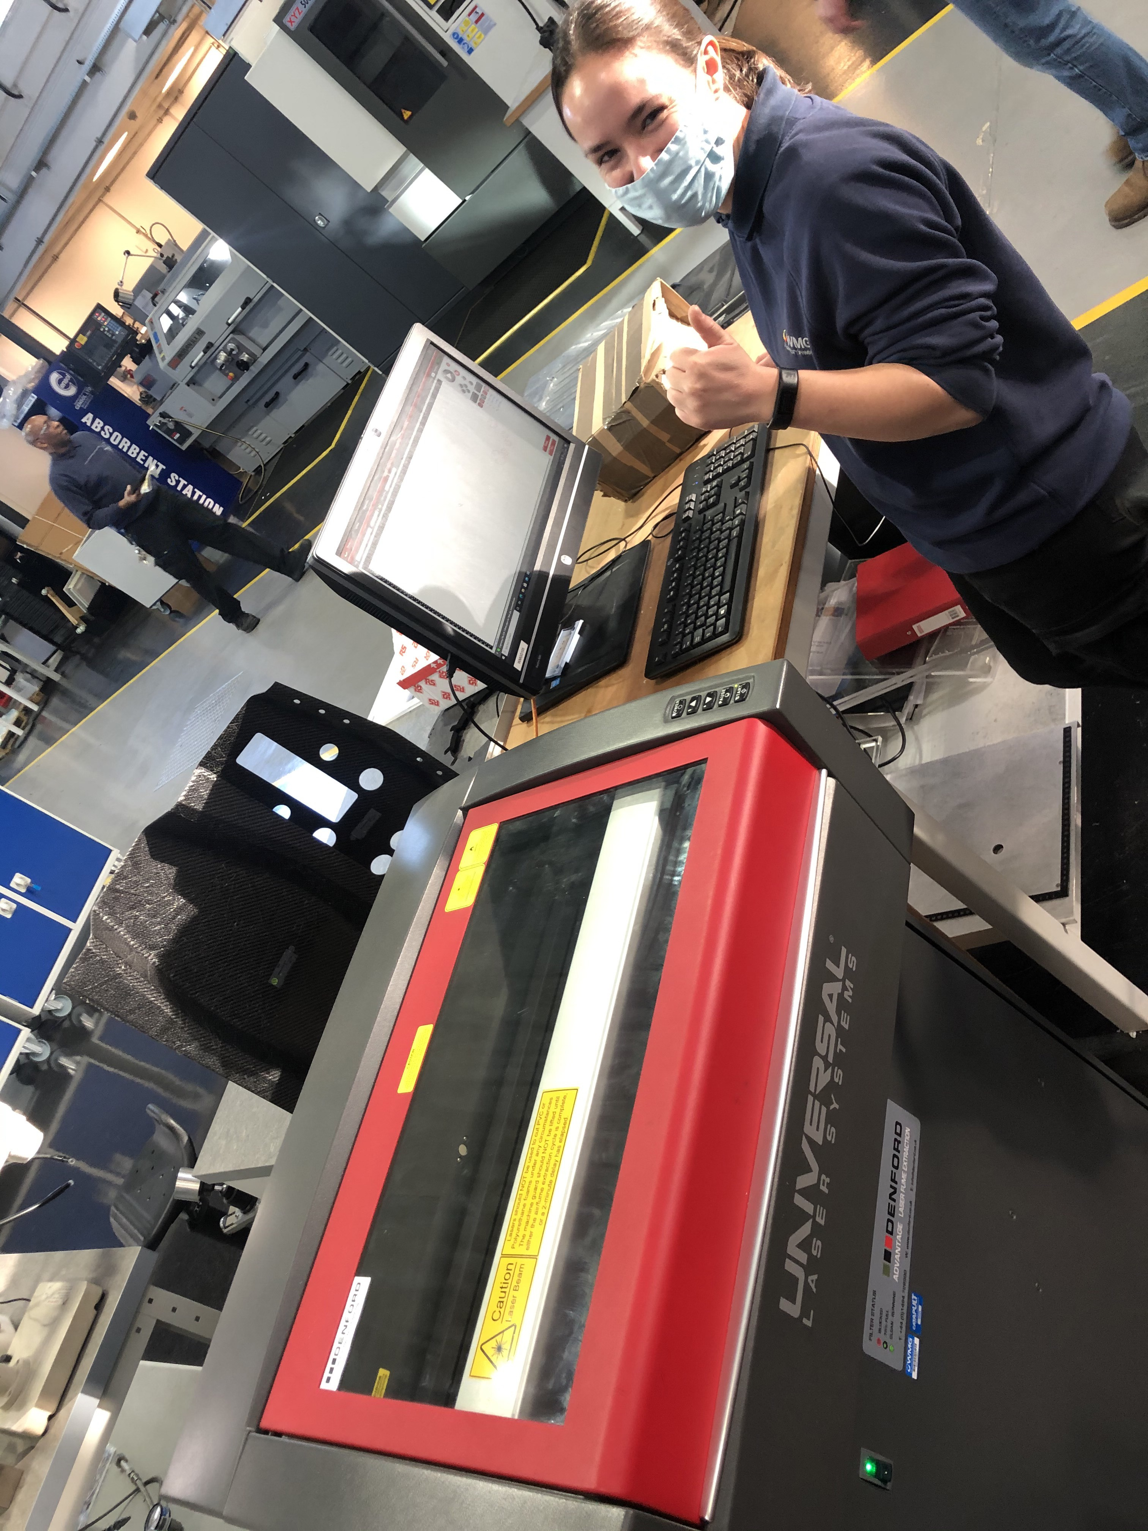
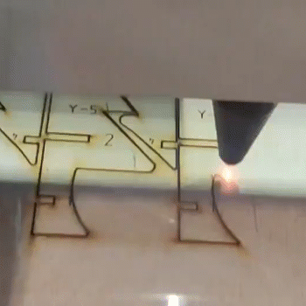
Laser cutting – in action!
A laser is an incredibly bright beam of light that cuts through wood because of how hot it is!
Beth tells the
computer what
shapes she wants the
laser to cut out and
then just clicks "Go"!

Slide 7
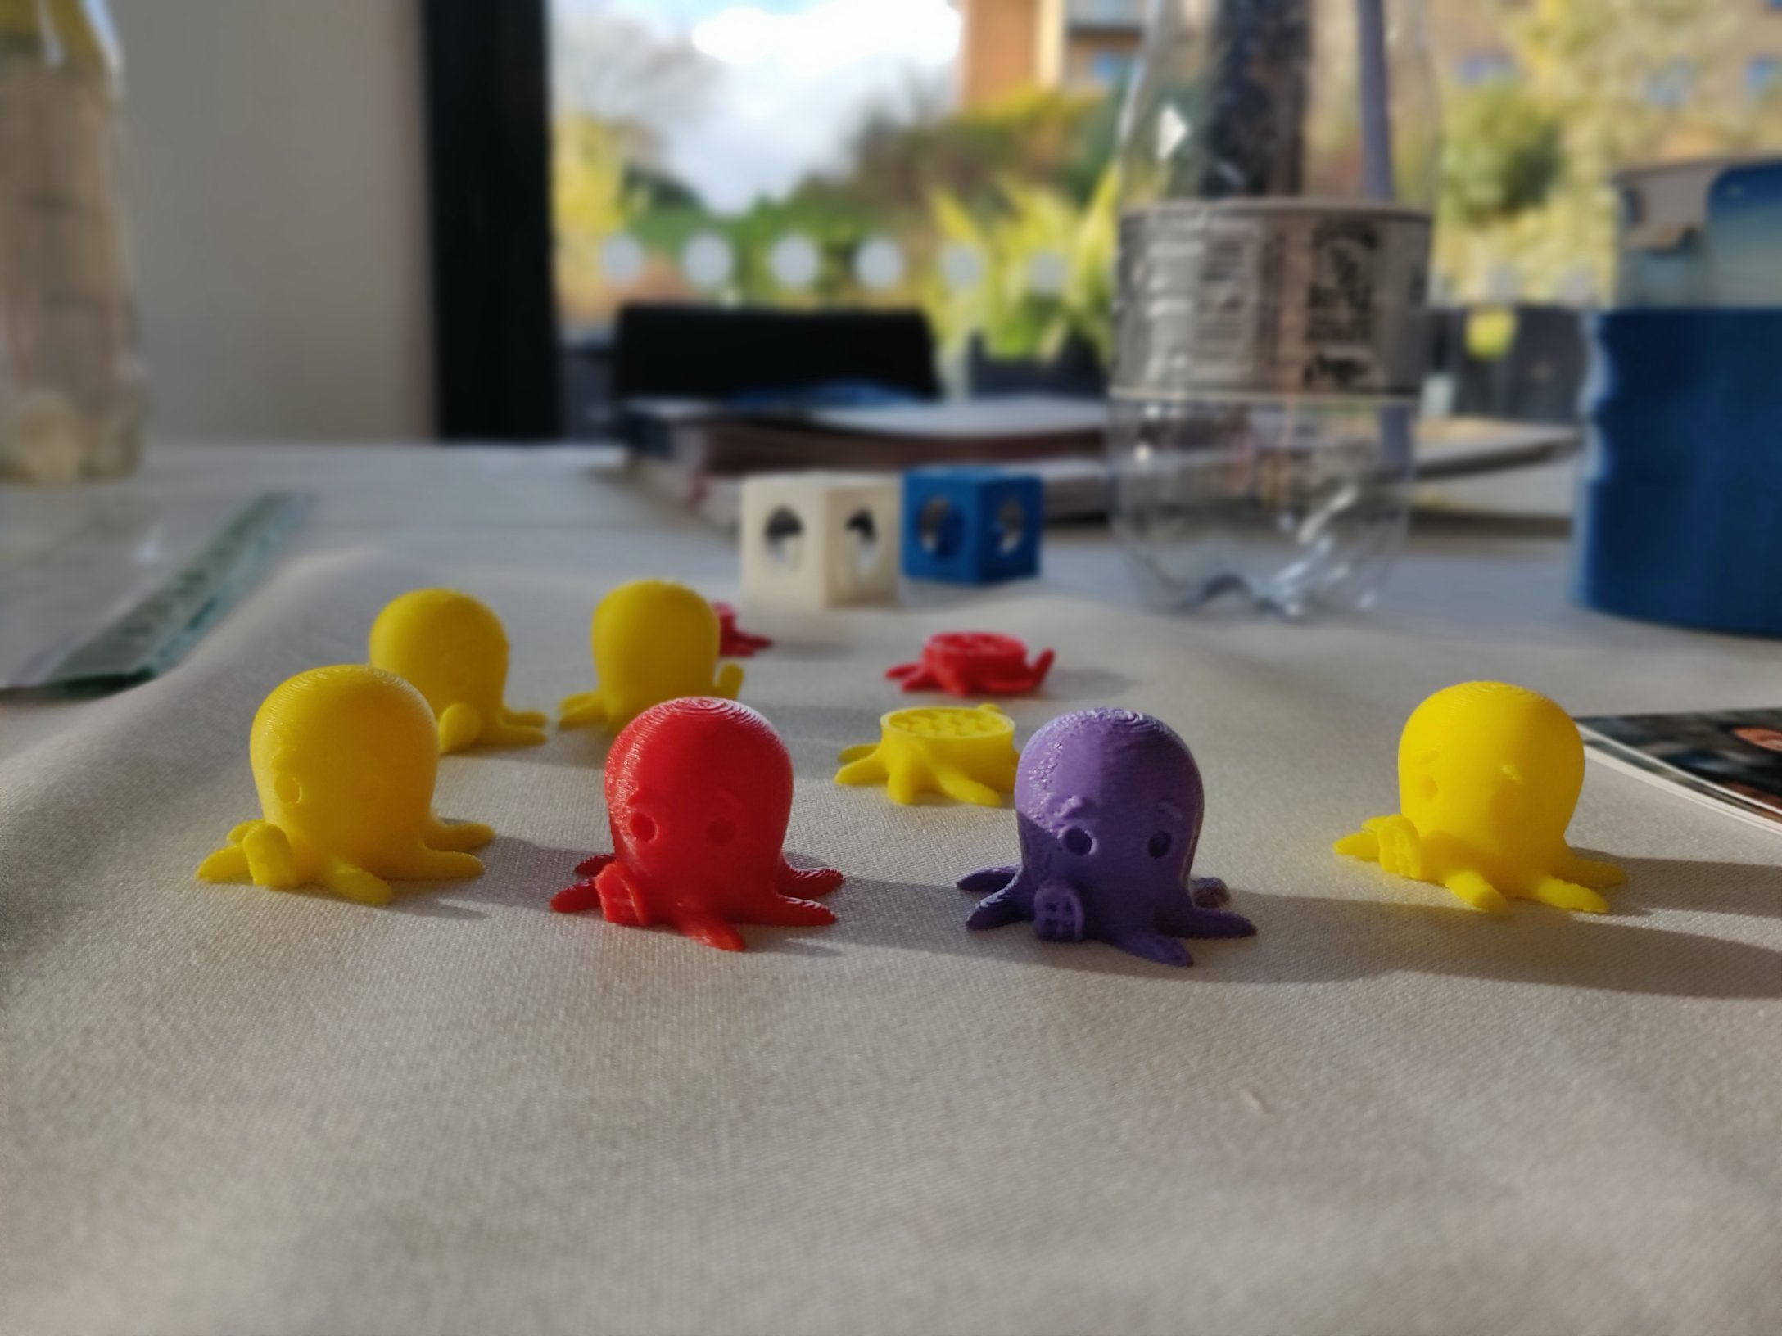
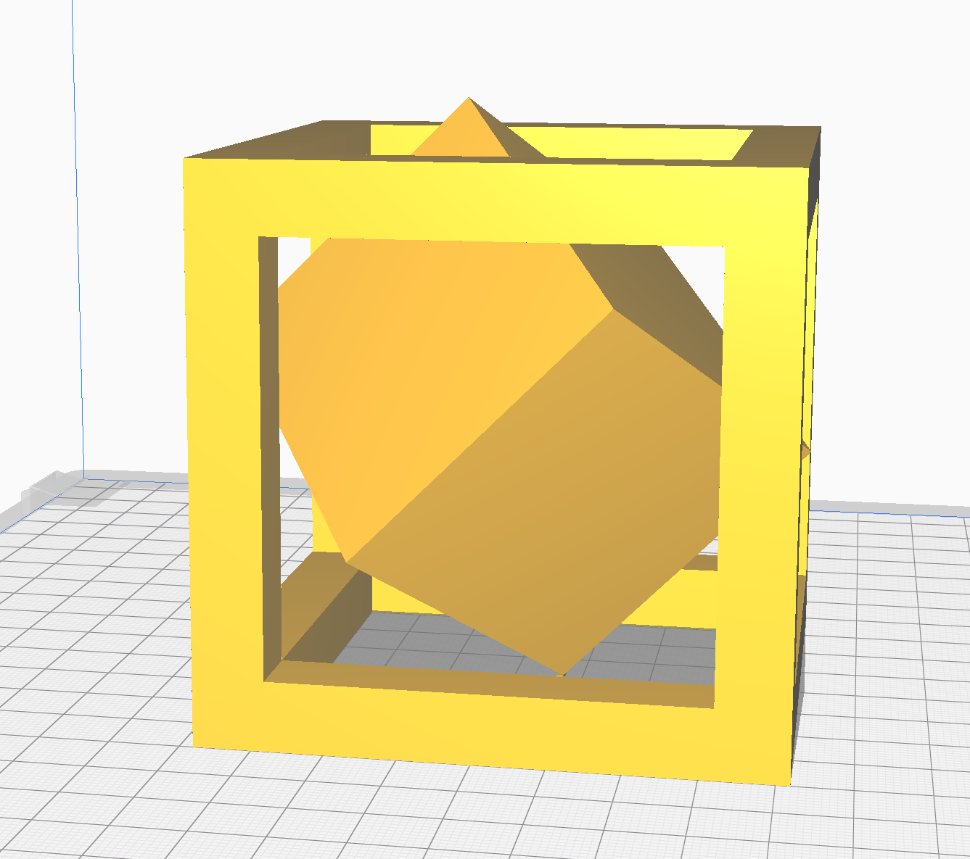
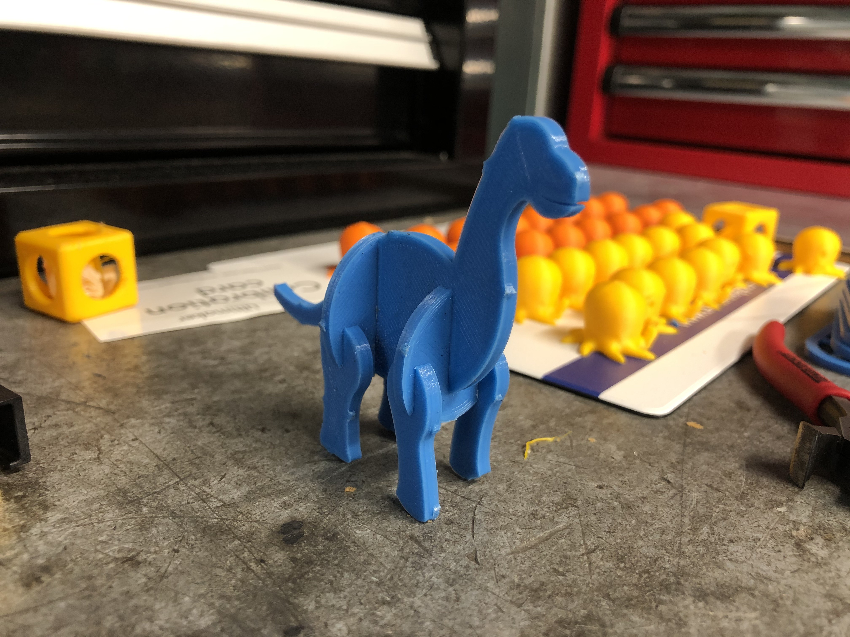
3D Printing
How do you think these pieces were made?
How did the small cube get inside the big cube?

Slide 8
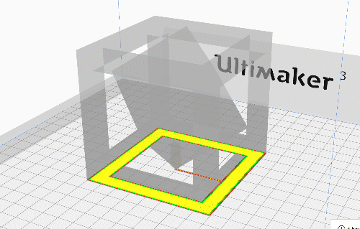
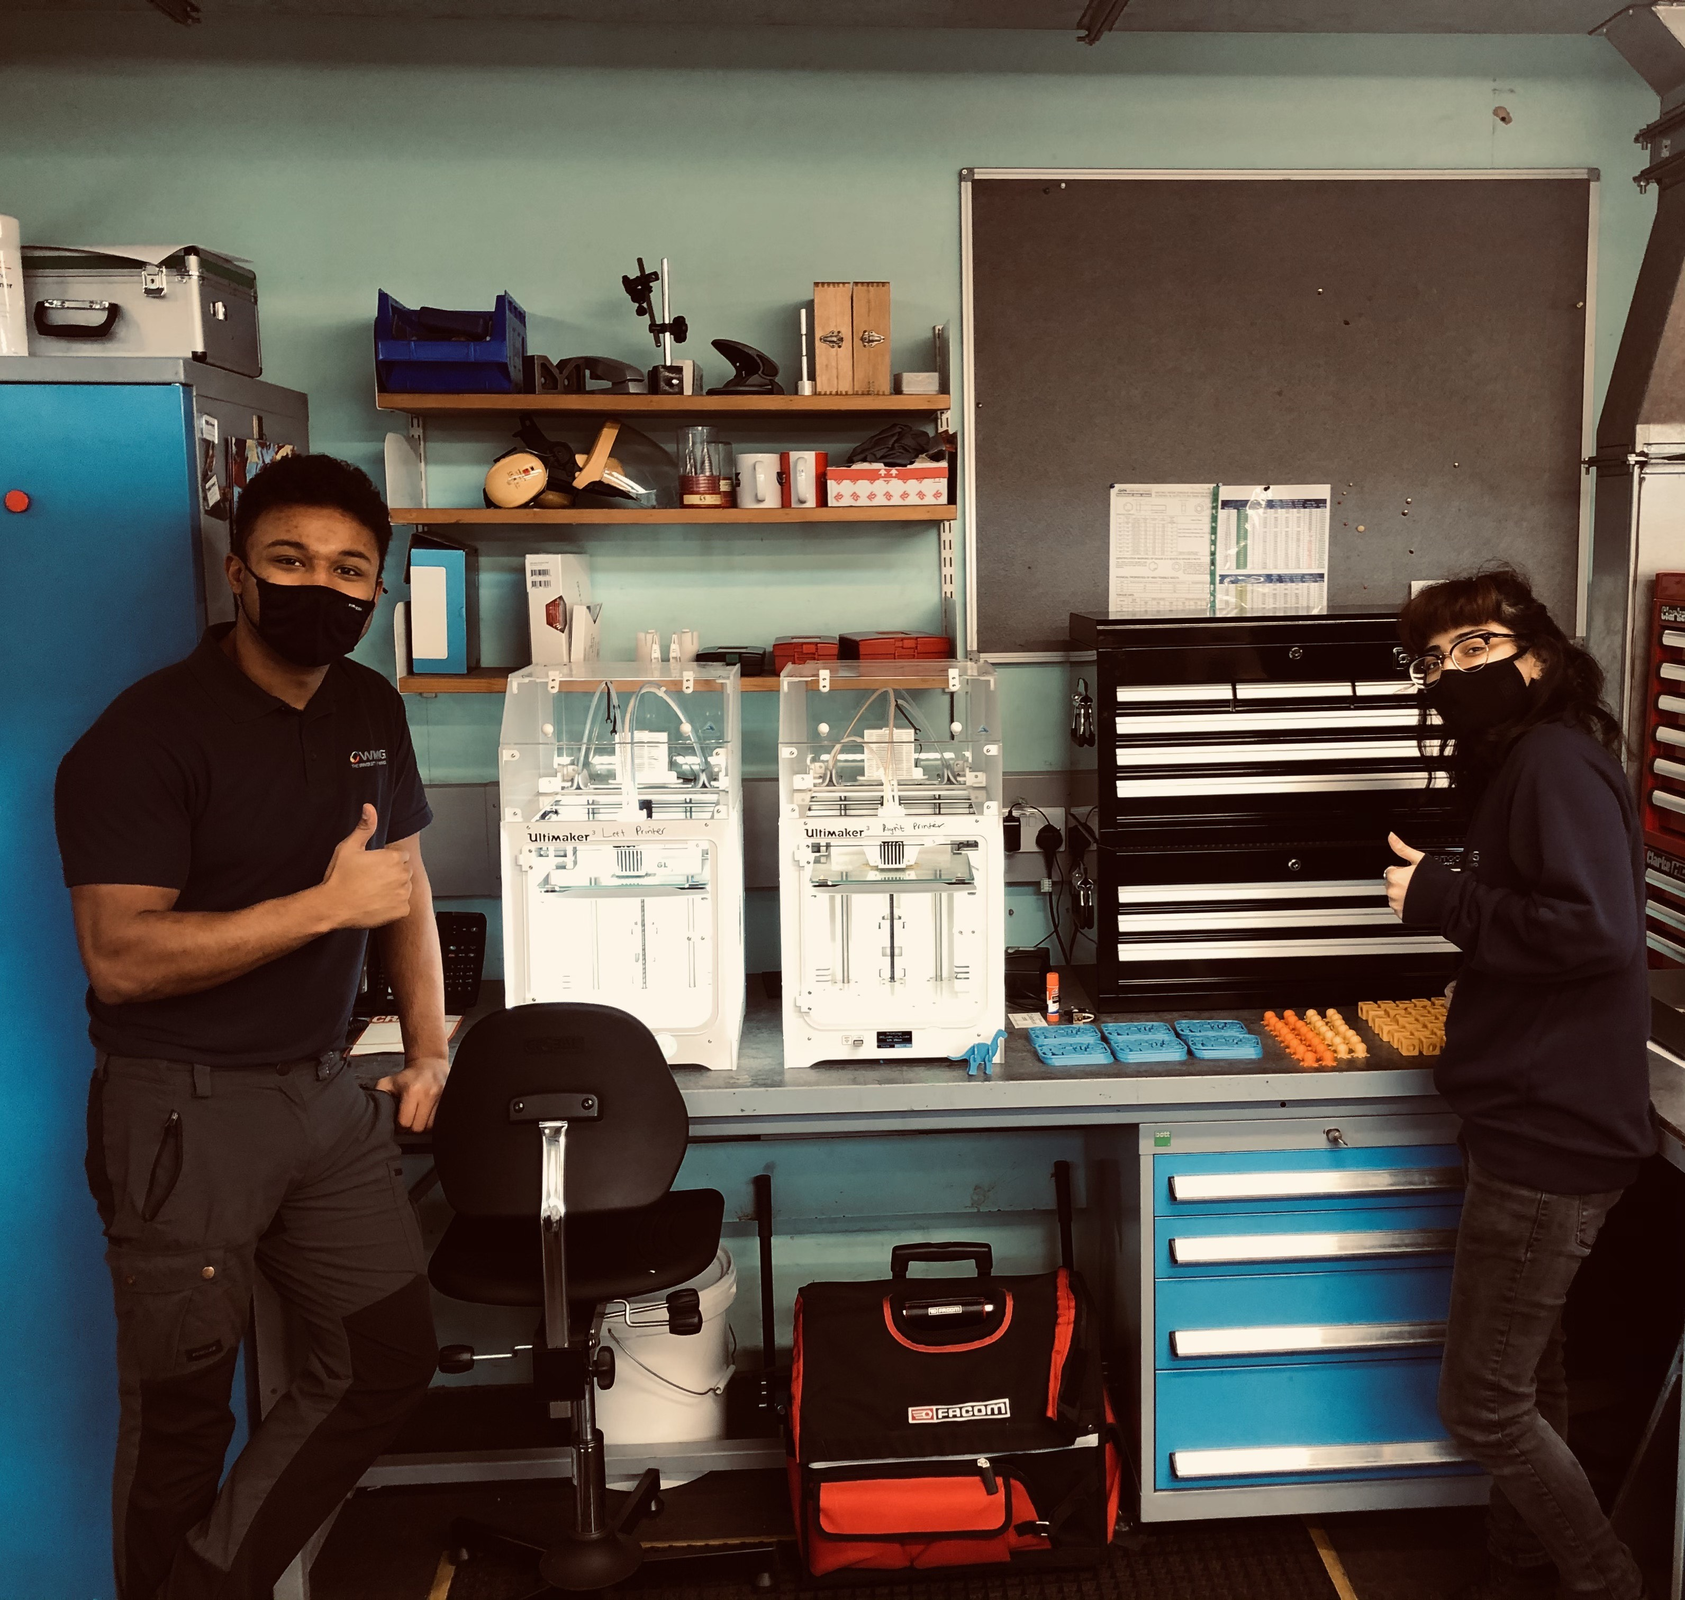
3D Printing
A robot controls a tube that squeezes out melted plastic.
It hardens as it cools down again.
The items are built up layer by layer!
Joe and Ehm printing
the plastic parts

Slide 9
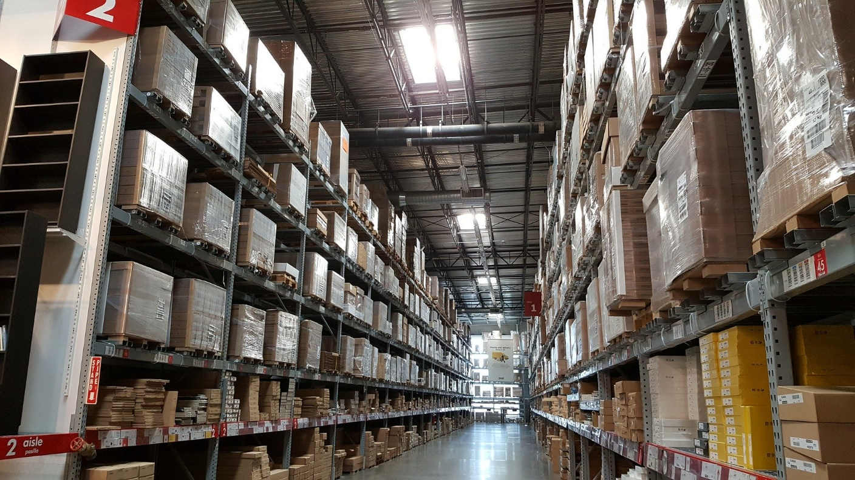
Where have you seen products flat-packed before?
What products can you think of that are bought like this?

Slide 10
What are the advantages of flat-packing products instead of sending them to the user ready-made?
What are the disadvantages?
Think about the manufacturer and the user.

Slide 11
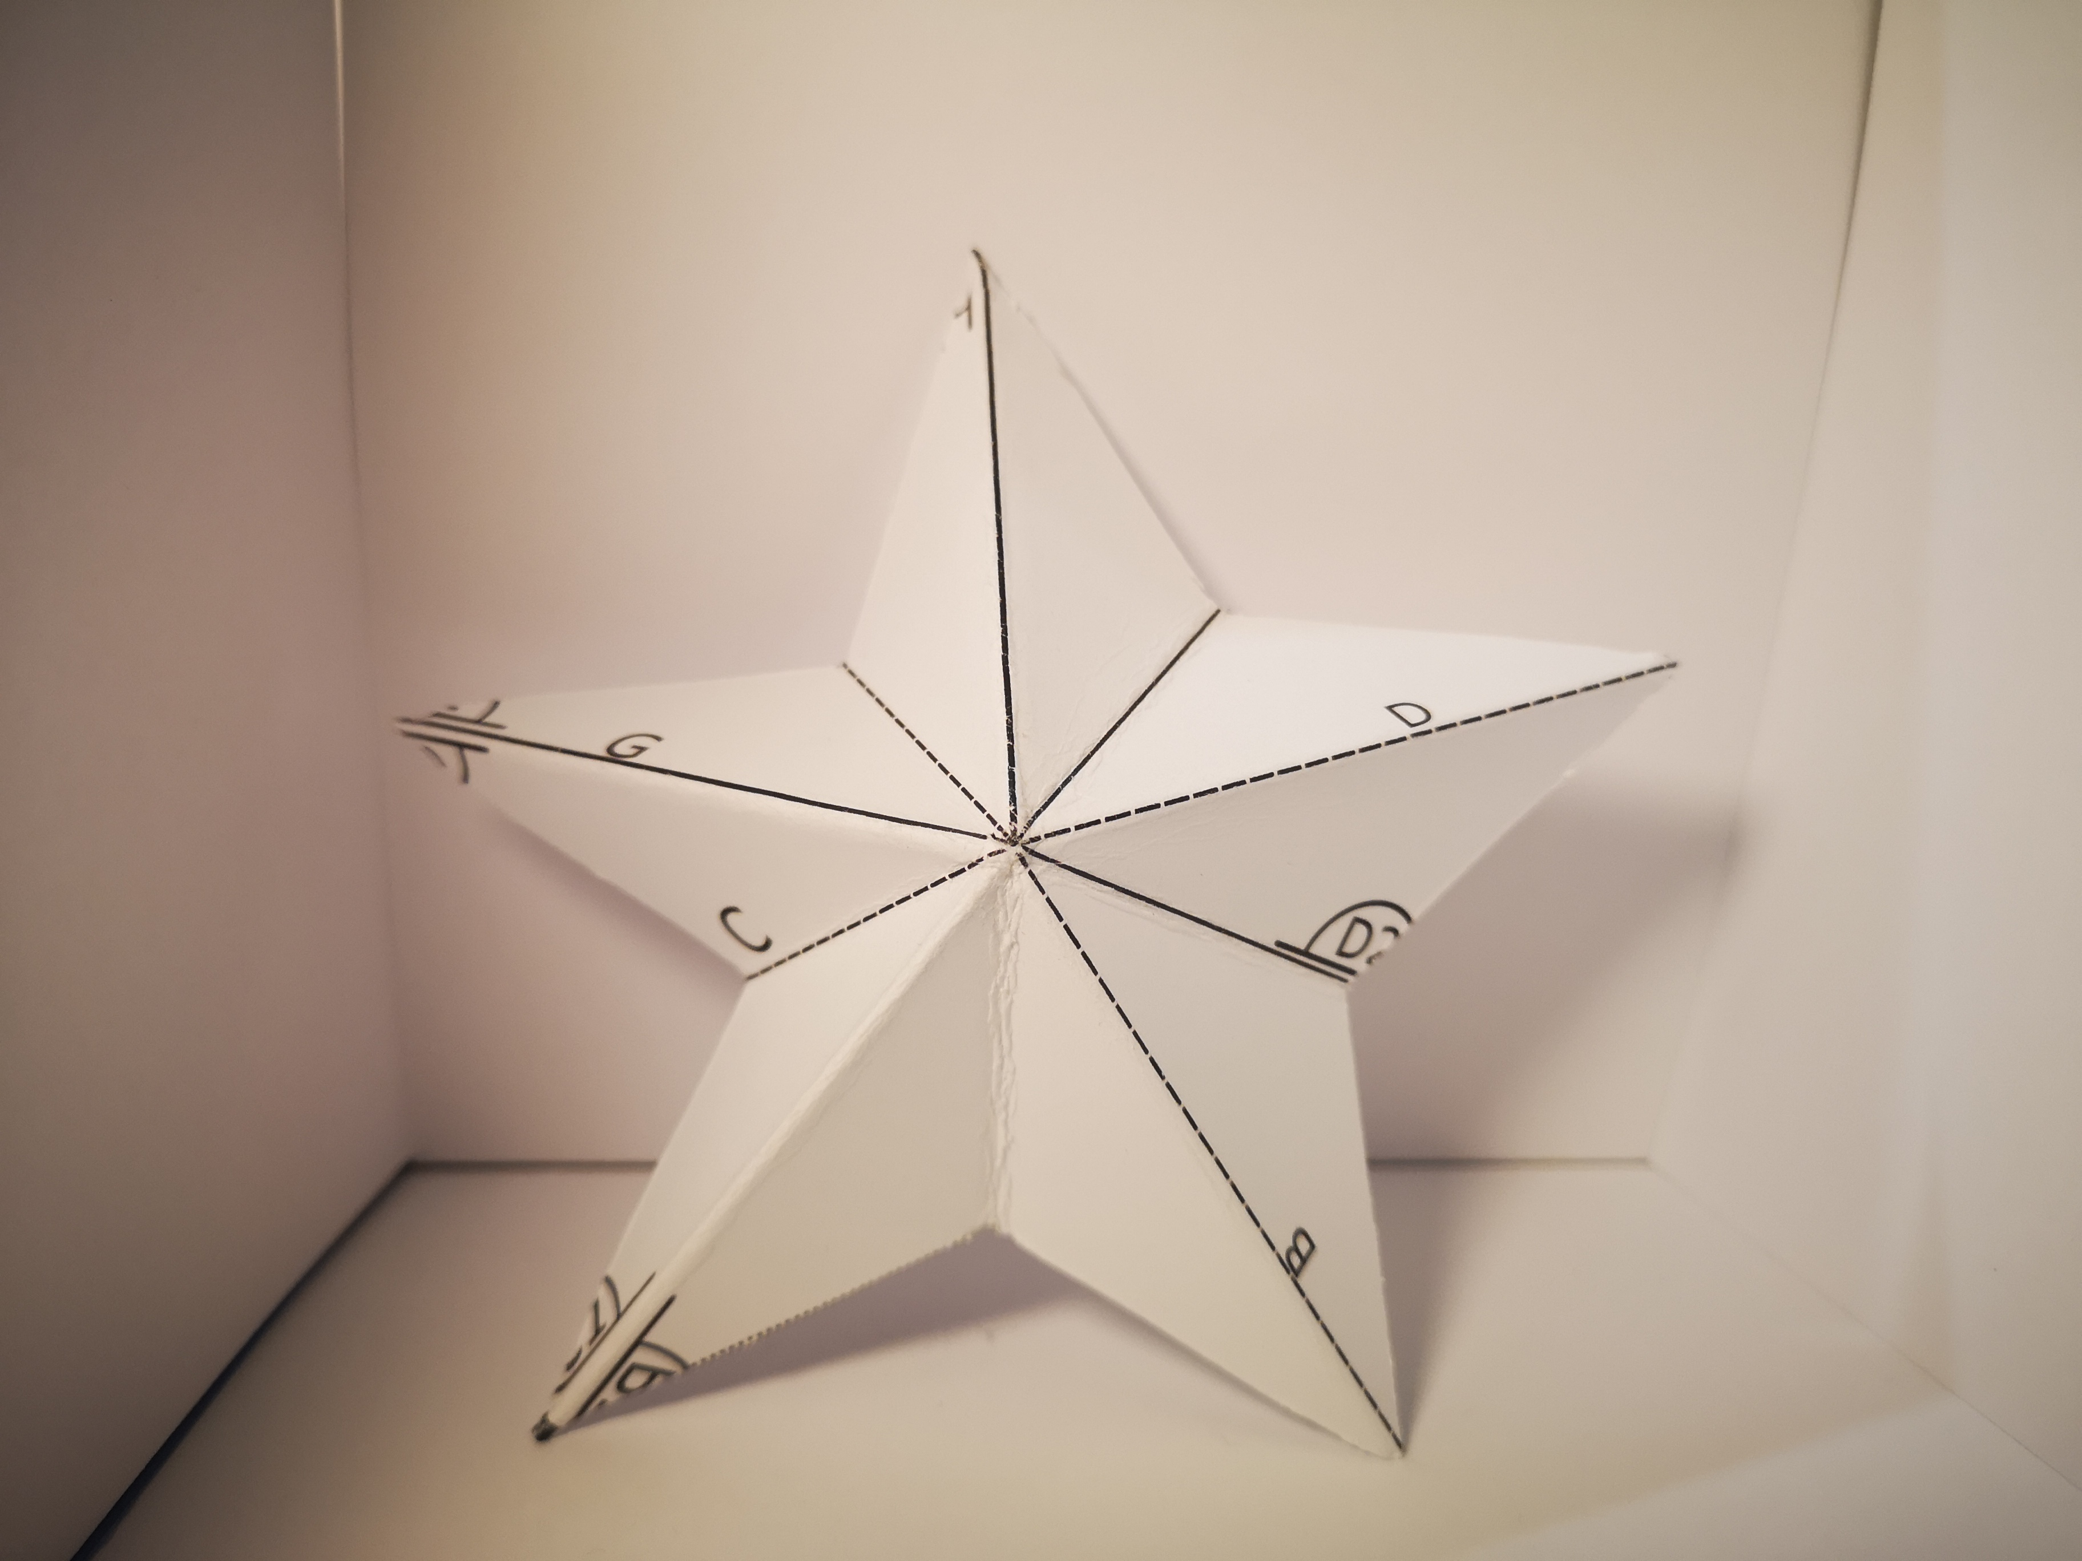
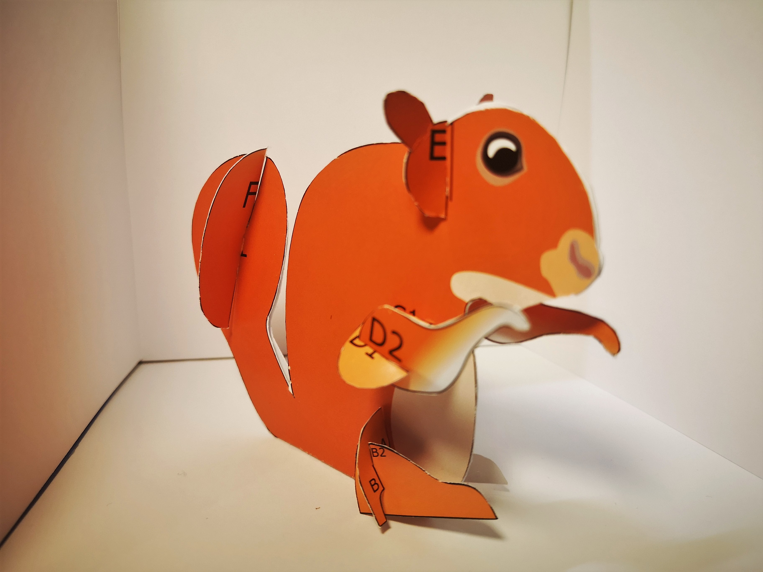
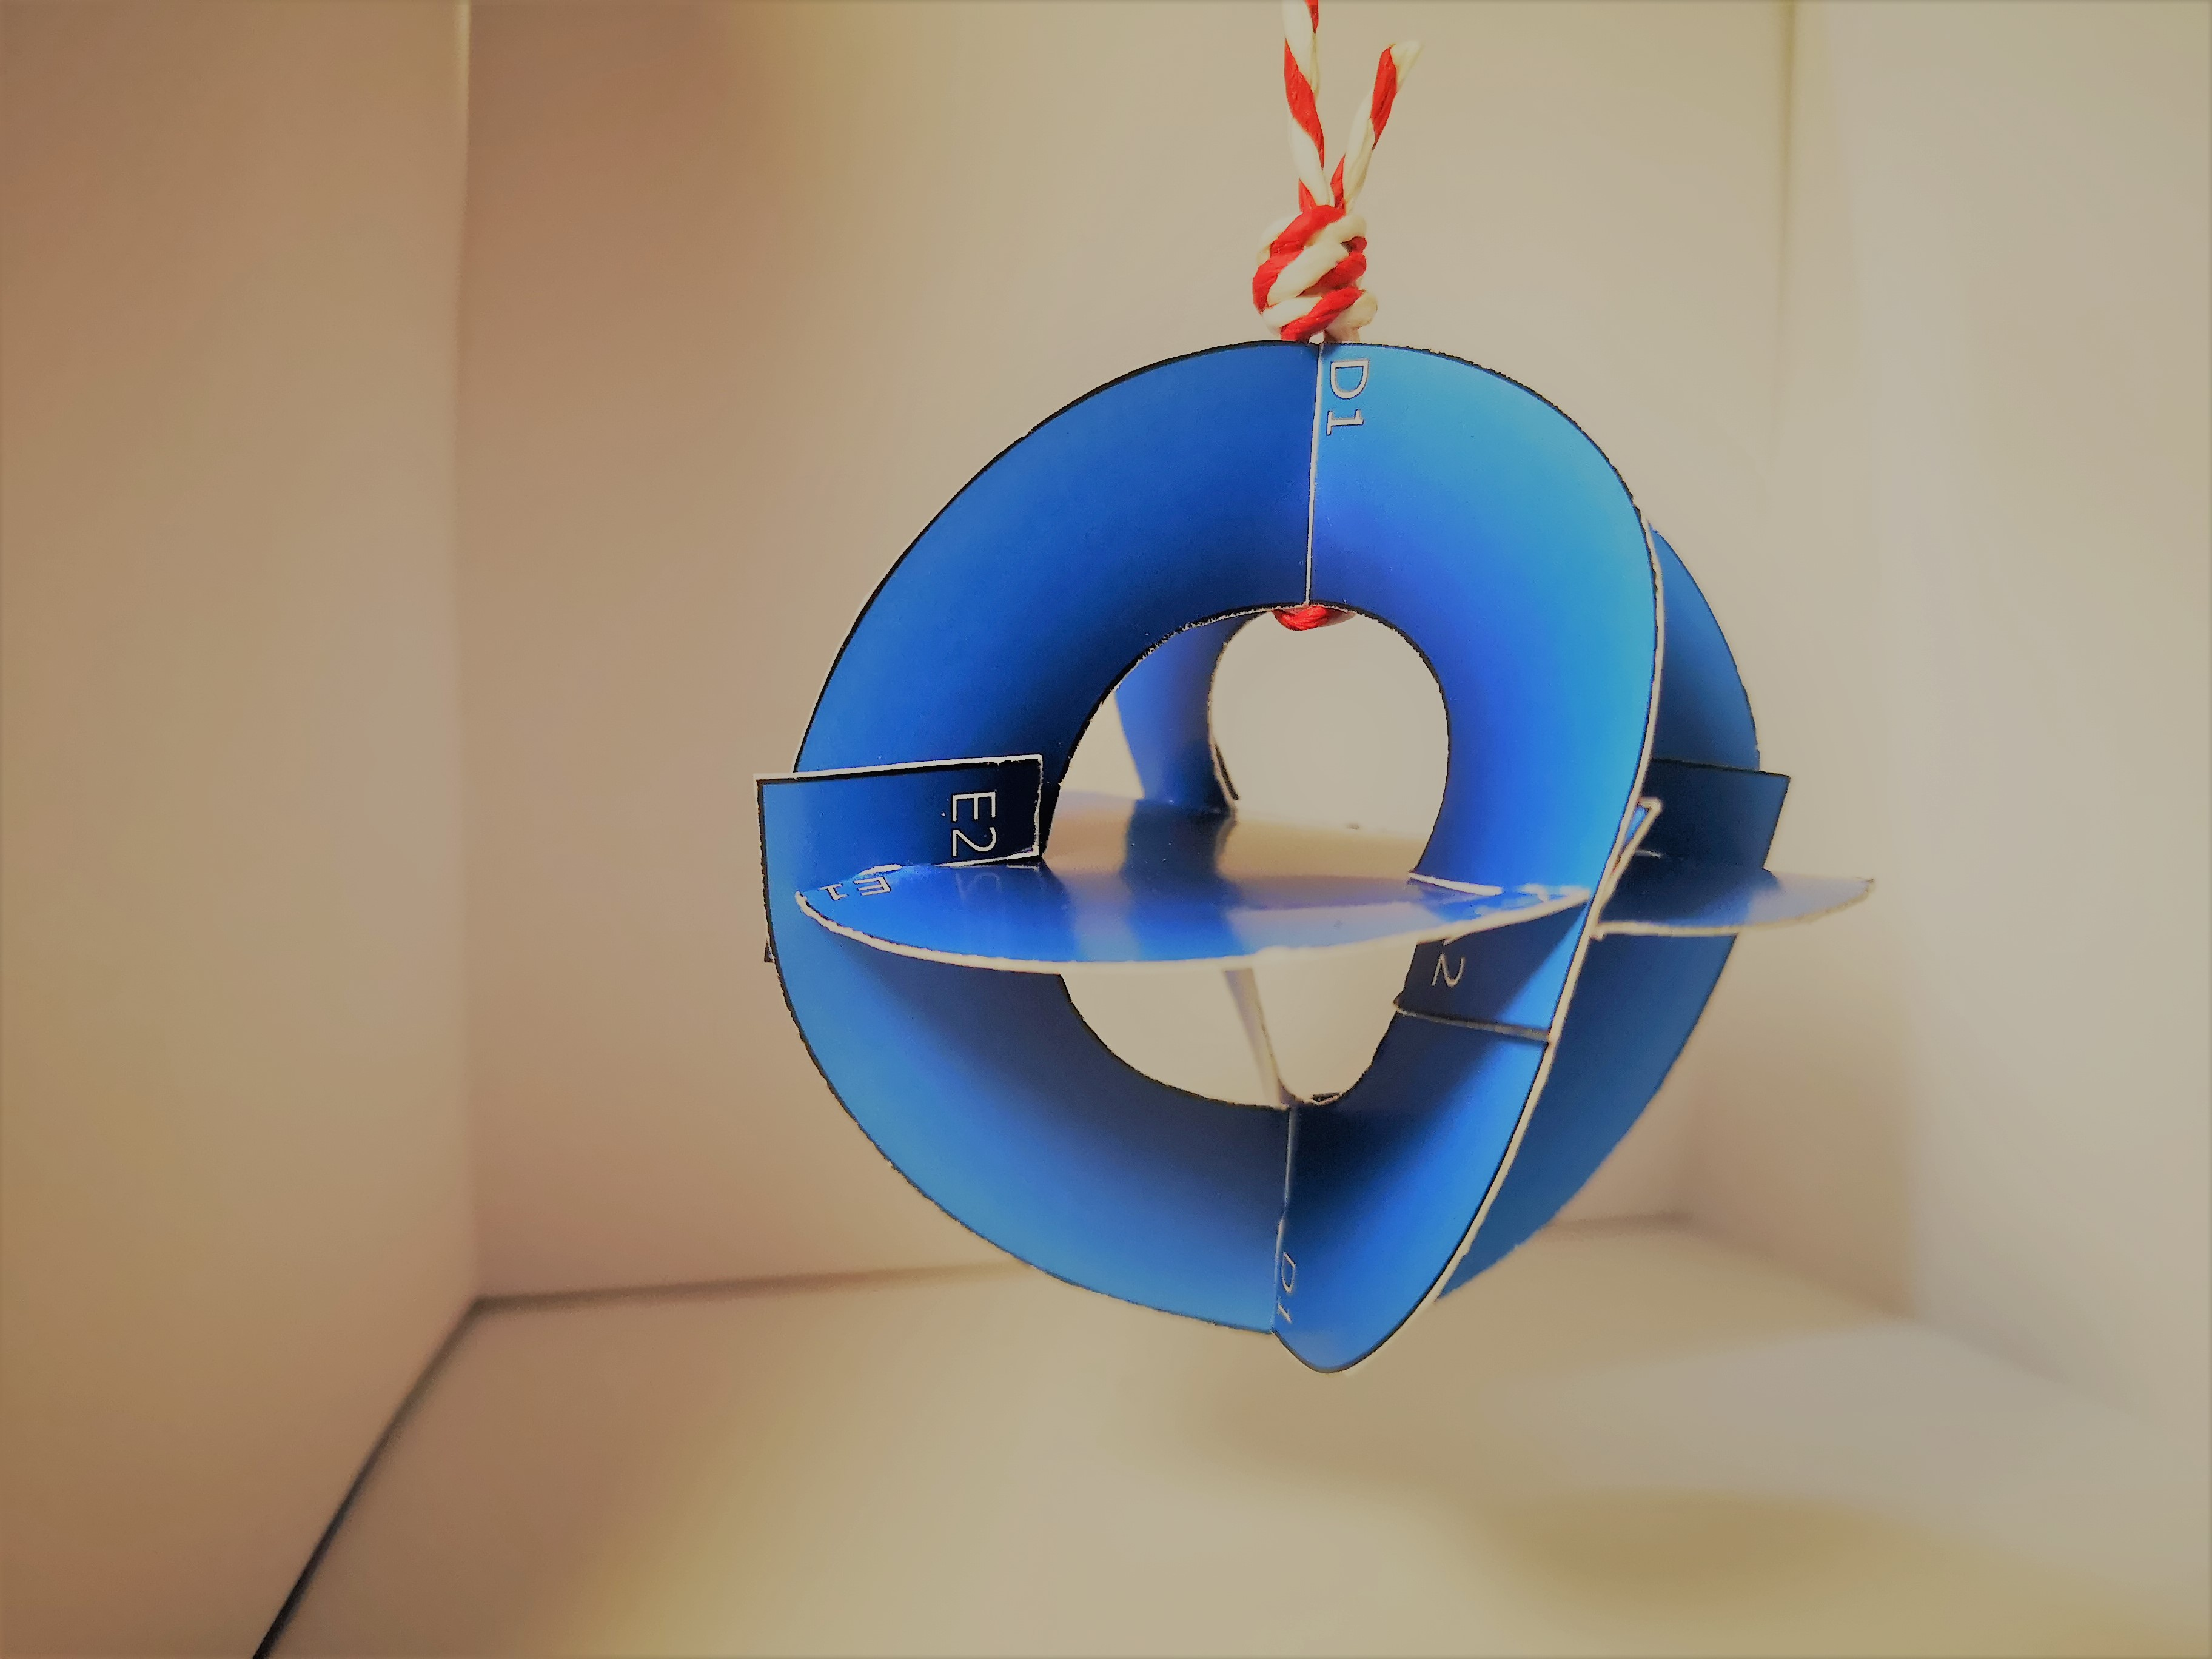
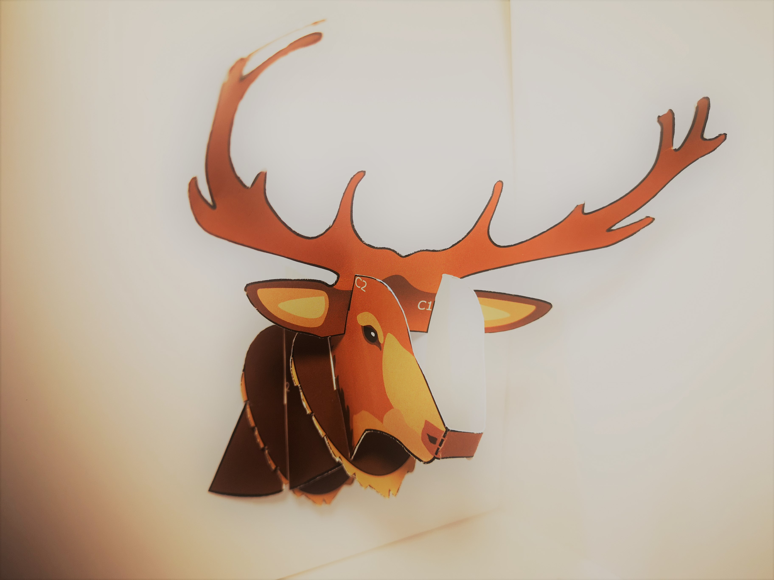
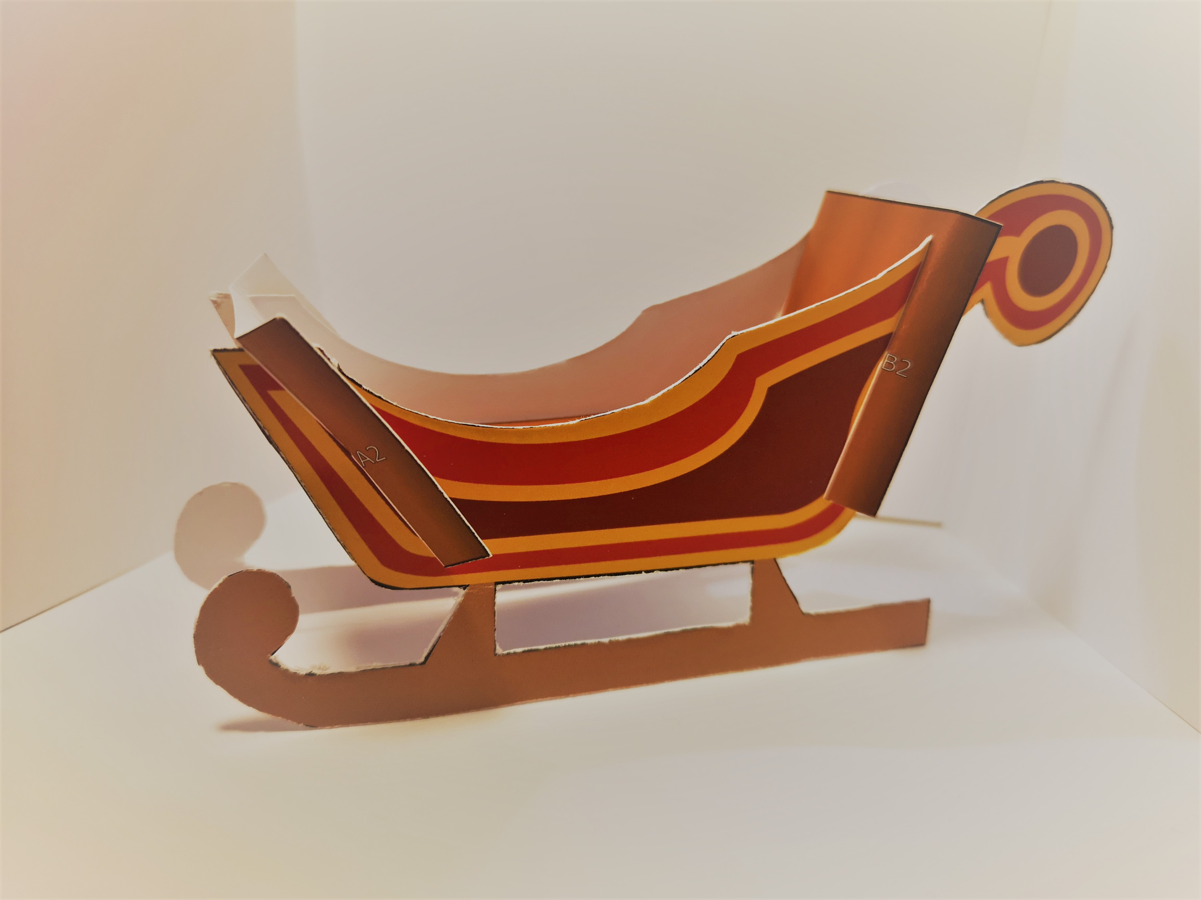
Practise making a 3D shape
Follow the steps on your template. Think about how the flat sheet turns into a 3D object!

Slide 12
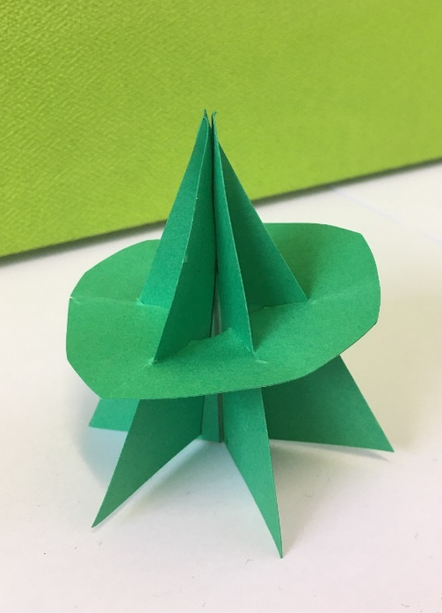
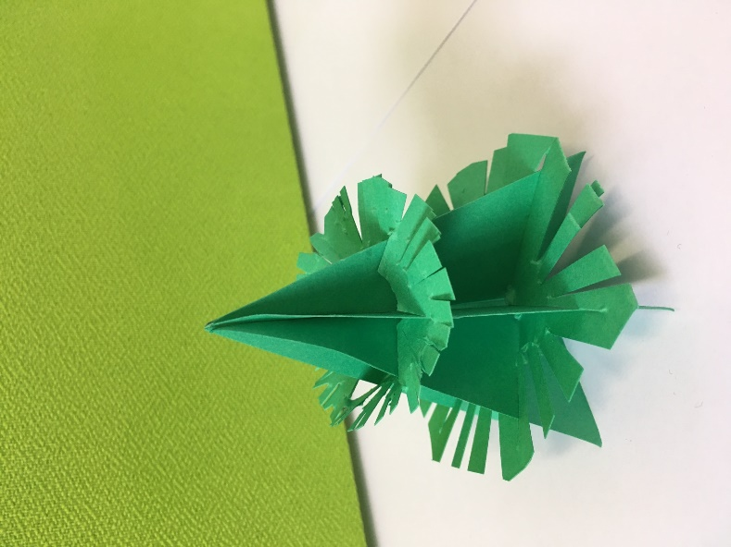
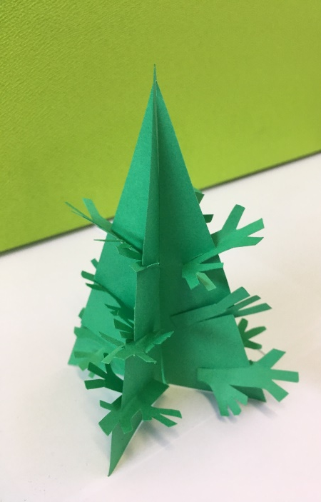
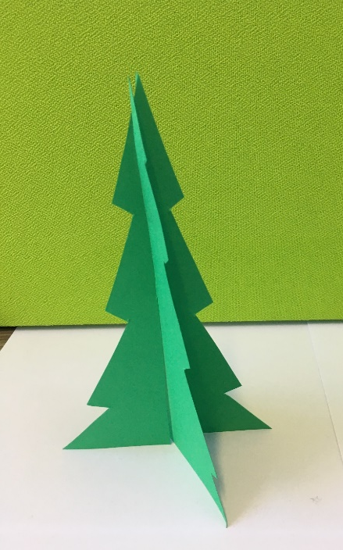
Now you will make your own product using similar methods.
It will be a Christmas tree or other product for display. Users should be able to take it apart and re-assemble it, like the examples you looked at, so you can’t use glue or tape.

Slide 13
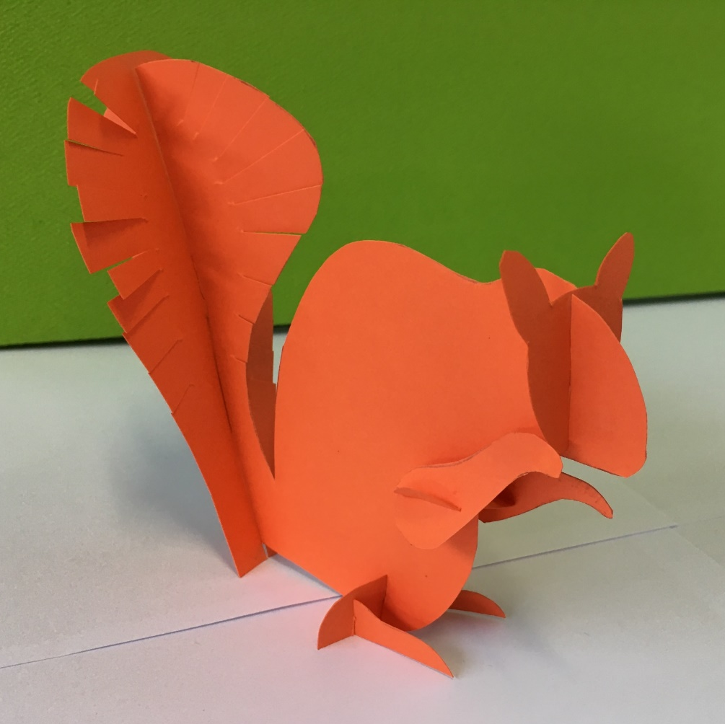
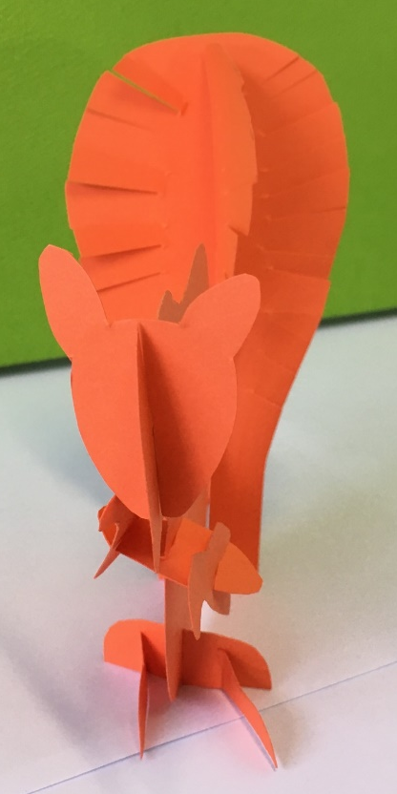
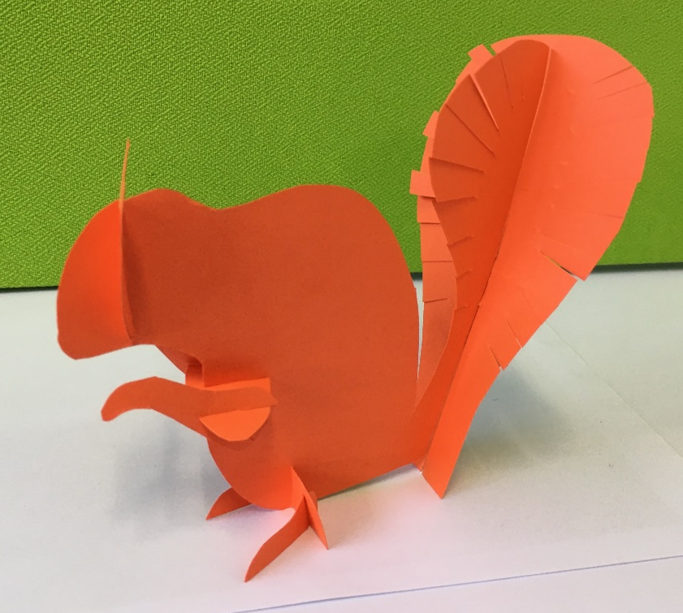
If you don’t want to make a Christmas tree, you could make something else.

Slide 14
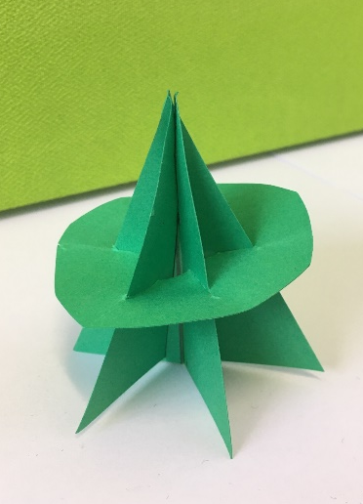



How could your design join together without glue or tape?
How could you make it stable?
How could you use measurements to help you?
What angles could you cut slots at?
How could you make it look like a tree?

Slide 15
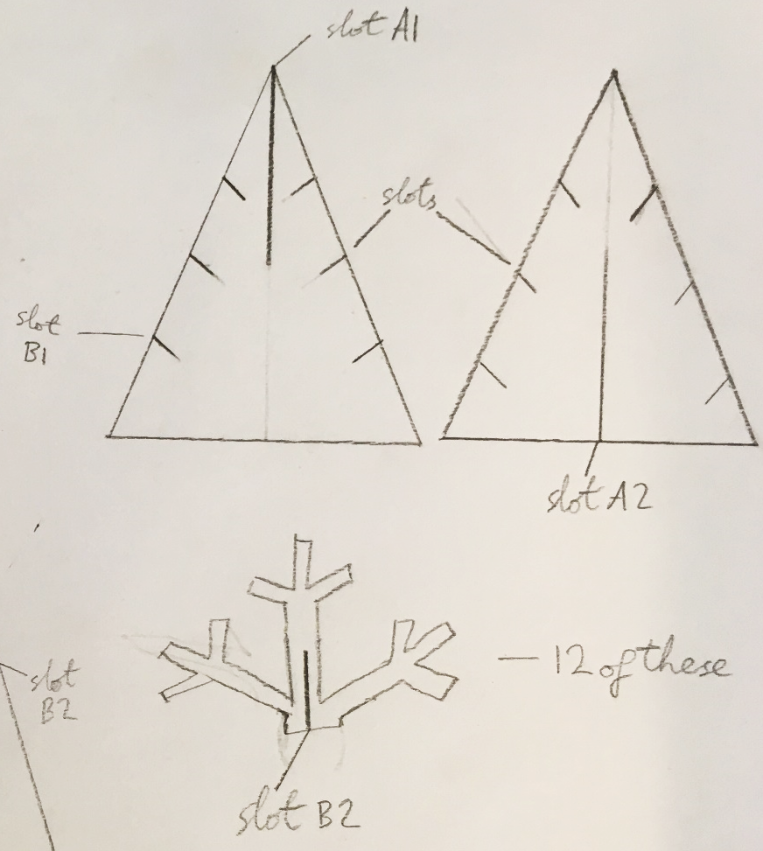
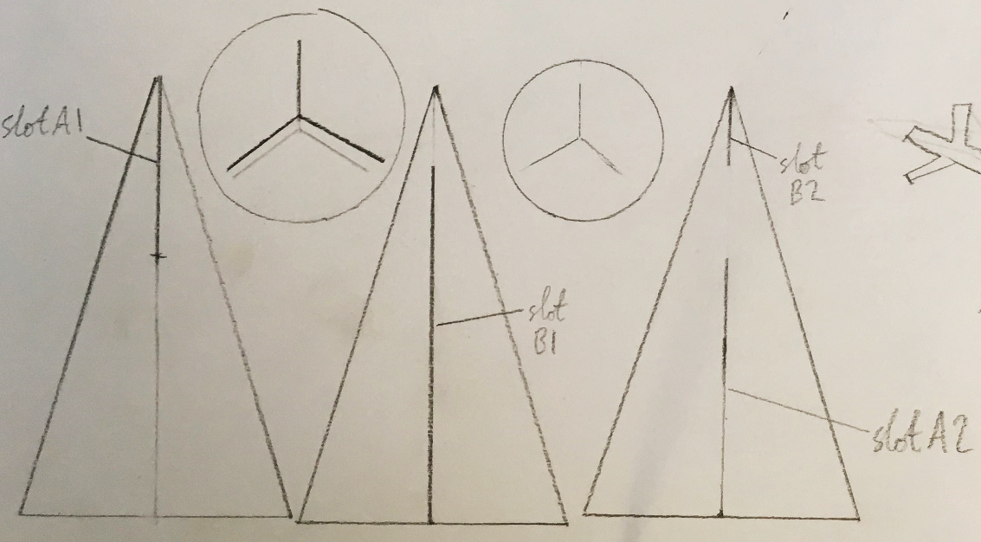
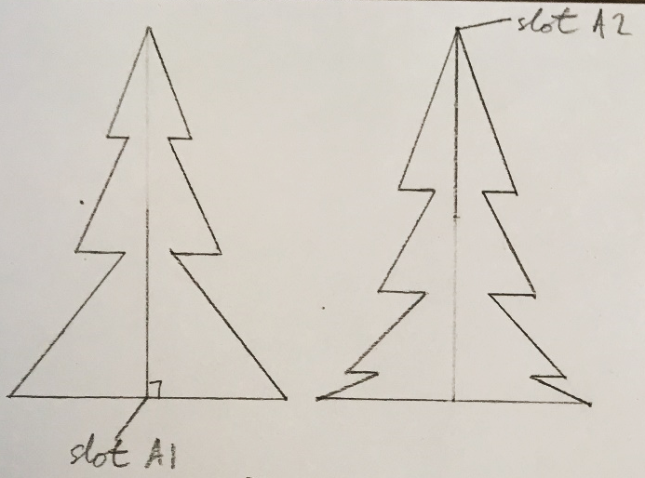
How will your design join together without glue or tape?
How will you make it stable?
How can you use measurements to help you?

Slide 16
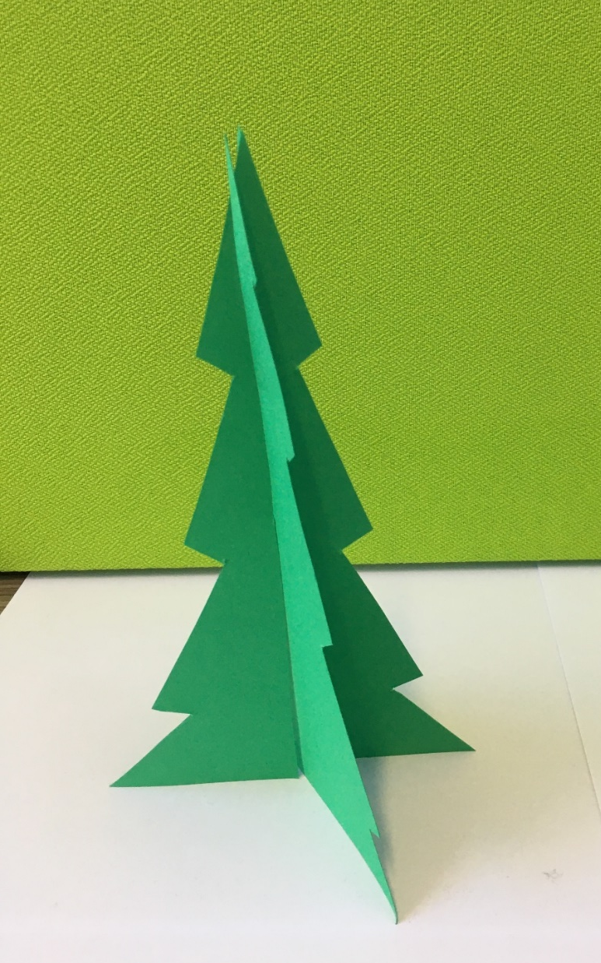
Example design

Slide 17

Example design

Slide 18

Example design

Slide 19
Designing your own product
How will your design join together without glue or tape?
How will you make it stable?
How can you use measurements to help you?

Slide 20
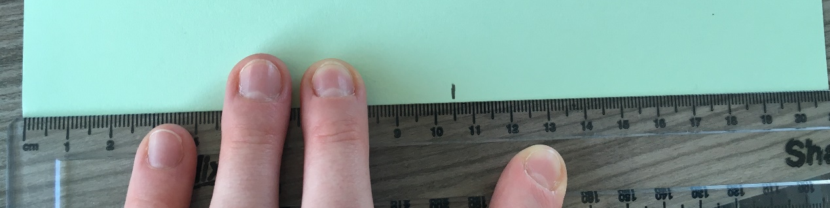
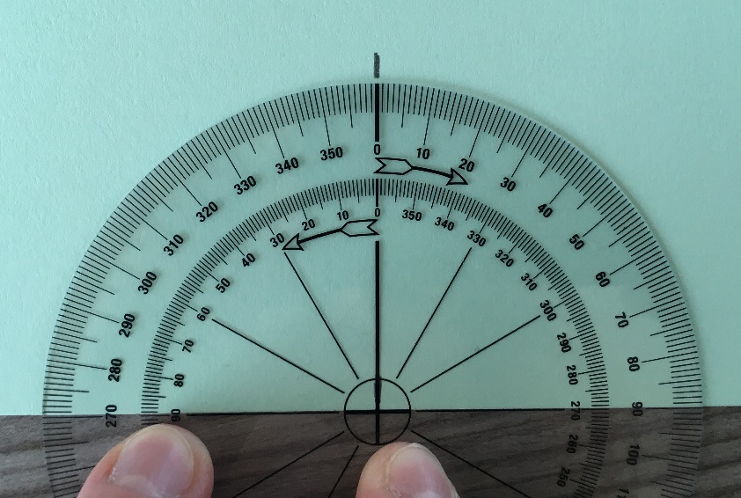
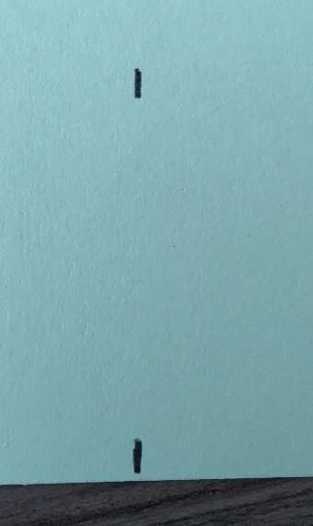
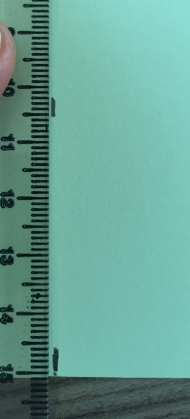
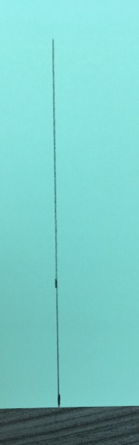
Making and testing your product
Is it stable? Is it simple to assemble?
How can you make it easier to assemble?
Does it need labels or instructions? (If so, make some.)

Slide 21
Now swap your products and try to assemble someone else’s.
What is successful about their design?
What improvements could they make?
Competition: you can submit a photo of your class work through our website https://warwick.ac.uk/fac/sci/wmg/about/outreach/resources/christmasboxes/. The most creative and impressive entry will win a visit for their class to our department, WMG, at the University of Warwick.

