Slide 1
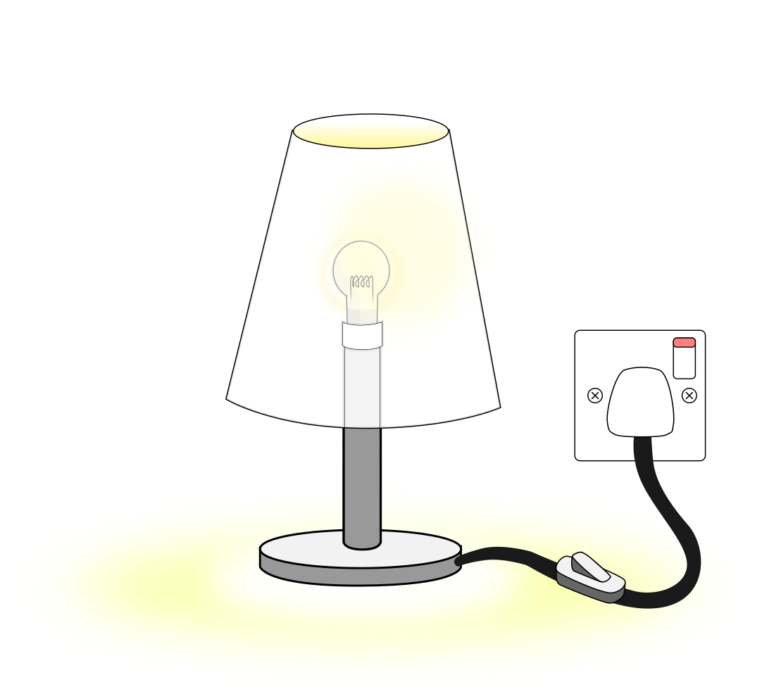
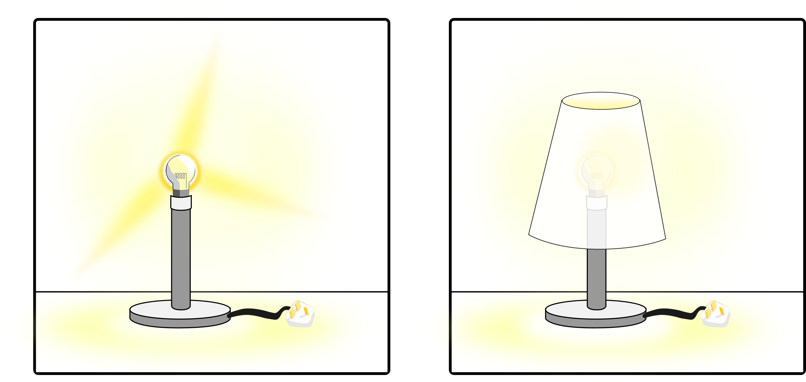
Illuminating Engineering
Lesson 1 worksheet
1. Label key parts of the lamp
2. What is the problem with the lamp on the left?
a)

Slide 2
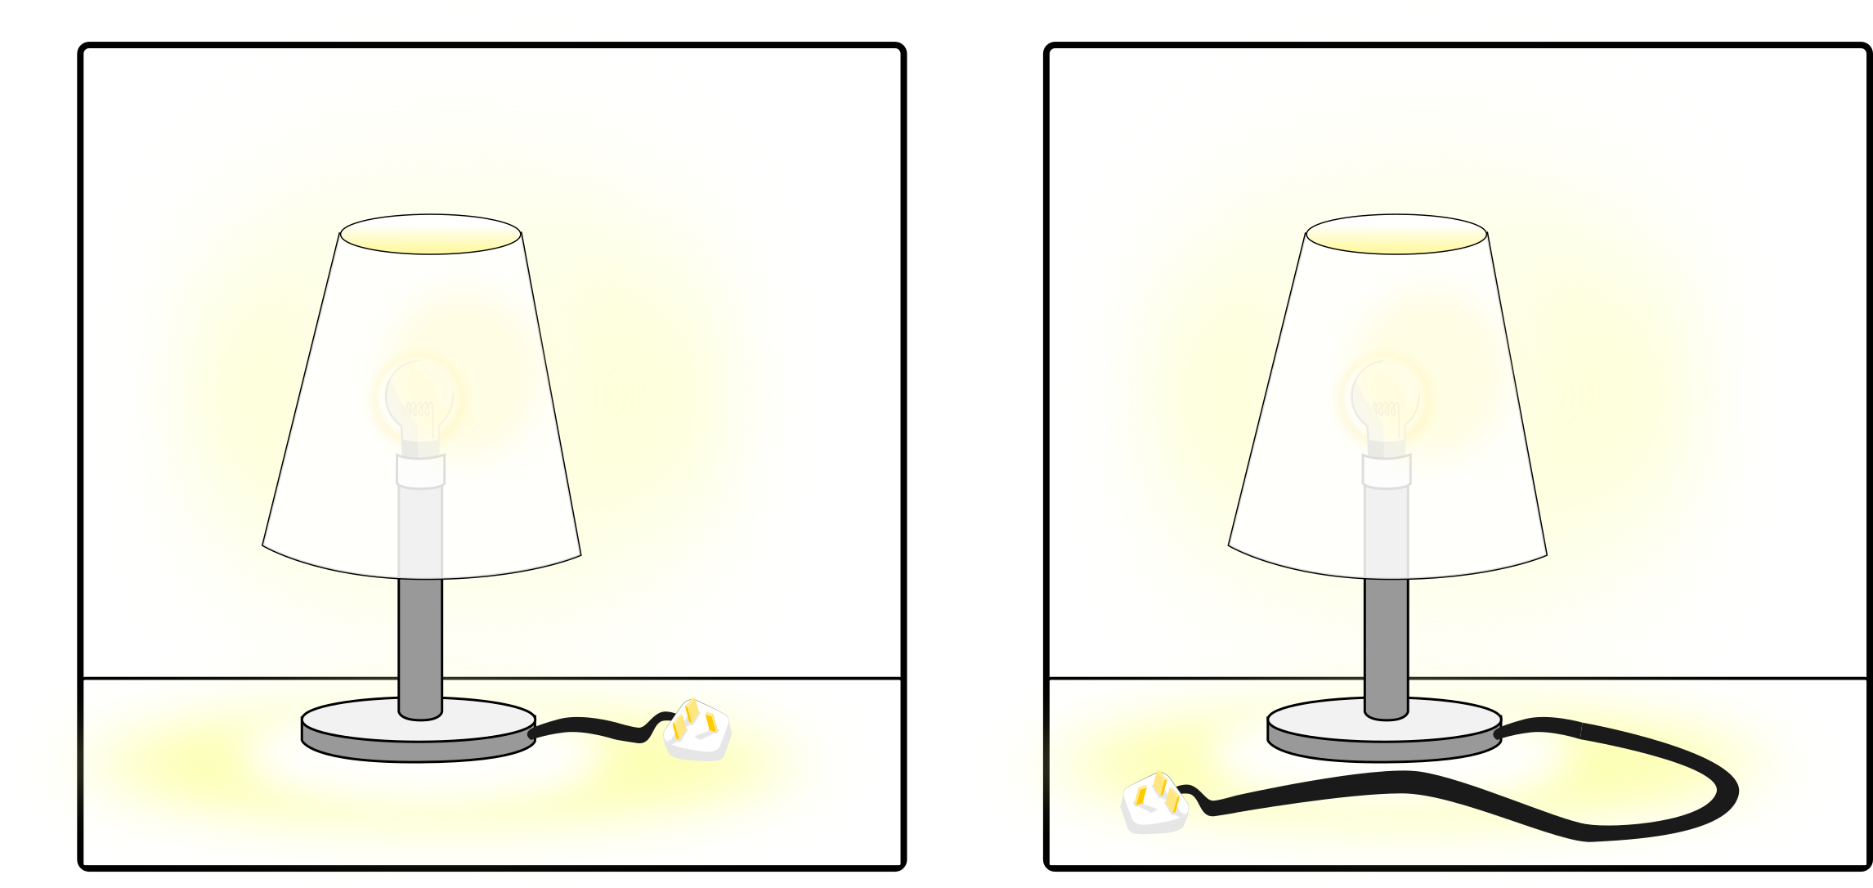
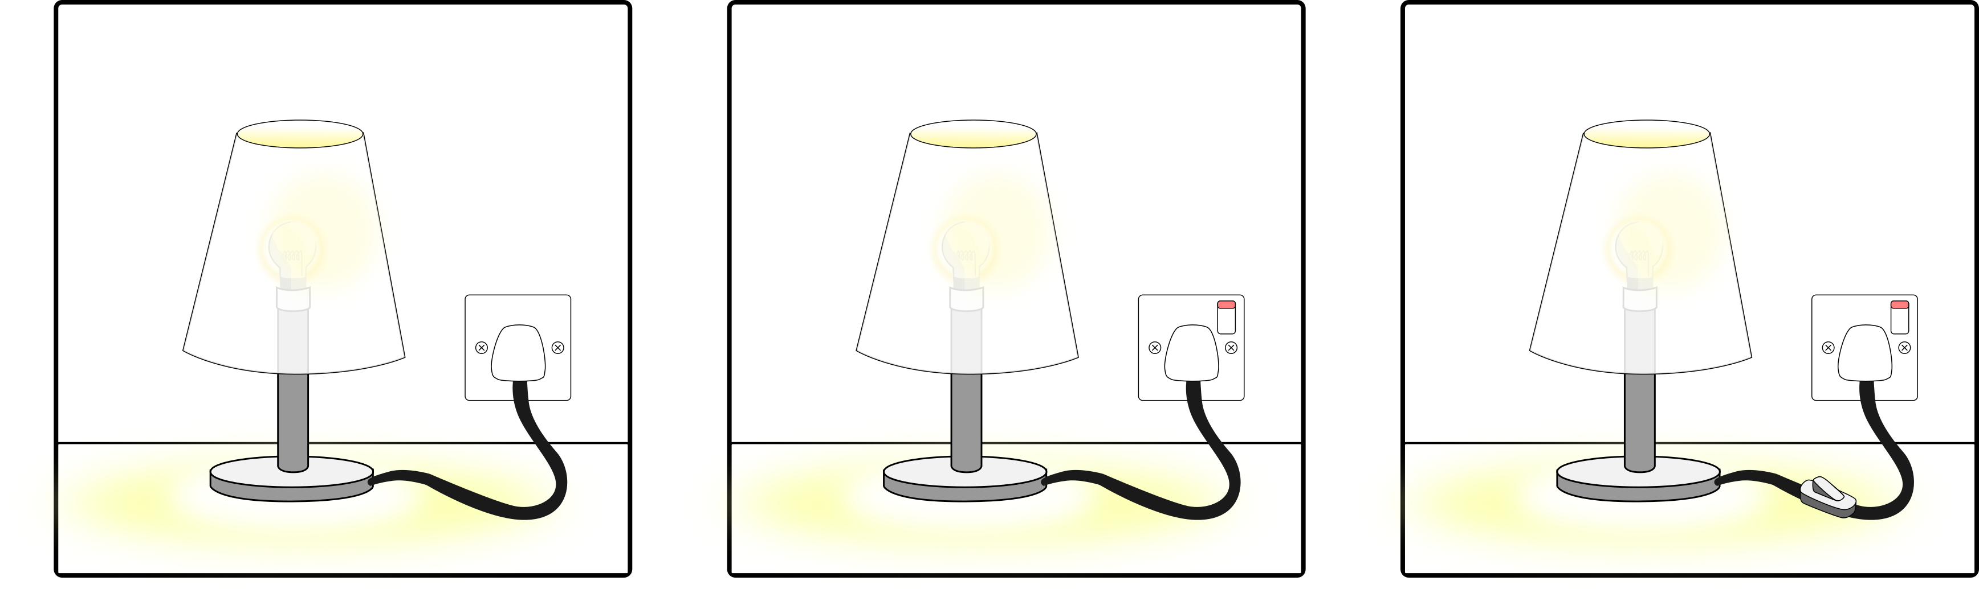
Illuminating Engineering
Lesson 1 worksheet
2. (Cont.) What is the problem with the lamp on the left?
b)
3. Which lamp would make the best bedside lamp? Explain why you have chosen that lamp.

