Slide 1

Lesson 4A – Net Shapes
How can we make 3D shapes from sheets of paper?

Slide 2

LO: We are learning how 3D shapes can be formed from net shapes
Success criteria:
I can describe how a 3D shape can be made from flat materials like paper.
I can build a 3D shape using these methods.
I can determine a net to create a simple 3D shape.

Slide 3
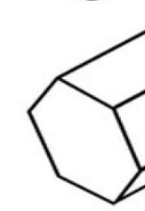
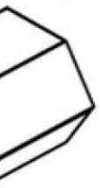
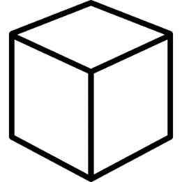
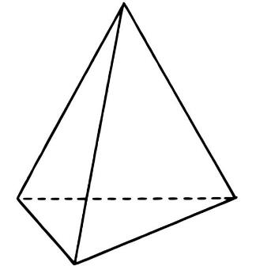
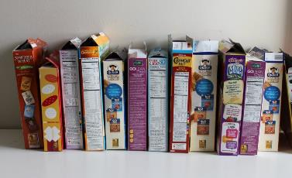
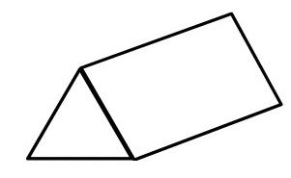
Starter
Discuss:
What 2D shapes do you know?
What 3D shapes do you know?
What 2D shapes make up these 3D shapes?
How are cereal boxes made?

Slide 4
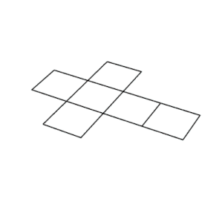
Net Shapes
Do you know what a net is?
A net is a 2D shape that can be folded to create a 3D shape.
Here is an example of a net for a cube and how it folds up:

Slide 5
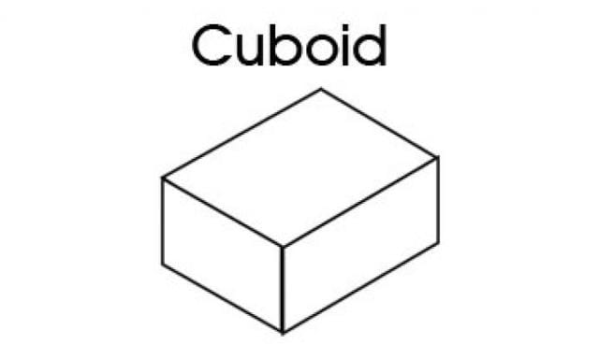
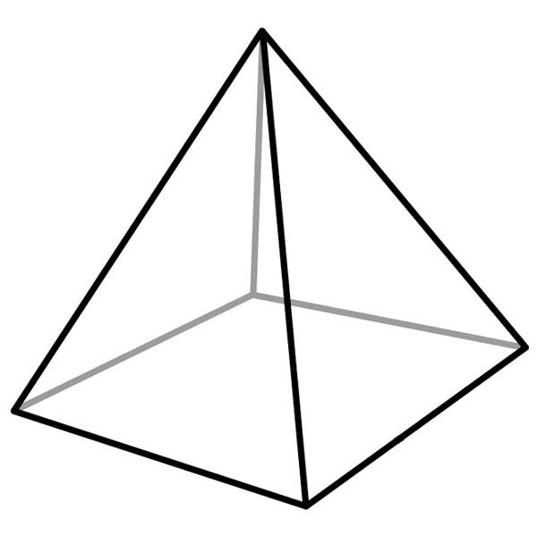
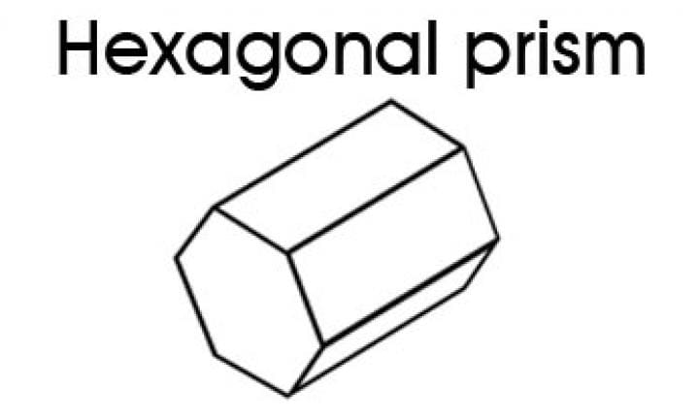
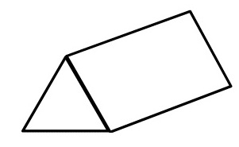
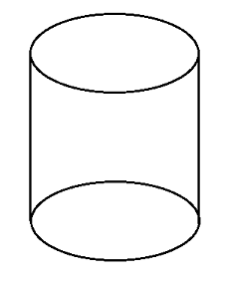

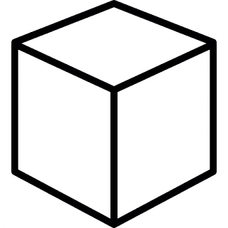
Worksheet: Match the Net to the Shape
Can you match the net to its corresponding 3D shape?
Think about how the net would fold up.

Slide 6
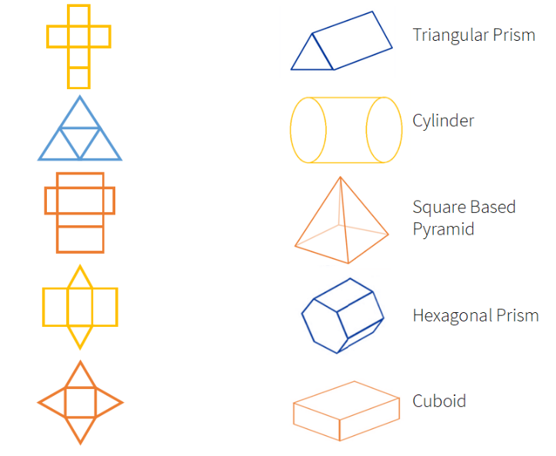
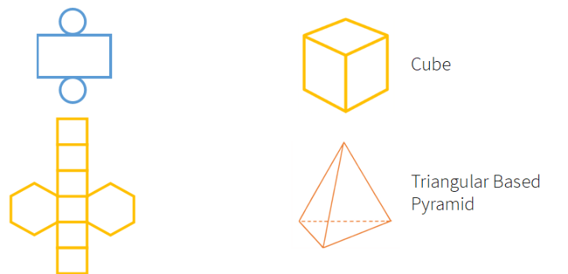

Slide 7
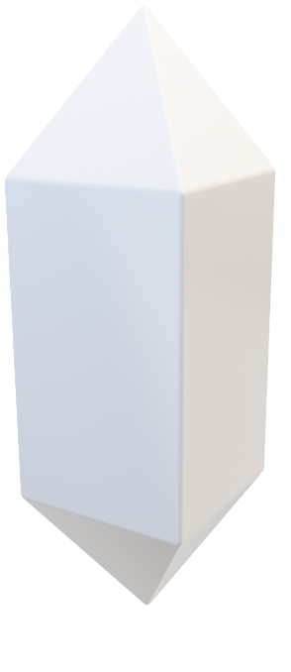
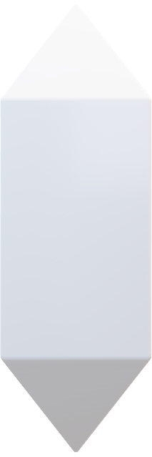
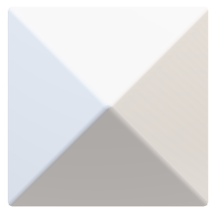
Challenge
Can you draw a sketch of the net for this 3D shape?

Slide 8
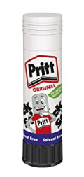
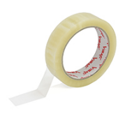
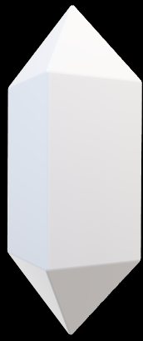
Answer
Discuss:
If you were to make this in real life out of paper, what would you need to do to make sure the net stays in place?

Slide 9
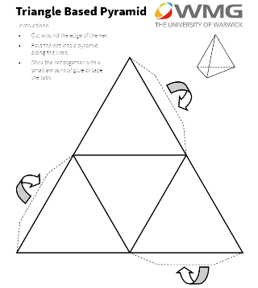
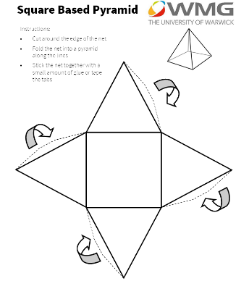
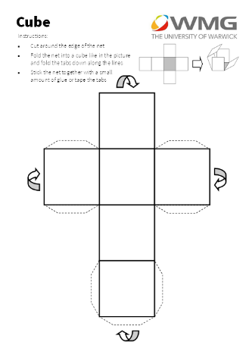
Worksheet: Constructing Simple 3D Shapes
Chose one out of the 3 worksheets
Now follow the instructions on the sheet
How do you think they fold up?

Slide 10
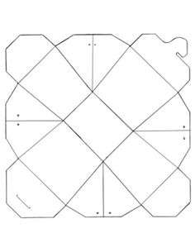
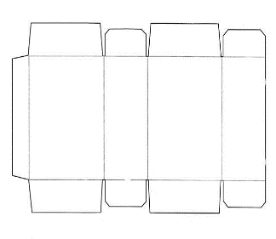
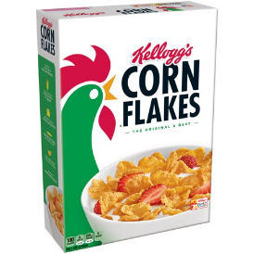

Real World Applications of Nets
Nets can be used to build containers from flat materials (e.g. card and cardboard)
Examples of their uses are cardboard boxes, here is an example of a net for a cereal box and a noodle box.

Slide 11
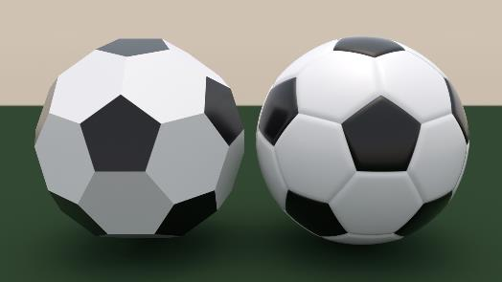
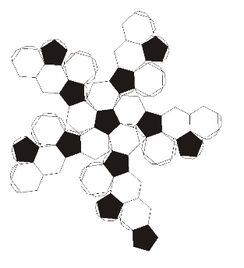
Footballs
You might think it is impossible to create a sphere form a net because there are no folds.
But we can make something very similar, like the net of a football.
When it is inflated, it becomes round.

Slide 12
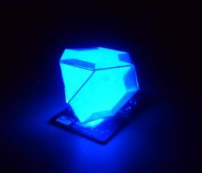
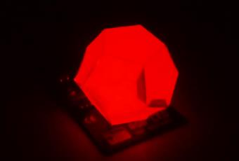
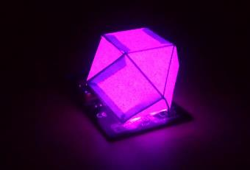
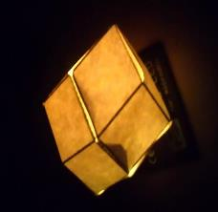
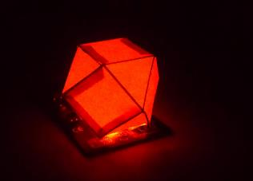
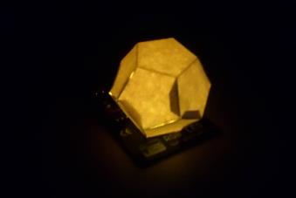
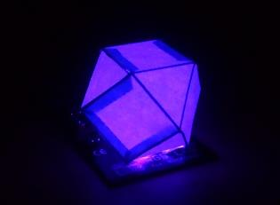
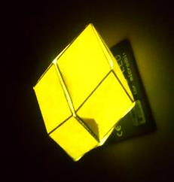
Practise Making a 3D Shape
Follow the instructions on the templates to create a lamp shade for you micro:bit LED.

Slide 13
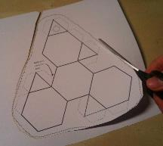
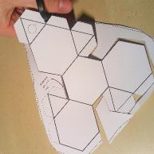
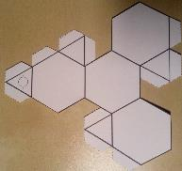
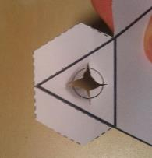
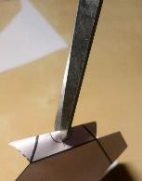
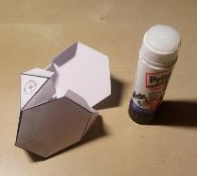
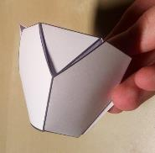
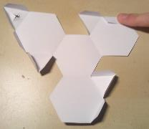
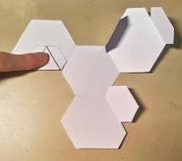
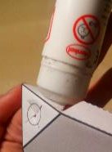
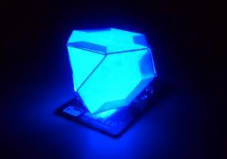
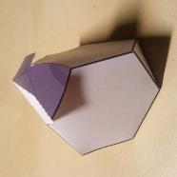
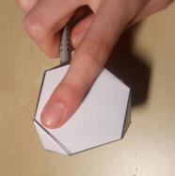


Pictures for Instructions

Slide 14




If you want to make your own…
You can use the nets from the previous worksheets you’ve seen to draw one to put on the LED, use a pencil and ruler. Remember to make a hole for the LED and add tabs.
Here’s an example of how I made one:
Draw 2 identical mirrored shapes and connect them with a straight strip, then measure the length of the sides of the shapes to workout where to put the folds on the strips. Think carefully about how the shape will fold when drawing a net.
Tip: to ensure the 2 shapes are exact mirror images, you could use a ruler and protractor or even better, tracing paper.

Slide 15
Now test your lampshades in the dark!

