Slide 1
Building the Future
How do engineers solve global challenges?

Slide 2
Learning Objectives
Understand how products are taken from the ‘design’ phase through to real products
See how engineers are using innovation to fight global challenges
Practise pitching an idea of your own to help make the world a better place

Slide 3
What challenges do you think our world is facing right now?

Slide 4


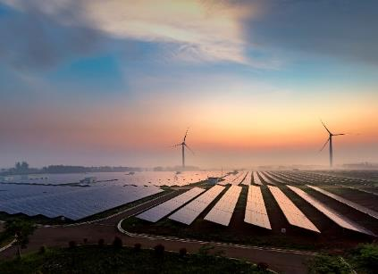

Global Challenges
CO₂ Emissions
Covid
Clean Energy
Future Transport

Slide 5
Video
Click here to view the video.

Slide 6
Let’s recap the innovations we have mentioned

Slide 7
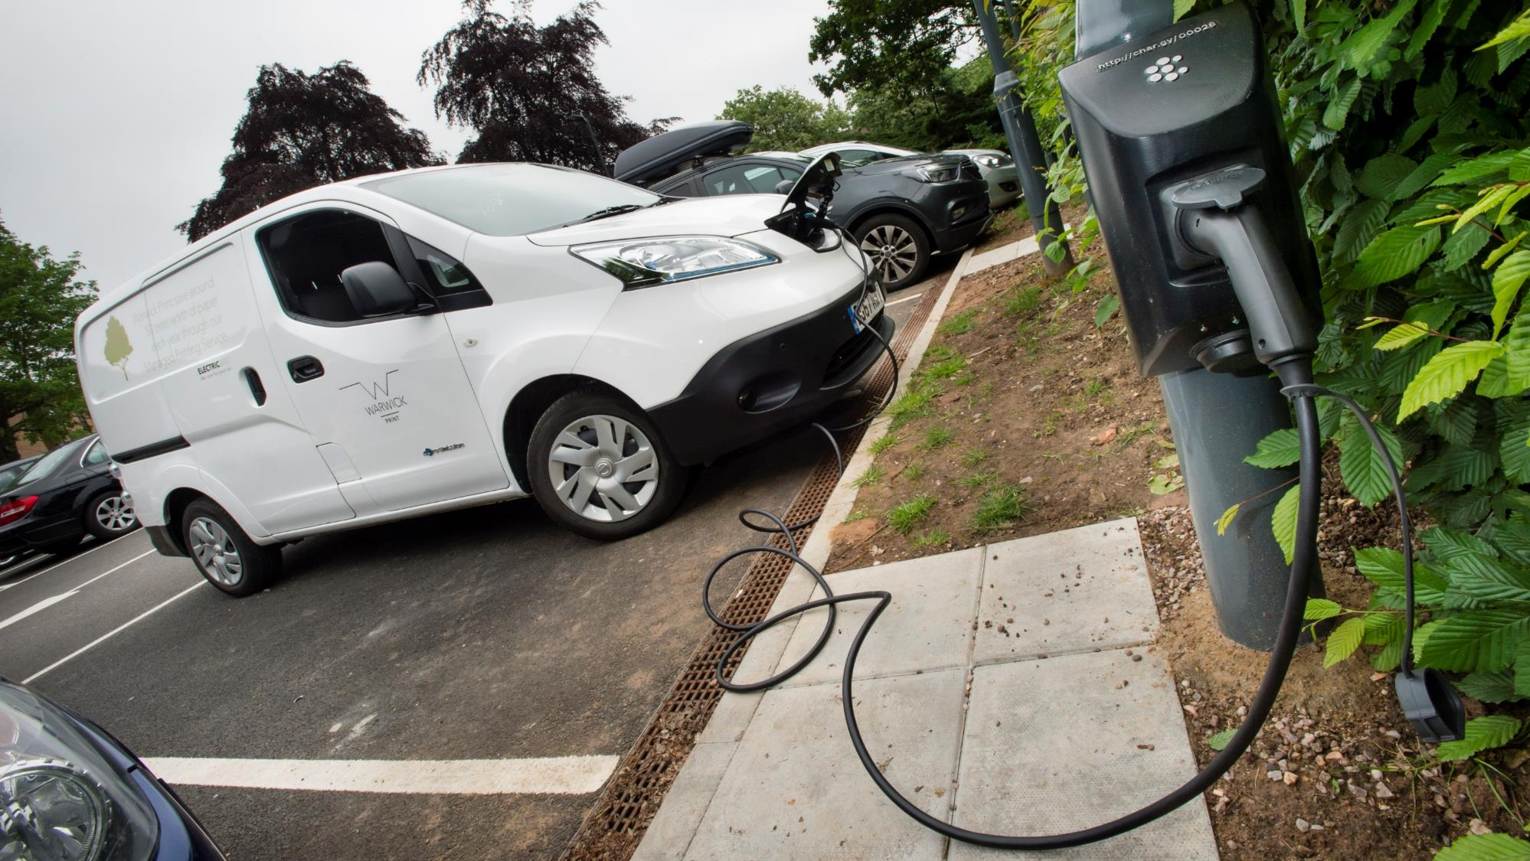
Electric Vehicles

Slide 8

Battery Manufacturing

Slide 9
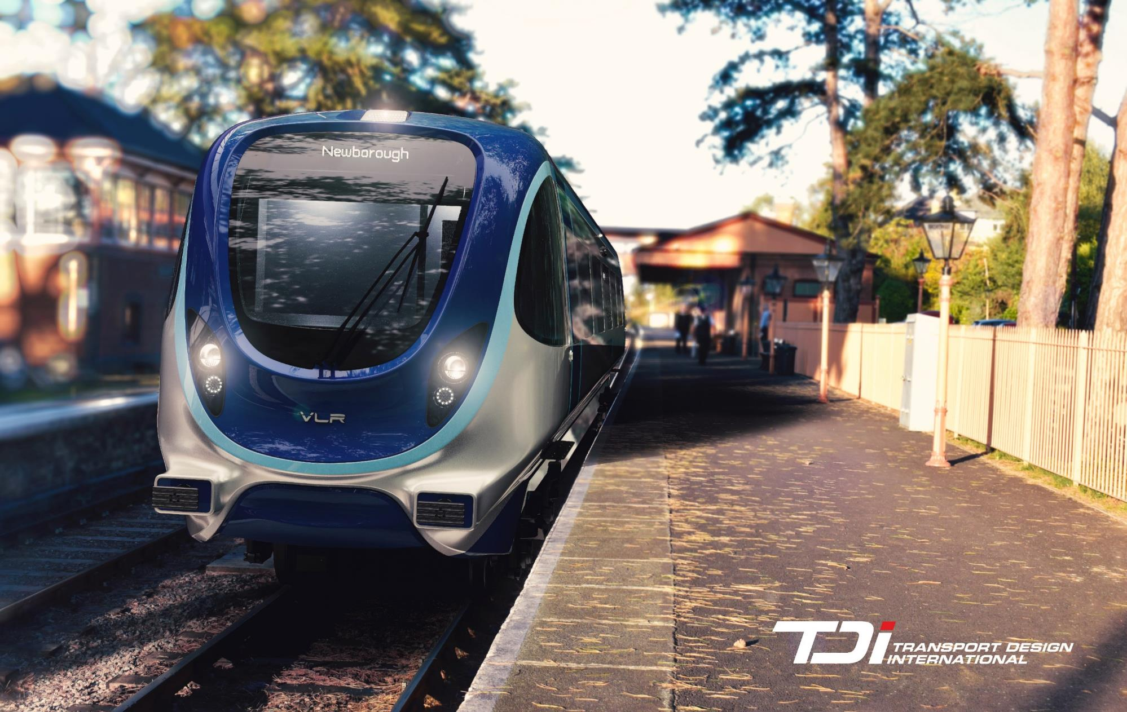
Future Transport

Slide 10
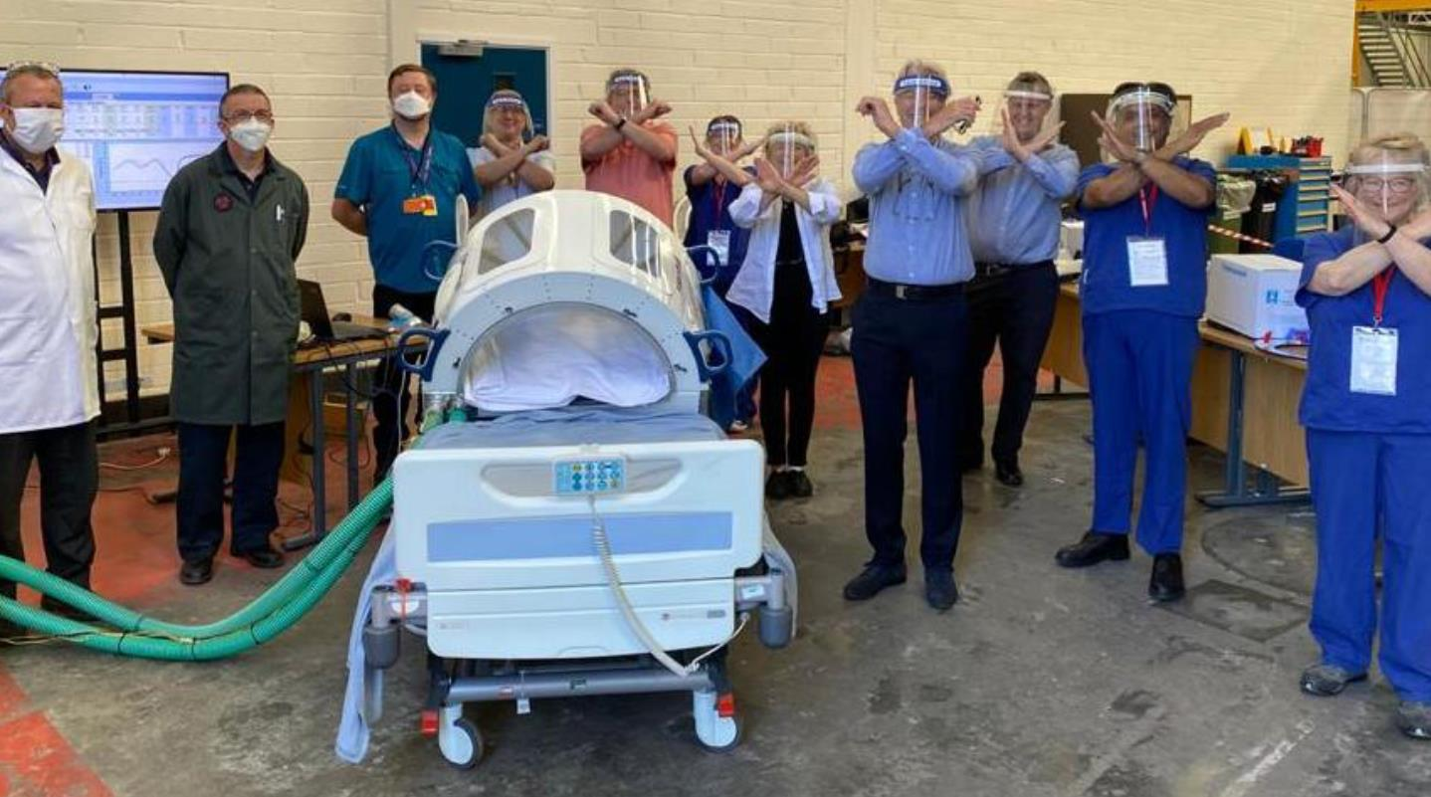
Innovative Healthcare

Slide 11

Sustainable Development

Slide 12
Your task:
Prepare a pitch to convince the government to fund a project.
You can pitch your own idea or use one of the innovations from the video

Slide 13
What is a pitch?
Video/audio
30 seconds long
Written
100 words
Introduce yourself
Describe your goals
Why is your idea the best?
Call to action
It should be confident, clear and convincing.

Slide 14

Video example

Slide 15
Written example
Hi, I’m Phil.
Humans achieve incredible things. Sometimes we don’t think things through, though. The right way now might not always be the right way. We have non-degradable plastics in every corner of our rapidly-heating planet.
I believe the most incredible thing we can do as a society is make a better future to exist in. To do that, governments must support and encourage sustainability. Consumers should demand sustainable products. Most importantly – companies and corporations must make our products in the most sustainable way.
If we all come together to do that, we will have a green future after all.

Slide 16
Your task:
Prepare a pitch to convince the government to fund a project.
You can pitch your own idea or use one of the innovations from the video

Slide 17
Thank you!
Building the Future

