Slide 1
Sustainable Materials
Which materials should we
build the future with?

Slide 2
What types of solid materials can
you think of?

Slide 3
Learning Objectives
Know 4 categories of solid materials
Polymer, ceramic, metal and composite
Understand the properties of those categories of materials
Be aware of sustainability when thinking about what material a product should be made of
Know the three ‘R’s of recycling
Reduce, reuse, recycle

Slide 4
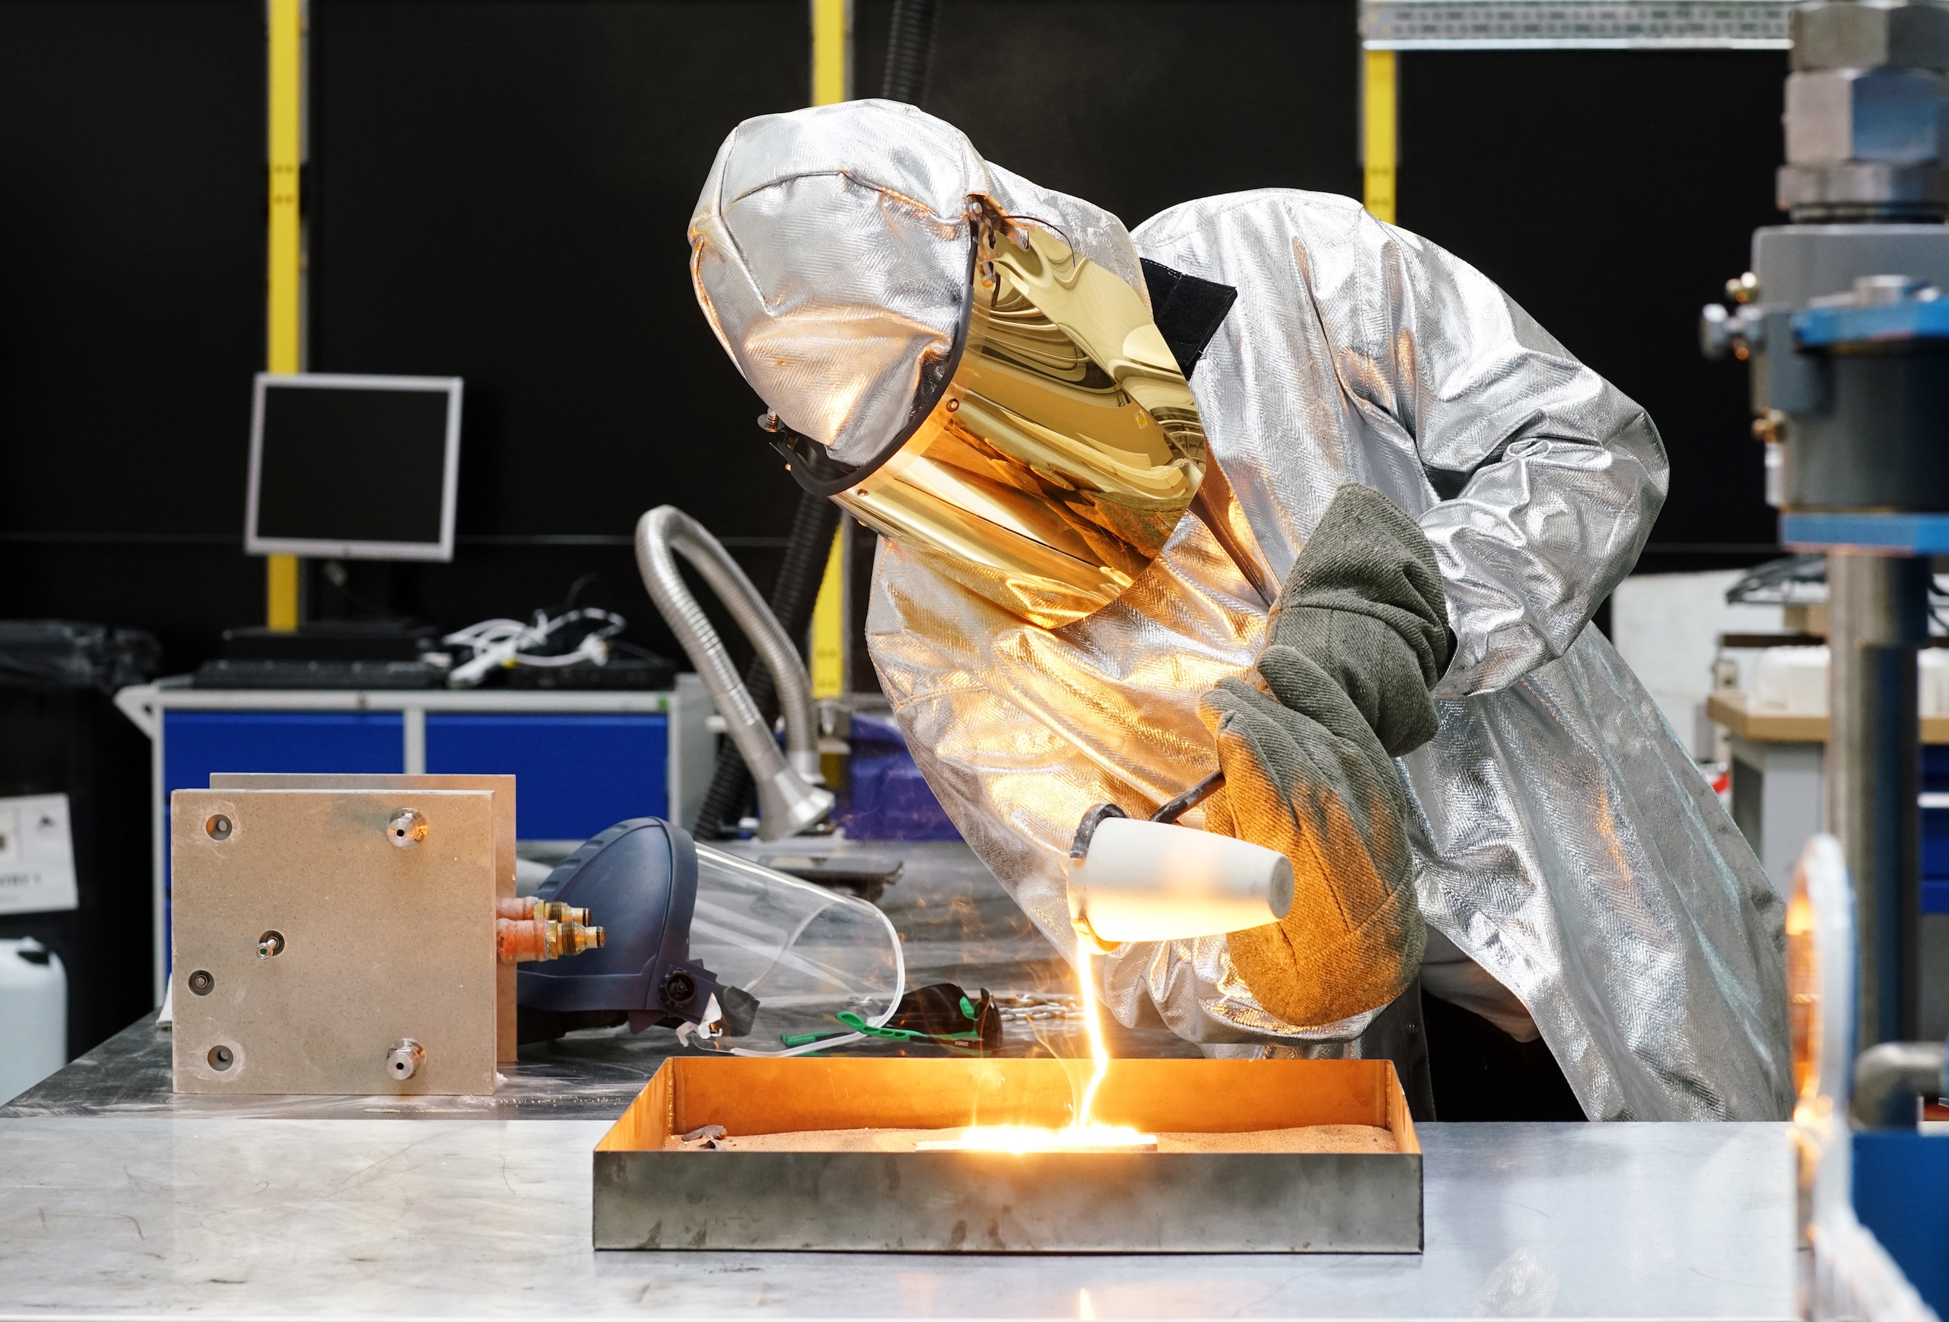
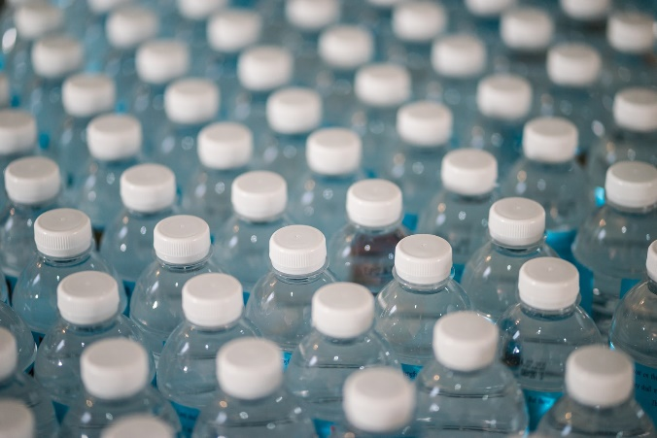
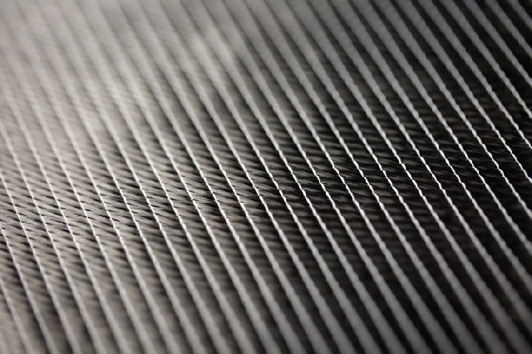
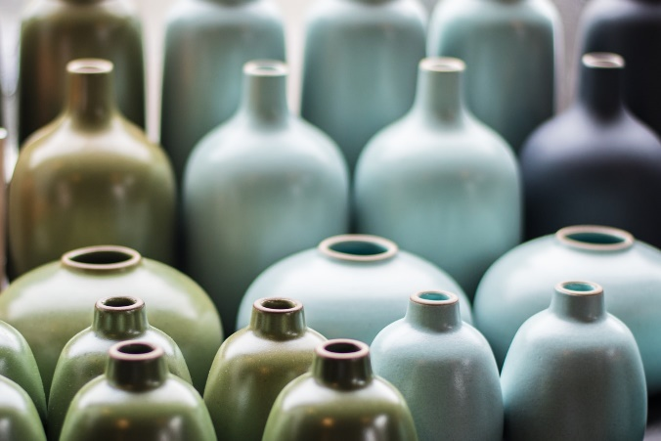
Types of solid material
Metals
Polymers
Photo credits
Polymers:
Jonathan Chng via Unsplash
Ceramics:
Jessica Ruscello via Unsplash
Composites
Ceramics

Slide 5
Metals
Typically:
Melt at high temperatures
Malleable (can be bent without snapping)
Good conductors
Made by refining and melting ore from the ground

Slide 6
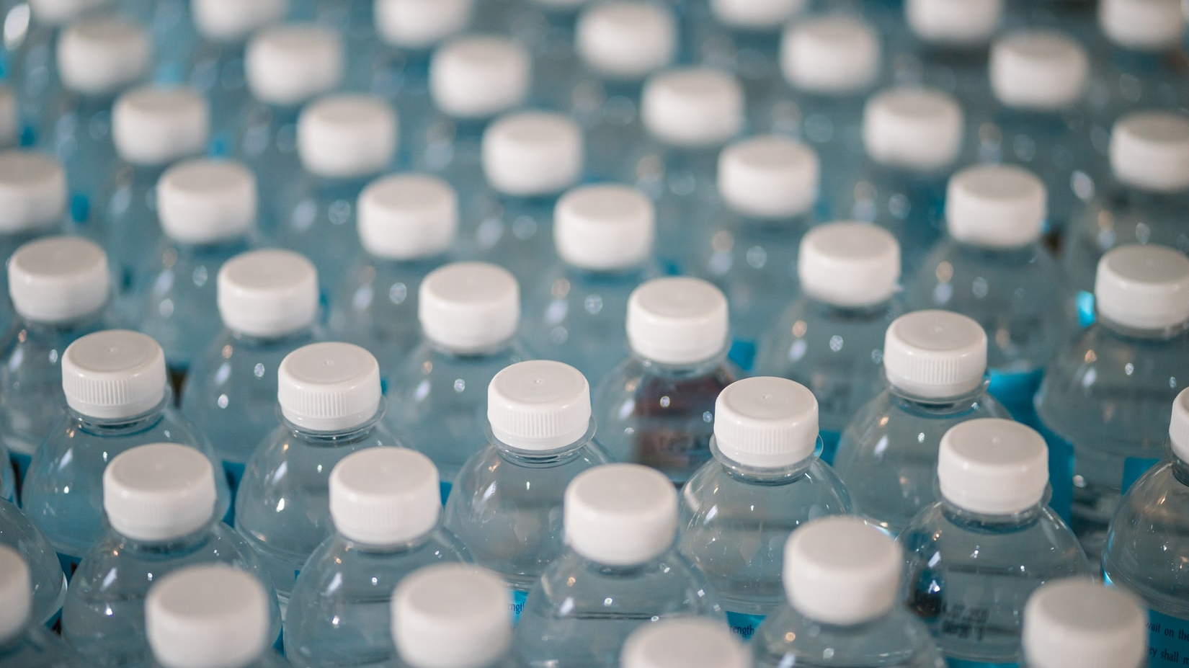
Polymers
Typically:
Melt at high temperatures
Malleable (can be bent without snapping)
Good conductors
Made from joining small blocks together
Photo credit: Jonathan Chng via Unsplash

Slide 7
Composites
Typically:
Strong
Light
Good conductors
Made by combining two materials like steel and concrete or fibres and glue.

Slide 8
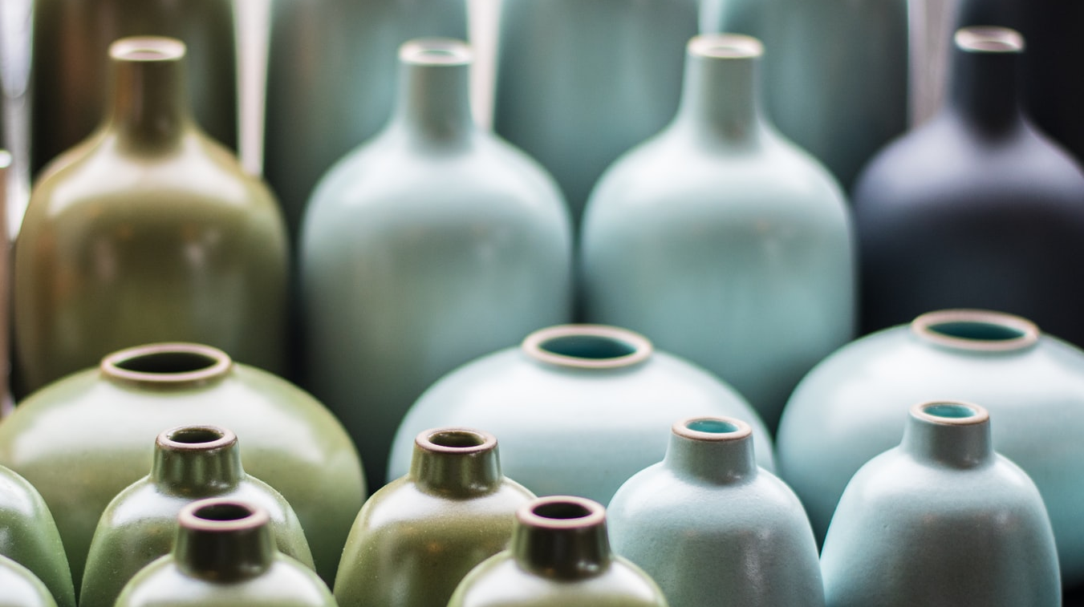
Ceramics
Typically:
Very hard
Brittle (will smash if hit hard)
Waterproof
Made by heating material like clay in a kiln
Photo credit: Jessica Ruscello via Unsplash

Slide 9

Which category do you think these materials are?
Metal
Polymer
Composite
Ceramic
Carrier bag
Photo credit: Christopher Vega via Unsplash

Slide 10
Which category do you think these materials are?
Metal
Polymer
Composite
Ceramic
Carrier bag
Photo credit: Christopher Vega via Unsplash

Slide 11

Which category do you think these materials are?
Metal
Polymer
Composite
Ceramic
Wood
Photo credit: Alexandre Jaquetoni via Unsplash

Slide 12
Which category do you think these materials are?
Metal
Polymer
Composite
Ceramic
Wood
Photo credit: Alexandre Jaquetoni via Unsplash

Slide 13
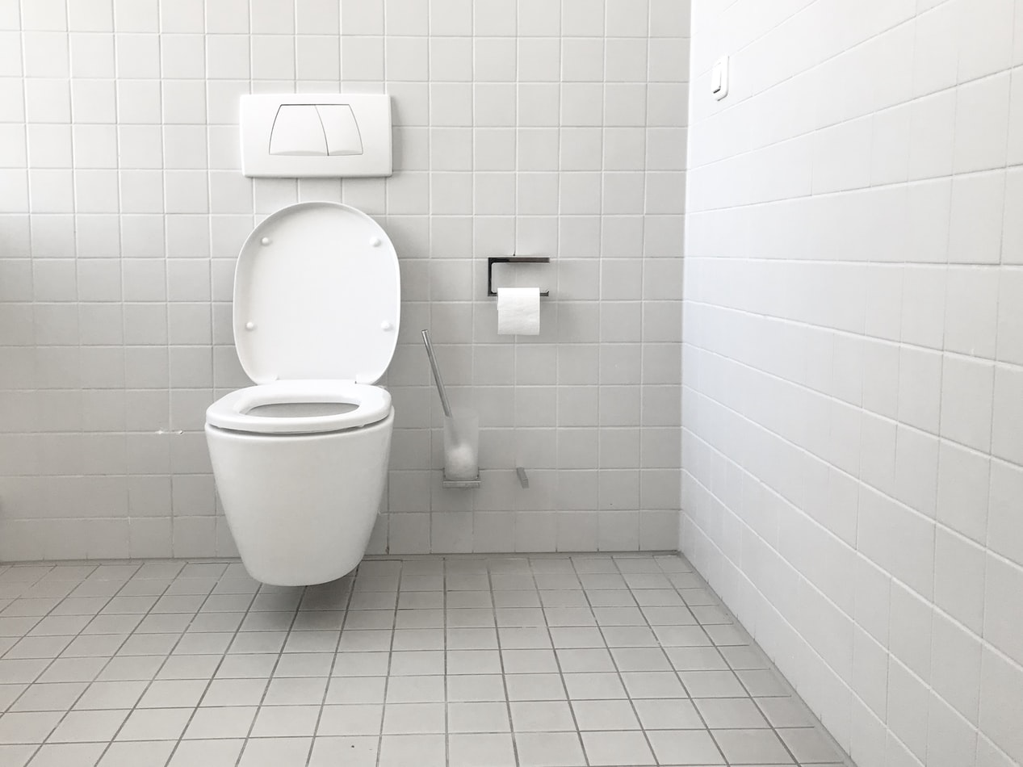
Which category do you think these materials are?
Metal
Polymer
Composite
Ceramic
Toilet
Photo credit: Jan Antonin Kolar via Unsplash

Slide 14
Which category do you think these materials are?
Metal
Polymer
Composite
Ceramic
Toilet
Photo credit: Jan Antonin Kolar via Unsplash

Slide 15
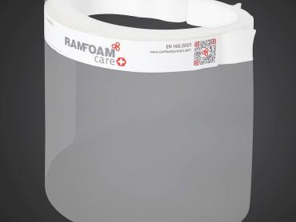
Which category do you think these materials are?
Metal
Polymer
Composite
Ceramic
PPE – Faceshields
Photo credit: Flexible Manufacturing When It Counts

Slide 16
Which category do you think these materials are?
Metal
Polymer
Composite
Ceramic
PPE – Faceshields
Photo credit: Flexible Manufacturing When It Counts

Slide 17
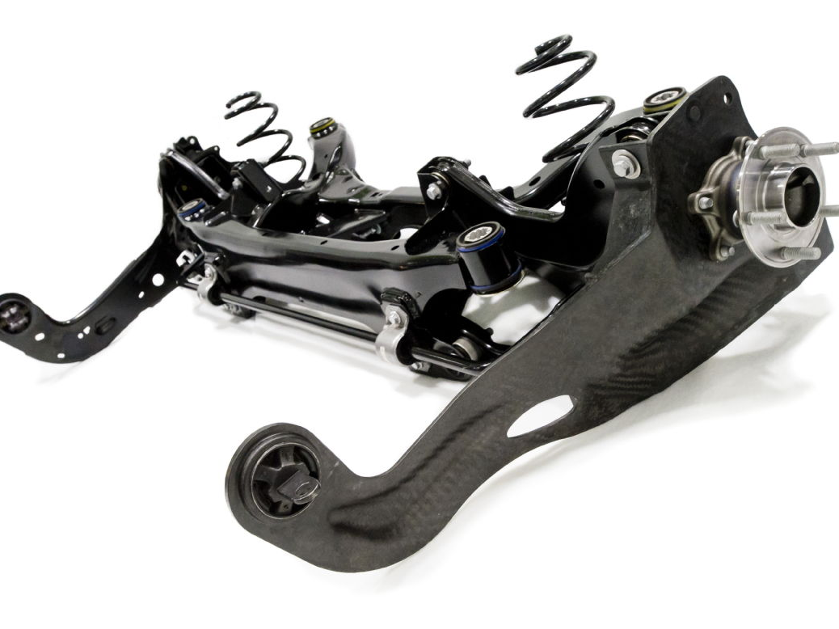
Which category do you think these materials are?
Metal
Polymer
Composite
Ceramic
High-Tech Car Suspension
Photo credit: WMG – Lightening the Load

Slide 18
Which category do you think these materials are?
Metal
Polymer
Composite
Ceramic
High-Tech Car Suspension
Photo credit: WMG – Lightening the Load

Slide 19
Which category do you think these materials are?
Metal
Polymer
Composite
Ceramic
High-Tech Car Suspension
We need the strength of steel but the lightest possible materials or vehicles.
Have you ever heard of carbon fibre? It’s a composite material. Resin is used to set strands of carbon fibres into a strong but light material.
Combining the right materials in the right way is the secret to the best products!
Photo credit: WMG – Lightening the Load

Slide 20
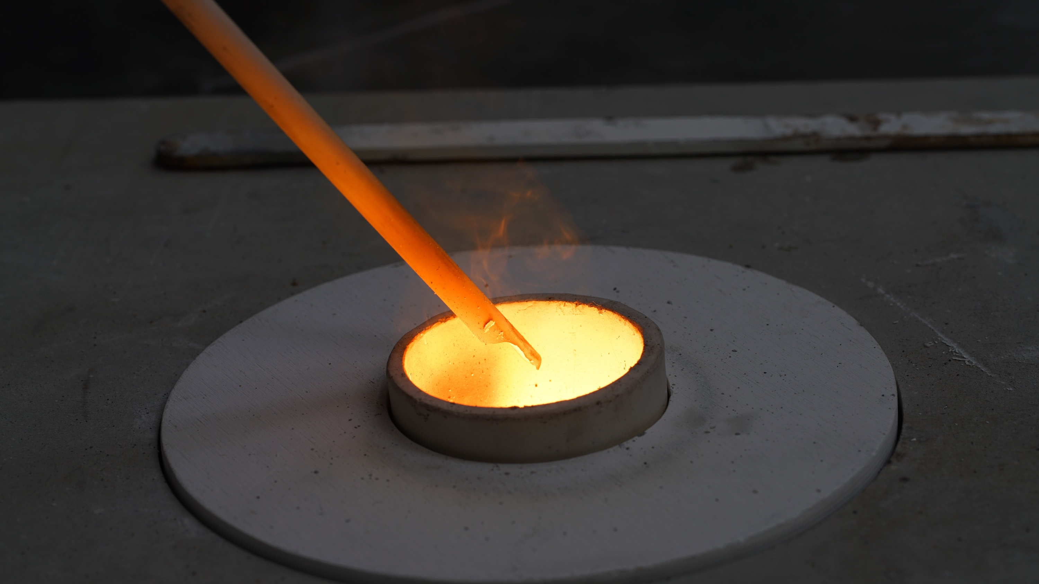
Metals
Let’s find out a bit more about Steel
Find Russ’ talk on our website HERE.

Slide 21
Metals
What have we learned about steel?
Which one of these is FALSE?
There are more types of steel than any other material
Alloy material
Made from copper
100% Recyclable

Slide 22
Metals
What have we learned about steel?
Which one of these is FALSE?
There are more types of steel than any other material
Alloy material
Made from copper
100% Recyclable

Slide 23
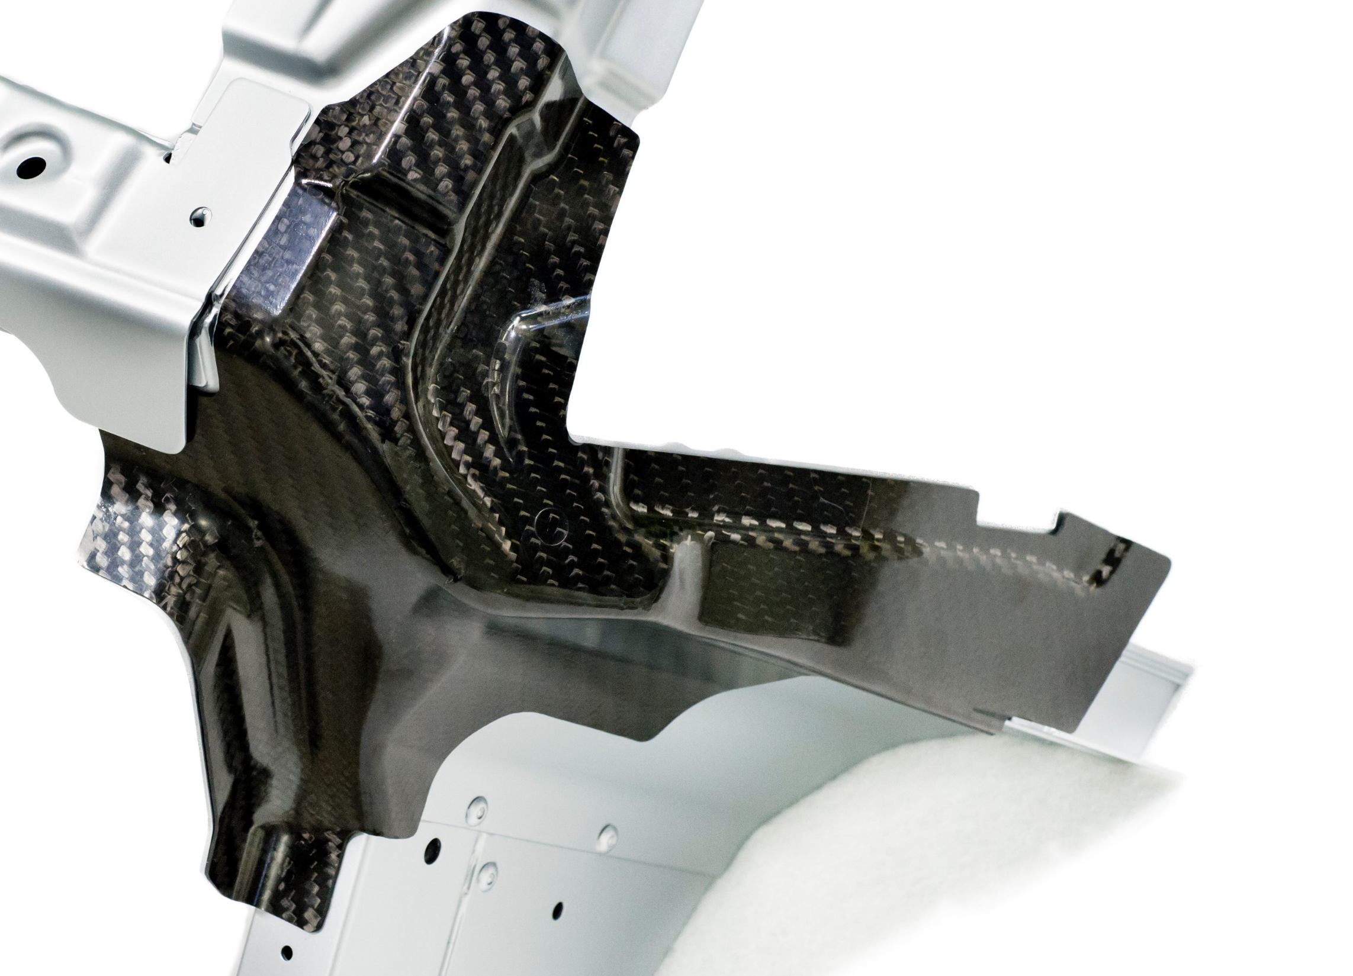
Composites
Let’s find more about Carbon Fibre
Find Pete’s talk on our website HERE.
If YouTube is blocked at your school, click here.

Slide 24
Composites
What have we learned about Carbon Fibre?
Which one of these is FALSE?
Easy to recycle
Easy to produce
Conductive
Lightweight

Slide 25
Composites
What have we learned about Carbon Fibre?
Which one of these is FALSE?
Easy to recycle
Easy to produce
Conductive
Lightweight

Slide 26
How have materials been used in the past?
The Simplest Material
Cheap
Fast
Available
Single use

Slide 27
How can we use
materials in a more sustainable way?

Slide 28
How can we use materials more sustainably?
The Right Material for the Right Job
Reusable
Efficient
Local
Recyclable

Slide 29

3 Rs
Notes:
https://www.istockphoto.com/photo/holding-the-paper-with-reuse-reduce-recycle-message-in-front-of-a-beautiful-blur-gm1262141034-369308674

Slide 30
Thank you!
Sustainable Materials

