Slide 1
Paper Engineering – Lesson 2
Bringing paper to life, from 2-Dimensional to 3-Dimensional

Slide 2
Project Learning Objectives: To create a 3D pop-up book suitable for a small child.
Week 1 | Week 2 | Week 3
Analysis of Pop-up books. Have a go at some basic pop-up techniques. | Explore the essential techniques for accurate pop-up. Continue to have a go. Introduce variations of pop-ups | Using knowledge learnt so far, introduce mechanisms. Know the difference between them.
Week 4 | Week 5/6 | Week 7/8
Discuss key criteria for a good story or pop-up book. Plan the story using a storyboard. | Evaluate the story plan so far. Start to make the pop-ups and mechanisms for all the pages. | Finish the pages, with text and decoration. Create the cover and assemble the finished book.
Success criteria:
(SC1) I can explain advantages and disadvantages of pop-up books
(SC2) I can identify advantages and disadvantages of making 3D shapes from flat sheets.
(SC3) I can describe how folding a flat (2D) sheet of paper makes it a 3D object.
(SC4) I can describe how different cuts and folds can make different 3D shapes.
(SC5) I can make a pop-up designs following instructions.
(SC6) I can make a pop-up designs from a blank piece of paper.
(SC7) I can identify the difference between pop-ups and mechanisms
(SC8) I can create a short, fun story and make it into a pop-up book.

Slide 3
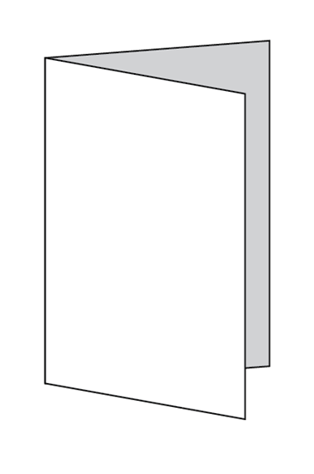
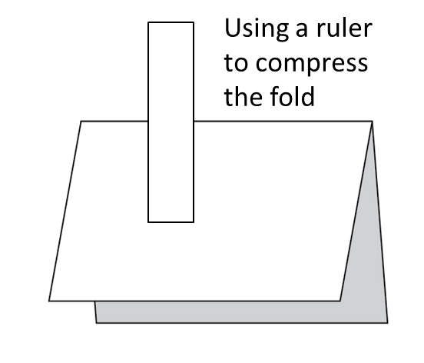

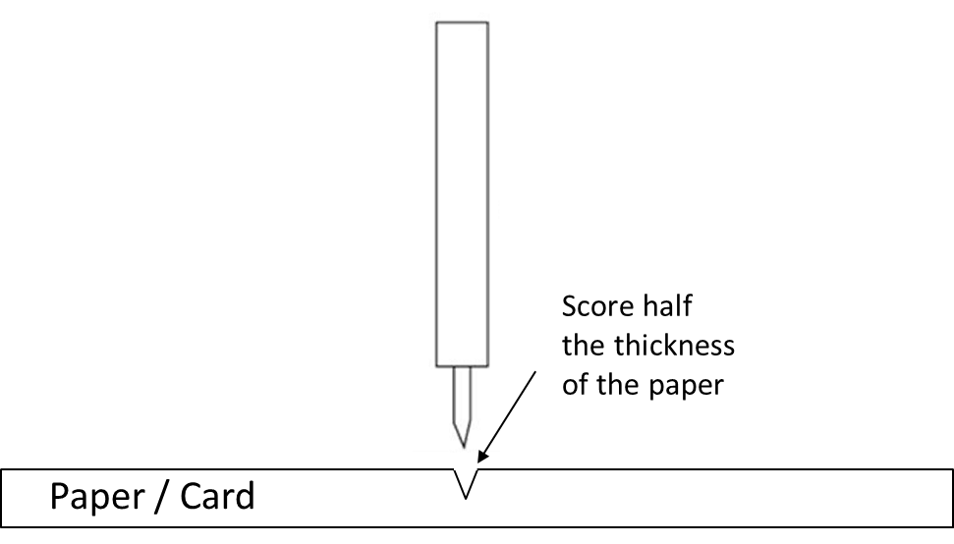
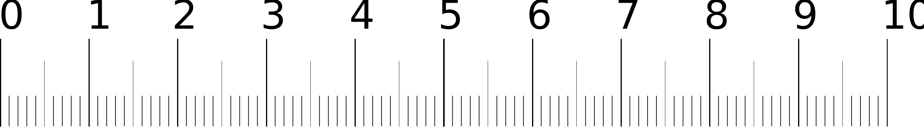
Introduction
Last lesson we looked at some basic pop-ups, one of the ‘tips’ given was about folding the paper to create a crease:
TIPS: Open the paper up again and fold the other way along the same crease. Repeat up to three times. This breaks the fibres of the paper or card, and makes the fold smooth and flexible
We will look at the essential techniques for accurate pop-up making:
FOLDING
SCORING
CREASING
MEASURING
CUTTING

Slide 4
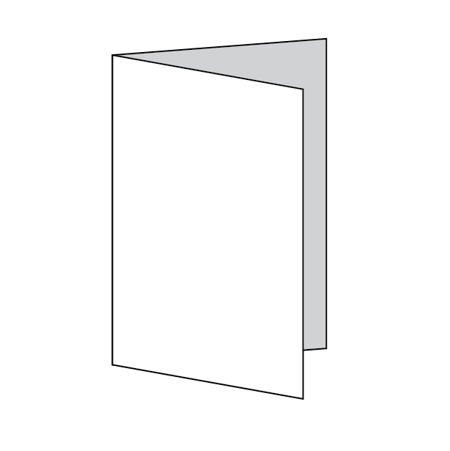
V-Fold: Variations – Mouth Fold
Folded Edge
1: Fold a piece of card in half down the centre. Use a ruler to crease along the fold, reinforcing it.
2: With the folded edge on the left, Draw a line at 90 degrees to the folded edge, just under halfway across the card, cut along this line.
3: Fold the card back along the dotted lines, these will be at 45 degrees to the folded edge.
Fold both ways and crease to break the fibres up and make the fold more flexible.

Slide 5
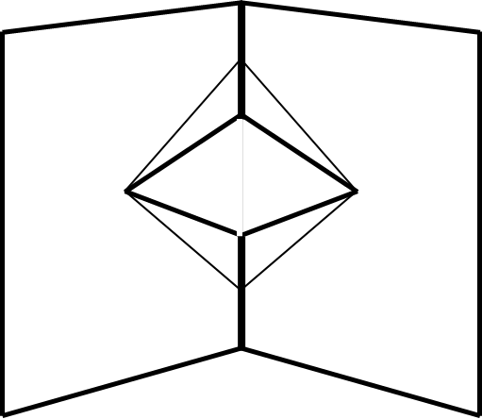
V-Fold: Variations – Mouth Fold
PUSH
4: Put both the top and bottom flaps back to their original positions.
5: Open the card like a tent.
The tricky bit…….using your thumb or fingers, push the top triangle through to the inside.
Repeat this for the bottom triangle.
6: Close the card and firmly press, creasing these edges
7: Open the card and see your Mouth Pop-up

Slide 6
V-Fold: Variations – Angle Fold
Folded Edge
1: Fold a piece of card in half down the centre. Use a ruler to crease along the fold, reinforcing it.
2: With the folded edge on the left, Draw a line at 90 degrees to the folded edge, just under halfway across the card, cut along this line.
3: Fold the card back along the dotted line.
Fold both ways and crease to break the fibres up and make the fold more flexible.

Slide 7
V-Fold: Variations – Angle Fold
PUSH
4: Put the flap back to its original position.
5: Open the card like a tent.
The tricky bit…….using your thumb or fingers, push the triangle through to the inside.
6: Close the card and firmly press, creasing the folded edge.
7: Open the card and see your Angle Fold Pop-up

Slide 8
Box Fold: Variations – Double Box
a)
b)
You will need 2 pieces of A4 card
1cm
3:
a) Mark and Fold a line 1cm from the top edge on both strips, these will form a tab.
b) Fold the strip from the bottom edge to the folded line.
1: One card is for the outer card; the other is for the strips to make the ‘floating plane’ box.
Cut two strips from the long edge, at least 1cm wide.
2: Fold a piece of card in half down the centre. Use a ruler to press along the fold, reinforcing it. Set aside.

Slide 9
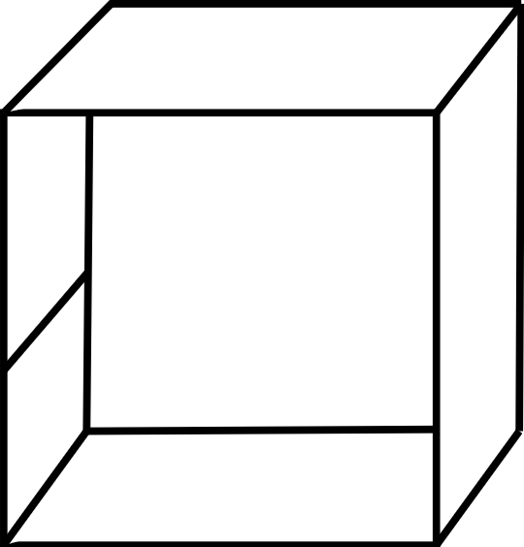
Box Fold: Variations – Double Box
c)
d)
5:
d) Fold along the folds, back and forth a couple of times to make the creases flexible.
Add some glue to the tab and form a square box.
4:
c) Fold the strip from the new folded bottom edge to the folded line.
6: Taking the first A4 sheet of card that has been folded in half that was set aside, open it out flat.
Line up one of the boxes folded edge with the crease on the folded sheet of card, with the long edge of the box facing away and glue in place.

Slide 10

Box Fold: Variations – Double Box
TIPS: Does the picture cover the two boxes?
The picture produces a ‘plane’ and to give the illusion of floating, the boxes need to be fully covered.
You could choose your picture first and then work out the sizes of your strips to achieve the correct size boxes, they could be thicker and shorter
7: Glue the other box directly opposite the first, mirroring its position.
Carefully close the sheet of card and press over the surface. The glue on the first box should stick to the second box.
This is a good way to check that the pop-ups are lined up when pages are closed.
8: Using the left-over piece of card, draw a picture on it, carefully cut it out and fold it in half horizontally, (bottom to top, not side to side).
Stick the picture to the top edge of the pop-up double box, by putting glue on the top edge of the two boxes, lining up the fold in the picture with the crease where the two boxes meet.

Slide 11
Box Fold: Variations – Tent
You will need 2 pieces of A4 card
10cm
1cm
8cm
8cm
1cm
1: One card is for the outer card; the other is for the strips to make the ‘floating plane’ box.
Cut two strips from the long edge, at least 1cm wide.
2: Fold a piece of card in half down the centre. Use a ruler to press along the fold, reinforcing it. Set aside.
3: On the second piece of card, draw a rectangle measuring 10cm by 18cm, measure a 1cm deep strip at each short end and mark the centre.
Cut out.

Slide 12
Box Fold: Variations – Tent
6cm
10cm
4: On the first piece of card, measure 6cm away from the centre crease and draw a line 10cm long, that is parallel to the centre crease, repeat on the other side of the centre crease.
5: Take your cut out rectangle and score along the 3 lines, putting glue along the tabs, fix to the main card, lining up the folded edge to the measured lines
6: The tent will stand up when the card is open at 180°

Slide 13
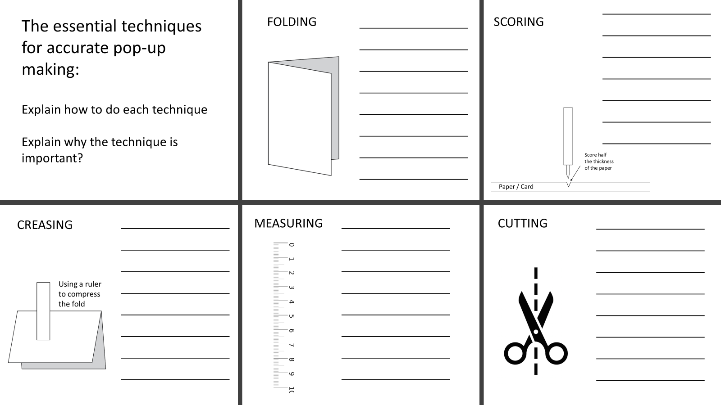
Assessment
Can you explain how to do each of the essential techniques for accurate pop-up making and why the technique is important?
Do any of the pop- ups stick out from the cards when they are closed?
Is there anything that needs to be improved and what would you need to do to improve it?

