Slide 1
Paper Engineering – Lesson 3
Bringing paper to life, from 2-Dimensional to 3-Dimensional

Slide 2
Project Learning Objectives:
To create a 3D pop-up book suitable for a small child.
Week 1 | Week 2 | Week 3
Analysis of Pop-up books. Have a go at some basic pop-up techniques. | Explore the essential techniques for accurate pop-up. Continue to have a go. Introduce variations of pop-ups. | Using knowledge learnt so far, introduce mechanisms. Know the difference between them.
Week 4 | Week 5/6 | Week 7/8
Discuss key criteria for a good story or pop-up book. Plan the story using a storyboard. | Evaluate the story plan so far. Start to make the pop-ups and mechanisms for all the pages. | Finish the pages, with text and decoration. Create the cover and assemble the finished book.
Success criteria:
(SC1) I can explain advantages and disadvantages of pop-up books
(SC2) I can identify advantages and disadvantages of making 3D shapes from flat sheets.
(SC3) I can describe how folding a flat (2D) sheet of paper makes it a 3D object.
(SC4) I can describe how different cuts and folds can make different 3D shapes.
(SC5) I can make a pop-up designs following instructions.
(SC6) I can make a pop-up designs from a blank piece of paper.
(SC7) I can identify the difference between pop-ups and mechanisms
(SC8) I can create a short, fun story and make it into a pop-up book.

Slide 3
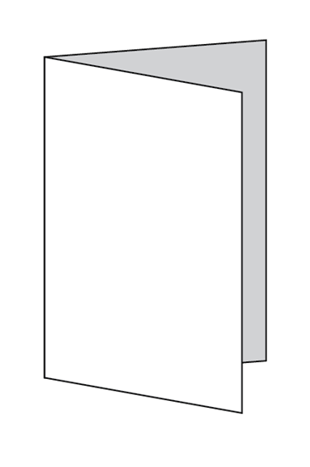
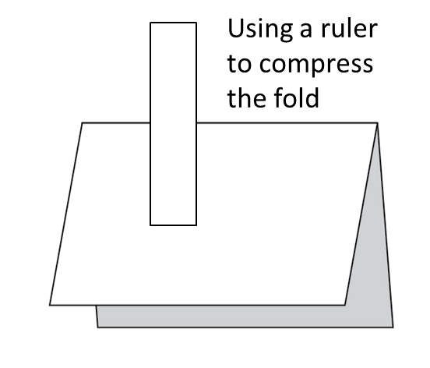

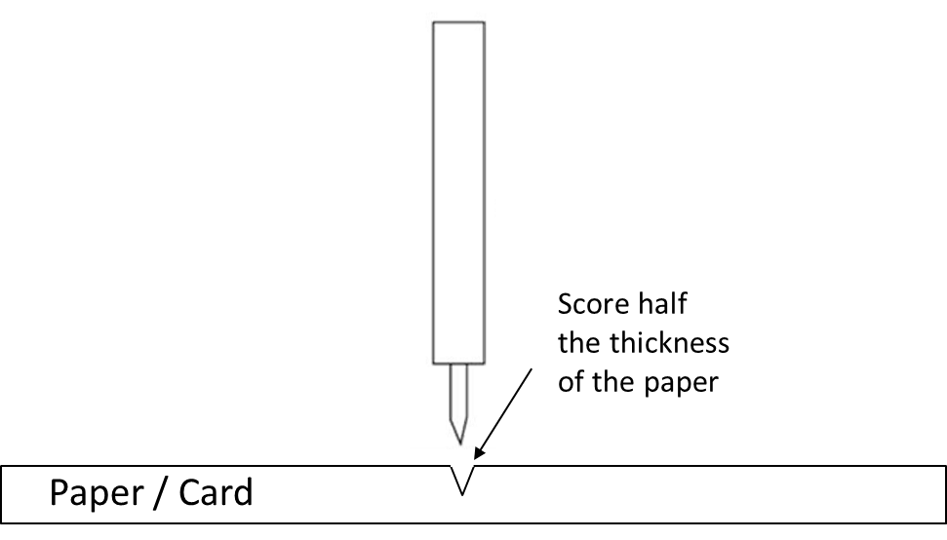
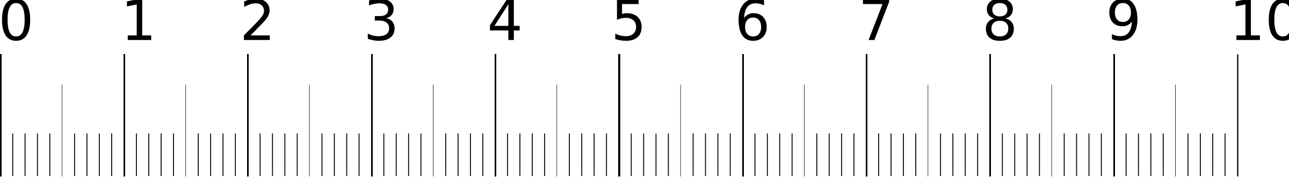
Introduction
Last lesson we looked at the essential techniques for accurate pop-up making:
FOLDING
SCORING
CREASING
MEASURING
CUTTING
Can you remember how to do these techniques and why?

Slide 4
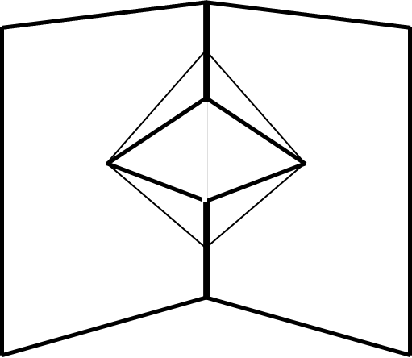
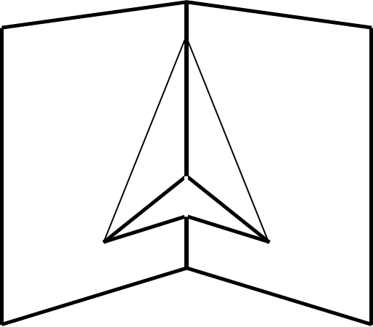
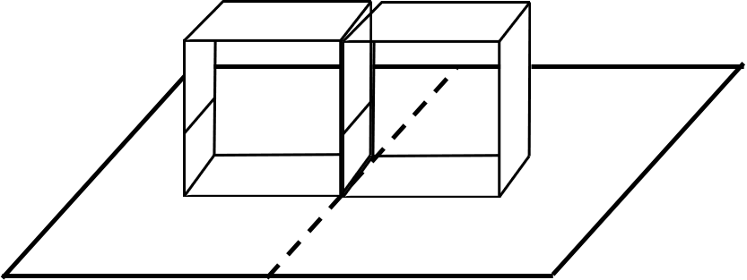
Introduction
Last lesson we also had a go at variations of V-Fold and Box Fold Pop-ups:
WHAT TYPE ARE THEY?
HOW COULD YOU USE THEM?
CAN YOU NAME THEM?

Slide 5
Have a go….
Last lesson we had a go at variations of V-Fold and Box Fold Pop-ups:
If you didn’t make some, have a go today

Slide 6
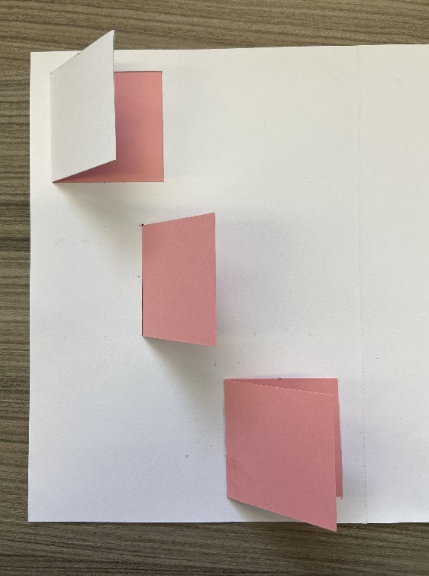
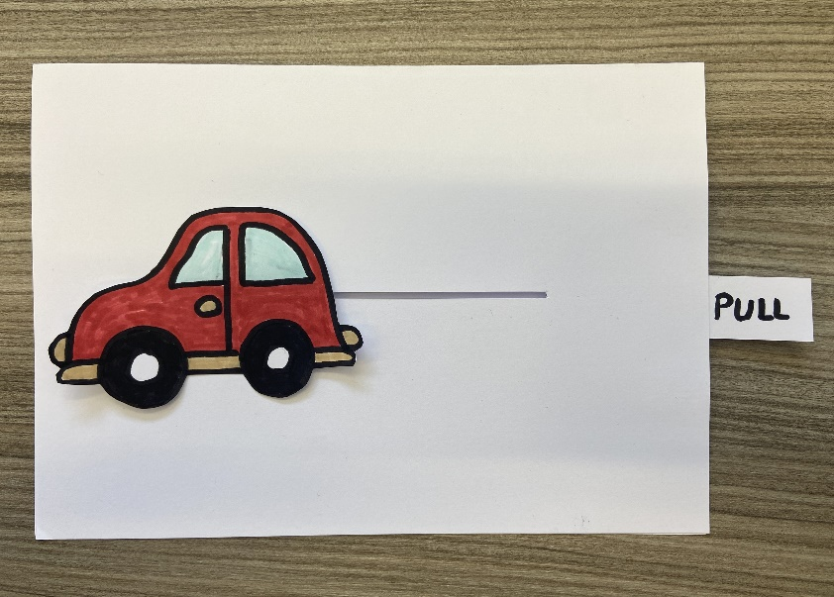
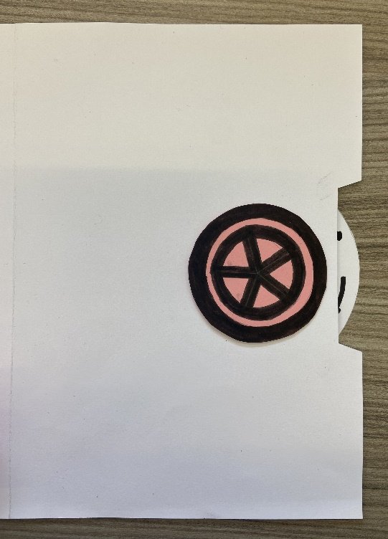
Mechanisms
You will have seen mechanisms in the Pop-up books that you looked at in lesson 1. Where Pop-ups do exactly that, as the book opens, mechanisms don’t, they can be a slide, a rotation or a flap of paper.
We will look at these three mechanisms today and have a go…..
ROTARY
LIFT UP FLAPS
PULL SLIDERS

Slide 7

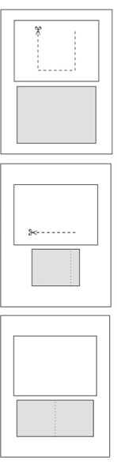
Mechanisms: Lift-up Flaps
Let’s look at different ways you can add a lift up flap into your Pop-up book
Option 1: By cutting out a door on the top piece of card and placing the reveal on a piece of card behind this
Option 2: By adding an extra piece of folded card, but slotting half through a slot, so one half of the folded card becomes the flap.
Option 3: By adding an extra piece of folded card

Slide 8
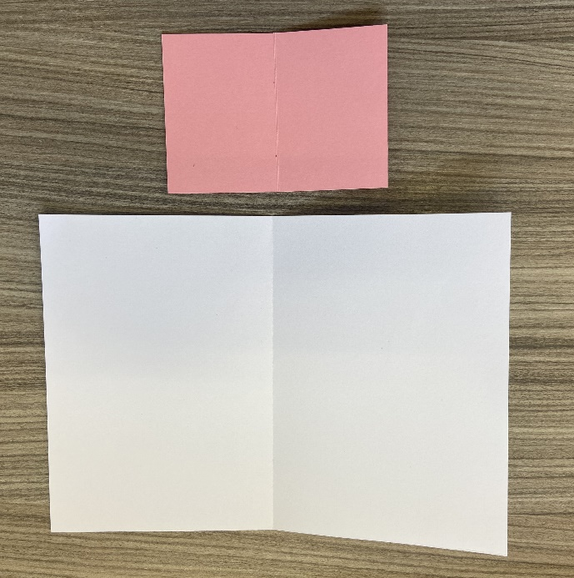
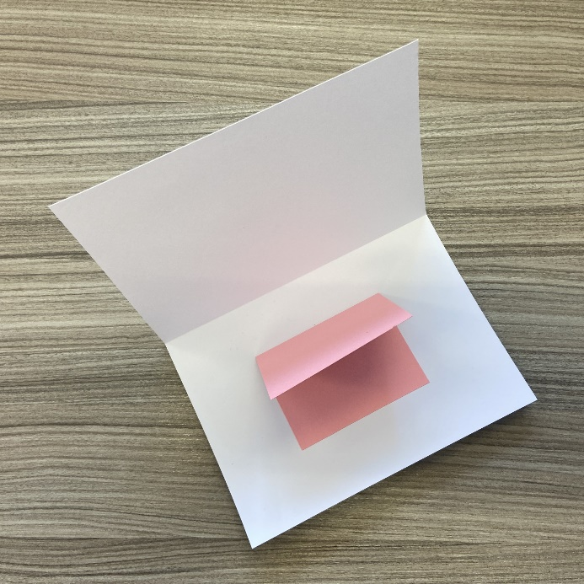
Mechanisms: Lift-up Flaps
How to instructions for Option 1: You will need 2 pieces of card (1 A4)
1: One card (A4) is for the outer card; the other is for the lift-up flap, size is determined by what you want to ‘hide’
2: Fold both pieces of card in half down the centre. Use a ruler to press along the fold, to reinforce it.
3: Glue the lift-up flap into place on the outer card.
Add decoration to the inside.

Slide 9
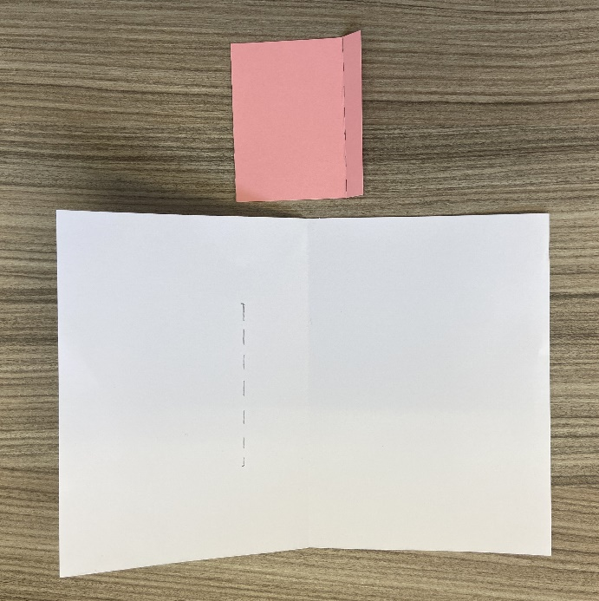
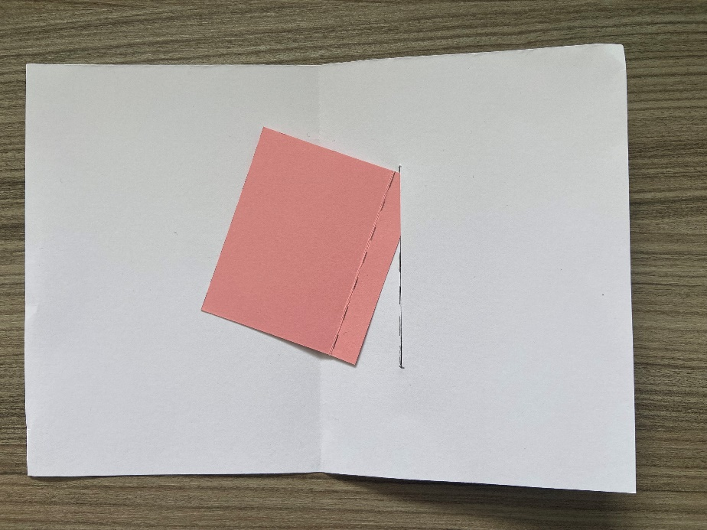
Mechanisms: Lift-up Flaps
How to instructions for Option 2: You will need 2 pieces of card (1 A4)
1: One card (A4) is for the outer card; the other is for the lift-up flap, size is determined by what you want to ‘hide’
2: Fold the A4 card in half and the smaller piece along the dotted line. Use a ruler to press along the fold, to reinforce it.
3: Mark a line for the slot on the main piece of card the length of fold of the smaller piece of card.
Carefully cut along this line.

Slide 10
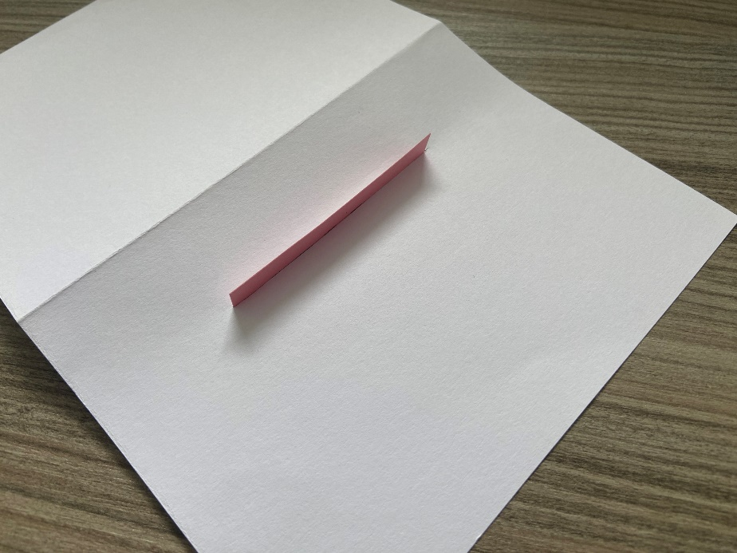
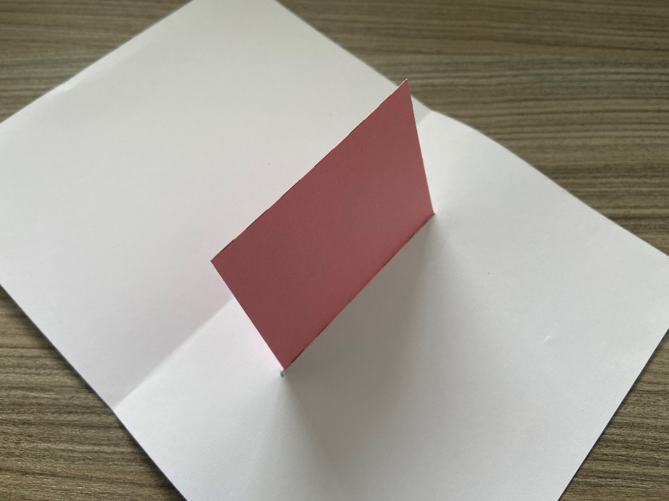
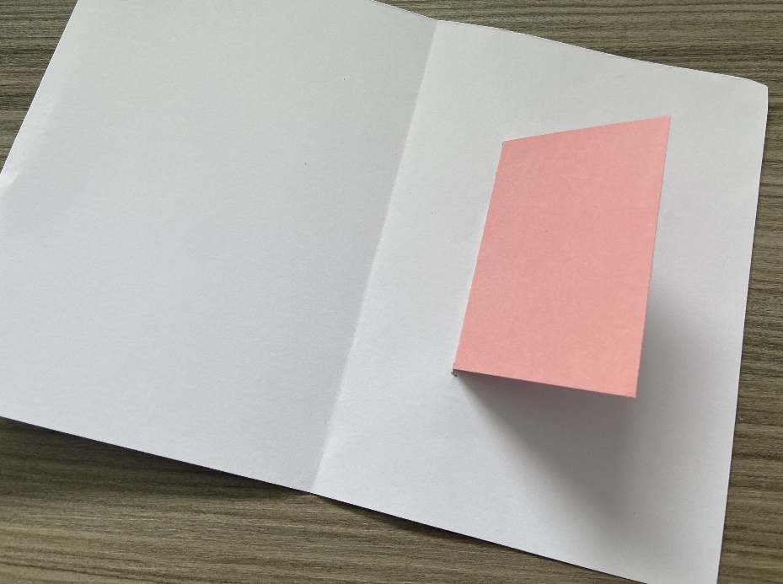
Mechanisms: Lift-up Flaps
How to instructions for Option 2: Continued
4: Slide the lift-up flap piece of card through the slot that you have created.
Add some glue to the tab and stick down.
5: Turn the card to the right side and fold the lift-up flap down.
6: Decorate underneath the lift-up flap

Slide 11
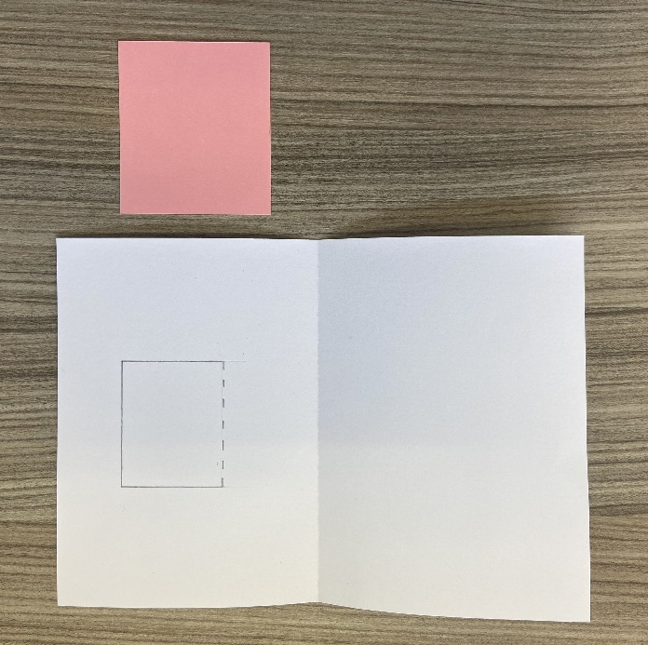
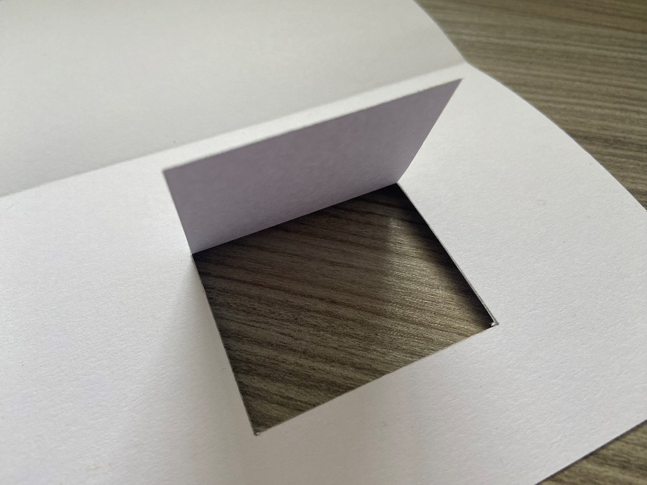
Mechanisms: Lift-up Flaps
How to instructions for Option 3: You will need 2 pieces of card (1 A4)
1: One card (A4) is for the outer card; the other is for the back piece of the aperture of the door created by the lift-up flap.
2: Fold the A4 card in half. Mark the size of the window that you want on the main card, this needs to be a bit smaller than the smaller piece of card.
3: Cut three sides to the aperture and fold and score along the remaining edge.

Slide 12
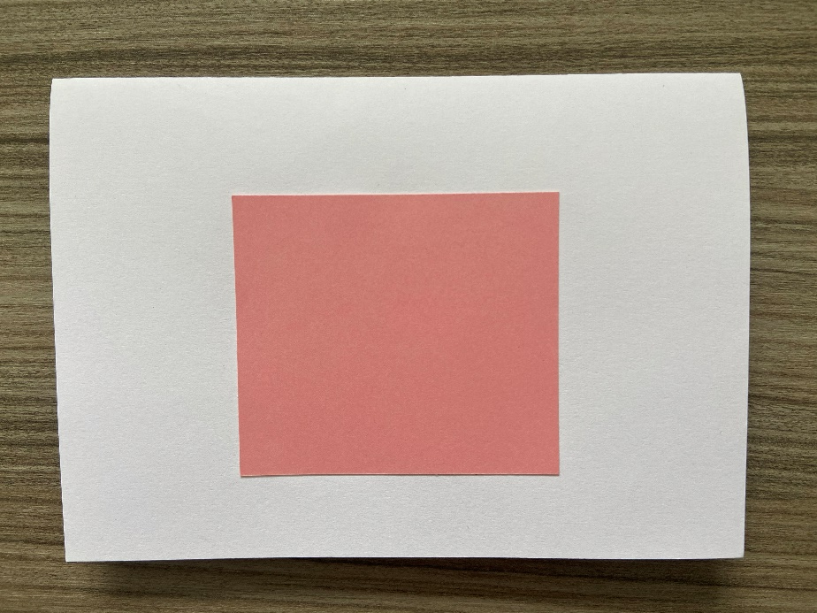
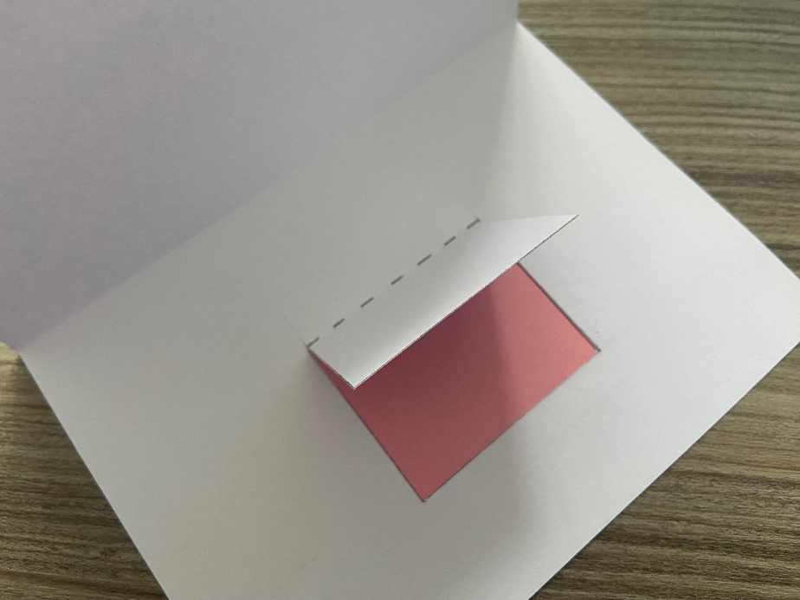
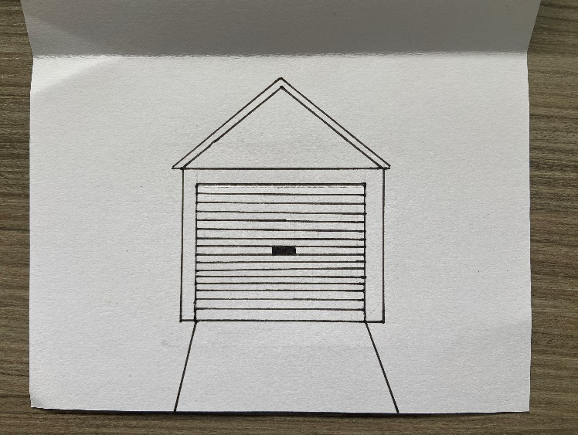
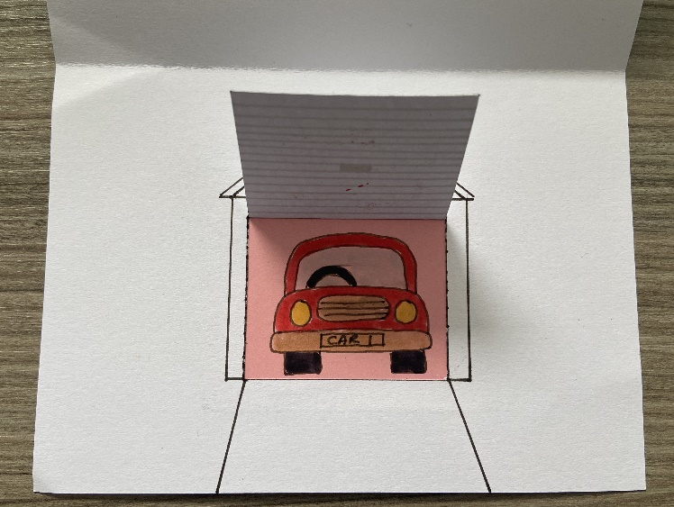
Mechanisms: Lift-up Flaps
4: Glue the extra piece of card to the back of the main card, behind the window
5: Add decoration to the extra piece of card, under the flap of the window

Slide 13
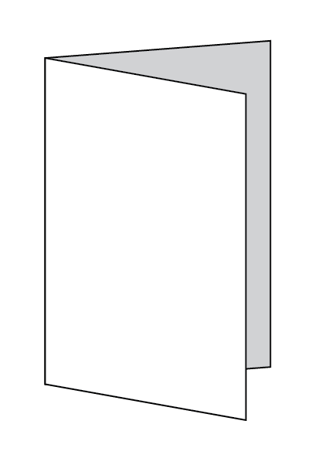
Mechanisms: Pull Slider
You will need 2 pieces of A4 card
1: One card is for the outer card; the other is for the slider mechanism and decoration.
2: Fold one piece of card in half down the centre. Use a ruler to press along the fold, reinforcing it. Set aside.
3: On the second piece of card, cut two strips from the long edge about 2cm wide

Slide 14

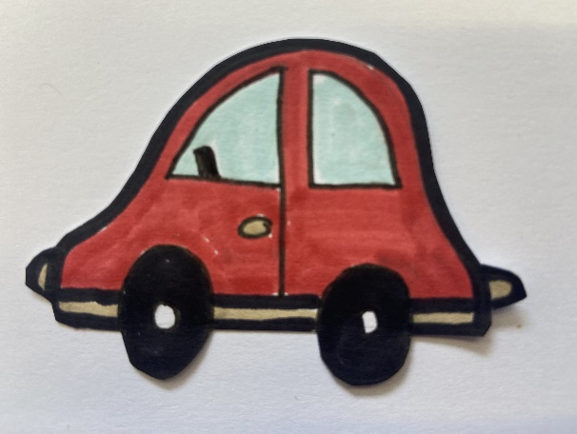
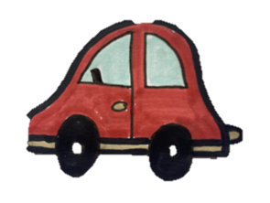
Mechanisms: Pull Slider
4: Create an Image that will have space to move from one side of the page to the other.
5: Mark the centre points of the image at the start and finish positions.
6: Mark a line / slot between these points and cut a slot out that is about 5mm wide.
7: On one strip mark two tabs 2 cm long, that will be folded in half along the dotted line, cut the remaining strip in half

Slide 15
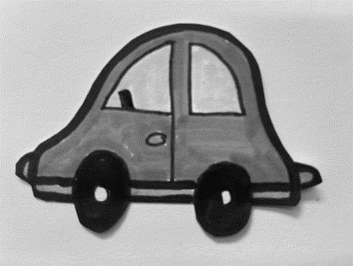
Mechanisms: Pull Slider
8: On the other strip, cut the strip to be the length from one end of the slot to about 1 cm longer than the card (see below)
This is your ‘Pull Tab’
9: With the pieces from the other strip, fold the two small tabs in half.
With the folded edges together, stick to the back of your cut out image.

Slide 16
Mechanisms: Pull Slider
10: Slot the loose tabs through the slot on the main card, so that you image is on the correct side of the card.
11: Glue the ‘Pull Tab’ strip to the tabs

Slide 17
Mechanisms: Pull Slider
12: With the other two strips from the first strip, glue these down over the ‘pull tab’ ensuring that you don’t stick them to the ‘pull tab’ and it can still move freely.
13: Turn the card over and you should be able to pull the ‘pull tab’ and your image will move across the page.

Slide 18
Mechanisms: Rotary
You will need 2 pieces of A4 card
1: One card is for the outer card; the other is for the rotary mechanism and decoration.
2: Fold one piece of card in half down the centre. Use a ruler to press along the fold, reinforcing it. Set aside.
3: On the second piece of card, draw one circle that is just smaller than the size of half the card.
Your image needs to fill a circle, just smaller than the first one.

Slide 19
Mechanisms: Rotary
5: On the large circle, mark the smaller circle as you did on the main card, mark 2 lines across the circle and then mark from these 2 tabs.
Cut along the solid lines, fold along the dashed lines.
4: On the main piece of card, place the large circle to the edge of the card, mark a slot, where you can turn the circle, also mark a smaller circle at the centre of the larger one, about 1cm wide.
Cut these out.
6: Place the large wheel inside your main piece of card, push the tabs through the small centre hole, to the front of the card.

Slide 20
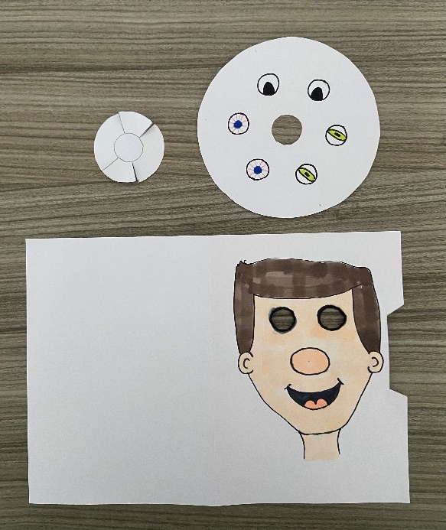

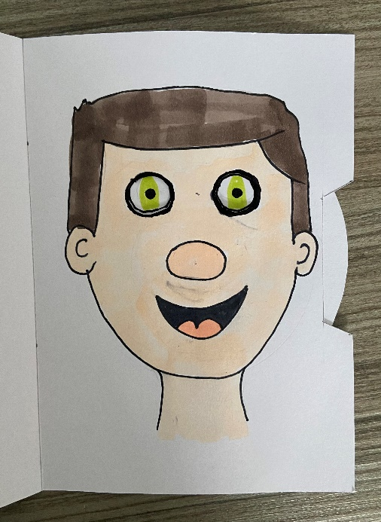
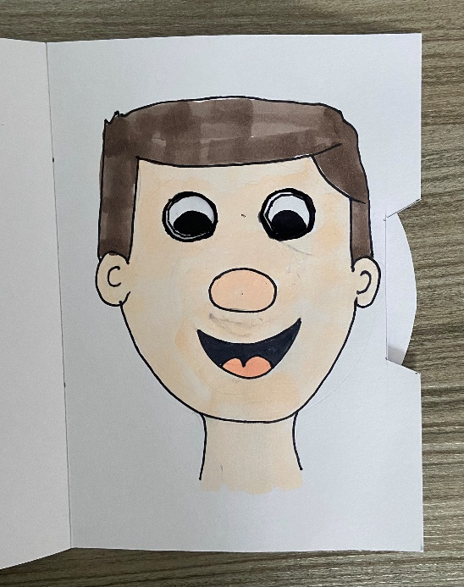
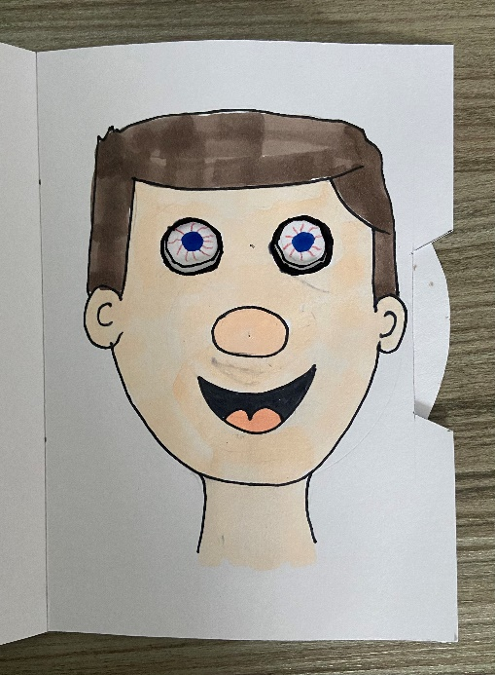
Mechanisms: Rotary
Variation to rotary mechanisms:
As well as having the moving part on the outside you can have the moving part on the inside, using windows or slots to see the moving image.
7: Glue your image / design on to the tabs, making sure that it is free to turn around.
Here, the eyes change, and move around behind the cut-out eyes of the face on the front.

Slide 21
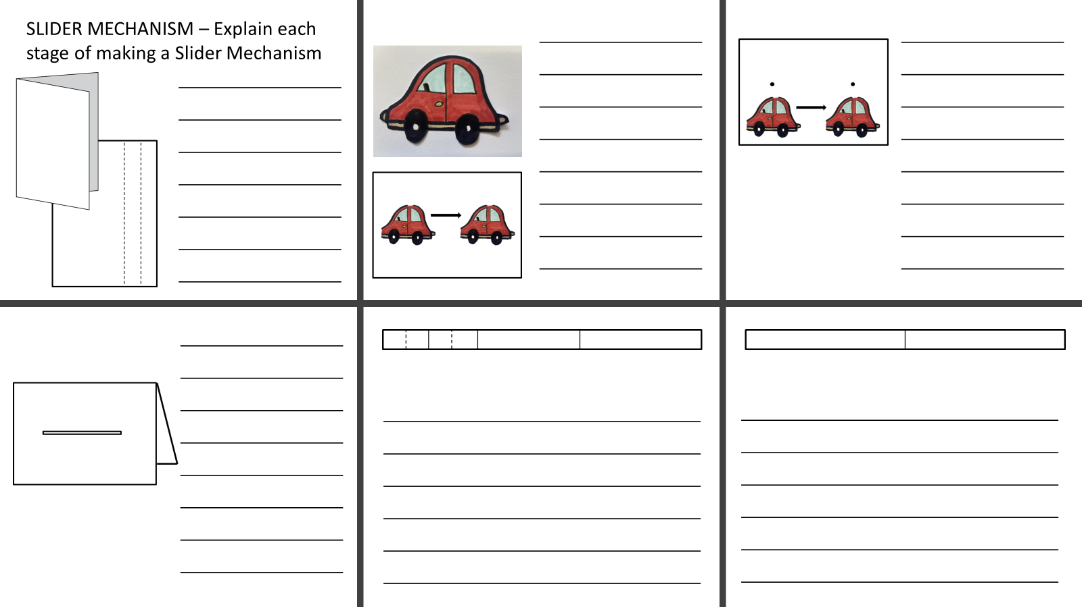
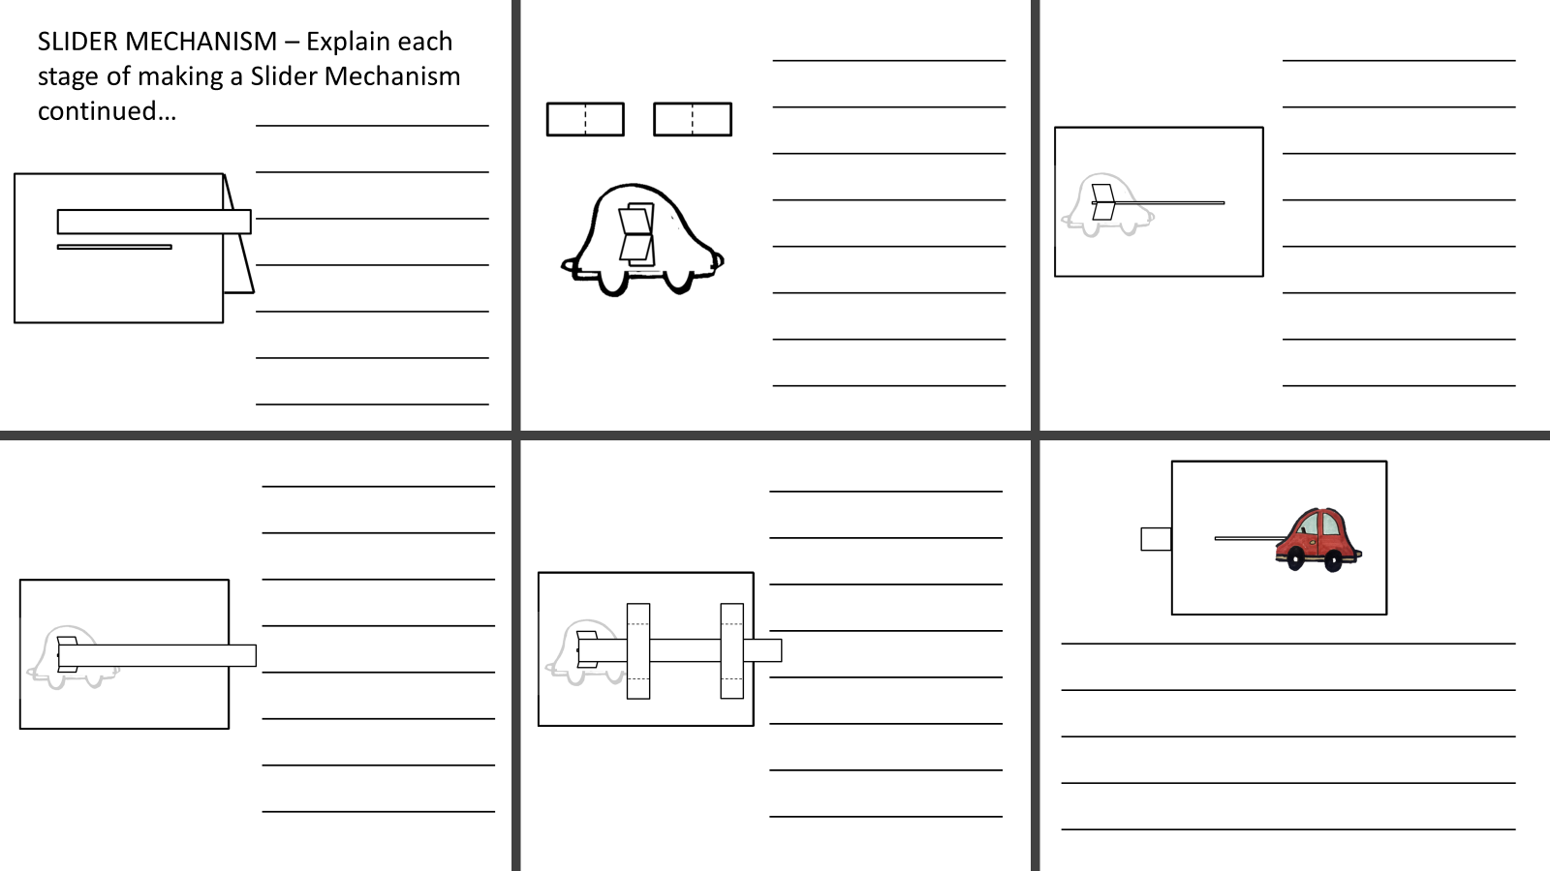
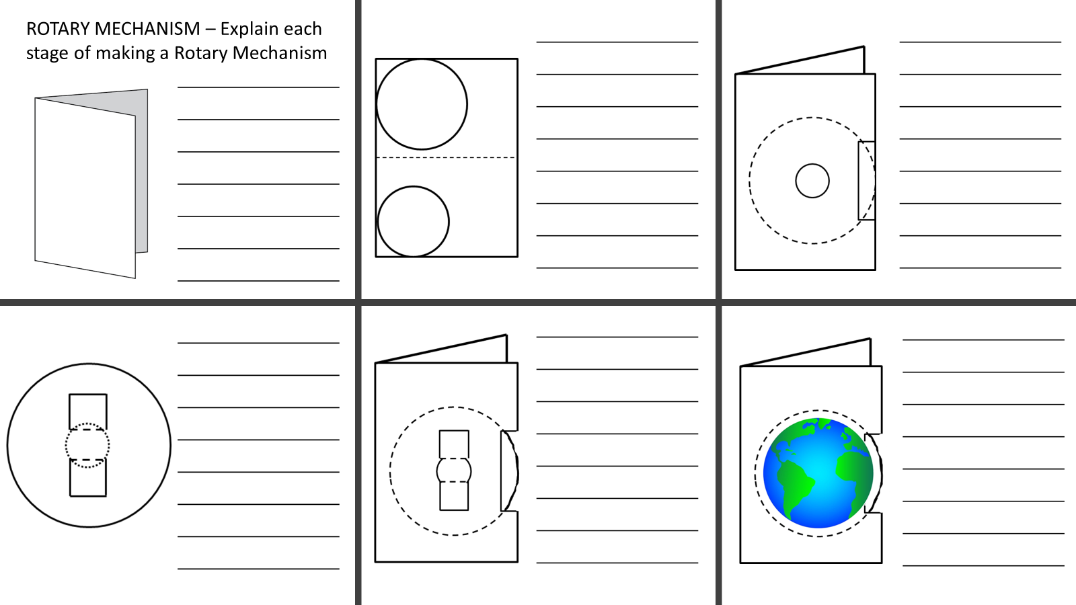
Assessment
Successfully made and explained more pop-ups and some mechanisms.
Can you explain the difference between and pop-up and a mechanism?

