Slide 1
Paper Engineering – Lesson 4
Bringing paper to life, from 2-Dimensional to 3-Dimensional

Slide 2
Project Learning Objectives: To create a 3D pop-up book suitable for a small child.
Week 1 | Week 2 | Week 3
Analysis of Pop-up books. Have a go at some basic pop-up techniques. | Explore the essential techniques for accurate pop-up. Continue to have a go. Introduce variations of pop-ups. | Using knowledge learnt so far, introduce mechanisms. Know the difference between them.
Week 4 | Week 5/6 | Week 7/8
Discuss key criteria for a good story or pop-up book. Plan the story using a storyboard. | Evaluate the story plan so far. Start to make the pop-ups and mechanisms for all the pages. | Finish the pages, with text and decoration. Create the cover and assemble the finished book.
Success criteria:
(SC1) I can explain advantages and disadvantages of pop-up books
(SC2) I can identify advantages and disadvantages of making 3D shapes from flat sheets.
(SC3) I can describe how folding a flat (2D) sheet of paper makes it a 3D object.
(SC4) I can describe how different cuts and folds can make different 3D shapes.
(SC5) I can make a pop-up designs following instructions.
(SC6) I can make a pop-up designs from a blank piece of paper.
(SC7) I can identify the difference between pop-ups and mechanisms
(SC8) I can create a short, fun story and make it into a pop-up book.

Slide 3
Introduction
Story Planning
Who is your audience?
Is it Fiction or Non-fiction?
Is there a theme?
Is it Educational?
How will you use the pop-ups and mechanisms?
Think about colour and text type and placement
Story Planning:
You need to think about a story that can use the pop-up and mechanisms that you have learnt so far, to make your book exciting.
Think about themes, characters, who your audience will be, colour, text type, and placement, is it fiction or non-fiction, is it educational?
Mind Map your ideas

Slide 4
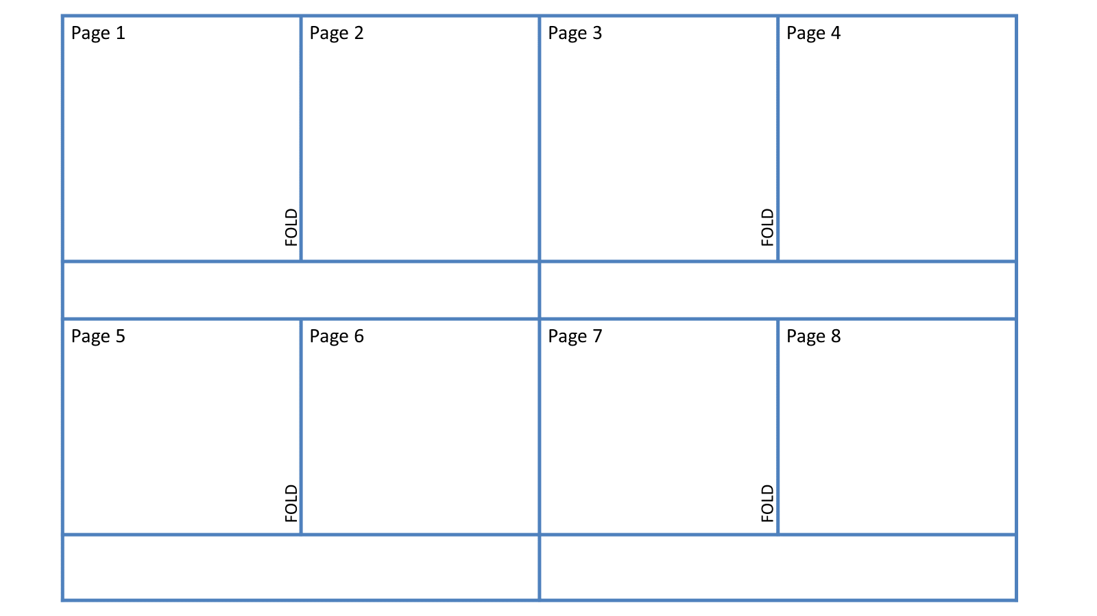
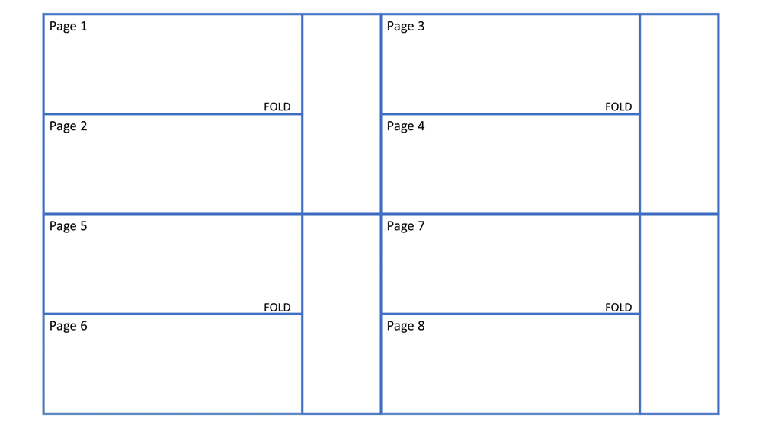
Storyboard
Story Board – Plan your story, what pop-ups / mechanisms will you use, where will they be placed, think about how they pop out, are they better portrait or landscape?
Your book needs to be one or the other!
PORTRAIT
LANDSCAPE

Slide 5
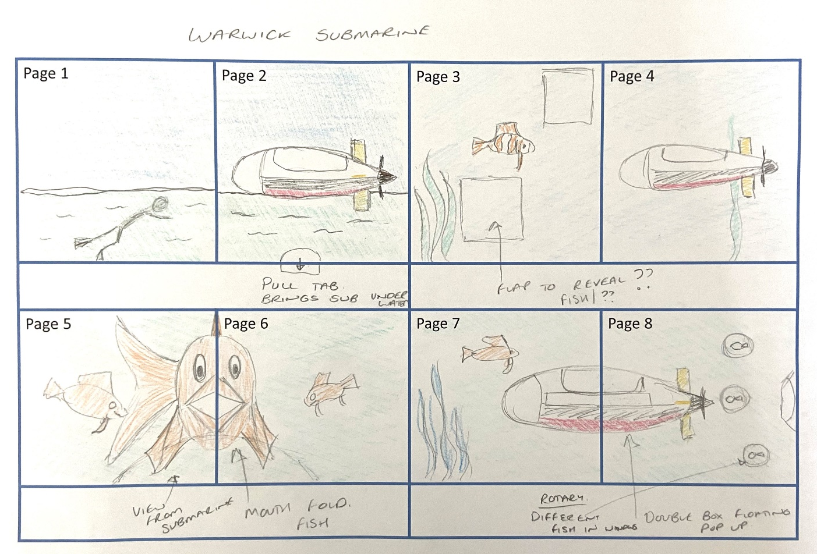
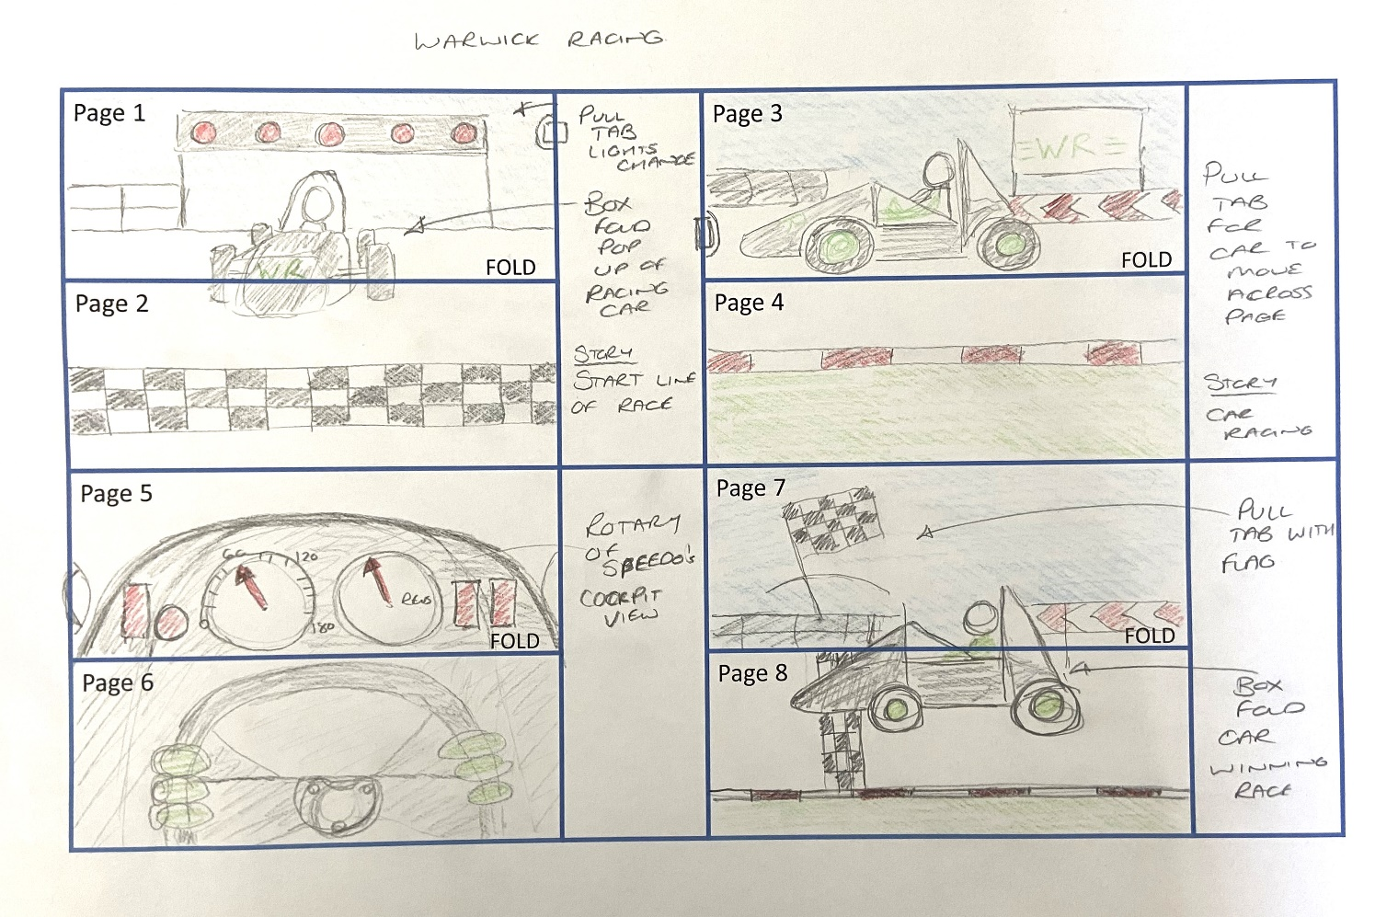
Storyboard – What could it look like?
MECHANISMS
POP-UPS
ANNOTATED

Slide 6
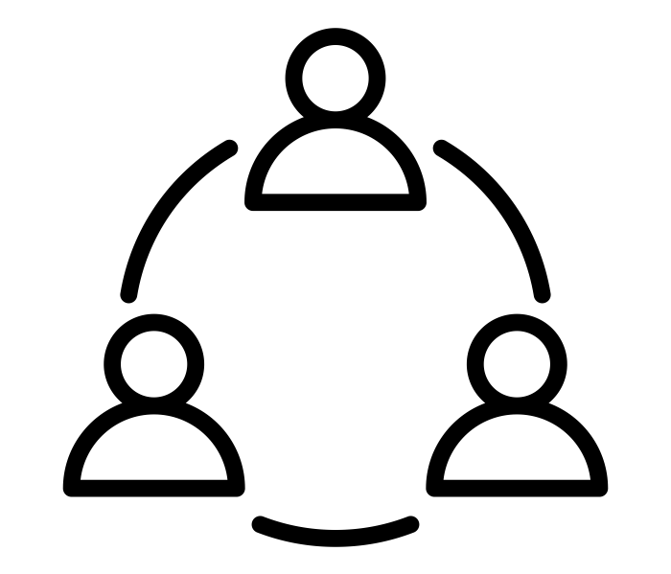
Assessment
Can you explain you story and plans to your small group?
In small groups, share your story and ideas with each other.
Give each other feedback on the ideas shared.
Are the pop-ups or mechanisms the best ones to use?
Do you need to make any changes based on your discussions?

