Slide 1
Paper Engineering – Lesson 5
Bringing paper to life, from 2-Dimensional to 3-Dimensional

Slide 2
Project Learning Objectives: To create a 3D pop-up book suitable for a small child.
Week 1 | Week 2 | Week 3
Analysis of Pop-up books. Have a go at some basic pop-up techniques. | Explore the essential techniques for accurate pop-up. Continue to have a go. Introduce variations of pop-ups. | Using knowledge learnt so far, introduce mechanisms. Know the difference between them.
Week 4 | Week 5/6 | Week 7/8
Discuss key criteria for a good story or pop-up book. Plan the story using a storyboard. | Evaluate the story plan so far. Start to make the pop-ups and mechanisms for all the pages. | Finish the pages, with text and decoration. Create the cover and assemble the finished book.
Success criteria:
(SC1) I can explain advantages and disadvantages of pop-up books
(SC2) I can identify advantages and disadvantages of making 3D shapes from flat sheets.
(SC3) I can describe how folding a flat (2D) sheet of paper makes it a 3D object.
(SC4) I can describe how different cuts and folds can make different 3D shapes.
(SC5) I can make a pop-up designs following instructions.
(SC6) I can make a pop-up designs from a blank piece of paper.
(SC7) I can identify the difference between pop-ups and mechanisms
(SC8) I can create a short, fun story and make it into a pop-up book.

Slide 3
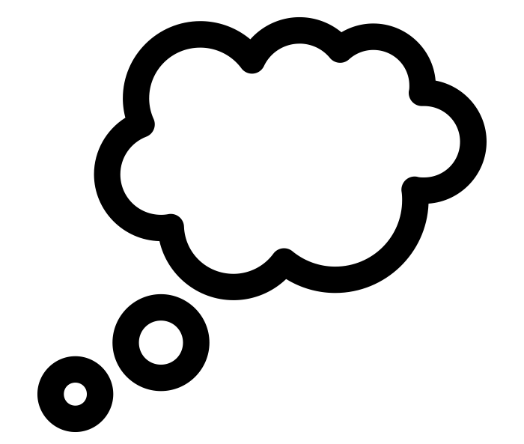
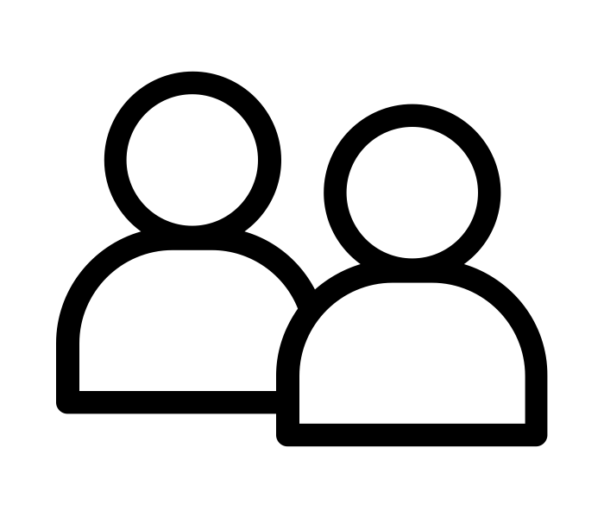



Introduction
Think
Pair
Share
What went well:
Even better if:
Think about your story you have planned, and the pop-ups and mechanisms you have used.
Explain you story and plans to your partner / small group.
Can you share what you have discussed, and any improvements suggested?
Notes:
Get pupils to think about their story plan, in pairs talk to each other and share opinions of WWW (what works well) and EBI (Even better if)

Slide 4
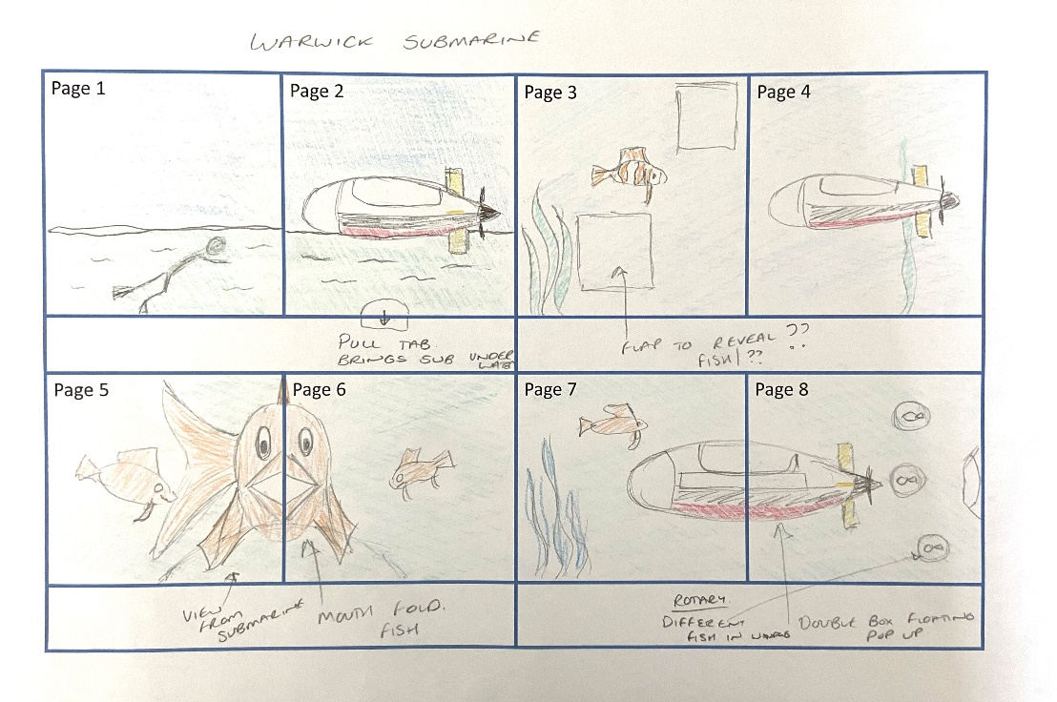
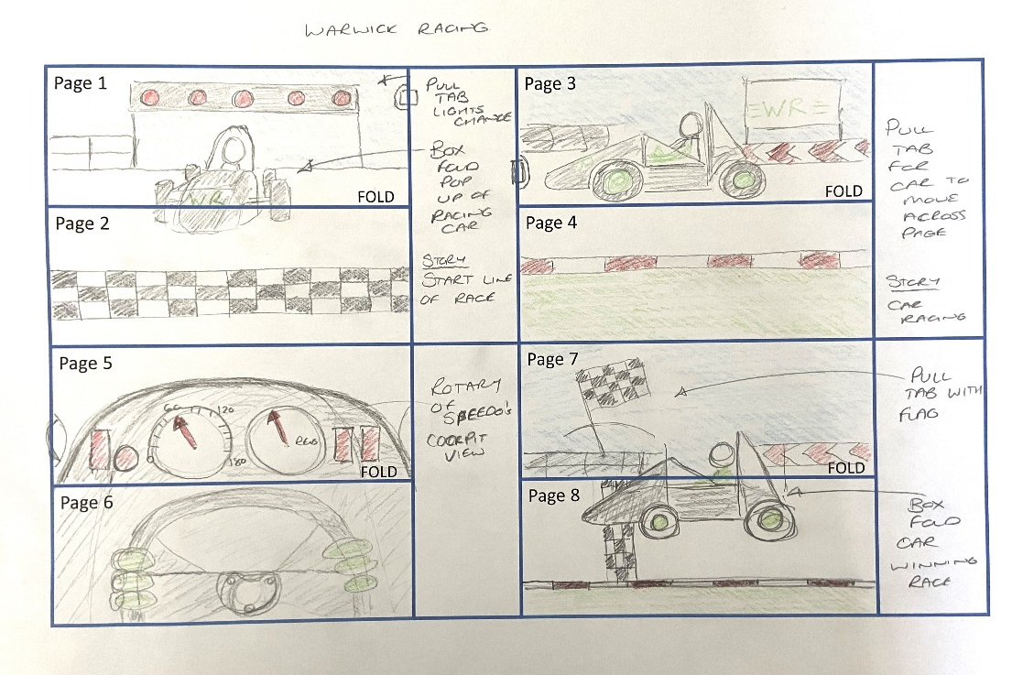
Creating your pages
Start making the pages for your book, create the pop up / mechanism first, get all the pages completed with any pop-ups and mechanisms, then add decoration, extra parts etc.
IS IT PORTRAIT OR LANDSCAPE?
WHERE WILL THE POP-UP OR MECHANISM BE PLACED?

Slide 5
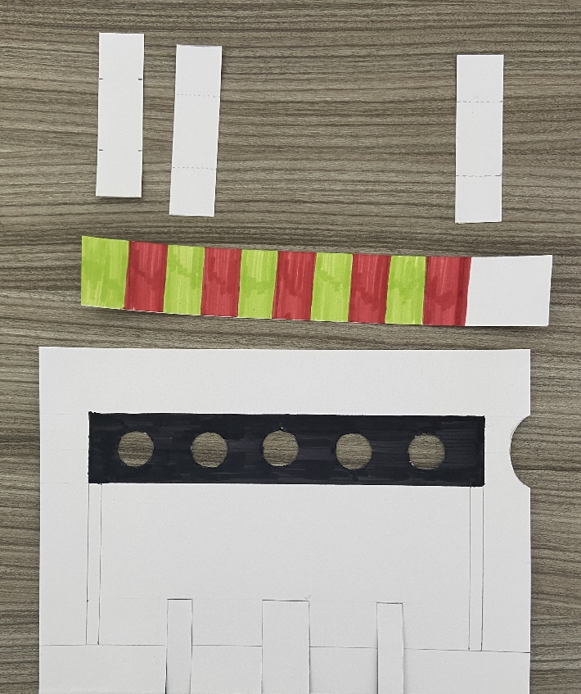
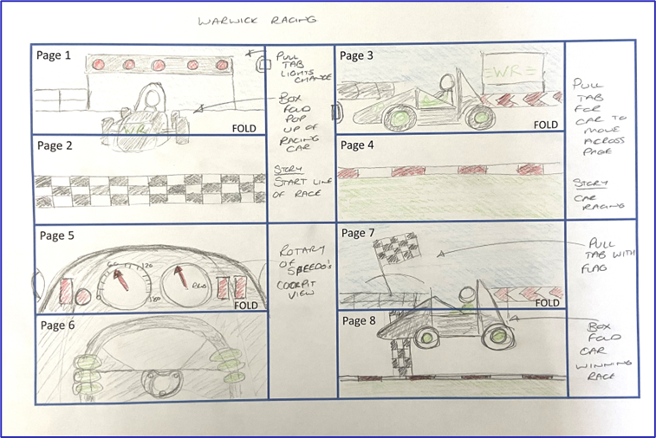
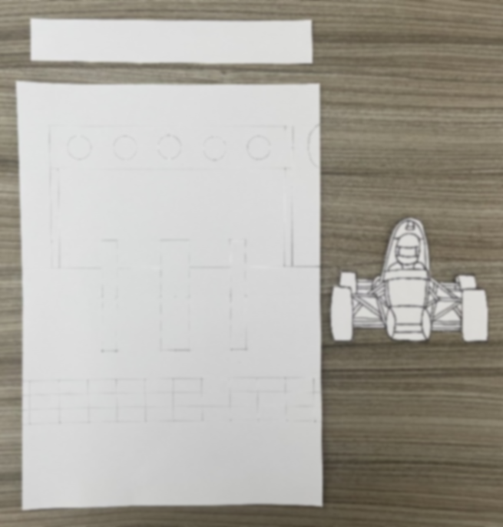
Creating your pages
Plan out where the pop-up or mechanism is going to be on the page, is it on one side or across the middle fold?.
Mark out in pencil where everything will be positioned on the page
Drawn image for the centre pop-up
Cut out areas for the lights pull tab and all parts for this mechanism, coloured these in ready for assembly.

Slide 6
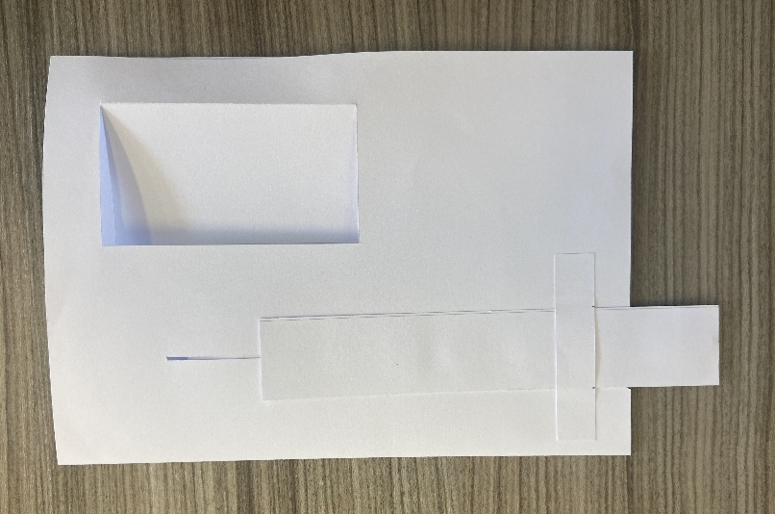
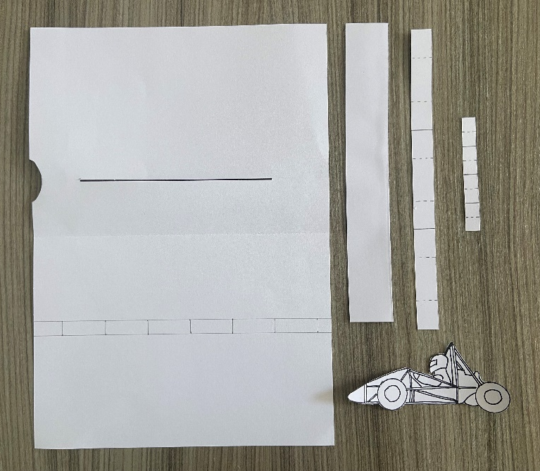
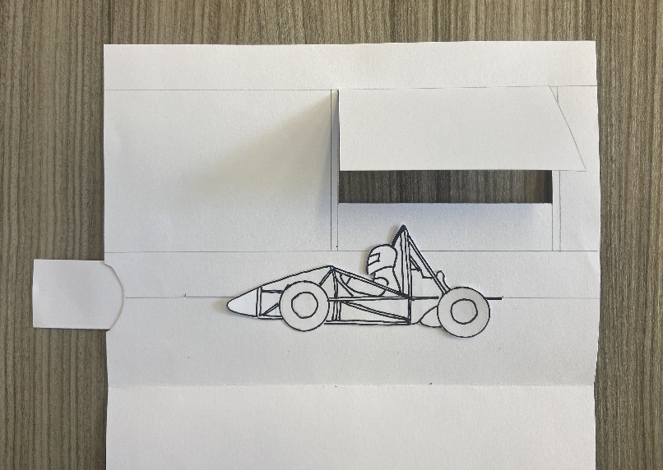
Creating your pages
Mark out in pencil where everything will be positioned on the page.
Cut out extra tabs and images for the mechanisms.
Assemble the sliding mechanism and cut out the lift up flap.

Slide 7
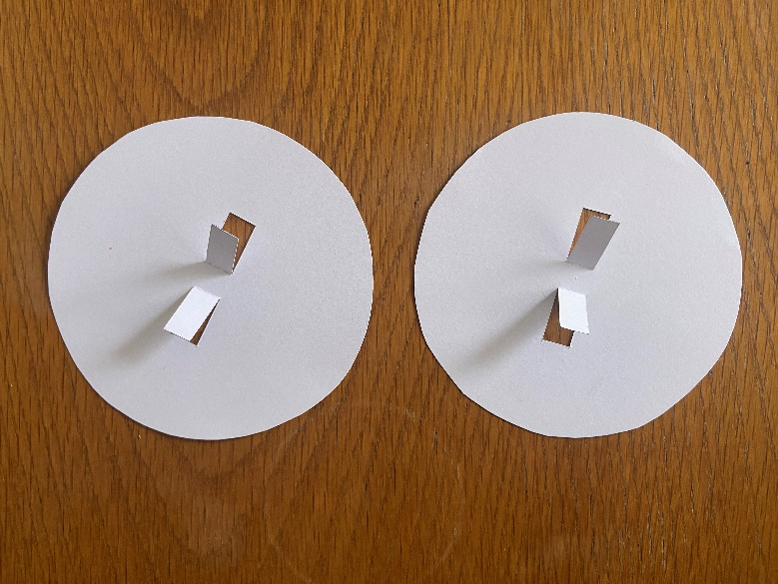
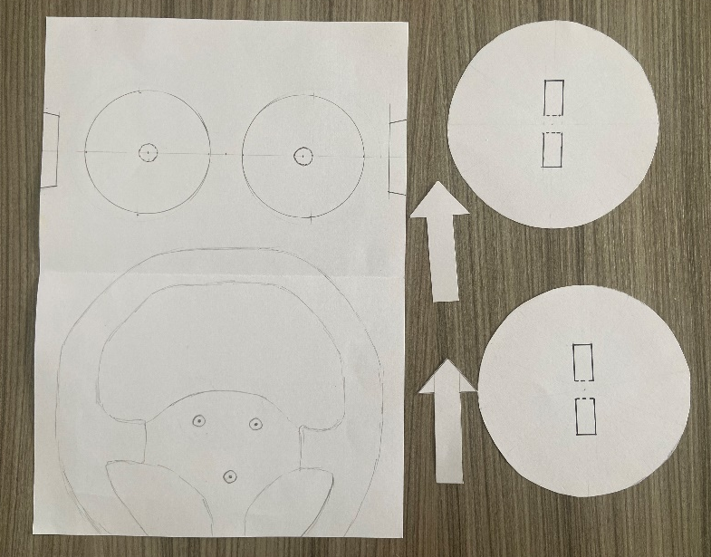
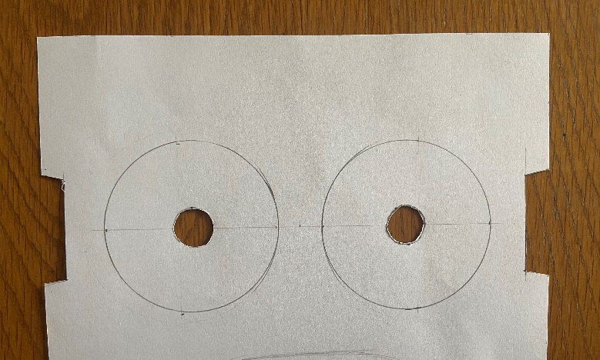
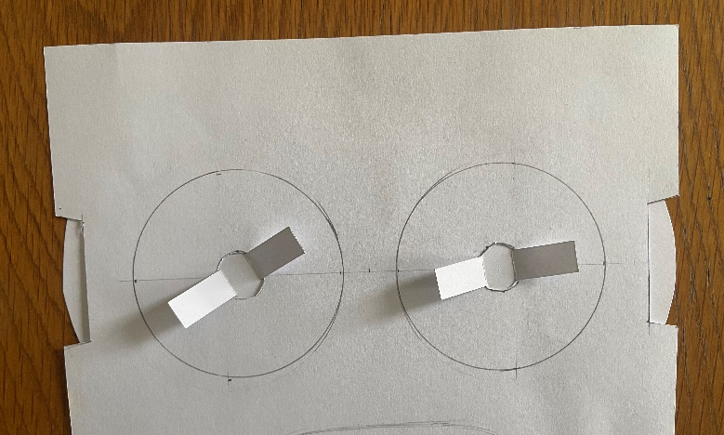
Creating your pages
Mark out in pencil where everything will be positioned on the page.
Cut out extra tabs and images for the mechanisms.
Assemble the mechanisms for rotating dials

Slide 8
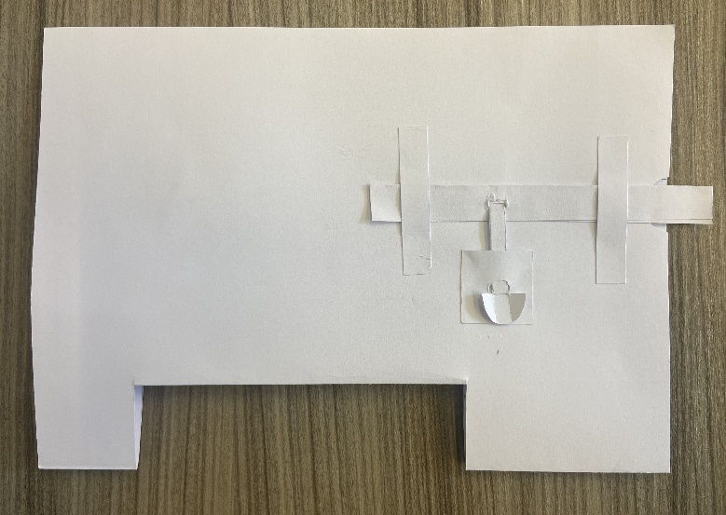
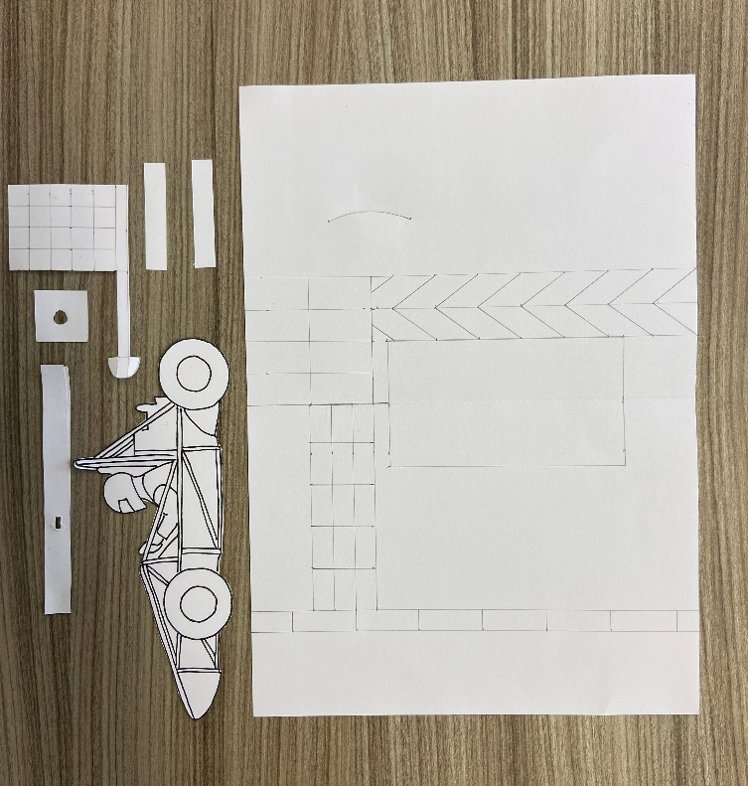
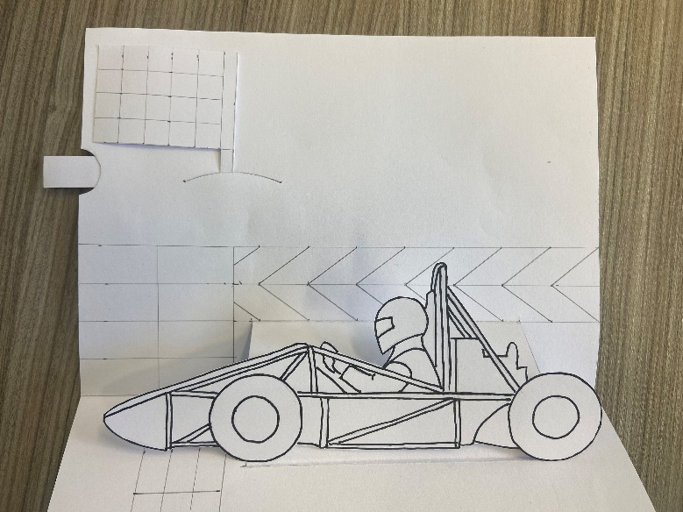
Creating your pages
Mark out in pencil where everything will be positioned on the page.
Cut out extra tabs and images for the mechanisms.
Assemble the mechanisms for the waving flag

Slide 9
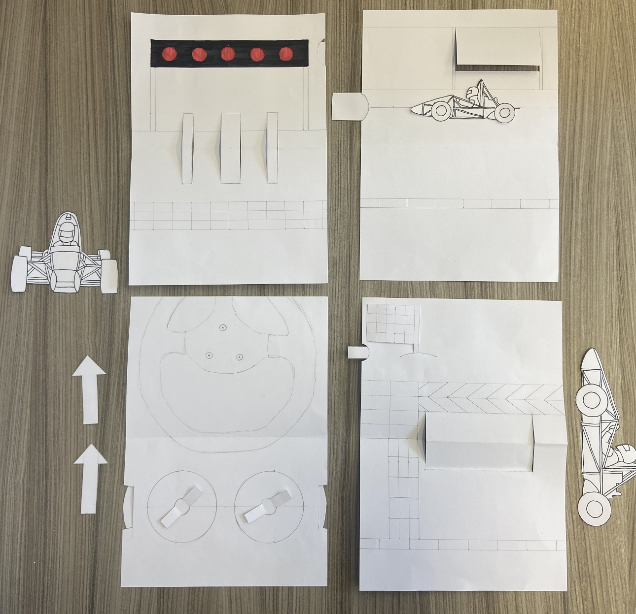
Creating your pages
Now all your pop-ups and mechanisms are made for all your pages, it is time to decorate and assemble them.
Complete Pop-Ups
Add
colour
Complete Mechanisms

Slide 10

Assessment
Still need to finish some pages, not all pop-ups or mechanisms are complete.
Finished planning all pages, making all pop-ups and mechanisms required.
Finished planning all pages, making all pop-ups and mechanisms. Have started assembly and decorating.
Notes:
How’s it going? Quick check around the classroom, to see how everyone is doing, have they completed most of their pages? This will help plan for the last lesson.
NB. If anyone is behind, they could finish decorating for homework.

