Slide 1
Paper Engineering – Lesson 6
Bringing paper to life, from 2-Dimensional to 3-Dimensional

Slide 2
Project Learning Objectives: To create a 3D pop-up book suitable for a small child.
Week 1 | Week 2 | Week 3
Analysis of Pop-up books. Have a go at some basic pop-up techniques. | Explore the essential techniques for accurate pop-up. Continue to have a go. Introduce variations of pop-ups. | Using knowledge learnt so far, introduce mechanisms. Know the difference between them.
Week 4 | Week 5/6 | Week 7/8
Discuss key criteria for a good story or pop-up book. Plan the story using a storyboard. | Evaluate the story plan so far. Start to make the pop-ups and mechanisms for all the pages. | Finish the pages, with text and decoration. Create the cover and assemble the finished book.
Success criteria:
(SC1) I can explain advantages and disadvantages of pop-up books
(SC2) I can identify advantages and disadvantages of making 3D shapes from flat sheets.
(SC3) I can describe how folding a flat (2D) sheet of paper makes it a 3D object.
(SC4) I can describe how different cuts and folds can make different 3D shapes.
(SC5) I can make a pop-up designs following instructions.
(SC6) I can make a pop-up designs from a blank piece of paper.
(SC7) I can identify the difference between pop-ups and mechanisms
(SC8) I can create a short, fun story and make it into a pop-up book.

Slide 3
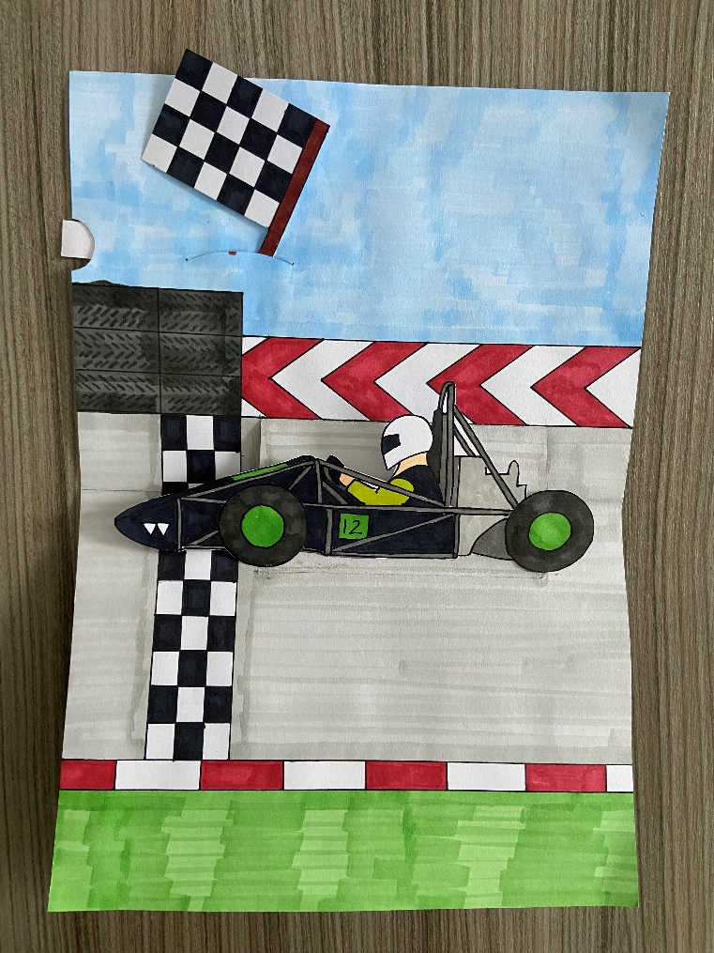
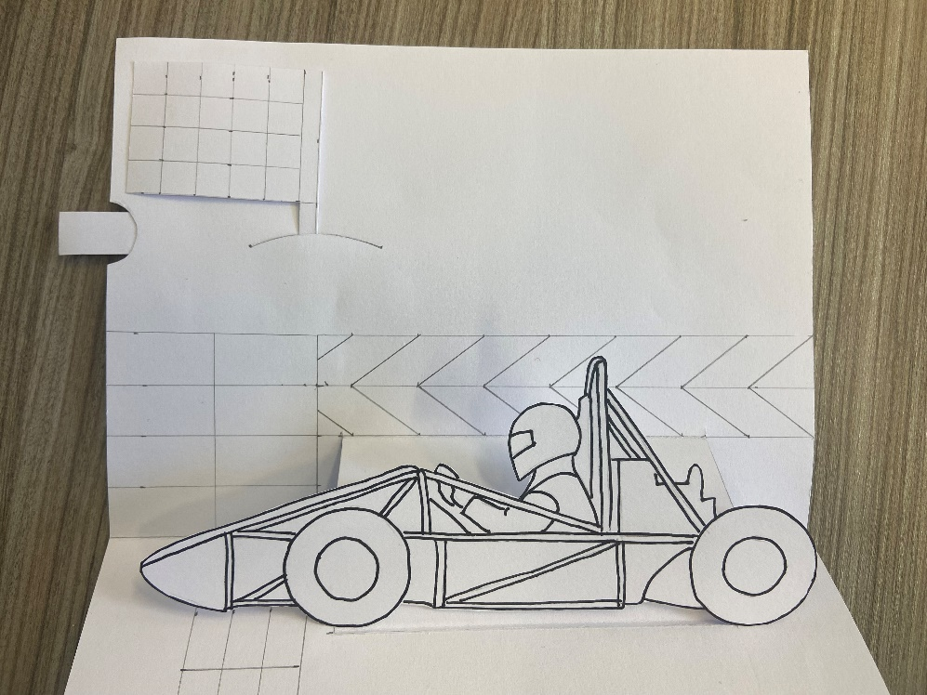
Introduction - Creating your pages
Now all your pop-ups and mechanisms are made for all your pages, it is time to decorate and assemble them.
Add
colour
Complete Mechanisms
Complete Pop-Ups
Notes:
Think of different ways to add colour to your pages: colouring pencils, Colour felt tips, Adding coloured paper.

Slide 4
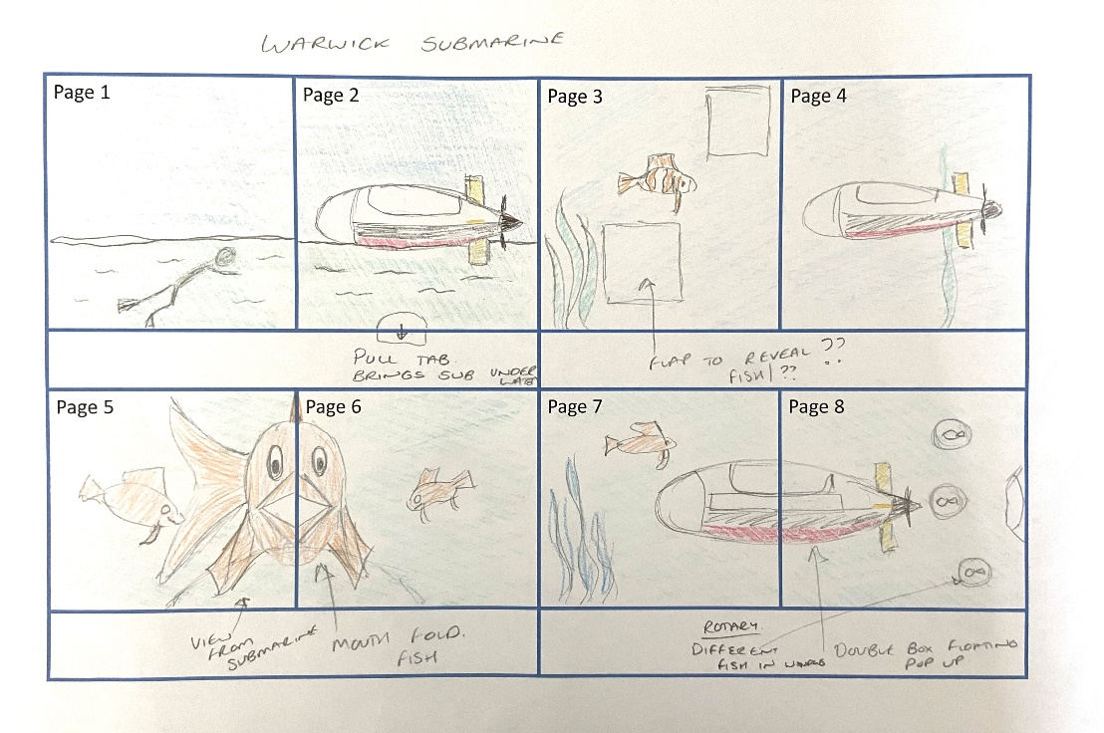
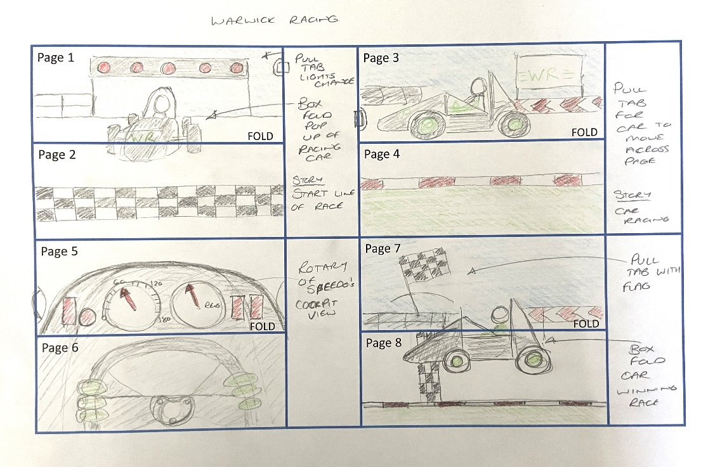
Creating your pages
Start making the pages for your book, create the pop up / mechanism first, get all the pages completed with any pop-ups and mechanisms, then add decoration, extra parts etc.
IS IT PORTRAIT OR LANDSCAPE?
WHERE WILL THE POP-UP OR MECHANISM BE PLACED?

Slide 5
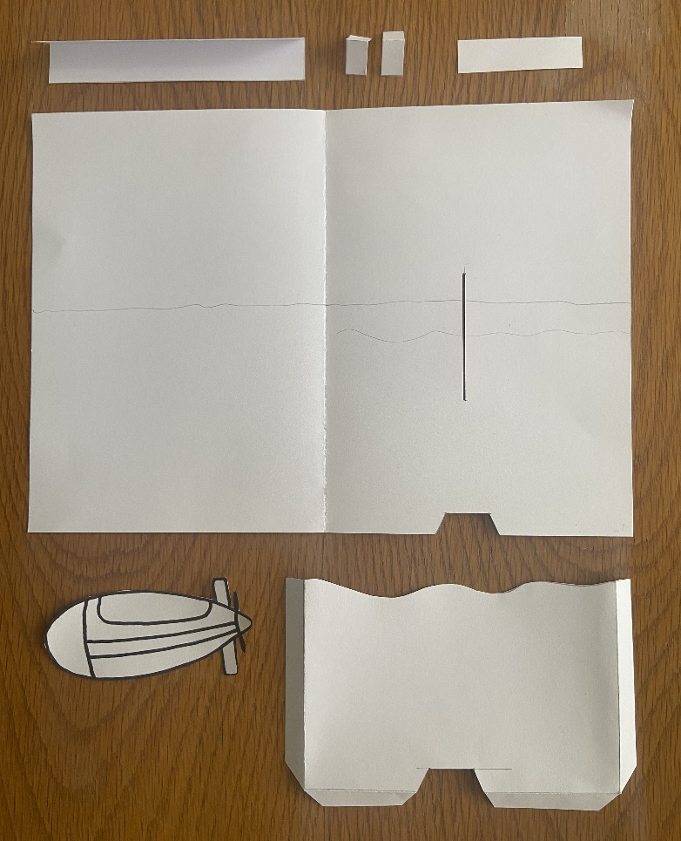
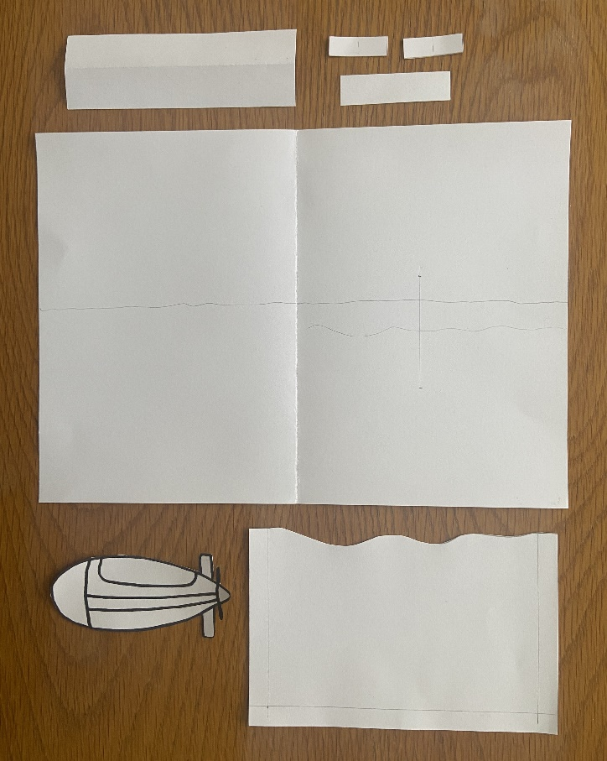
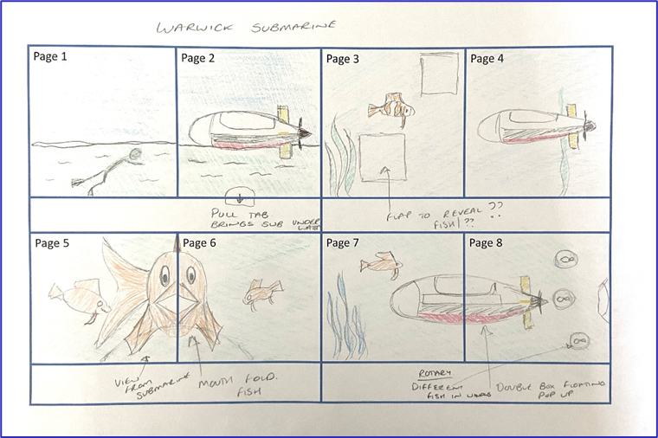
Creating your pages
Plan out where the pop-up or mechanism is going to be on the page, is it on one side or across the middle fold?.
Mark out in pencil where everything will be positioned on the page, cut out all the parts for the mechanism.
While planning this page, I needed to add an extra part as the sea that the submarine, would hide behind.
Fold all the parts and cut slit and slots for slider

Slide 6
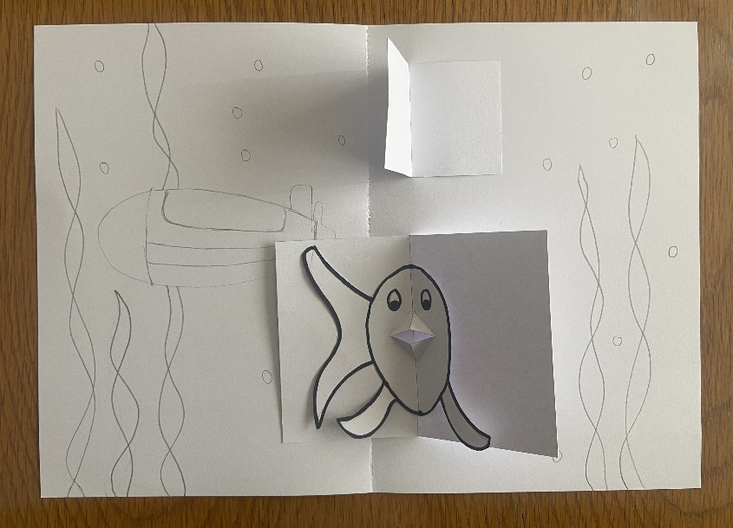
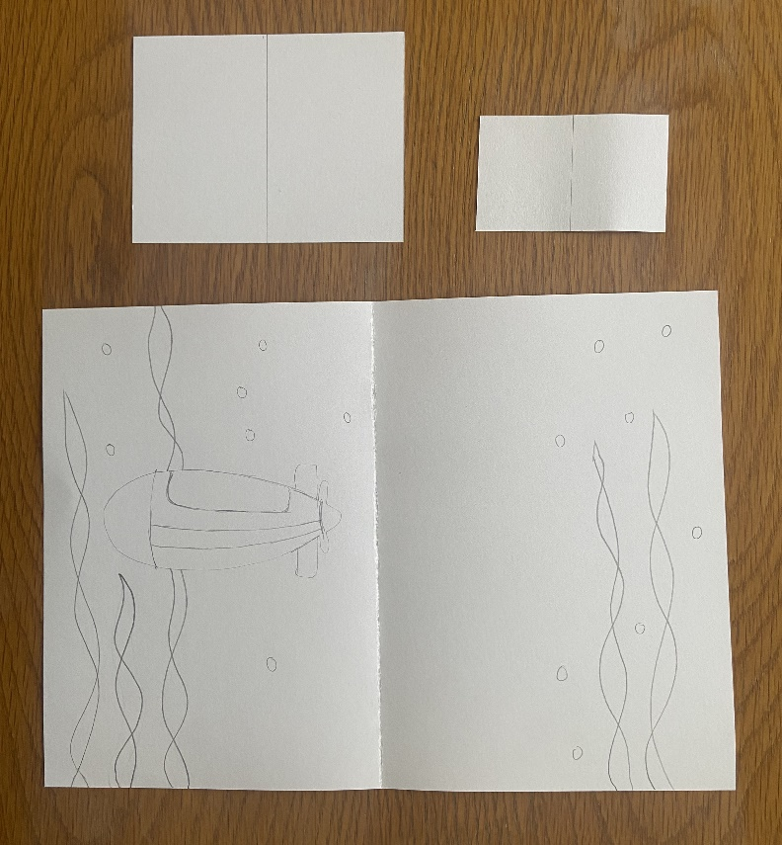
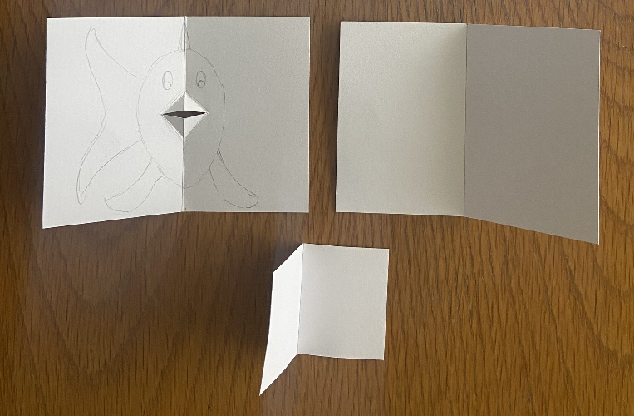
Creating your pages
Mark out in pencil where everything will be positioned on the page.
Cut out the extra parts for the lift-up flaps.
While planning out this page, I decided to create one of the lift-up flaps as a mouth fold, so needed an extra lift-up flap to surround it.
As I created the mouth fold fish, I decided to cut around the shape, this will then be stuck into the extra lift-up flap I created.

Slide 7
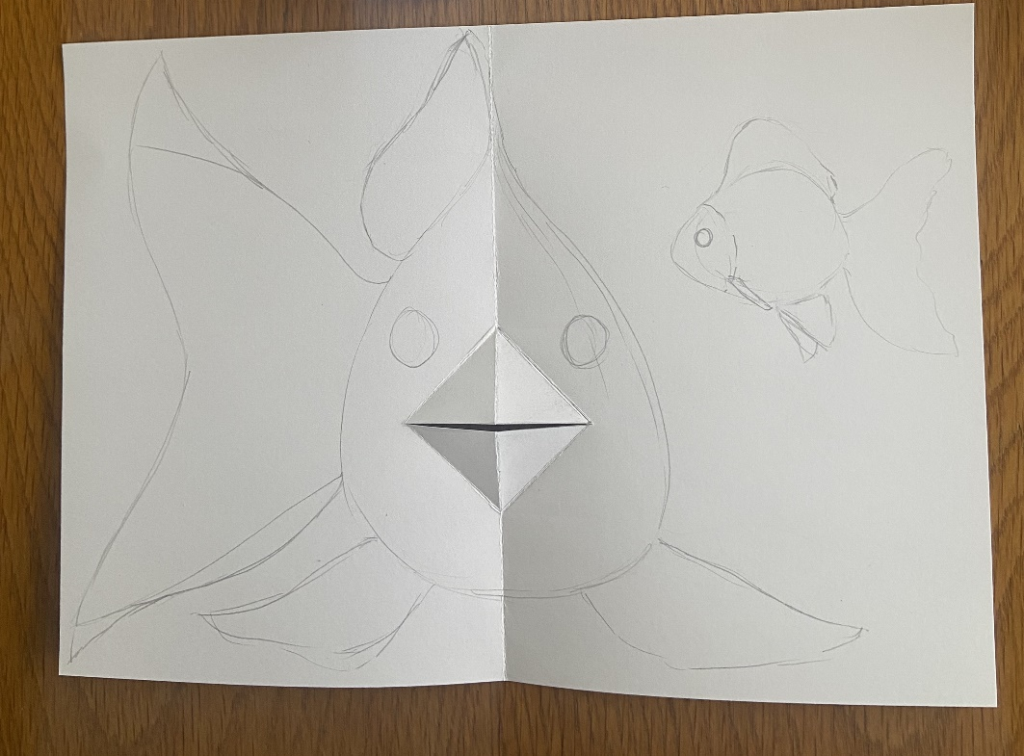

Creating your pages
Mark out in pencil where everything will be positioned on the page.
Cut out the mouth fold for the fish's mouth.
Create a back to go behind the mouth fold

Slide 8
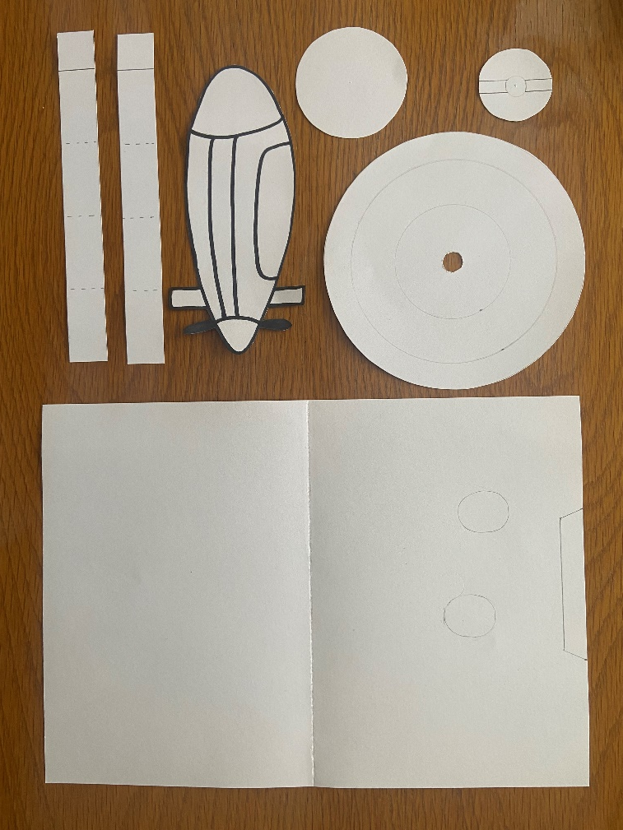
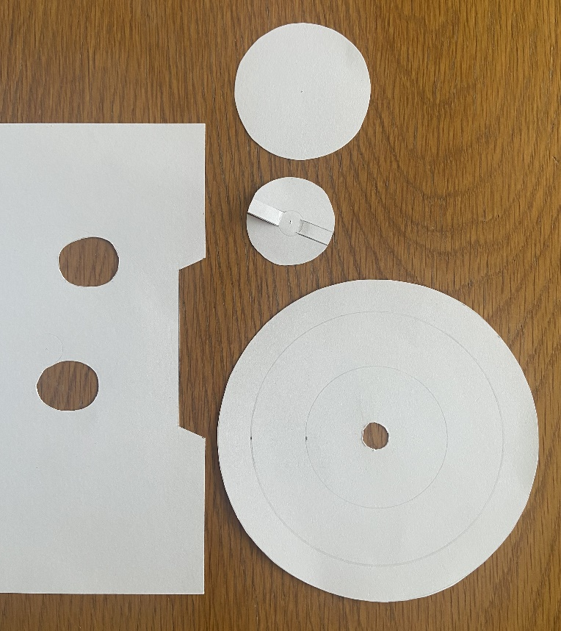
Creating your pages
Mark out in pencil where everything will be positioned on the page.
Cut out extra tabs and images for the double box fold and the parts for the rotary mechanism.
Work out where the holes need to go on the main card as the rotary wheel will turn, cut all parts needed

Slide 9

Assessment
Still need to finish some pages, not all pop-ups or mechanisms are complete.
Finished planning all pages, making all pop-ups and mechanisms required.
Finished planning all pages, making all pop-ups and mechanisms. Have started assembly and decorating.
Notes:
How’s it going? Quick check around the classroom, to see how everyone is doing, have they completed most of their pages? This will help plan for the last lesson.
NB. If anyone is behind, they could finish decorating for homework.

