Slide 1
Making Maths Matter
with TurtleStitch
Margaret Low, Phil Jemmett, Robert Low
Notes:
Please open these two websites to use during the lecture.
www.warwick.ac.uk/turtlestitch
www.turtlestitch.org

Slide 2
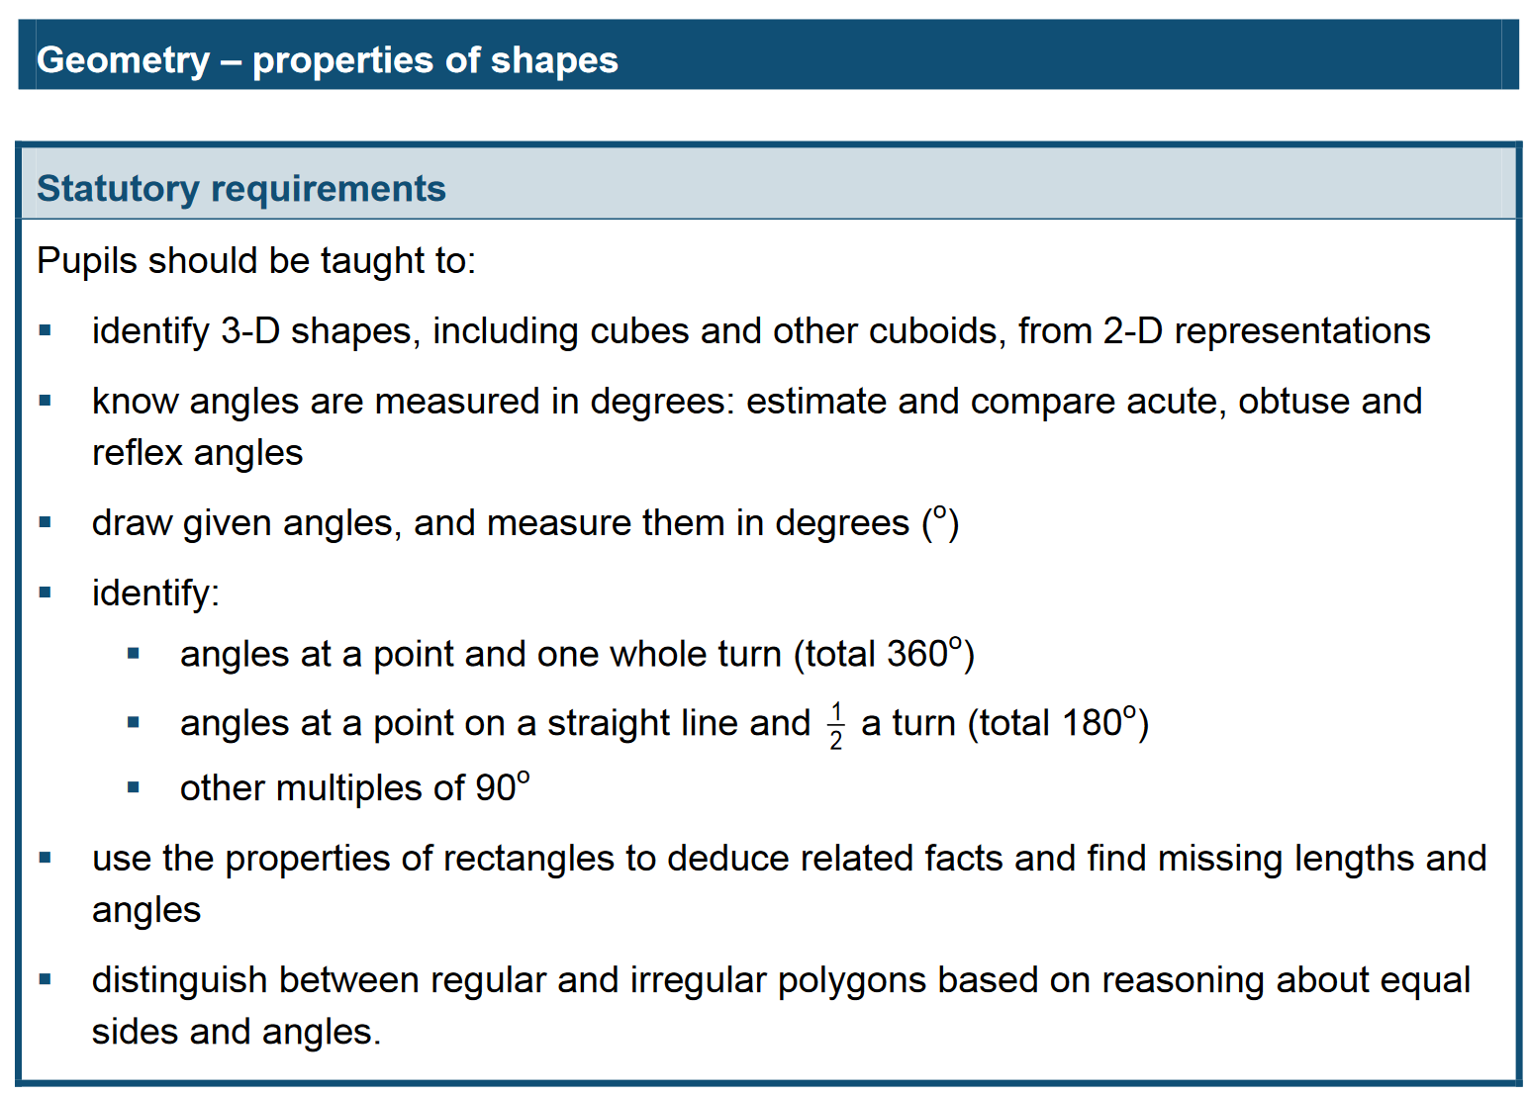
Year 6 UK Maths Curriculum – Geometry (10-11)
Notes:
Project website:
https://warwick.ac.uk/about/cityofculture/get-involved/projects/stitchintime/

Slide 3
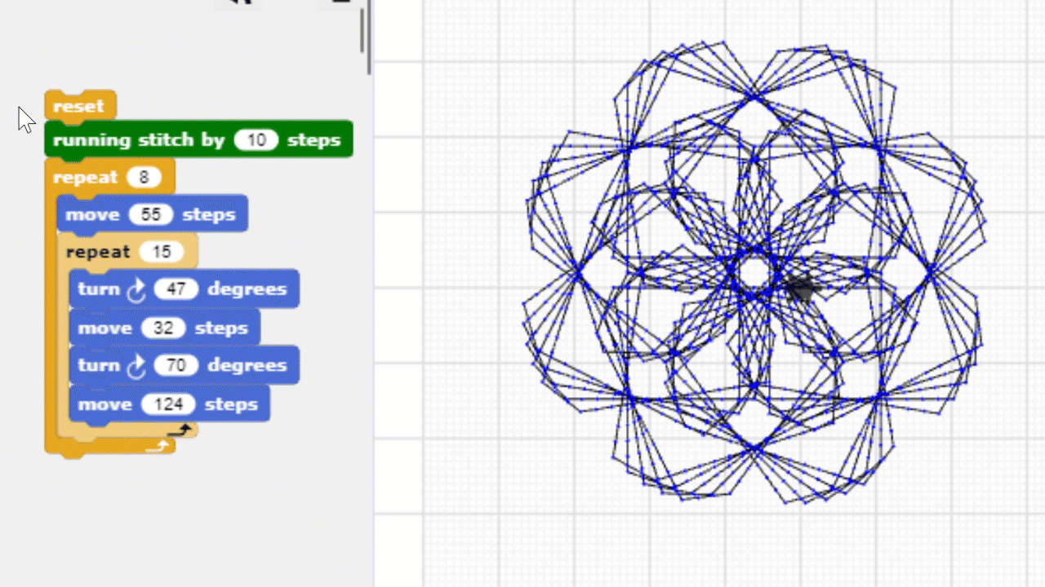
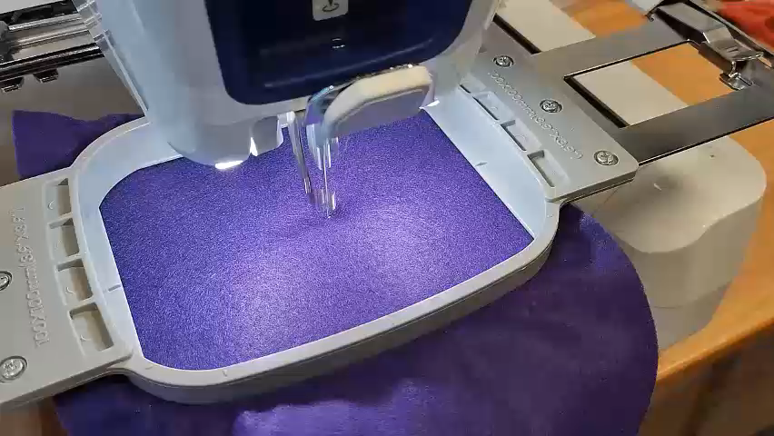
Introducing TurtleStitch: www.turtlestitch.org
Our resources: warwick.ac.uk/turtlestitch
Notes:
Project website:
https://warwick.ac.uk/about/cityofculture/get-involved/projects/stitchintime/

Slide 4
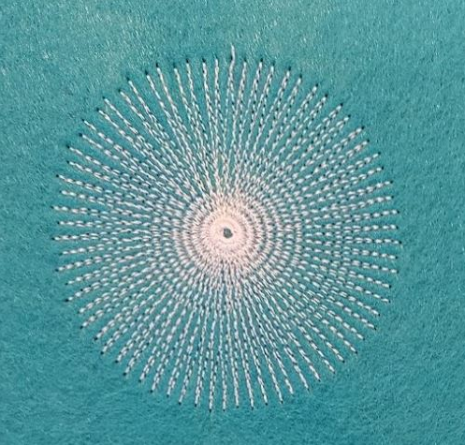
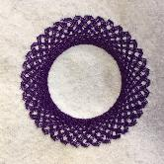
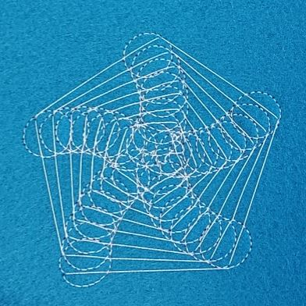
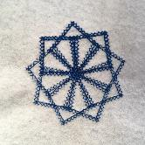
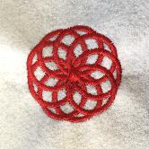
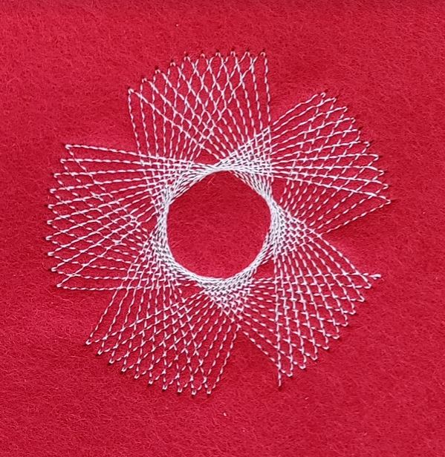
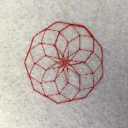
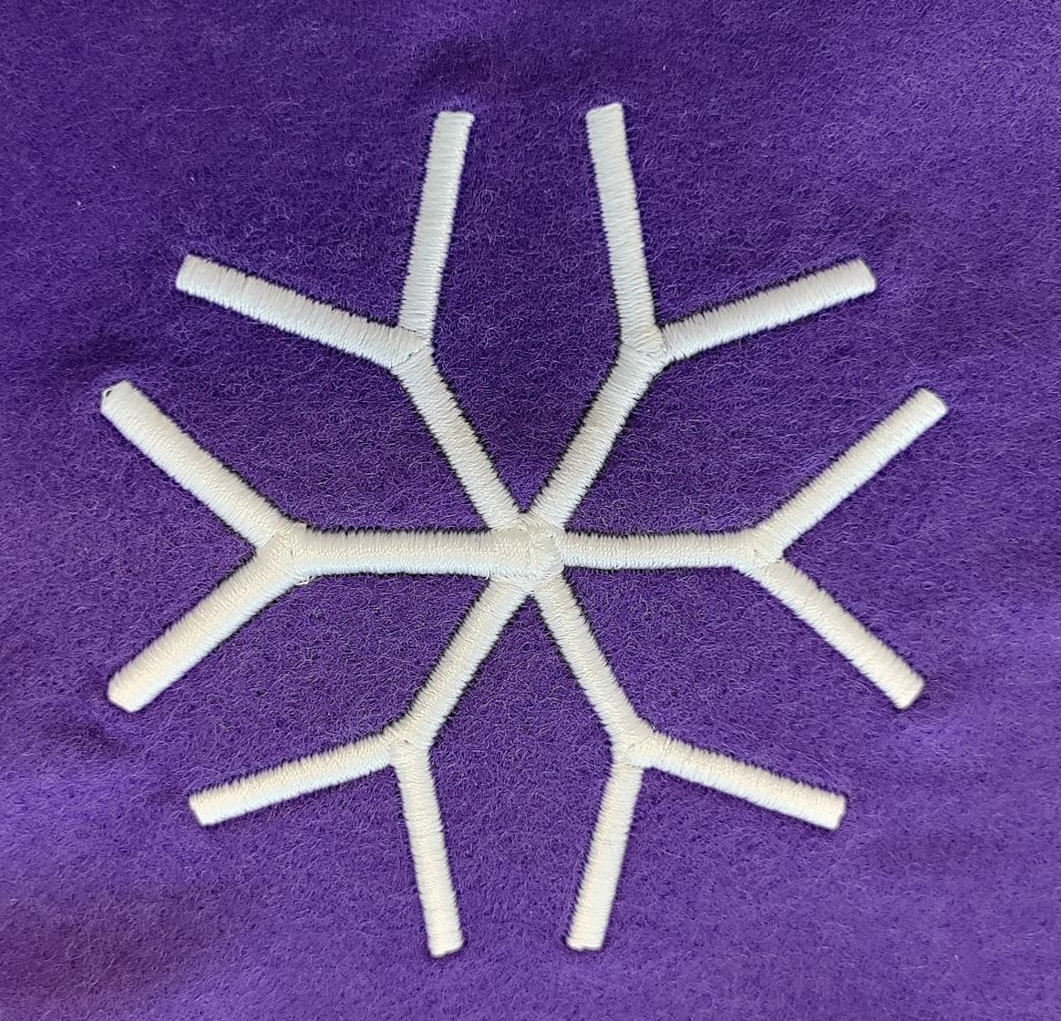
Examples of work (ages 9 – 11)
Notes:
Year 5 children’s work

Slide 5
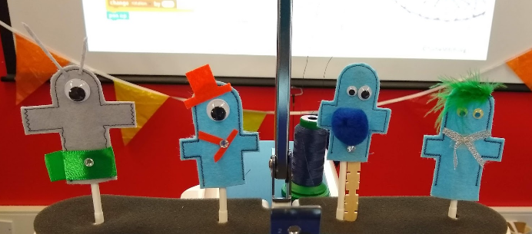
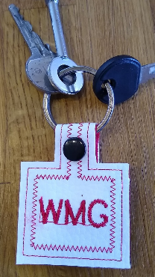
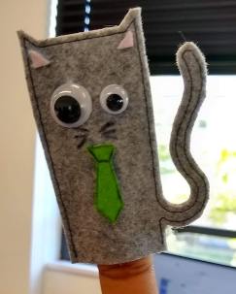
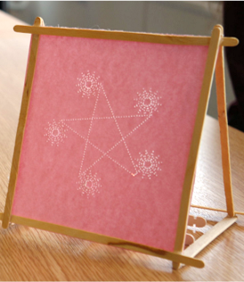
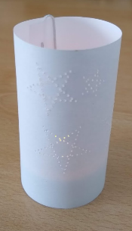
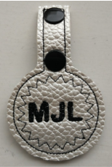
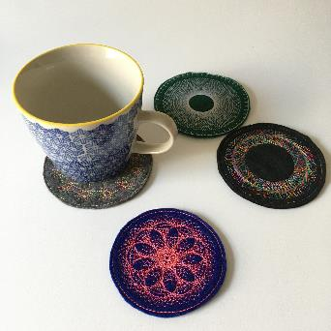
Notes:
Year 5 children’s work

Slide 6
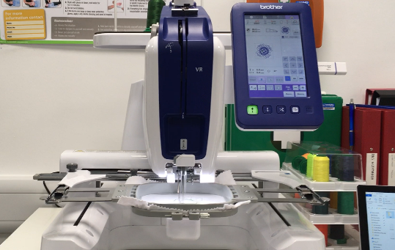
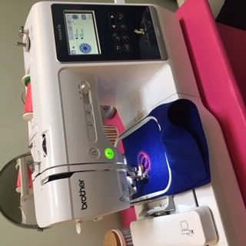
Accessible Manufacturing
Resources: warwick.ac.uk/turtlestitch
Notes:
Compare to 3D printer
Educational discount
Faster
Link to a secondary school? May be unused.
USB stick
Will mention other methods of display later

Slide 7
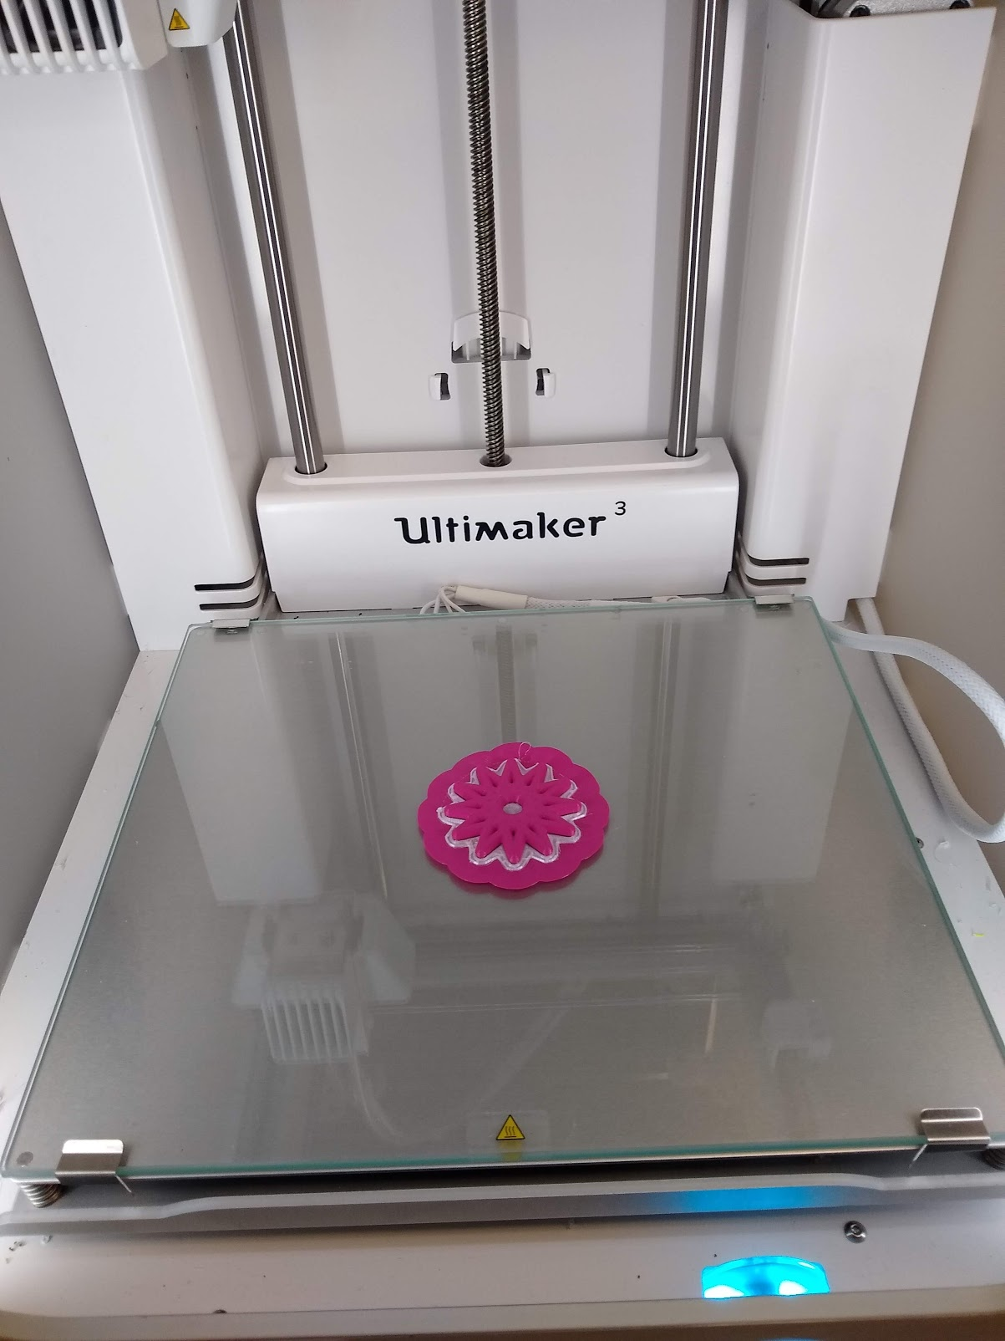
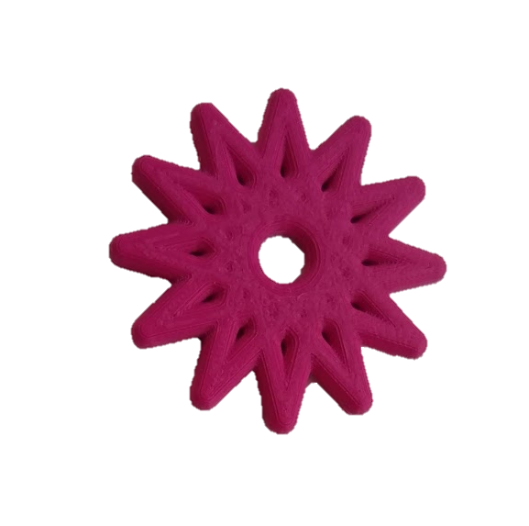
Accessible Manufacturing
←1 hour
5 minutes →
Resources: warwick.ac.uk/turtlestitch
Notes:
Compare to 3D printer
Educational discount
Faster
Link to a secondary school? May be unused.
USB stick
Will mention other methods of display later

Slide 8
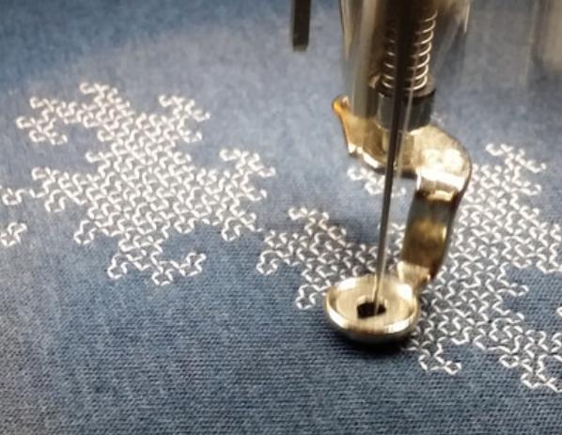

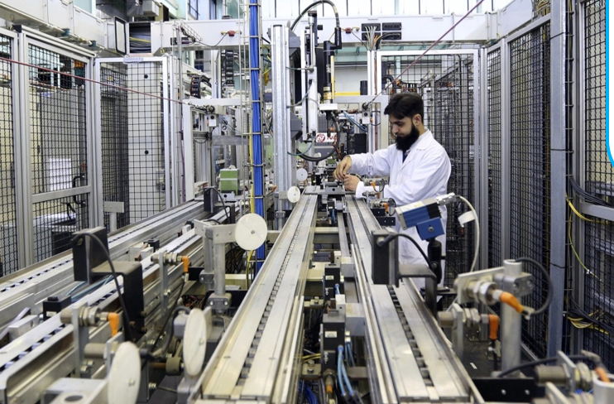

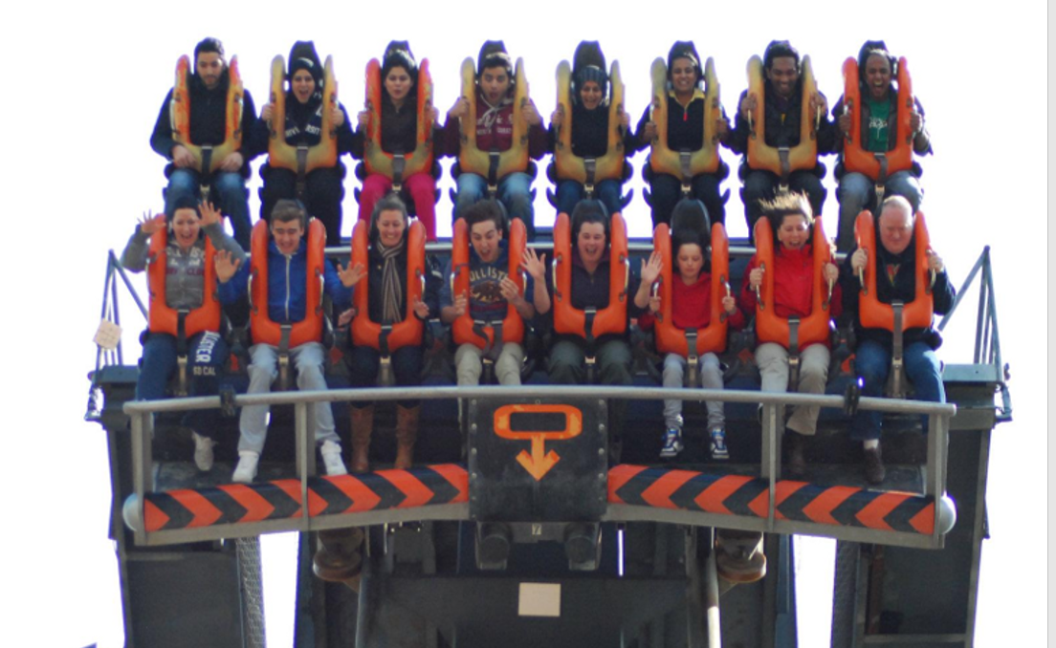
Careers in software and control
Resources: warwick.ac.uk/turtlestitch
Notes:
Photos https://pixabay.com/photos/stage-concert-crowd-performance-336695/

Slide 9
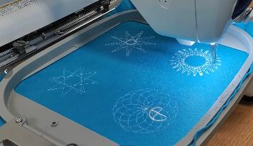
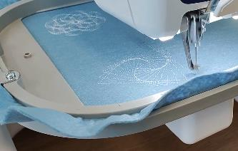
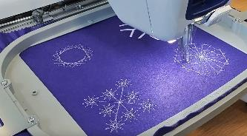
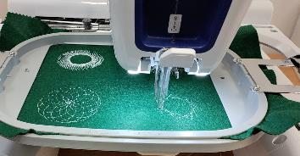
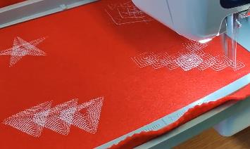
Pattern design
"a spinning football"
"the resurrection of Coventry after the Blitz"
"pineapple designs when we were looking at the historic images"
"bicycle wheels"
"intertwined circles to represent all people of different cultures who came together as citizens of our multicultural city"
"ribbons manufacturing"
Notes:
Free rein on designs but with brief including dimensions and stitch count
...segue to next slide: trying to realise their design was motivating, which supported their resilience

Slide 10
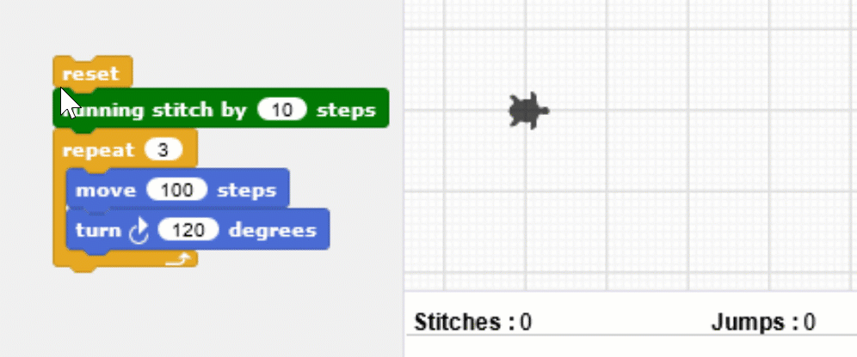
Introducing Turtle Geometry: Create a closed shape
Notes:
Angles – interior & exterior angles
polygons
Project website:
https://warwick.ac.uk/about/cityofculture/get-involved/projects/stitchintime/

Slide 11
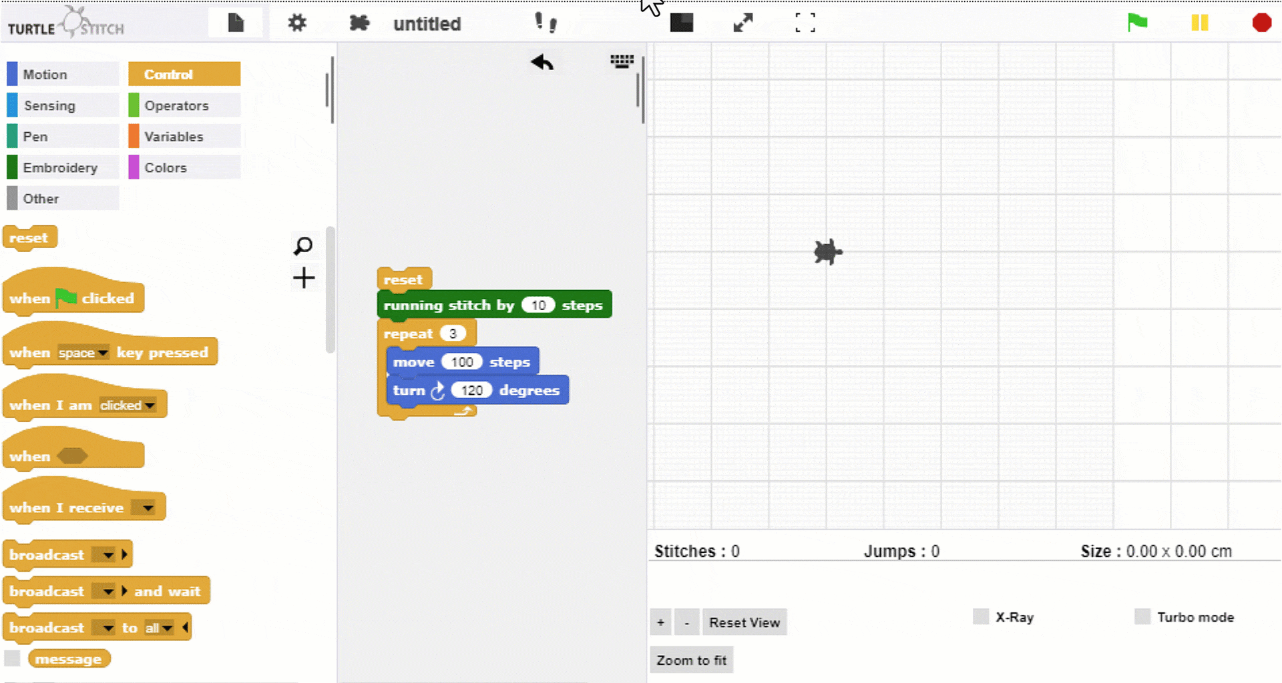
Teaching the Turtle a new word
Notes:
Project website:
https://warwick.ac.uk/about/cityofculture/get-involved/projects/stitchintime/

Slide 12
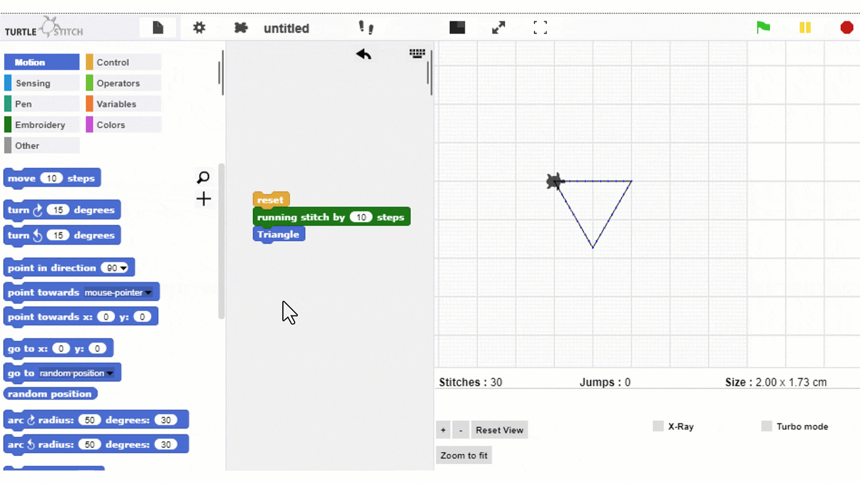
Introducing parameters: little and large
Notes:
Project website:
https://warwick.ac.uk/about/cityofculture/get-involved/projects/stitchintime/

Slide 13
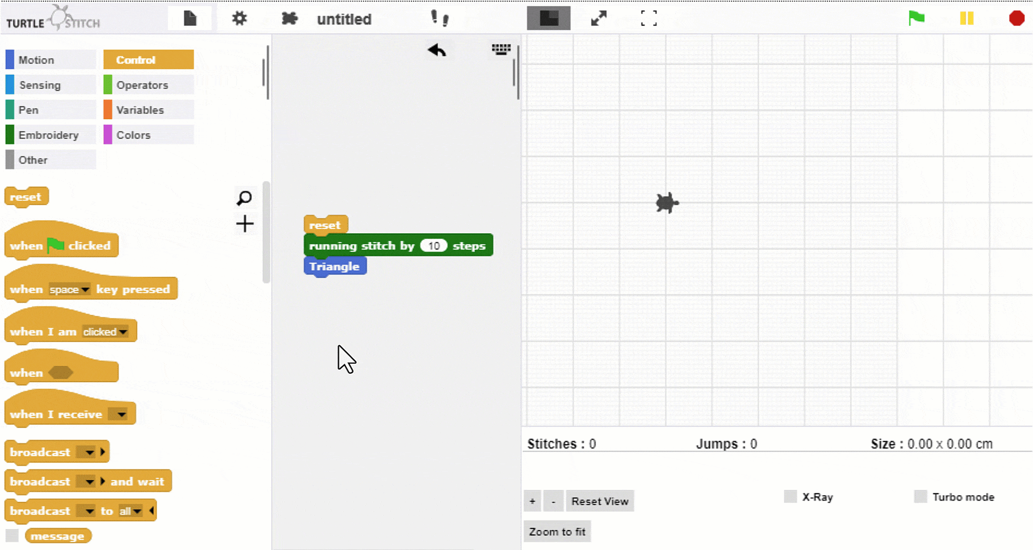
Going for a spin
Notes:
Project website:
https://warwick.ac.uk/about/cityofculture/get-involved/projects/stitchintime/

Slide 14
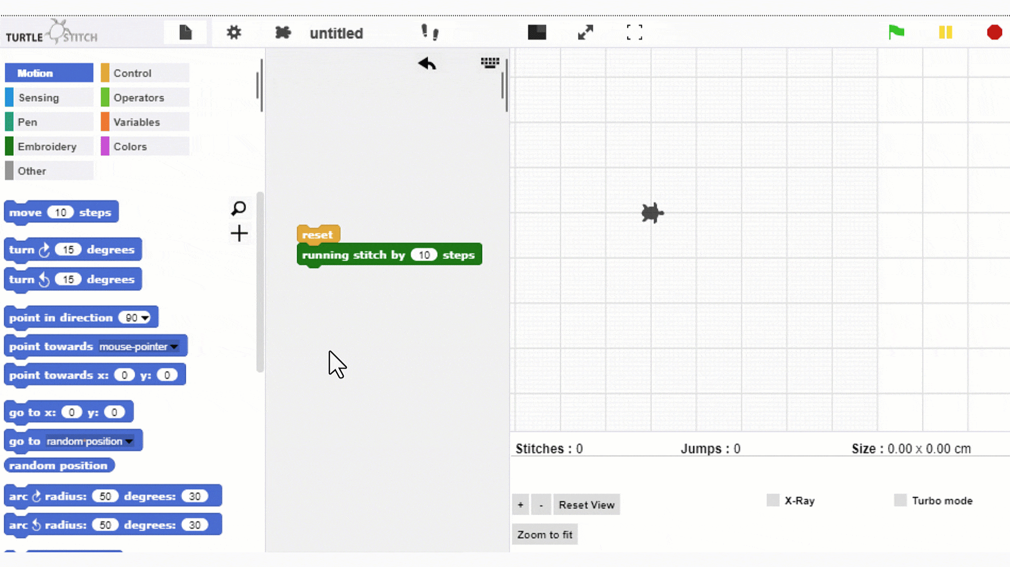
Recursion – first create Step block
Notes:
Project website:
https://warwick.ac.uk/about/cityofculture/get-involved/projects/stitchintime/

Slide 15
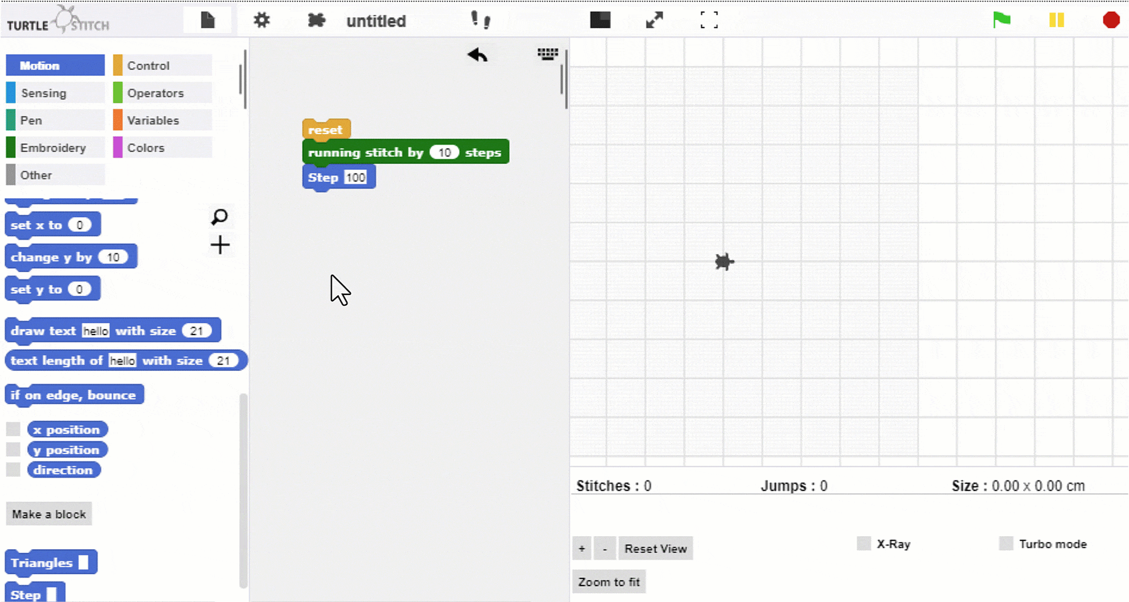
Recursion – Step Larger
Notes:
Project website:
https://warwick.ac.uk/about/cityofculture/get-involved/projects/stitchintime/

Slide 16
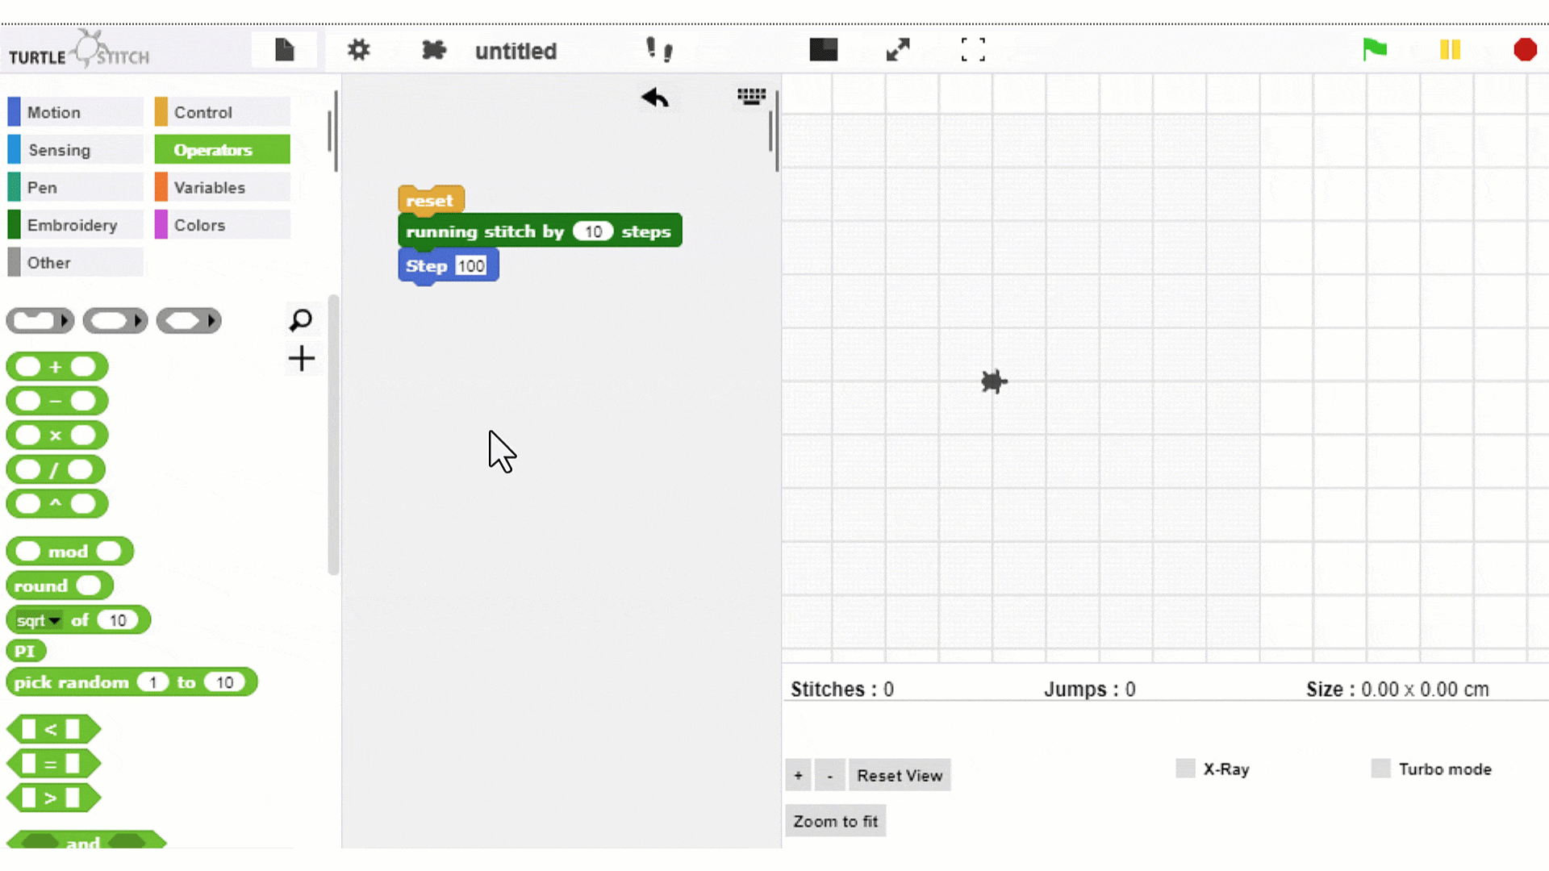
Recursion – introduce end condition
Notes:
Project website:
https://warwick.ac.uk/about/cityofculture/get-involved/projects/stitchintime/

Slide 17
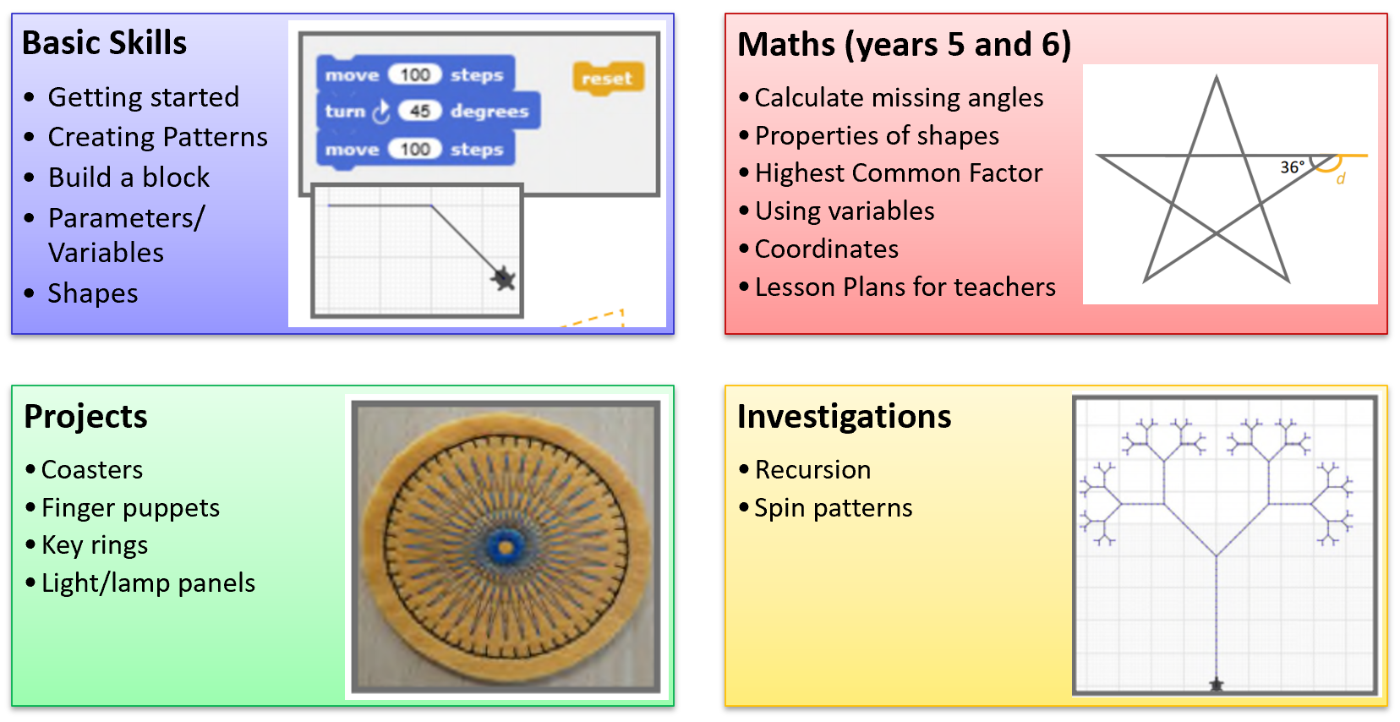
warwick.ac.uk/turtlestitch
Notes:
On our webpage:
Printable – double sided A4 creates A5 maths cards. Answer cards also.
Video tutorials – for own training rather than showing the kids (aimed at general audience, not specifically children)
Lesson plans with links

Slide 18
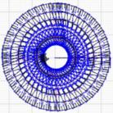

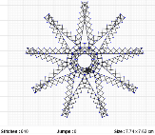
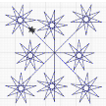
Motivation
"resilience to keep going when their ideas didn’t quite work as expected"
"excited by the prospect of seeing their work on a computer turn into something ‘real’."
"to use an applied computing skill was inspiring for our children"
"enjoyed applying mathematical thinking to a practical activity"
"several children were inspired to try Turtlestitch for themselves at home and come back to school with even more developed design ideas."
"motivated to experiment
with programming skills,
review and refine their work."
Notes:
trying to realise their design was motivating, which supported their resilience

Slide 19
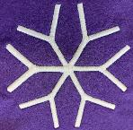

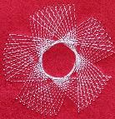
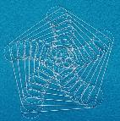
Skills
"co-operating and taking turns"
“Having the planning done for us... helped us to feel confident with delivering the project... knowledge I can use again when I’m teaching KS2 [ages 9-11] next year.”
"problem-solving skills improved"
“I found out I was more resilient than I had thought.”
“When you mess up you just don’t get frustrated you try again.” ​
"applying mathematical thinking to a practical activity"
Notes:
Programming skills (obviously)
Applying mathematical knowledge
Following a brief
Paired work = communication skills
Resilience – including with team
Teacher skills = longevity / impact of project in future years

Slide 20
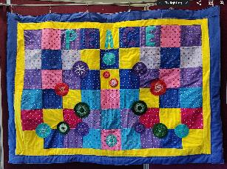
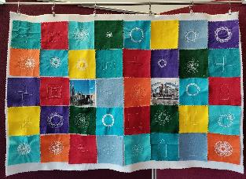
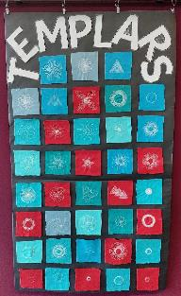
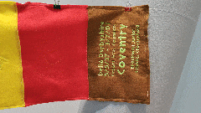
Stitch in Time: programming + textiles + culture www.warwick.ac.uk/stitchintime
Notes:
On our webpage:
Printable – double sided A4 creates A5 maths cards. Answer cards also.
Video tutorials – for own training rather than showing the kids (aimed at general audience, not specifically children)
Lesson plans with links

