Slide 1
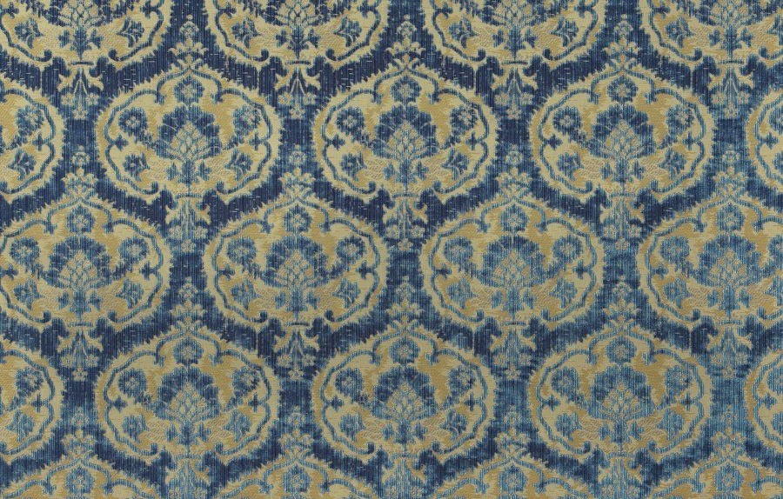
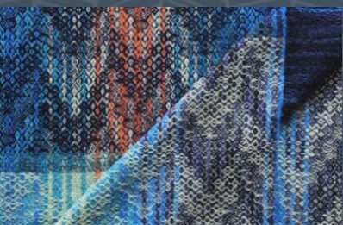
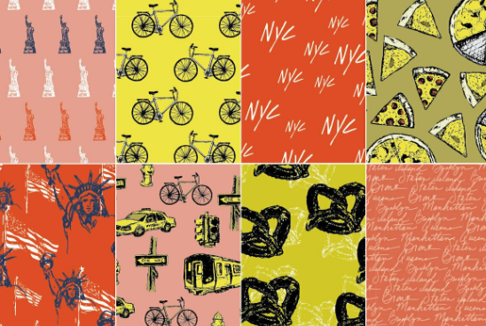
Lia
This Italian Renaissance pattern displays my heritage on my Mom's side. I like how the contrasting colors seemingly change as they grow close together and the intricate pattern of only two colors.
This Scottish textile displays the heritage from my Dad's side of our family. I like how the colors blend together and change seamlessly as the color moves from contrasting reds to blues.
This image displays some key traits of NYC. These images remind me of home and the many wonderful activities and events in NYC.

Slide 2
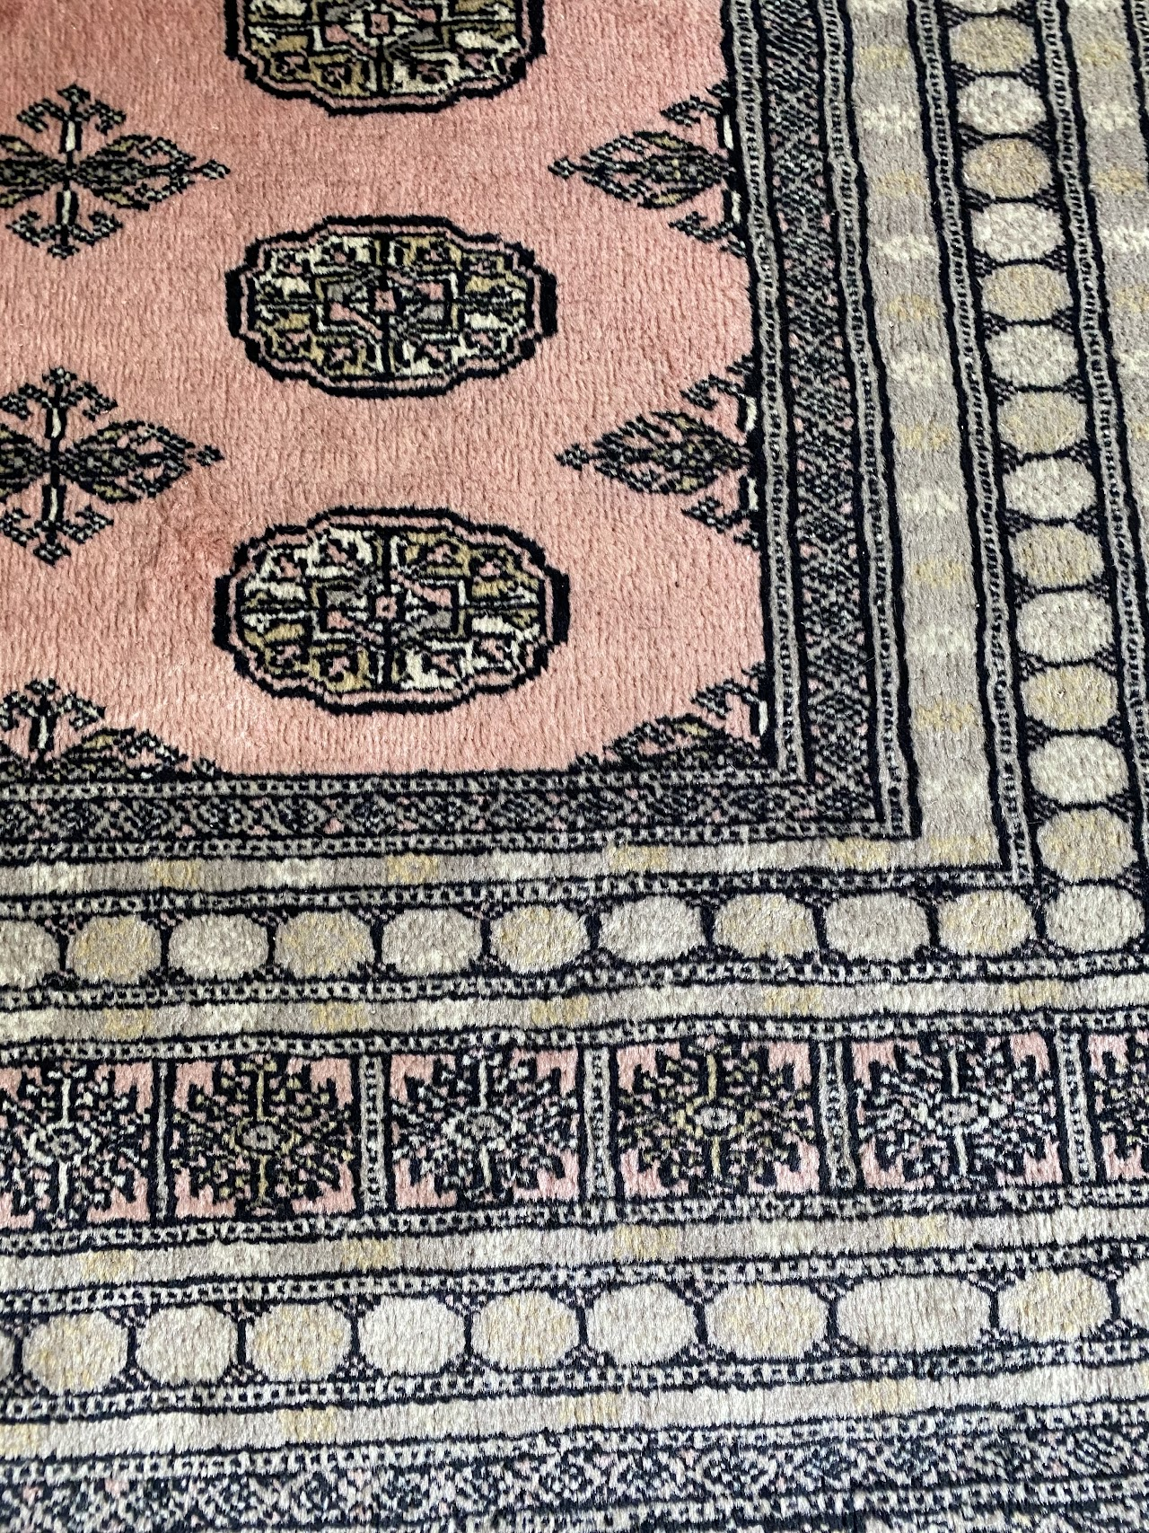
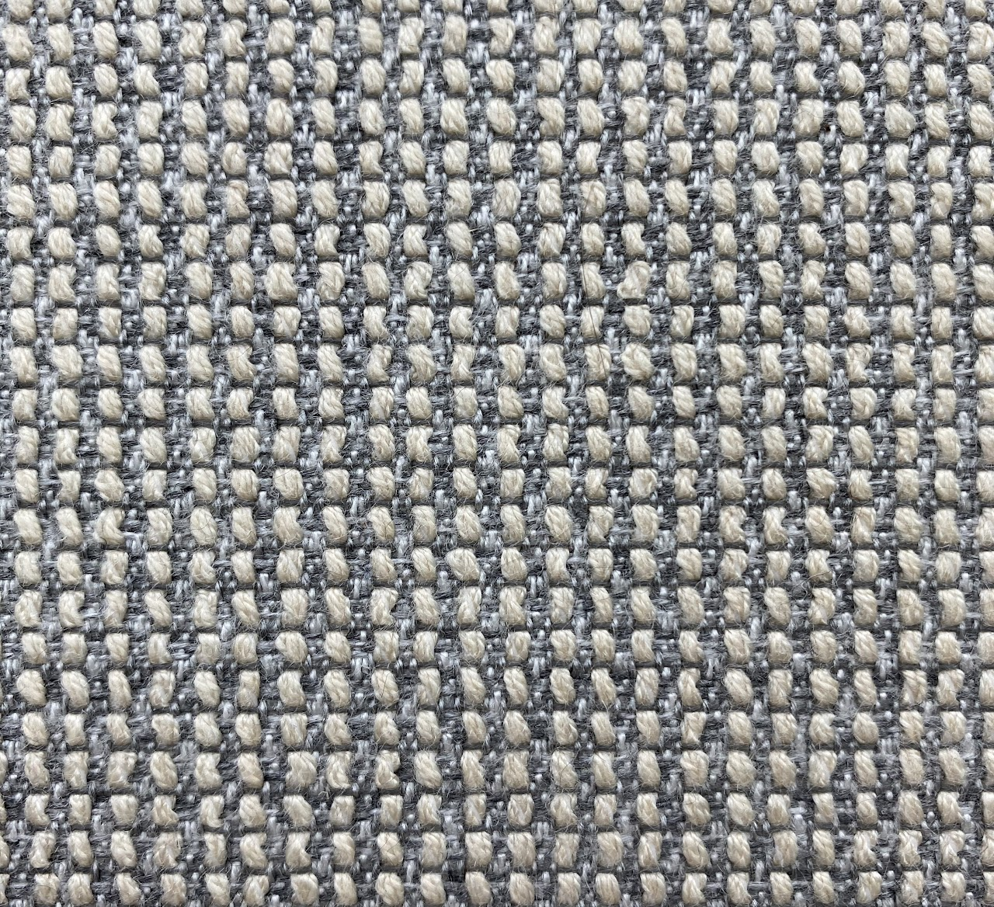
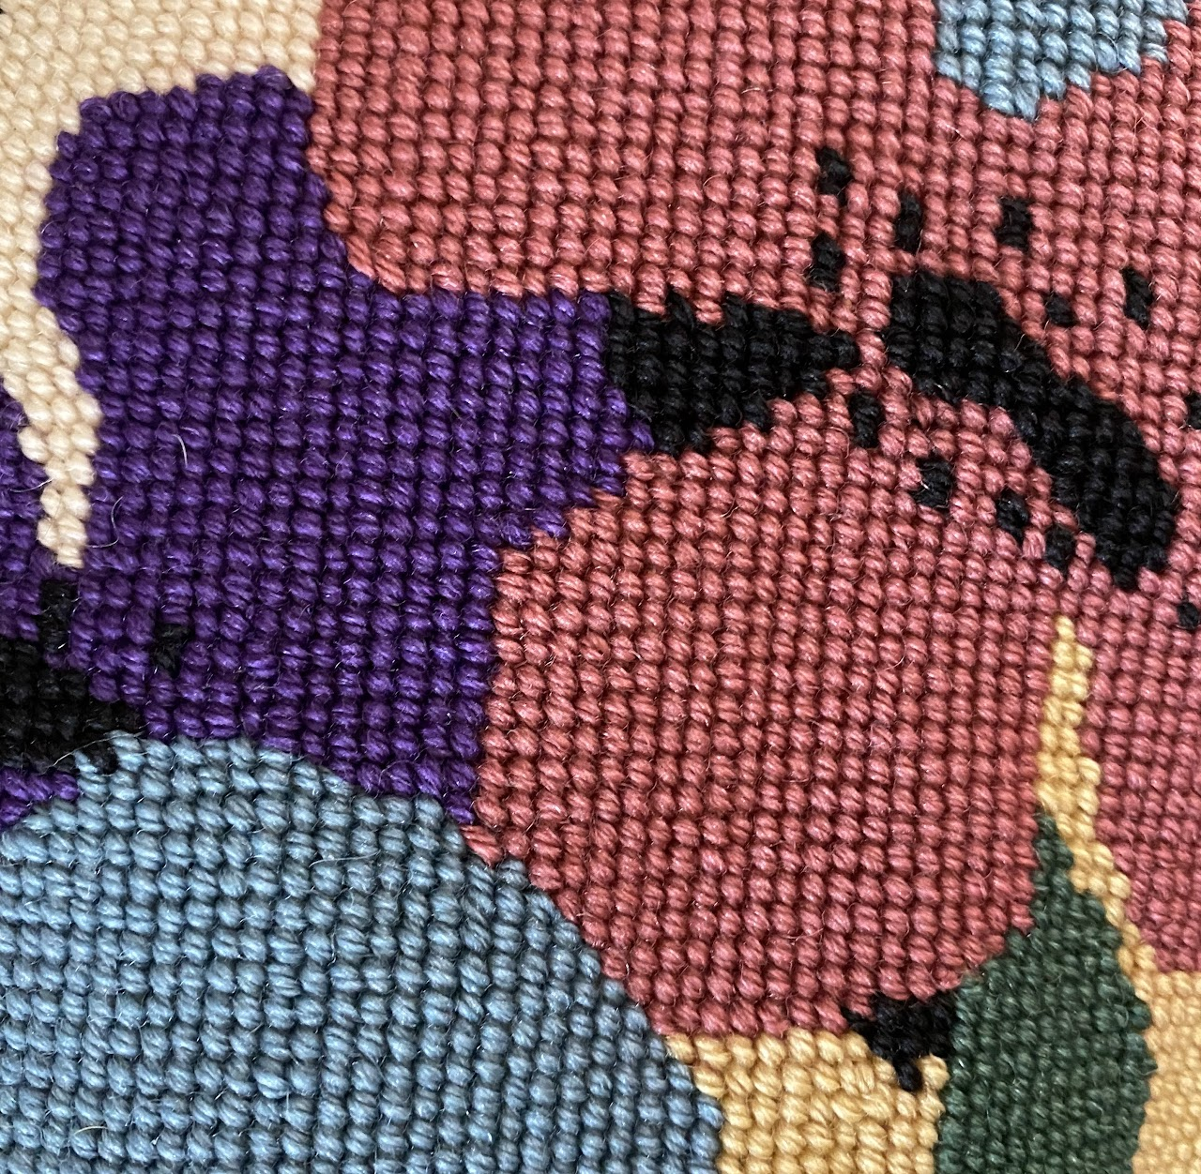
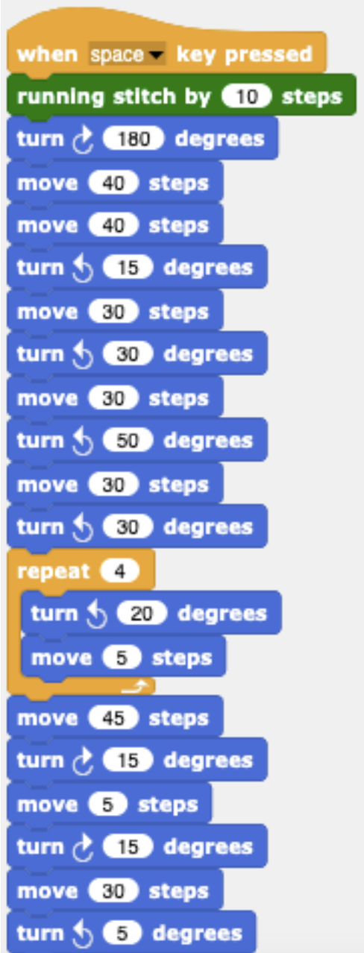
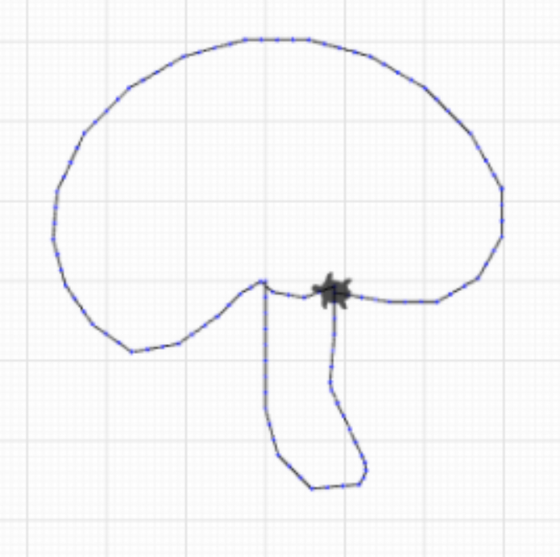
Lia
Patterns around my home

Slide 3
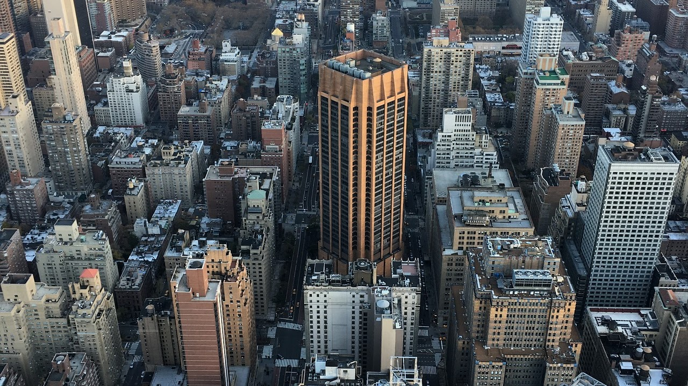
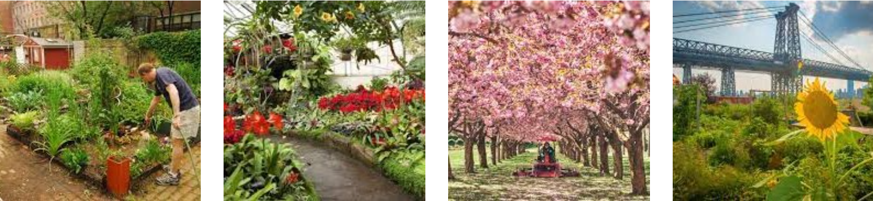
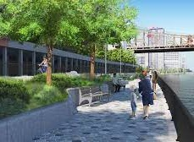
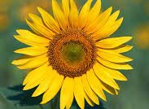
Ellery
I am from Manhattan, NY. You would suspect that the "Concrete Jungle" has no flowers, but hidden in pockets of the city are community gardens and beautiful flower arrangements in parks.
My favorite flowers are sunflowers, as they remind me of important family members who have passed away.
I want to combine sunflowers with the pattern of the tiles commonly found in NYC, especially on the east river promenade

Slide 4
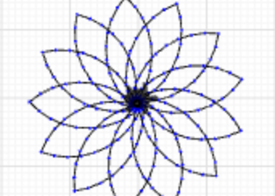
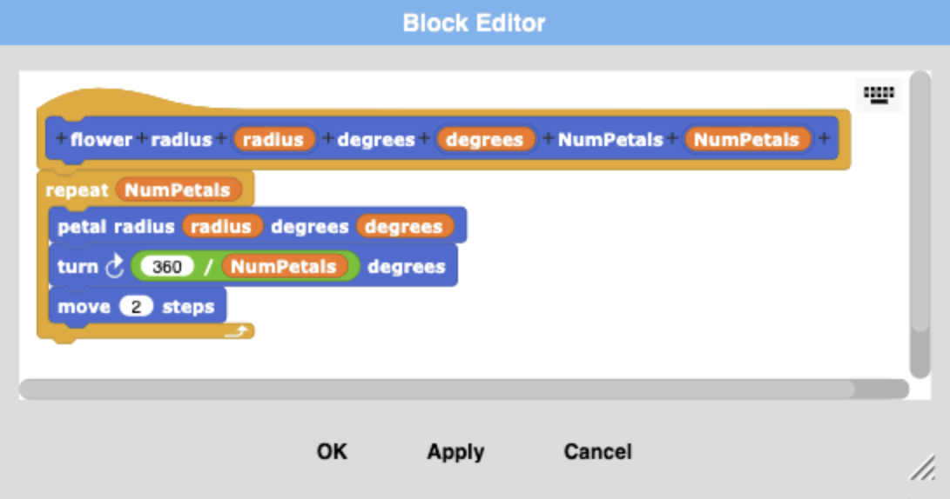
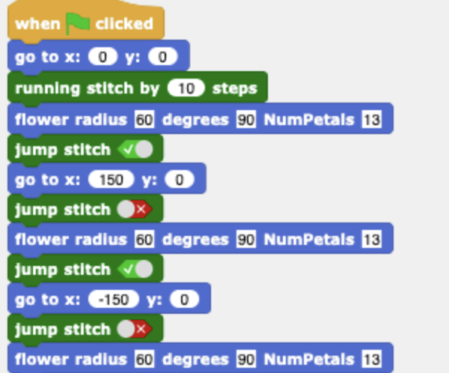
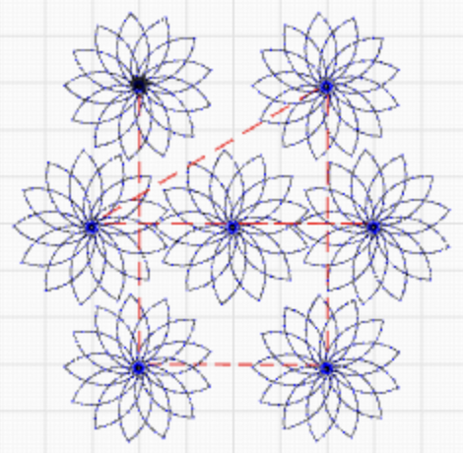
Ellery
For this project, I started by making a block that will make the flower. I wanted to play around with the length of the petals as well as the quantity. I modeled this after a previously created series of blocks that served a similar purpose from my AP Computer Science class on SNAP.
After creating my sunflower, I used the "jump stitch" block, in conjunction with the "move to x position, y position" block to repeat the stitching of the sunflower in different locations. I experimented with this several times to ensure that the flowers didn't overlap and had similar geometrical placing as the tiles on the eastern promenade.

Slide 5
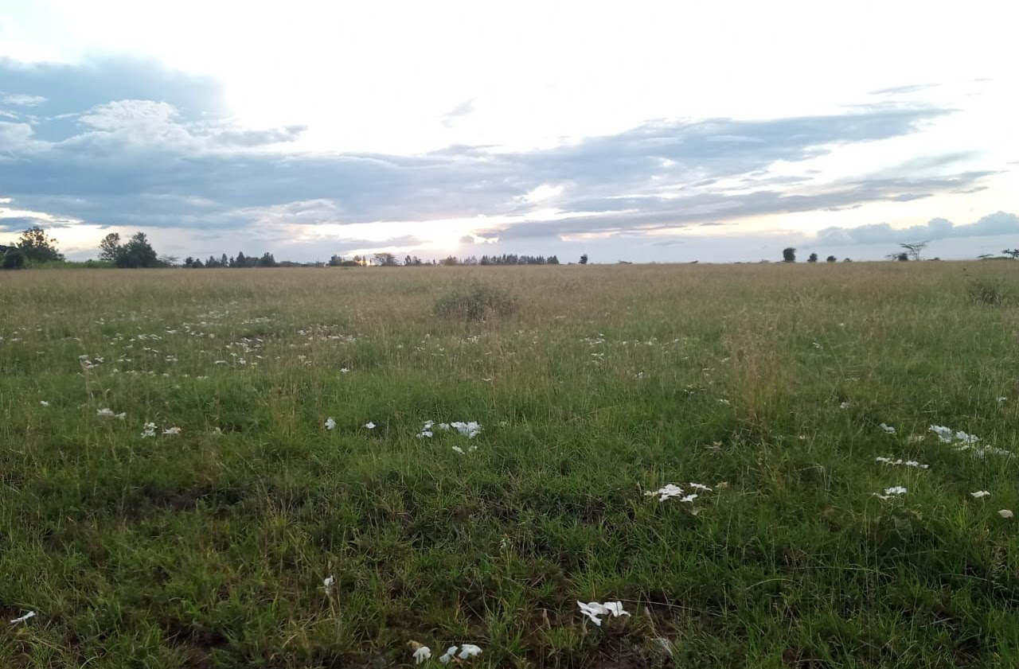
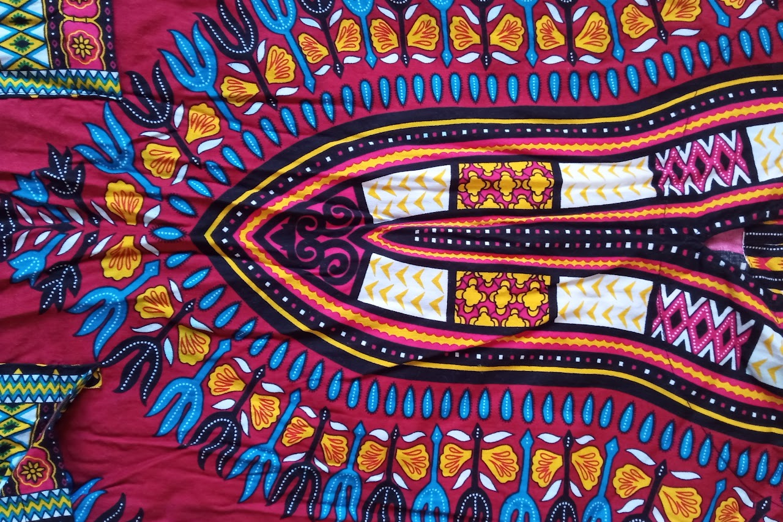
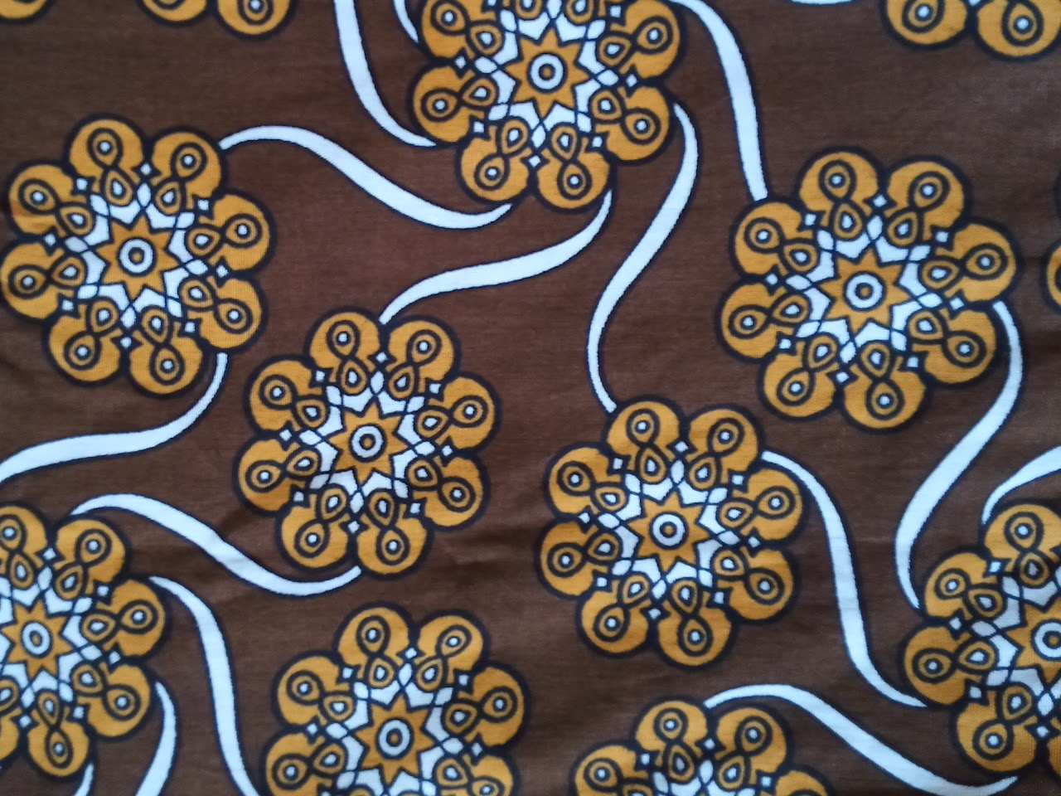
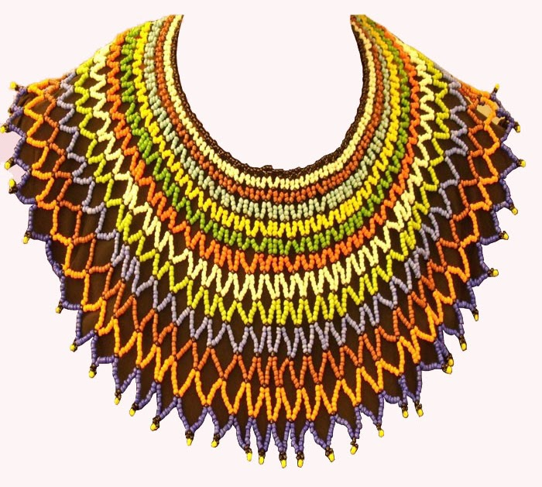
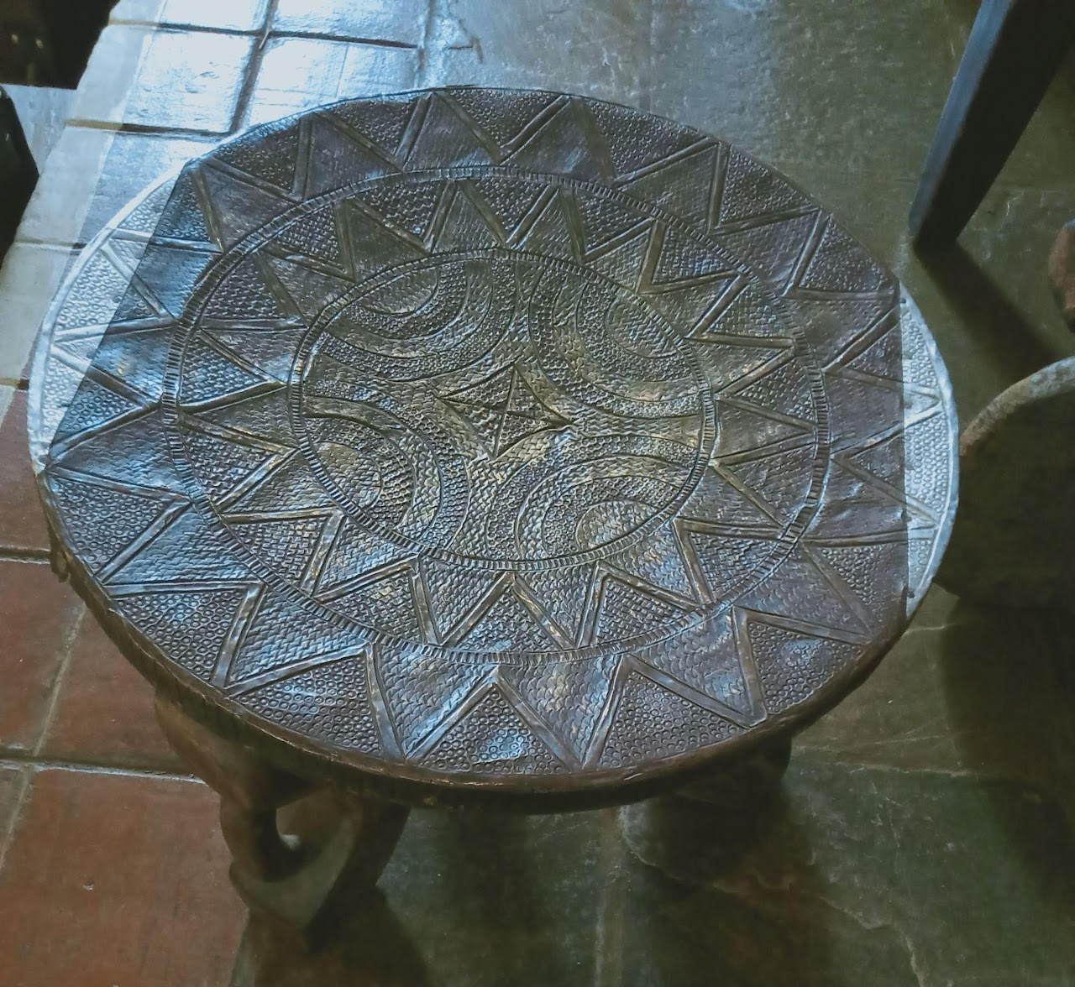
Brenda
A calm day in Kitengela, Kajiado (My home). White flowers come up on the grass after a rainy season
Dashiki prints are originally from West Africa's Yoruba community and currently commonly worn in Kenya.
Designs from a Kenyan coastal print known as Kitenge on my dress.
Necklace beads worn by Maasai (Or the Zulu of South Africa, as I discovered).
3-legged stool

Slide 6
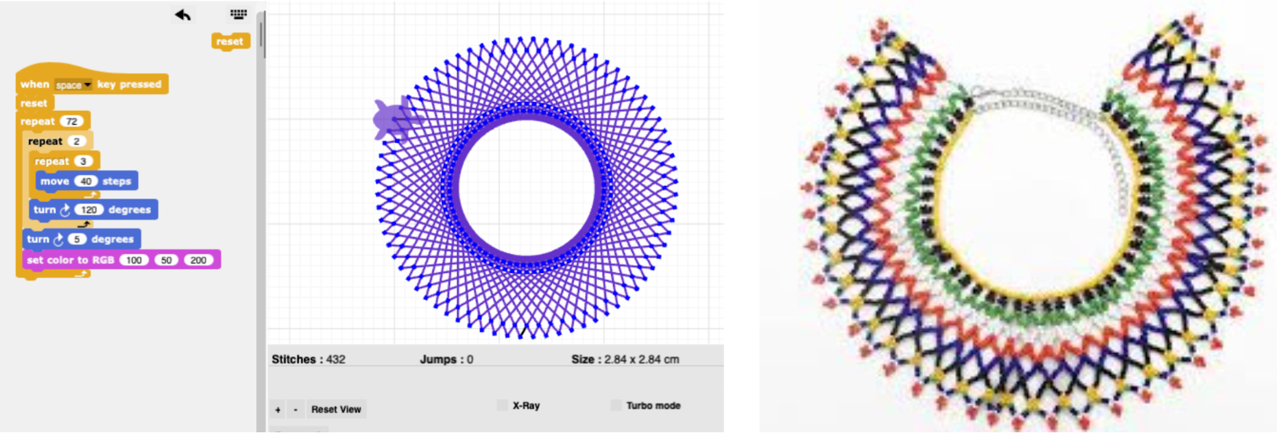
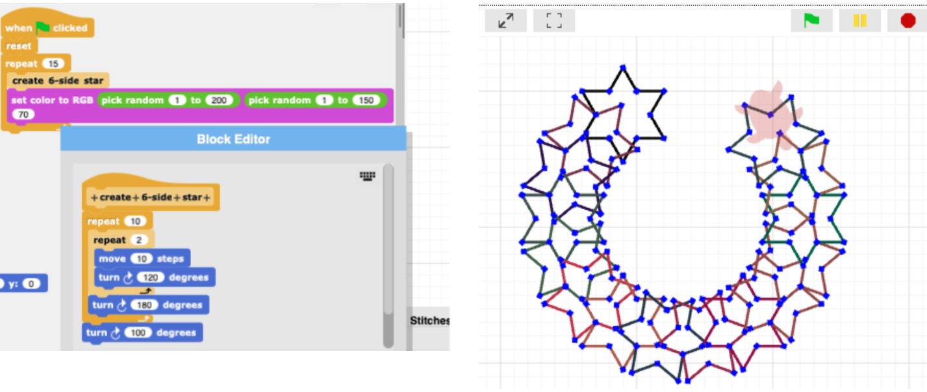
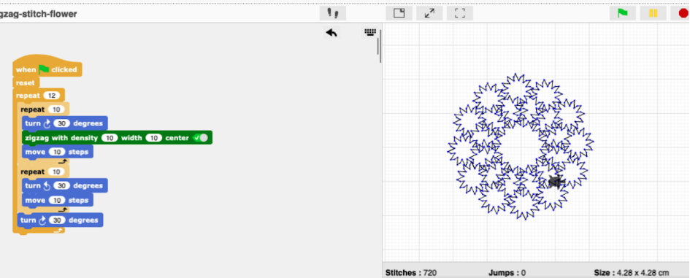
Brenda
Close design of a huge beaded necklace worn by Maasai women as shown on the right.

Slide 7
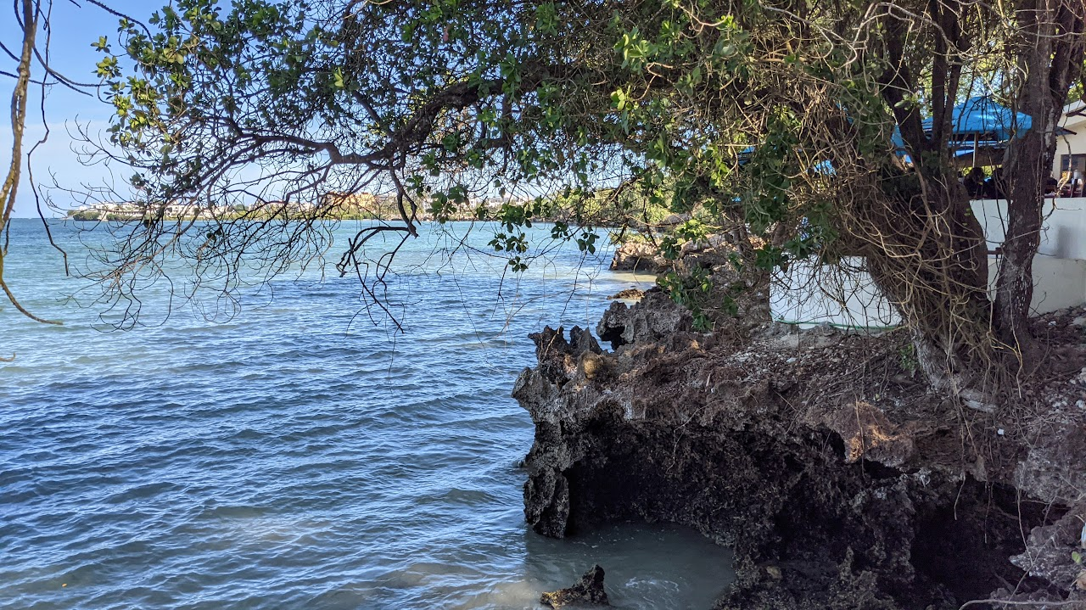
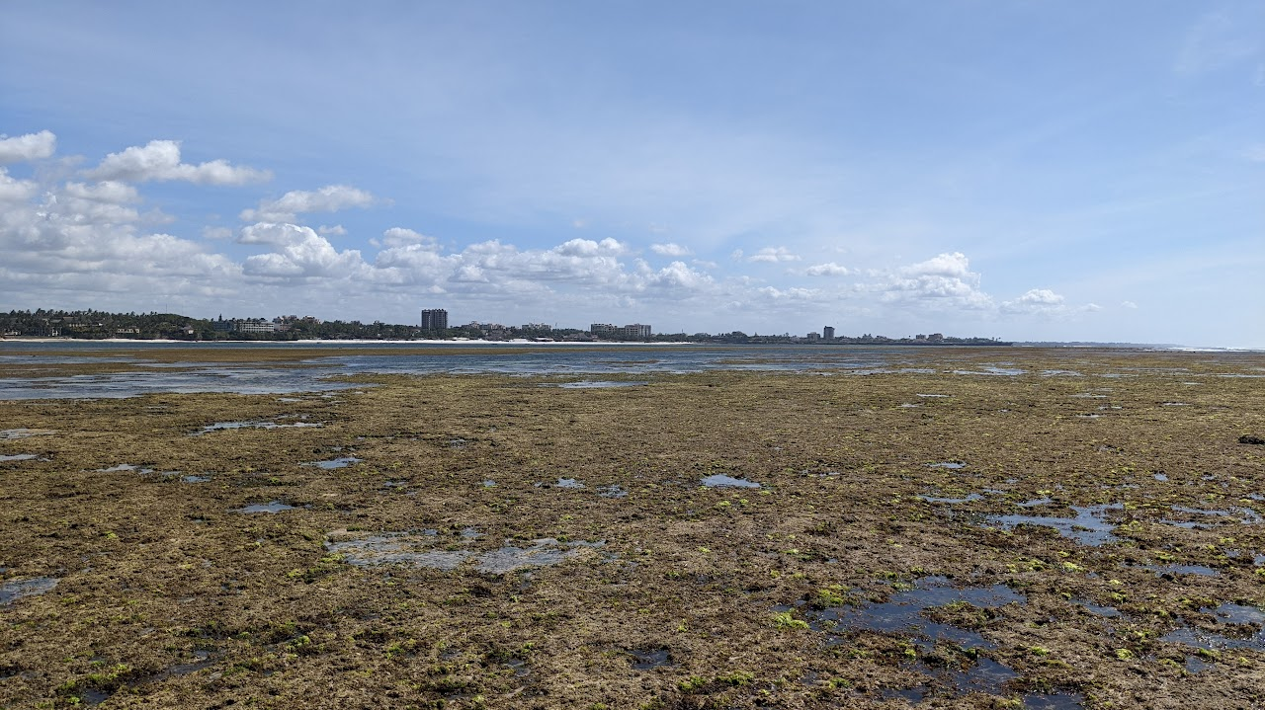
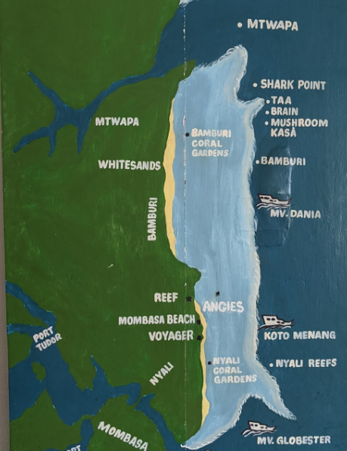
Max
The Nyali coast at high tide.
The coast at low tide
Nyali Coral Reef Map

Slide 8
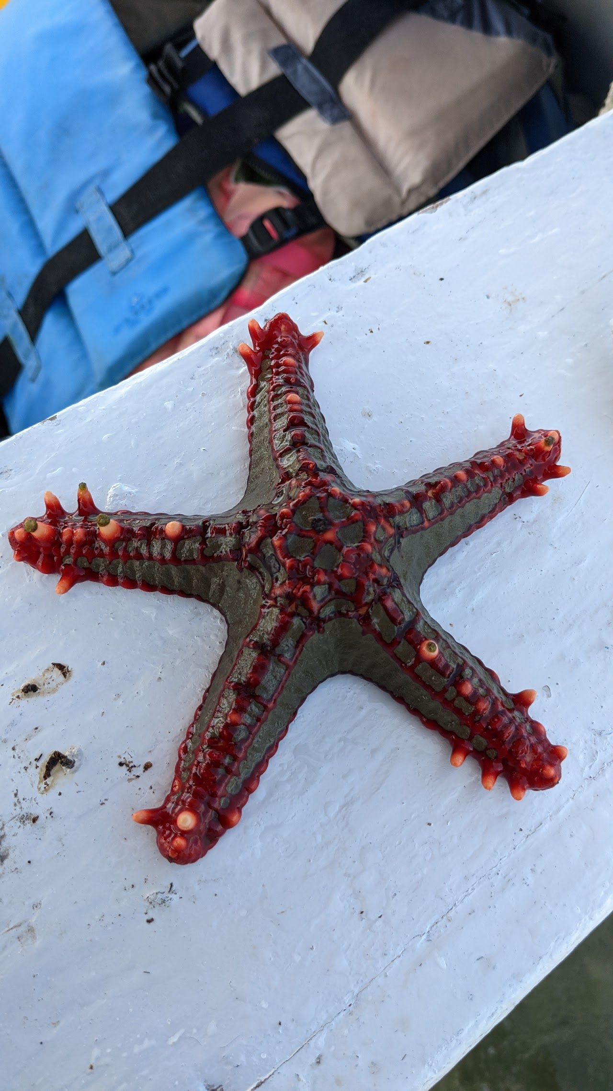

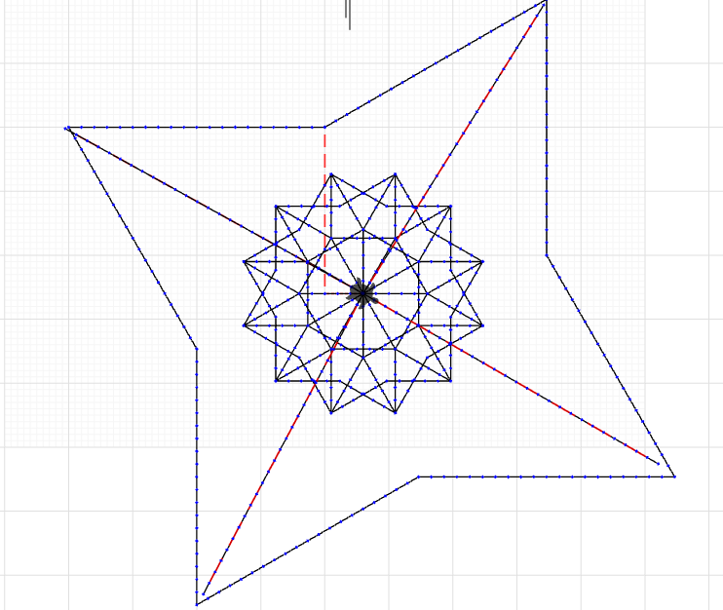
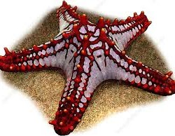
Max
Inspired by Starfish wildlife on Mombasa beach on the indian ocean
African Red Knob Starfish

Slide 9
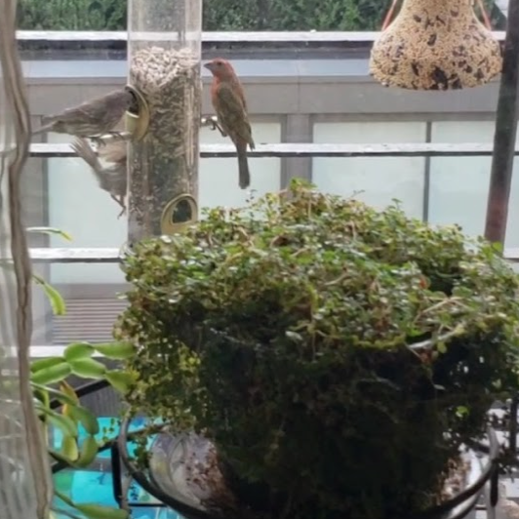
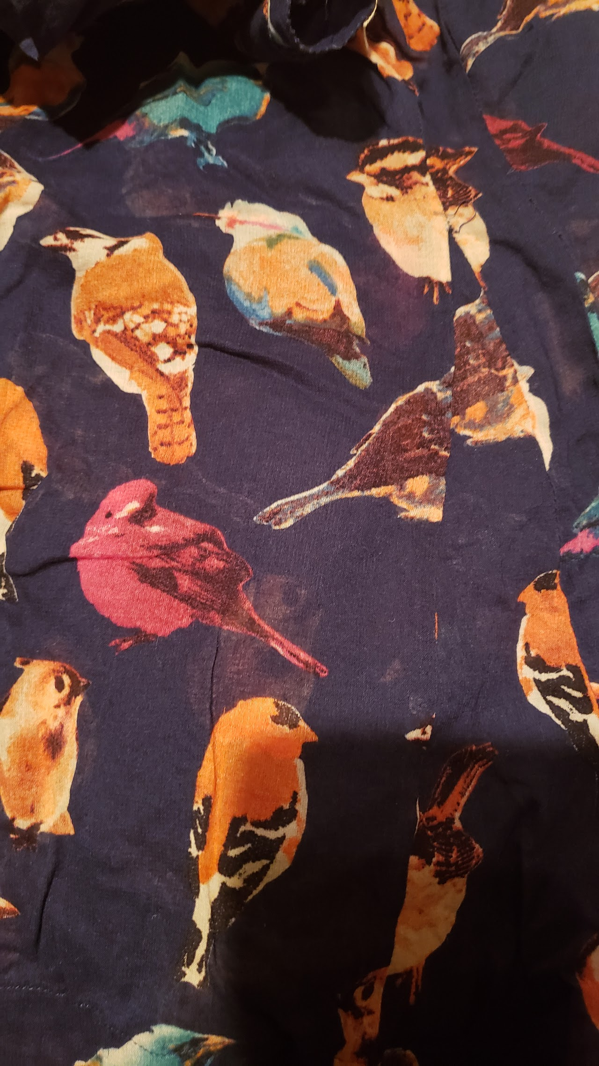
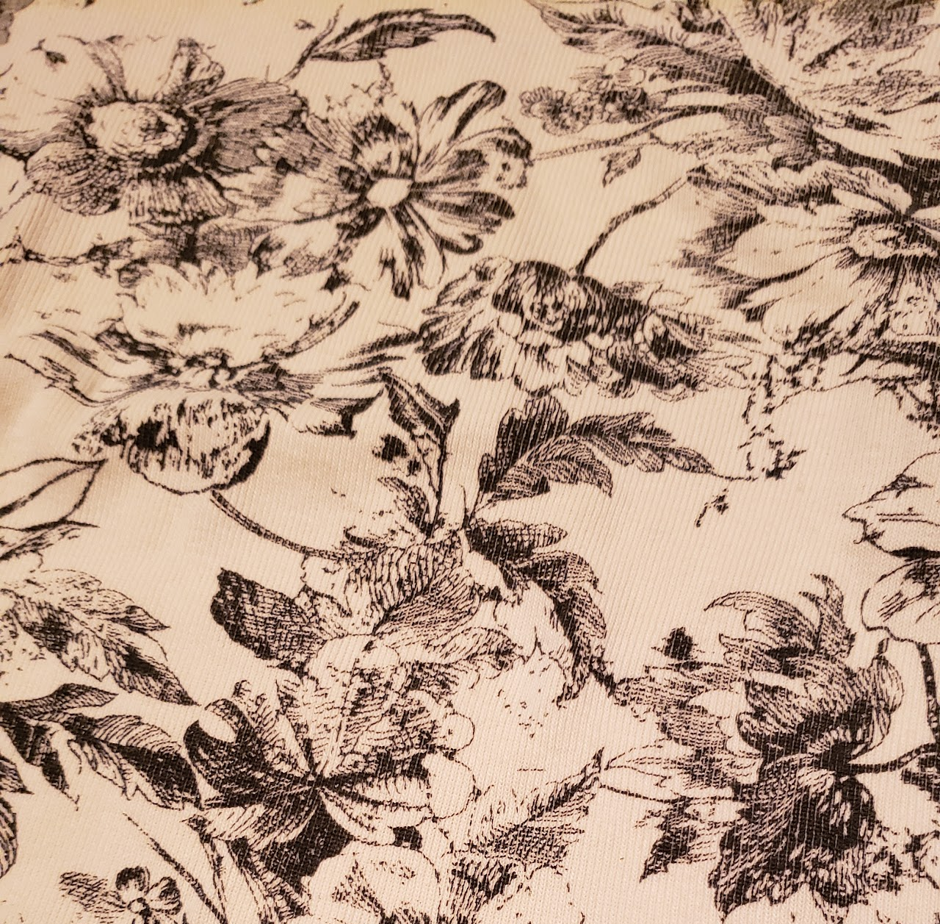
Susan
During the pandemic, I was teaching remotely and spent time feeding and watching the birds out my window every day.
As a printmaker and visual artist, birds and chickens and plants and organic shapes were always personal images.
I also had a little more time to explore coding and had taken one of the machines from school home so I could even experiment with stitching at home.

Slide 10
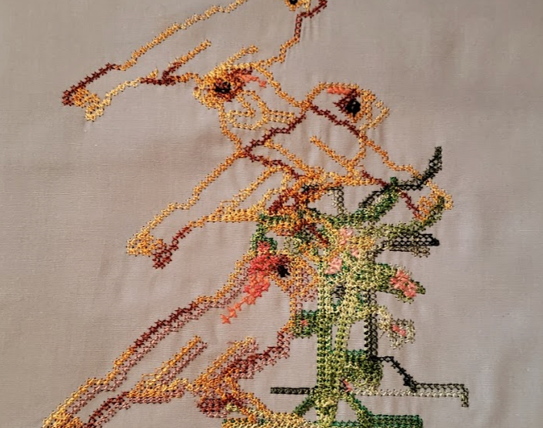
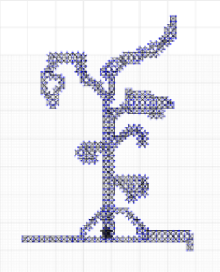
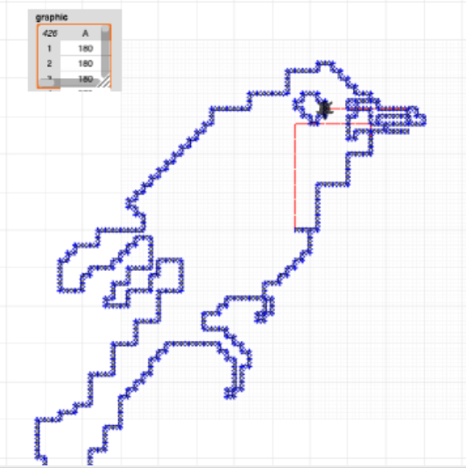
Susan

Slide 11
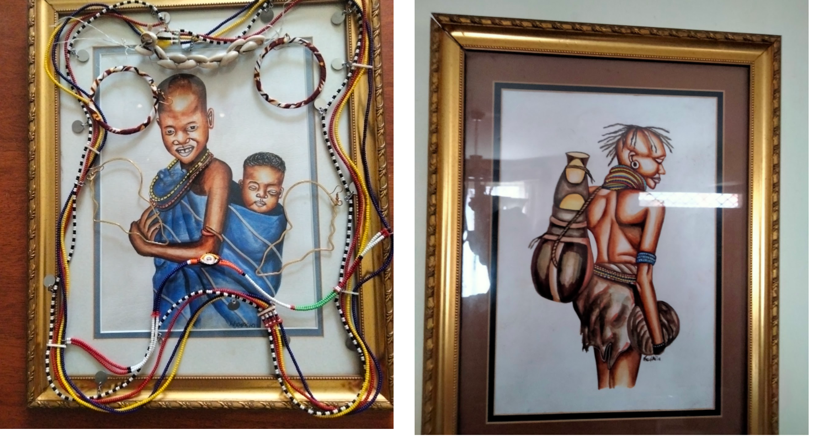
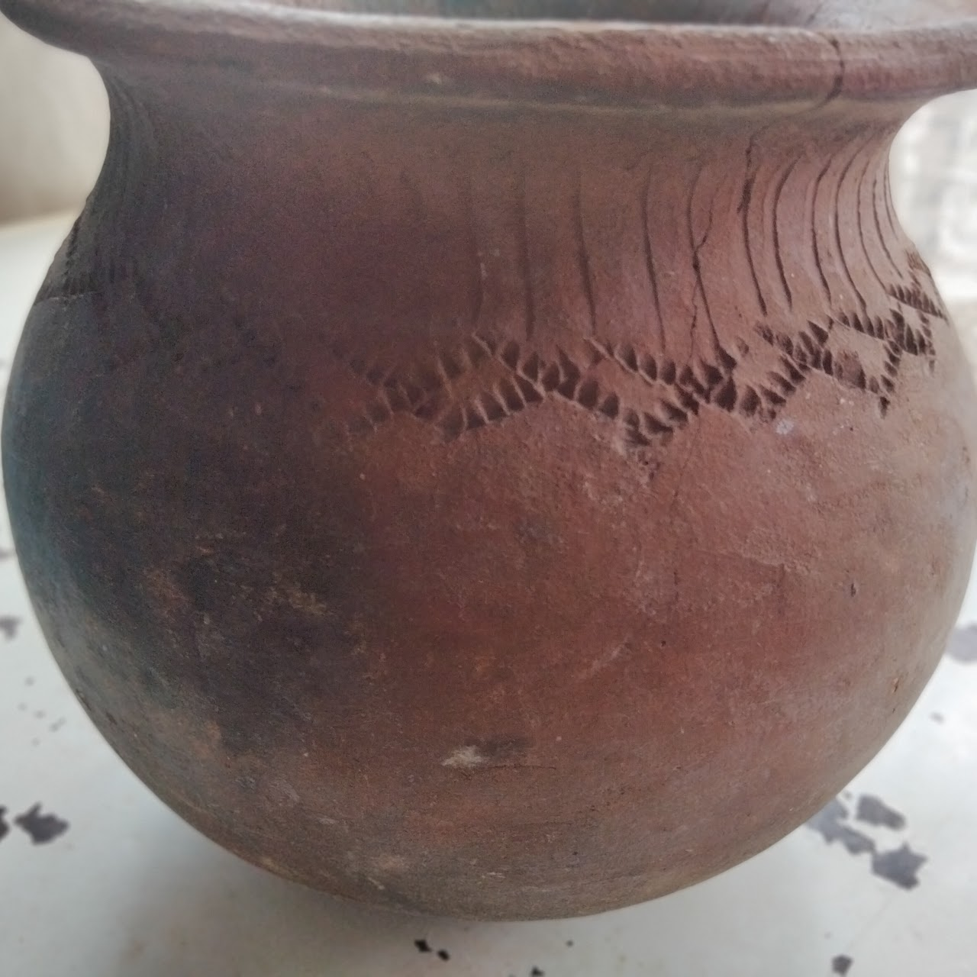
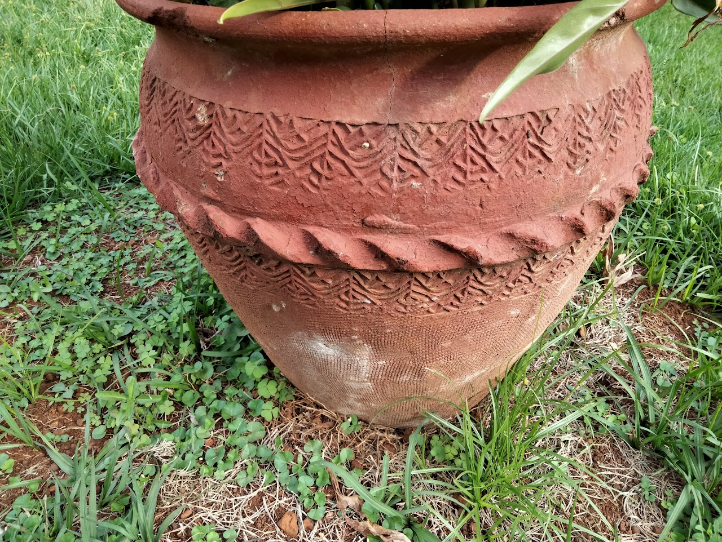
Maya
Some of the depictions of Nilotic traditional people/clothes/art around our house.
They remind me of my Kalenjin culture and roots.The Kalenjin are a group of Southern Nilotic peoples indigenous to East Africa, residing mainly in what was formerly the Rift Valley Province in Kenya.
clay pot for cooking
flower pot designs outside

Slide 12
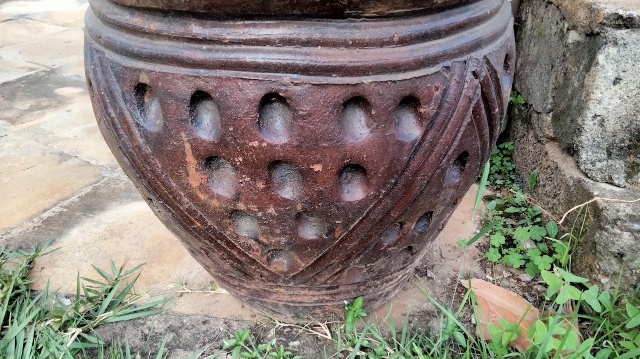
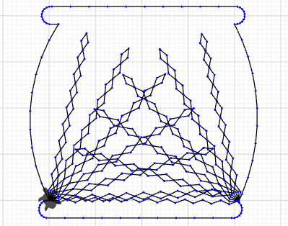
Maya

Slide 13
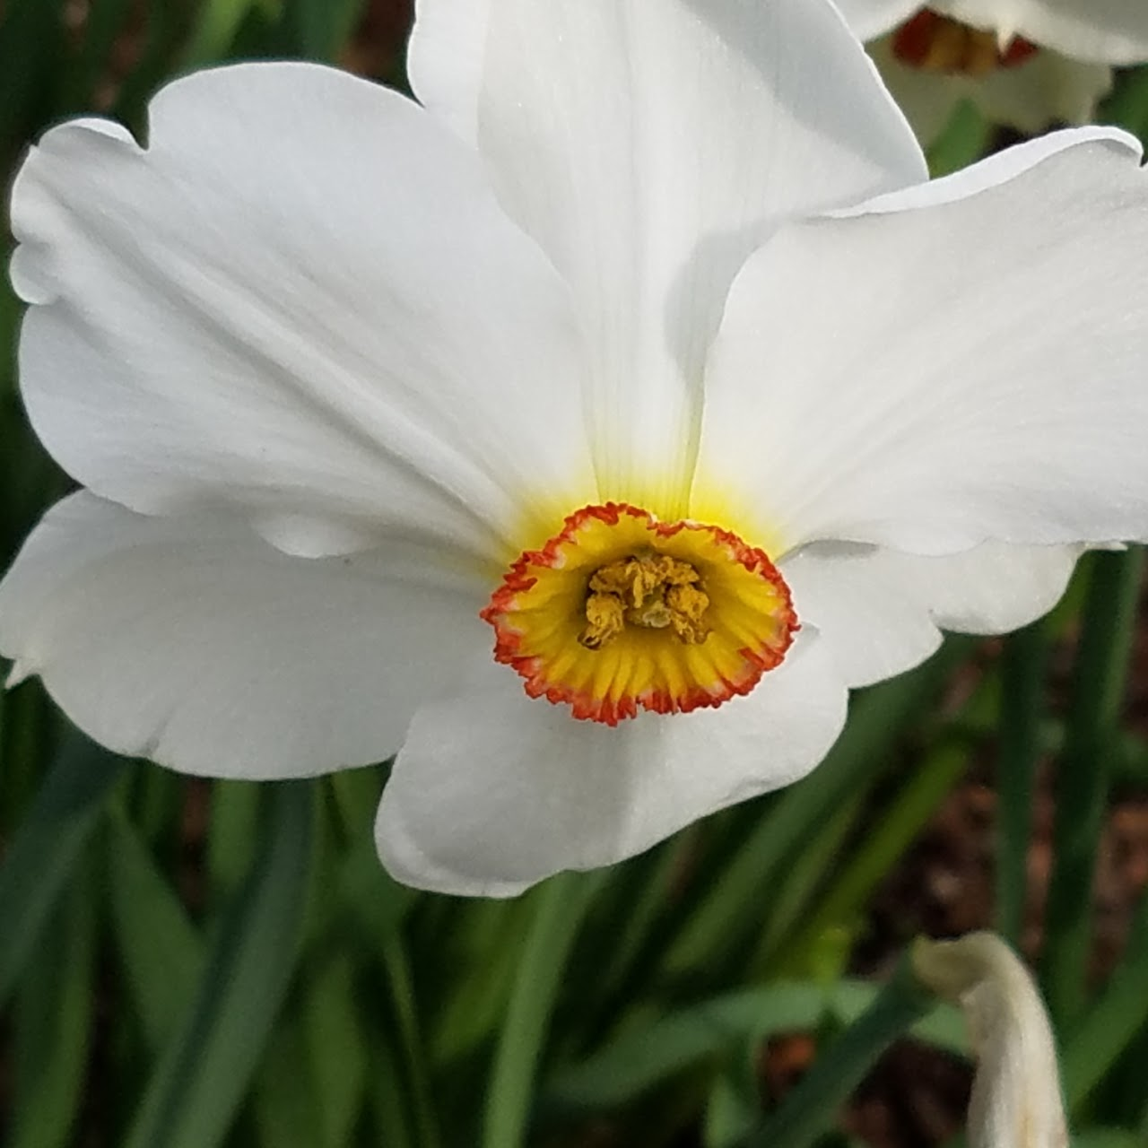
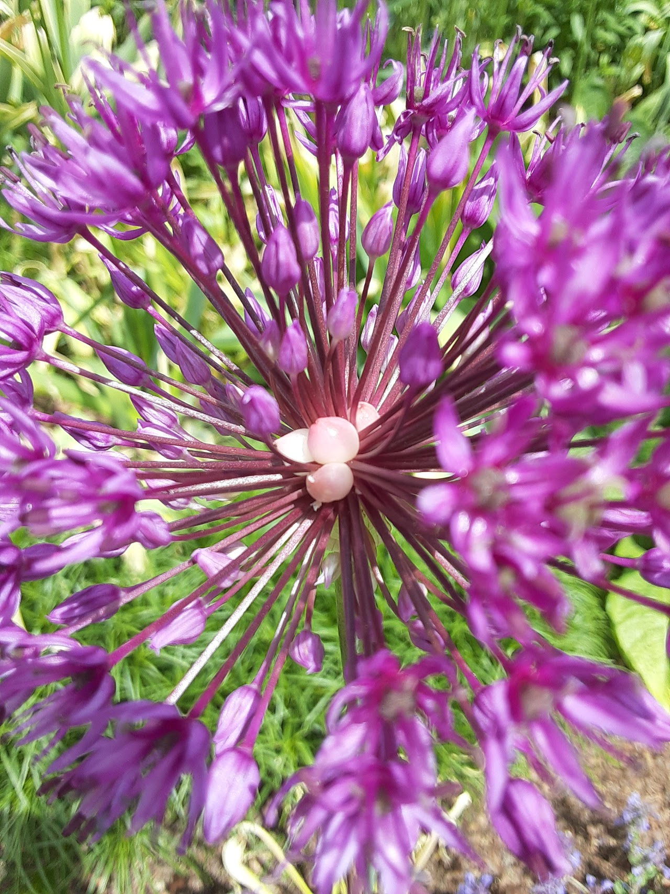
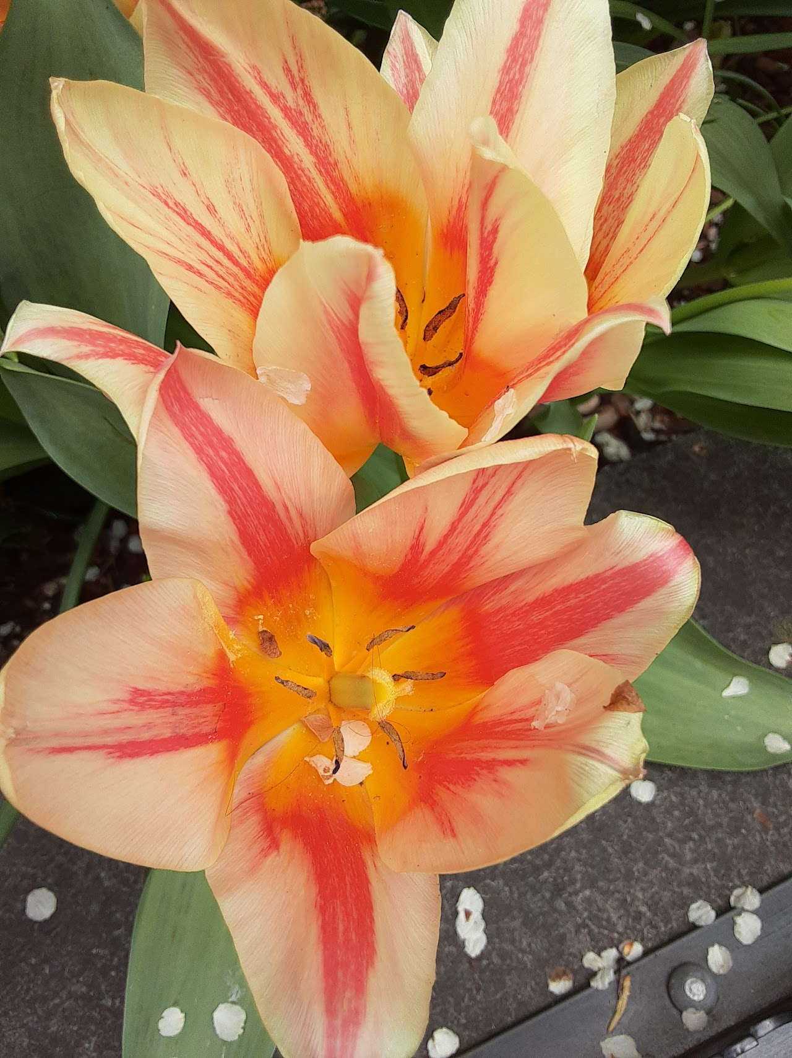
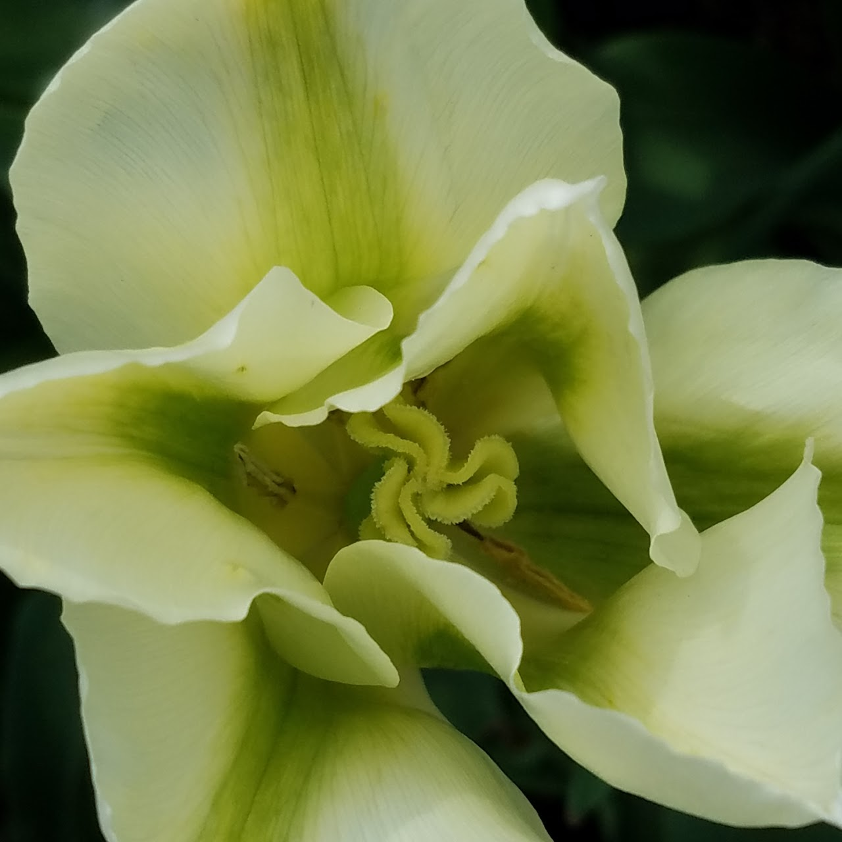
Sidney
Spring in my temporary home in Port Washington .

Slide 14
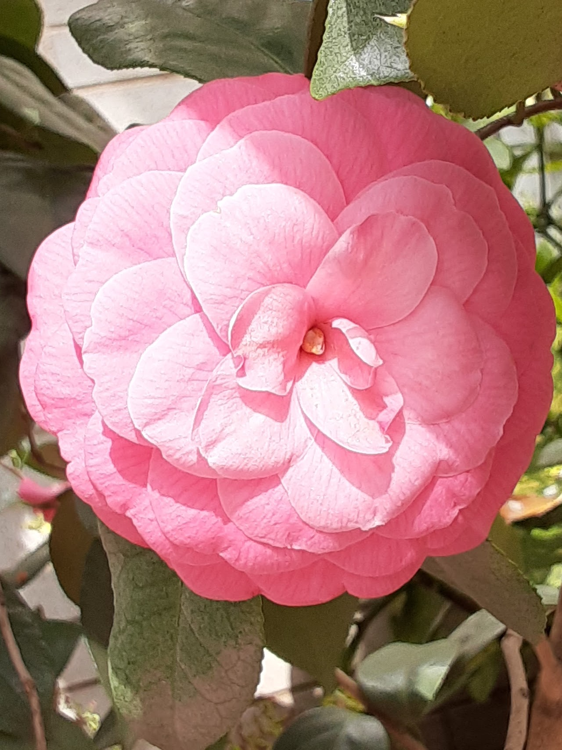
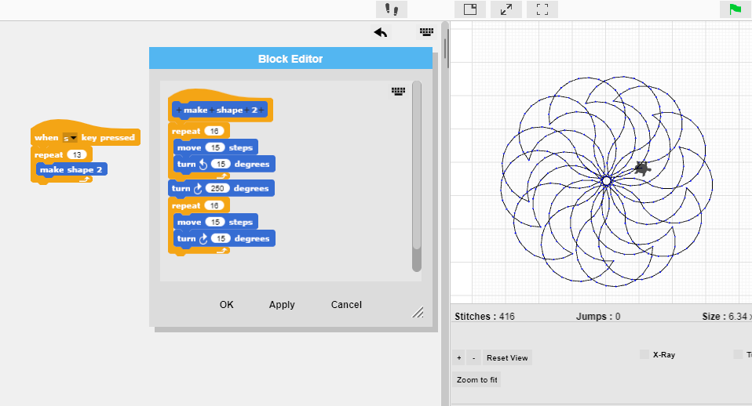
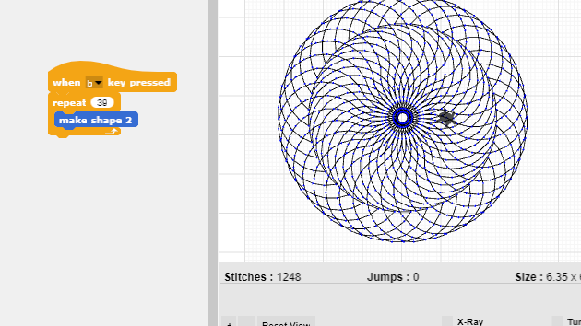
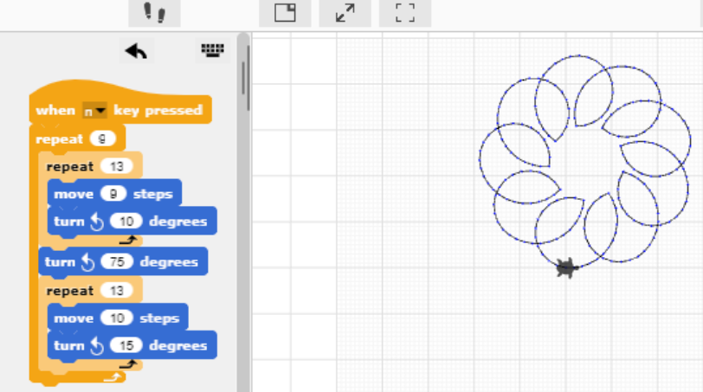
Sidney
I observed the stitching to identify what one rotation looked like and figured out that I just needed to make it repeat 1 more time
I noticed an outer ring started to form which gives it almost a 3D look as if the outer ring is closer than the center.
I was playing with the code I made so that the ending point would line up with the starting point.

Slide 15
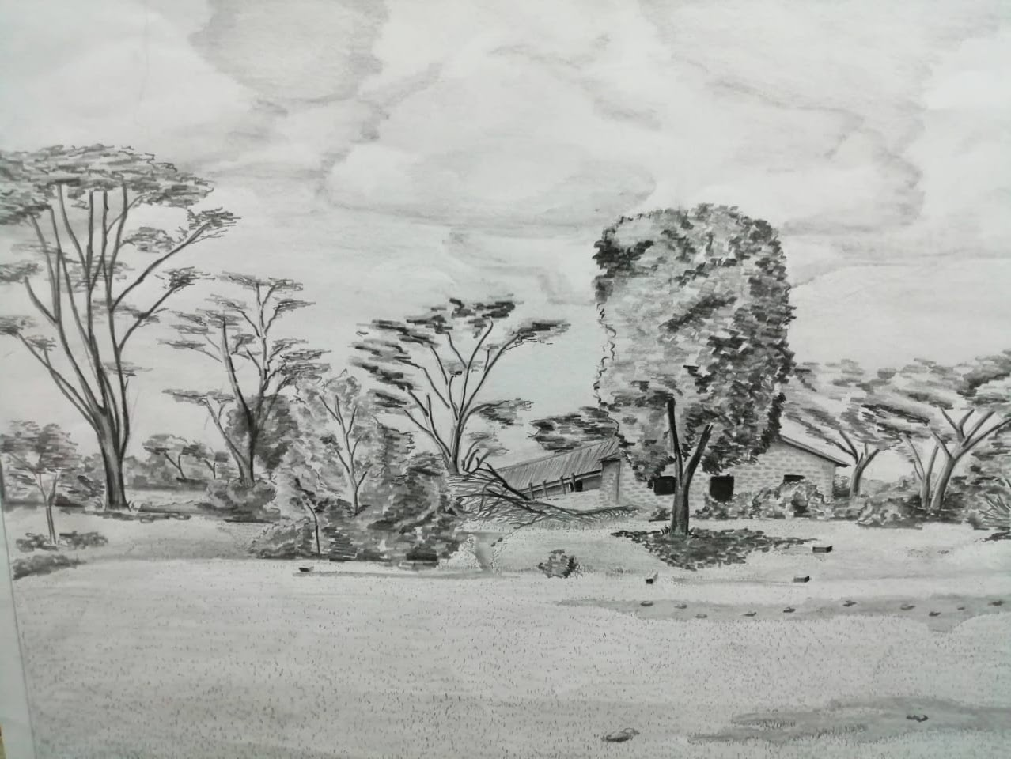



Andrew
I love art. Just me and the pencil.
Scenery of coconut trees in Kenyan Coast countryside.

Slide 16


Andrew

Slide 17



Sophia
I am currently a senior at High School in NYC. Some things that inspired me were the views and nature around Roosevelt Island.
The Queensboro Bridge and the tram go over the island.
I was also inspired by the beautiful cherry blossoms that bloom in late March on Roosevelt Island.

Slide 18




Sophia
I began by making the Queensboro bridge, which connects Manhattan and Queens.
I also created a cherry blossom flower.

Slide 19


project website

