Slide 1
Leadership for Performance Management
The Hiring and firing policies of Jack Welch and Deming’s Management of People

Slide 2
Structure
Jack Welch’s hiring and firing policies
Deming’s System of Profound Knowledge
Maslow’s and Herzberg’s motivation theories
Discussion

Slide 3

Jack Welch
“I want to create a company where people dare to try new things-where people feel assured in knowing that only the limits of their creativity and drive, their own standards of personal excellence, will be the ceiling on how far and how fast they move”
Notes:
At the start of Jack Welch’s role as CEO of GE he stood before Wall Street bosses and stated:
HR department under his leadership gained a central role at the exectutive table as he regarded human resource at the top of the list.
The policies that he implemented towards this goal were very good in many respect, but did his policy of hiring and firing go against the creation of creativity and joy in work?

Slide 4
Differentiation
Jack Welch considers differention a method applicable to both Businesses and people
Differentiation
Vitality Curve
(Welch, 2001)
Notes:
Jack Welch’s philosphy at GE when he started was to weed out the under performing businesses, the managers had to fix them, sell them or last restort dispose of them. He puported the belief that spreading your resources out across many businesses was the easy option that caused real issues for long term performance in such a globalized competitive world. He suggest through the freeing up of resources from less profitable endevours businesses that are No.1 or No.2 can be reniforced.
Differentiation of people
He applied this same philosophy in many respects to GE’s human assets.
Every year GE would require each of GE’s businesses to rank all of their top executives. The concept being that it forced business leaders to differentiate their leadership. Cultivating the strong and culling the weak.
A company has only so much money and time. Winning leaders invest where the payback is highest. They cut their losses everywhere else. Welch applies the same mentality to hardware as well as software ‘people’.
Differentiation took a decade to implement to estalishbish the right levels of candor, it cannot be rushed.
P39
I would like to make a distinction between differentiation and the vitality curve, whilst Jack Welch used them hand in hand. In the business world there are a much great number companies that use evaluate their workers, give bonuses and pay for performance. There are few the explicitly rank their employees and remove the bottom 10%, even GE has moved away from this policy to one of team building.

Slide 5
Appraisal
GE’s four E’s of Leadership
Energy – Self energy
Energize – The ability to energize others
Edge – The ability to make difficult decisions.
Execute – The ability to deliver the numbers.
Differentiation rating of People
A Players
B Players
C Players
(Welch, 2001)
Notes:
Appraisal happens through the GE four Es of leadership –
Energy – Self energy
Energize – The ability to energize others
Edge – The ability to make difficult decisions.
Execute – The ability to deliver the numbers.
All of these are connected by one P – Passion, which is the real thing that separates the As and Bs.
The differentiation boils down to assessing the A, B and C players
The A players– are filled with passion, committed to making things happen, open to ideas from anywhere, and blessed with lots of runway ahead of themselves. They have ability to energize not only themselves, but everyone who come into contact with them. They make business productive and also fun at the same time.
The B players–These people are the heart of the company and are critical to operational success. B need a lot of energy devoted to them every day to help them achieve what is missing to become an A, their manager’s job is to get them to this point.
The C players – These people cannot get the job done, they sap energy, they procrastinate rather than deliver. Time cannot be wasted on these people, however resources are used for redeployment elsewhere.

Slide 6
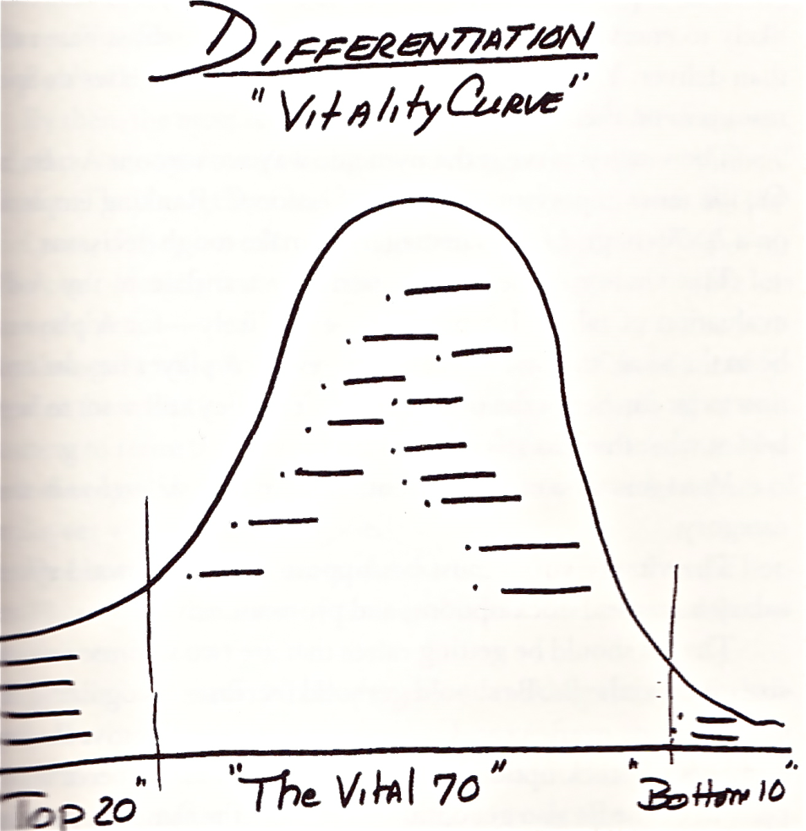
GE’s Viltality Curve
(Welch, 2001)
Notes:
The Vitality Curve
The Vitality curve is the dynamic means by which A’s, B’s and C’s, having rank players 20-70-10 forces tough decisions to be made by managers.
There is no perfect translation of A,B,C players on to the curve, A player may be placed in the vital 70%. These A players are the best at what they do but may lack the ambition to move further. The mangers that find themselves in the bottom 10 can be seen as unable to differentiate themselves.
The vitality curve must supported by a system of rewards, salary increases, stock options and promotions. A should receive raises two to three times the B’s, who should receive solid increase every year in line with their contributions, and C do not receive anything.
Naming the A players is the easy part of a manager role, the really difficult part is naming the C players. This process is easiest for new managers, when managers have been in place for years objectivity can be clouded by the relationships that have been built up. These emotional attachments can make having to choose the bottom 10 an extremely difficult task. It can be a brutal process according to some, but it is suggested by Jack Welch to be ‘false kindness’ keep people that wont grow and prosper. Moreover he purports that the earlier a person finds out that the might not be right for the role and will not go any further the better it is for them to move to something else.
Implementing a Vitality curve is no easy task, for it to work the cultural mentality must be one of building a performance culture at every level with candid feedback. Candour and openness are key foundations for a vitality curve to work.
They had to identify the top 20%, the vital middle 70% and the bottom 10% by name and compensation.
The bottom 10% of performers generally would be moved or removed, it is suggest that while a few late blooming stars will be missed the overall chances of building an all-star team are greatly increased. Consistently year after year the process of differentiation raises the bar and improves the overall calibre of the organisation. Dynamic nature of the system means that people are kept on their toes and must constantly assure their worth to stay in at the top of their game.
Differentiation in his view allowed him to constantly improve the

Slide 7

Deming
‘unleash the power of human resource contained in intrinsic motivation,’

Slide 8
Deming’s System of Profound Knowledge (DSPK)
This theory (DSPK) is based on the principal that all organizations, whether they are service or production organizations, must be viewed as a system or network of processes
Deming, W. E., (1994),
Notes:
As a statistician, Dr. Deming’s lifelong mission had been to seek sources of improvement. World War II had quickened the pace of quality technology, but as World War II ended, progress in quality control began to wane. Many companies saw it as a wartime effort and felt that it was no longer needed in a booming market. Given the failure of statistical methods for quality control to endure, he figured out what might have caused the failure and how to avoid it in the future. He gradually concluded that what was needed was a bedrock philosophy of management, with which statistical methods were consistent. He was ready with new principles to teach when the Japanese called him in 1950 to aid in the reconstruction of their country.
The theory is built on statisics, a large part of leadership is feelings,

Slide 9
The system of profound knowledge includes four components
Appreciation for a system
Knowledge about variation
Theory of knowledge
Psychology

Slide 10
How to measure performance
Performance measures should be based on real improvement of the whole system i.e
Improving processes which affect the performance of all individuals within the system
Determine potential chronic problems which may be causing performance variance

Slide 11
Performance Improvement
In order to improve performance ,behaviour change will be required by people in the organization . (Buckler, B.,1998).
Performance Improvement
i.e
Innovation, Improvement in Processes, Products and Services
Behavioural
Change
i.e.
Changing
What we do
and
How we do it
Learning
i.e.
Acquiring and
Developing new
Knowledge
Attitudes
and Skills
will
require
will
require
Notes:
The aim of Dr. Deming’s theory of management also known as, ‘System of Profound Knowledge,‘ challenges leaders to embrace a new paradigm based on the following three major points:
Foster an environment to allow all people to experience ‘joy in their work’ and pride in the outcome
Optimize the system of interdependent stakeholders so that everybody wins. Avoid optimizing one stakeholder group’s welfare at the expense of another stakeholder
Improve and innovate the condition of society
The purpose of the new paradigm transformation is to ‘unleash the power of human resource contained in intrinsic motivation,’ and to foster an environment of full cooperation between people, departments, companies, governments, and countries to achieve win-win scenarios through process improvement, team work, and innovation.
The system of profound knowledge is a fitting theory for leadership in any culture or business. In some circles people think incorrectly of Total Quality Management with industrial connotations. For example, in the health care arena the customer is the patient, and production could be equated to the quality of patient care. Indeed many of the concepts which are espoused by TQM relate to interpersonal interaction as much as they do to other more production oriented criteria.

Slide 12
Deming’s Assumptions
Management's function is to optimize the whole system, not just the components
Cooperation works better than competition
Manage using both a process and results orientation, not only a results orientation
People are motivated by a mix of intrinsic and extrinsic motivation
Notes:
‘unleash the power of human resource contained in intrinsic motivation,’
1. Management's function is to optimize the whole system, not just your components
E.g., Western-style management: Reward-punishment performance appraisal systems optimize components of the system.
E.g., Deming-style management: A better way is to evaluate an individual long-term virtue, to know if they are in the system or out of the system, and to understand the performance issues as special or common cause. According to statistical research by Deming, Ishikawa, and Juran over 80% of problems are related to common cause or system problems of the organization.
2. Cooperation works better that competition
E.g., Western-style management: Internal competition to recognize the top 10% sales people in an organization creates a system where 90% of the population is labeled substandard performers or worse yet losers for those on the bottom half.
E.g., Deming-style management: In any distribution curve, 50% of the population is going to be below average, and only 10% are going to be top performers. It does not make sense to grow an organization of malcontents because nobody wants to labeled a loser. If the system is stable and has good hiring policies in place, a better way to manage is to have a goal to shift the distribution curve to the right by continuous improvement and removing common causes of variation. All employees in the system should be recognized for the accomplishments of the enterprise, rather than just the top 10%.
3. Manage using both a process and results orientation, not only a results orientation
E.g., Western-style management: Asking to sell 30% more (by a MBO goal) without understanding the process that allows that goal to be attained, or providing a process for goal attainment, creates a fail syndrome (demanding unreasonable greater results has the opposite effect that contradict the Pygmalion effect).
E.g., Deming-style management: A better way is to analyze historical performance using statistics. Then basing sales growth goals within +/- 3 standard deviations from the mean, where 99% of the sample population is predicted to attain the goal, and shifting the curve to the right by improving the sales process. If a stable system is pushed beyond its limits, the system typically breaks down.
4. People are motivated by a mix of intrinsic and extrinsic motivation
E.g., Western-style management: Recognizing people solely through extrinsic motivation by giving plaques, letters of commendation, bonuses, and pats in the back to motivate employees.
E.g., Deming-style management: A better way is for management to combine extrinsic and intrinsic motivation to increase quality and pride in the work. Intrinsic motivation is the enthusiasm and positive stimulation an individual experiences from the sheer joy of an endeavor. Management can release intrinsic motivation by creating a culture that encourages employee involvement in using process improvement tools such as the Deming wheel (SDSA and PDSA) to innovate and improve quality.
Each of these assumptions are directly associated with the interrelationships between people. They all revolve around a key concept, receptivity of the management style by those who are not only managing but those who are being managed. The implementation of management philosophies obviously revolves around employee motivation, and not all employees are either easily motivated or receptive to management styles that differ from those to which they have been accustomed.
What motivates an individual, therefore, is at the center of Total Quality Management philosophy. Motivational theory in itself has a long history of both direct and indirect applicability to many aspects of management in general and to Total Quality Management in particular. Indeed, the importance of teamwork in the organizational atmosphere cannot be underestimated. Before employees can effectively interact as a team, however, they must be able to function independently in an efficient and productive manner.

Slide 13
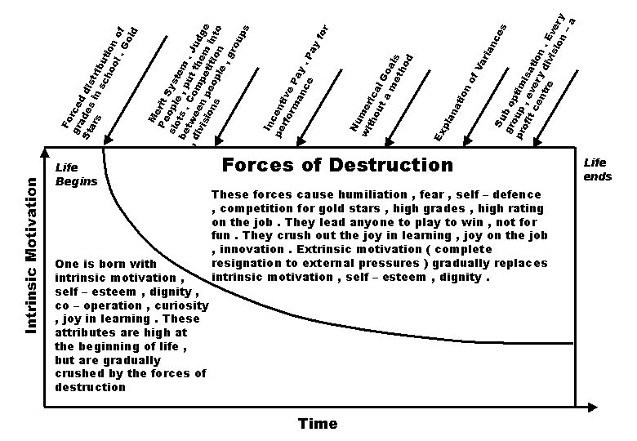
Reward culture
Notes:
Effects of the Present style of reward
The present style of rewards is suggest to result in an destructive effect, that squeezes a person’s ‘innate intrinsic motivation, self-esteem and dignity’. What is left is fear, self-defence, and extrinsic motivation. Deming states that we have been destroying our people from birth all the way through to university.
Diagram

Slide 14
Reward system according to DSPK
Provide system of reward that recognize superior performance, innovation extraordinary care and commitment
The above is incompatible
Create & maintain stimulating, and enjoyable work environment , with the aim to attract, develop and retain self-directed and talented people

Slide 15
Motivation
Maslow’s Hierarchy of Needs
Herzberg's motivation-hygiene theory
Pay and performance
Notes:
What is the theory of knowledge for motivation? Over the years, motivational theory has included the input of people like Frederick Taylor, George Mayo, Douglas McGregor, Abraham Maslow, Frederick Herzberg and Peter Drucker. Each has added something new to our knowledge of motivation. The work of Maslow and Herzberg is reviewed below in relationship to the system of profound knowledge.

Slide 16
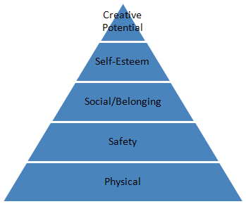
Maslow’s Hierarchy of Needs
(Maslow 1954)
Notes:
In 1962 Abraham Maslow developed a hierarchy of needs which is shown in the figure above. Amazingly, this work is still valid today. This sequence of needs outlines the basic forces that motivate all of us. The hierarchy of needs represents stages people go through, often several times a day. The first stage is physiological needs - food, sleep, and clothing. If these needs are not satisfied, you cannot go to the next level. If you are worried about where your next meal will come from or where you will sleep tonight, you cannot achieve the higher levels.
If these needs are taken care of, we progress to the next level which deals with safety and security. We want to feel safe and secure, both physically and psychologically. There are many reasons that we may feel unsafe or insecure. These include working in an unsafe or unhealthy environment, fear of losing our job, fear of being dressed down by the boss, or fear of a poor rating on our annual performance review. This is point 8 of Dr. Deming's 14 points: Drive out fear so everyone can work effectively for the company. It also includes point 12: Remove barriers that rob the hourly worker of his right to pride of workmanship. The same holds for management.
If the needs of the first two levels are met, we progress to the next level. This level involves belonging and social acceptance. Everyone wants to feel part of something - a team, an organization, a church, etc. If this occurs, we move to the fourth level which is self-esteem. At this level we can begin to build our self-worth and improve our confidence. Once achieving this, we can move to the last level which is self-fulfillment and creativity. We all have special talents and unique skills.
Maslow's hierarchy of needs has been supported by brain research over the past two decades. The brain is really a triune brain. One part of the brain, called the stem or reptilian brain, takes care of three things: physical needs, survival, and sex. It ensures that the species continues. The second part of the brain is called the limbic system. This part of the brain takes care of emotions. The third part of the brain is called the neocortex or the cerebrum. This is where purpose, creativity, and logic - the things we want to believe we are paying attention to - occur. The triune brain - physical, safety, sex, then emotions, then logic and creativity - follows Maslow's hierarchy of needs. It is in the brain - we don't have a choice.
The role of a manager is to determine how to keep employees in this upper level and how to make the best use of their talents and skills. This means that the employees must have their physical needs met, feel safe and secure, and have a sense of belonging to the organization. Only then can employees begin to develop self-esteem and their creative potential. After all, quality improvement will occur only when employees are at these higher levels. Self-fulfillment, creativity, and self-worth are the strong internal motivators that give people pleasure.

Slide 17
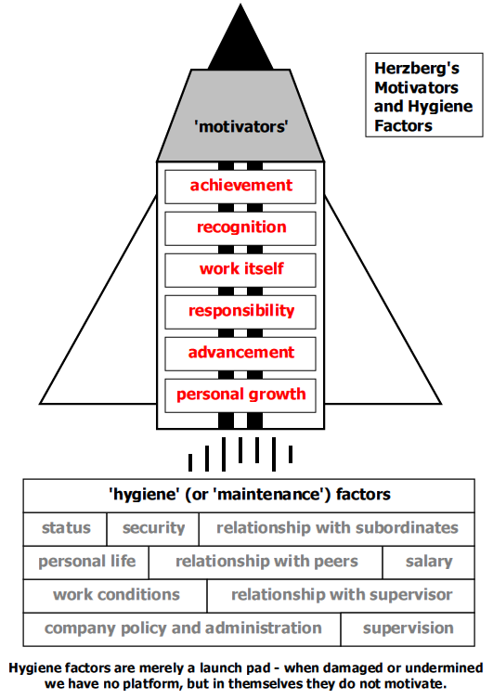
Herzberg
(Herzberg, 1959)
Notes:
Assuming that a manager understands this hierarchy of needs, how does he motivate employees? Offer them more money? A bonus if they reach their objectives? Fredrick Herzberg did research on what motivates people. Basically, he was trying to answer the question "Will money make you happy?"
What Herzberg discovered was that there are hygiene factors - money, benefits, safety, protection - that must be met to keep employees from being dissatisfied. Meeting these hygiene factors does not mean that the employees are satisfied - they are just not dissatisfied. They will put in eight hours of work and go home. However, they are not motivated to be creative, offer suggestions for improvement, etc.
The hygiene factors include the following:
* Company policies and procedures
* Supervision
* Working conditions
* Salary
* Interpersonal relationships
* Status
* Security
Herzberg discovered that the people who were satisfied and happy on the job talked about self- esteem, contributing to the organization, being recognized for their jobs, meeting challenges, etc. He called these items motivators. These are the pleasurable motivators that increase performance. They include both internal and external motivators. Many of the external motivators, such as praise and recognition, can help build pride over time. In addition, these types of motivators are free. Management should focus its attention on these motivators. Yes, the hygiene factors need to be there, but that will not bring what Dr. Deming described as "joy on the job."
The motivating factors include:
* Achievement
* Responsibility
* Recognition
* Growth
* Interesting Work
* Advancement
http://www.businessballs.com/herzberg.htm

Slide 18

Pay and Performance Misconceptions
People are motivated by money.
2. We can use an incentive system to effectively motivate someone to do the job we want them to.
3. There is a fair way of determining how much someone gets paid based on the work done by the individual or by the team.
(Kohn, 1993; Amabile, 1988; Deci & Ryan, 1985; Meyer, 1975; Pfeffer, 1998).
Notes:
1. People are motivated by money.
There are tons and tons of data and surveys that show what motivates people most are the intangible things -- interesting work, being creative, challenging work, etc. You can see it in the work done by Herzberg, Maslow and even the brain material. This research has been continuously ignored
2. We can use an incentive system to effectively motivate someone to do the job we want them to.
3. There is a fair way of determining how much someone gets paid based on the work done by the individual or by the team.
Money is always an issue with employees. We always want more. However, as long as we have sufficient money to meet our physical and security needs, money is not really a motivator. Of course, we work to provide for our families and for our future. However, few people think about the issue of money every day as a reason for doing work. I don't hear that "I've got to do this today because I get paid a week from Friday."
But many people think that money is a motivator - that we can get people to do what we want if we can figure how to pay them. This logic is flawed for three major reasons. The three misconceptions that people still seem to have are:
1. People are motivated by money.
2. We can use an incentive system to effectively motivate someone to do the job we want them to.
3. There is a fair way of determining how much someone gets paid based on the work done by the individual or by the team.
Each of these is addressed below.
1. People Are Motivated by Money
Let's start with "people are motivated by money." This simply is not the case. There are tons and tons of data and surveys that show what motivates people most are the intangible things -- interesting work, being creative, challenging work, etc. You can see it in the work done by Herzberg, Maslow and even the brain material. Yet, we tend to forget all this information when it comes to discussing pay systems.
Of course people are interested in money. They want to be paid fairly for the work they do, but that is not what motivates them. Seldom do people change jobs for increases in pay. People normally change due to the lack of things on the job that make it challenging and rewarding. Dr. Deming said it over and over -- money is not a motivator, it will not bring "joy on the job."
Of course, the less money we make, the more concerned we are about money. We need to be able to buy the things we need to survive. So, one could assume that the "lower" a person is in the organization, the more concern about money he or she will have. Again, however, this is not the primary source of motivation for the vast majority of the people.
There seems to be the belief that salespeople, in particular, are motivated by money. I do not agree with that conclusion. Money is not why a salesperson gets up in the morning to go to work. There are also data to support this. A poll, for example, done in 1991 ("Money Isn't Everything" Sales and Marketing Management, May 1991) listed increased compensation as the last reason for salespeople changing jobs.
Money as a motivator? We know it is not true yet we want to set up systems based on that incorrect assumption. I think Dee Hock, the man who built Visa, said it very well:
"Money motivates neither the best people, nor the best in people. It can move the body and influence the mind, but it cannot touch the heart or move the spirit; that is reserved for belief, principle and morality. As Napoleon observed, "No amount of money will induce someone to lay down their life, but they will gladly do so for a bit of yellow ribbon.“
2. We Can Effectively Use an Incentive System to Motivate People to Do the Job We Want Them To
OK. So maybe money is not a big motivator. But can't we design an incentive system to get people, particularly those who are lower in the organization, to do what we want them to? So, is it different with people who are "low" in the organization? What about a picker in the warehouse? Will he/she work harder if we put a "carrot" out there? The following appears to be what many people think:
Hmm, kind of makes sense, right? After all, they aren't compensated like salespeople or managers, for example. They would like more money, pay off some of their bills. Plus, we can set up the system to get them to focus on what we want them to do -- fewer errors, pick more lines. Pay them more, either individually or as a team, when they reach the goal. Let's reward them when they do good work.
Sounds great, but the reasoning continues to be flawed by the underlying assumptions. Alfie Kohn is the author of a book called Punished by Rewards: The Trouble with Gold Stars, Incentive Plans, A's, Praise and Other Bribes. Mr. Kohn takes a different viewpoint on the use of rewards in school, at home and at work. He believes that rewards and punishment are not opposites at all but are "two sides of the same coin." Both are aimed at controlling behavior. As suggested above, there are five major reasons that rewards for the picker in the warehouse fail.
a. Rewards Punish
Can this be true? Unfortunately, yes. Rewards are aimed at controlling someone's behavior. If you do this, I will give you something you like. While the reward may be pleasurable, people do not like to be controlled. In addition, we may not get all the reward we think we are due. In this case, the reward becomes a punishment. "Rewards feel punitive because they, too, amount to an effort to manipulate people's behavior. Moreover, employees may find a bonus or other incentive deliberately withheld or withdrawn from them, or else they may simply fail to obtain it despite their best efforts."
b. Rewards Rupture Relationships
Individual rewards, such as for individual pickers, will definitely rupture relationships that exist. It will foster competition, not cooperation. There is only one best -- everyone else is a loser. A sure fire way to destroy teamwork is to make the people compete against each other for a bonus. In addition, it is likely to change the relationship between supervisor and associate. If the supervisor determines the bonus, the associate may not tell him/her certain things. Teamwork once again fails.
c. Rewards Ignore Reasons
To improve, we must know what causes problems. The use of rewards, even those tied to process improvement, tend to hinder the search for reasons for problems. In fact, this reward process allows management to ignore its true job of coaching and helping. The assumption is that if we pay them enough, the job will get done. Then we don't have to lead them -- simply offer the carrot.
d. Rewards Discourage Risk-Taking
People will do what it takes to get the reward, but only what it takes. Having a sliding scale does not change that. In addition, people will not take any risks that could affect the reward.
e. Rewards Undermine Interest
This is the biggest issue here. Intrinsic motivators are more powerful than extrinsic. However, "extrinsic motivators not only are less effective than intrinsic motivation, but actually reduce intrinsic motivation." In other words, rewards, like incentives, can hurt the person's motivation for doing the activity. The focus changes from the activity to the reward.
Dr. Deming contends that "one is born with intrinsic motivation, self-esteem, dignity, cooperation, curiosity, joy in learning." This may or may not be true, but Dr. Deming correctly says that throughout life there are forces that prevent people from being intrinsically motivated, having self-esteem, etc. Dr. Deming lists some of these forces as being grades in school, merit system, incentive pay, numerical goals without numbers, and sub-optimization (see the first part of this series).
3. There is a Fair Way of Determining How Much Someone Gets Paid Based on the Work Done by the Individual or the Team.
OK, so money is not a big motivator and it may be difficult to set up an incentive system that doesn't ultimately demotivate people. But, let's do it anyway. How can we design a system to pay people for the work done -- either individually or as a team?
As Dr. Deming pointed out, you can't design such a system. It is impossible to separate out the contribution of an individual or team to the process's output from the contribution of the system. For example, let Z be the output we are interested in measuring and for which we reward a team. For example, it might be for the pickers in the warehouse. Let X be the contribution of the pickers to the process. Let Y be the contribution of the system to the process. By system, I mean the processes involved in picking, the type of supervision, the layout of the warehouse, etc. The equation for lines picked is then
X + Y = Z
Suppose Z is 1000 lines picked. The equation above cannot be solved for a unique value of X or Y. It is impossible to separate the two.
So people might say that is not a big deal. Just forget about the system's input. Ever know somebody who did a poor job in one department, then was moved to another and became a great performer? Of course, we all do. The person was the same in this case. Why the difference? The system, of course. Maybe it was supervision. What does supervision add to the process?
So what do you do with pay? Intrinsic motivation is a far better motivator than rewards such as bonuses and incentives. The key is to make the work the motivator and try to keep the pay from being a demotivator. As you know, when you begin to mess with pay issues, you put people in lower Maslow.
Basically, the pay system should be fairly simple. Brian Joiner suggests a simple system in his book Fourth Generation Management. Pay a salary that is in line with the market for the job. You don't want to be below the average, but not too far above it either. This is fair to people. They know you are paying them about what they could make elsewhere. They will not leave due to pay issues if this is the case.
Give the same percentage salary increase to all employees once a year. The increase is to keep people's salaries in line with the market and is not related to how the company is doing.
When the company is doing well, share with the people. For people who have been with the company for a certain time frame, give them each a certain number of weeks of pay. Prorate it for people who have not been with the company long enough (for example, two years). There will be times when the company will not have money to share.
Some people may require some special adjustments to salary, but the above simple system is fair and people will sense that it is fair to everyone involved - one that takes into account that we are all part of the same system.

Slide 19
Failed Pay for Performance a case study
Beer carried out an experiment in conjunction with HP as they implemented pay for performance of 13 sites.
HP's San Diego site serves of a strong example of highlighting the problems of pay for performance and Deming’s theories on process.
Beginning – love for the new system everyone hit targets , so due to cost performance levels were raised. (just like Jack Welch’s high levels).
Then teams got frustrated at the factors out of their control (system process) – reduced transfer of staff across teams because with reduced learning.
Mangers concluded they spent too much time implementing the system and it was motivating workers to work hard or more importantly learn.
Promise and Peril in Implementing Pay for Performance: A Report on Thirteen Natural Experiments (Beer & Cannon, 2002)
Notes:
One HP unit that threw the matter into relief was HP's San Diego site. The experiment in pay-for-performance began naturally enough, driven by a transition to self-managed teams in production. Managers launched a program of team goals coupled with team-based pay with three possible levels of reward. Managers reckoned that 90 percent of teams could reach Level 1, 50 percent could reach Level 2, and 10-15 percent Level 3.
For the first six months, everyone loved the new system. The majority of teams hit Levels 2 and 3. And, said Beer, because the payout was greater than expected, management adjusted the goals upward. Then the complaints began.
The teams were frustrated that factors out of their control, such as the delivery of parts, affected their work. The high-performance teams often refused to admit people whom they thought to be below their level of expertise, leading to disparities among the teams. There was reduced mobility between teams, preventing the transfer of learning across teams. Employees built their lifestyles around the higher level of pay, and were angry when they could not achieve it consistently.
Managers for their part felt they were spending too much time reengineering the pay system. They concluded that it did not motivate employees to work harder or, perhaps more importantly, to learn. It was also hard to maintain consistency of pay across the larger site. Managers also grappled with the question of sustaining pay-for-performance over time.

Slide 20
Leadership
Amitai Etzioni – Three methods of organisation
Coercive – the threat of falling into the bottom 10%
Utilitarian – Differentiation money can buy you labour but not goodwill.
Normative - inspiration that makes people devote themselves to a cause - Deming’s theories
(Tichy, 1993)
Notes:
In many ways the two policy touch on the theories of Amitai Etzioni that have already been discussed earlier in this module.
The three methods of organizational control –
Coercive – the threat of being fired through falling into the bottom 10% is like having a gun pointed at you
Utilitarian – This is the basis of differentiation, money can buy you labour but not goodwill.
Normative – this is the inspiration that makes people devote themselves to a cause and is the most effective but difficult to rely on completely. Deming’s theories need this aspect to be prominent to get the best out of the work force and get the best out the team.

Slide 21
Questions for thought
Do we need to differentiate between people, if so how can this be done most effectively for the organisation and the individual?
Does Jack Welch’s policy of removing the bottom 10% really improve the effectiveness of the whole organisation towards achieving its goals?
Notes:
Bring the various threads together

Slide 22
Discussion
Do we need to differentiate between people, if so how can this be done most effectively for the organisation and the individual?
Non differentiation – increases hierarchy
Tenure based progress, function not performance, Japan
Pushes some further, pushes down the rest
Deming 12 - pride in workmanship
Variation
Intrinsic motivation, self-esteem, teamwork, and creativity
Rewarding the best doesn’t motivate, negative effect for the rest
Herzberg – Maintenance factors
Motivation though support, learning recognition of progress
Notes:
Deming advocates the abolishment of the annual merit system and management by objective, both representing barriers to an employee’s right to right to pride workmanship (Deming, 1986). The annual merit system and management by objectives both may foster a short term span of discretion in employees (jaques,1989).
Furthermore Deming reasons that it is impossible to accurately measure employee overall performance within systems plagued by assignable and assignable causes of variation/error. Deming uses his Red Bead experiment to highlight the fallacy of the merit system.
Deming's point 12 – pride in workmanship
pay for performance systems can have a destructive effect on intrinsic motivation, self-esteem, teamwork, and creativity (Kohn, 1993
; Amabile, 1988; Deci & Ryan,1985; Meyer, 1975; Pfeffer, 1998).
----------------------
Proponents – ‘detrimental to efforts to make an organization less hierarchical and more competitive, focused, adaptable and collaborative’ (Baker, 1993).
Jack Welch
For example, traditional pay systems may experience the following problems: pay becomes an entitlement, benefits are given for tenure, base pay is a function of levels and not performance, merit increases do not differentiate performance sufficiently, and even executive bonuses become an entitlement. Japanese culture age hierarchy -
Furthermore, other scholars have argued that the real problem is that incentives work too well. Specifically, they motivate employees to focus excessively on doing what they need to do to gain rewards, sometimes at the expense of doing other things that would
help the organization.
------------------------------
Fundamentally we want to know who our best workers are but consideration must be taken if it is the performance of the person or due to the variation system.
Some suggest balance between performance incentives at individual, unit, and whole firm levels, with comparatively less weight on individual incentives, to foster team worker.
Award for improvements in process changes to improve organisational effectiveness.
Rewards shouldn’t be based on remuneration, motivation is much more effective through supporting people to meet their goals, make sure they are progressing through continuous learning. This should of course be built on the foundations laid out by Herzberg ‘the maintenance factors’ that form the launch pad from which people can develop.

Slide 23
Discussion
Does Jack Welch’s policy of removing the bottom 10% really improve the effectiveness of the whole organisation towards achieving its goals?
Jack Welch – keep people on their toes and then allows people to move on – sports teams
Deming’s 7 point – ‘Cop’ to ‘Coach
Deming’s 8 point – Elimination of fear
Destroys team work – divisive
Incentivises some, represses the rest
Coercive motivation
Maslow – safety
Notes:
Deming’s 7 point of Prof Know states that leadership should recognised as the primary responsibility of management. In order to help employee to perform effectively, managers must transform their employees perceptions of them to from that of a cop to that of a coach (Gabour, 1990).
Deming’s 8 point calls for management to drive fear out of the organisation so that everyone may work effectively for the organisation (Deming, 1986). Therefore trust building is a behaviour necessary to eliminate pervasive organisational fear (Marlow, 1992).
Both of these point goes directly in the face of the implicit knowledge that employee are aware of under the regime of 10% being fired every ye
ar, this creates fear and the ranking and appraisal system cannot help but to portray managers as “cop” who they must ……….
Vitality curve widely rejected as a poor method even GE have moved away from the idea to basing it more round team work.

Slide 24
HR Polices at GE
Jack Welch’s policies may have been only possible due to the particular conditions at General Electric over his 20 year period as CEO
The 100,000 person downsizing
The vast Human Resources of GE
Great organisational success despite vitality curve policy
Notes:
I am not convinced that using a vitality curve is the most effect method, although many would agree evaluation of employee is a necessary requirement.
I propose that there are three factors of GE made Jack Welch’s hiring and firing policy possible and still made GE a leader where in other businesses in might not have.
The differentiation of businesses and people went hand in hand, over the period of his tenure 100,000 people were lost from the company so ‘cutting away the fat’ was part of the overall plan.
As Jack Welch suggests the system took ten years to implement and requires a fully candid culture. The size of the GE means that the business produces the majority of its managers through its own ranks. Which supplied GE with an army of people wanting to move up all who were used to this differentatiation culture is something that not alll companies have access to more often having to bring in outsidered as they grow.
Additionally movement between departments was also easier due to the great number of possibilities if that route was taken as opposed to firing. It is not a approach that can be implemented quickly or in a small company.
These aspects may just not be possible in a company without such vast human resources as GE does.
GE was a highly successful business and as such Jack Welch stay on as CEO for 20 years and his policies were kept in place as he supported them regardless of any complaints. Jack suggests that a company that implements this technique and recieves poor peformance.
However, since Jack Welch's departure from the company, less emphasis has been placed on eliminating the bottom 10% and more emphasis placed on team-building.

Slide 25
Final Remarks
“I want to create a company where people dare to try new things-where people feel assured in knowing that only the limits of their creativity and drive, their own standards of personal excellence, will be the ceiling on how far and how fast they move”
Do you agree with the arguments against differentiation, if so do you feel when you are in a position to lead you will be able to change a system which is so ingrained into society?
Notes:
People are might be less likely to dare to take the risk and be creative he suggests they will if they are in fear of being in the bottom 10%, while this may encourage the top performers the lower end will become less productive, and the middle 70% is stated as being vital.
While they might move quickly it is not necessarily due to their capabilities, it could be if we take Deming’s variation due to the process favouring them.
The pay performance the Jack piled on to his best performing employee really is detrimental the rest of the organisation the majority of the work

Slide 26
References
Amabile, T. (1988). A model of creativity and innovation in organizations. In Staw, B.M. and Cummings, L.L. (Eds.). Research in Organizational Behavior, 10. Greenwich, CT: JAI
Anjard, R. P., (1996), Understanding and Applying Deming’s Primary Concept of Profound Knowledge. Microelectron. Reliab, Vol. 36, No 2, pp. 207-211
Buckler, B., (1998), Practical steps towards a learning organisation: applying academic knowledge to improvement and innovation in business processes. The Learning Organization, Vol. 5, No 1, pp. 15–23U
Deci, E.L. and Ryan, R.M. (1985). Intrinsic motivation and self-determination in human
behavior. New York: Premium.
Deming, W. E., (1994), The New Economics For Industry, Government, Education. 2nd edition, London England: MIT Press.
Hillmer, S., and Karney, D., (2001), In support of the assumptions at the foundation of Deming’s management theory. Journal of Quality Management, Vol. 6, pp. 371–400.
Herzberg, F. (1959). The motivation to work. New York: Wiley.
Kohn, A. (1993). Why incentive plans cannot work. Harvard Business Review, 71(5), p.54.
Maslow, Abraham (1954). Motivation and Personality. New York: Harper.
Meyer, H. (1975). The pay for performance dilemma. Organization Dynamics, 3, 39-50.
Neave, H. R., (1990), The Deming Dimensions.2nd edition, Knoxville, Tennessee: SPC Press,
Pfeffer, J. (1998). Six dangerous myths about pay. Harvard Business Review, 76, 108-119.
Tichy, N. M., & Sherman, S. (1993). Control your destiny or someone else will: How Jack Welch is making General Electric the world's most competitive corporation. New York: Doubleday.
Waldman, D.A., (1994), Designing Performance Management Systems for Total Quality Implementation. Journal of Organizational Change Management, Vol. 7, No. 2, pp. 31-44.
Welch, J., & Byrne, J. A. (2001). Jack: Straight from the gut. New York: Warner Books.
Welch, J., & Welch, S. (2005). Winning. New York: HarperBusiness Publishers.
Notes:
http://www.spcforexcel.com/dr-w-edwards-deming-and-profound-knowledge-part-4
http://www.businessballs.com/herzberg.htm
http://qualityshabbir.tripod.com/Articles/Deming14.htm

Slide 27
Critics of Differentiation – Jack’s Retort
It is unfair because it is corrupted by company politics
Differentiation is about bullying the weak kids
Differentiation undermines teamwork
Differentiation only work in the US culture
Differentiation leaves the middle 70% in limbo
Differentiation favours energetic and extroverted types
(Welch, 2005)
Notes:
It is unfair because it is corrupted by company politics
Jack Welch suggests that when differentiation used in a company and politics rules then eventually it will destroy itself through poor performance. What if at GE there this was prevalent but other aspects of company performance were so good that it didn’t matter.
Differentiation is about bullying the weak kids
Reference to school grades – Protecting under performers back fires – suggesting it hurts the people themselves – letting them move on as early as possible
Differentiation undermines teamwork
He uses the example of professional sports teams – part of leadership management of differentiation within a team some people will be inherently better than others and receive remuneration for it. Reward of the deserving members of the team annoys only the underperformers. He suggest motivating people to give their all.
Differentiation only work in the US culture
He states that it was only fair to have the same policies in all of GE’s operations world wide, the same polices that work in Ohio work in Japan.. Go slow in implementation is the advice
Differentiation leaves the middle 70% in limbo
Jack Welch admits this is an issue, being the hardest category to manage, it can cause managers to leave demotivating people, he suggests it offers a silver lining by motivating some to push harder and give the middle 70% a tangible goal of the top 20%.
Differentiation leaves the middle 70% in limbo
He suggests that in business energetic and extroverted people tend to be favoured in success and is reflective of societal values. However results speak for themselves.
He closes by saying that if you want the best people on your team then facing up to differentiation is fairest, most transparent and speediest way of managing people. Like candor it clarifies business improving it in every way

