Slide 1
“LEADERSHIP”
A Definition by Team III

Slide 2
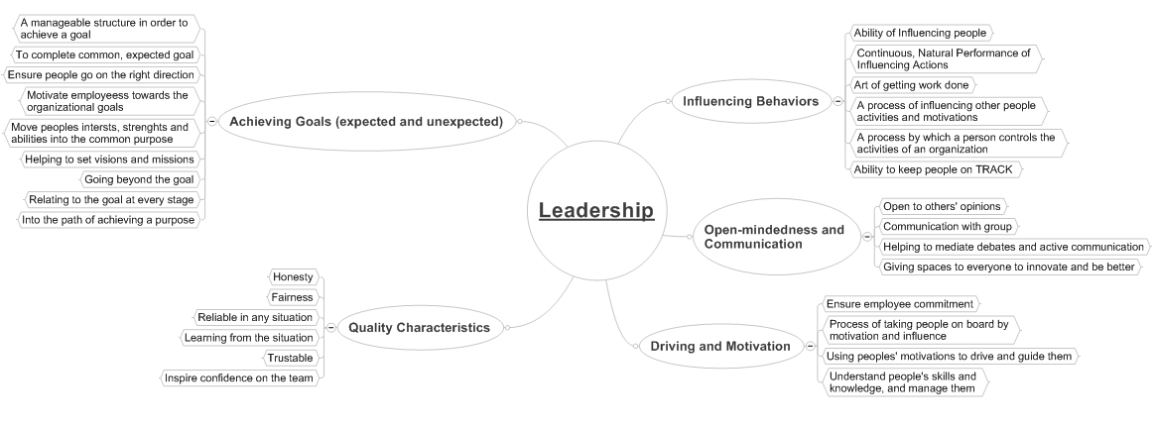
Mind-map

Slide 3
The Proposed Definition
“ The art of driving the thoughts and actions of a group/ individual by influencing, motivating and directing it towards a common goal through effective communication and respect based relationships.”
-Team III

