Slide 1
TEAM A3

Slide 2

PRESENTS:
©Copyright

Slide 3

PERFORMANCE APPRAISAL
FEATURING:
JUAN CARLOS OTALORA SUPRATEEK ROY

Slide 4

AGENDA:
DEFINITION
POSITIVE & NEGATIVE ASPECTS
BEHAVIOURS
MOTIVATION
TEAMWORK
TEAM SUGGESTIONS (PA)
CONCLUSIONS

Slide 5

DEFINITION:
Part of Performance management.
Method of performance evaluation.
Is an analysis of employees successes and
Failures.
Comparison between goals and
Achievements.
Systematic Review of a person work on
A determined period of time.

Slide 6



KEY ASPECTS OF PA
The five key elements of the performance appraisal are:
Measurement
Feedback
Positive reinforcement
Exchange of views
Agreement
Notes:
The five key elements of the performance appraisal are:
Measurement – assessing performance against agreed targets and objectives.
Feedback – providing information to the individual on their performance and progress.
Positive reinforcement – emphasising what has been done well and making only constructive criticism about what might be improved.
Exchange of views – a frank exchange of views about what has happened, how appraises can improve their performance, the support they need from their managers to achieve this and their aspirations for their future career.
Agreement – jointly coming to an understanding by all parties about what needs to be done to improve performance generally and overcome any issues raised in the course of the discussion.

Slide 7

POSITIVE & NEGATIVE ASPECTS
Behaviours
Positive Aspects
well defined tasks and responsibilities (Edmonstone, 1996, p. 9)
efficient management control tool (Edmonstone, 1996, p. 11)
jeopardizes: systems & Business performance (Scholtes, 1993)
deprives people of their commitment (Solanti, Meer and Williams, 2005, p. 212)
Negative Aspects
limits people’s long-term views (Solanti, Meer and Williams, 2005, p. 212)
spreads fear and distrust among employees (Solanti, Meer and Williams, 2005, p. 214)

Slide 8
POSITIVE & NEGATIVE ASPECTS
Motivations
Positive Aspects
opportunity for performance measurement (Edmonstone, 1996, p. 9)
development of company’s mission and objectives (Edmonstone, 1996, p. 9)
Jeopardizes: Motivation (Scholtes, 1993)
Employees are blamed for mistakes and underperformance
Negative Aspects
Focus is on quantity, not quality (Solanti, Meer and Williams, 2005, p. 212)
justification for reward schemes (Edmonstone, 1996, p. 9)
opportunity for staff development (Edmonstone, 1996, p. 10)

Slide 9
POSITIVE & NEGATIVE ASPECTS
Teamwork
Positive Aspects
jeopardizes: Teamwork (one will care only for one’s own performance level) (Scholtes, 1993)
Negative Aspects
enhanced communication between managers and employees (Edmonstone, 1996, p. 11)

Slide 10
Team suggestions about PA:
Continuous Evaluation of development - Analysis
Goals based on employees and managers agreement
Training & Support Documentation
Assessment done by co-workers, employees, superiors (360°) - Objectivly
Self-assessment
Evaluation of people’s potential – improvement process
Fair assessment by third-party
Team performance appraisal may be considered
Positive reinforcement and criteria setting
Scope for reflection and analysis

Slide 11







CONCLUSIONS
Performance appraisal is present in every context
Many advantages when the system is designed and used properly
Employees decisions and careers
Commitment and Satisfaction
Performance management
Administrative purposes
Between person, within person, systems maintenance and documentation
Managing not measuring (un-measurable)

Slide 12
TEAM A3
Juan Otalora Rey
Awal Takkar
Ting Zhao
Ayham Fattoum
Suprateek Roy
Marcin Czajkowski
Control
Speak Up
Punctuality
Criticism
Contributions

Slide 13
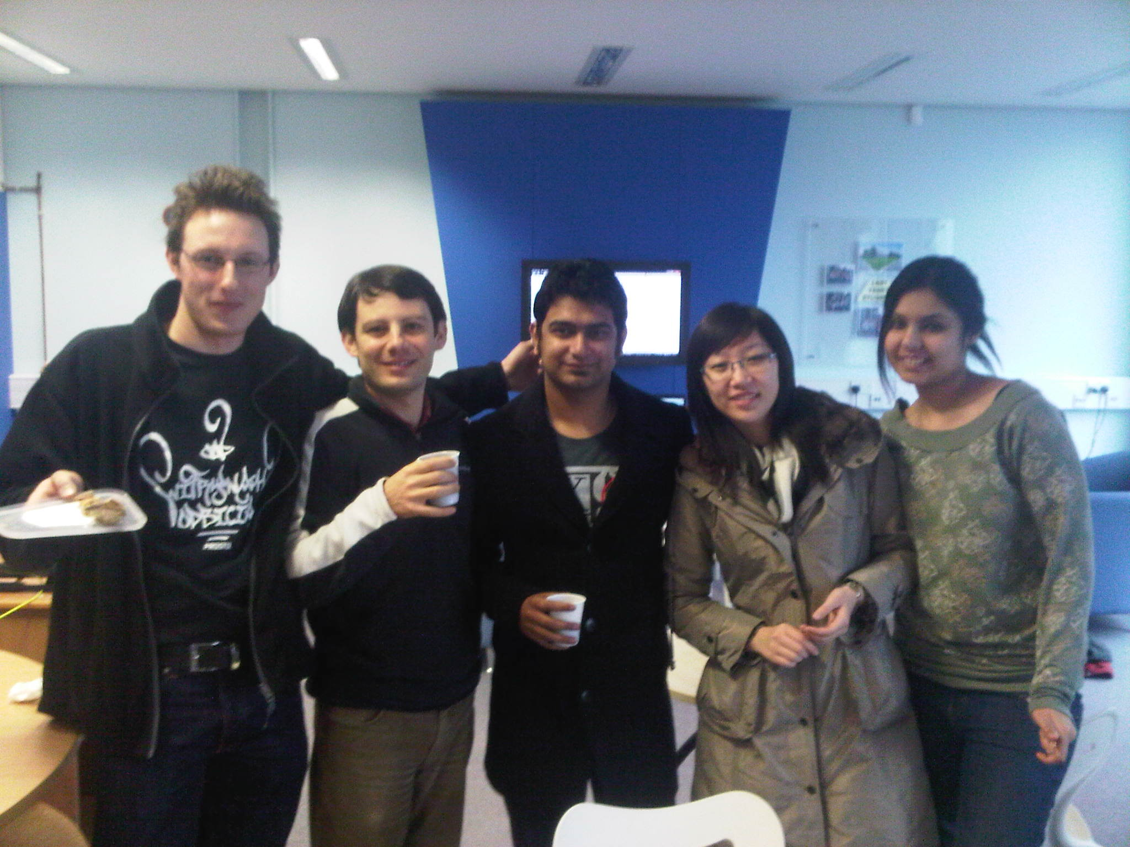
But most importantly
Thank You!!

Slide 14

QUESTIONS??

Slide 15
References
Danielle S. Wiese and M. Ronald Buckley (1998). The evolution of the performance appraisal process. Journal of Management History, 4 (3), pp. 233-249. © MCB University Press.
Deborah F. Boice and Brian H. Kleiner (1997). Designing effective performance appraisal systems. Work Study, 46 (6), pp. 197–201, MCB University Press.
Edmonstone, J. (1996). Appraising the state of performance appraisal. Health Manpower Management, 22, 6, 9-13.
FLETCHER CLIVE. (1985). Performance appraisal for career development. [S.l.], Pub By Bu.
Halachmi, A. (2005). Performance measurement is only one way of managing performance. International Journal of Productivity and Performance Management, 54, 7, 502-516.
HEATH, G. (1989). Staff development, supervision and performance appraisal. Harlow, Longman.
http://www.cipd.co.uk (The Chartered Institute of Personnel and Development)
http://www2.warwick.ac.uk/fac/sci/wmg/ftmsc/modules/modulelist/le/sessions/ (Module Notes)
Scholtes, P. R. (1993). ‘Total quality or performance appraisal: choose one’, National Productivity Review, 12(3), pp. 349– 363.
Solanti, E., & Meer, R., & Williams, T. (2005). A Contrast of HMR and TQM Approaches to Performance Management: Some Evidence. British Journal of Management, 16, 211-230.
WILLIAMS, M. R. (1972). Performance appraisal in management. London, Heinemann.

