Slide 1
WaveRiders
Winning Strategy
Deployment for Continuous Improvement
Team 3
Juan Carlos Otalora-Rey,
Awalpreet Kaur Takkar,
Yuting Zhao,
Ayham Fattoum,
Suprateek Roy,
Marcin Czajkowski

Slide 2




Hoshin Kanri (Policy Deployment)
Typical Organisation
Aligned Organisation
High performance
Low performance
Source: Hutchins,2008
Notes:
Constancy of purpose (first point of Deming’s 14 points)
Clarity of Vision
Opinion Based
Departmental Goals & Organisational Goals
People Commitment

Slide 3






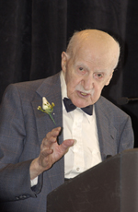
Hoshin Kanri: Success story
(1954) Juran
(1958) “Policy & Planning”
(1964) Bridgestone Hoshin Kanri
(1990s) Worldwide
(1970) Japanese Common use
Source: Lee & Dale, 1998

Slide 4
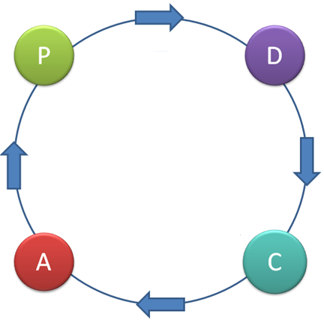
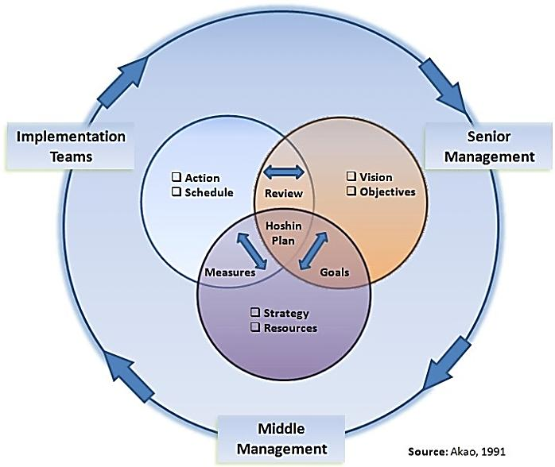
Hoshin Kanri: Approach
Source: Akao, 1991
Notes:
Hoshin Kanri is the step by step planning, implementation and review process of managed change.

Slide 5
Hoshin Kanri vs. Balanced Scorecard
Increases interdepartmental cooperation
The planning process is continuously improved, uses and reinforces Plan-Do-Check-Act
Creates disciplined planning system that is responsive and flexible
Creates a common focus throughout the organization
Planning is systematic
Pros
Long term commitment
The breakthrough objective must be stable during a 3-5 year period
Cons

Slide 6
Hoshin Kanri vs. Balanced Scorecard
Hoshin
Kanri
Breakthrough performance, alignment, and integrated targets for all levels
Balanced
Scorecard
Catchball
Comprehensive
Measurement
Notes:
BS minimizes information overload
Forces managers to focus on the handful of measures that are most critical.

Slide 7
Policy Deployment: Overview
CHECK
ACT
PLAN
DO
Current situation
Target setting
strategic deployment plan
Implementing plan
Review
Source: Lee & Dale, 1998
Notes:
Different researchers say that HK is PDCA applied. Some say starting with A, some say with C. We realized that this (CAPD) is the sequence in which we apply it and it suits our situation.

Slide 8
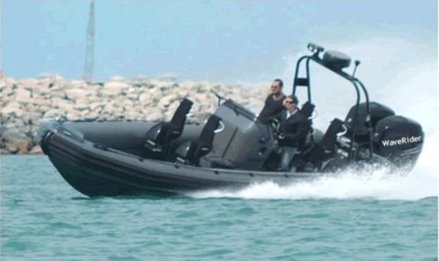
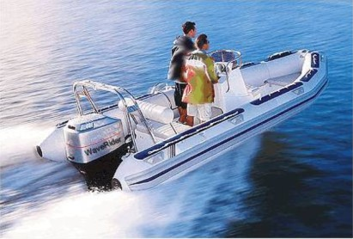
Current situation
WaveRiders
Check
Business performance has been in decline over the last 5 years:
Declining profits
Falling sales
Overproduction
High stockholding
Rising costs or inefficiency
ROCE decreased, due to capital inefficiency
Poor debt recovery or lack of investment
Overproduction, large quantities of stock
Falling returns
Stagnant UK Market
Constant Market share over five years
SeaHorse
SeaSpray
Notes:
In the first, (CHECK) stage, we define first, our current scenario

Slide 9
Current situation
WaveRiders
Check
= WaveRiders
= Surf ZA
= Hagen
Production Differentiation
Products/ Market | UK(%) | EU(%)
SeaSpray | 95 | 5
SeaHorse | 90 | 10
Worse products
Better products
Other markets
Product Distribution
ZA
H
WR
UK market
Market Matrix
Porter Matrix for Competitor Analysis
Notes:
Further, within the check stage, we analyse Wave-riders against the background of the market.

Slide 10
SWOT
WaveRiders
Check
Strength
Weaknesses
Opportunities
Threats
Better product than competition
Trained staff
Good production potential
Inefficient use of Human Resource
Stagnant market share over past five years
Higher price as compared to competition
Complex discounting system
Improvements in marketing techniques, distribution channels
Explore foreign markets
Explore new customers
Severe market conditions in UK since past five years
Stagnancy of UK market
Competition- price competitiveness
Notes:
As a result of our analysis, we do the SWOT of the current scenario, so as to further realise our potential, and develop upon it.

Slide 11
Ideal future state
Stakeholder’s interest
Company activities
To become a leader in the market of inflatable boats within Europe and UK
WaveRiders
ACT
Reorganize Finance and HR departments
Invest new technology
Reorganize the sales team
Increase price by 2.5%
Open new market
Strategy 3
Notes:
In the ACT stage we discuss how we develop the vision and the strategy to improve upon our current scenario

Slide 12
X-Matrix Approach
WaveRiders
PLAN
 |  |  |  |  |  |  | Policy Deployment - X Matrix
 |  |  |  |  |  | 5
 |  |  |  |  |  | 4
 |  |  |  |  |  | 3
 |  |  |  |  |  | 2
 |  |  |  |  |  | 1
 |  |  |  |  |  |  |  |  |  |  |  |  | RESOURCES
 |  |  |  |  |  | A | Gain substantial European market share
 |  |  |  |  |  | B | Increase the profits after tax to £1m
 |  |  |  |  |  | C | Increase sales to £15m
 |  |  |  |  |  | D | Improve company reputation through quality
 |  |  |  |  |  | E | Reduce the operating costs by 10% improving efficiency
Improvement Priorities
Annual Objectives
Targets to Improve
5 Year
Breakthrough Objectives
WHAT

Slide 13
X-Matrix Approach
WaveRiders
 |  |  |  |  |  | Policy Deployment - X Matrix
 |  |  |  |  | 5
 |  |  |  |  | 4
 |  |  |  |  | 3
 |  |  |  |  | 2
 |  |  |  |  | 1
Reorganize Finance and HR departments | Invest new technology | Reorganize the sales team | Increase price by 2.5% | Research European Market |  |  |  |  |  |  |  | RESOURCES
 |  |  |  | X | A | Gain substantial European market share
 |  |  | X |  | B | Increase the profits after tax to £1m
 |  | X |  |  | C | Increase sales to £15m
 | X |  |  |  | D | Improve company reputation through quality
X |  |  |  |  | E | Reduce the operating costs by 10% improving efficiency
How FAR
Improvement Priorities
Annual Objectives
Targets to Improve
5 Year
Breakthough Objectives
PLAN

Slide 14
X-Matrix Approach
WaveRiders
 |  |  |  |  |  | Policy Deployment - X Matrix
 | X |  |  |  | 5 | Improving the quality and productivity
X |  |  |  |  | 4 | Improving the organization structure by moving wages and salaries manager into financial department
 |  |  |  | X | 3 | Research pricing structure, discounting, distribution, competition, product, and safety specifications in European market
 |  |  |  | X | 2 | European sales representative in the rescue sales team
 |  | X |  | X | 1 | Hire additional two leisure sales people (3Ex + 3In)
Reorganize Finance and HR departments | Invest new technology | Reorganize the sales team | Increase price by 2.5% | Research European Market |  |  |  |  |  |  |  | RESOURCES
 |  |  |  | X | A | Gain substantial European market share
 |  |  | X |  | B | Increase the profits after tax to £1m
 |  | X |  |  | C | Increase sales to £15m
 | X |  |  |  | D | Improve company reputation through quality
X |  |  |  |  | E | Reduce the operating costs by 10% improving efficiency
How
Improvement Priorities
Annual Objectives
Targets to Improve
5 Year
Breakthough Objectives
PLAN

Slide 15
X-Matrix Approach
WaveRiders
 |  |  |  |  |  | Policy Deployment - X Matrix
X | X |  |  | X | 6 | Introducing new financial package for Euros |  |  |  |  | x
 | X |  |  |  | 5 | Improving the quality and productivity |  | x |  | x
X |  |  |  |  | 4 | Improving the organization structure by moving wages and salaries manager into financial department |  |  |  |  | x
 |  |  |  | X | 3 | Research pricing structure, discounting, distribution, competition, product, and safety specifications in European market | x |  | x
 |  |  |  | X | 2 | European sales representative in the rescue sales team | x
 |  | X |  | X | 1 | Hire additional two leisure sales people (3Ex + 3In) | x |  | x |  | x
Reorganize Finance and HR departments | Invest new technology | Reorganize the sales team | Increase price by 2.5% | Research European Market |  |  | Increase the ratio of sales in Europe to UK to 40/60 | Reducing waste and defects by 20% | Achieve winning promotional strategies to a market spend of £250k | Capital expenditure of £150k on technological advancement | Reduce administrative costs by 10% | RESOURCES
 |  |  |  | X | A | Gain substantial European market share
 |  |  | X |  | B | Increase the profits after tax to £1m
 |  | X |  |  | C | Increase sales to £15m
 | X |  |  |  | D | Improve company reputation through quality
X |  |  |  |  | E | Reduce the operating costs by 10% improving efficiency
PLAN
Improvement Priorities
Annual Objectives
Targets to Improve
5 Year
Breakthough Objectives
How much

Slide 16
X-Matrix Approach
WaveRiders
 |  |  |  |  |  | Policy Deployment - X Matrix
X | X |  |  | X | 6 | Introducing new financial package for Euros |  |  |  |  | x |  |  |  | x
 | X |  |  |  | 5 | Improving the quality and productivity |  | x |  | x |  |  |  |  |  |  | x
X |  |  |  |  | 4 | Improving the organization structure by moving wages and salaries manager into financial department |  |  |  |  | x |  |  |  | x
 |  |  |  | X | 3 | Research pricing structure, discounting, distribution, competition, product, and safety specifications in European market | x |  | x |  |  |  | x
 |  |  |  | X | 2 | European sales representative in the rescue sales team | x |  |  |  |  |  |  |  | x |  |  |  | x
 |  | X |  | X | 1 | Hire additional two leisure sales people (3Ex + 3In) | x |  | x |  | x |  |  |  | x |  |  |  | x
Reorganize Finance and HR departments | Invest new technology | Reorganize the sales team | Increase price by 2.5% | Research European Market |  |  | Increase the ratio of sales in Europe to UK to 40/60 | Reducing waste and defects by 20% | Achieve winning promotional strategies to a market spend of £250k | Capital expenditure of £150k on technological advancement | Reduce administrative costs by 10% | RESOURCES
 |  |  |  |  |  |  |  |  |  |  |  | MD |  |  | FD |  | PD |  | HR
 |  |  |  | X | A | Gain substantial European market share
 |  |  | X |  | B | Increase the profits after tax to £1m
 |  | X |  |  | C | Increase sales to £15m
 | X |  |  |  | D | Improve company reputation through quality
X |  |  |  |  | E | Reduce the operating costs by 10% improving efficiency
Improvement Priorities
Annual Objectives
Targets to Improve
5 Year
Breakthough Objectives
PLAN

Slide 17
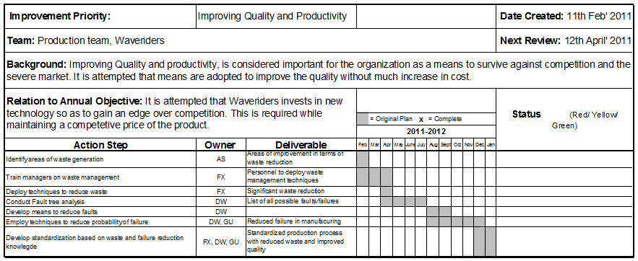
Action Plan
WaveRiders
DO

Slide 18
Self-Assessment
Review
Monthly Gantt Chart checks and updates
Revision of actions where required
Annual assessment of X-matrix objectives
Generation of new X-matrix

Slide 19
How it Works?

Slide 20
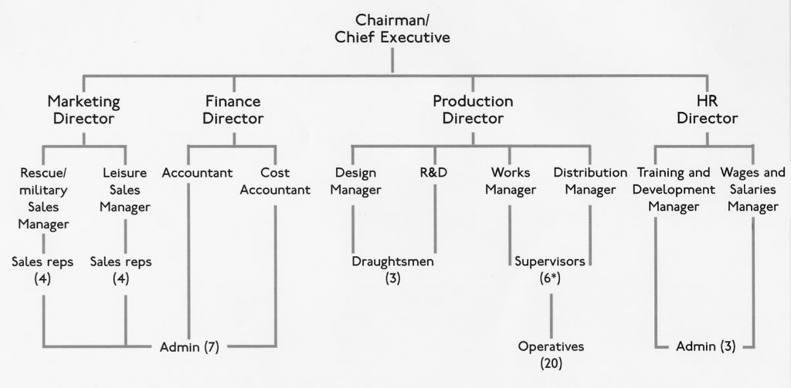
Catchball
WaveRiders

Slide 21
The Challenge
WaveRiders
Long term commitment
The breakthrough objective must be stable during a 3-5 year period

Slide 22
2011 BUSINESS PLAN
WaveRiders
VISION
To become a leader in the market of inflatable boats through achieving a substantial share of the European market, and be recognized for constant focus on customer-satisfaction and quality.
PURPOSE
The purpose of this plan is to communicate through all levels of the organisation, the new business strategy, which is being aimed at, through realization of a shared goal, and hence deriving the means to achieve it.
OBJECTIVES
Gain substantial European market share
Improve company reputation through quality

Slide 23
Conclusion
WaveRiders
“It is not enough to do your best; you must know what to do, and then do your best.”
W. Edwards Deming

Slide 24
References
Newcomb, J.E. (1989), “Management by policy deployment”, Quality, Vol. 28 No. 1, pp. 29-30.
Lee, R. G., & Dale, B. G. (1998). Policy deployment: an examination of the theory. International Journal of Quality and Reliability Management, 15, (5), 520-540.
Akao, Y. (1991). Hoshin Kanri policy deployment for successful TQM. Productivity Press: Weston
Hutchins, D. (2008). Hoshin Kanri the strategic approach to continuous improvement. Gower House: England
Kaplan, R.S., and Norton, D.P. (1992). The Balanced Scorecard - Measures that Drive Performance. Harvard Business Review: Boston
Makarenko, Y. M. (1981), ‘X-matrix simplex method’, Dokl. Akad. Nauk SSSR,259, No. 1, Pp 30-33.

Slide 25
Thank you
Questions/ Suggestions Welcome..

