Slide 1

Leadership
& Excellence
Fani Dimopoulou,
Thomas Kandrikal,
Surya Saha,
Ji Shen,
Ivaylo Stoykov,
Miia Zhang
Team 4 / MBE-LE

Slide 2
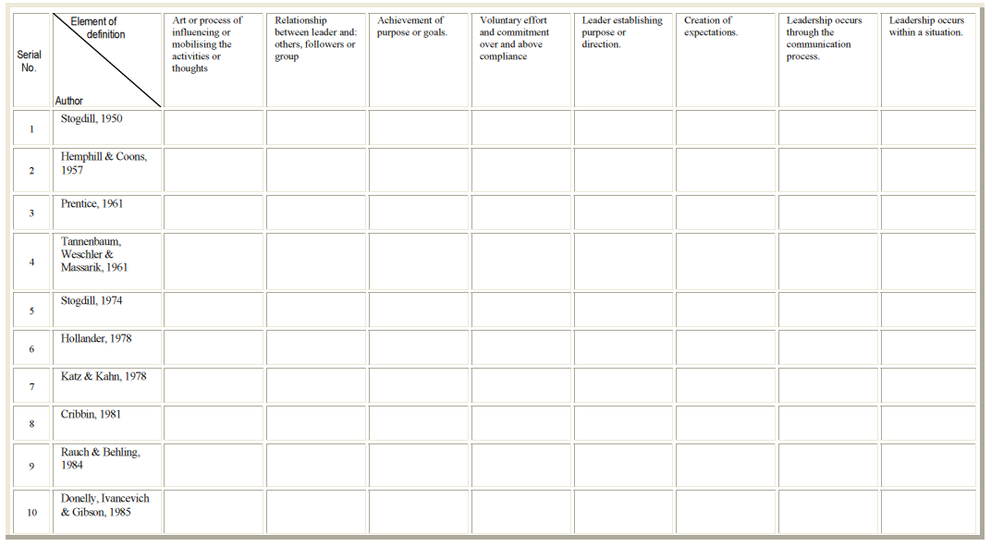
Analysis Matrix 1/2

Slide 3
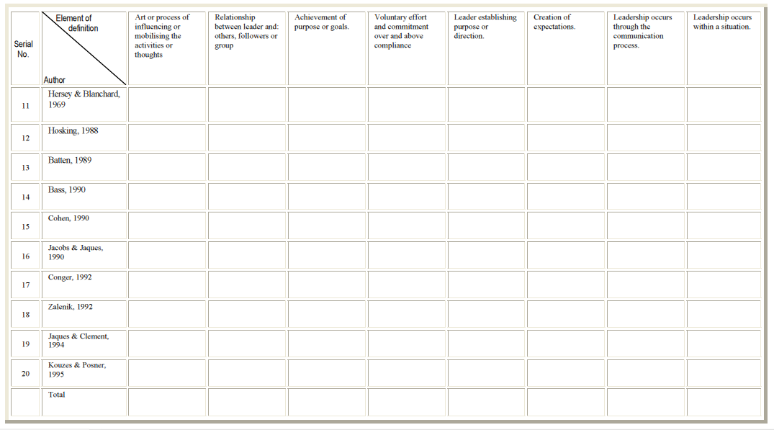
Analysis Matrix 2/2
15
8
11
2
4
4
2
3

Slide 4
Team’s Definition of Leadership
Leadership is the art of motivating the activities or thoughts of individuals through building relationships between the leader and the followers towards goal achievement.

