Slide 1
Corporate Social Responsibility
Fani Dimopoulou
Thomas Kandrikal
Surya Saha
Ji Shen
Ivaylo Stoykov
Miia Zhang
Team A4 – Leadership & Excellence / MBE
23/02/2011

Slide 2
Content
Part Ⅰ: CSR and Marine Industry
Definition of CSR
Leisure Marine Industry Concerns on CSR
The Best CSR Practices
Part Ⅱ: Implementation of CSR in WaveRiders
Leadership, Vision and values
Workforce Activities
Supply Chain Activities
Marketplace activities
Community Activities
Environmental Activities

Slide 3
Definition
World Business Council
  “The continuing commitment by business to behave ethically and contribute to economic development while improving the quality of life of the workforce and their families as well as of the local community and society at large.”
The European Commission
  “Being socially responsible means not only fulfilling legal expectations, but also going beyond compliance and investing more into human capital, the environment and relations with stakeholders.”

Slide 4
Pyramid of CSR
Philanthropic
Responsibility
Ethical Responsibility
Legal Responsibility
Economic Responsibility
Engaging in philanthropy is desired.
Behaving ethical is expected.
Obeying the law is required.
Making profit is the required foundation.
Pyramid of CSR by Archie B. Carroll.
Source: individual illustration in dependence on Carroll 1996: 39 and Schranz 2007: 28.

Slide 5
Sustainable Development
- non air and water pollution
- use environmentally friendly
wrapping
- carry out company recycling
- use waste reduction program
- carry an energy-conservation
program
- use recycling materials in
production
- promote ethical workforce behavior
- provide for safe workplace
- adhere non discrimination policies
- prevent sexual harassment at the workplace
- make an allowance for medical costs and treatment
- help find placement for displaced workers
- engages in philanthropic giving to education and donate to charity
- employ polite and obliging workforce
Corporate Social Responsibility
- ensure safety of goods and services
- law obedience in all areas of business
- not to use delusive advertising
- quick respond to customer interests
- constant attempt for quality improvement of products
- not engage in illegal, non fair business practice in the past and future
Economic Responsibility
Environmental Responsibility
Social Responsibility
Legal Responsibility
Transparency
Corporate Giving
Corporate Volunteering
Source: individual illustration in dependence on Mayerhofer/Grusch/Mertzbach 2008: 8. and Marrewijk van 2003: 101. and Kohl 2006: 10.

Slide 6
Leisure Marine Industry Concerns on CSR
The UK leisure marine industry came together in Nov 2009 to commit to putting sustainability at the heart of what it does
  Use sustainability to drive performance and cut costs
  Sustainability is not just a moral issue, but a financial one too.
  Concentrated on 3 main issues : resource efficiency, waste management, green purchasing
Source from Greenwise, 2009

Slide 7
The Best CSR Practices Among Our Contemporaries

Slide 8
The Best CSR Practices in Marine Industry
Pollution Avoidance and Control
Waste Management
Chemical Management
Percentage of profits to finances for social responsibilities projects
Community Responsibility, Education and Involvement
Environmental Management
Renewable Energy and Resource Efficiency

Slide 9
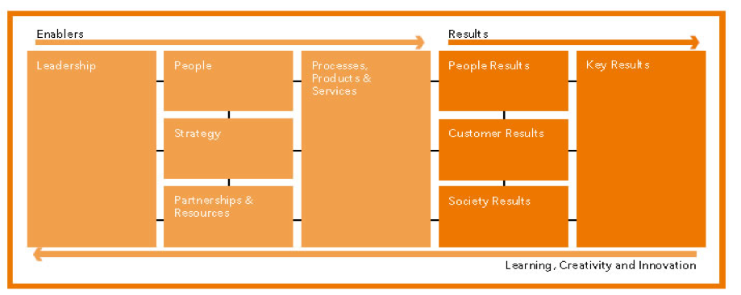
The Excellence Model and CSR
CSR Activities
CSR Activities
CSR Activities
CSR Activities
CSR Activities
Source adopt from EFQM, 2010

Slide 10
Implementation of CSR in WaveRiders
Leadership, Vision and Values
Environmental Activities
Workforce Activities
CSR in WaveRider
Community Activities
Supply Chain Activities
Marketplace Activities

Slide 11
Leadership, Vision and Values
Ethical leadership
  Defining a clear position on political contributions
  Combating corruption and bribery
  Refraining from aggressive tax-avoidance procedures
Putting it into practice
  Empowering people
  Training on ethics and CSR
Policies and procedures
  Developing policies
  Integrating CSR into corporate governance

Slide 12
Workforce Activities
Employee communication
Ensuring employee development
Diversity and equality
Pay policies and work-life balance
Health, safety and hygiene

Slide 13
Supply Chain Activities
Being a fair customer
  Agreeing honest and fair terms with suppliers
  Ensuring fair pricing
Driving standards through the supply chain
  Screening suppliers for compliance with social and environmental standards
  Monitoring social and environmental performance of suppliers
  Applying CSR standards throughout the supply chain (SA8000)
  Promoting fair trade
  Setting targets for suppliers
  Embedding policies to exclude child and forced labour
Promoting social and economic inclusion via the supply chain
  Providing access for suppliers run by minority groups
  Providing access for small and local suppliers
  Stimulating a sustainable local economy

Slide 14
Marketplace Activities
Responsible customer relations including marketing and advertising
  No misleading advertising
  Clear product information (safety environmental)
  Linking sales to charitable organisation
  Listening to customers feedback and suggestions for new product
Product responsibility
  Sourcing raw material to disposal at the end of its useful life
  Introducing potential harmful effect of use
  Vulnerable consumer protection
  Consider life-cycle of the product
Ethical competition
  Ensure fair price
  Avoid unreasonable acts in sales (high pressure selling techniques, sales bonus system)

Slide 15
Community Activities
Supporting charity
Engaging in partnerships with community organizations
Promoting the company in partnership with supported organization
Donate for reasonable causes
Sponsoring

Slide 16
Environmental Activities
Resource and energy use
  Running awareness initiatives for employees on efficient energy and resource use
  Using ‘green’ technologies
  Improving energy efficiency
  Purchasing ‘green’ materials
Pollution and waste management
  Reusing and recycling
  Treating emissions
Environmental product responsibility
  Managing the supply chain for environmental benefit
  Certifying and labelling products
Transport planning
  Reducing goods transport

Slide 17
Conclusions
Better anticipation and management of an ever-expanding spectrum of risk.
Improved reputation management.
Improved innovation, competitiveness and market positioning.
Improved ability to attract and build effective and efficient supply chain relationships.
Improved relations with regulators.
Notes:
Prepare slides for the appendix in the event that more details or supplemental slides are needed. The appendix is also useful if the presentation is distributed later.

Slide 18
References
Burchell, J. (2008), Just what should business be responsible for? Understanding the concept of CSR. In: Burchell, Jon (ed.): The corporate social responsibility Reader. New York: Routledge. 77-83.
Carroll, A. B. (1996), Business & Society. Ethics and Stakeholder Management 3rd Edition. Cincinnati, Ohio: South Western College Publishing.
EFQM (2010), EFQM Excellence Model, http://www.efqm.org/en/tabid/132/default.aspx, / [access: 20/02/2011
Forthports (2011) CSR in Foeth Ports, http://www.forthports.co.uk/ports/aboutus/csr/ [access: 20/02/2011]
Greenwise, (2009), Leisure Marine Industry Commits to Action Sustainability, http://www.csrinternational.org/?tag=rya/ [access: 20/02/2011]
Kohl, A. (2006), Konzepte und Widersprüche bei der Anwendung von Corporate Social Responsibility mit besonderer Berücksichtigung der lindustrie. Diplomarbeit der Wirtschaftsuniversitt Wien.
Marrewijk V. M., Werre, M. (2003), Multiple Levels of Corporate Sustainability. In: Journal of Business Ethics, Vol. 44. 107-119. http://www.springerlink.com/content/gx6676pw16574338/fulltext.pdf / [access: 20/02/2011]
Mayerhofer, W., Grusch, L. and Mertzbach, M. (2008), Corporate Social Responsibility. Einfluss auf die Einstellung zu Unternehmen und Marken. Wien: Facultas Verlags- und Buchhandels AG.
Perrini, F., Pogutz, S. and Tencati, A. (2006), Developing Corporate Social Responsibility. A European perspective. Cheltenham, Northampton: Edward Elgar Publishing.

Slide 19
Thank you

