Slide 1
Promotion & Firing Policy
Fani Dimopoulou
Thomas Kandrikal
Surya Saha
Ji Shen
Ivaylo Stoykov
Miia Zhang
Team A4 – Leadership & Excellence / MBE
23/02/2011

Slide 2
Presentation’s Outline
Understanding Jack Welch’s approach
Framing Jack Welch’s approach with SoPK
Analyzing the impact

Slide 3
Understanding Welch’s approach
A Company that bets its future on its people must remove that lower 10%, and keep removing it every year—always raising the bar of performance and increasing the quality of its leadership (General Electric, 2000, p.4)

Slide 4
Welch’s journey to Leadership
Project Manager of the PPO product sales
(1960)
Bureaucracy
General Manager of the entire plastics division
(1968)
General Manager of the entire chemical metallurgical division (1971)
Experiencing losses
CEO
(1973)
Lack of faith by top managers “contingency leader”
Standardized raises for all first year employees
High external competition
One main failure
Too many levels of management - 29

Slide 5
Forced Ranking
Redundancy
Cost cutting
Strong Proponents of Performance Management
A handy grading tool for creating a high-performing culture
Enables managers to better manage low performers
Vitality
Curve
Jack Welch – an enthusiastic supporter of forced ranking

Slide 6
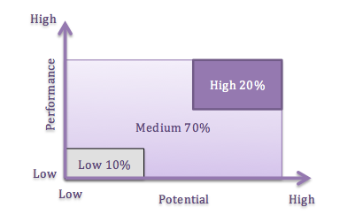
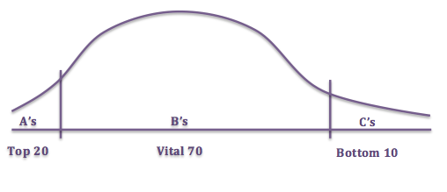
The Vitality Curve
The top 20% were considered the future leaders of the organization (Player A).
The vital 70% were the solid worker-bee performers that could be counted on day-in and day-out to consistently perform their jobs(Player B).
The bottom 10% was fired(Player C).

Slide 7
Vitality Curve in GE
Implementation period : 1981- 1988 (Batlett C. et al, 2005)
Characteristics: - used only for upper management
- excess manager capacity supported the VC implementation
- used as a sorting tool / part of a larger management system
- Need for legal backup on firing decisions
-Progressively higher performing work force
EXAMPLES:
Acme Services Company
Enron, Accenture,
deloitte, PwC
Benefits: - 28 fold increase in earnings
- 5 fold increase in revenue
- kept the best talented people

Slide 8
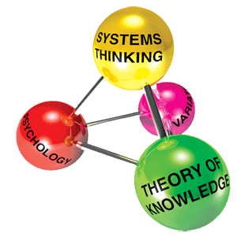
Framing Welch’s approach with SoPK
Individual responsibility
Internal competition
Budgeting
Strict policy
Levels of hierarchy
Performance rating
Individual contribution undermining team spirit
Repress creativity & innovation
Part of all strata of management
Lower moral, productivity & communication
Interdepartmental relationships
Lack of measure techniques for loyalty
Change in performance levels

Slide 9


SoPK Welch’s approach
 | Appreciation of system | Theory of knowledge | Psychology of change | Knowledge of variation
People
Reward
Leadership
System Improvements
Process
SoPK
Jack Welch
- NAND
- Contradicting
- Agreeing
Source: Team’s brainstorming

Slide 10


Conclusions
Conclusions
10
Unsatisfied top performers due to inadequate distinction from high-level peers
Sabotage colleagues
Or
Cheating the system
Constant stress
Fluctuations in employees’ moral
Fact:
It was used for 7 years.
Was it efficient?
Logic
Effect on behaviour
Validity
Is it logical to reduce10% of your employees every year?
Is it logical to have fixed criteria for ranking?
Is it logical to have a strict policy?

Slide 11

Further Discussion
Contradictory articles on :
        How the vitality curve was implemented in GE (period)
        To whom it was implemented in GE
Notes:
On going through the literature available on the vitality curve we found contradictory articles on two main aspects.
The first being the period during which it was implemented and the second aspect being to what catagories of employees it was implemented to: either the entire organisation or was it just concentrated to the top management

Slide 12
References 1/2
Abetti, A. (2006) "Case Study: Jack Welch’s Creative Revolutionary Transformation of General Electric and the Thermidorean Reaction (1981–2004)",CREATIVITY AND INNOVATION MANAGEMENT JOURNAL, Vol.15 Iss.01
Anderson, V. R. (2010), ‘How Internal Competition Destroys Morale and Inhibits Productivity’, The Journal for Certified Managers.17(2) 151-166
Bartlett, C. A., & Wozny, M. (2005, May 3). GE's Two-Decade Transformation: Jack Welch's Leadership. Harvard Business School
Davis, G. and Olson, C.(2003) "PROS AND CONS OF FORCED RANKING AND OTHER RELATIVE PERFORMANCE RANKING SYSTEMS", Society for Human Resource Management [electronic version] Retrieved 10-02-2011 from http://www.nichols.edu/currentstudents/academicresources/faculty/lgmoore/hrm213/performance_appraisal/Pros%20and%20cons%20of%20forced%20ranking.doc

Slide 13
References 2/2
Davis, P. and Rogers, B. (2005), ‘Managing the “C” Performer: An Alternative to Forced Ranking’, Development Dimensions International
Hazels, B., & Sasse, C. M. (2008). Forced Ranking: a review. SAM Advanced Management Journal , volume 73 source issue:2.
Jack, W. and Byrne, A. J. (2003), Jack: straight from the gut, Warner Books
Olson, C. A., & Davis, G. (2003). Pros and Cons Of forced Ranking and other Relative Performance Ranking Systems.
Richard C.Grote. (2005). Forced ranking: making performance management work. U.S.A: Harvard Business School Press.
Schultz, L. E. (1994). Profiles in quality. New York: Quality Resources.
Waters, R. C. (2009). Evolution of Leadership Development at General Electric. Engineering Management Journal

Slide 14
Thank you

