Slide 1
Promotions and firing policy
In Deming’s world
How this may affect the performance of the system
Team B2:
Vagelis Kitsos
Aditi Mittal
Usama Nadeem
Nandia Ntikou
Rong Wan
Zain Waseem

Slide 2
Agenda
Introduction
Deadly disease / SoPK
Effects
Appreciation for a system
Knowledge about variation
Theory of knowledge
Psychology
Conclusion

Slide 3
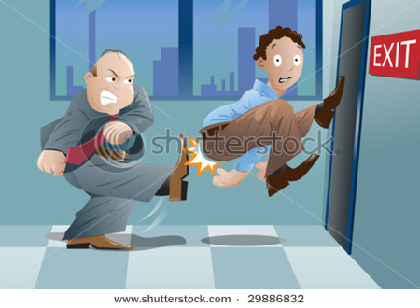
Introduction
Jack Welch, CEO of GE Corporation and Six Sigma Guru stated
“A company that bets its future on its people must remove the lower 10%...and keep removing it every year”
Annually out of 10 people:
  2 should be promoted
  7 should stay where they are
  1 should be sacked
References: MBE web-site, (2011)

Slide 4
Deadly disease / SoPK
Evaluation of performance, merit rating, or annual review
Appreciation for the system
Knowledge about Variation
Theory of Knowledge
SoPK
14
Points
Psychology
References: Deming, (2000:101) ; Deming, (1994:92)

Slide 5
Effects
Nourishes short-term thinking
Annihilates long term planning
Builds Fear
Demolishes team work
Increase competition
Destroys people psychology, make them feel inferior
It is unfair (Problems are caused by the system)
References: Deming, (2000:101)

Slide 6
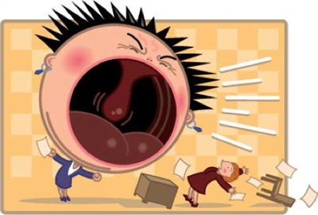
Appreciation for a system
P.1:Create constancy of purpose for staying in business
P.3:Eliminate inspection by building quality from the first point
P.4: End the practice of awarding business on the basis of price
P.5:improve constantly the system of production for decreasing the total costs
P.9: Break down barriers between department
P.11: Eliminate quotas and management by objectives. Substitute leadership
P.14: Put everyone to accomplish transformation
The one who is under the goal tries to compete and beat the better one
Everyone propels for his own good
Doing well in the system not for the system
Short term thinking for achieving the targets
Vagelis (Fear)
System Performance
Aditi
(Purchasing)
Lucy
(Manufacturing)
Nadia
(Marketing/Sales)
Zain
(Logistics)
Usama
(Service)
References: Deming, (2000: 23:101) ; Deming, (1994:92)
Notes:
The one who is under the goal tries to compete and beat the better one
Everyone propels for his own good. Doing well in the system not for the system

Slide 7
Appreciation for a system
System Performance
James (Purchasing)
Nick (Manufacturing)
Ian
(Marketing/Sales)
Vagelis
(Logistics)
Maria
(Service)
References: Deming, (2000: 23:101) ; Deming, (1994:92)

Slide 8
Knowledge about variation
Differences of people’s performance arise entirely from the system
There is no fair rating
Some people will be lucky
The one that is outside the limits. There is no indicator that it will continue to operate in that performance next year
U.L
L.L
The one that doesn’t doing his best for the group will be find his way into an other work or job
References: Deming, (2000:101) ; Deming, (1994:92)
Notes:
Differences of people’s performance arise entirely from the system
Outstanding performance is when someone is outside of the limits or it creates a pattern
The one that is outside the limits. There is no indicator that it will continue to operate in that performance next year. Management should on one hand see what is the special cause and then take action.
The one that doesn’t doing his best for the group will be find his way into an other work or job
Some people will be lucky

Slide 9
Theory of knowledge
People have to show something
They must keep their job safe from firing (No risk)
P: 13: Institute a vigorous program of education and self assessment
Theory
Practice
D
S
P
A
There is no substitute for Knowledge
References: Deming, (2000: 23:101) ; Deming, (1994:92:132)
Notes:
People must show something. Without theory for doing it better. They must keep their job safe from firing (No risk)
People are not contributing with knowledge into the company. But wit what is necessary to get a promotion

Slide 10
Psychology
Solutions:
P.2: Adopt the new philosophy
P.6: Institute training
P.7: Institute Leadership
P.8: Drive out fear
P.10: Eliminate slogans and targets for new levels of productivity
P.12: Remove the barriers that rob pride of workmanship
Problems:
Managing the end of the products. No leadership for helping people
Work only for showing the results
People work in fear
Reduce pride of workmanship
Chasing only External awards
Poor extrinsic motivation
Intrinsic motivation
References: Deming, (2000: 23:101) ; Deming, (1994:92)
Notes:
Managing the end of the products. No leadership for helping people
People must show something
People live in fear
Reduce pride of workmanship

Slide 11
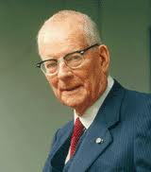
Conclusion
Deming:
“Unemployment is not inevitable, unemployment is a sign of bad management”
Thank you

Slide 12
References
Deming, W.E., (1984). Interview. The five deadly diseases. Retrieved at February, 12, 2011 by: http://www.youtube.com/watch?v=ehMAwIHGN0Y
Deming, W.E., (1994). The new economics for industry, government, education (2nd ed.). Cambridge. Massachusetts: Massachusetts Institute of Technology
Deming, W.E., (2000). Out of the crisis (1st MIT press ed.). Massachusetts: Massachusetts Institute of Technology.
MBE web-site (2011). Retrieved at 2011 by: http://www2.warwick.ac.uk/fac/sci/wmg/ftmsc/modules/modulelist/le/assessment/team_projects/mini-projects/

